Slide 1
Aluminium Kinetic Inductance Detectors at 1.54 THz limited by photon noise and generation-recombination noise
Pieter de Visser, Jochem Baselmans, Juan Bueno, Nuria Llombart, Teun Klapwijk
SRON
TU Delft, Faculty of Applied Sciences
TU Delft, Faculty of Electrical Engineering Mathematics and Computer Siences

Slide 2
Optical Noise Equivalent Power @ 1.54 THz
Photon
Noise
GR - Noise

Slide 3
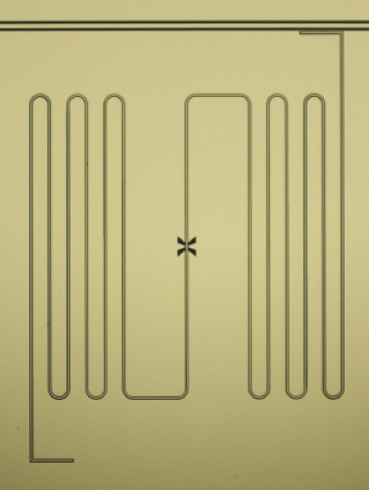
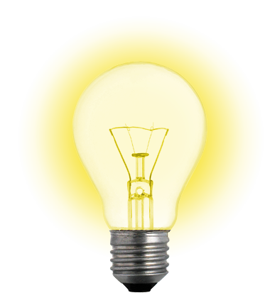
Operation principle
Cooper Pairs
2Δ
hν
Quasiparticles
Photons break Cooper pairs => quasiparticles
Higher resistance and kinetic inductance
Dip depth / amplitude: resistance
Resonant frequency / phase: inductance
Day et al, Nature 425, 817 (2003)

Slide 4
Anticipated fundamental limits
KID is a pair breaking detector: fluctuations in the quasiparticle number
Photon noise (= generation noise)
Recombination noise
Generation-recombination noise
Prediction from dark experiments:
NEP of 2 x 10⁻¹⁹ W/Hz^{1/2} limited by the presence of excess quasiparticles

Slide 5
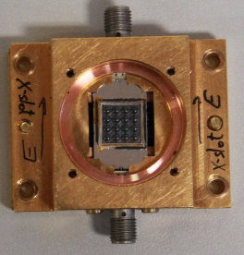
Design
All Aluminium KID
Central Line: 50 nm Al
Groundplane: 100 nm Al
Halfwave resonator with isolated central strip
X-slot Antenna, broad band around 1.54 THz
2 mm silicon elliptical lenses
Design suitable for higher frequencies >1.54 THz

Slide 6
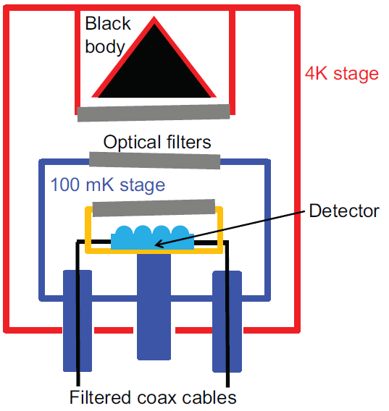
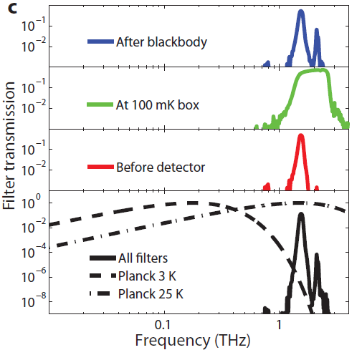
Controlled optical setup
8 optical filters!
Box-in-box setup
J. Bueno, Poster 106 (Thursday)
Baselmans et al. JLTP 167, 360 (2012)
Notes:
Mention polariser

Slide 7
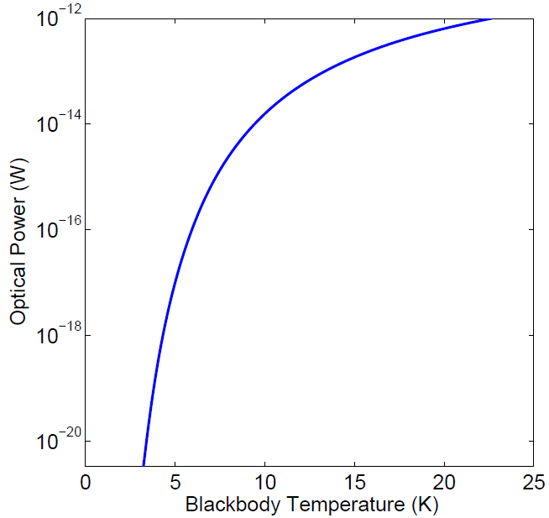
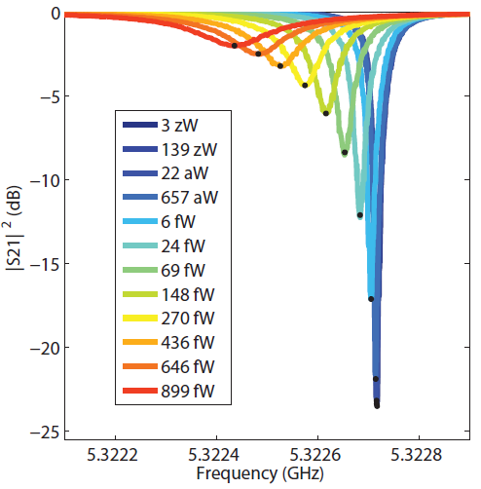
Large range in optical power

Slide 8


Fundamental limit: Photon Noise
Random arrival rate
of the optical photons
+ recombination noise
$$S_{A}=2PhF{\left(\frac{dA}{dP}\right)}^{2}\frac{1}{1+{\left(2πfτ\right)}^{2}}$$
Recombination time scales with
$\sqrt{Power}$ as expected
Optical Power (fW)

Slide 9
Generation-recombination noise
Quasiparticle fluctuations
De Visser et al. PRL 106, 167004 (2011)
Wilson & Prober, PRL, 87, 067004 (2001)

Slide 10
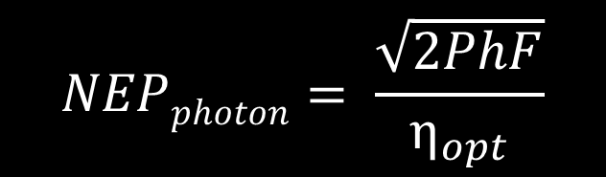

Optical Noise Equivalent Power
Photon
Noise
GR - Noise
$$NEP=\frac{\sqrt{Spectrum}}{Responsivity}(1+{\left(2πfτ\right)}^{2})$$
$$NEPphoton= \frac{\sqrt{2PhF}}{η_{opt}}$$
Photon noise limited NEP => Measure of optical efficiency: 48%

Slide 11
Optical responsivity + lifetime: Microwave readout power dependent
De Visser et al. APL 100, 162601 (2012)
Goldie, SuST, 26, 015004 (2013)

Slide 12
Microwave readout power: Excess quasipartilces AND nonlinear reponse due to redistribution of quasiparticles
arXiv: 1306.4992
Poster 104 (Monday)

Slide 13
Summary
Kinetic Inductance Detector at 1.54 THz
  Fundamental noise sources for pair breaking detectors revealed:
    Photon noise limited
    Generation-recombination noise => excess quasiparticles
  NEP 3.8 x 10⁻¹⁹ W/Hz^{1/2}, 48% optical efficiency
Well controlled optical setup, large power range
1.54 THz experiment - arXiv:1306.4238
Microwave response - arXiv:1306.4992

Slide 14
KID at 1.54 THz
Optical efficiency: 48%
Photon
Noise
GR - Noise
arXiv:1306.4238

