Slide 1
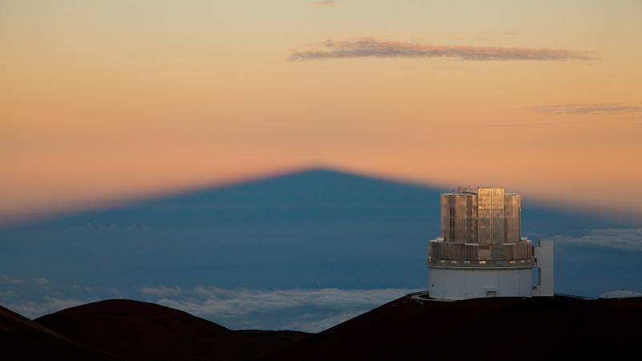
Directly Imaging Extrasolar Planets Around Accelerating Stars with the OASIS Survey
Thayne Currie
(UTSA/Subaru)
currie@naoj.org
Coauthors: Masayuki Kuzuhara (Co-PI), Jeff Chilcote, Olivier Guyon, Olivier Guyon, Motohide Tamura, Mona El Morsy, Yiting Li, Brianna Lacy, Taylor Tobin, Dillon Peng, Danielle Bovie, Marah Brinjikji, Ziying Gu, Jie Li, Qier An, Tim Brandt, Vincent Deo, Rob de Rosa, Tyler Groff, Markus Janson, Jeremy Kasdin, Julien Lozi, Christian Marois, Bertrand Mennesson, Naoshi Murakami, Eric Nielsen, Sabina Sagynbayeva, Nour Skaf, Garima Singh, William Thompson, Taichi Uyama, Seb Vievard, Alice Zurlo
Funded by NSF (science) &
NASA HQ (strategic support for Roman CGI)
Notes:
-[mention title: Directly Imaging Extrasolar Planets around Accelerating Stars with the OASIS survey]
-led by myself, Co-PI Masayuki Kuzuhara, & over 30 collaborators listed below, including a very large number of early-career researchers who have taken a leading role in this survey
-funded by NSF for its science & NASA HQ for strategic support of the Roman Coronagraph (“give us tech targets”)
-Main message: OASIS is a large survey for exoplanets & brown dwarfs combining direct imaging and astrometry, providing new and better characterized discoveries, key insights the formation & evolution of planetary systems, & what I believe is crucial support for JWST and especially Roman.

Slide 2
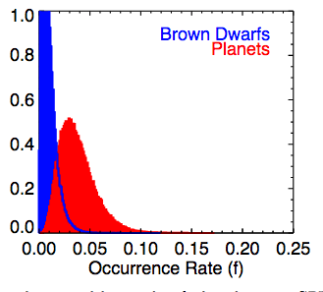
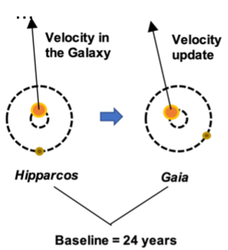
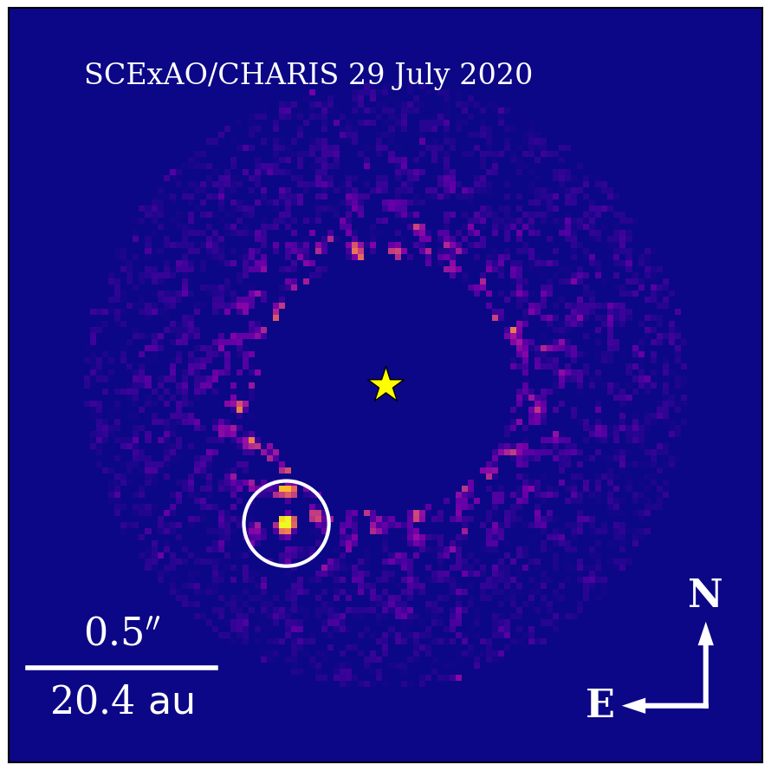
Motivation and Basic Program Design
Currie et al. 2023
Previous Exoplanet Imaging Searches
An Astrometry-Selected Exoplanet Direct Imaging Search
Large “unbiased/blind” surveys
(e.g. GPIES, SPHERE/SHINE) few discoveries
They yield limited knowledge of planet’s orbit and mass
Precision Astrometry from Gaia & Hipparcos Identifies Stars That Are Being Gravitationally Accelerated by An Unseen Companion
Target accelerating stars that are young enough to have imageable planets
(see also talks by E. Rickman, K. Franson)
Nielsen et al. 2019
Brandt 2018, 2021
Notes:
-sense of context, past 20 years have just over ~20 directly-imaged planets, most draw from the ground, and most from what I will call ‘unbiased or blind’ surveys (GPIES, SPHERE-SHINE), these have been excellent for demographics and planetary atmospheres.
-But generally low rate of discoveries (e.g. 2 planet discoveries out of 600 stars from GPIES). Astrometric coverage -- ~ a few years – small compared to likely orbital time periods: poor constraints on orbits. Masses inferred from luminosity evolution models, not measured directly.
-Instead, our program is one of several that instead have a dynamics selected, specifically astrometry-selected approach to exoplanet discovery and characterization.
-We use precision astrometry from the Hipparcos Gaia Catalogue of Accelerations to identify stars showing dynamical evidence for a companion. Specifically, we compare the long-term, 24-year scale proper motion derived from the Hipparcos-Gaia scaled positional difference to short-timescale proper motion measurements from Gaia in 2016 and Hipparcos in the 1990s: deviations from this long term motion, identify an acceleration.
-Combine absolute astrometry from Hipparcos & Gaia with relative astrometry of the companion from imaging to directly determine the dynamical mass and constrain key orbital properties with greater precision than before.
-The community broadly has recognized the power of this approach, as explained by Emily’s excellent introductory talk and independent work that Kyle will present after me.

Slide 3
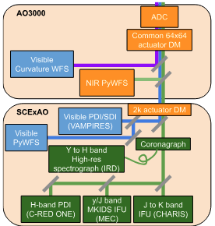
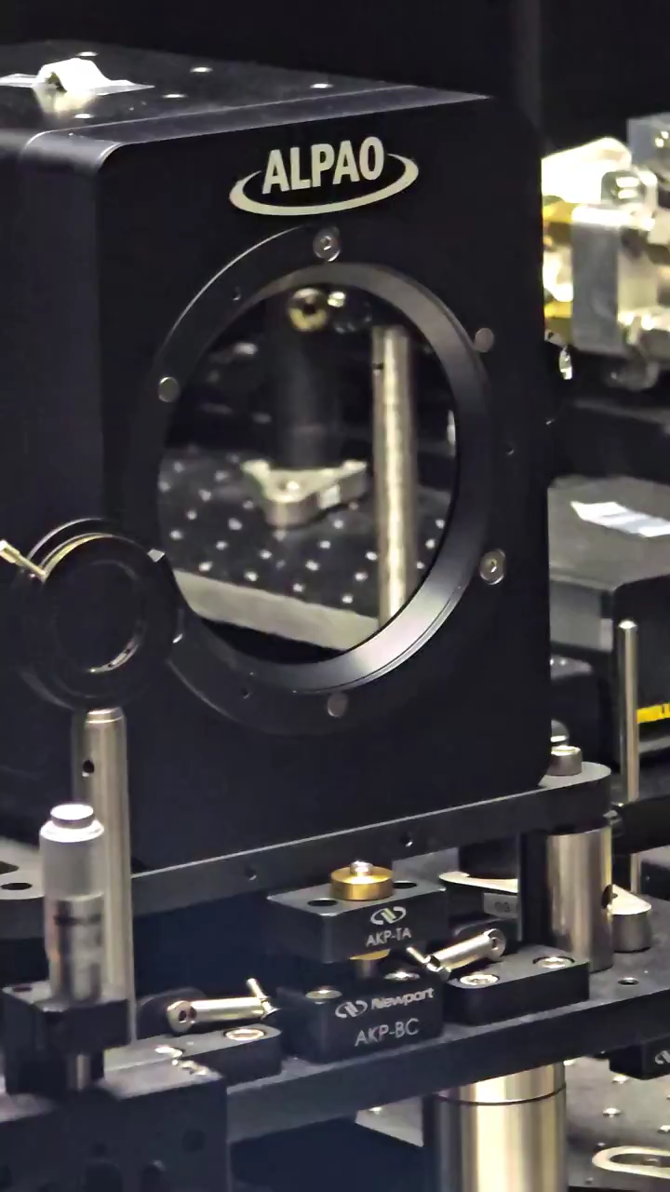
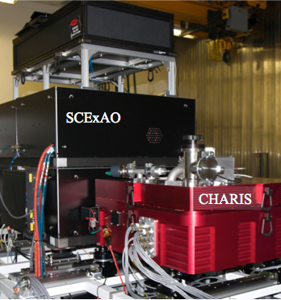
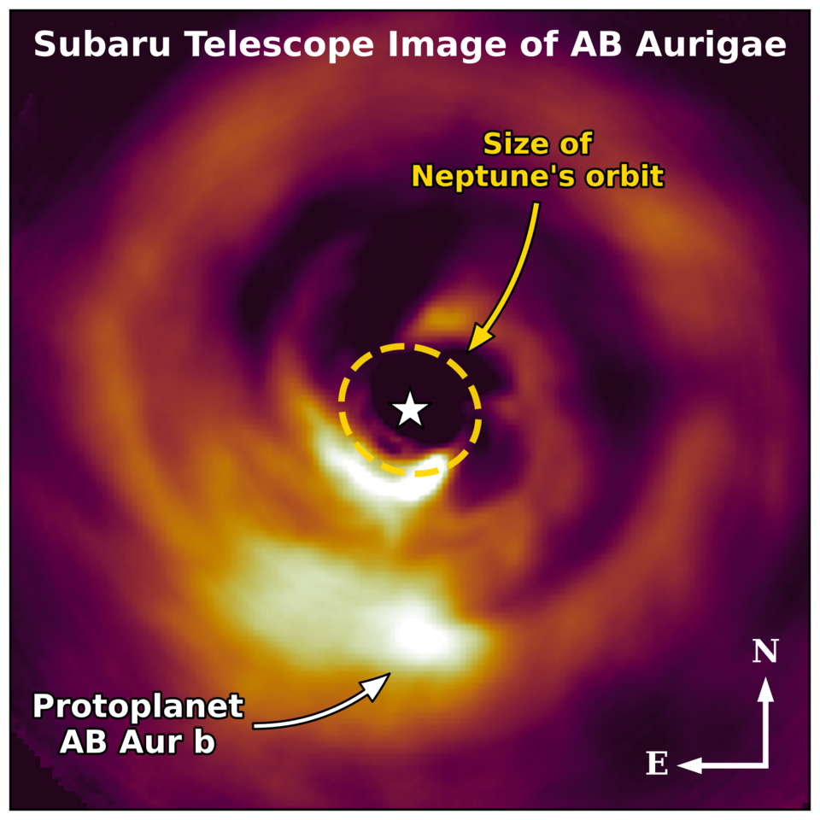
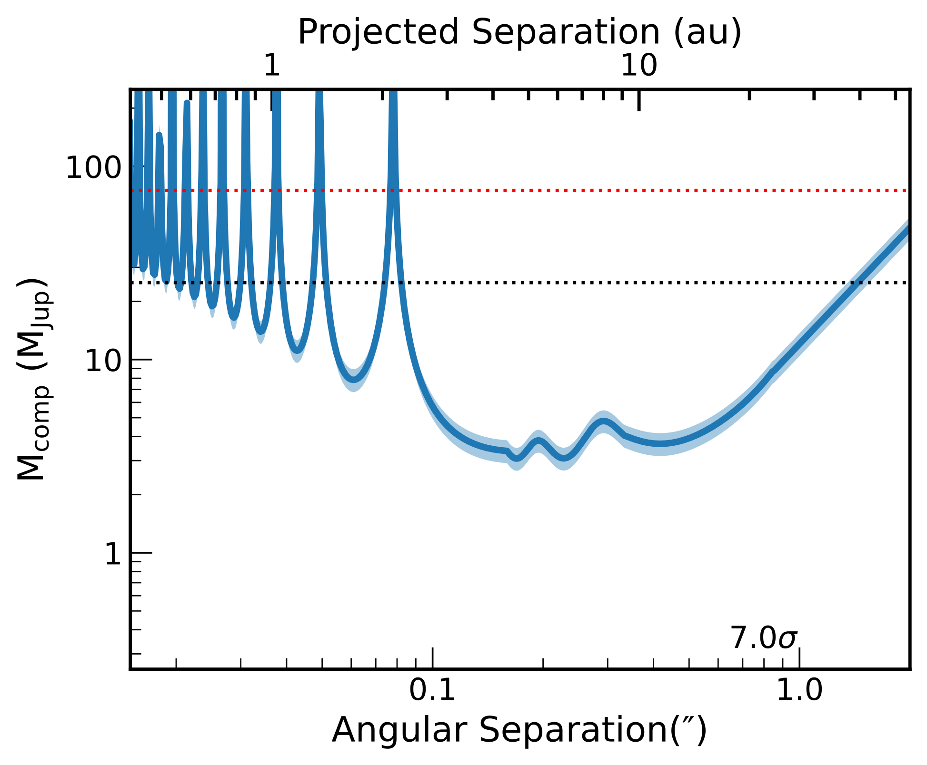

Observing Accelerators with SCExAO Imaging Survey (OASIS)
(PI. T Currie, Co-PI M. Kuzuhara)
Sample
~150 young BAFG stars
Currie et al. 2022, 2025; Dykes et al. 2024
(see poster by Erica Dykes)
Notes:
-our program is the “Observing Accelerators with SCExAO Imaging Survey”, or ‘OASIS’
-primarily uses extreme AO imaging with the Subaru Telescope. The first stage is AO3k, 3000 actuator DM driven by a near-IR Pyramid WFS at about 1 kHz; the second stage is SCExAO, 2000 actuator DM driven by optical Pyramid WFS at 2 khZ. Together, they comprise a two-stage extreme AO system.
- sharpened starlight blocked by a coronagraph and sent to the CHARIS integral field spectrograph, yielding spatially-resolved spectra at 1.1 to 2.4 microns. With ADI and SDI, achieves contrasts of about 1e-6 at 0.5” and 1e-5 at 0.2”.
-Depending on your research focus, you might know SCExAO more from protoplanet imaging work. It was responsible for the discovery of the AB Aurigae b protoplanet shown at the right – which is still there (we have additional data), and still weird -- and is used for programs to image planet formation, such as that carried out by my graduate student Erica Dykes.
-We complement SCExAO with thermal IR imaging from Keck/NIRC2.
-The core time allocation is 42 nights, and we are obtaining more time through complementary allocations, some of which are substantial. Over the next few years, probably end up with over 60-65 nights.
-Our parent sample is comprised of about 150 young accelerating stars. Characteristic age is about 200 Myr with a few younger systems and a tail out to about 1 Gyr. We follow analysis from Kervella et al to estimate the phase space of mass vs. angular separation for possible companions. Most of targets have accelerations consistent with being driven by a superjovian planet in the 5—15 Jupiter-mass range.

Slide 4
Observing Accelerators with SCExAO Imaging Survey (OASIS)
(PI. T Currie, Co-PI M. Kuzuhara)
Sample
~150 young BAFG stars
Instruments & Time
Subaru: two-stage extreme AO system
AO3k+SCExAO (see talk by J. Lozi)
CHARIS IFS (1.1—2.4 microns)
~1e-6 contrast at 0.5”, ~1e-5 at 0.2” (to be improved upon)
Complementary Keck/NIRC2 imaging at Lp (3.78 microns)
42 nights core time allocation + additional time
(projected ~65+ nights in total)
this is the largest current (ground-based) exoplanet direct imaging search
Notes:
-our program is the “Observing Accelerators with SCExAO Imaging Survey”, or ‘OASIS’
-primarily uses extreme AO imaging with the Subaru Telescope. The first stage is AO3k, 3000 actuator DM driven by a near-IR Pyramid WFS at about 1 kHz; the second stage is SCExAO, 2000 actuator DM driven by optical Pyramid WFS at 2 khZ. Together, they comprise a two-stage extreme AO system.
- sharpened starlight blocked by a coronagraph and sent to the CHARIS integral field spectrograph, yielding spatially-resolved spectra at 1.1 to 2.4 microns. With ADI and SDI, achieves contrasts of about 1e-6 at 0.5” and 1e-5 at 0.2”.
-Depending on your research focus, you might know SCExAO more from protoplanet imaging work. It was responsible for the discovery of the AB Aurigae b protoplanet shown at the right – which is still there (we have additional data), and still weird -- and is used for programs to image planet formation, such as that carried out by my graduate student Erica Dykes.
-We complement SCExAO with thermal IR imaging from Keck/NIRC2.
-The core time allocation is 42 nights, and we are obtaining more time through complementary allocations, some of which are substantial. Over the next few years, probably end up with over 60-65 nights.
-Our parent sample is comprised of about 150 young accelerating stars. Characteristic age is about 200 Myr with a few younger systems and a tail out to about 1 Gyr. We follow analysis from Kervella et al to estimate the phase space of mass vs. angular separation for possible companions. Most of targets have accelerations consistent with being driven by a superjovian planet in the 5—15 Jupiter-mass range.

Slide 5

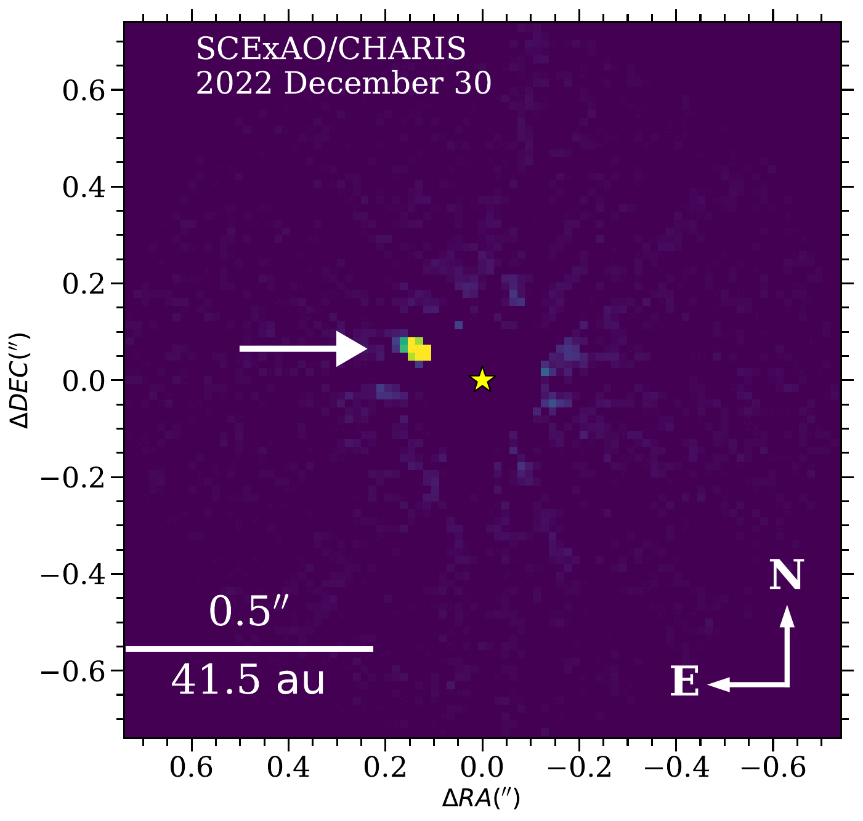
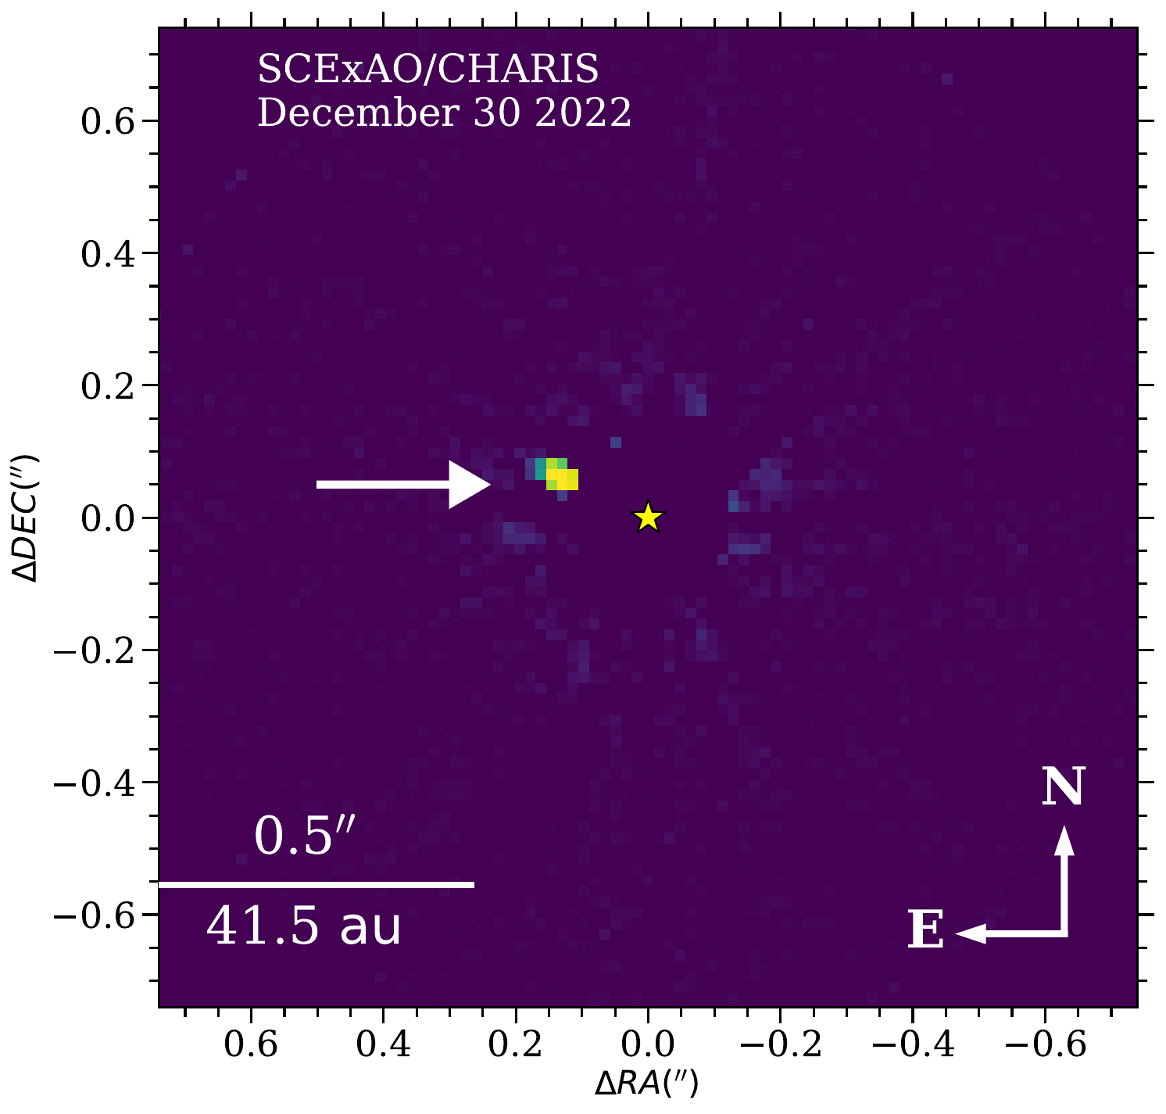
OASIS discovery #1 : A New Planet – HIP 54515 b
HIP 54515 (aka 66 Leo):
a young A star (~23-200 Myr)
5-sigma significant astrometric acceleration
~3--4 lambda/D separation!
Currie & Li et al. 2026, AJ, 171,5
**TC dedicates this work to the recently departed Wallace Ishibashi Jr: former OMKS cultural monitor, Hawaiian cultural practitioner, supporter of the Thirty Meter Telescope & current MK observatories, and friend
Notes:
-our first discovery is a planet around HIP 54515 (aka 66 Leo). This is a young A star lying at or maybe slightly below the Pleiades locus, similar to beta Pictoris. Curiously, this star had never been targeted for a planet search before of any kind: no GPI, no SPHERE, no Keck, even though it is easily targetable from both Maunakea and Paranal. Just ‘rando star’.
-However, it has a 5-sigma significant astrometric acceleration.
-And a companion, HIP 54515 b, detected at 3-4 lambda/D from the star. This was a challenging detection. Knowing that this star showed evidence for a companion justified our the lengthy observing sequences needed to detect it. Also, wanted to note that this work is co-led by Yiting Li from the University of Michigan.
-Finally, this discovery is dedicated to my friend Uncle Wally Ishibashi, whose passing happened around the time I got the first detection of HIP 54515 b. who was a Hawaiian cultural practitioner on Maunakea: the guy whose job it was protect Maunakea’s cultural resources. A very wise person who very nuanced take on all things surrounding Maunakea and Hawaii, while supporting the observatories and TMT. So this work is dedicated to him.

Slide 6
OASIS discovery #1 : A New Planet – HIP 54515 b
~2100-2400 K, M/L transition object
Mass: ~17.6 Mj
Mass ratio ~9e-3
(similar to HR 8799 cde, HIP 99770 b)
sma ~ 25 au, ecc ~ 0.4
Notes:
-HIP 54515 b’s spectrum is best fit by a fairly hot object compared to many we heard about yesterday, a bit over 2000 K near the M/L transition, probably an L0 spectral type.
-As you can see in the movie, HIP 54515 b shows substantial orbital motion over the course of about 2 years. We combine the companion’s relative astrometry with absolute astrometry of the star from Hipparcos & Gaia. We constrained its mass to be ~17.6 Jupiter masses (just slightly above HIP 99770 b), a very low companion to primary mass ratio of 0.9% fairly similar to (HR 8799 e and HIP 99770 b). It has a semimajor axis of ~25 au, and a moderate eccentricity of about 0.4.

Slide 7
Interpreting HIP 54515 b: Evidence Suggests a Planet, Not a Brown Dwarf
Deuterium burning limit fails to distinguish between planets and brown dwarfs
(Currie, Biller and Lagrange et al. 2023; Currie et al. 2023)
HIP 54515 b lies well below the empirical mass turnover from planets to brown dwarfs (~25-30 Mj) …
also lies below the empirical mass ratio turnover (q ~0.02-0.03)
(see also Sahlmann et al. 2011, Ma & Ge 2014, Feng et al. 2023, Meyer et al. 2025; Giacolone et al. 2026)
Currie & Li et al. 2026, AJ, 171, 5
Notes:
how do we interpret this object. Although most of the posterior distribution lies above 13 Jupiter masses, the current evidence favors interpreting it as a super-Jovian planet, not a brown dwarf.
-admittedly, this is a particular hobbyhorse of mine, but the deuterium-burning limit as the delimiter between planets and brown dwarfs may have made sense in the 1990s but it not supported by the current peer-reviewed literature. This point is described extensively in the PPVII review article on direct imaging as well as the HIP 99770 b discovery paper in Science. A demographics-informed criteria – like that drawn from the California Legacy Survey data -- better supports a transition at about 25-30 Jupiter masses and a mass ratio of about 2-3 percent. There is also a slew of papers over the last decade arriving at effectively the same conclusion shown below.
-In this paper, we used a different sample of substellar companions with dynamical masses to establish a context for HIP 54515 b. It again supports the interpretation that HIP 54515 b is best consistent with the planet population, not brown dwarfs.

Slide 8

OASIS discovery #2 – HIP 71618 B
The First* Target Demonstrably Suitable for the Roman CGI Tech Demo
Predicted 575 nm contrast of a few x 10⁻⁷
A high SNR detection will fulfill TTR5
~60-65 Mj (likely) brown dwarf at ~11 au
Predicted location in 2027:
ρ ∼ 0.′′26, well within the 0.′′15–0.′′45 CGI dark hole region
*and, to date, the only one from peer-reviewed literature
El Morsy et al. 2025, ApJL, 995, L4
Notes:
-the second discovery is HIP 71618 B, which is probably a high-mass brown dwarf in an eccentric orbit 11 au from a young, bright A star.
-this discovery is important because it is the First target demonstrably suitable for the Roman Coronagraph technology demonstration and to-date the only one shown in peer-reviewed literature.
-we used the posterior distribution of its orbital parameters to estimate its location during the tech demo phase. It should lie at about 0.26”, well within the coronagraph dark hole at 575 nm. We used both atmospheric models from Brianna Lacy as well as empirical benchmarks from Kevin Luhman to estimate a 575 nm contrast of a few x 1e-7. Thus, a high SNR detection of HIP 71618 B should fulfill the coronagraph’s core TTR5 requirement.

Slide 9
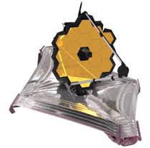



OASIS: Enhancing the Science Return of JWST
Enhanced Metallicity in the atmosphere of HIP 99770 b
(Balmer et al. 2026 in press); see poster by A. Messier
Notes:
Slow down and explain

Slide 10

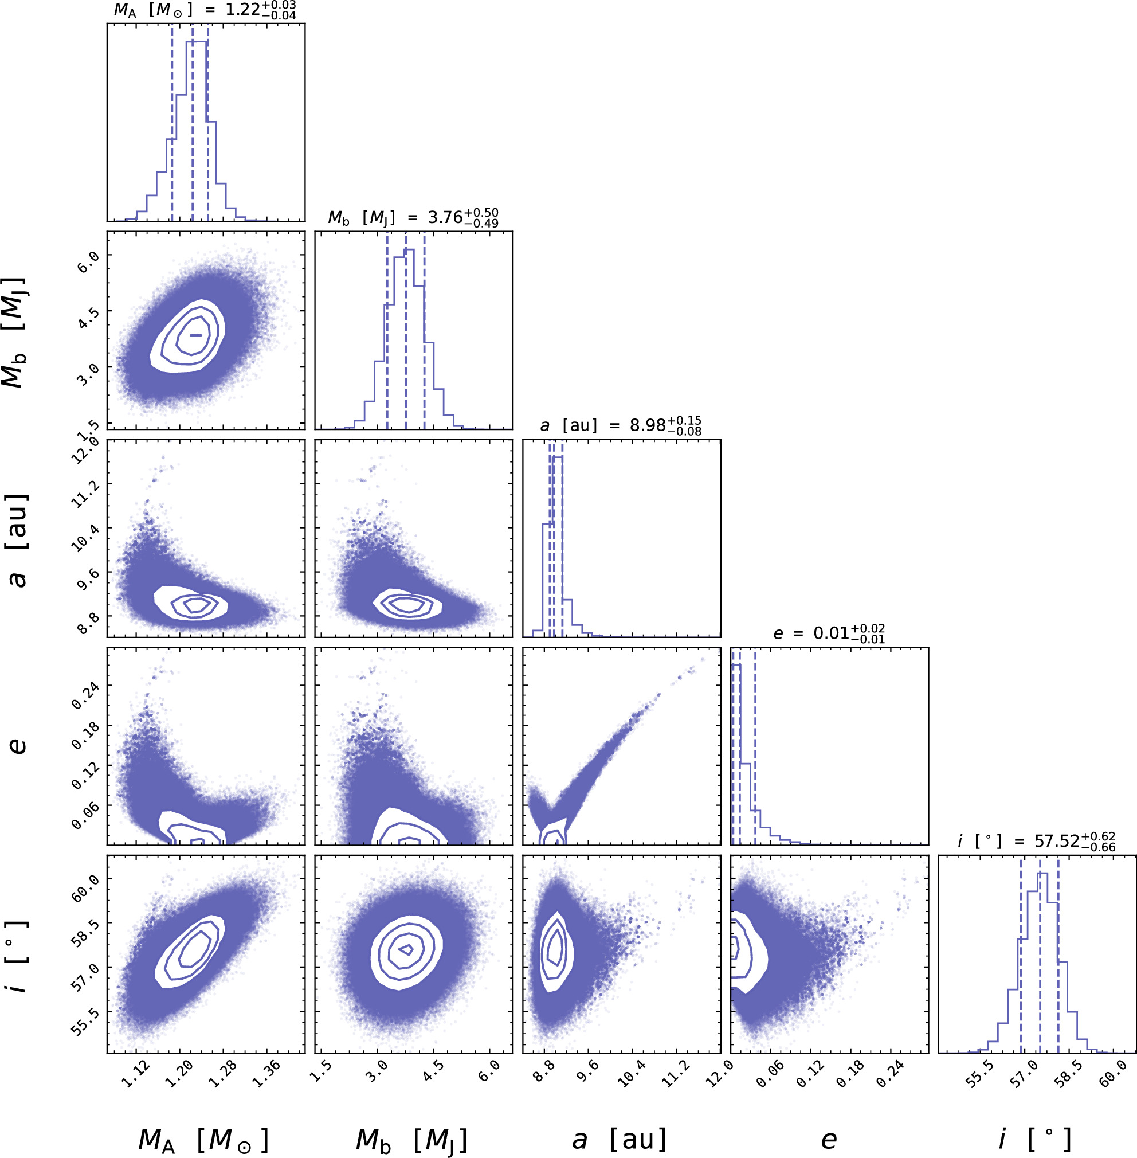
Broader Scientific Impact
Anchoring Luminosity Evolution Models
Atmospheric Evolution (e.g. Surface Gravity)
PZ Tel B
Published planets (prior work)
Published BDs (prior work)
Current planets (OASIS)
Current BDs (OASIS)
Simulated, expected new detections (OASIS)
Shape is surface gravity dependent
Peaked = low, Flat = high
Typical OASIS
age uncertainty
See poster by D. Bovie
Adapted from Bovie et al. (2025)
Eccentricities for Planets vs. Brown Dwarfs
(e.g. Bowler et al. 2020; Nagpal et al. 2023)
?
HIP 71618 B
(~60 Mj)
AF Lep
(3-4 Mj)
HIP 99770 b
(~15 Mj)
HIP 54515 b
(~17 Mj)
Notes:
FAST!!!!

Slide 11
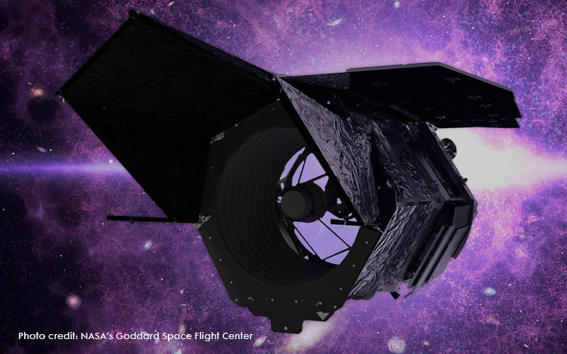
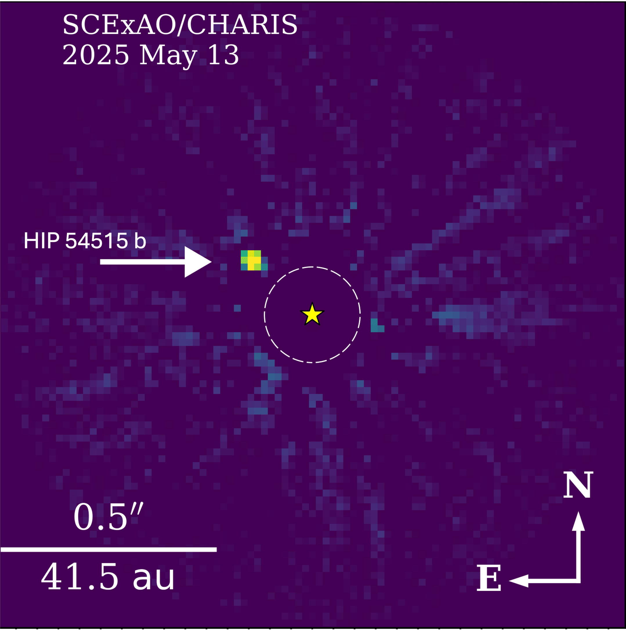
OASIS: Ensuring the Success of the Roman Coronagraph
HIP 71618 B: Fulfillling TTR5 (El Morsy et al. 2025) – Selected as First Roman CGI Target!
HIP 71618 B brown dwarf
and HIP 54515 b planet:
Also selected for Roman CGI spectroscopic mode observations
Tests high-contrast performance in space,
motivating a Roman-CGI science program
Currie, Lacy, et al. 2026 (new on arxiv)
El Morsy et al. (2025)
Notes:
Slow down and explain

Slide 12
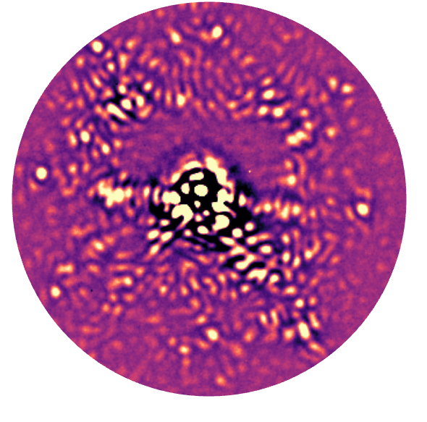
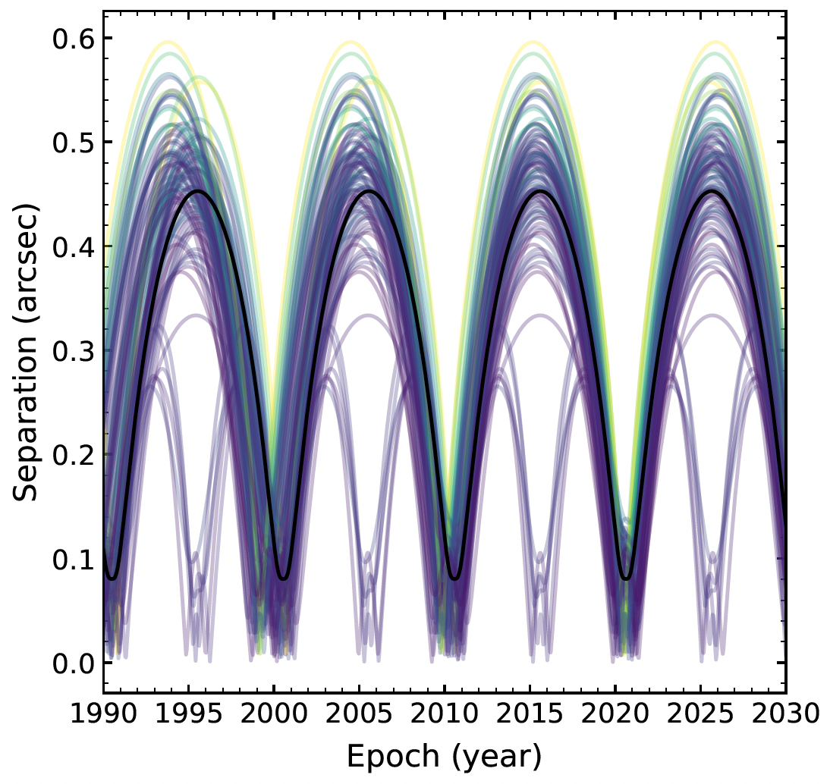
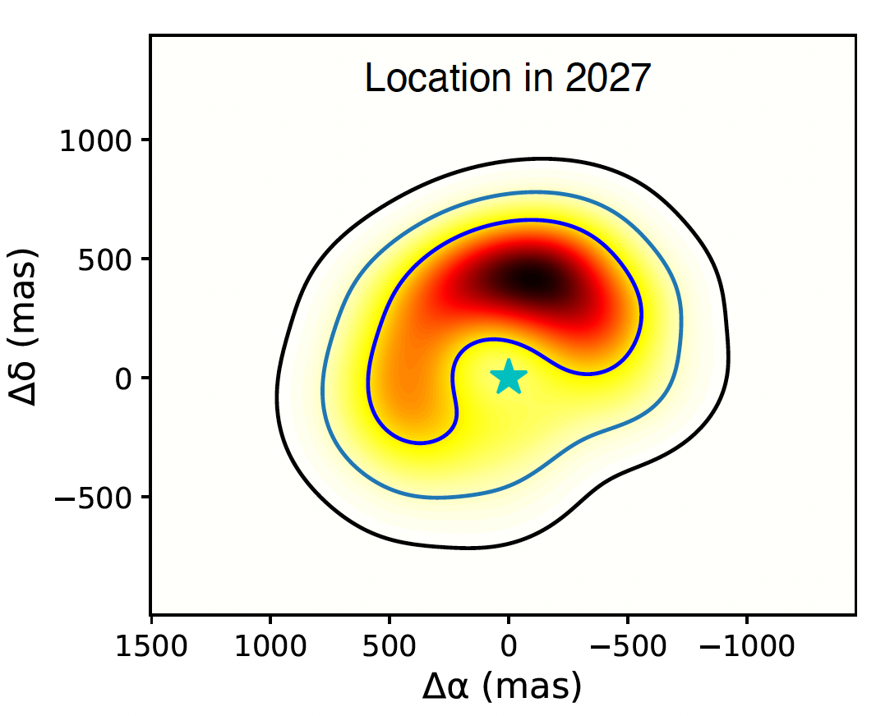

Next Steps
See poster by Jie Li
(Li, El Morsy, Currie et al. 2026)
Possibly detectable with Roman-CGI (reflected light) +
ELTs (thermal emission)
One of ~25+ new planets discovered from HGCA + archival RV
Multiple potential Roman CGI reflected-light targets
See poster by William Thompson;
talk by Christian Marois
SCExAO/SPIDERS, ~2e-6 contrast at ~0.3”
(no PSF subtraction techniques applied)
→ Deeper contrast, lower-mass detections
Notes:
Slow down and explain

Slide 13
Summary
OASIS: A Subaru Survey for Exoplanets combining Direct Imaging and Astrometry
First Results
-a new planet & a new brown dwarf/Roman CGI tech demo target
The survey will provide key insights into the formation & evolution of planetary systems
OASIS supports and enhances the science return of JWST and Roman
Thank you!
TC wishes to acknowledge the Mauna Kea Stewardship and Oversight Authority for their responsive, community-led administration of mauna lands, safeguarding the rights of Hawaiian cultural practitioners and enabling continued, transformative astronomical discoveries from this mountain.
Notes:
Slow down and explain

