Slide 1
The Galactic Bulge Time Domain Survey in Context with Galactic Models
Macy Huston
Jessica Lu, Matthew Penny, Jonas Kluter, Samson Johnson, Naoki Koshimoto, Farzaneh Zohrabi, Marz Newman
RGES PIT Galactic Models + Simulations Working Groups

Slide 2
GBTDS Simulations with Galactic Models
Motivation: Roman Galactic Exoplanet Survey PIT requirements verification & survey optimization
Simulation process with Galactic model:
Creation of SynthPop framework
Evaluating multiple model configurations against observation
Selection/tuning of model to improve on the model used in Penny et al. 2019
Monte carlo integration for “true” microlensing event rates + characteristics
Running GULLS simulations on model catalogs to account for survey/instrument factors & estimate yields

Slide 3
SynthPop - Galactic Population Synthesis Model Framework
Synthpop: an object-oriented, modular Python framework for generating synthetic stellar catalogs
Input: module selections for each population (e.g. stellar mass distribution, IMF), configuration (e.g. extinction maps, field selections, magnitude limits).
Output: catalog of simulated stars with positions, kinematics, properties, and synthetic photometry
Software paper in prep: Klüter, Huston, et al.
https://github.com/synthpop-galaxy/synthpop

Slide 4
SynthPop model development
Initial model: Besancon model from Robin et al (2003)
Some key changes:
Bulge model from Cao+2013
Disk components + kinematics from Koshimoto+21 (genstars/genulens)
MESA Isochrones and Stellar Tracks (MIST; Choi+16, Dotter+16)
Extinction map: 2-d map from Surot+20, 3-d implementation based on galaxia
IFMR for compact objects (based on PopSyCLE; Lam+20, Rose+22)
Nuclear Stellar Disk population (based on Sormani+22)
Stellar multiplicity in progress (work being done by Marz Newman)

Slide 5
SynthPop model development
Early results from model testing:
Improved match to proper motion studies in SWEEPS fields + Stanek window
Improved match to CMDs from OGLE EWS maps for selected events
Good match to inner Galaxy field luminosity functions from HST Bulge Treasury Program
Producing peak IR event rate in Galactic plane, as seen in VVV

Slide 6
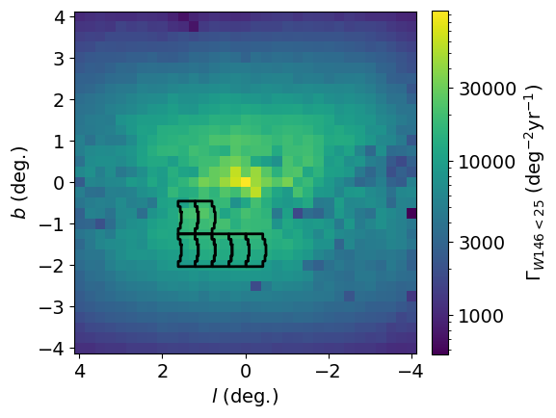
Microlensing Event Rate for GBTDS Primary Filter
Huston et al. (in prep)

Slide 7
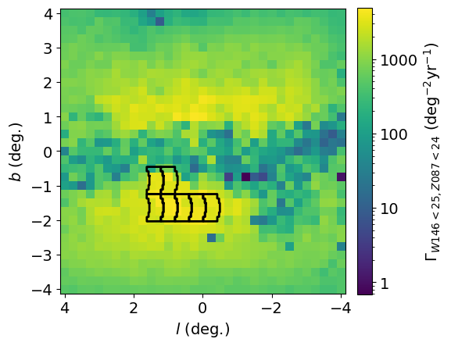
Microlensing Event Rate for GBTDS in 2 filters
Huston et al. (in prep)

Slide 8
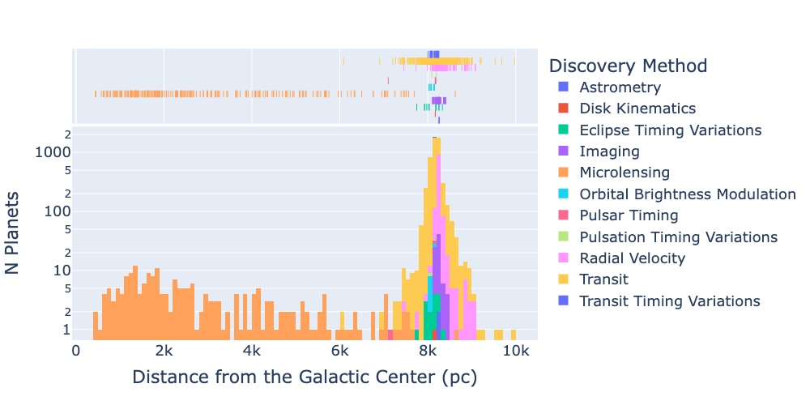
Exoplanets Across the Milky Way
Figure adapted from Nate Smith; data from NASA Exoplanet Archive, July 2024

Slide 9
Probing Galactic Populations
 | 7-field layout |  | 9-field layout |  | 1 GC field
populations | lenses | sources | lenses | sources | lenses | sources
bulge | 85% | 80% | 85% | 82% | 46% | 45%
disk | 15% | 19% | 15% | 18% | 9% | 9%
nuclear stellar disk | <1% | ~1% | <1% | <1% | 45% | 46%
Huston et al. (in prep)

Slide 10
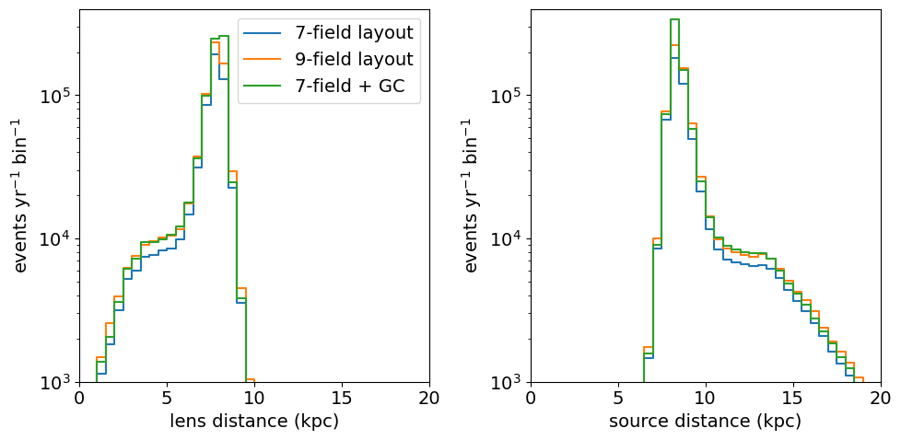
Probing Galactic Populations
bin width: 0.5kpc
Huston et al. (in prep)

Slide 11
Refining Galactic models with Roman
Roman will provide a new, vast data set to further improve Galactic models
The Galactic Plane Survey will also be a valuable resource
Figure 1 from Sanderson et al (2024)

Slide 12
Conclusions
SynthPop Galactic modeling framework is accessible here: https://github.com/synthpop-galaxy/synthpop (paper coming soon)
Our current model is testing well, and we are getting ready to start updated RGES PIT simulations with SynthPop and GULLS
The GBTDS will probe stellar (+ planet and compact object) populations across the Galaxy, testing our models for planet formation, stellar evolution, and Galactic structure

