Slide 1
Synthetic survey catalogs for the Galactic Roman Infrared Plane Survey (GRIPS) using py-ananke
Adrien Thob, Robyn Sanderson
Roman@Caltech, July 10, 2024

Slide 2
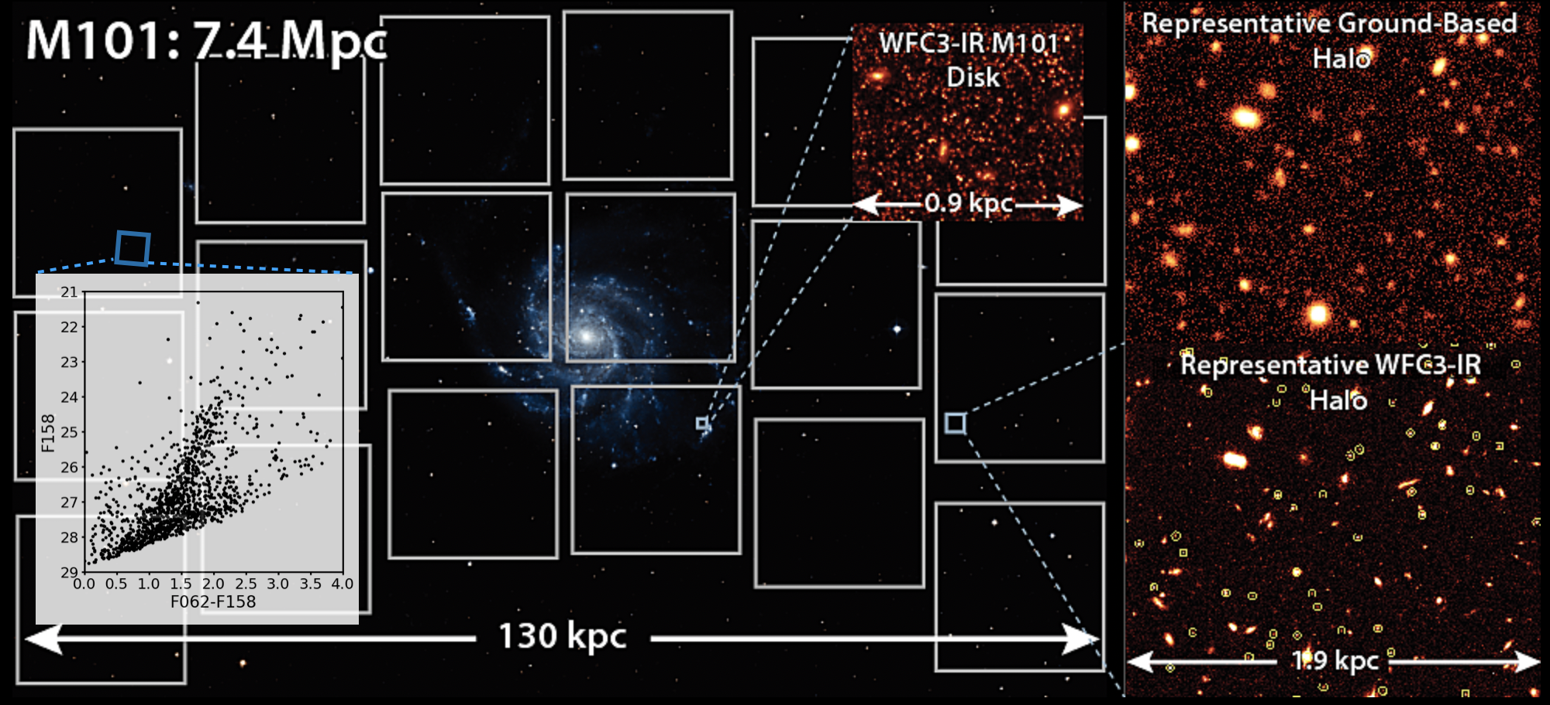
Roman Infrared Nearby Galaxies Survey (RINGS)
PI - | Benjamin Williams | (UW)
Deputy PI - | Robyn Sanderson | (UPenn)
Image credit: RINGS team

Slide 3
RINGS pipeline
https://github.com/benw1/WINGS
Galaxy model
Synthetic Stellar Survey
Mock Images
Reduced Photometry
py-ananke,
WALTER
STIPS
DOLPHOT
See also Katryn Wynn’s poster!

Slide 4
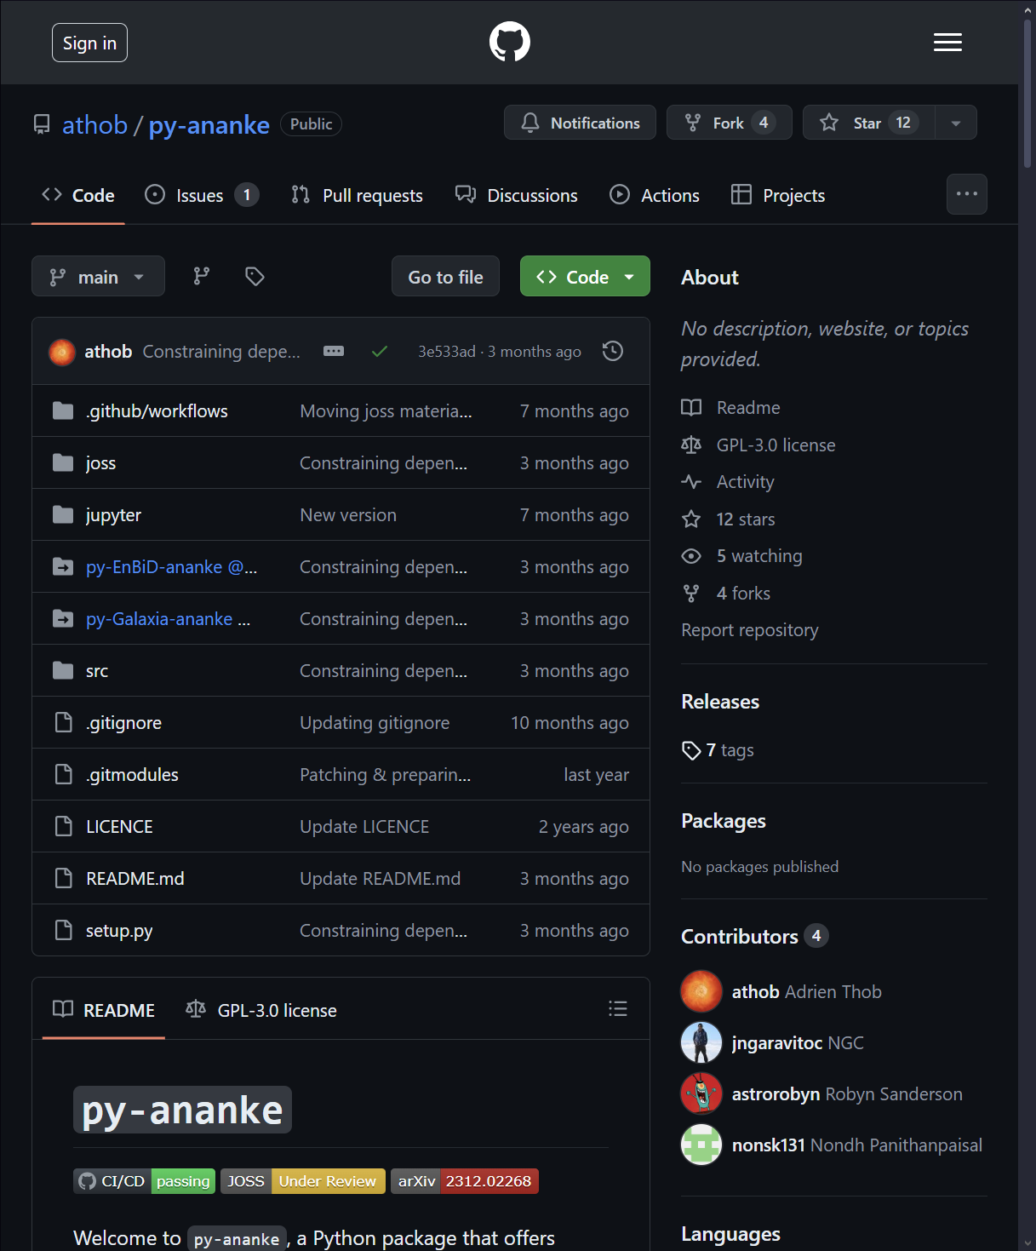
py-ananke
pip install git+https://github.com/athob/py-ananke@main
arXiv:2312.02268

Slide 5
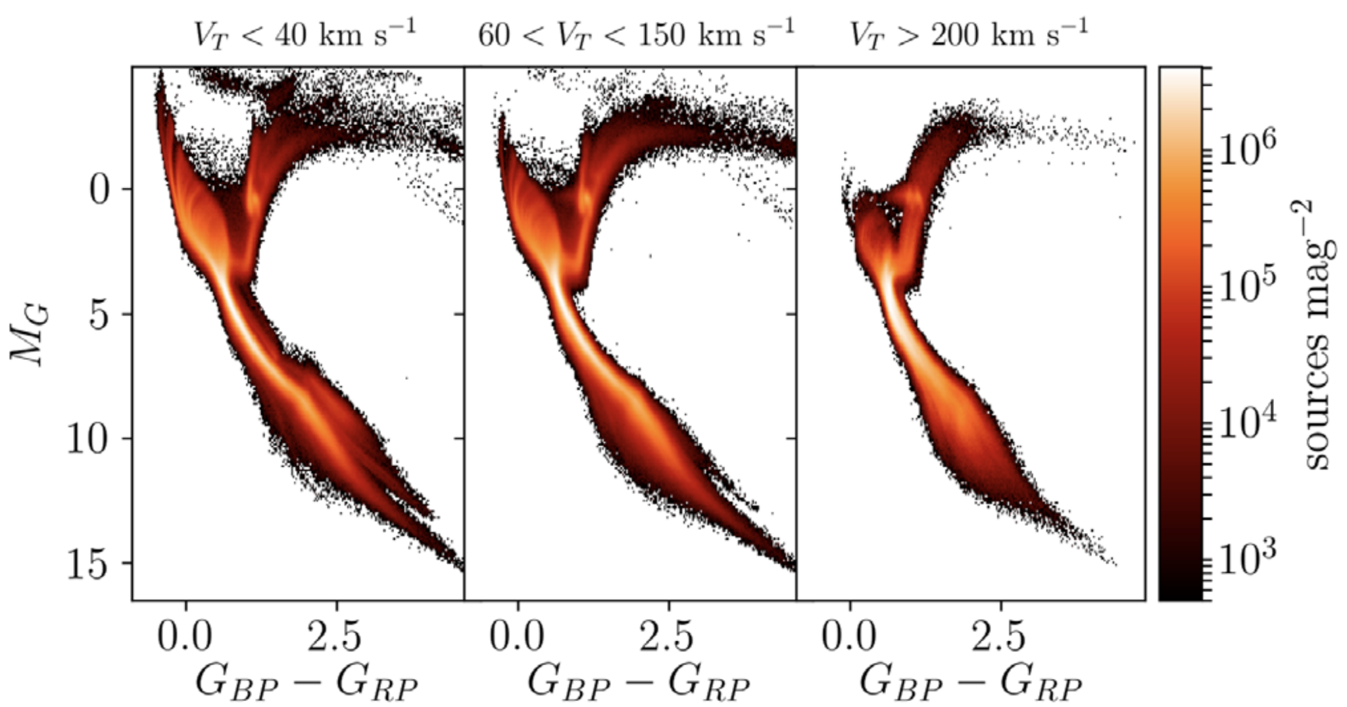
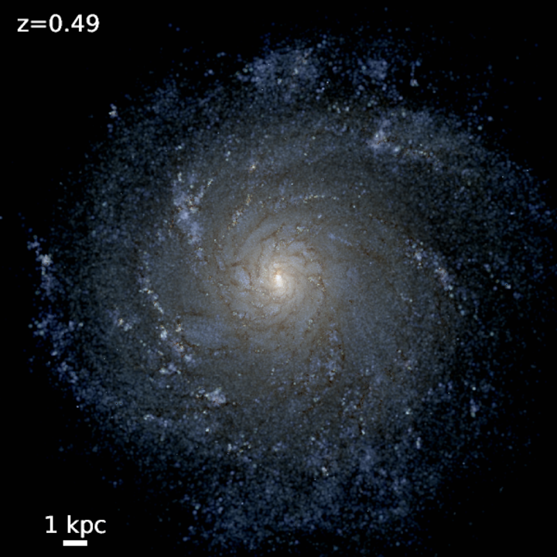
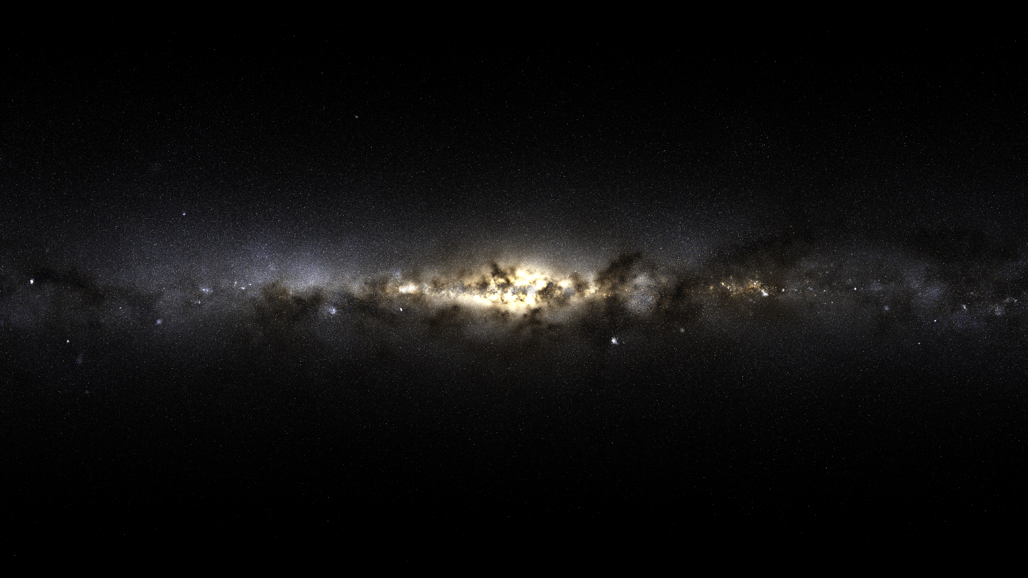
ananke & py-ananke
Image credit: Arpit Arora
Sanderson et al. 2020
ananke | py-ananke
individual python & C++ routines | single streamlined “plug & play” python package
GAIA only | + HST, JWST, Euclid, Rubin, Roman, (DECam, DESI,) … & more to come
Hard to debug or expand | modular implementation = easier to upgrade

Slide 6
Ananke’s Framework
Galaxia - Sanjib et al. 2011
EnBiD - Sanjib & Steinmetz 2011
Extinction coeffs from
Wang & Chen 2011

Slide 7
Galactic Roman Infrared Plane Survey
Paladini et al. 23 white paper
Key specifications:
Galactic coordinates
disk $|l|<60°$ & $|b|<3°$
bulge $|l|<10°$ & $|b|<10°$
ABmag sensitivity
24.6 in F106
25.3 in F158
24.7 in F213
Producing also Gaia DR2 & LSST photometry!
IN POST-PROCESSING

Slide 8
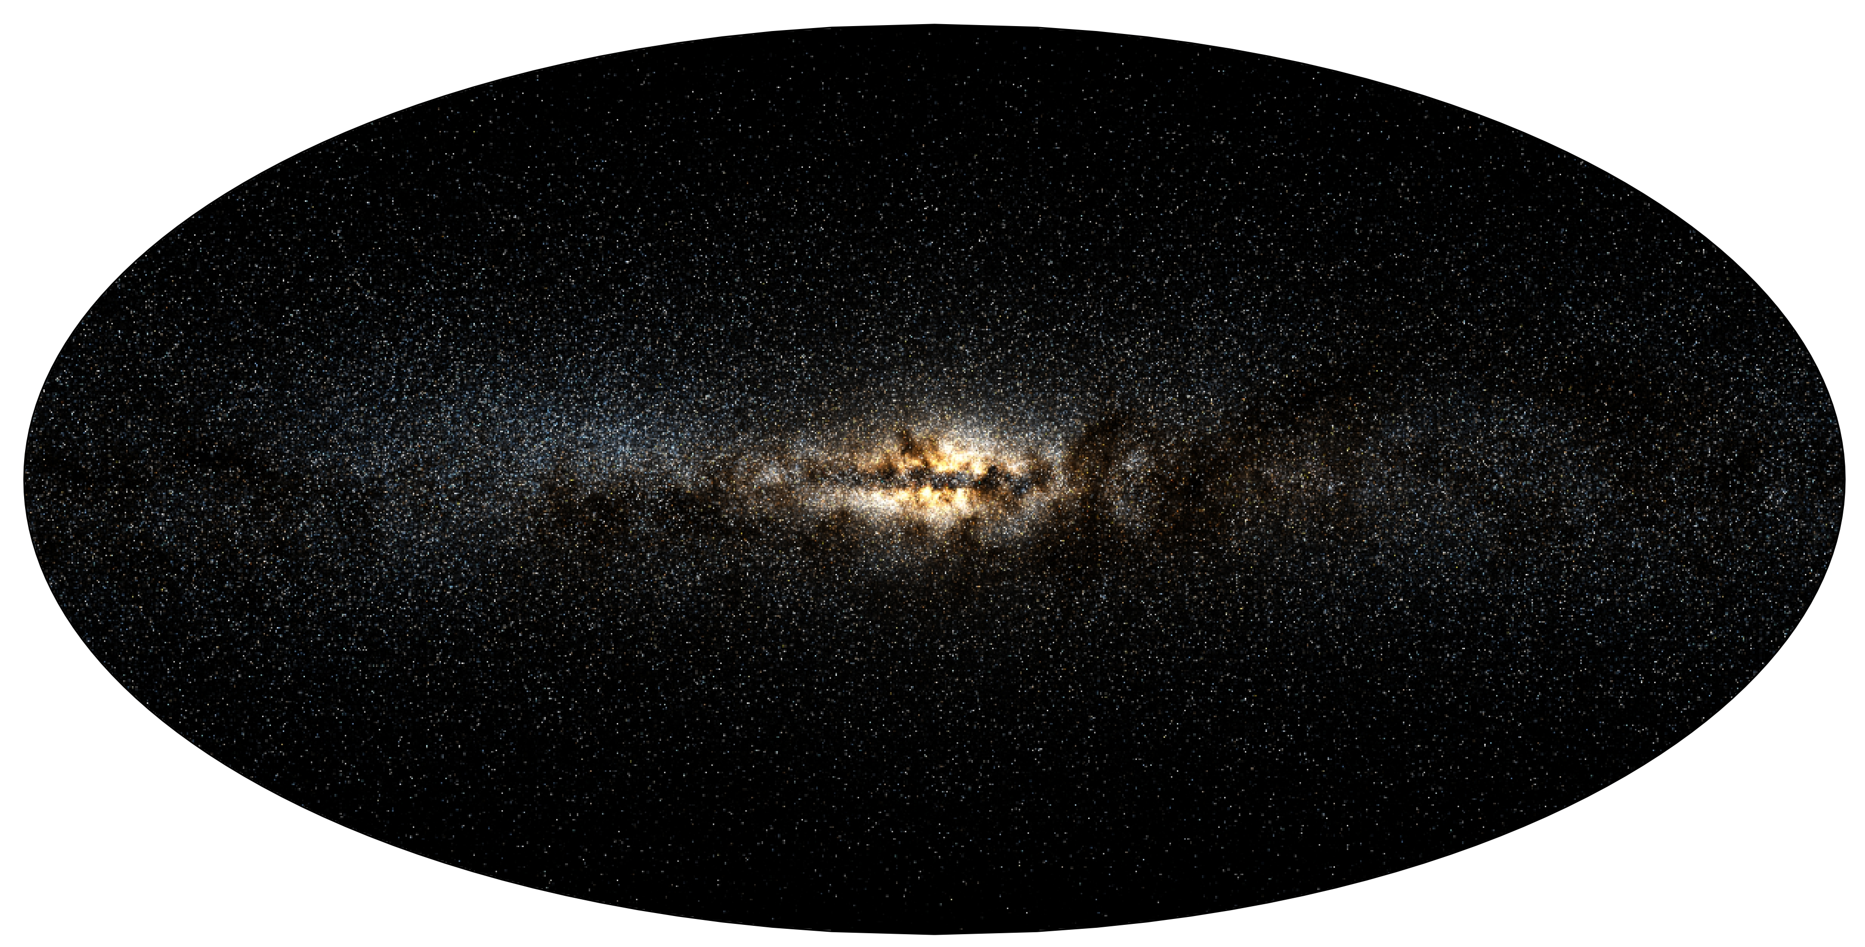
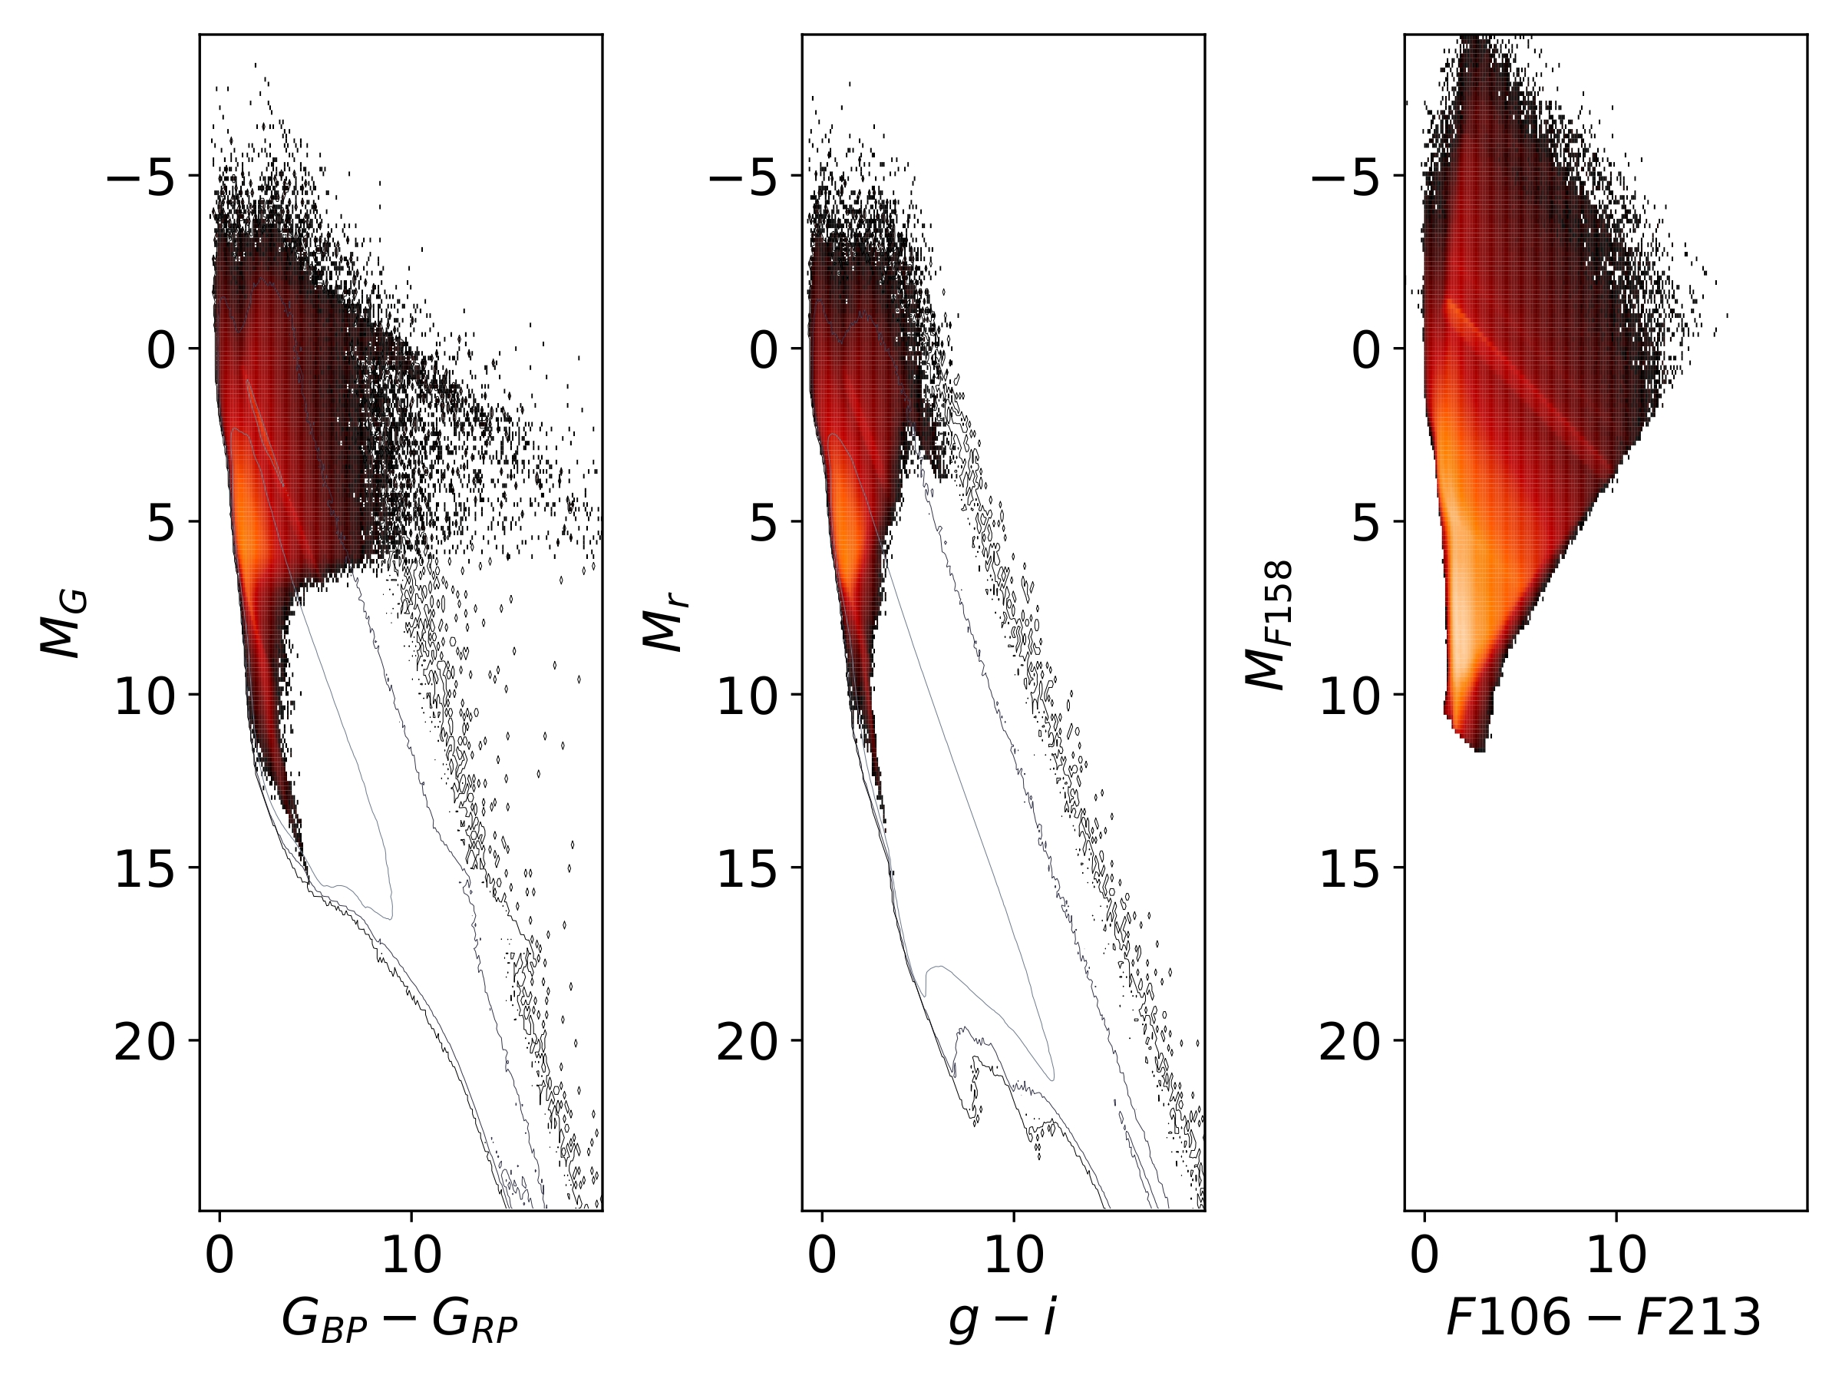
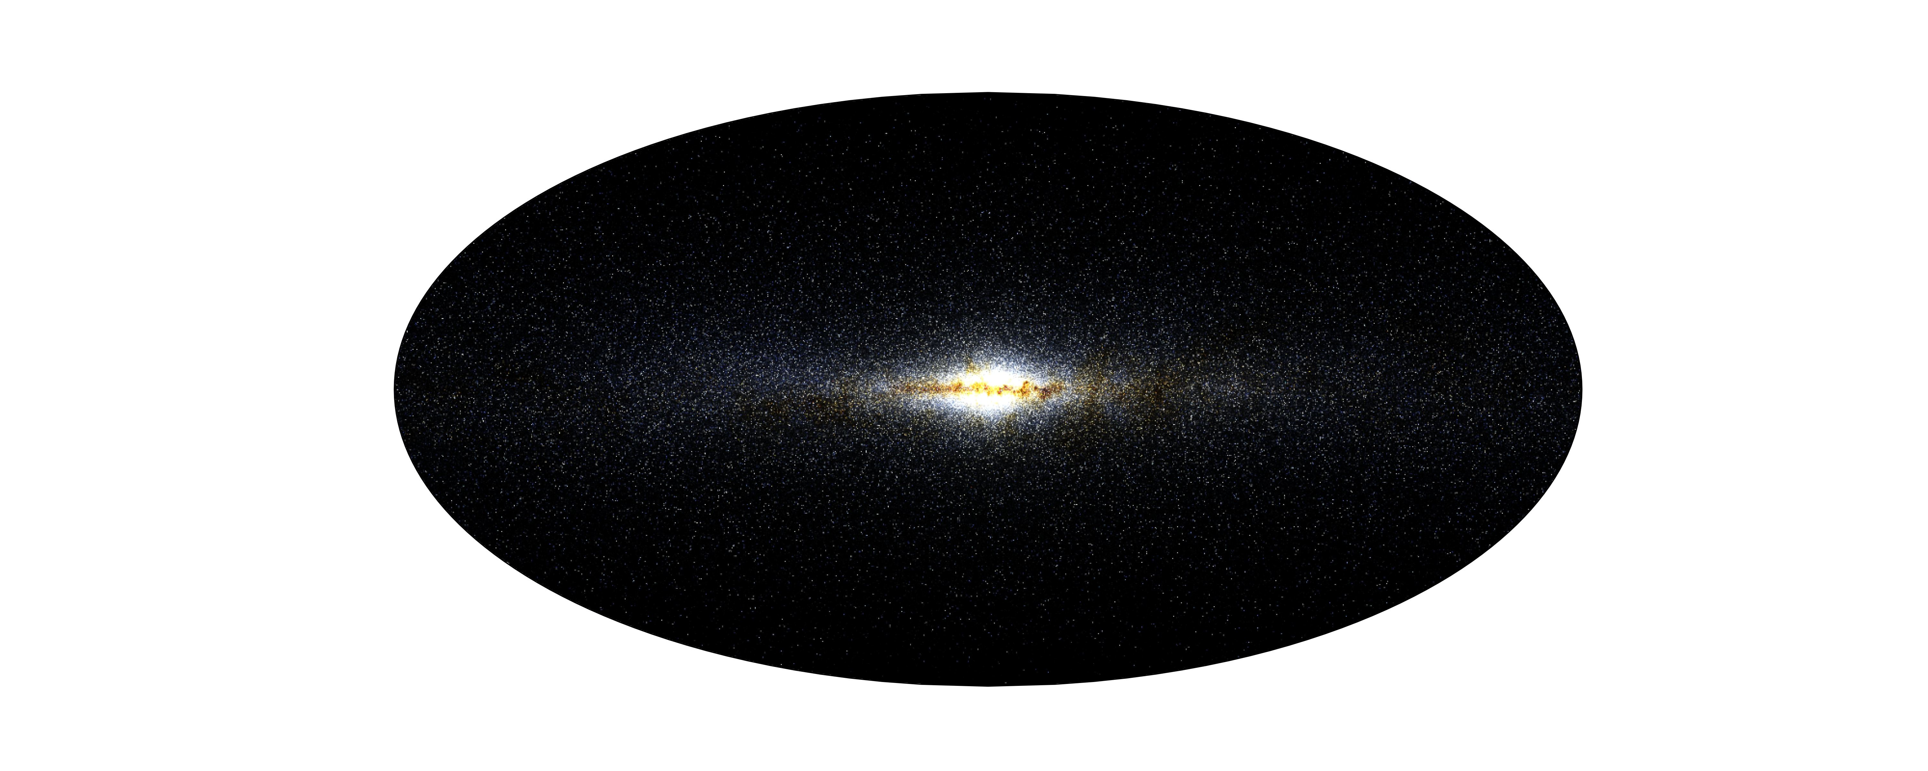
Prototype 2% survey
GAIA DR2
Flux maps
GAIA DR2
~25 million
LSST
~22 million
Roman
~670 million
m_{G} < 20.7
m_{u} < 23.8
m_{g} < 24.5
m_{r} < 24.03
m_{i} < 23.41
m_{z} < 22.74
m_{y} < 22.96
RGB =
G_{RP} G G_{BP}
~ 2.4 billion stars
Roman
m₂₁₃ < 24.7
m₁₅₈ < 25.3
m₁₀₆ < 25.5
RGB =
F₂₁₃ F₁₅₈ F₁₀₆
Using extincted & reddened absolute magnitudes

Slide 9
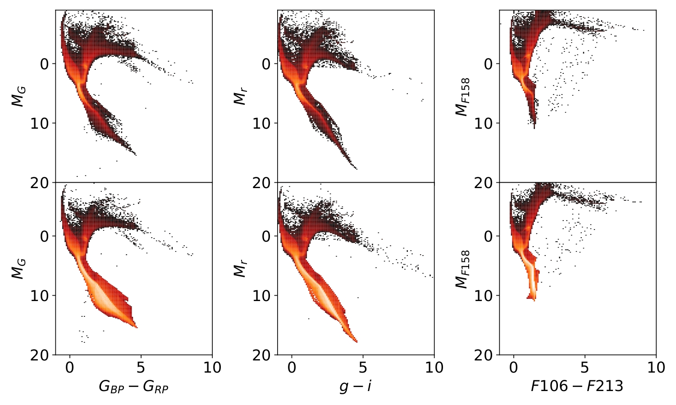
Roman vs LSST & GAIA
Using unextincted & unreddened absolute magnitudes
GAIA DR2
LSST
Roman
Roman & Gaia or LSST
~30 million
Roman only
~640 million

Slide 10
Catalog & Future work
Current catalog: dataset of ~ 2TB
Photometry:
Roman, LSST & Gaia DR2
Separate contributions for:
intrinsic magnitudes
distance modulus
extinction
Astrometry:
As projected without error model
Parallax, celestial, galactic, and galactocentric coordinates
Proper motion/velocity properties
Simulation-carried properties:
Ages and chemical abundances from parent particles
Future work:
New Data Integration:
Gaia DR3
Euclid
Full-Scale Survey Optimization:
Generate a complete 100% survey
Post-Processing Enhancements:
Error model simulation
Interstellar dust infrared emission map
Expanded Surveys:
Other simulations in latte (full-scale)
Different observer positions (2%)

Slide 11
Thank you for your attention

