Slide 1
Validating Injected SNe Ia in the Roman OpenUniverse Time-Domain Survey Simulations
Challenging Theory with Roman: From Planet Formation to Cosmology 07/11/2024
Lauren Aldoroty
Postdoctoral Research Associate
Duke University
lauren.aldoroty@duke.edu

Slide 2
What can we expect from Roman?
Roman was designed with supernova cosmology in mind, and will conduct the High Latitude Time Domain Survey (HLTDS).
More SNe Ia than ever (N ~ 10⁴) observed out to a higher redshift (z ~ 3) than ever
Millimagnitude accuracy (< 1% photometric precision; 10x more precise than HST)
So many SNe that statistical uncertainty will be negligible, and statistics will be dominated by intrinsic SN Ia variation (~0.1 mag).
Notes:
Type Ia Supernovae are an extremely powerful tool for measuring the expansion of the Universe. Roman was designed with supernova cosmology in mind. The High Latitude Time Domain Survey is designed to leverage this. We expect to find more SNe Ia than ever out to a higher redshift than ever with unprecedented levels of photometric precision. In fact, there will be so many SNe that statistical uncertainty will be negligible and we will be left with only systematic uncertainties from intrinsic SN variation.
-----------------------------------------------------------
Notes:
Roman SN redshift will go down to z ~ 0.3.
Hubble diagram currently has thousands SNe Ia up to z ~ 2.
Currently only 20 well-sampled enough SNe Ia w/ z > 2
w = w0 + (1-a)wa, w/ w0=-1 and wa=0 for cosmological constant

Slide 3
Cosmology targets
Goal: Accuracy to ~1% for w₀ and ~10% for w_{a}.
We base our requirements on the “Figure of Merit” (FoM, Albrecht et al. 2006).
Need to work backwards to figure out how to obtain such accuracy… which is where the OpenUniverse simulations come in.
Albrecht et al. 2006
FoM = 1/(area)
95% confidence region
Notes:
In order to make all this worth it, we need to have goals on how accurate our results are. In this case, we want to calculate the cosmological “w” parameters. Roman will be especially good for constraining this because we will be pushing the limit on SN Ia redshift further than before. So we need to work backwards to figure out how to obtain such accuracy. We will forecast the results starting with this quantity called the “figure of merit”, which is related to uncertainties in the w parameters, and tells you how capable your dark energy experiment is. The larger the number, the better.
-----------------------------------------------------------

Slide 4
Rose et al. 2021
As we stack experimental error contributions, the FoM decreases. The error budget can be distributed accordingly amongst requirements like cadence, depth, and number of SNe.
Notes:
As we stack experimental error contributions, the figure of merit decreases, and the error budget can be distributed accordingly. We can calculate how many SNe we will need to get the desired statistics, as well as frequency of light curve sampling, appropriate redshift bins, and other observational requirements.
-----------------------------------------------------------
NOTES:
“Wide tier”: N ~ 7000, 0.3 < z < 1.0
“Deep tier”: N ~ 4000, 0.5 < z < 3.0
Survey capability:
>100 SNe Ia per z=0.1

Slide 5
Rose et al. 2021
Then, we can simulate SN Ia observations and build a projected Hubble diagram to the specifications determined from the FoM.
Notes:
Then, based on those values, we can simulate SN Ia observations and build a projected Hubble diagram to the specifications originally determined from this figure of merit value.
-----------------------------------------------------------
NOTES:
“Wide tier”: N ~ 7000, 0.3 < z < 1.0
“Deep tier”: N ~ 4000, 0.5 < z < 3.0
Survey capability:
>100 SNe Ia per z=0.1
FoM > 325

Slide 6
Roman SN Project Infrastructure Team (SN PIT)
End goal: Pixel-to-cosmology pipeline
This includes both catalog- and image-level simulations
Three simulation products:
Catalog-level light curves and spectra for all transients
Pixel-level HLTDS images (OpenUniverse) with injected point sources from SNANA (SNe; Kessler et al. 2009)
3D spectral datacubes
Will be able to download and process images in “real time”
We need a difference imaging and photometry pipeline!
OpenUniverse-Roman-LSST DESC
Notes:
I am a member of the Roman SN project infrastructure team. Our end goal is to build a pixel-to-cosmology pipeline; in other words, we are planning on delivering software that can take us from raw Roman data to cosmological parameters that satisfy the accuracy requirements we’re looking for. In order to do this, we need both image- and catalog-level simulations. The catalog-level simulations can be used for optimizing observing strategy, but we still need image simulations to feedback into the catalog-level simulations because there are things that we can’t learn from a catalog that we can only learn from images, like artifacts, detector effects, noise, and saturation. We will have 3 simulation products: 1. Catalog-level LCs and spectra for Sne (all kinds), 2. Pixel-level HLTDS images w/ injected SN point sources, 3. 3D spectral datacubes. We will be able to download and process the images in like, simulated Twilight Zone “real-time”, which personally I’m excited about just because I think it’ll be a fun time.

Slide 7
Difference imaging pipeline specifications
Precise: SNe will have a large range of brightness across a large redshift range. Photometric systematics strongly affect constraints on cosmological parameters.
Challenge: How to accommodate Roman’s spatially-varying PSF?
Fast: Pipeline should detect SNe ASAP

Slide 8
Difference imaging with SFFT
Testing difference imaging on Roman simulations with Saccadic Fast Fourier Transform (SFFT) method (Hu et al. 2022)
More accurate results than HOTPANTS (fewer subtraction-induced artifacts); faster than both HOTPANTS and ZOGY
Hu et al. 2022
Notes:
-----------------------------------------------------------
On “statistically optimal”, Lei says: “if the statistical noise (e.g., for photon/detector) propagation to difference image is well calculated, I think an optimal subtraction should create a difference image with SNRs following a standard Gaussian distribution N(0, 1). Expect for the pixels associated with flux variability.”
On the SNR estimation, Lei says: “I propagate Photon noise from reference and science to difference, and divide the noise map to get SNR. The source Photon noise at a pixel on reference (science) is estimated as np.sqrt(flux/gain), coupled with a background noise with standard deviation bkgsig . Assume they are independent, it is ok use the sum of the two variance. If you ignore the effect of convolution during the image subtraction, i.e., it is reduced as a simple elementwise operation: diff = ref - sci, so that you can estimate noise on difference as the sum of variance of reference and science. This is a simplified way to approximate noise propagation. but should be good enough for now to quality our image processing.”

Slide 9
Difference imaging with SFFT
Testing difference imaging on Roman simulations with Saccadic Fast Fourier Transform (SFFT) method (Hu et al. 2022)
More accurate results than HOTPANTS (fewer subtraction-induced artifacts); faster than both HOTPANTS and ZOGY
Hu et al. 2022
Notes:
-----------------------------------------------------------
On “statistically optimal”, Lei says: “if the statistical noise (e.g., for photon/detector) propagation to difference image is well calculated, I think an optimal subtraction should create a difference image with SNRs following a standard Gaussian distribution N(0, 1). Expect for the pixels associated with flux variability.”
On the SNR estimation, Lei says: “I propagate Photon noise from reference and science to difference, and divide the noise map to get SNR. The source Photon noise at a pixel on reference (science) is estimated as np.sqrt(flux/gain), coupled with a background noise with standard deviation bkgsig . Assume they are independent, it is ok use the sum of the two variance. If you ignore the effect of convolution during the image subtraction, i.e., it is reduced as a simple elementwise operation: diff = ref - sci, so that you can estimate noise on difference as the sum of variance of reference and science. This is a simplified way to approximate noise propagation. but should be good enough for now to quality our image processing.”

Slide 10
Difference imaging pipeline specifications
Precise: SNe will have a large range of brightness across a large redshift range. Photometric systematics strongly affect constraints on cosmological parameters.
SFFT results in fewer artifacts and better accuracy than other methods
SFFT accommodates the spatially-varying PSF
Fast: Pipeline should detect SNe ASAP
SFFT’s computation time is an order of magnitude faster than other methods
Already tested on transient data from ZTF, TESS, DECam (Hu et al. 2022), and JWST images (Hu and Wang 2024)

Slide 11
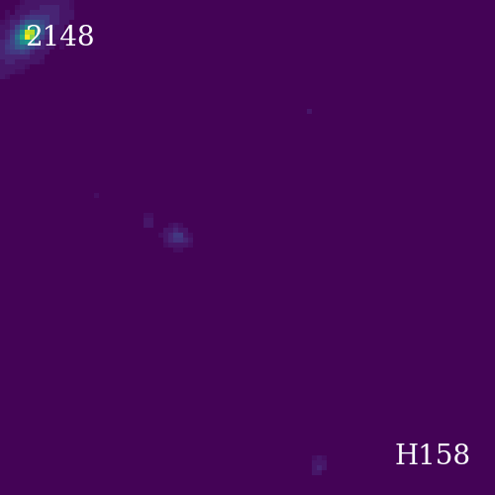
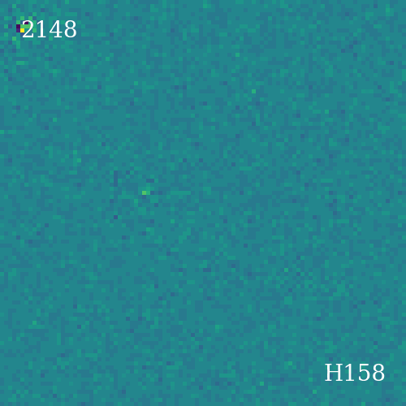
Unsubtracted SFFT
20172782

Slide 12
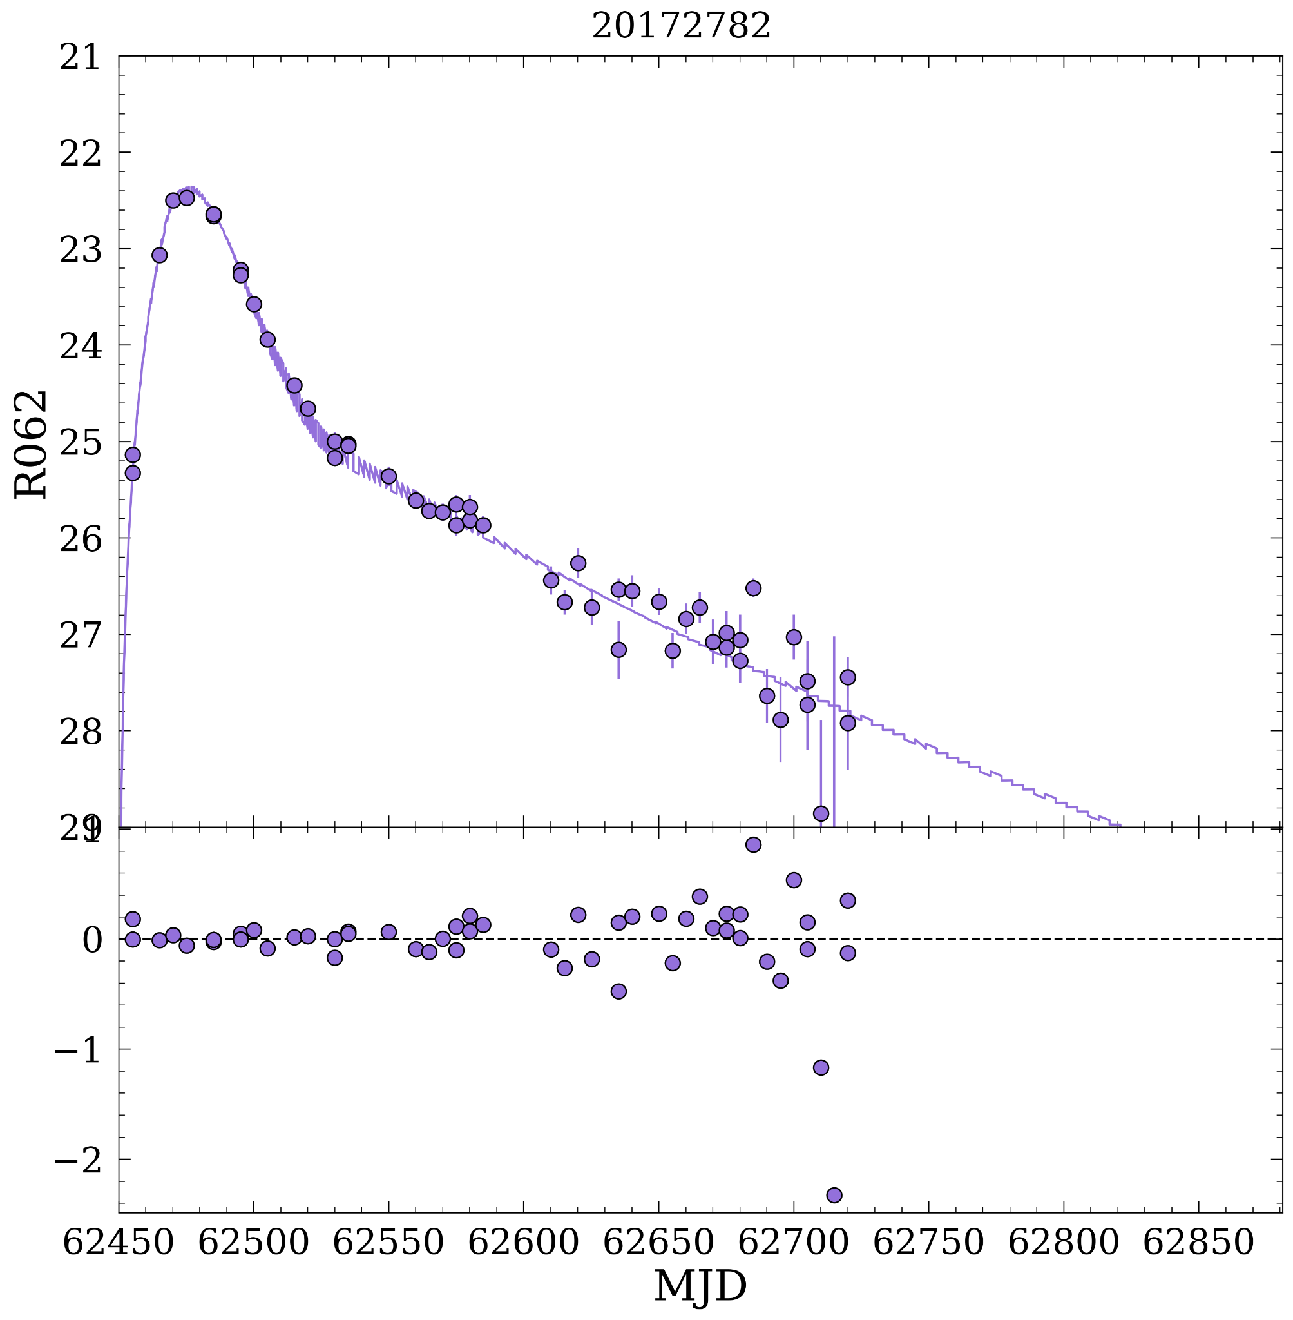
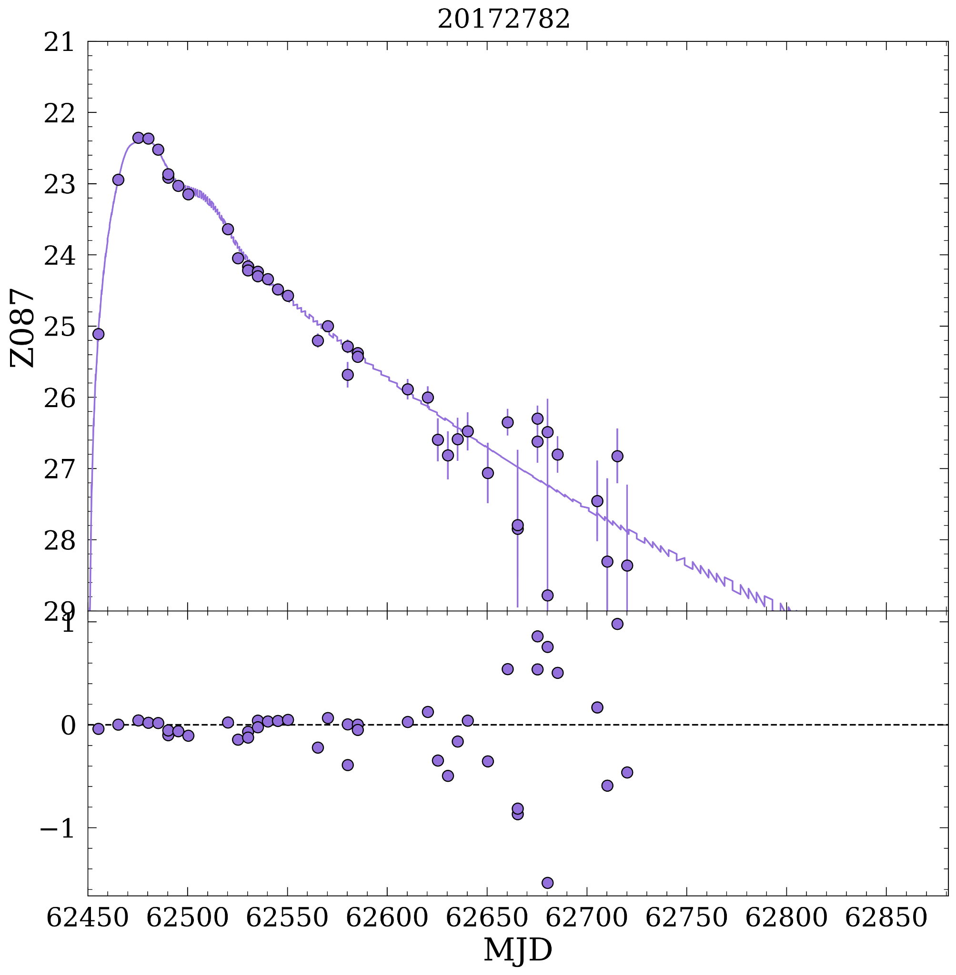
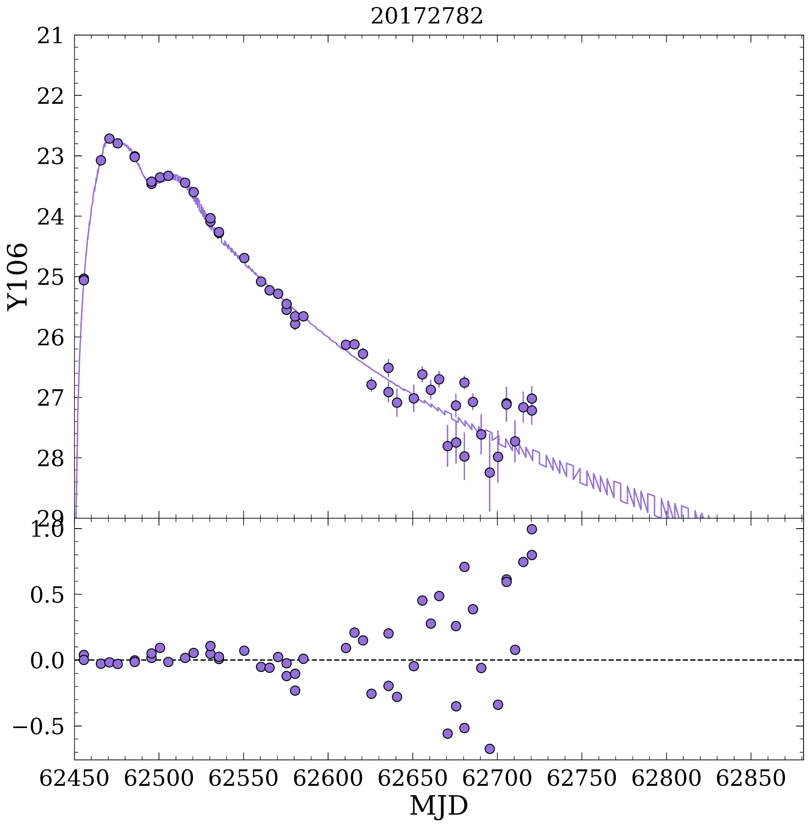
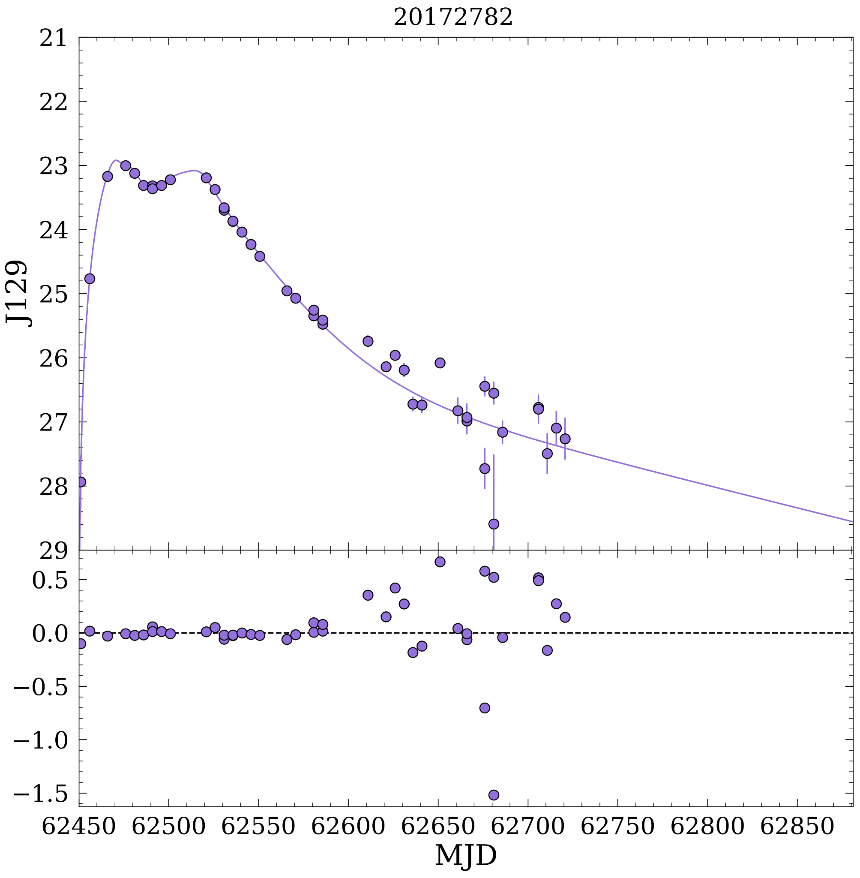
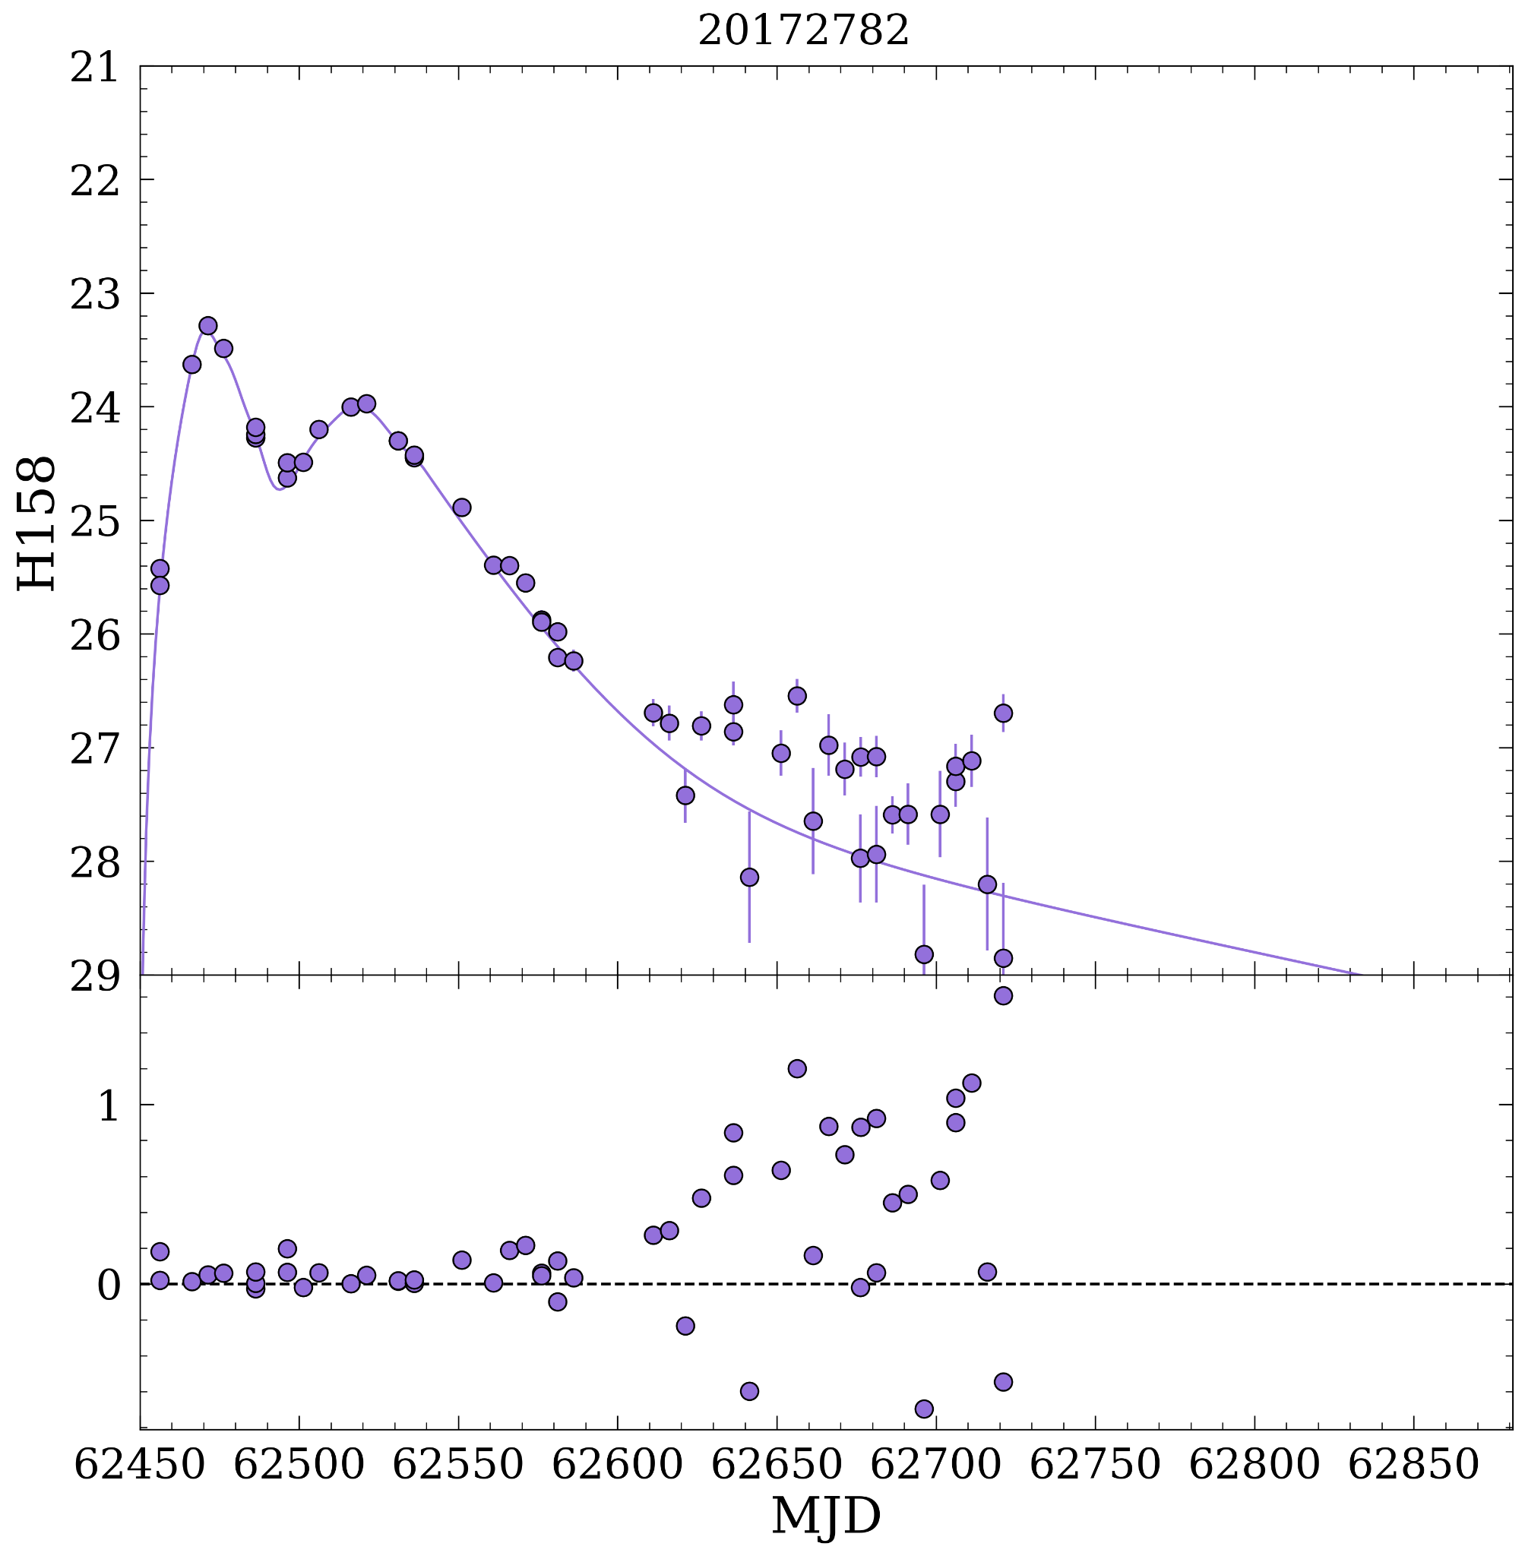
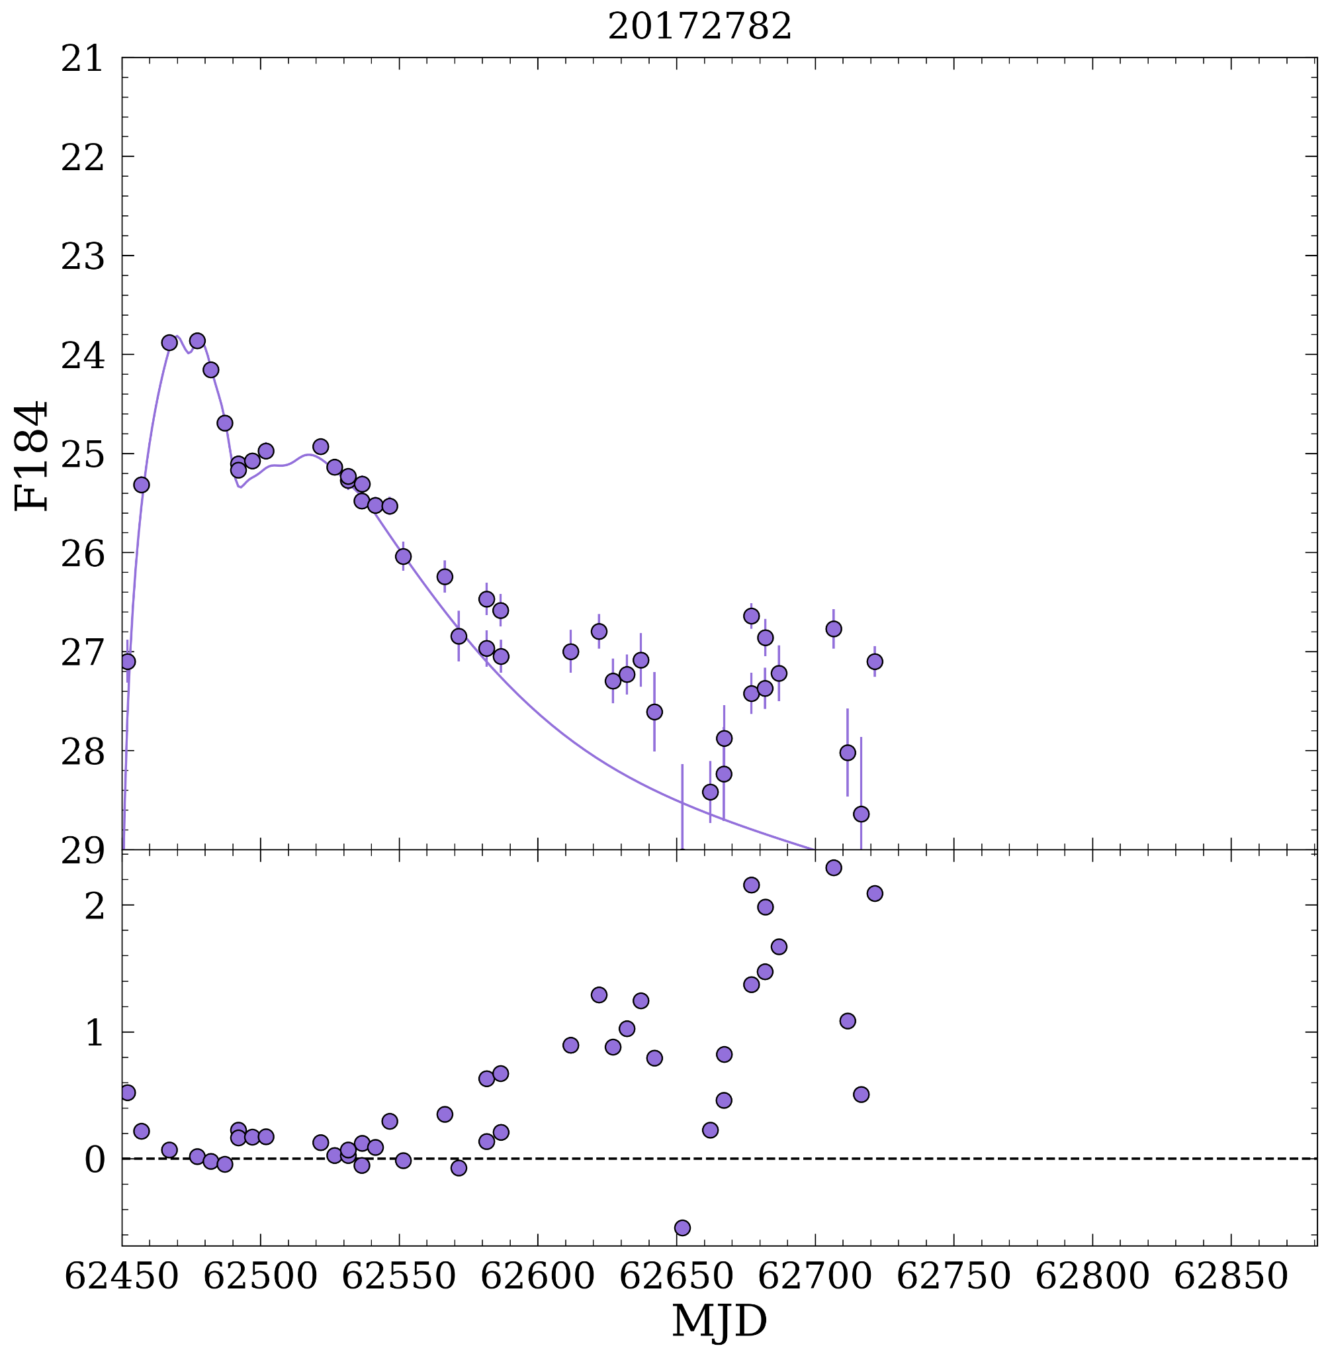
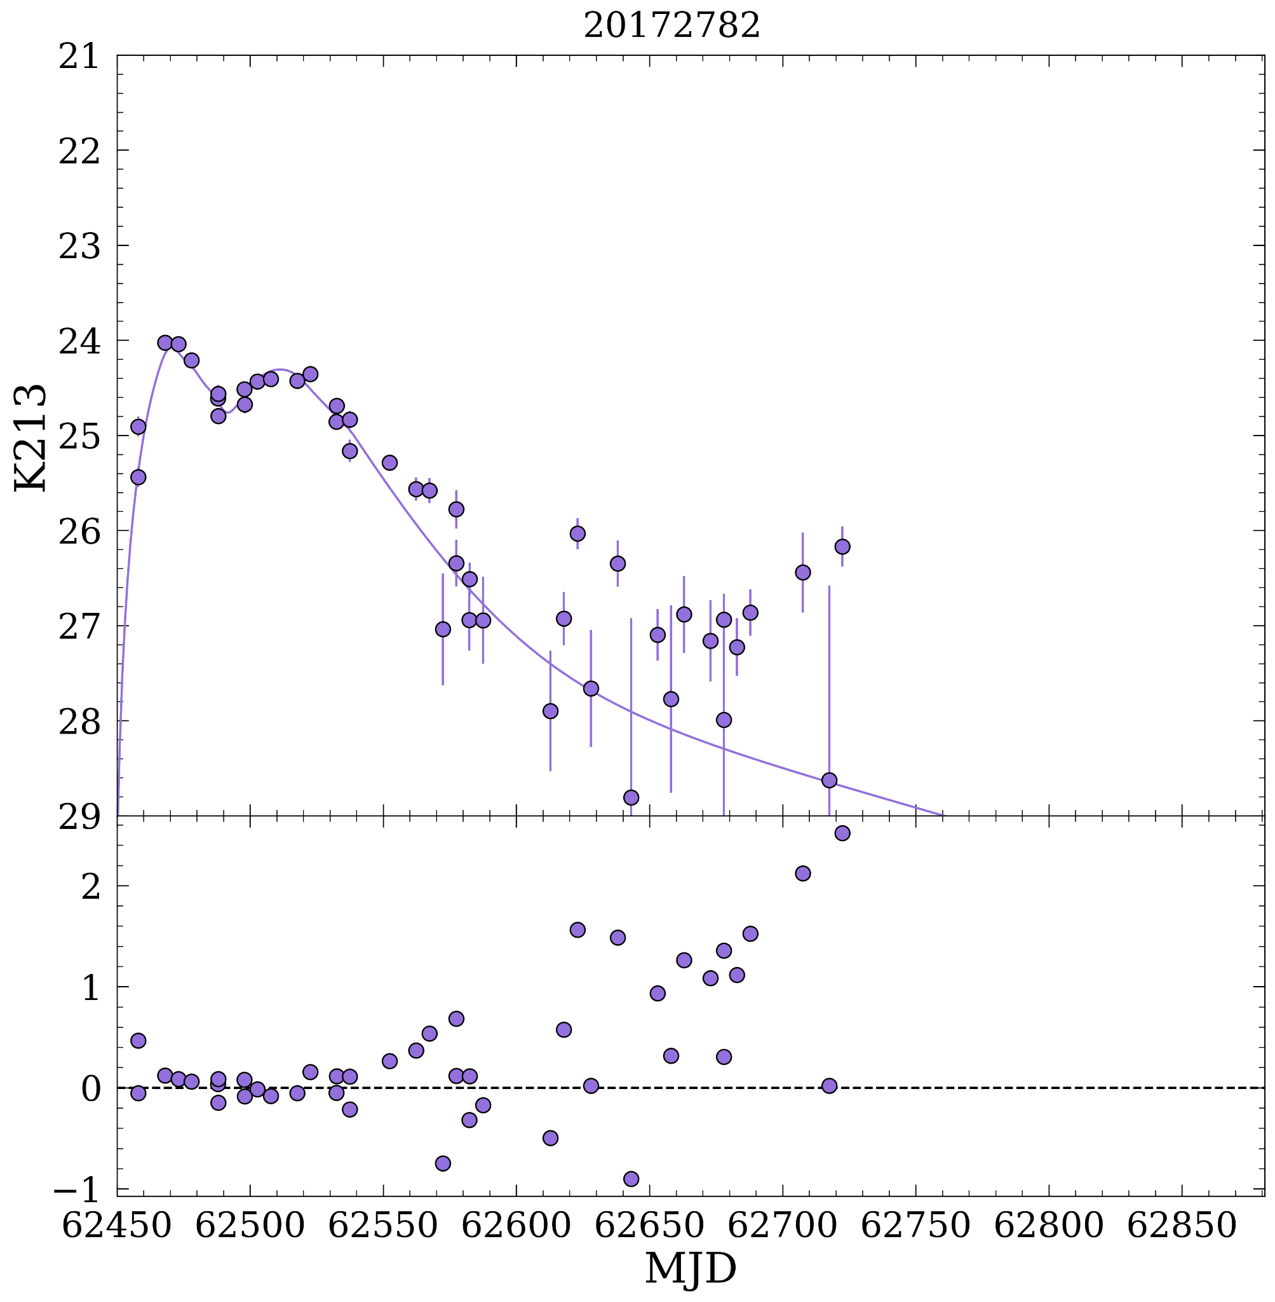
We successfully recover input light curves (solid lines) with PSF photometry (circles) on SFFT-subtracted OpenUniverse Roman images.

Slide 13
Software
I have written (am still writing) some tools! They are in a Python package I’m calling phrosty (https://github.com/laldoroty/phrosty/tree/main). Feel free to use it, but note that I am making changes almost daily.
In short, at this time, it does: aperture photometry, PSF photometry, SFFT difference imaging, and provides some tools for quickly accessing info in the sim files.

Slide 14
What’s next?
Short term
Coadded template images for subtraction
Characterize transient detection efficiency vs. SNR for input to catalog sims
Paper in progress: Characterizing photometry from simulated Roman High Latitude Time-Domain Survey images, Aldoroty et al. in prep
Long term
Full difference imaging pipeline to recover input light curves from the OpenUniverse Roman simulations, including object detection (i.e., not relying on known coordinates baked in to the sims)
Develop PIPPIN+SNANA job to get cosmological results (including systematics) from recovered light curves

Slide 15
Bonus slides

Slide 16
List of Instrumental Effects
See Troxel et al. 2022 for details
Relative quantum efficiency
Brighter-fatter effect
Persistence
Dark current
Saturation
Non-linearity
Inter-pixel capacitance
Read noise
Gain
Notes:
List instrumental effects, uncertainties (check proposal Table 12 Hounsell et al 2018 and A.1 Troxel et al 2022)

Slide 17
SFFT is like other difference imaging methods, but least-squares minimization is in Fourier space.
Science image
Differential background
Difference image
Matching kernel (δ-function basis, matches the PSFs)
Reference image

Slide 18
So, you take the usual difference imaging equation (below), but you put it in Fourier space, then turn it into a loss function, and minimize that.
Science image
Differential background
Difference image
Matching kernel (δ-function basis, matches the PSFs)
Reference image

Slide 19
SFFT: Step-by-step
Make cutout

Slide 20
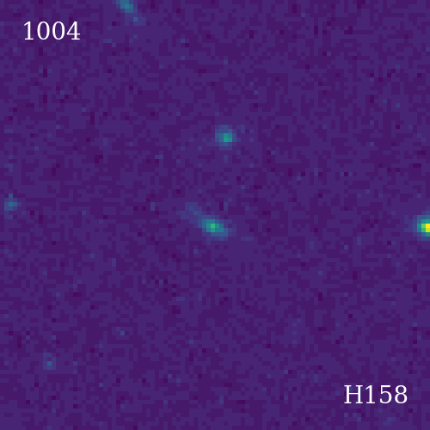
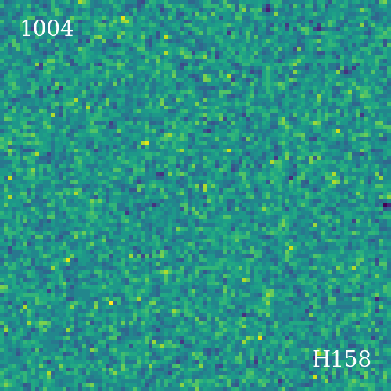
Unsubtracted SFFT

