Slide 1
Assessing the Impact of Binaries on Microlensing in PopSyCLE
Natasha S. Abrams Jessica R. Lu, Casey Y. Lam, Michael S. Medford, Matthew W. Hosek Jr., and Sam Rose
Challenging Theory With Roman Conference 07/12/24
Notes:
subtitle

Slide 2
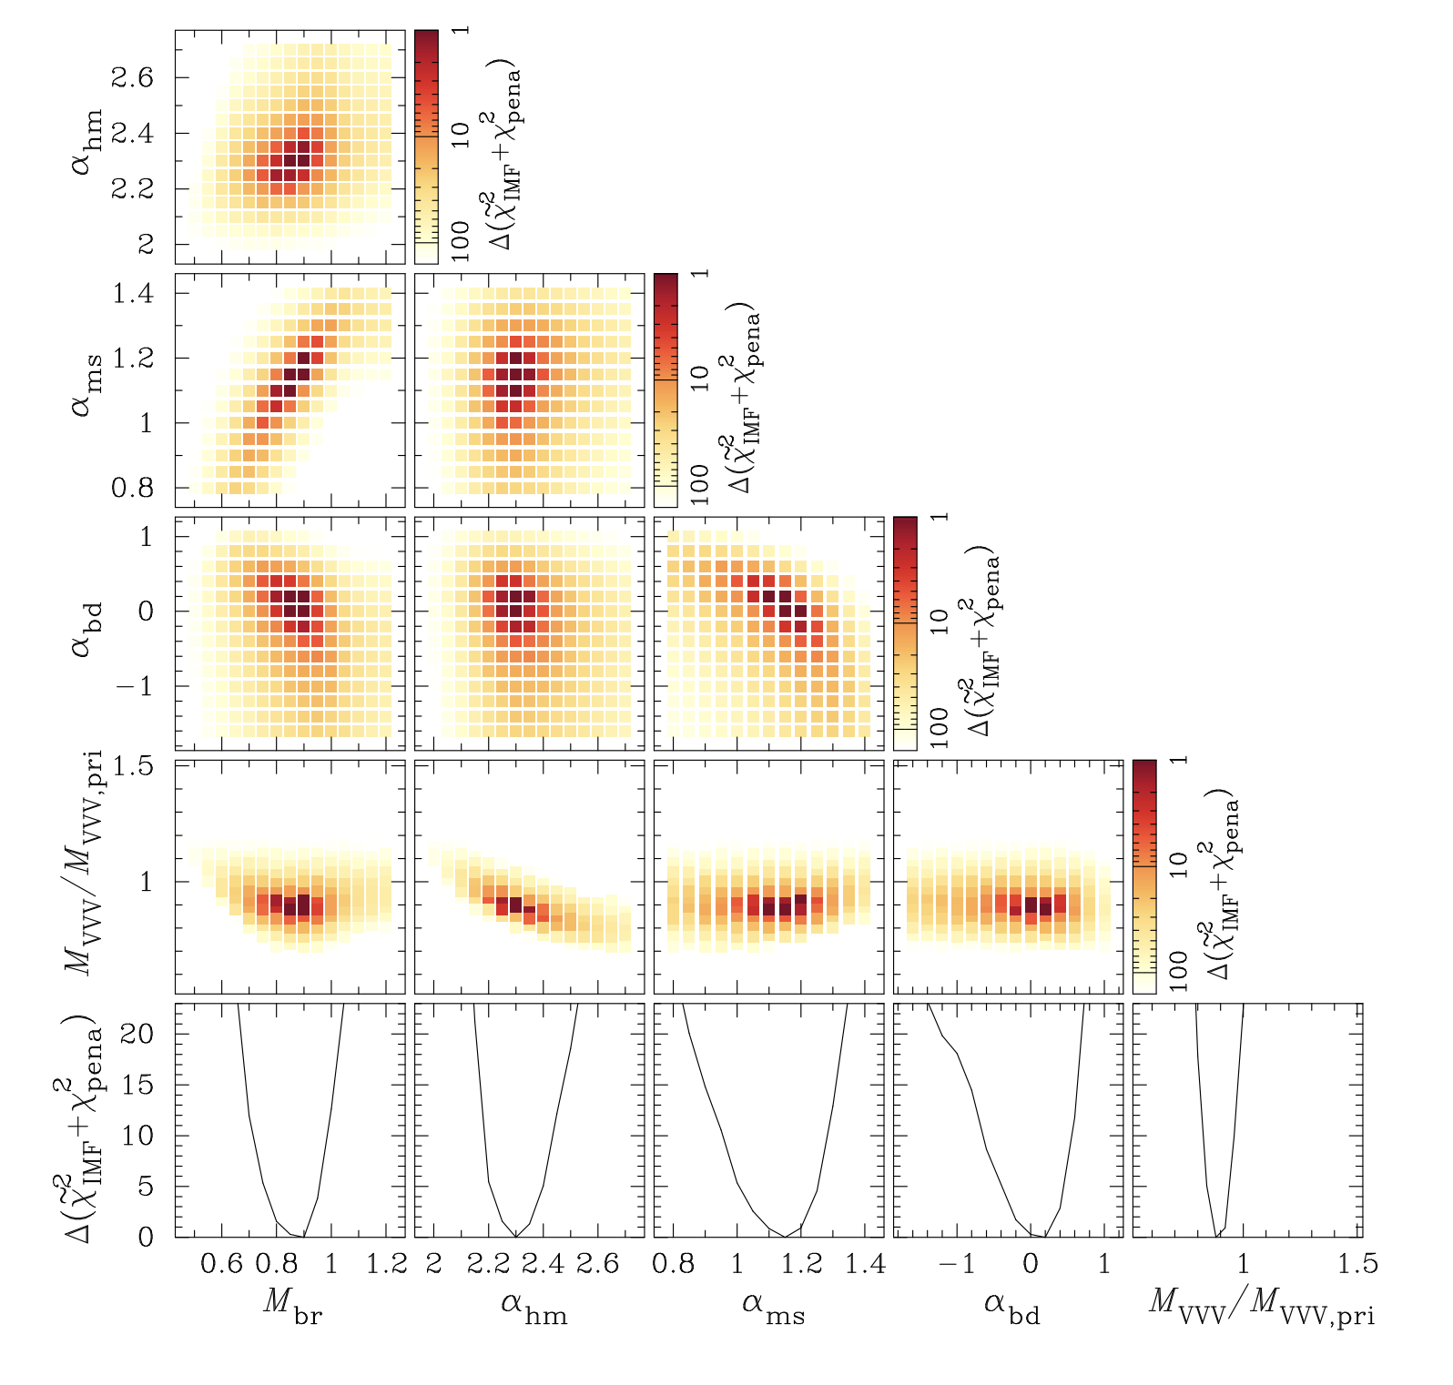
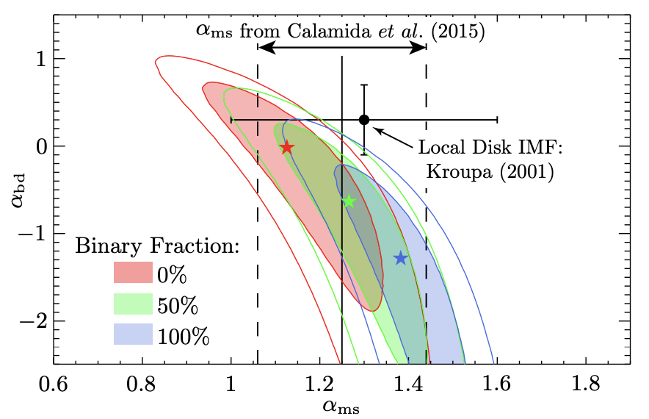
Microlensing reveals: IMF
Source: Koshimoto et al. 2021
Source: Wegg et al. 2017

Slide 3
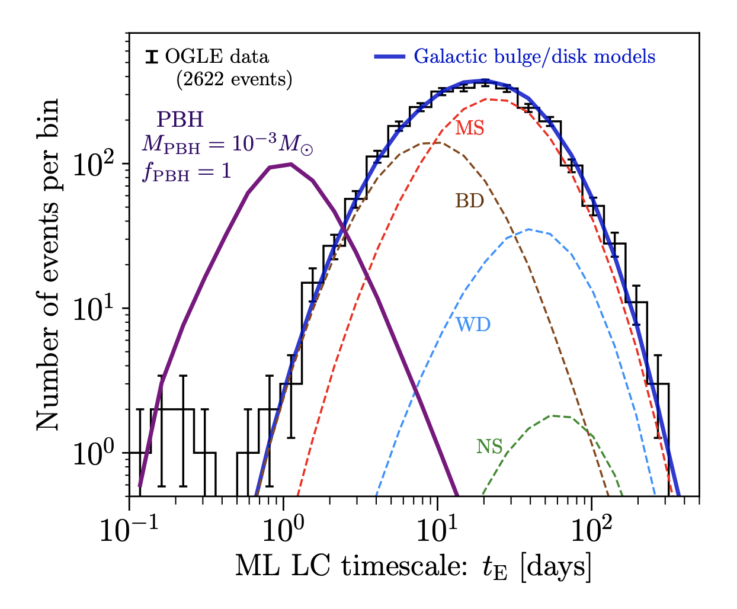
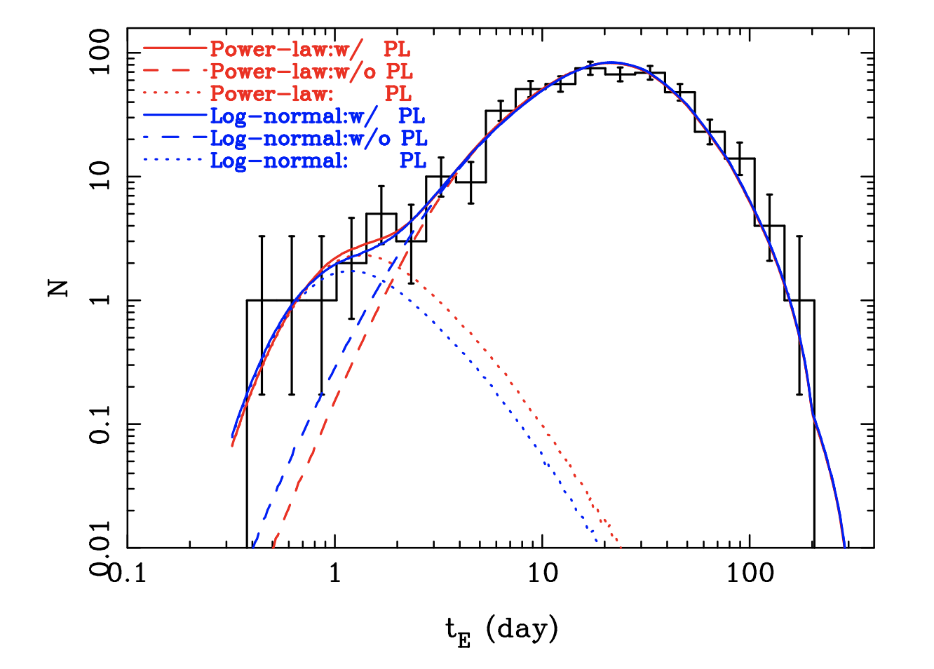
Microlensing reveals: dark populations
Source: Sumi et al. 2011
Source: Niikura et al. 2019

Slide 4
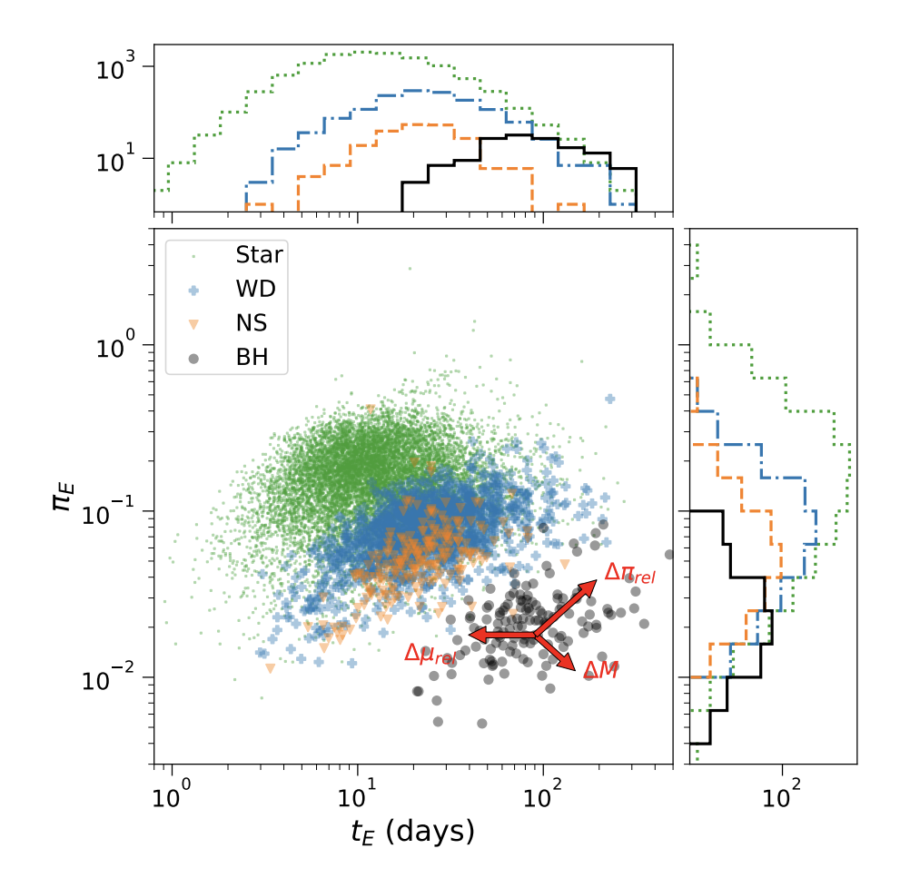
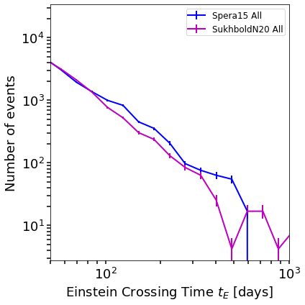
Microlensing reveals: other galactic properties
Galactic structure (distances and proper motions):
IFMR:
Source: Rose et al. 2022
Source: Lam et al. 2020

Slide 5
Binaries are critical both for: Modeling individual events Statistically interpreting a distribution of events

Slide 6
PSPL
PSBL
BSPL
Notes:
How do binaries influence microlensing?
Several different geometries/flavors

Slide 7
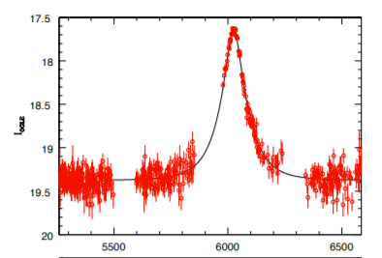
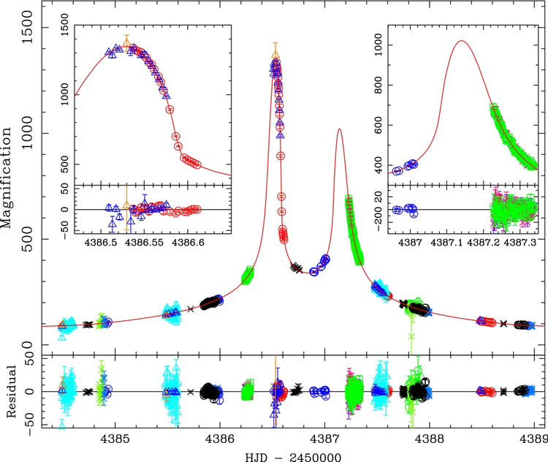
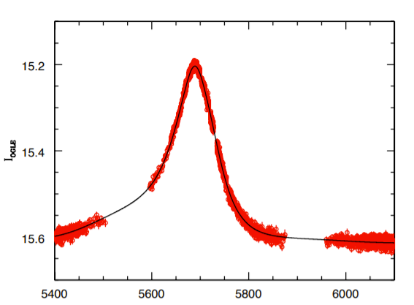
Some Binary Microlensing Can Masquerade as Single Lenses
Obvious binary
Single lens
Ambiguous Binary lens
Source: Miyake et al. 2012
Source: Lu et al. 2016

Slide 8
Simulate a mock microlensing survey including binaries using PopSyCLE

Slide 9
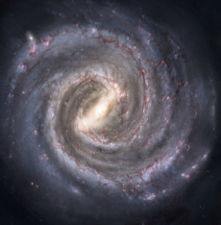
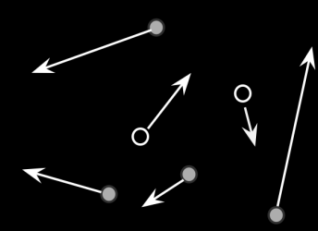
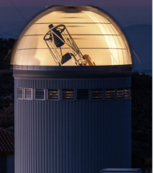
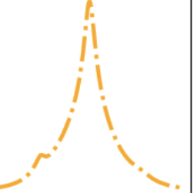
PopSyCLE
Galaxia
Simulate the Milky Way (single stars only)
Population Synthesis code
Useful beyond microlensing!
Add compact objects and binaries with positions and velocities
Mock microlensing survey
Simulate binary light curves
Galaxia – Sharma et al. 2011; SPISEA – Hosek et al. 2020; PopSyCLE – Lam et al. 2020
https://github.com/jluastro/PopSyCLE

Slide 10
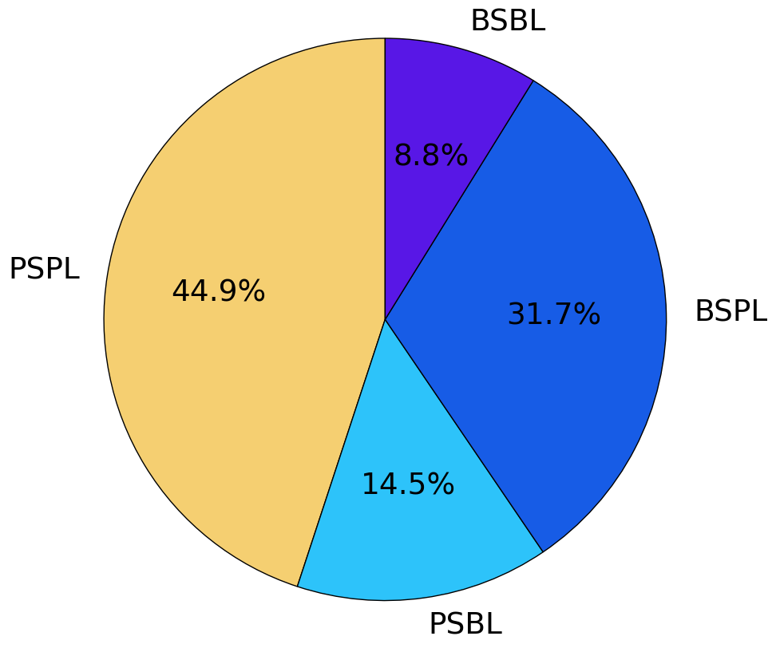
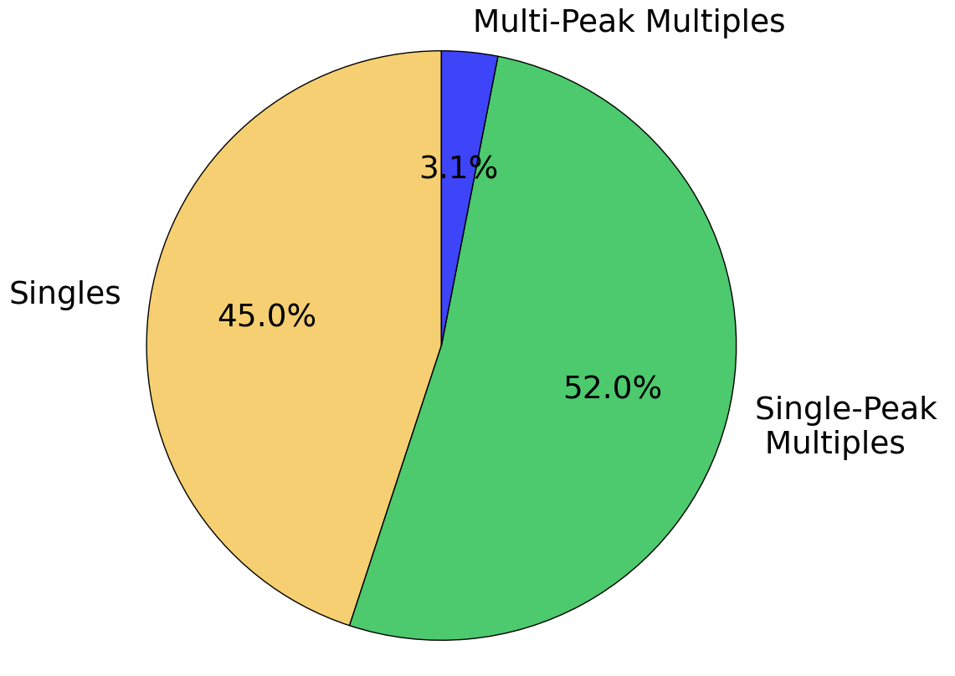
More than half of stellar and compact object microlensing events have at least one binary
…~52% appear as singles
Abrams et al., in review
Notes:
Towards the galactic bulge
Preliminary
Recognizable
Build on old stat 1s2l

Slide 11
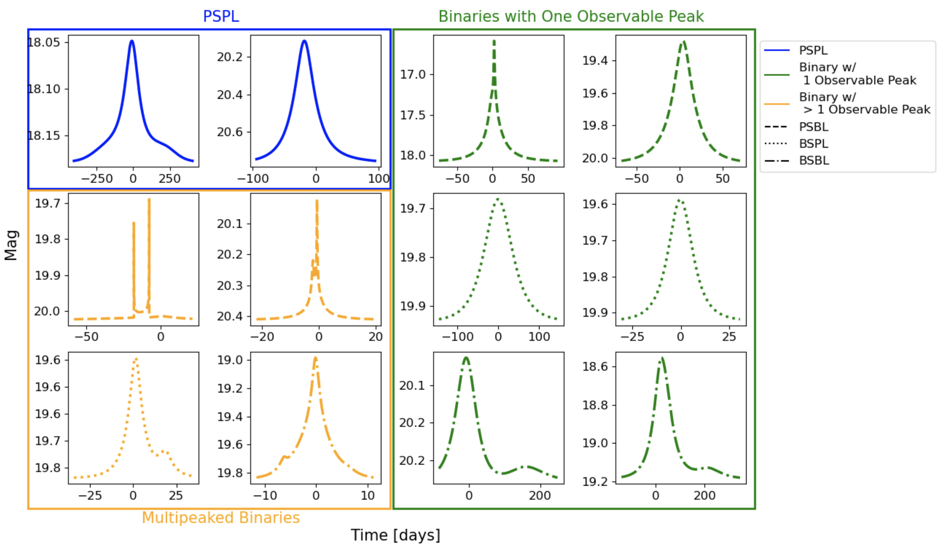
Abrams et al., in review

Slide 12
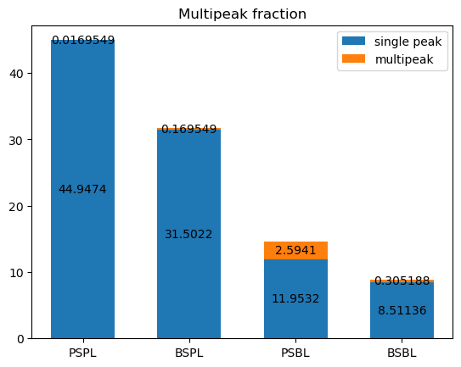
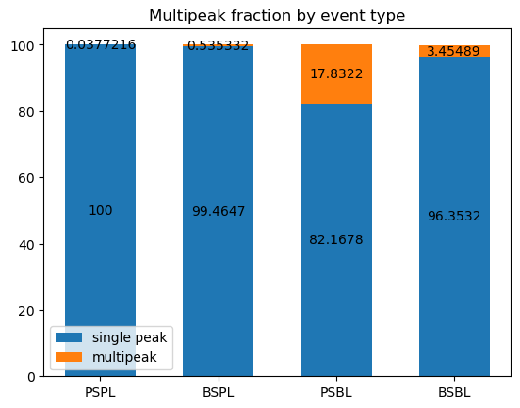
A higher fraction of binary lens events are multipeaked

Slide 13
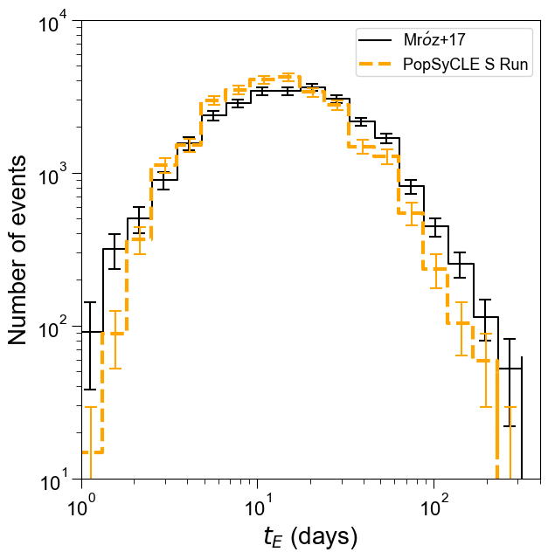
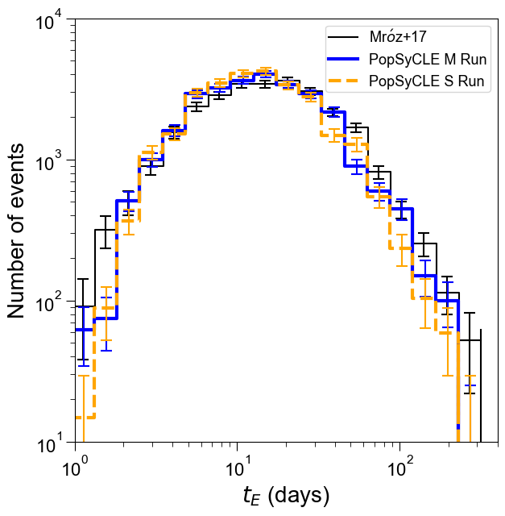
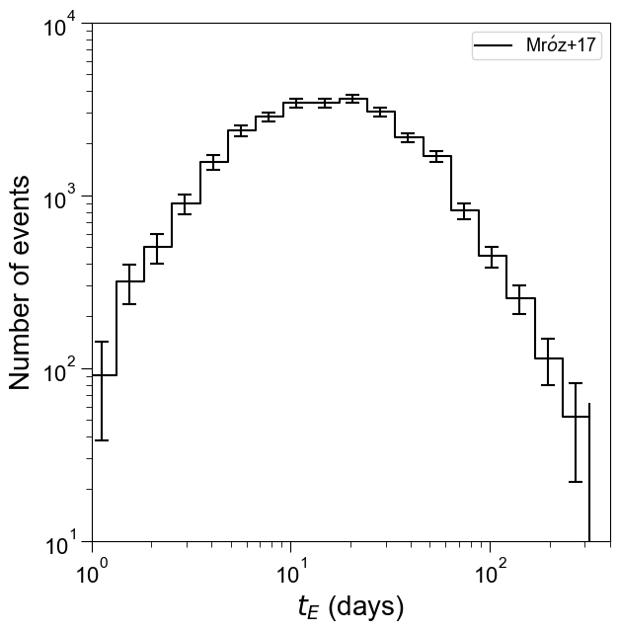
Brings t_{E} distribution into agreement with data
Mean t_{E} averaged across 18 fields:
OGLE: 25.6±3.3 days
Singles only: 18.7±1.2 days
Singles + single peaked multiples: 25.6±1.4 days
S Run – Model with only singles
M Run – Model with multiples and singles
Mróz et al. 2017 Mróz et al. 2019
Abrams et al., in review
Notes:
Label, color, cite in bottom

Slide 14
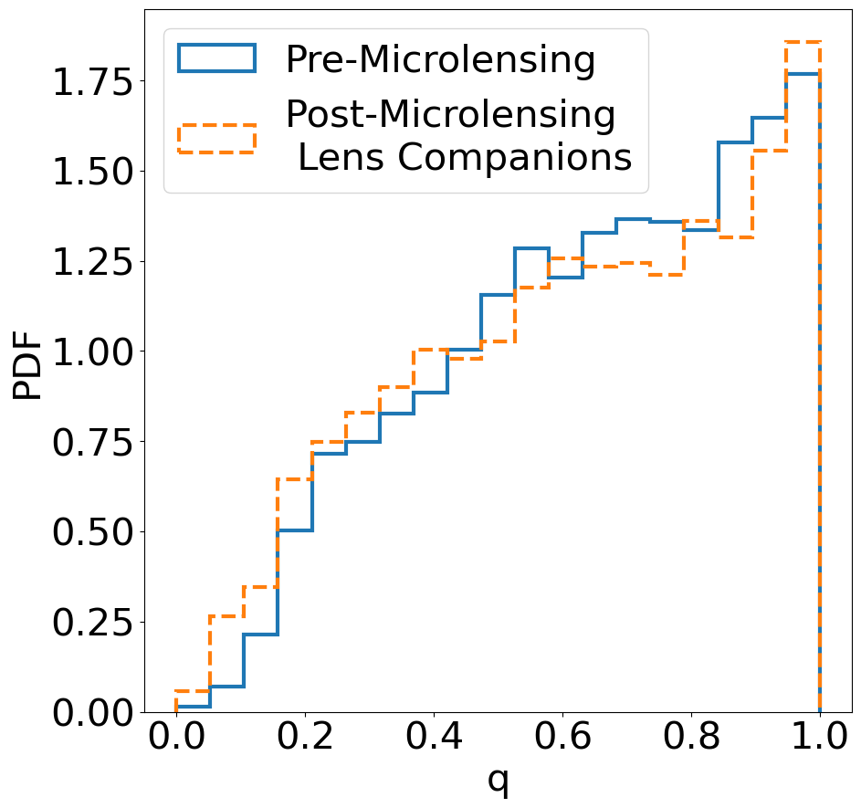
Binary Parameter Bias with Microlensing
Abrams et al., in review

Slide 15
Selecting black holes for follow-up
Black holes still relatively isolated in t_{E}-𝜋_{E} space
Observations in seasonal gaps of Roman could:
Help characterize those quantities
Reveal signatures of binarity
Characterize long duration astrometric signals
Abrams et al., in review

Slide 16
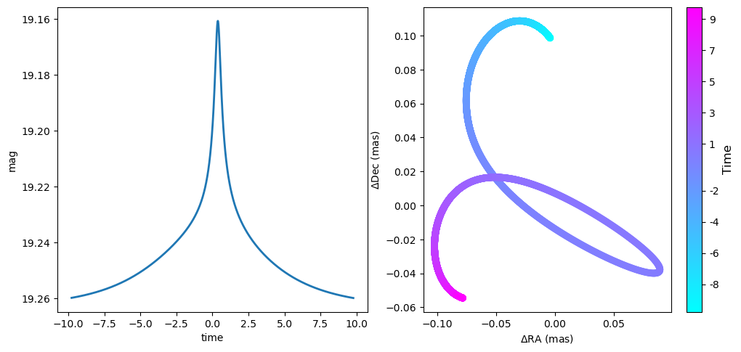
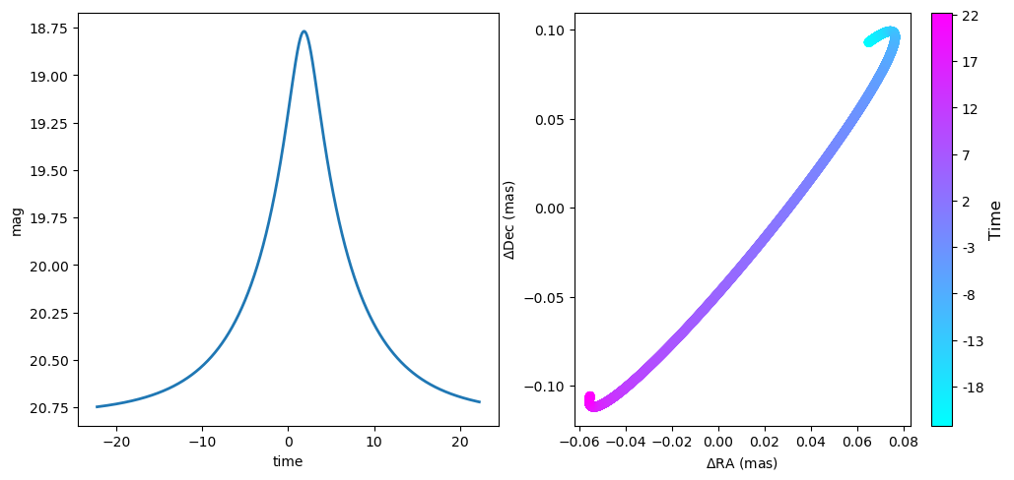
Binary lens lightcurves with a single peak may be distinguishable in their astrometric microlensing signal
PSBL
PSPL
Abrams et al., in review

Slide 17
Future Work
Fitting all binaries with PSPL (w/ and without parallax) to see how parameters are biased
Binary interactions - Shambhavi Srivastava
No common envelope, mass exchange, or binary disruption
Codes like BPASS (Eldridge, Stanway, et al. 2017) and COSMIC (Breivik et al. 2021) could be integrated
Binary orbital motion (xallarap) – Dex Bhadra
Parameters generated
Triples and higher order systems

Slide 18
Binaries in microlensing are important
Over half of microlensing events have at least one binary system most of which appear like single events
Inclusion of binaries brings t_{E} into agreement with data
Binary lenses with single peaked lightcurves may have a strong binary astrometric signal
Natasha Abrams – nsabrams@berkeley.edu

Slide 19
BINARY POPSYCLE BACKUP SLIDES

Slide 20
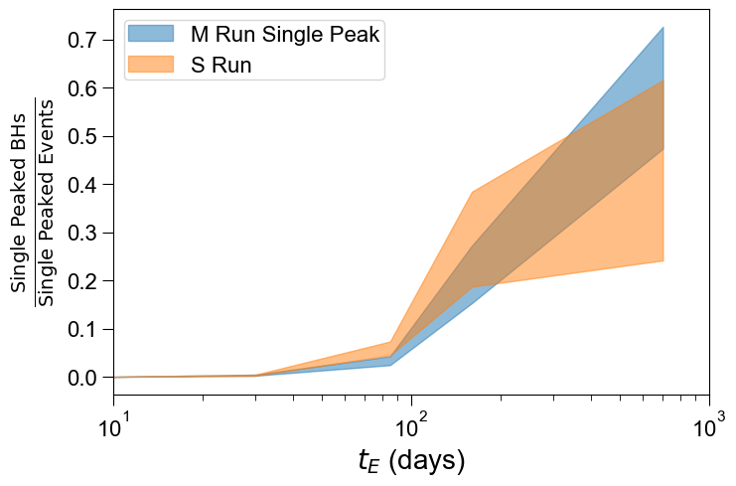
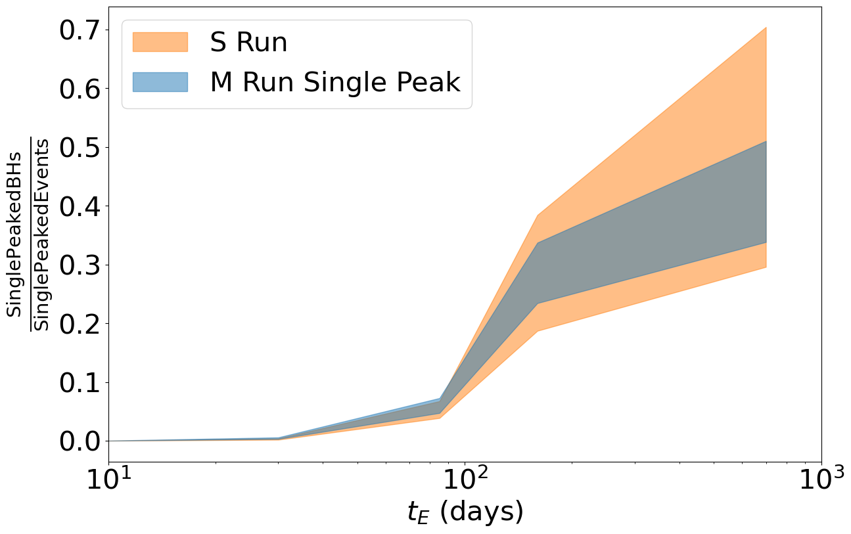
Binaries do not appear to affect black hole selection
We select black hole candidates for astrometric follow-up to determine mass without galactic model (Lu et al. 2016, Lam et al. 2022, Lu et al. in prep)
At long t_{E} we expect most events to be black holes in singles only or singles + multiples
Consistent with sample
BH Sample
Notes:
120 BH sample
Blue on top of yellow

Slide 21
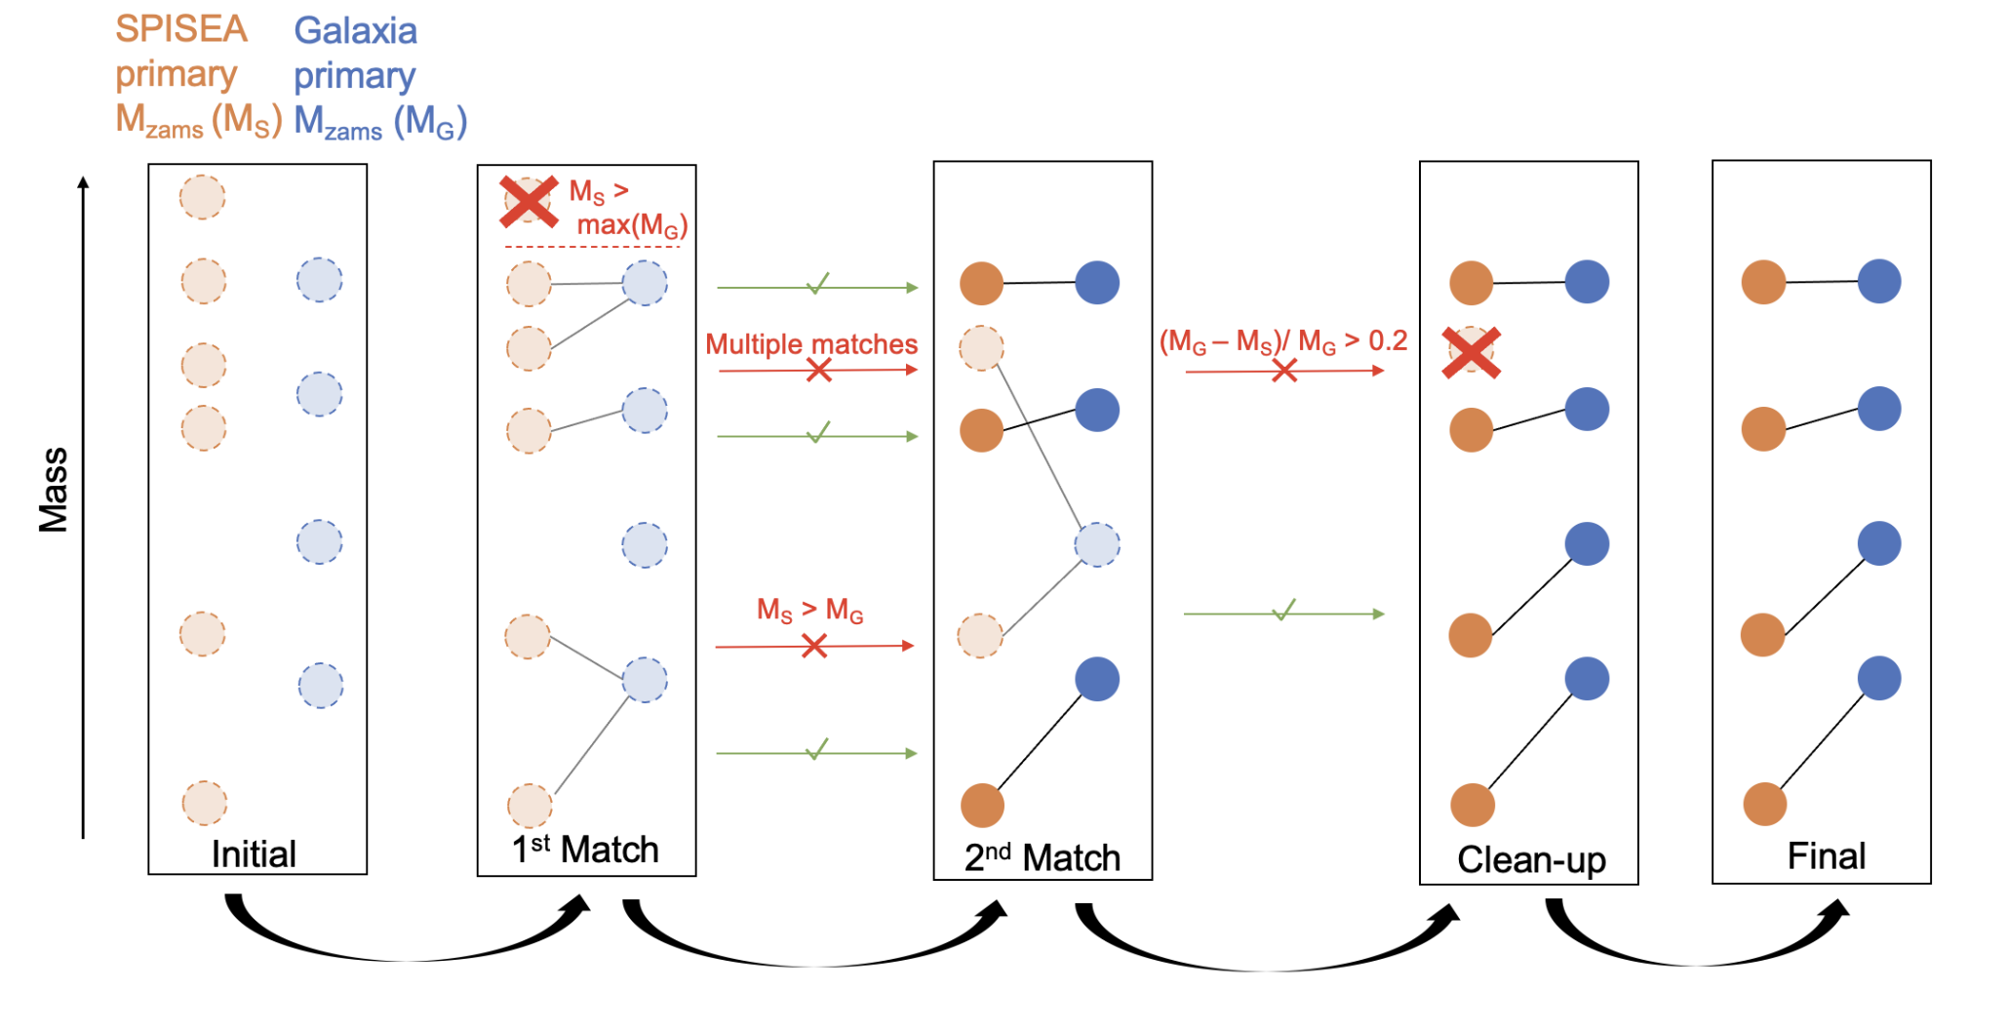

Slide 22
Number of events in better agreement, but number of stars still lowish

Slide 23
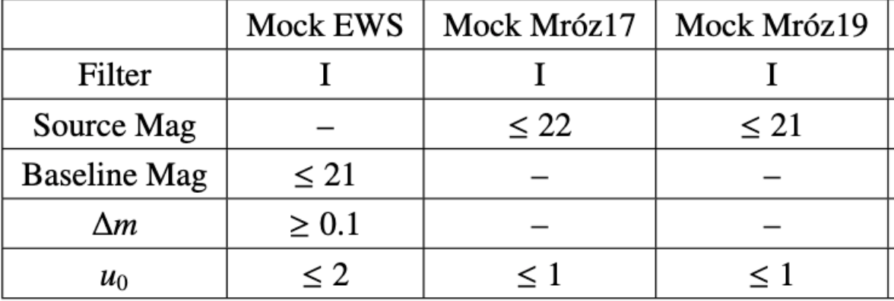
Cuts Summary

Slide 24
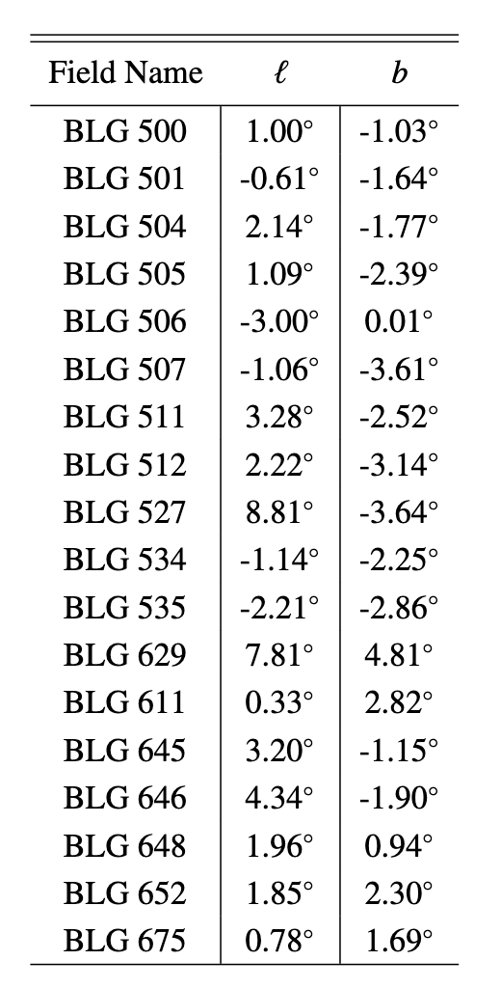
Field summary:
Area: 0.34 deg squared
IFMR: Subkhold N20
Filter: ubv I
Blend radius: 0.65”

Slide 25
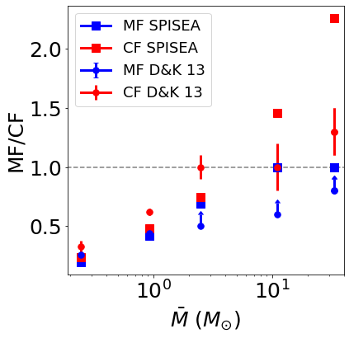
Binary Properties from Stellar Observations
Multiple system frequency: MF(M) = 0.44M^{0.5}
Companion frequency: CF(M) = 0.5M^{0.45}
Mass ratio: f(q) = q^{-0.4}
Binary disruption not included
Duchêne and Kraus 2013

Slide 26
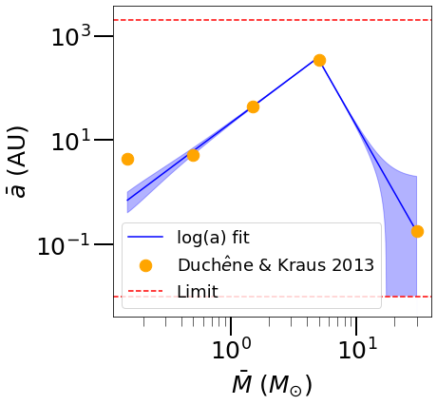
Resolved Binary Properties from Stellar Observations
Eccentricity f(e) = 2e
Inclination: uniform in cos(i)
Separation:
$a\left(M\right)=\left\{\begin{aligned}\text{A}{\text{(}\text{M}\text{/}{\text{M}}_{\text{break}})}^{−α_{1}^{}} \text{M}\text{<}{\text{M}}_{\text{break}} \\ \text{A}{\text{(}\text{M}\text{/}{\text{M}}_{\text{break}}\text{)}}^{−α_{2}^{}} \text{M}\text{>}{\text{M}}_{\text{break}}\end{aligned}\right.$
A = 379.8, M_{break} = 4.9 M⊙, 𝝰₁ = -1.8, 𝝰₂ = 4.2
${\text{σ}}_{\text{log}\left(\text{a}\right)}\text{(}\text{M}\text{)=}\text{mlog}\left(\text{M}\right)\text{+}\text{b}$
m = 0.84, b = 0.31
Limits
10⁻² < a < 2x10³
${\text{σ}}_{\text{log}\left(\text{a}\right)}$>= 0.1
Duchêne and Kraus 2013

Slide 27
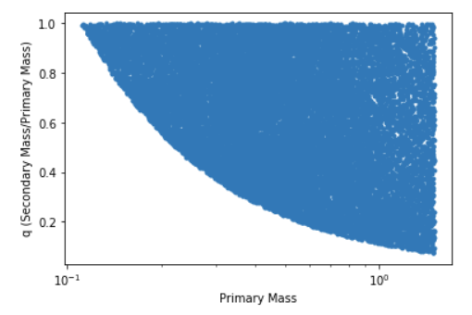
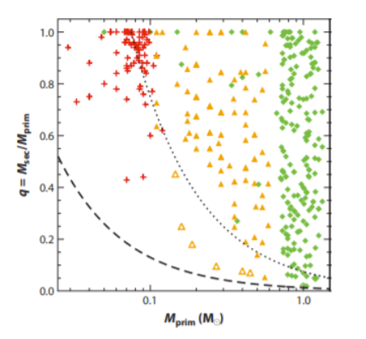
Unresolved Multiple Properties (No positions)
q – mass fraction
P(q) = q^{-0.4}

Slide 28
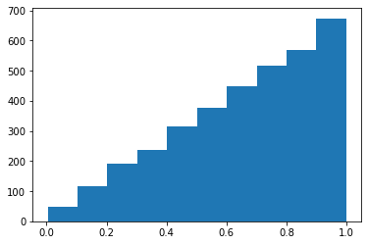
Adding Resolution - Eccentricity
f(e) = 2e

Slide 29
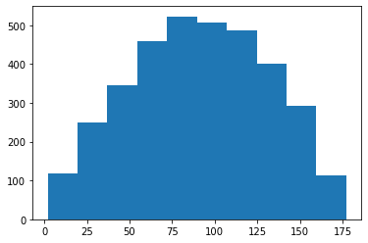
Adding Resolution – Inclination
Frequency follows sin curve

Slide 30
Previous Statistics and Simulations
~3-10% of microlensing events as binaries generally accepted (e.g. Jaroszyński 2002, Alcock et al. 2000a, Sumi et al. 2006, Mróz et al. 2017)
Previous simulations either don’t include multiples: (e.g. Kerins et al. 2009, Penny et al. 2013)
Include them in a simplistic way (e.g. Niikura et al. 2019, Sajadian & Poleski 2019, Wegg et al. 2017)
Or are designed to get out other properties using microlensing (e.g. Koshimoto et al. 2021)

