Slide 1
Simulating Asteroseismic Detections for the Roman Galactic Bulge Time Domain Survey
Noah Downing, The Ohio State University
Roman Asteroseismology Wide Field Science Team

Slide 2
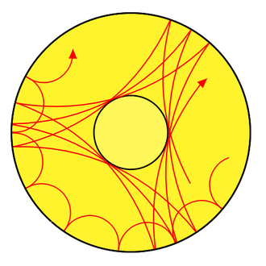
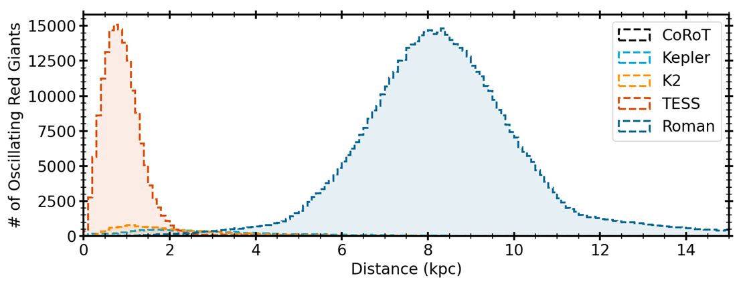
Asteroseismology and Roman
Asteroseismology utilizes stellar oscillations to determine stellar parameters (mass, radius, age, etc)
Roman’s Galactic Bulge Time Domain Survey will provide a wealth of time series data for oscillating Red Giants useful in asteroseismic studies
Studying Red Giants will lead to insights in the stellar populations of the Galactic Bulge
To simulate Roman Asteroseismology I use modified Kepler light curves following GBTDS observing strategies
Illustration of stellar wave patterns
Huber, et al. 2024

Slide 3
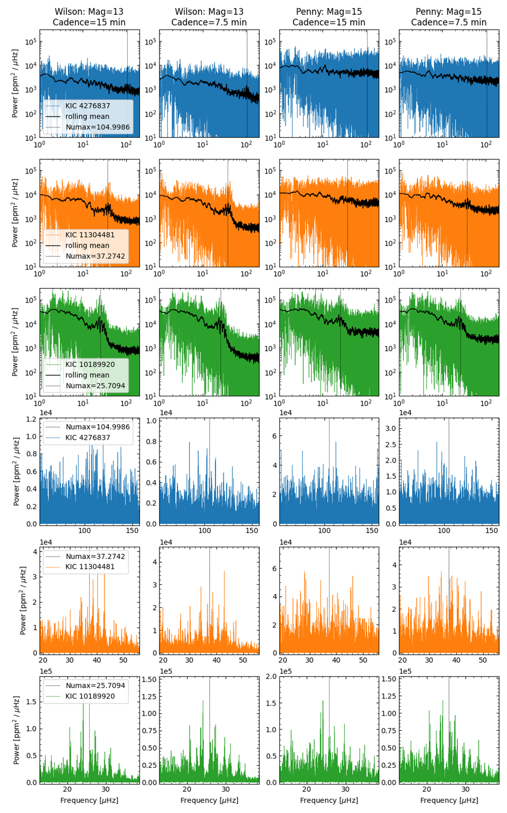
Key Results
Asteroseismic signals fall close to the noise floor for the Red Clump
15 minute cadence loses detections in the lower RGB and Red Clump
Implementing a faster sampling strategy greatly improves detections in the Red Clump
Accurate saturated star photometry improves detections in the lower RGB
Frequency [μHz] Frequency [μHz] Frequency [μHz] Frequency [μHz]

