Slide 1
Deciphering Baryonic Feedback from Galaxy Clusters
Nihar Dalal, Chun-Hao To, Chris Hirata

Slide 2
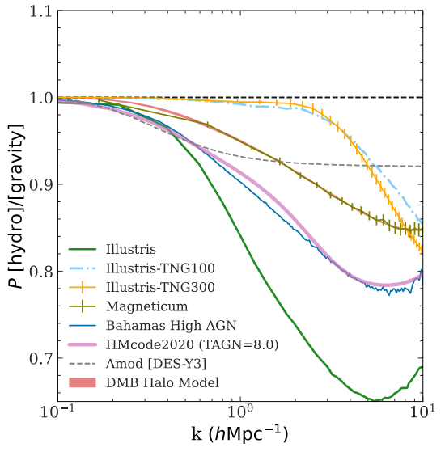
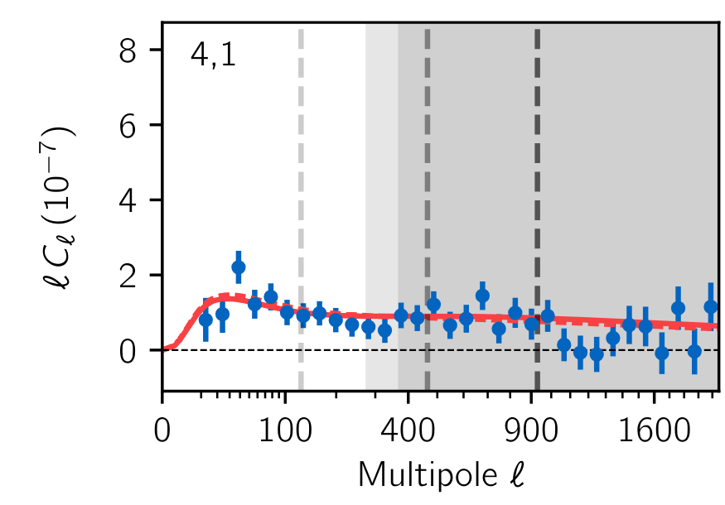
Baryonic feedback & Cosmic Shear
Baryonic effects cause a characteristic suppression in the matter power spectrum at scales k > 1 h/Mpc
Hydrodynamical simulations vary considerably in their predictions for this suppression due to different implementations of baryonic physics
Leads to scale cuts in cosmic shear that limit precision on parameters of interest
To et al. 2024 (arXiv: 2402.00110)
Doux et al. 2022 (arXiv: 2203.07128)

Slide 3
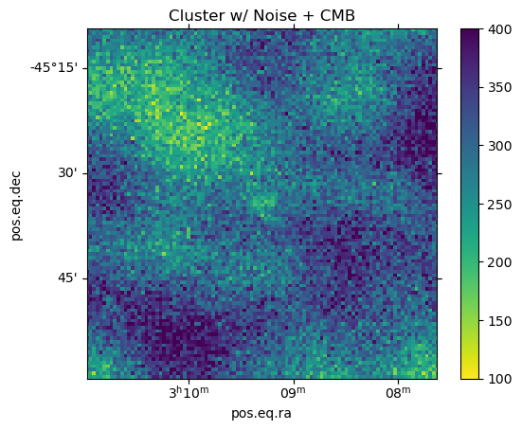
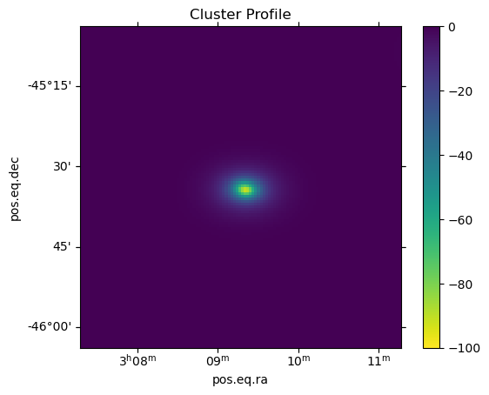
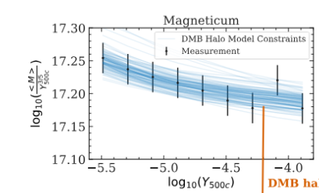
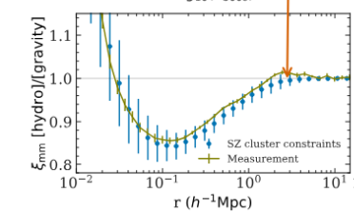
Model & Method
Noisy ACT Data
Extract Cluster Profiles
Fit DMB Model
Suppress Matter Power Spectrum
10 parameter
Dark Matter + Baryon Model
(S. Pandey et al. 2024)
Forward Model
with an emulator
(Dalal et al. in prep)

Slide 4
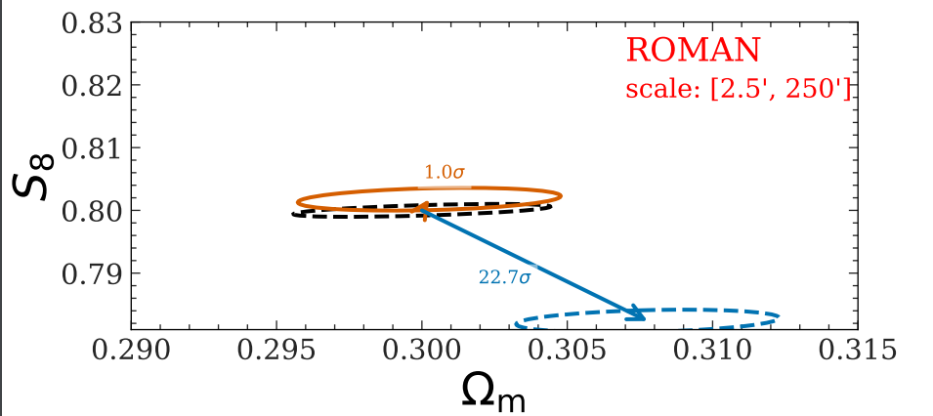
Forecasts

