Slide 1
Free-floating planets and Roman: confronting theory with observations
William DeRocco
University of Maryland/Johns Hopkins University
IPAC Roman Workshop
July 12th, 2024
Notes:
Hello! My name is William DeRocco, and today I’m going to be talking about free-floating planets in the era of Roman.

Slide 2
Motivation
Notes:
So before I dive into the meat of the talk, I just want to provide a bit of motivation. I think a lot of you have probably seen some version of this plot before, and I know it’s been shown a few times at this workshop. It shows the discovery space for Roman’s microlensing survey on a plot of planet semimajor axis versus mass.
However, something that I think is often overlooked when this plot is shown is that this parameter space does not truly cut off at 100 AU. Rather, it extends further, all the way to infinity, which is the domain of fully unbound objects.

Slide 3
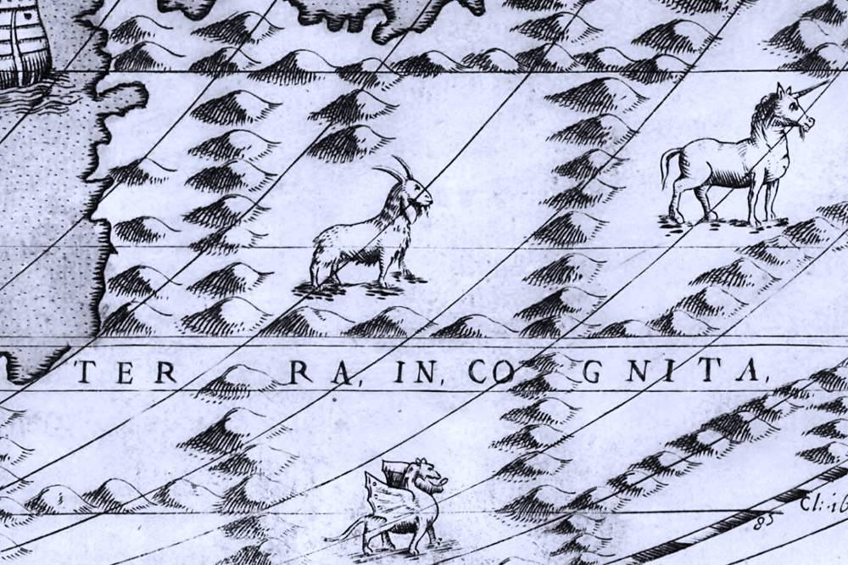
Motivation
∞
Notes:
But there’s a reason a reason this is often not shown– we don’t really know what’s out there. So, in keeping with the label that old cartographers used to use for the regions off the edge of their map, this parameter space constitutes a kind of “terra incognita.”

Slide 4

Motivation
∞
Notes:
However, in recent years, we have just begun to explore this uncharted domain. Thanks to the tremendous, decades-long efforts of ground-based microlensing surveys like MOA, KMTnet, and OGLE, we have gotten our first few detections of the worlds that inhabit this parameter space. So what are they?

Slide 5
Motivation
free-floating planets
∞
Notes:
These are the free-floating planets, or, more colorfully, “rogue worlds,” planets that drift through the interstellar void, unbound to any stellar system. And our initial handful of observations from ground-based surveys have provided evidence that such worlds may actually dramatically *outpopulate* their bound counterparts by a factor of more than 20 to 1 in the Earth mass range, making free-floating planets the largest demographic of planets in the Galaxy.
Unfortunately, our current handful of observations provide only a tantalizing hint of this population and the details remain unknown.

Slide 6
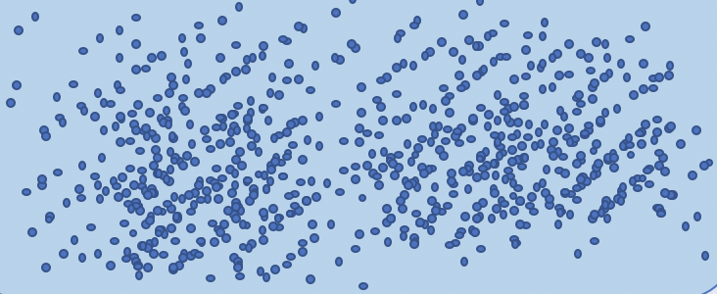
Enter Roman...
∞
Notes:
But this will change with Roman. Roman’s Galactic Bulge Time Domain Survey is expected to detect hundreds, if not thousands of these worlds, providing us for the first time with the statistics necessary to begin exploring this vast uncharted domain of planetary demographics.

Slide 7
Driving questions
What might be out there ...
... and what can we actually see?
Notes:
And so there are two primary driving questions of my research program, both of which I will address in the remainder of this talk. Namely, what might be out there? What sorts of theoretical predictions do we have for this population? And, perhaps more importantly, what will Roman actually be able to see?

Slide 8
Part I: What might be out there?
∞
Notes:
But let’s start with the first of those questions– what might be out there?

Slide 9
Origins
FFPs
“star-like”
“planet-like”
direct collapse
planet-star interactions
planet-planet interactions
Notes:
In order to start to predict what the FFP population might look like, we need to start by discussing their origins. This is still a large open question, and a large number of mechanisms have been proposed, ranging from “star-like” formation mechanisms such as the direct collapse of gas clouds in interstellar space, to “planet-like” formation mechanisms, in which the planet is formed initially bound in a protoplanetary disk and is then subsequently ejected, either by scattering off an inner binary or by scattering off another planet.

Slide 10
Origins
FFPs
“star-like”
“planet-like”
direct collapse
planet-star interactions
planet-planet interactions
high mass,
low velocity
intermediate mass, high velocity
low mass,
intermediate velocity
Notes:
But the key point here is that each of these different mechanisms imprints different features in the distribution of masses and velocities of FFPs. If we were to take these mechanisms and plot them in FFP mass versus velocity space, we’d get something like this:

Slide 11
velocity
planet-star interactions
10 km/s
planet-planet interactions
1 km/s
direct collapse
mass
M_{Earth}
M_{Jupiter}
Notes:
Here, you can see that each of the mechanisms is expected to lie in a different general region of this parameter space. So you can start to see why being able to reconstruct the mass function of FFPs would provide immediate insight into the relative contributions of their proposed origin scenarios.
Now, this is just a cartoon, so if we really want to make predictions for what the population of FFPs might look like in this parameter space, we have to rely on simulations.

Slide 12
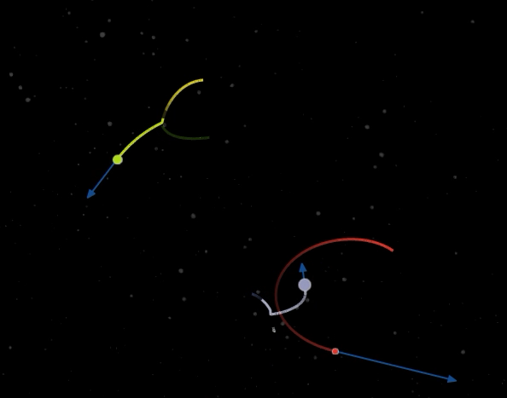
Existing studies
N-body interactions with fully-formed planets
Arbitrary initial conditions make connection to physical abundance challenging
Notes:
There is a large body of existing literature on planetary ejection from which to draw (and in fact, we just heard a great talk from Sam about one such result), however the majority of these studies begin with fully-formed planets on fixed, possibly unphysical orbits. These fairly arbitrary initial conditions make it a significant challenge to connect the results of these simulations to predictions for the Galactic population.

Slide 13
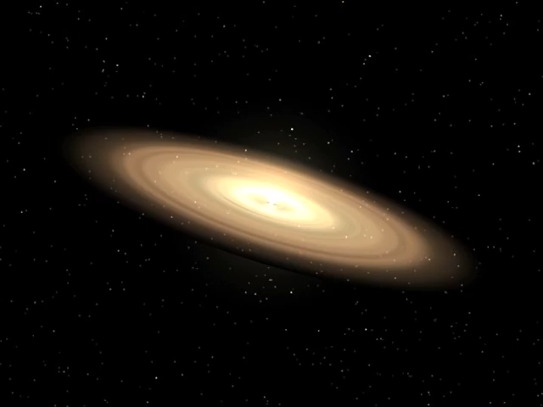
Building a galactic population (Coleman+DeRocco 2024)
Ab initio simulations of planet formation, evolution, migration, and ejection in protoplanetary disks
Include contributions from multiple stellar populations
Provides direct connection between planet formation and observables
Notes:
This is where the work of me and my collaborator comes in, our first results of which appeared on the arXiv a few days ago. Rather than begin from fully-formed planets, we have run 2000 dedicated simulations that track the formation, evolution, migration, and ejection of growing planetesimals and planets in protoplanetary discs.
Furthermore, we included a realistic distribution of different stellar system architectures in the Galaxy, including single star systems, close binaries, and wide binaries. By convolving all these results, we were able to make predictions for the mass function of FFPs. And the really exciting thing about this work is that because we’ve run these simulations from the ground up, we can make a *direct connection* between planet formation theory and observable features in the mass function.

Slide 14
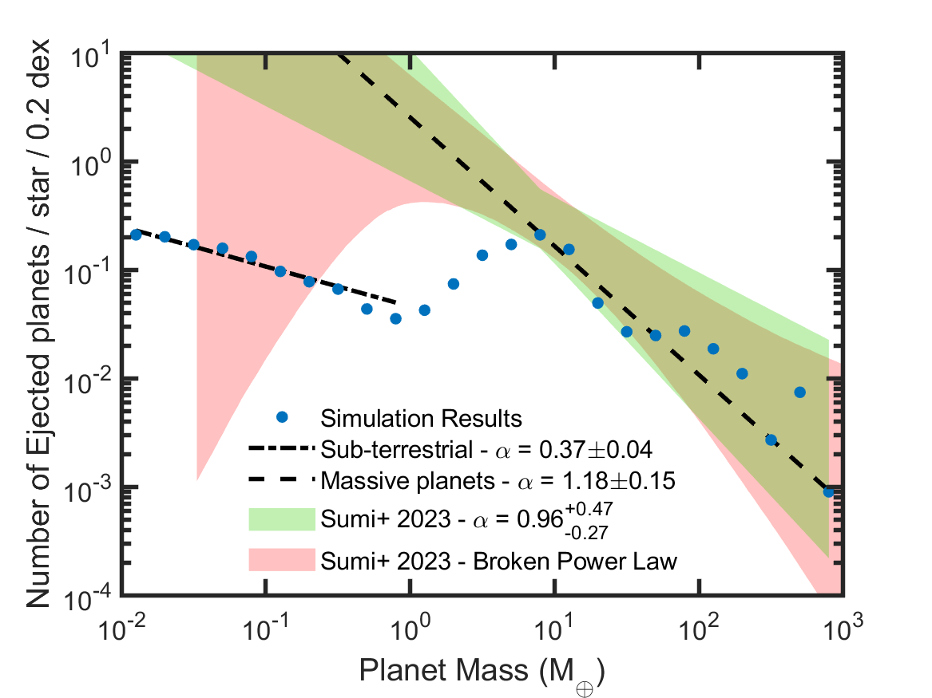
Confronting theory with observation
Simulations coincide with existing observations at high masses (Sumi+ 2023)
Testable predictions for unexplored low-mass range
Predictions provide direct connection between planet formation and observables
ground-based observations
Notes:
But so, your first question might be “how well does all this line up with the existing detections we have of FFPs from ground-based observatories?” And the answer is shown over on the right here, where our simulation results are shown in blue while the green and red band correspond to one sigma uncertainties from the most up-to-date study of FFP detections, led by Takahiro Sumi, who is somewhere around here.
You’ll see that our results agree to a surprising degree, predicting a similar power-law to what’s already been detected. I wish to stress that our results were in NO WAY tuned to existing data, so we were pretty surprised to find that they aligned so well.
However, this is just at the high masses. Below about an Earth mass is where we really enter terra incognita because at present, we lack sufficient observations to probe this mass range. And this is where things get interesting.

Slide 15
Confronting theory with observation
Simulations coincide with existing observations at high masses (Sumi+ 2023)
Testable predictions for unexplored low-mass range
Predictions provide direct connection between planet formation and observables
terra incognita
ground-based observations
Notes:
And that’s because we make a prediction for the mass function that significantly differs from a power-law extrapolation to existing data. We predict a dramatic decline in FFP abundance below an Earth mass, and a shallower power-law in the subterrestrial range.
So this is already exciting in its own right, because it provides a clear target for Roman to go after.

Slide 16
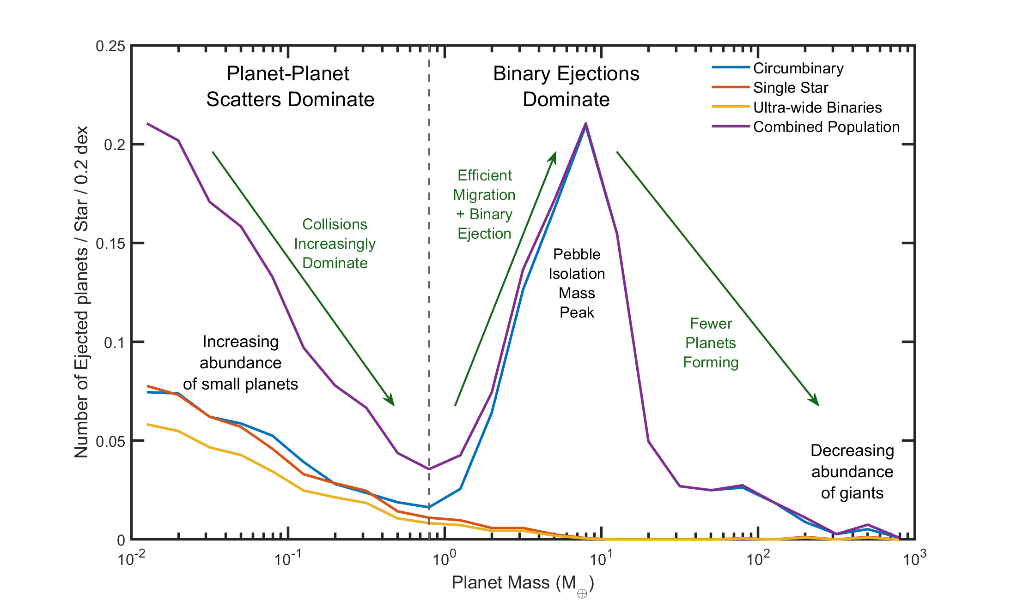
Confronting theory with observation
Simulations coincide with existing observations at high masses (Sumi+ 2023)
Testable predictions for unexplored low-mass range
Predictions provide direct connection between planet formation and observables
Notes:
But even more excitingly, since we’re able to connect each of these predicted features to underlying physical parameters in models of planetary formation, if Roman CAN measure, for example, the location of this peak, it would provide immediate insight into the origins of FFPs and the underlying environment in which they form.

Slide 17
Confronting theory with observation
Simulations coincide with existing observations at high masses (Sumi+ 2023)
Testable predictions for unexplored low-mass range
Predictions provide direct connection between planet formation and observables
  Key Takeaway #1: Free-floating planets provide a unique window into planetary formation and system evolution.
Notes:
So the takeaway of the first part of the talk here is just that free-floating planets provide a unique window into planetary formation and system evolution.

Slide 18
Part II: What can we actually see?
∞
Notes:
Which brings us to the big question, and the focus of the second part of this talk: what can we actually *see* with Roman?

Slide 19
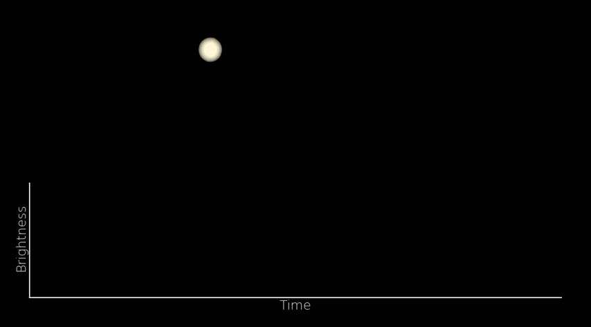
But there’s a catch.
Microlensing events don’t give direct mass measurement.
Notes:
Well, here’s the catch. It turns out microlensing detections don’t actually give you a direct measurement of the mass.

Slide 20
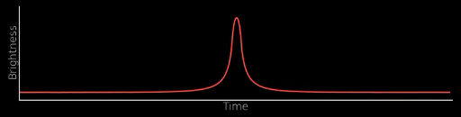

But there’s a catch.
Microlensing events don’t give direct mass measurement.
One instead observes an event duration that depends on lens mass, distance, and velocity.
$$t_{E}$$
Notes:
Rather, what they give you is effectively an event duration, which is a degenerate combination of the lens mass, distance, and velocity.

Slide 21
But there’s a catch.
Microlensing events don’t give direct mass measurement.
One instead observes an event duration that depends on lens mass, distance, and velocity.
It’s difficult to estimate lens mass on an event-by-event level.
$$t_{E}$$
Notes:
Which means that on an event by event level, trying to estimate the mass of an FFP is extremely difficult. Now, historically, since we’ve only had a handful of FFP events to work with, this was as good as we can do.

Slide 22
Population-level inference
now
with Roman
Microlensing events don’t give direct mass measurement.
One instead observes an event duration that depends on lens mass, distance, and velocity.
It’s difficult to estimate lens mass on an event-by-event level.
Roman will provide first opportunity to leverage population-level statistics to reconstruct the mass function.
Notes:
But Roman provides a solution. Its large number of detections will allow us, for the first time, to be able to to leverage population-level statistics rather than simply rely on event by event modeling.

Slide 23
Reconstructing the mass function with population-level inference
(DeRocco, Perkins, McGill, Johnson 2024)
(very!) preliminary
(very!) preliminary
Notes:
And so that’s the premise of the work I’ve been leading with collaborators at Lawrence Livermore and elsewhere. We are building a hierarchical Bayesian inference framework to reconstruct the FFP mass function at the population level. And you can see that our preliminary results are extremely promising. The black lines in these plots correspond to the true injected mass function while the blue bands constitute the 90% confidence interval that we reconstruct. On the left, we’ve injected Sumi et al’s power law extrapolation, while on the right, we’ve injected the predicted mass function I discussed in the previous section. And you can see that Roman will (hopefully) be able to reconstruct the general features of this distribution, and would certainly be able to discriminate it from a power-law.

Slide 24
Reconstructing the mass function with population-level inference
(DeRocco, Perkins, McGill, Johnson 2024)
  Key Takeaway #2: Leveraging population-level statistics, Roman will be able to start answering fundamental questions about the demographics of free-floating worlds.
Notes:
And so the main takeaway here is that by leveraging population level statistics, Roman will be able to start answering fundamental questions about the demographics of free-floating worlds.

Slide 25
Summary
What might be out there?
  Key Takeaway #1: Free-floating planets provide a unique window into planetary formation and system evolution.
What can we actually see?
  Key Takeaway #2: Leveraging population-level statistics, Roman will be able to start answering fundamental questions about the demographics of free-floating worlds.
Notes:
And so with that, I want to summarize what we talked about. Currently, low-mass FFP constitute a kind of terra incognita for planetary demographics despite potentially being the largest demographic of planet in that mass range.
Via dedicated ab initio simulations, we are able to make concrete predictions for this population, and connect features in its distribution to underlying planet formation models.
Furthermore, Roman will be able to leverage its large number of FFP detections to begin doing population-level inference of the FFP mass function, revealing key features that probe the origins of these enigmatic worlds.

Slide 26
What’s next?
Theory
  Dedicated simulations for a larger range of stellar systems.
  Inclusion of “star-like” FFP formation processes and stellar fly-bys.
  Getting the rest of the theory community involved!
Observation
  Hierarchical Bayesian inference for mass and velocity.
  Exploring joint parallax measurements.
  ... False positives. 😱
Interested? Join the RGES-PIT FFP working group!
(Contact: wderocco@ucsc.edu)
Notes:
But as exciting as all this is, there is still much more to do. On the theory side, we’re working on extending our simulations to an even larger range of stellar systems and formation processes so we can provide better predictions for this population.
Meanwhile, on the observation side, I’m continuing the push to build this framework for Bayesian inference of the underlying FFP mass function and hopefully extending to velocity space as well. And then there’s also the problem of false positives, which is an Elephant in the Room that we need dedicated work to understand if we want to be able to do any of this.
And I just want to end by saying that I’m serving as the co-chair of free-floating planet working group for Roman, and so I am actively recruiting anyone from the theory or observation side who wants to get involved in these efforts. FFPs present an immense opportunity, but also an immense challenge, so if you’re willing to strap on your boots and venture forth into this vast unexplored domain with us, let me know, we’d be happy to have you.

Slide 27
Thank you!
Contact: wderocco@uscc.edu
∞

Slide 28
Building a galactic population (Coleman+DeRocco 2024)
Notes:
So what did we find? Well... it certainly isn’t a simple power-law, as many existing models have attempted to fit. Rather, it exhibits several interesting non-monotonic features that are directly attributable to different formation processes and physical processes occurring during system evolution.
I’m going to try to take you through a few of them, which will hopefully provide a bit of illumination on where our predicted features come from.

Slide 29
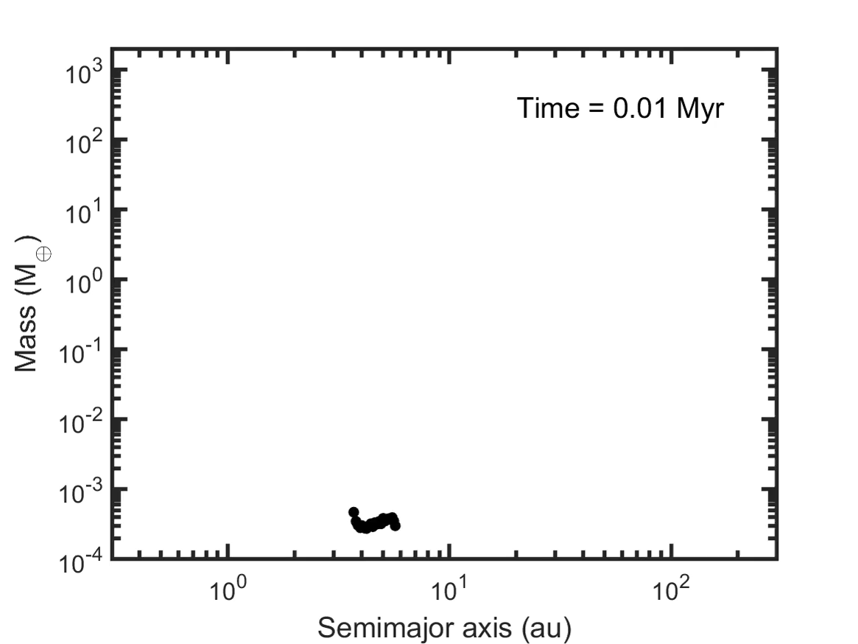



System evolution
Ab initio simulations of planet formation, evolution, migration, and ejection in protoplanetary disks
Include contributions from multiple stellar populations
Provides direct connection between planet formation and observables
planet-planet
planet-binary
collision
(representative circumbinary simulation)
Notes:
To do this, we need to talk about planet formation. On the right here, I’m showing one representative circumbinary simulation from our suite. It shows the evolution of planets in terms of semimajor axis versus mass. Watch for the appearance of black and red x marks, as these indicate ejections, either by planet-planet scattering or planet-binary scattering.
So let’s break this simulation into chunks and look at them one by one.

Slide 30
System evolution
Stage 1: Pebble accretion
  Planet-planet ejection of (sub) Earths
Stage 2: Pebble isolation mass
  Planet-binary ejection of (super) Earths
Stage 3: Slow gas accretion
  Planet-binary ejection of gas giants
Stage 4: Secular perturbations
  Planet-planet ejection of gas giants
planet-planet
planet-binary
collision
(representative circumbinary simulation)
Notes:
In the first stage, rapid pebble accretion onto planetesimals forms a large swath of planets spanning masses up to that of Earth. These planets form primarily out past the ice line in regions of low gravitational potential where they can interact with one another and eject via planet-planet scattering. So at these sub-terrestrial masses, planet-planet ejection dominates.

Slide 31
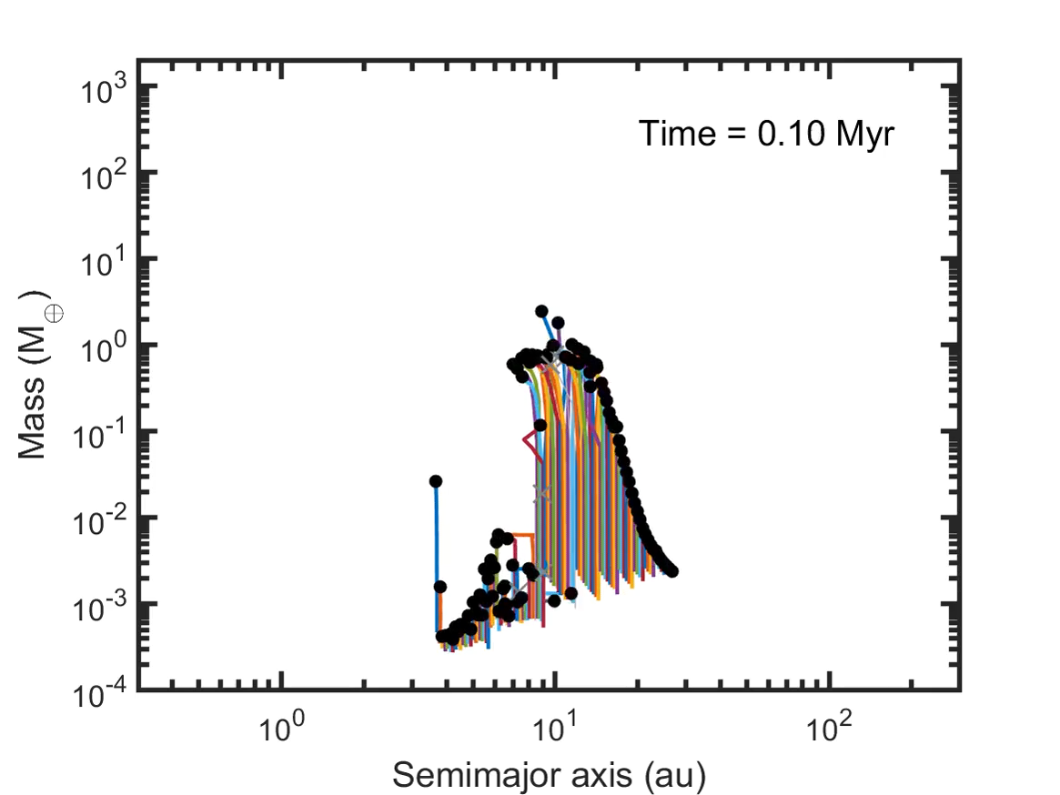
System evolution
Stage 1: Pebble accretion
  Planet-planet ejection of (sub) Earths
Stage 2: Pebble isolation mass
  Planet-binary ejection of (super) Earths
Stage 3: Slow gas accretion
  Planet-binary ejection of gas giants
Stage 4: Secular perturbations
  Planet-planet ejection of gas giants
planet-planet
planet-binary
collision
(representative circumbinary simulation)
Notes:
In this next phase, the planets become sufficiently massive that they begin to migrate efficiently inwards. This brings these super-Earth planets towards the inner binary, whereupon they congregate and can be ejected by the binary, leading to a large abundance of FFPs produced in this mass range.

Slide 32
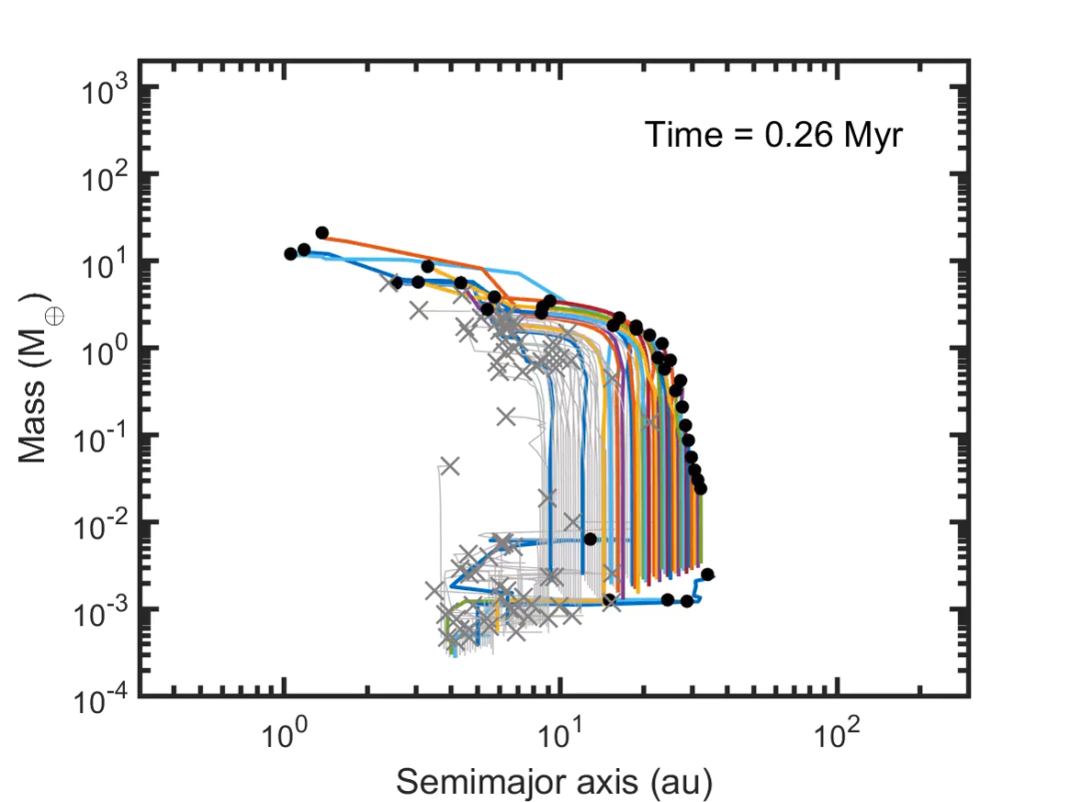
System evolution
Stage 1: Pebble accretion
  Planet-planet ejection of (sub) Earths
Stage 2: Pebble isolation mass
  Planet-binary ejection of (super) Earths
Stage 3: Slow gas accretion
  Planet-binary ejection of gas giants
Stage 4: Secular perturbations
  Planet-planet ejection of gas giants
planet-planet
planet-binary
collision
(representative circumbinary simulation)
Notes:
Afterwards, the remaining planets undergo slow gas accretion, and interactions with the central binary continue to eject them all the way up to Jupiter masses.

Slide 33
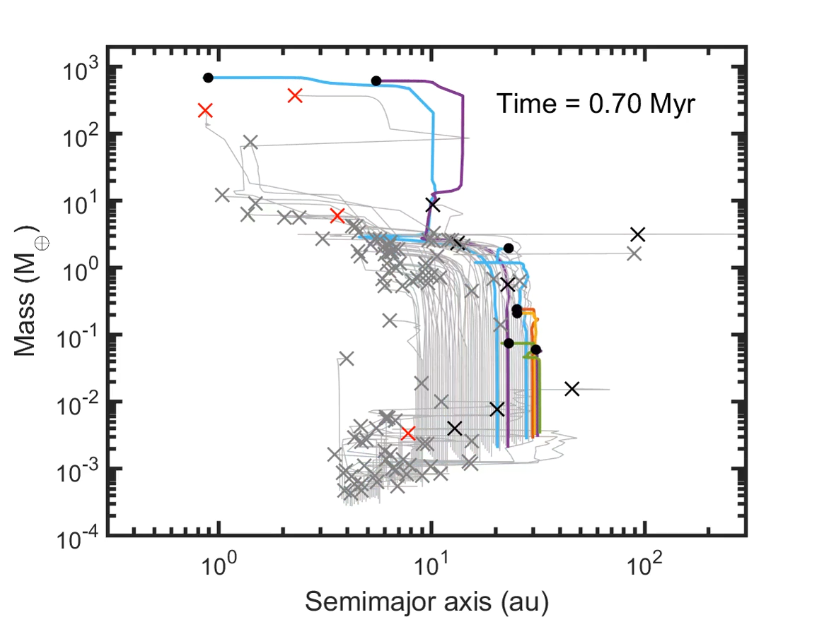
System evolution
Stage 1: Pebble accretion
  Planet-planet ejection of (sub) Earths
Stage 2: Pebble isolation mass
  Planet-binary ejection of (super) Earths
Stage 3: Slow gas accretion
  Planet-binary ejection of gas giants
Stage 4: Secular perturbations
  Planet-planet ejection of gas giants
planet-planet
planet-binary
collision
(representative circumbinary simulation)
Notes:
Finally, on long timescales, the surviving gas giants undergo slow drift, kicking out lower-mass planets as they go, hence planet-planet scattering becomes efficient again.

Slide 34
Building a galactic population (Coleman+DeRocco 2024)
Notes:
And so taking all these effects into consideration, one ends up with a predicted distribution that looks something like this.
At the lowest masses, planet-planet scattering at large semimajor axis early in system evolution dominates the FFP contribution. At around an Earth-mass, the dominant mechanism transitions to binary ejections of rapidly migrating super-Earths, leading to a peak around the pebble isolation mass, then at higher masses, gas giants continue to be ejected, but at ever decreasing rates.
So you might ask, well, this all looks interesting, but how well does it agree with our existing ground-based observations?

Slide 35
Motivation
∞
Notes:
Penney plot
Here there be dragons

Slide 36
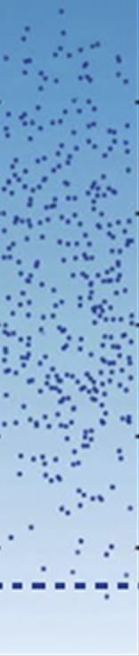
Motivation
∞
Notes:
Penney plot
Here there be dragons

Slide 37


Motivation
∞
Notes:
Penney plot
Here there be dragons

Slide 38
Motivation
∞
Notes:
Penney plot
Here there be dragons

Slide 39
Reconstructing the mass function with population-level inference
(DeRocco, Perkins, McGill, Johnson 2024)
nuisance parameters
mass distribution
t_{E} distribution
Notes:
But this will change with Roman. Rather than tens of events, we may have upward of a *thousand.* This provides the opportunity to start probing the FFP mass function *at a population level* rather than on an event by event basis.
And this is the basis for the work I am currently doing with my collaborators Scott Perkins, Peter McGill (who is in the audience now), and Samson Johnson. The basic idea is show here: the true underlying distribution of FFP masses will, when combined with Roman’s detection capabilities and their associated distances and velocities, give a distribution of these event timescales. However, we wish to run this in reverse.

Slide 40
Reconstructing the mass function with population-level inference
(DeRocco, Perkins, McGill, Johnson 2024)
nuisance parameters
mass distribution
t_{E} distribution
marginalization
Notes:
By marginalizing over these parameters, we can take an observed tE distribution and start to make estimates of the underlying mass function of FFPs.

