Slide 1
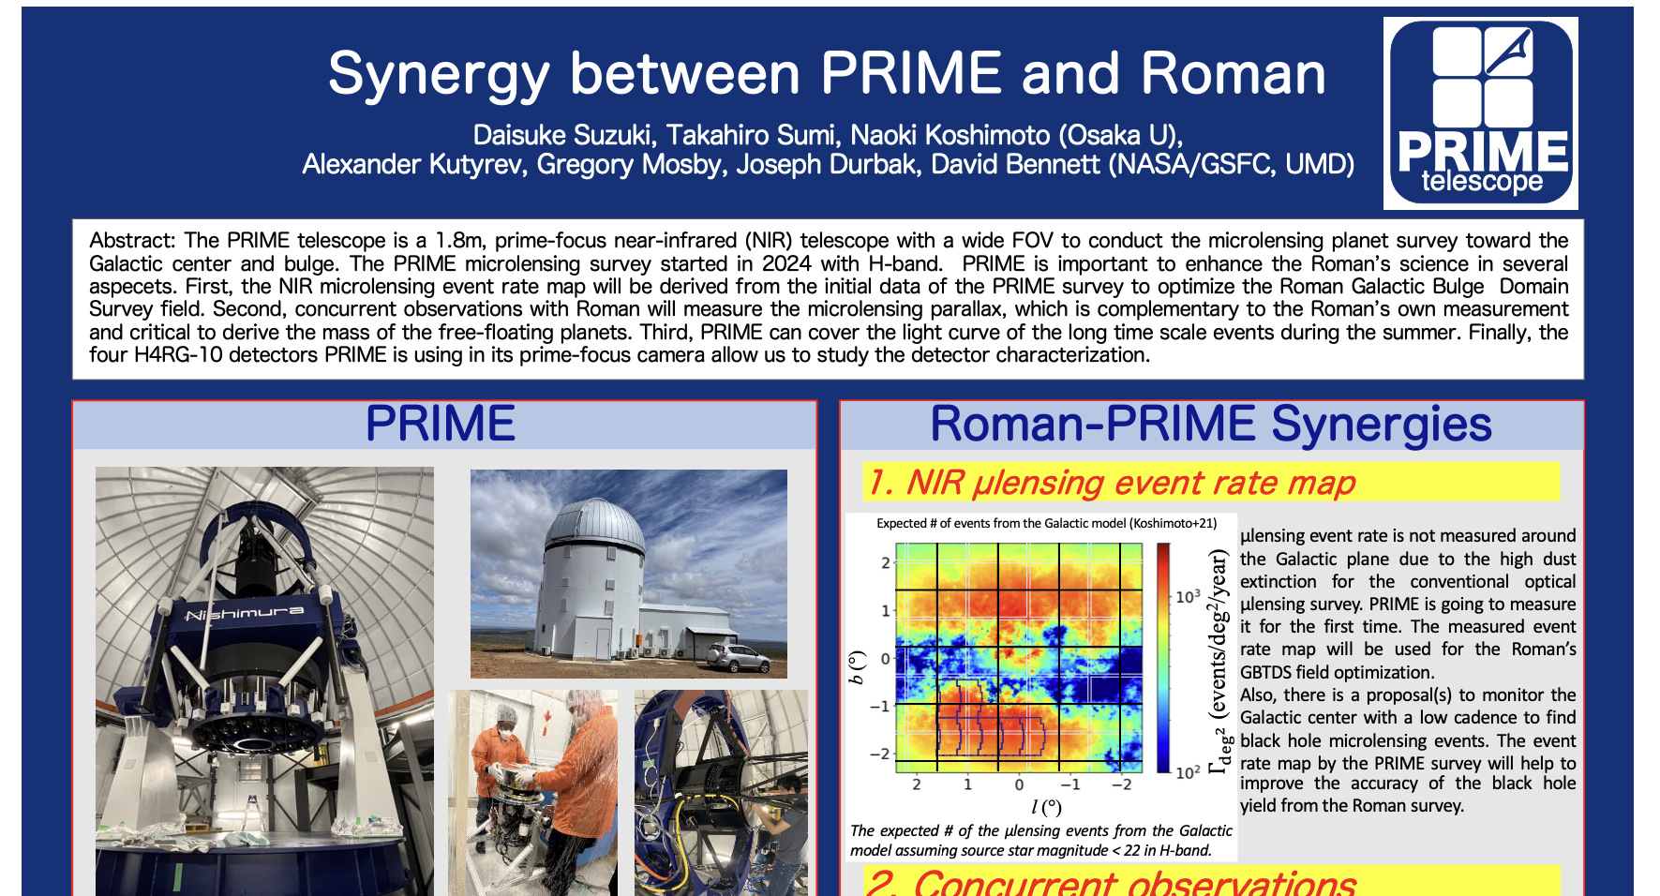

Slide 2
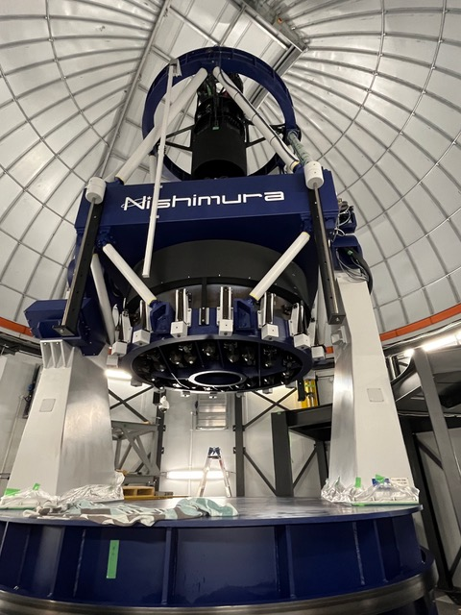
PRIME telescope
@SAAO, in South Africa
New NIR telescope build in 2022 for H-band microlensing planet survey
  1.8m primary mirror
  Four H4RG-10 detectors used in PRIME-Cam
  FOV = 1.45deg²
  Filters: ZYJH, NB1063, NB1243, NB1630
Operated by Osaka U team
Time allocation:
  µlens survey:50%
  SAAO: 14%, OU, ABC, NASA/UMD 12%
µlensing survey has started
Synergy between PRIME and Roman by Daissuke Suzuki et al.

Slide 3
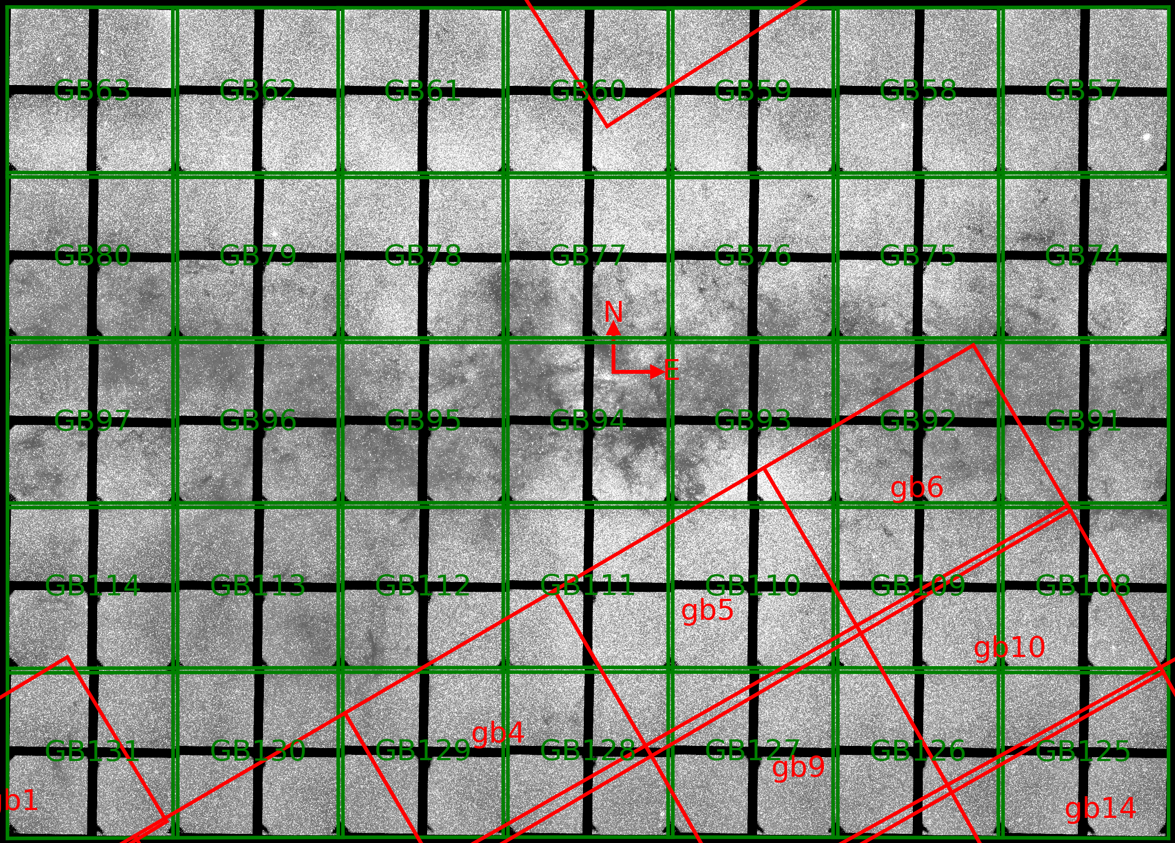
PRIME H-band
reference images
Figure by courtecy of Ian Bond
Synergy between PRIME and Roman by Daissuke Suzuki et al.

Slide 4
Roman-PRIME Synergies
NIR microlensing event rate map
    To optimize the Roman galactic bulge time domain survey field
Concurrent observations
    To measure the mass of and distance to the lens (FFPs, planets, brown dwarfs, binary stars…)
Observations during Roman’s rest
    To cover the Roman light curve gaps to measure the whole light curve shape to measure event time scale and parallax
Detector characterization
Synergy between PRIME and Roman by Daissuke Suzuki et al.

Slide 5
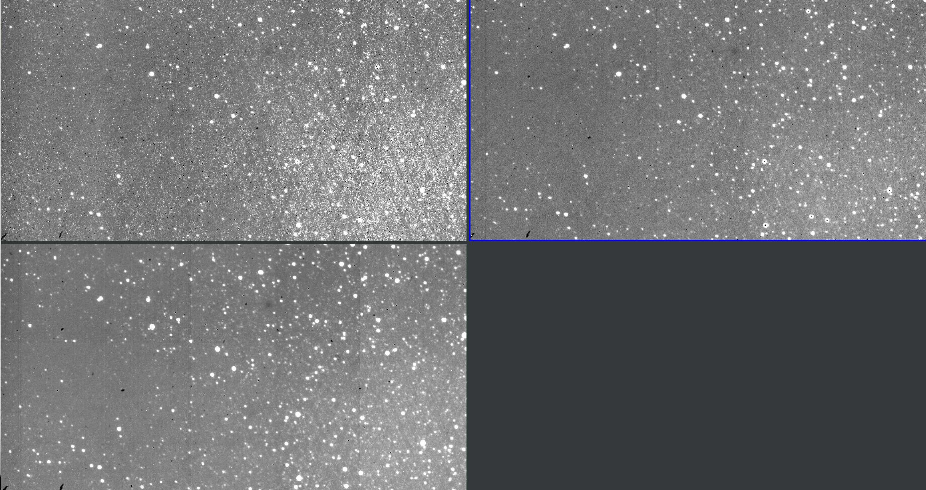
NEW NLC (Non-Linearity-Correction)
Ramp image w/ JWST NLC method
Ramp image w/ NEW NLC method
RAW image (the last frame of up-the-ramp)
PRIME Chip4 images prepared by Ryusei Hamada (Osaka U)
PRIME H4RGs are operated at 117K, leading to many hot pixels.
Conventional JWST NLC method cannot work well (the Left image)
  Cross-hatching pattern shows-up
We developed the dark current model within the NLC framework.
This NEW method works well even for the hot pixels.
Synergy between PRIME and Roman by Daissuke Suzuki et al.

Slide 6
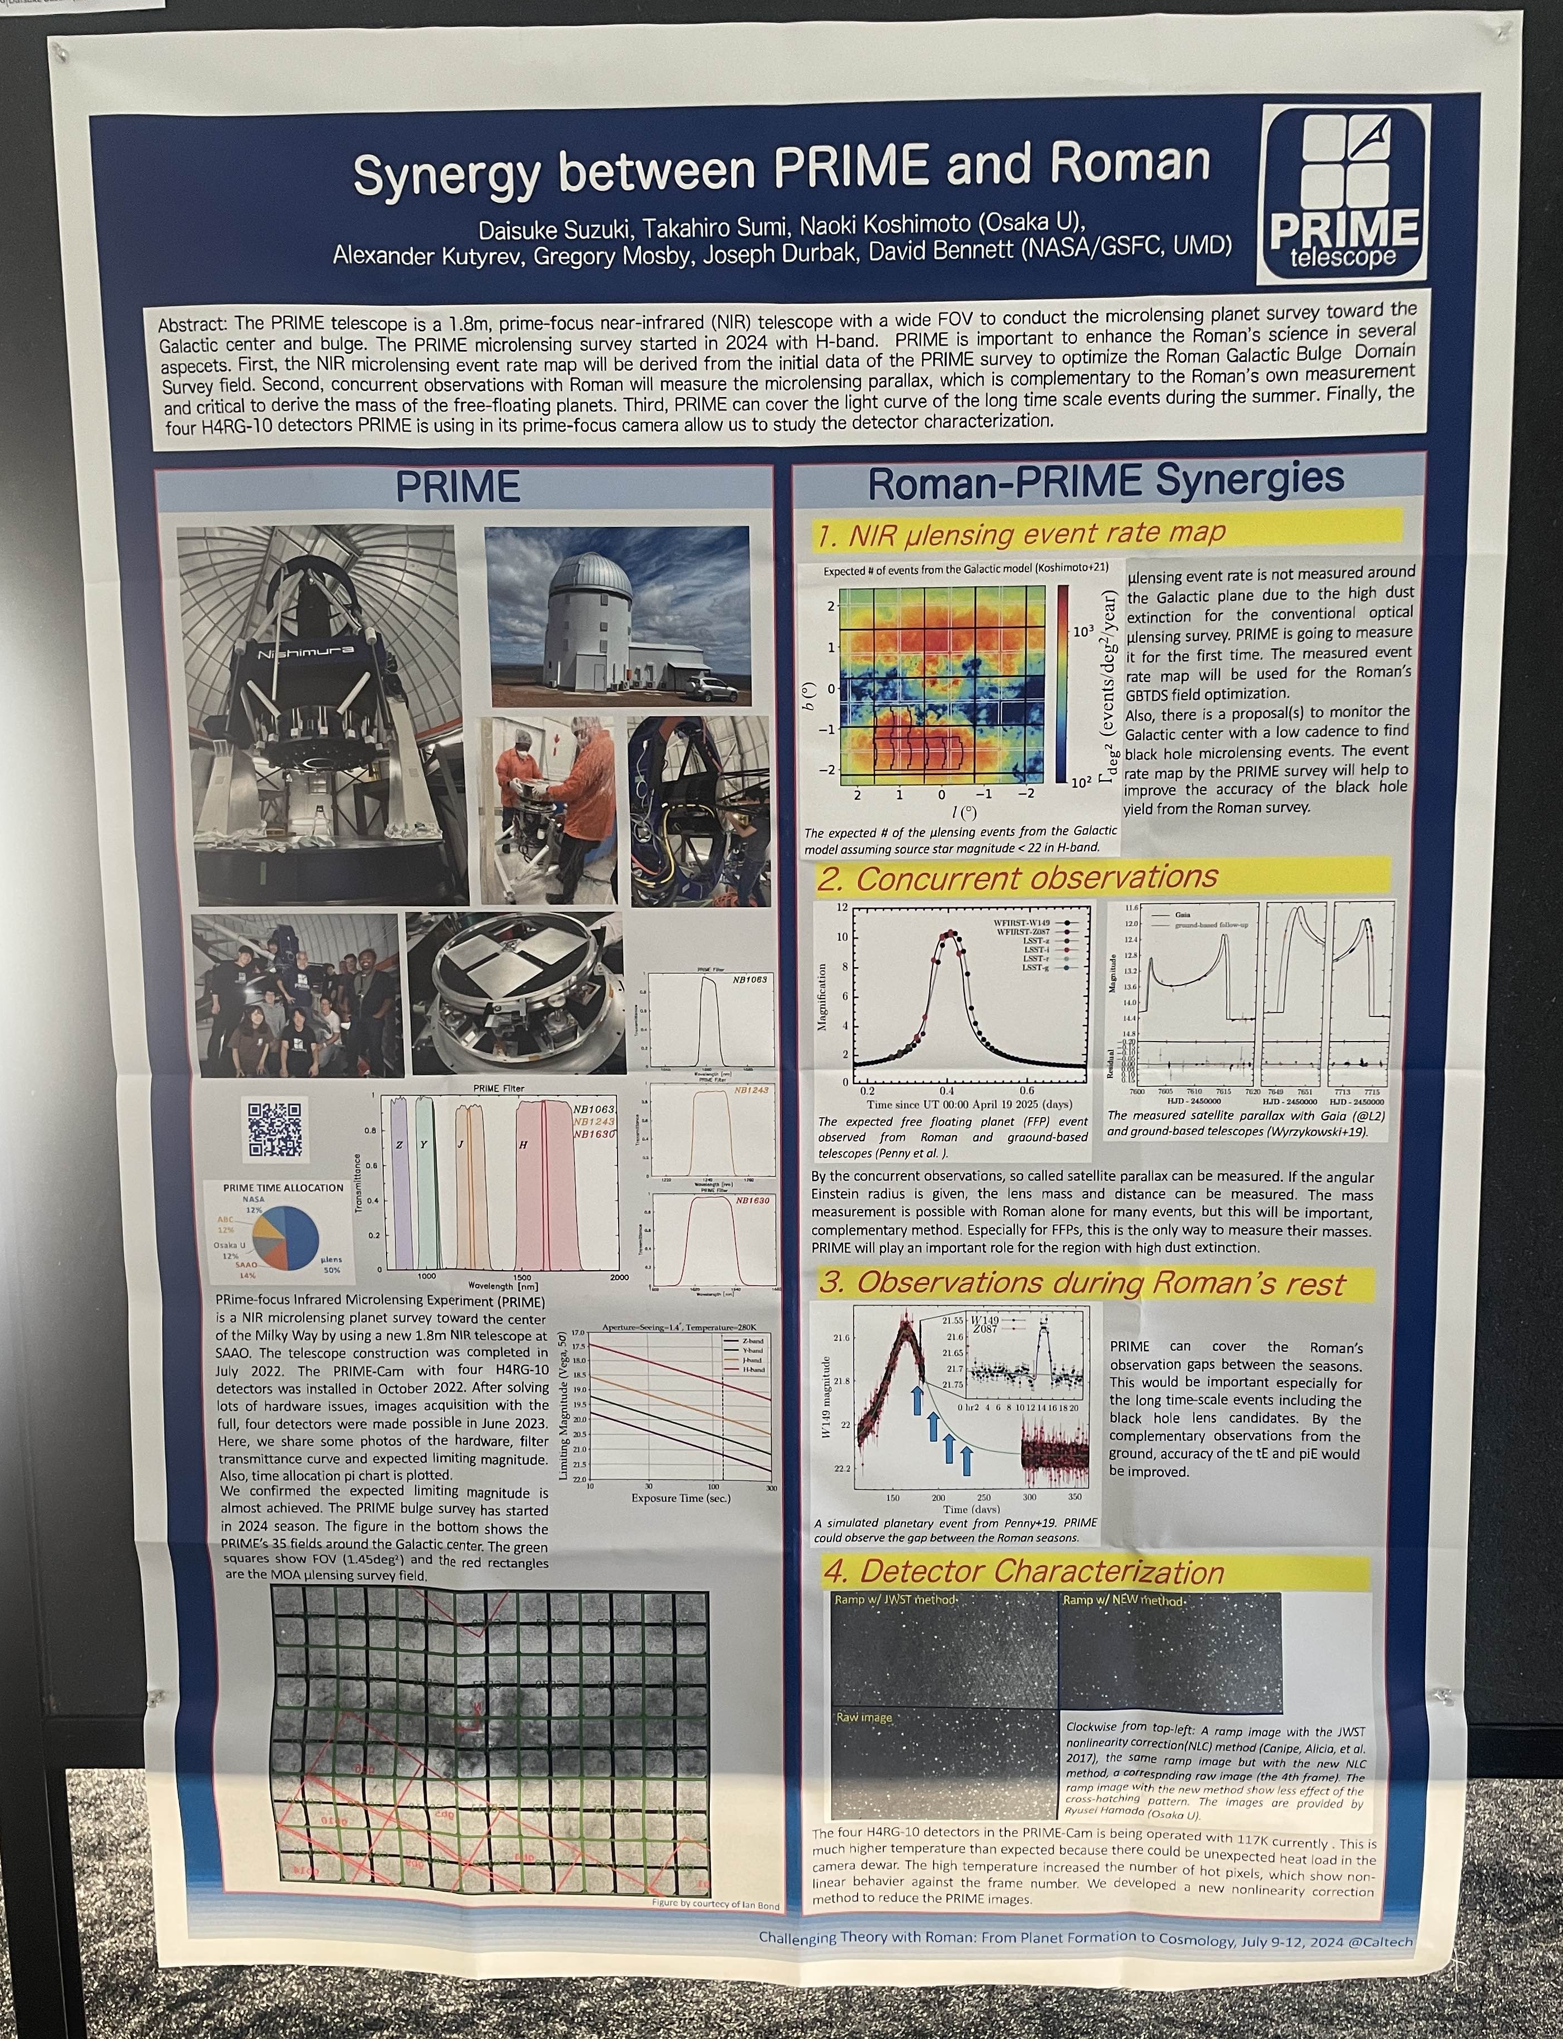
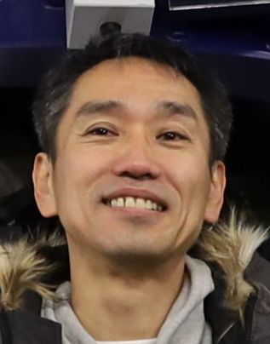

Please come to my poster
Takahiro Sumi
Naoki Koshimoto
Synergy between PRIME and Roman by Daissuke Suzuki et al.

