Slide 1
The Roman Galactic Exoplanet Survey Project Infrastructure Team (RGES PIT) Challenging Theory with Roman 7/12/2024
Scott Gaudi
The Ohio State University
RGES PIT PI
(on behalf of the PIT)

Slide 2
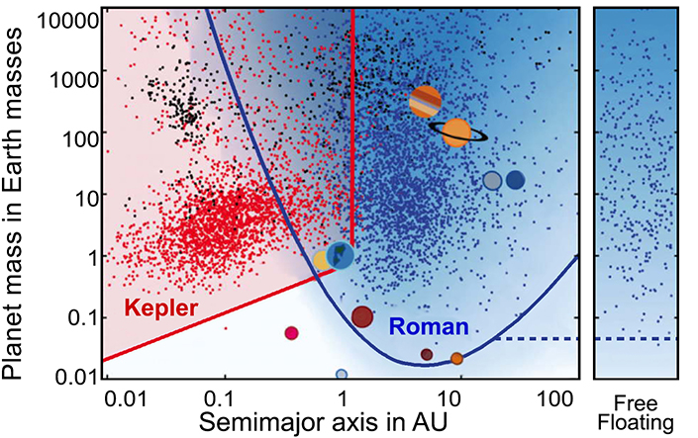
A Complete Statistical Census of Exoplanets
(Bennett et al. 2002, Penny et al. 2019, Johnson et al. 2020)
~1400 bound planet detections.
Some sensitivity to “outer” habitable zone planets.
Sensitive to analogs of all the solar systems planets except Mercury, including ice giants.
Hundreds of free-floating planets (~60 with M$≤$M_{Earth}).
Measure masses and distances of at least ~40% of hosts
Determine the Galactic distribution of cold planets.
Sensitive to lunar-mass satellites.
Sensitive to wide circumbinary planets.
~100,000 transiting planets.

Slide 3
The Roman Galactic Exoplanet Survey Project Infrastructure Team
Goals
Develop the infrastructure required to plan, execute, and extract cold exoplanet demographics from the RGES survey.
Help the Roman project, Science Centers, other PITs, other WFI science teams, the community, and you!

Slide 4
The RGES PIT Team
People
Science PI – Dave Bennett
Large number of people distributed all over the world
77 people on the RGES PIT Slack
Always looking for more people to help!

Slide 5
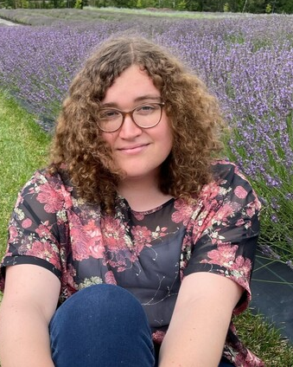
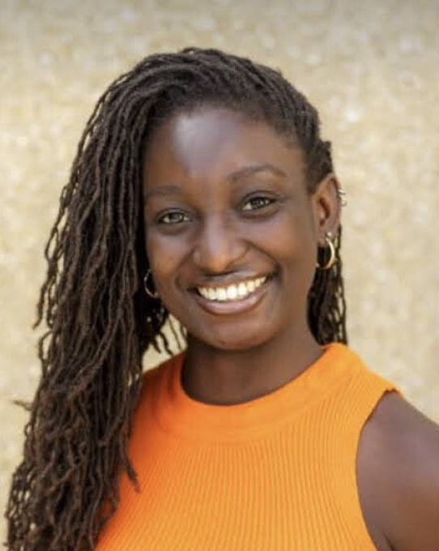
OSU Graduate Students working on Roman Say hi!
Kylee Carden
Developing semi-analytic estimates of the yield of transiting planets with the RGBTDS to aid in survey optimization and interpretation.
Arjun Murlidhar
Studying the prospects for detecting and characterizing wide circumbinary planets with microlensing with the RGBTDS
Sinclaire Jones
Studying the prospects for detecting and characterizing solar system analogs with the RGBTDS

Slide 6
Roman Galactic Exoplanet Survey
Carry out a statistical census of planetary systems in the Galaxy, from the outer habitable zone to free floating planets, including analogs to all the planets in our Solar System with the mass of Mars or greater.
Level-1 Science Requirements – Those in red not verified. Those verified do so at ~20% margin with old slew/settle times and assuming 6 x 72 day seasons.
EML 2.0.1: RST shall be capable of measuring the mass function of exoplanets with masses in the range 1M⊕ < m < 30M_{Jupiter} and orbital semi-major axes ≥ 1 au to better than 15% per decade in mass.
EML 2.0.2: RST shall be capable of measuring the frequency of bound exoplanets with masses in the range 0.1M⊕ < m < 0.3M⊕ to better than 25%.
EML 2.0.3: RST shall be capable of determining the masses of, and distances to, host stars of 40% of the detected planets with a precision of 20% or better.
EML 2.0.4: RST shall be capable of measuring the frequency of free floating planetary- mass objects in the Galaxy from Mars to 10 Jupiter masses. If there is 1M⊕ free-floating planet per star, measure this frequency to better than 25%.
EML 2.0.5: RST shall be capable of estimating η⊕ (the frequency of planets orbiting FGK stars with mass ratio and estimated projected semimajor axis within 20% of the Earth-Sun system) to a precision of 0.2 dex via extrapolation from larger and longer-period planets

Slide 7
RGES PIT Primary Goals
Survey Simulation Pipeline
Verify Science Requirements
Test Data Reduction and Analysis Pipeline
Optimize Survey Strategy – not just for us!
Data Reduction and Analysis Pipeline – in collaboration with Science Support Center/MSOS Team
Photometry/Astrometry Pipeline
Event Detection and Characterization Pipeline
Occurrence Rate Pipeline – purview of PIT alone
Precursor and Contemporaneous Observations
Euclid, Rubin, PRIME, HST/JWST, ground-based AO, input catalogs, extinction maps
Recently awarded 177 HST orbits to image a subset of the fields likely to be targeted by RGBTDS! (PI – Sean Terry)

Slide 8
RGES PIT Primary Goals
Human Infrastructure – led by Keivan Stassun
Draft code of conduct, publication policy, presentation policy.
Develop publicly available modeling tools and references – e.g., ExoFAST, PyLIMA, PyLIMASS, RTModel, MuLensModel, vbblensing, eesunhong, Microlensing Source, more.
Training workshops – 2025 Sagan Summer Workshop?
Develop microlensing ‘mini courses’
Issue and curate data challenges
Seek to recruit and train graduate students and postdocs in microlensing, drawing as much as possible from pools of talent from underrepresented backgrounds.

Slide 9
RGES PIT Primary Goal!
Help the Roman project, other PITs, other WFI science teams, the community, and you!

Slide 10
Working Groups
There are already several active working groups (some of which have been active since 10/23)
Simulations Working Group – Lead: Matthew Penny
Event Modeling and Analysis Working Group – Lead: David Bennett
Lens Flux Analysis Working Group – Lead: Aparna Bhattacharya
Variable Stars Working SubGroup – Leads: Alexander Stephan and Rachel Street
Galactic Models Working SubGroup – Lead: Macy Huston
We are in the process of spinning up new working groups
Free-floating planets Working Group – Leads: Willian DeRocco and Naoki Koshimoto
Anomaly Detection Working Group – Lead: Weicheng Zang
Data Challenges Working Group – Leads: TDB
False Positive Working Group?

Slide 11
Simulations Working Group
Lead: Matthew Penny
Goals
Develop an end-to-end simulation tool for survey optimization and testing the data reduction pipeline
Includes an updated Galactic model (Huston et al. in prep)
Verify the $η_{⊕}$ requirement (Samson Johnson)
Simulating a large number of planetary (and single-lens) events
Inform choices for and test the MSOS pipeline.
Basis for data challenges
Verify the exoplanet host mass/distance requirements – in collaboration with the Event Modeling and Analysis Working Group
Have developed two ~independent methods of verifying our mass/distance requirements and hope to have these tested and implement in the next few weeks.

Slide 12
Simulations Working Group pt. 2
Optimization of survey strategy
Working with the RGBTDS Definition Survey Definition Committee
Optimize the survey strategy for the microlensing science and the other science enabled by the GBTDS
New slew and settle times allow some margin and thus some flexibility in survey strategy and allow for MORE SCIENCE!
Types of alterations from Penny et al. 2019 strategy include:
Constant cadence but increasing the number of fields
Increasing the cadence but decreasing the number of fields
Monitor a subset of fields at higher cadence
Low-mass FFP, moons, potentially habitable planets, wide-orbit planets
Offset fields
Different cadence and exposure time of observations in other filters
Intra-season observations
Periodic observations in all the filters
🎉🥳

Slide 13
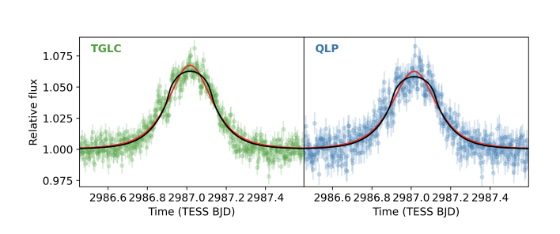
Variable Stars Subgroup
Leads: Rachel Street and Alexander Stephan
Goal: Create and curate a database of variable stars with Roman cadence, filters, and photometry
Main approach for light curve generation:
Utilizing the SNANA code by the LSST team to produce realistic light curves of a variety of variable sources
Passband translation:
Need to translate light curves into Roman passbands
Source types catalogue:
Growing list of source types that we are considering to include
False positives?
Flares $↔$ FFPs, short timescale perturbations
Spotted/eclipsing stars $↔$ low SNR minor image deviations (‘dips’)
Kunimoto et al, submitted

Slide 14
Event Modeling and Analysis
Lead: David Bennett
Some immediate goals:
Develop semi-analytic formula that can be used to estimate the uncertainty on the lens flux and source flux, lens and source parallax, lens and source proper motion of simulated events – in collaboration with Lens Flux Analysis Working Group
Modeling a large suite of simulated planet detections to help determine the minimum requirements for the MSOS pipeline, and develop and test the algorithms, e.g.,
Determine the robustness of our current methods of finding trial solutions.
Triage for complex events: do we need to fit to orbital motion for all events, and if not, what errors do we incur?

Slide 15
Lens Flux Analysis Working Group
Lead: Aparna Bhattacharya
Goal
Assist MSOS with Lens Flux Analysis component based on experience with analysis High Resolution Imaging data of observed and simulated microlensing events
Activities
Recently tackled the issue of the need for and required size of ‘image cutouts’ of individual microlensing events – required size is like 200 pixels x 200 pixels

Slide 16
Current and Future Meetings
Meetings
Yearly F2F meetings
First meeting October 23 at OSU
Next meeting this fall at GSFC – dates TBD
Monthly virtual PIT meetings
First Tuesday of every other month at 10am ET (July 2)
First Thursday of every other month at 4pm ET (August 1)
Add-on workshops to other meetings (yearly Microlensing meeting, upcoming Roman meeting at IPAC, etc).
F2F workshops with Working groups as needed
Have had two Event Modeling/Lens Flux Analysis + MSOS workshops
Periodic virtual working group meetings:
Event Modeling – every two weeks on Wednesday at 11am ET (June 26)
Lens Flux Analysis every two weeks on Wednesday at 1:30pm ET (July 10)
Variable Star – every two weeks on Friday at noon ET (June 28)
Simulations – every month on Tuesday at 4pm ET (July 9)

Slide 17
Always looking for more help!
Contact me (gaudi.1@osu.edu) or any other PIT member if you’d like to get involved
No microlensing experience necessary!
Thank you!

