Slide 1
Simulating continuum-based redshift measurement in the Roman’s High Latitude Spectroscopy Survey
Zhiyuan Guo, Duke University

Slide 2
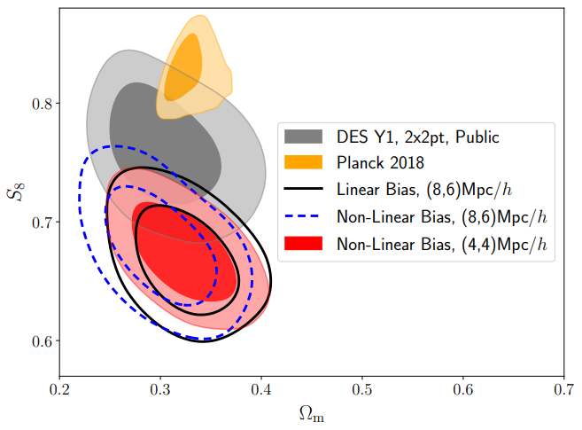
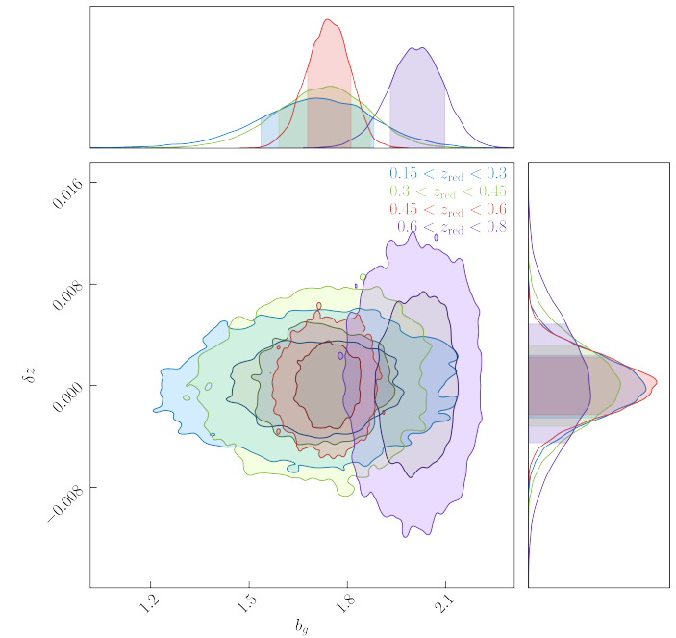
Red, quiescent galaxies is important for cosmology study
DES 2X2pt anylsis using DES RedMaGiC sample
KiDS DR4 clustering with LRGs
When combine Rubin and Roman, we can potentially have a more complete sample of red galaxies.
Goal: Quantify how well we can measure redshift for high-z red galaxies in Roman HLSS

Slide 3
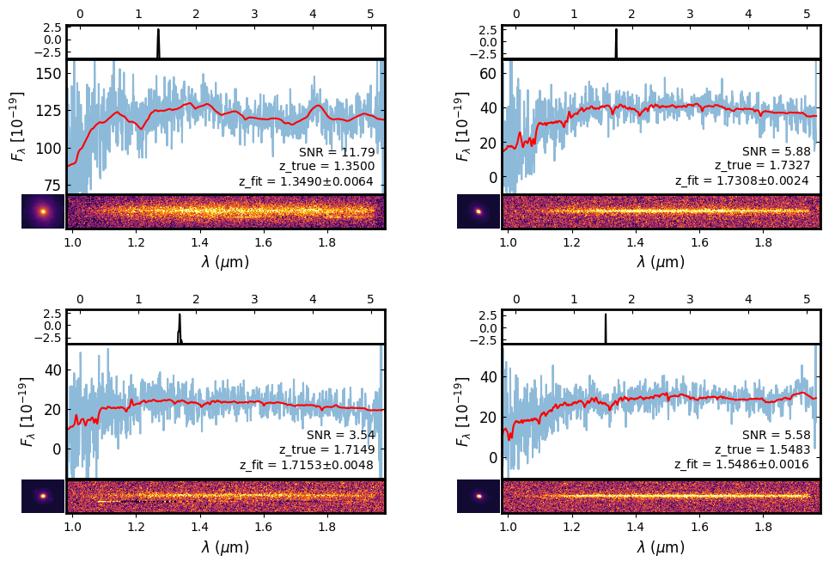
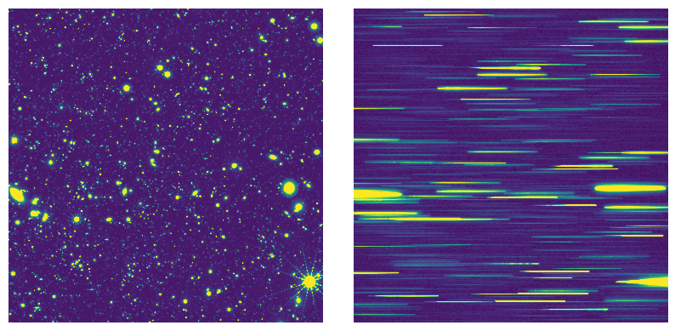
Method:
Simulate Roman grism based on HLSS reference survey parameters.
Perform spectra extraction and redshift estimates on every red galaxies in the simulation.
Guo et al. in prep

Slide 4
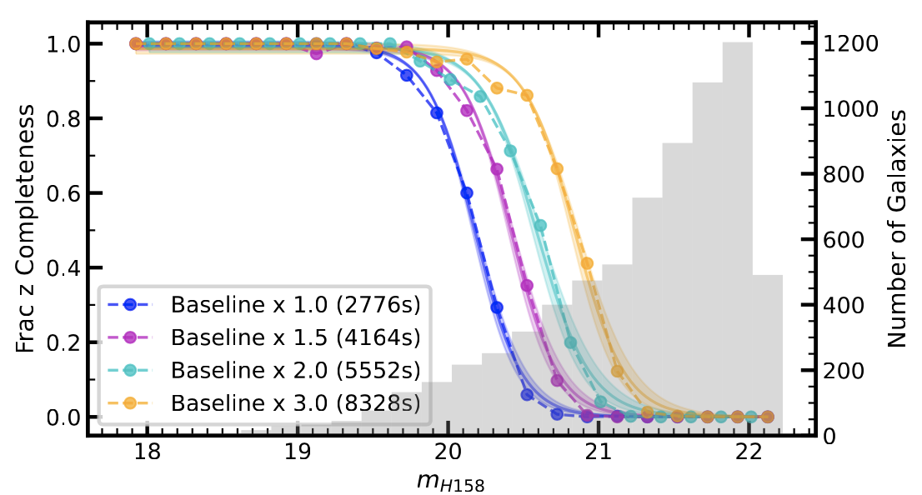
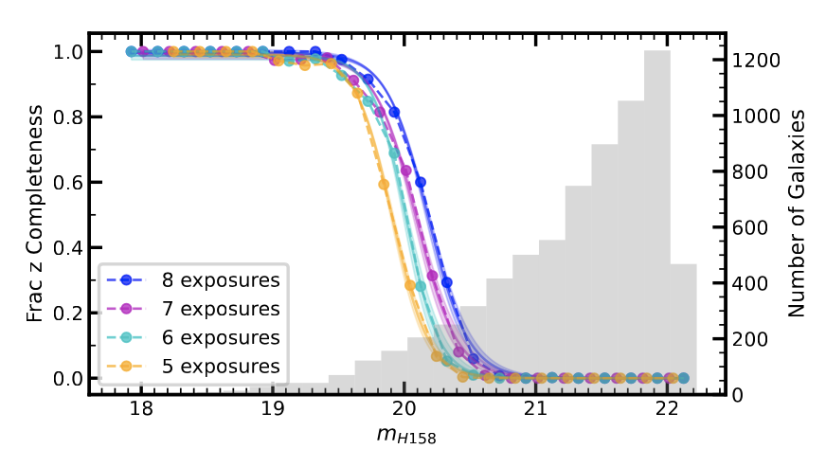
Results: Redshift efficiency curve
Different exposures times
Different number of exposures times
Guo et al. in prep
Guo et al. in prep

