Slide 1

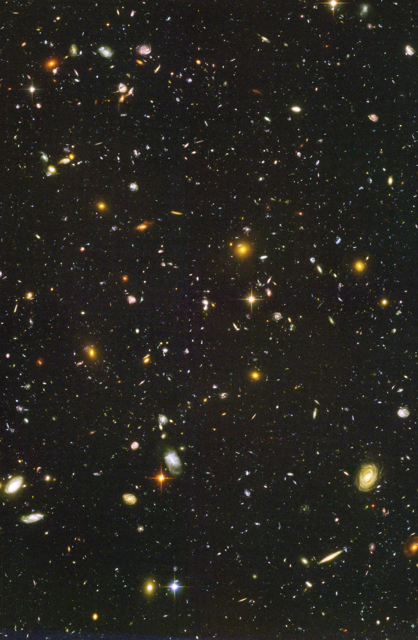
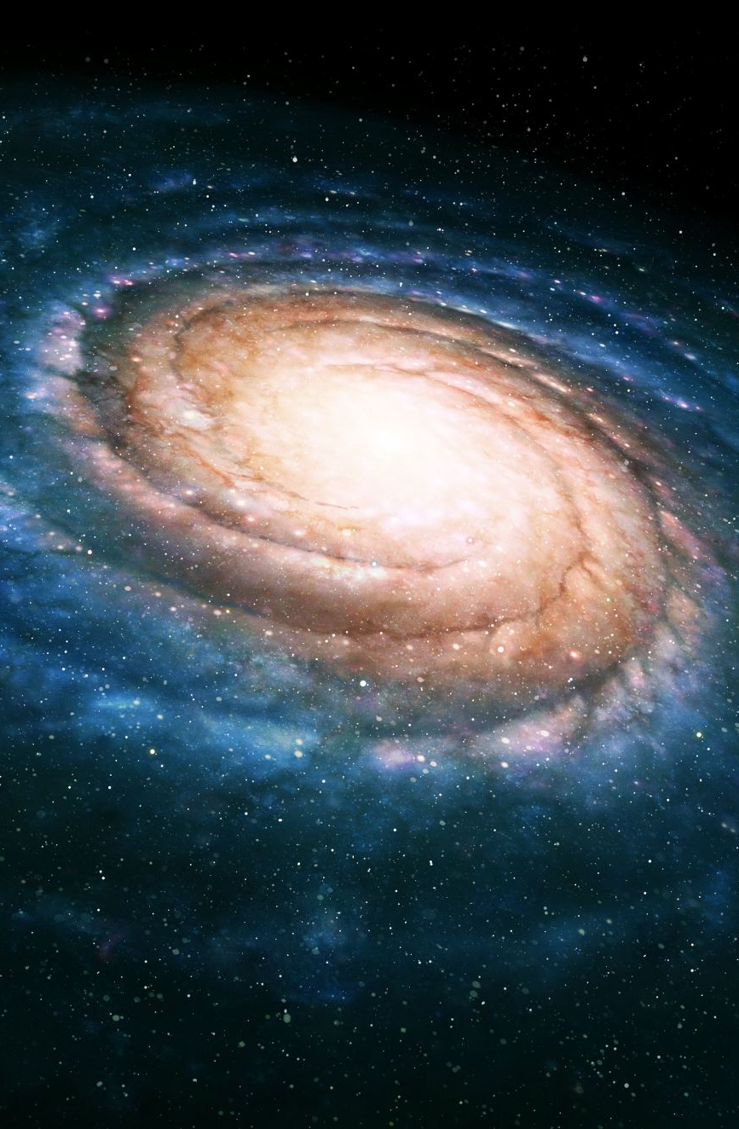
Photometric redshifts from the Roman HLTDS: implications for supernova cosmology and galaxy evolution science
Bhavin Joshi
with Russell Ryan, Lou Strolger, and Rick Kessler
For the Roman SN PIT
Bhavin Joshi -- Roman IPAC July 2024
HUDF, Beckwith et al 2006

Slide 2
Photometric redshifts from legacy galaxy redshift/supernova surveys
SDSS, Pan-STARRS, DES have photometry 5 bands (optical (u)grizy; no NIR data)
Photometric redshifts calibrated by algorithms that attempt to learn the color-redshift relation from a spectroscopic training set
  Training set of spec-z requires VERY accurate redshifts, 𝜎_{z} <~ 10⁻³ (1+z)
  The training set galaxies must also span, with dense coverage, the color-redshift space over which we will estimate photo-z
For this analysis, we assume that a training set of spectroscopic redshifts will not be available for the Roman HLTDS, and therefore the photo-z estimation must rely only on the broadband data.
  Note: Roman prism data might not be useful as a training set given the low and variable spectral resolution which in turn leads to lower redshift accuracy than required for a training set. Whereas the Roman grism can only achieve shallower depths, for a comparable exposure time, relative to the prism.
  Redshifts from Subaru PFS: while these will help mitigate many issues for SN Ia cosmology, they are unlikely to be a representative training set.

Slide 3

EAZY run details
Test cases for various HLTDS filter configurations:
  RZYJ, YJHF – reference survey configurations from Rose et al. 2021
  along with other configurations (total 10 configurations) from 4 bands to 7 bands (excluding the extremely wide F146 filter)
  Roman and Rubin galaxy photometry from DIFFSKY (Hearin et al. 2023, Alarcon et al. 2023)
100K galaxies considered in each test case (with 0 < z_{true} < 3)
  Redshift for fitting was in the range: 0 < z_{phot} < 6
We haven’t simulated a ZP systematic offset yet, but this can become a concern when considering photometric data from different telescope & instrument combinations, e.g., Rubin + Roman + other ground and/or space-based data
EAZY (Brammer et al. 2008): Template fitting for best-fit redshift through min $χ2$
Has 12 templates with non-negative linear combinations of templates allowed

Slide 4
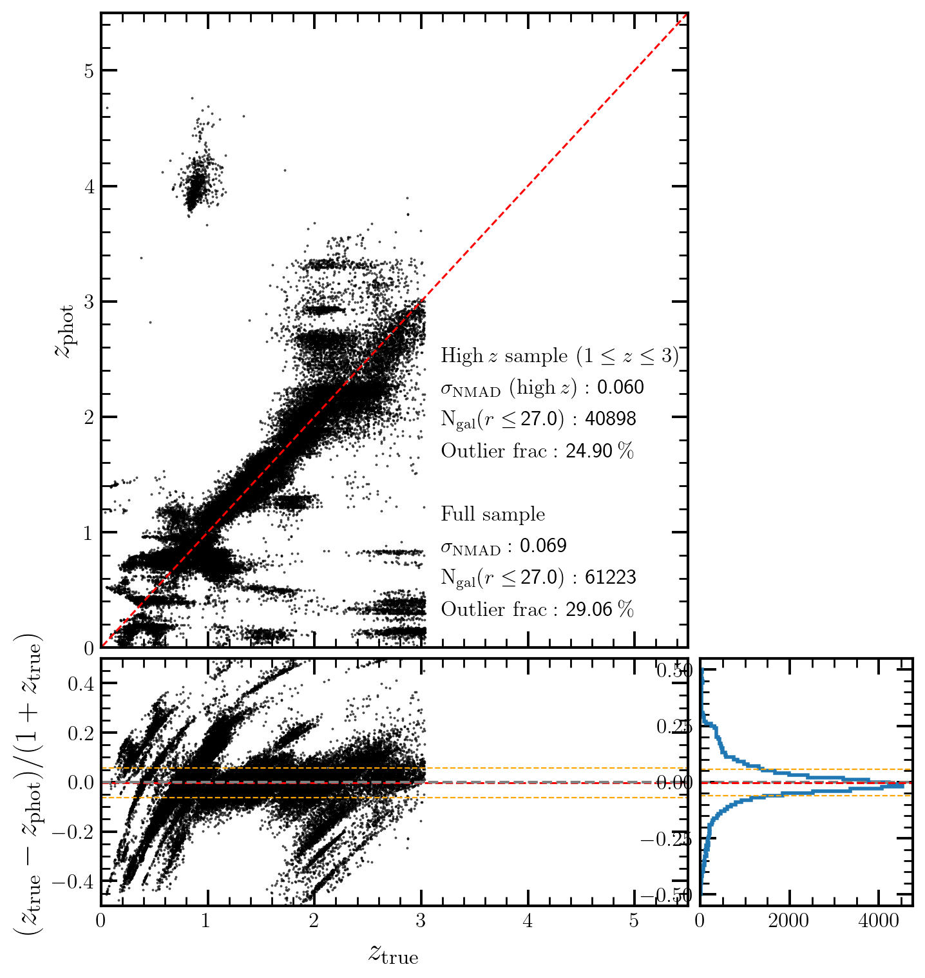
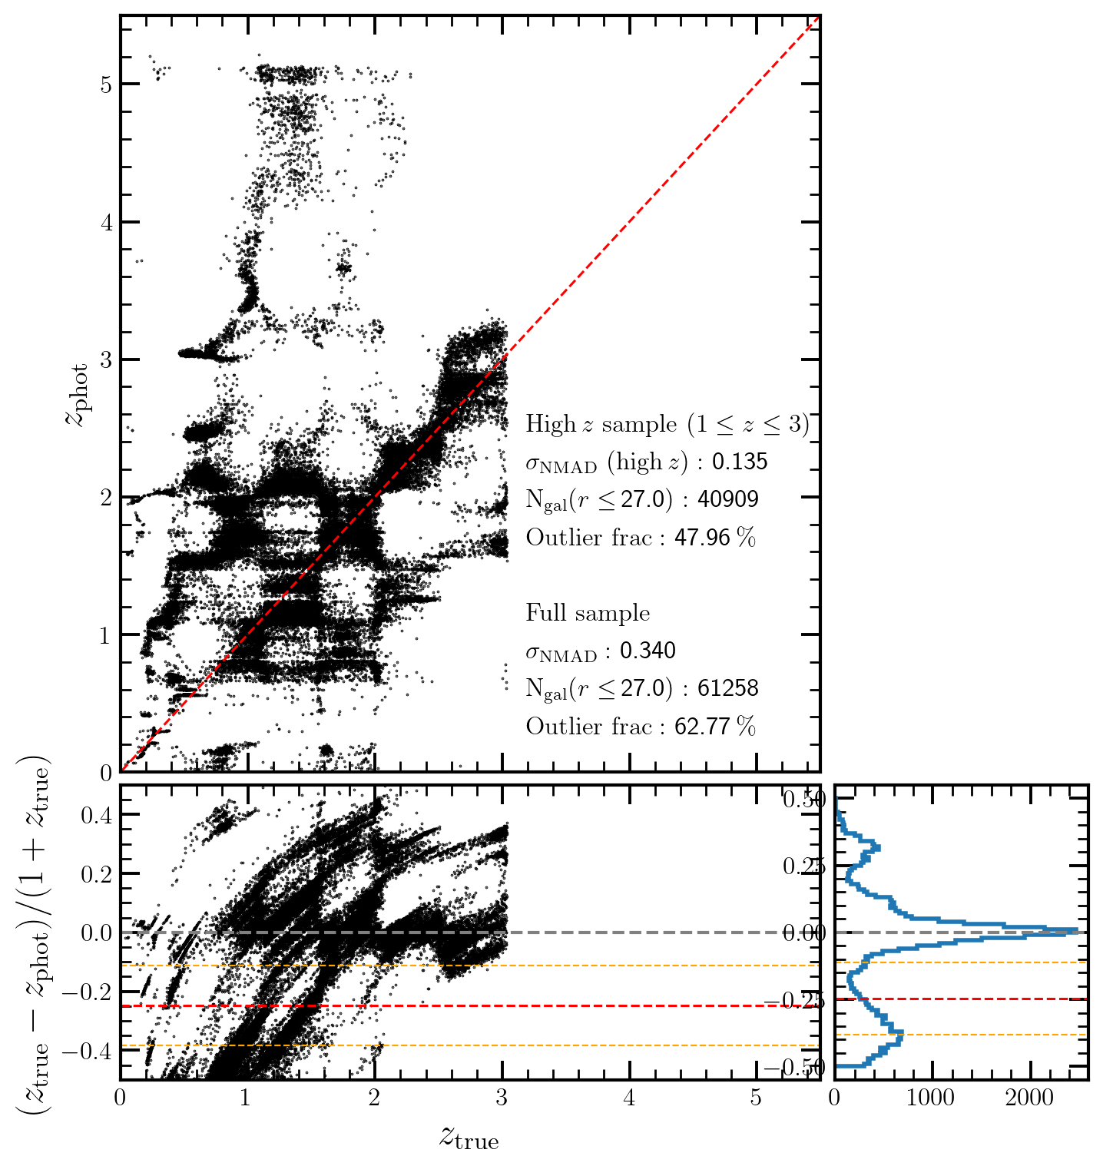
Results from 4 filter combinations of the design reference mission
RZYJ
YJHF

Slide 5
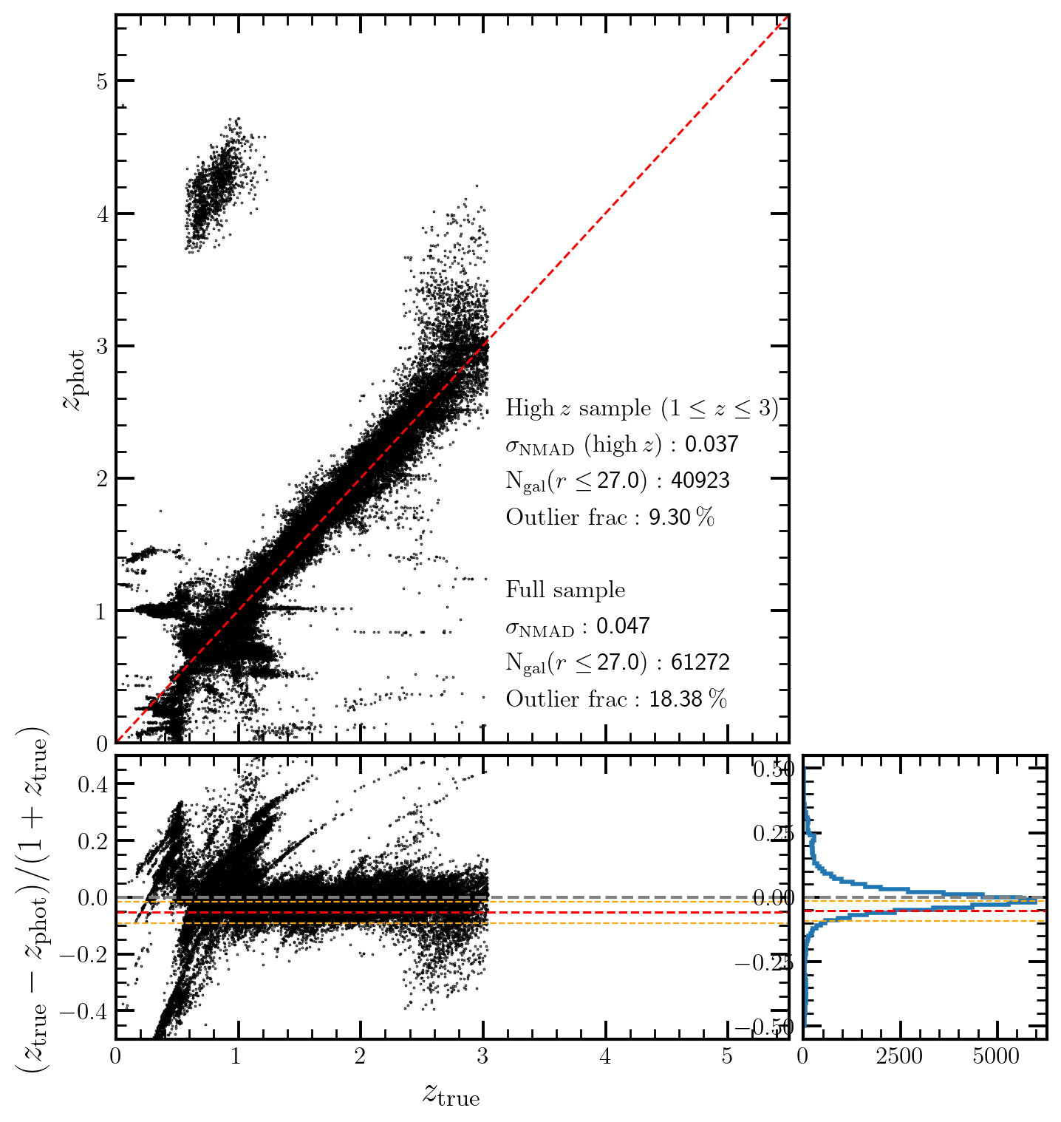
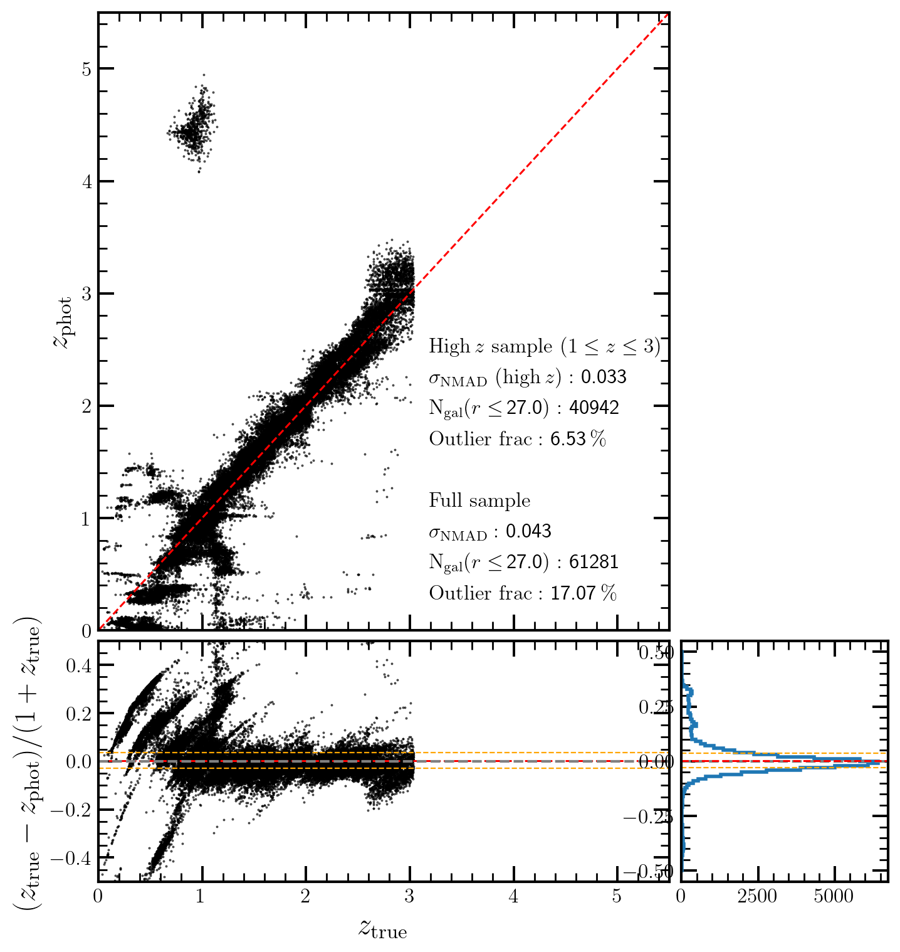
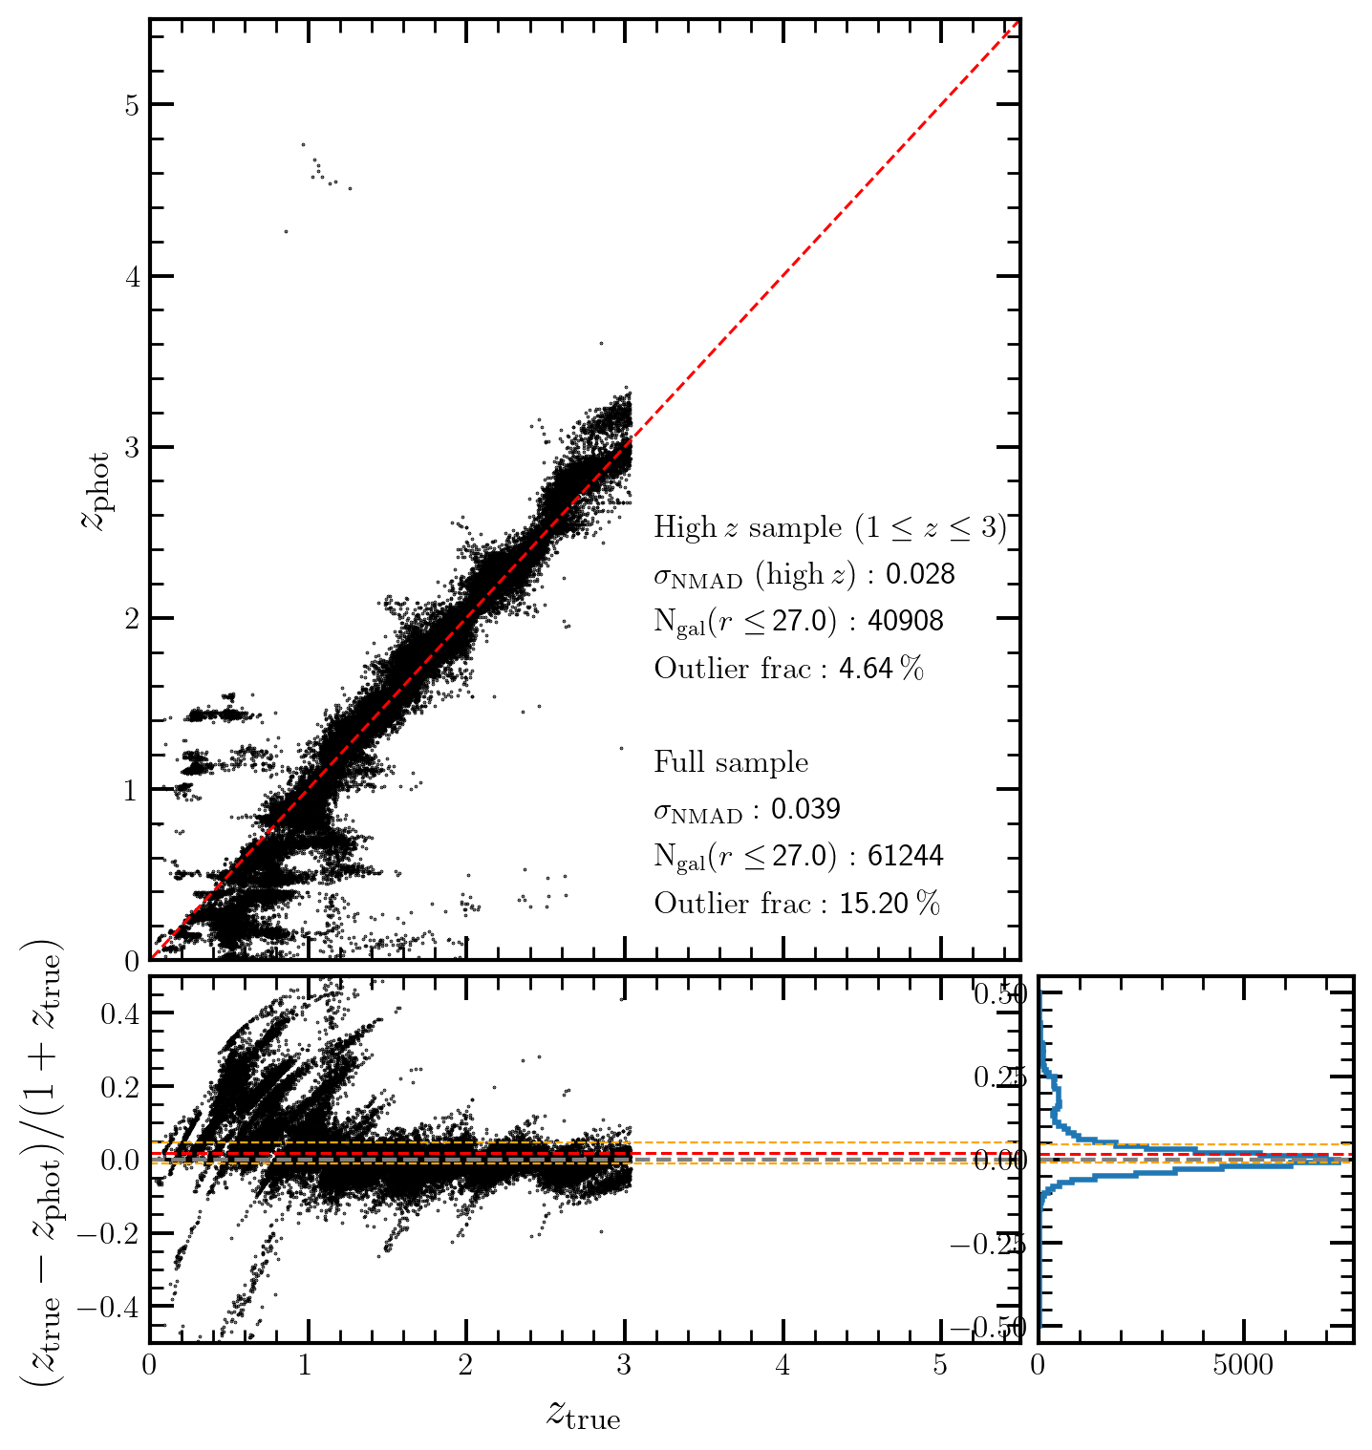
Results from 5, 6, and 7 WFI band configurations
RZYJH
RZYJHF
RZYJHFK
Photo-z bias also improves significantly as well – reducing systematic error for SN Ia cosmology!
Main modes of failure:
Misidentification of the 4000A/Balmer breaks as the Lyman break
Confusion between strong emission lines such as [OIII]5007 and H⍺

Slide 6
Longer wavelength baseline is crucial to reducing the scatter and outlier fractions!
R band, in particular, is important for outlier reduction
Bhavin Joshi -- Roman IPAC July 2024

Slide 7
Comparisons with photometric redshifts from other deep fields
The Hubble Ultra Deep Field (Beckwith et al. 2006)
  NUV data responsible for reduction by factor of 2 in scatter and 3 in outlier fraction (UVUDF; Teplitz et al. 2013, Rafelski et al. 2015)
COSMOS (Scoville et al. 2007)
  Photometric redshifts with scatter and outlier fractions <1% with >30 bands (Mobasher et al. 2007, Ilbert et al. 2009, Laigle et al. 2015, Weaver et al. 2020)
From the Roman science requirements documentation:
SN 2.0.3: RST shall enable a SN survey to observe more than 100 SNe-Ia per Δz=0.1 bin.
SN 2.0.4: RST shall enable a SN survey with the systematic bias in redshift, σ_{z} /(1 + z), less than the values in the following table:
Z | 0.3 | 0.6 | 0.9 | 1.2 | 1.5
σz / (1+z) | 0.001 | 0.0016 | 0.0019 | 0.0022 | 0.0024
Bhavin Joshi -- Roman IPAC July 2024

Slide 8
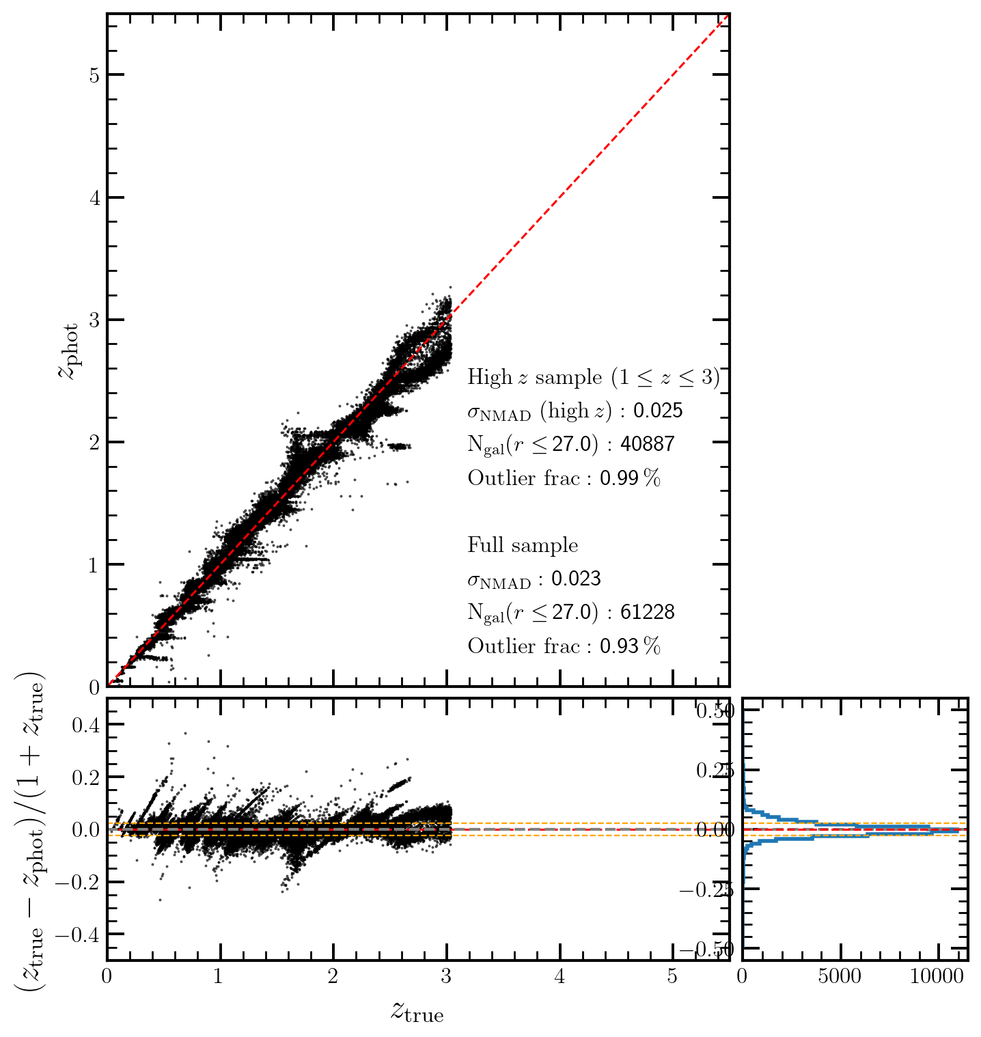
With Rubin data included – Rubin ugrizy with Roman JHFK
10 band photo-z now has outliers < 1% and bias~0
Photo-z at low redshifts (z<1) now significantly improved
Caveat: same depth was assumed for Rubin and Roman which is unlikely to be true, although the broader implications about bias, outliers, and improved low-z photo-z should still hold.

Slide 9
Conclusions
The bluest bands (R and Z bands if reliant only on Roman WFI) are critical to reducing the outlier fraction and bias of photometric redshifts
  Photo-z performance even better if complementary optical Rubin bands can be included
Regions with pre-existing spectroscopic redshifts could serve as potential photo-z calibration fields
  e.g., GOODS, COSMOS, NEP
  Data in this field can be taken prior to HTLDS execution as a precursor field to calibrate the color-redshift relation
  Could serve as a steppingstone for a future Roman deep field (Koekemoer et al. 2019, Drakos et al. 2022)
[Future Work] We will add Roman grism/prism data within the fitting procedure to test redshift improvement (e.g., Ryan et al. 2007, Joshi et al. 2019) especially for galaxies without strong emission lines
Bhavin Joshi -- Roman IPAC July 2024

Slide 10
Bhavin Joshi -- Roman IPAC July 2024

Slide 11
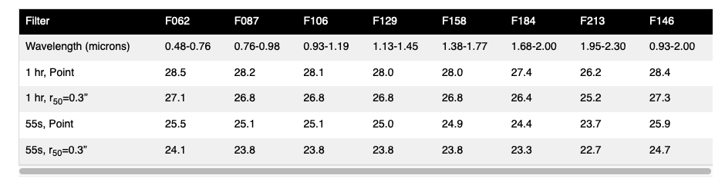
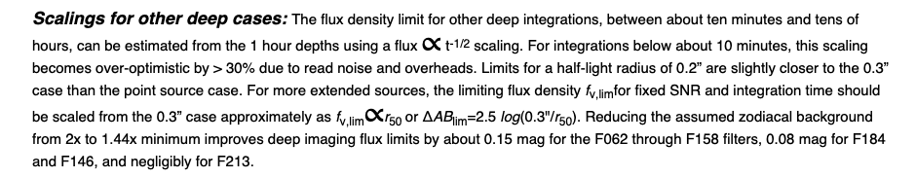
WFI Imaging Filter Sensitivity.
Reproduced from Roman GSFC page: https://roman.gsfc.nasa.gov/science/WFI_technical.html#filters
Bhavin Joshi -- Roman IPAC July 2024

