Slide 1
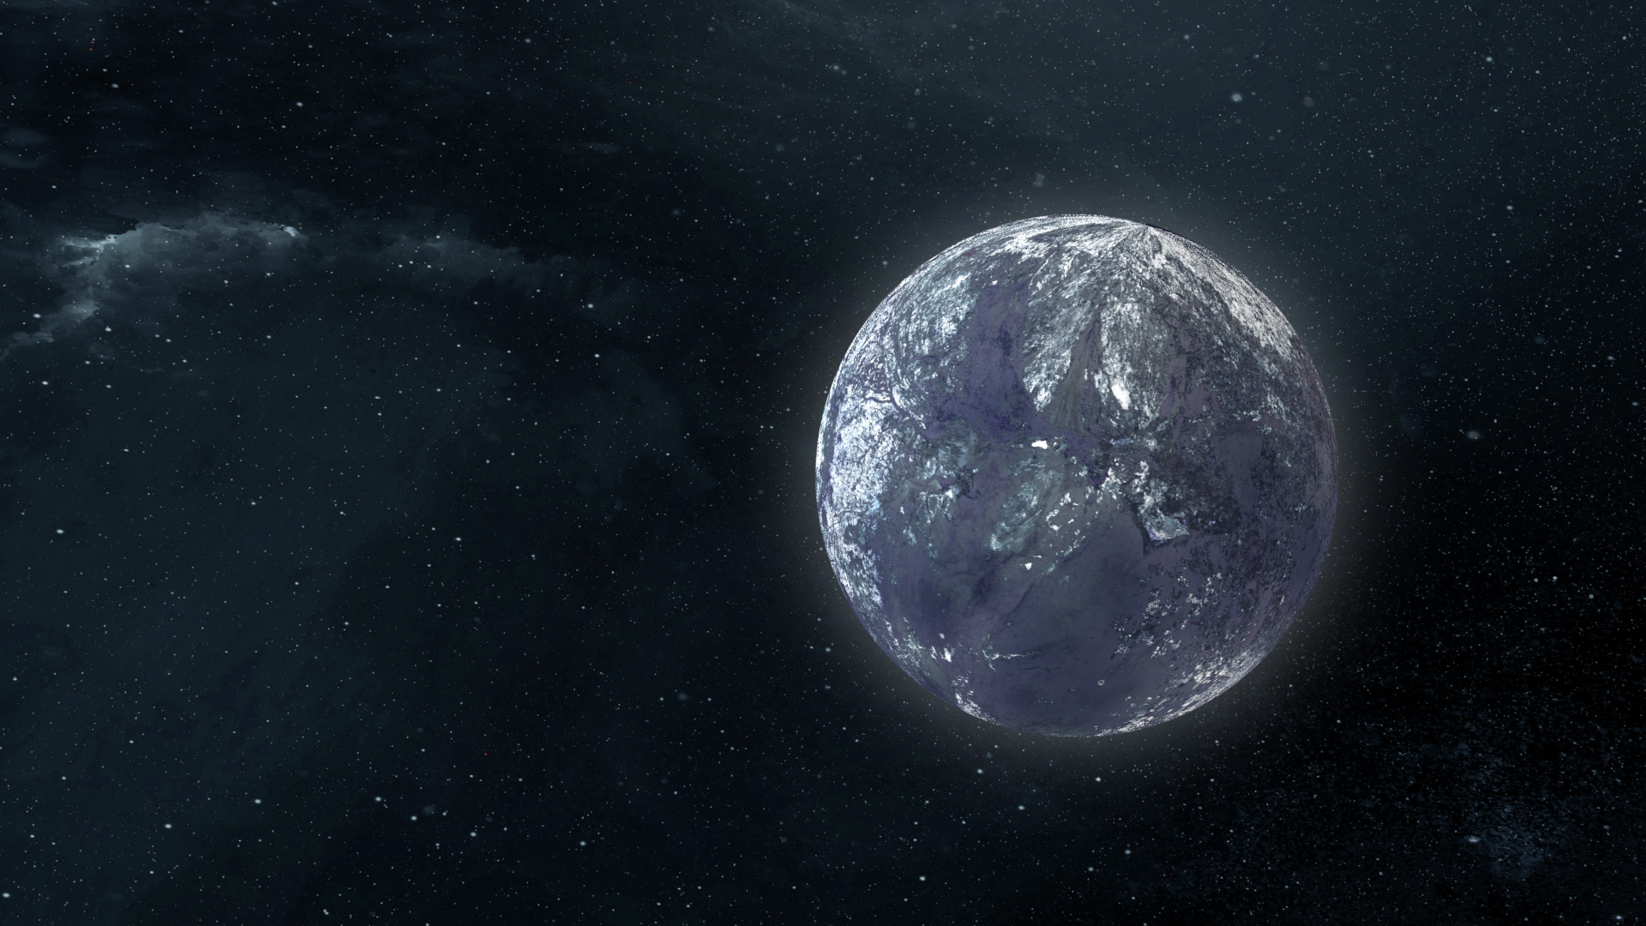
Free-floating planet mass function from
MOA-II 9-year survey and expectations for Roman
NK, Sumi et al. (2023), AJ, 166, 107
Sumi, NK et al. (2023), AJ, 166, 108
Naoki Koshimoto, Takahiro Sumi (Osaka Univ.),
MOA collaboration
©️NASA/GSFC

Slide 2
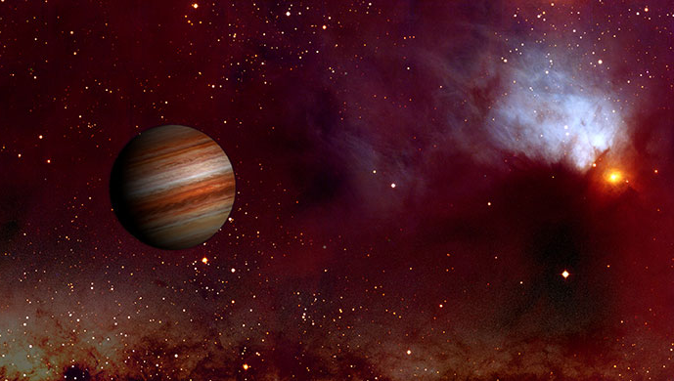
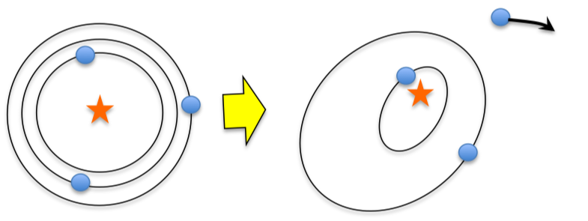
Free-floating planets (FFPs)
Illustration of a young, giant FFP detectable by direct imaging (Núria Miret-Roig et al. 2021)
Planetary mass objects without host stars
Possible formation scenarios：
  In-situ （only massive gas-giants?）
  Formed in a protoplanetary disk and then gravitationally scattered due to other planets or stars
©️ Université de Bordeaux
Illustration of a cold, small FFP detectable by gravitational microlensing (NK et al. 2023)
Detection method：
  Direct imaging for nearby young (hot), massive FFPs
  Gravitational microlensing for old (cold) or small FFPs (~20 so far)
©️NASA/GSFC

Slide 3
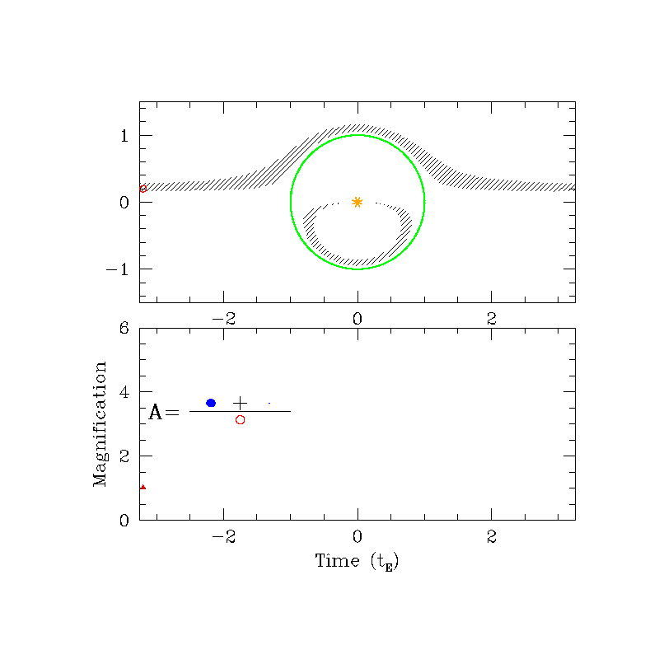
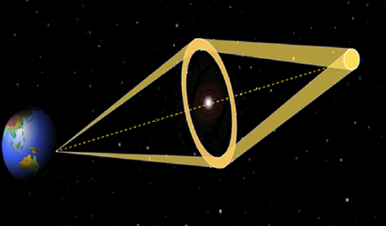
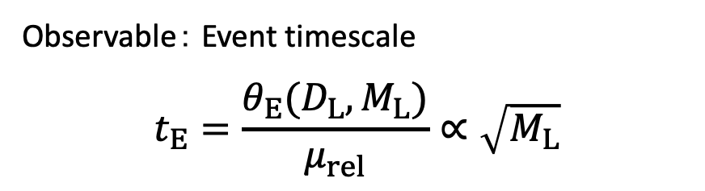
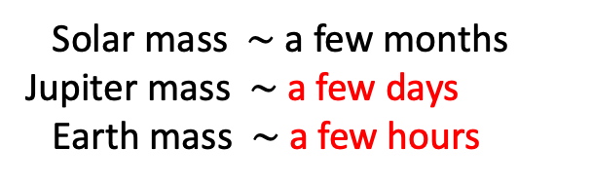
Gravitational microlensing
Lens object
Source star
Einstein ring
Images
Einstein ring
Source star
μ_{rel}
When the lens is a single object
θ_{E}
)
Lens object
(can be FFP)
Angular Einstein radius
θ_{E} ~ 0.5 mas
Event rate：~10⁻⁵ /star/year
Observable： Event timescale
$$t_{E}=\frac{θ_{E}(D_{L}, M_{L})}{μ_{rel}}∝\sqrt{M_{L}}$$
Typical timescale
t_{E}
Solar mass $∼$ a few months
Jupiter mass $∼$ a few days
Earth mass $∼$ a few hours
©️S. Gaudi

Slide 4


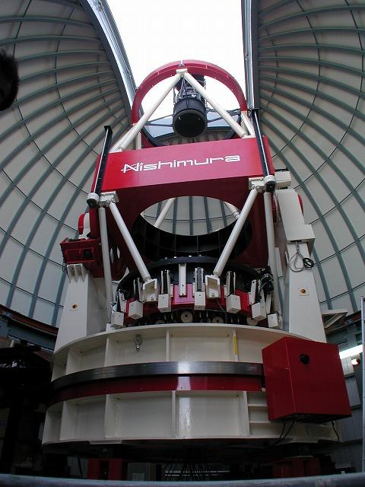
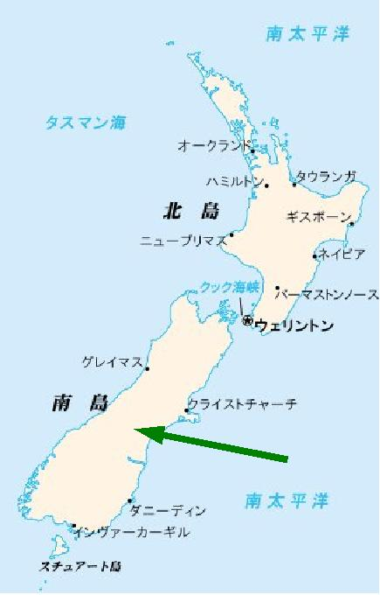
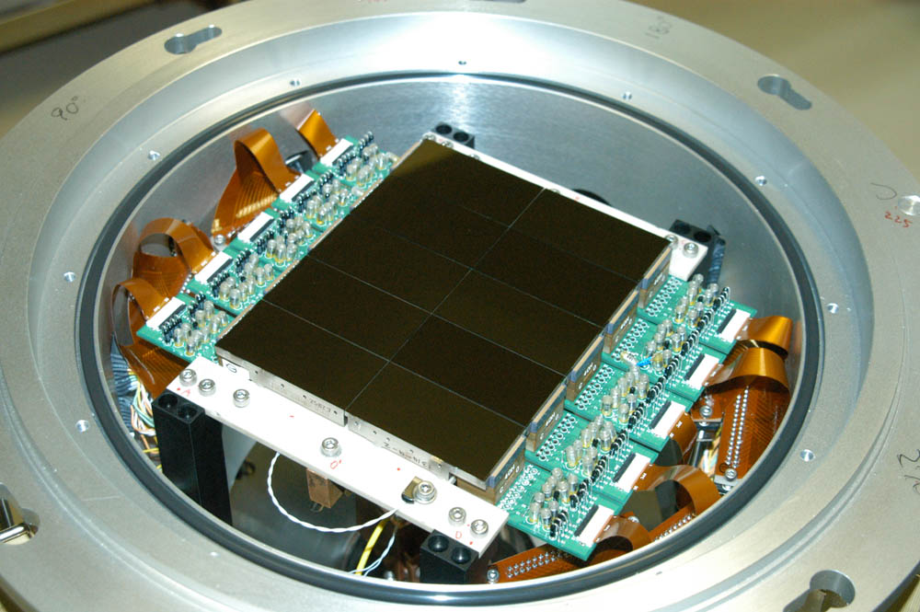
MOA (= Microlensing Observations in Astrophysics)
- High cadence survey of the Galactic bulge using the MOA-II telescope since 2006.
MOA-II telescope (1.8 m)
New Zealand
Mirror : 1.8m
CCD : 80M pix.(12x15cm)
FOV : 2.2 deg.²
(10 x full moon)
MOA
@Mt. John in Tekapo

Slide 5
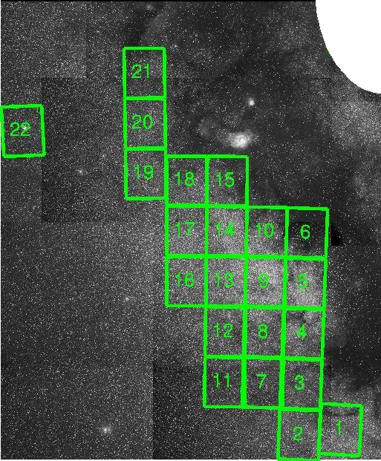
Survey fields: Galactic bulge (very crowded area)
50 deg.²(50Mstars)
Cadence (sensitivity)
1/night (>M_{Jup})
1/95min.(M_{Jup})
1/47min.(M_{Nep})
1/15min. (M_{Earth})
G.C.
G.plane

Slide 6
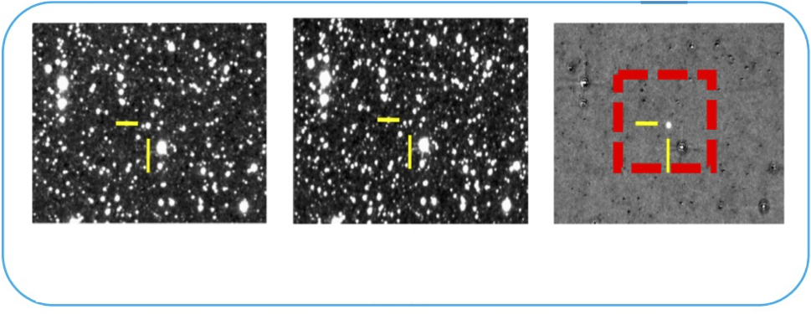
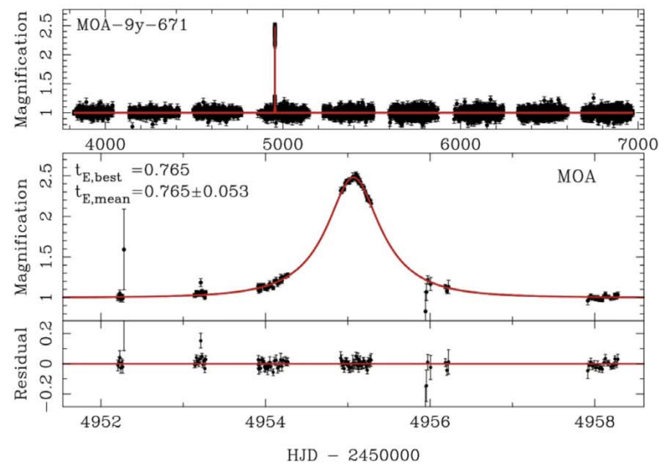
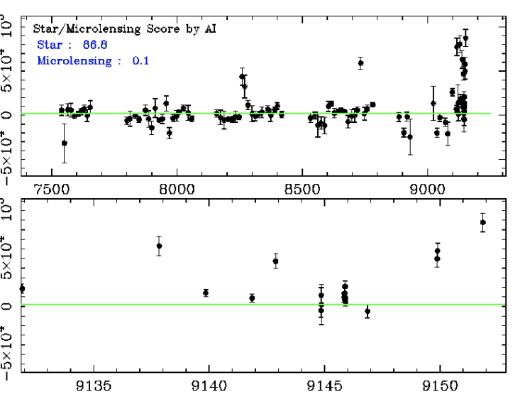
Systematic analysis of MOA-II 9-year data during 2006-2014
Select microlenses by certein criteria
263,491 images over 9-years
Variable objects
ΔFlux
Microlens!
ΔFlux
Observed
Reference
Subtracted
Difference Image Analysis (DIA)
Improvements from previous study by Sumi+11 for 2006-2007:
ΔFlux
Removed systematic errors (mainly due to differential refraction) correlated with airmass and seeing.
Considered the finite-source effect.
Garbage
(99%)
ΔFlux
JD-245000

Slide 7
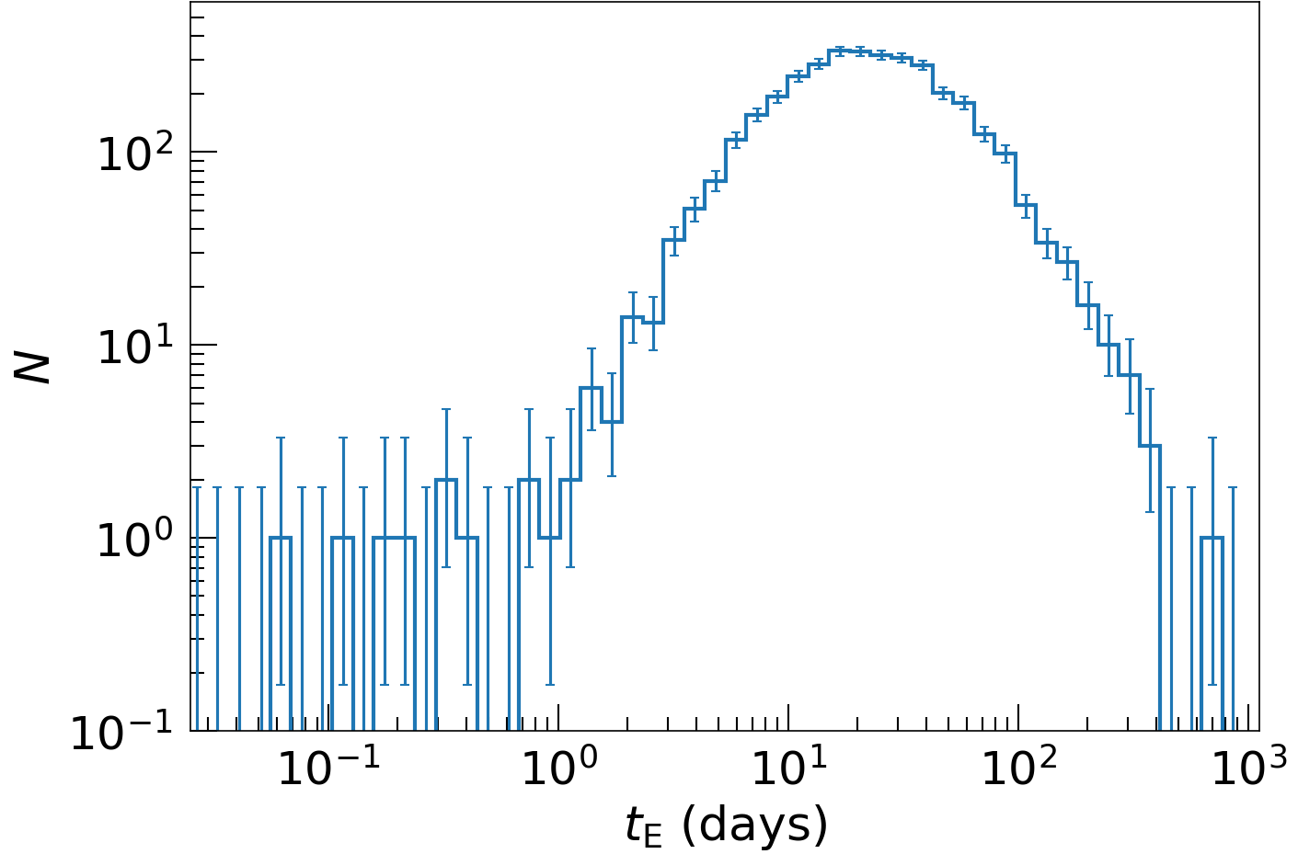
Selected sample
3535 events ($0.057 days<t_{E}<757 days$) detected in the 9-year data
Event timescale t_{E} (days)

Slide 8
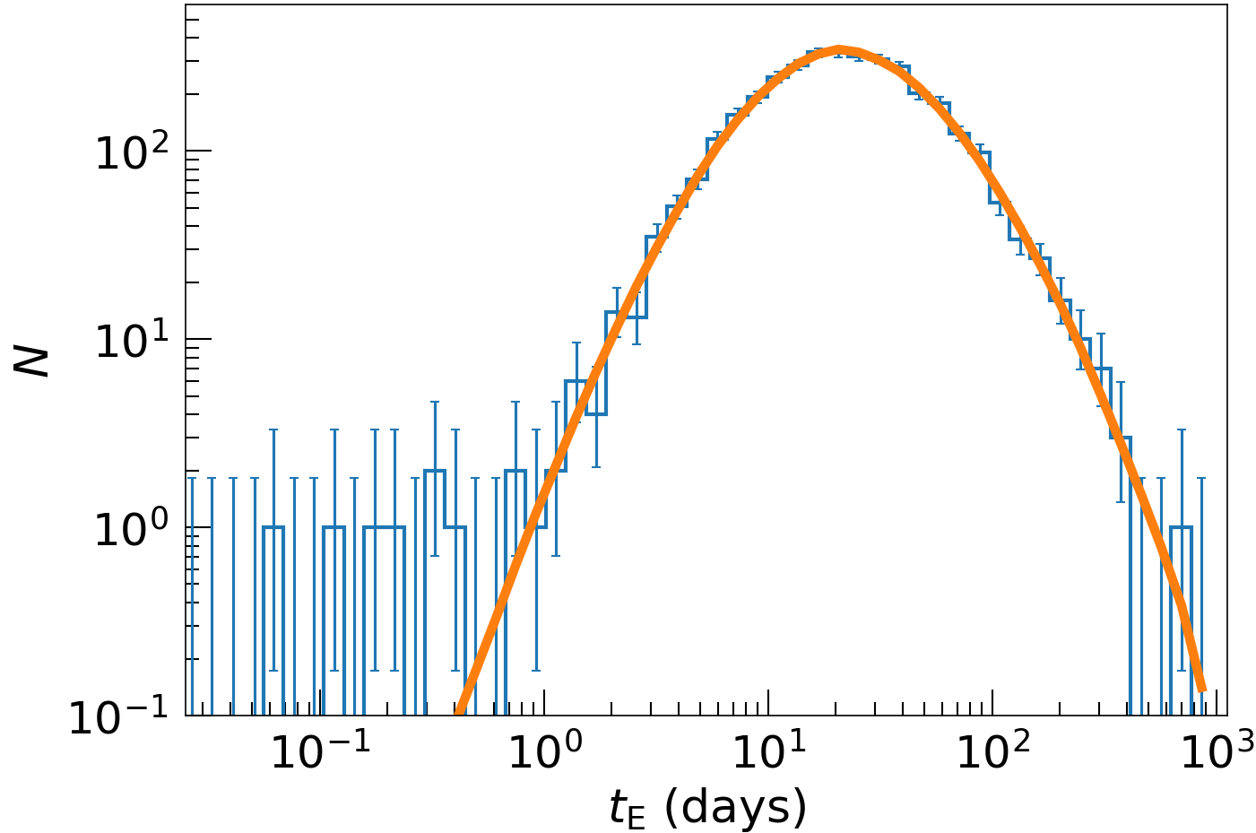

Selected sample
3535 events ($0.057 days<t_{E}<757 days$) detected in the 9-year data
(Koshimoto+21’s
Galaxy model)
Event timescale t_{E} (days)

Slide 9
Selected sample
3535 events ($0.057 days<t_{E}<757 days$) detected in the 9-year data
(Koshimoto+21’s
Galaxy model)
6 FFP candidates!!
(could be wide-orbit planets)
Event timescale t_{E} (days)

Slide 10
Selected sample
3535 events ($0.057 days<t_{E}<757 days$) detected in the 9-year data
(Koshimoto+21’s
Galaxy model)
6 FFP candidates!!
(could be wide-orbit planets)
Event timescale t_{E} (days)

Slide 11
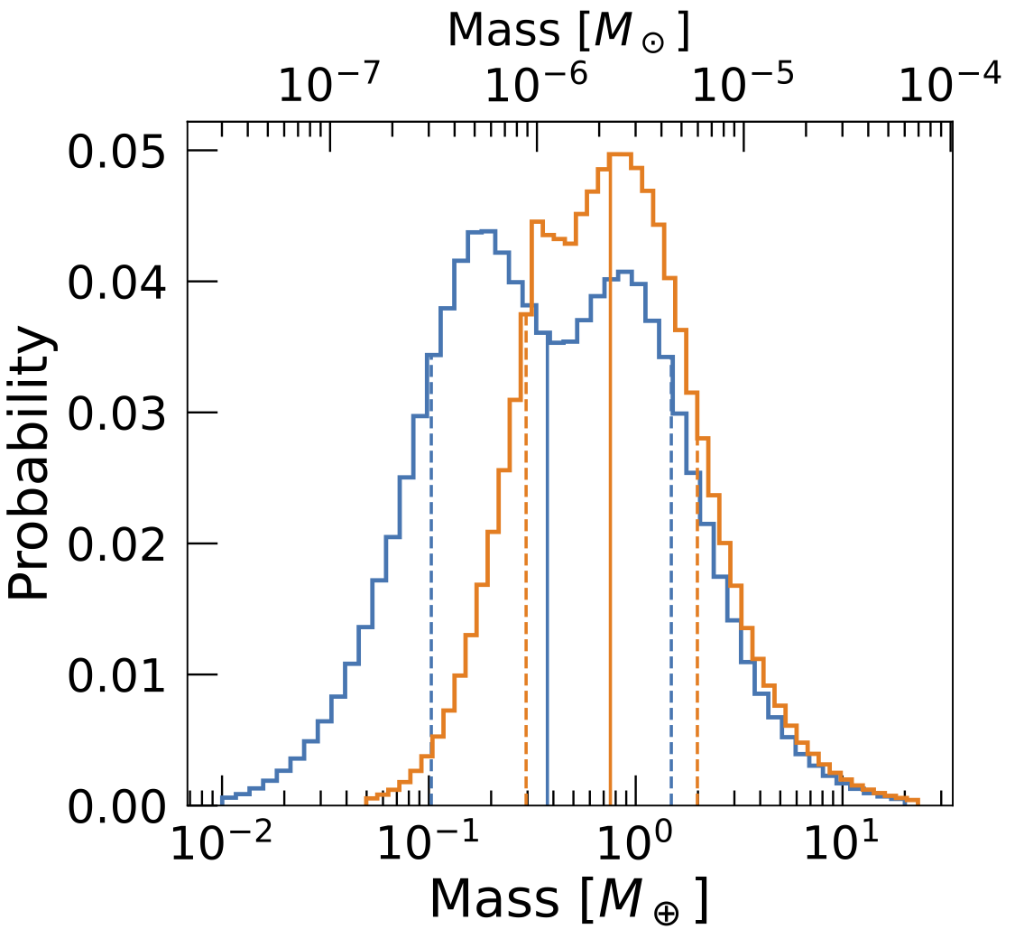
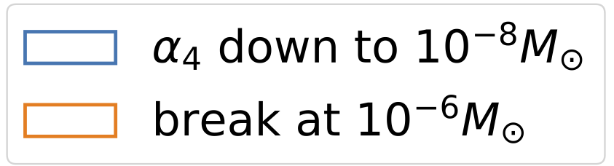



Terrestrial-mass FFP candidate： MOA-9y-5919
Second terrestrial-mass FFP candidate to date
Posterior distribution from a Bayesian analysis using a model of our Galaxy
$$t_{E}=0.057±0.016 day$$
2.5
$$M={0.8}_{−0.5}^{+1.2} M_{⊕}$$
2
Magnification
$$M={0.4}_{−0.3}^{+1.1} M_{⊕}$$
1.5
1
Color: different prior
～6 hours
0.5
Residual
0
-0.5
4600.5
4601
4601.5
4602
HJD-2450000(day)

Slide 12
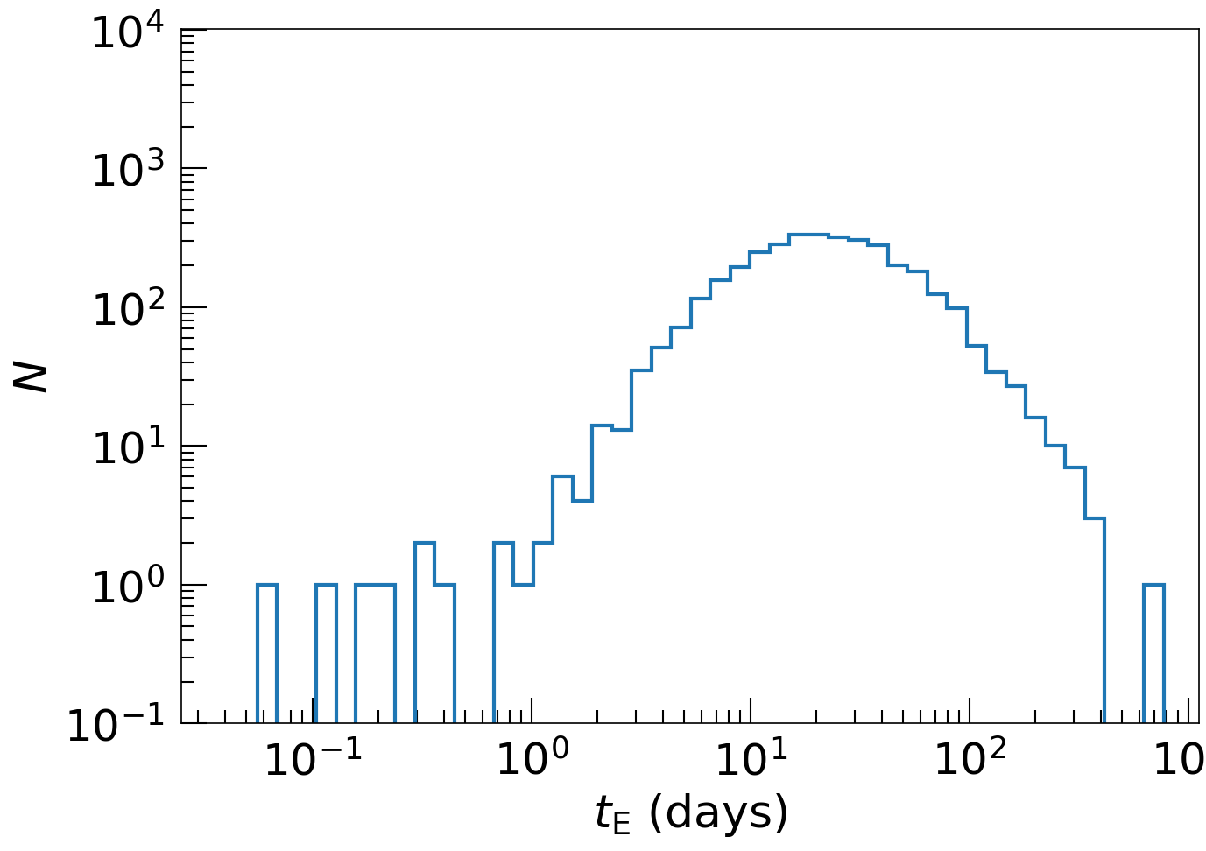

Detection efficiency
Correction for detection efficiency is required to have the intrinsic distribution.
Injection/recovery tests of 64 million artificial events using the same selection criteria
t_{E} distribution of 3535 events

Slide 13
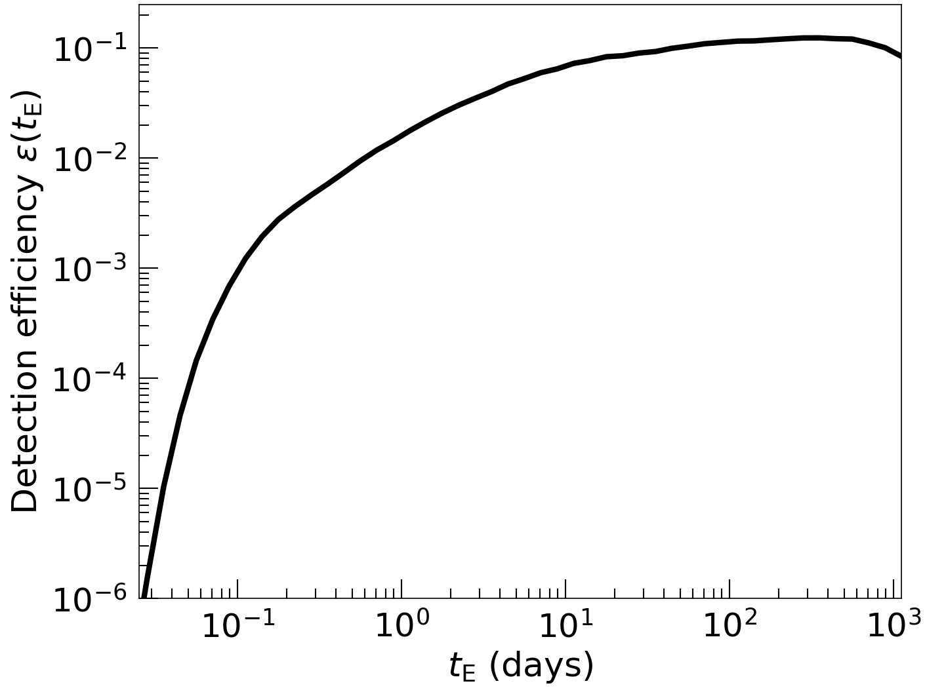
Detection efficiency
Correction for detection efficiency is required to have the intrinsic distribution
Injection/recovery tests of 64 million artificial events using the same selection criteria
t_{E} distribution of 3535 events
Computed detection efficiency

Slide 14
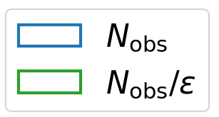
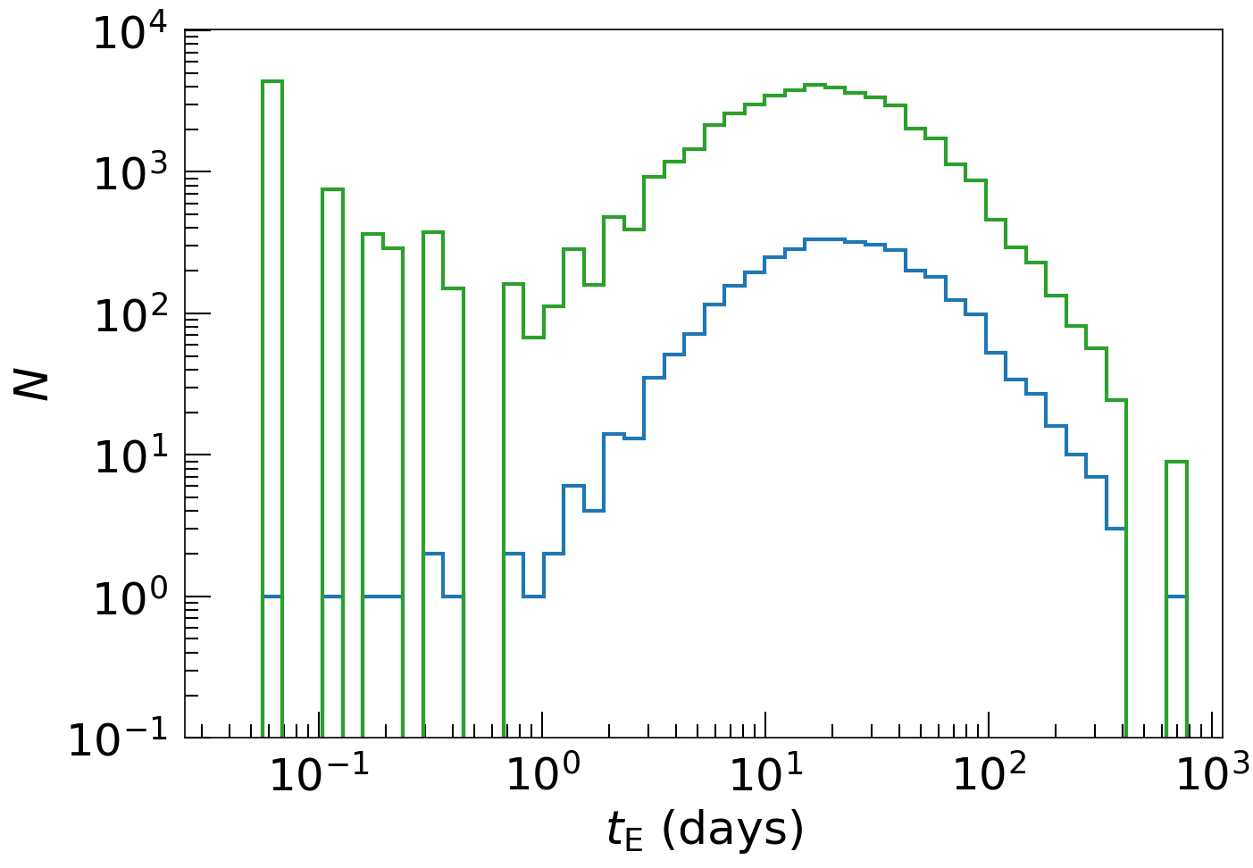
Detection efficiency
Correction for detection efficiency is required to have the intrinsic distribution
Injection/recovery tests of 64 million artificial events using the same selection criteria
t_{E} distribution of 3535 events
Computed detection efficiency

Slide 15
Detection efficiency
Correction for detection efficiency is required to have the intrinsic distribution
Injection/recovery tests of 64 million artificial events using the same selection criteria
A large number of FFPs implied
t_{E} distribution of 3535 events
Computed detection efficiency

Slide 16
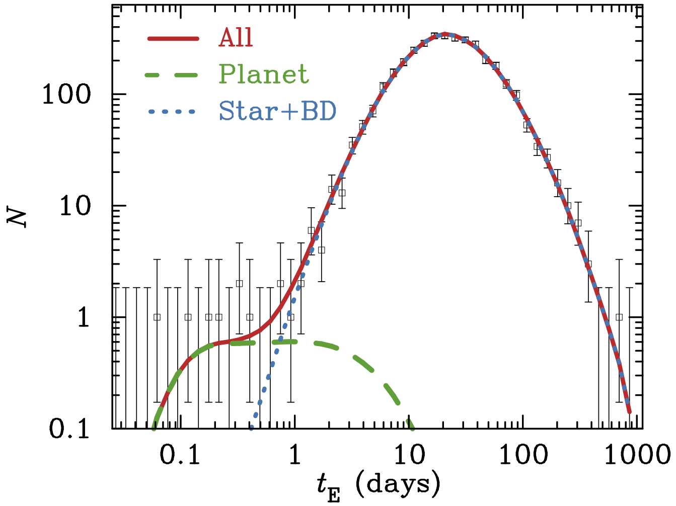
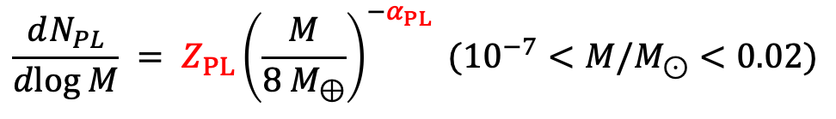





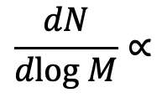

Likelihood analysis for FFP mass function
Model the observed distribution by
  Detection efficiency
  + Stellar density and velocity distributions in our Galaxy (Koshimoto et al. 2021)
+ Mass function
$$M^{−1.32} (0.86<M/M_{⊙}<120)$$
$$\frac{dN}{dlog M}∝$$
$$M^{−0.13} (0.08<M/M_{⊙}<0.86)$$
$$M^{−α_{BD}} (3×{10}^{−4}<M/M_{⊙}<0.08)$$
Best-fit model
$$\frac{dN_{PL}}{dlog M} = Z_{PL}{\left(\frac{M}{8 M_{⊕}}\right)}^{−α_{PL}} ({10}^{−7}<M/M_{⊙}<0.02)$$
Result from MCMC
$$α_{BD}=−{0.58}_{−0.16}^{+0.11}$$
$$α_{PL}={0.96}_{−0.27}^{+0.47}$$
$$Z_{PL}={2.18}_{−1.40}^{+0.52} dex^{−1}star^{−1}$$

Slide 17
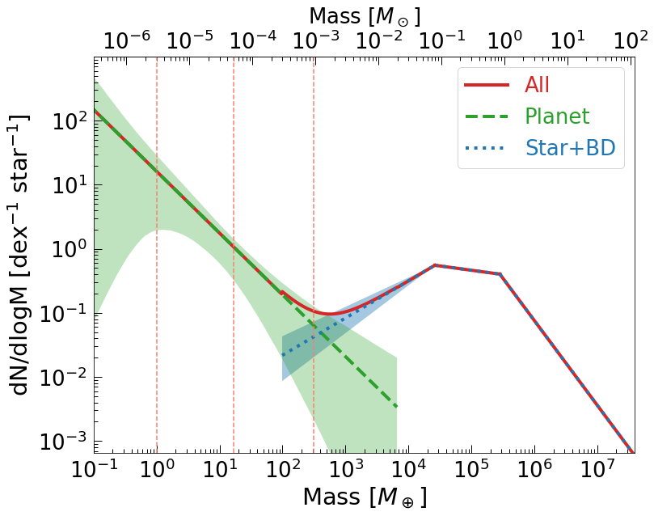

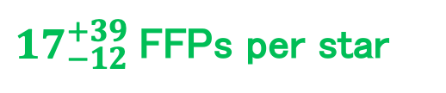
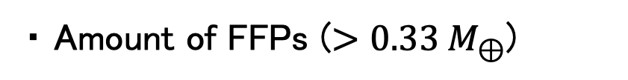

Mass function over $∼$8 orders of magnitude
・ Low mass FFPs are abundant
・ Amount of FFPs ($>0.33 M_{⊕}$)
${17}_{−12}^{+39}$FFPs per star
Earth
Jupiter
or ${69}_{−36}^{+107} M_{⊕}$ per star
Neptune

Slide 18
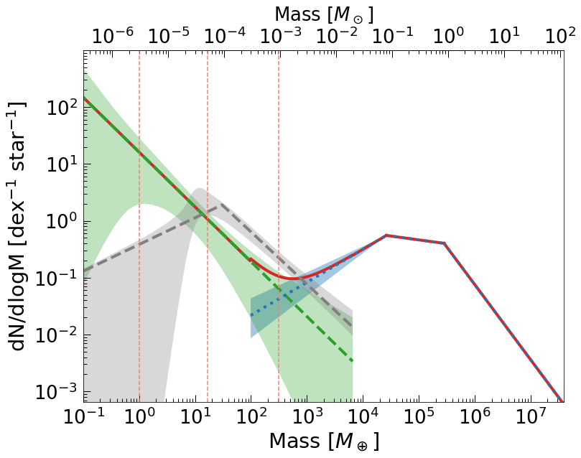
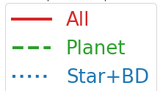

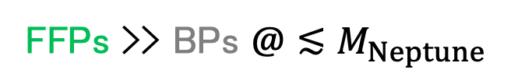
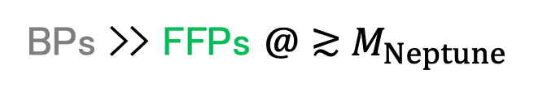
Mass function over $∼$8 orders of magnitude
・ Low mass FFPs are abundant
・ Amount of FFPs ($>0.33 M_{⊕}$)
${17}_{−12}^{+39}$FFPs per star
Earth
Jupiter
or ${69}_{−36}^{+107} M_{⊕}$ per star
Neptune
・ Bound planets vs FFPs
(from microlensing
Suzuki+16)
BPs >> FFPs $@≳$ $M_{Neptune}$
FFPs >> BPs $@≲M_{Neptune}$
Small planets are likely to be ejected from their birthplace while massive planets are likely to remain?

Slide 19
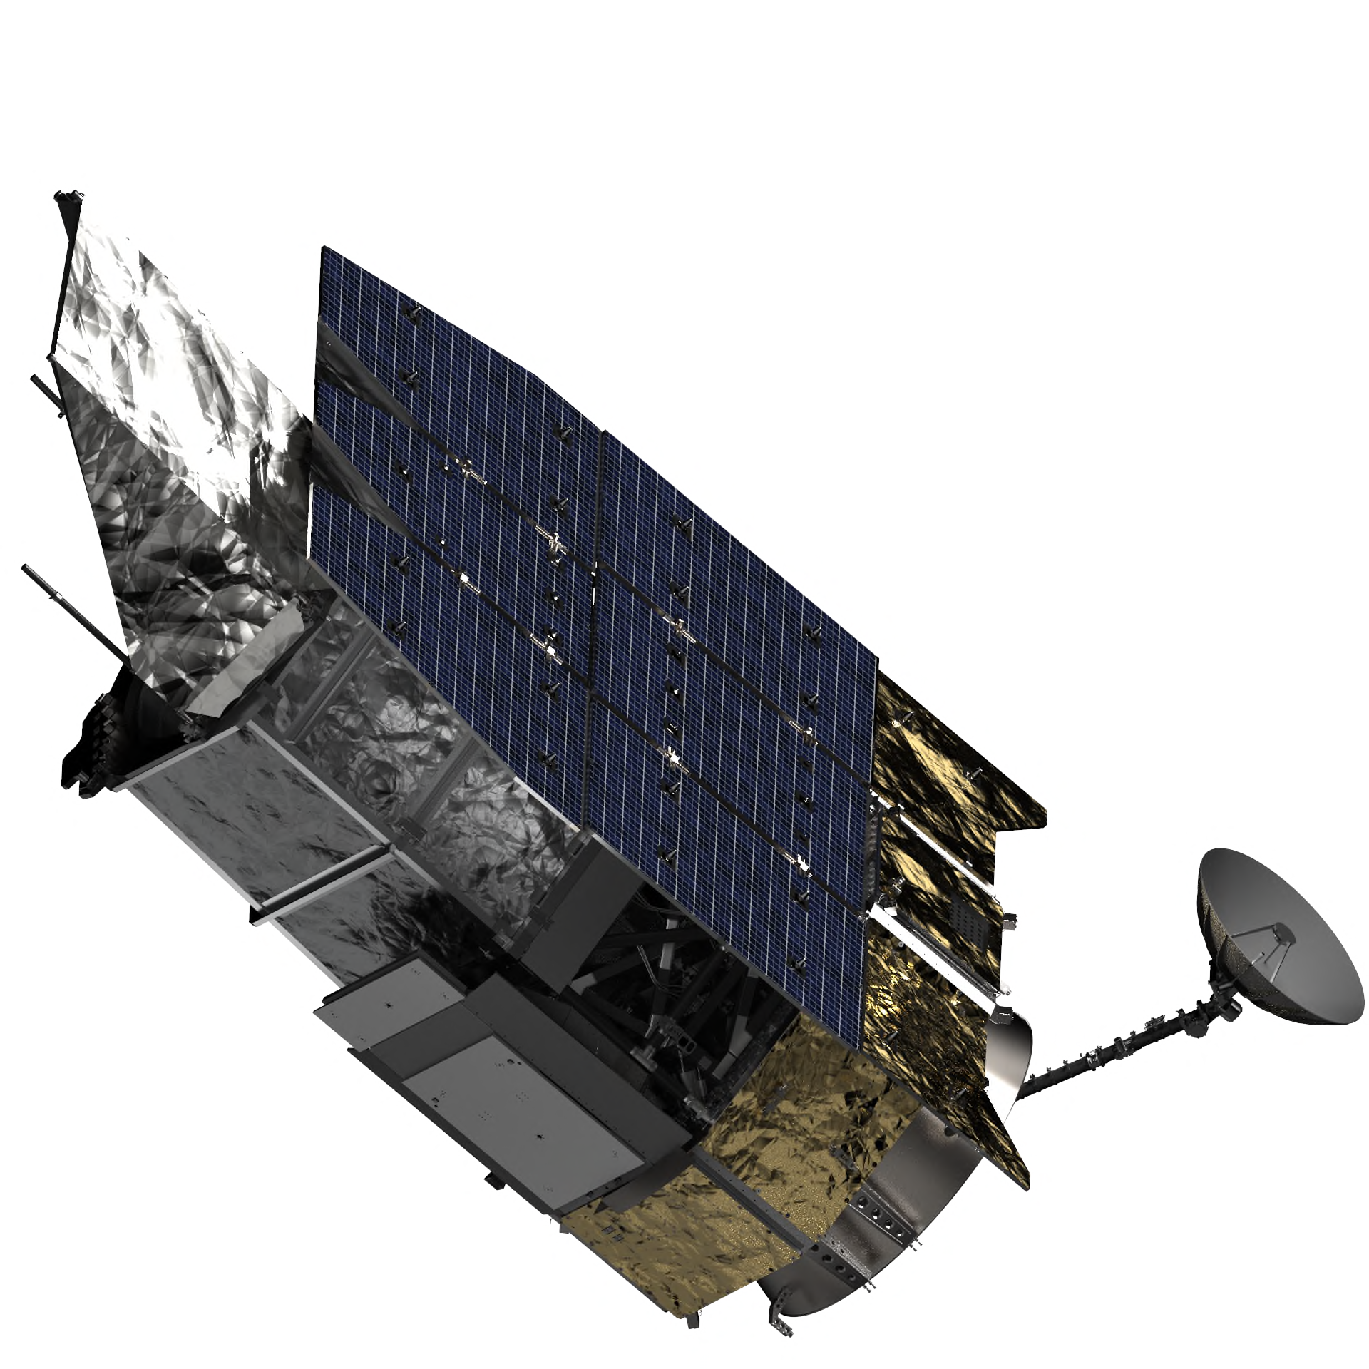
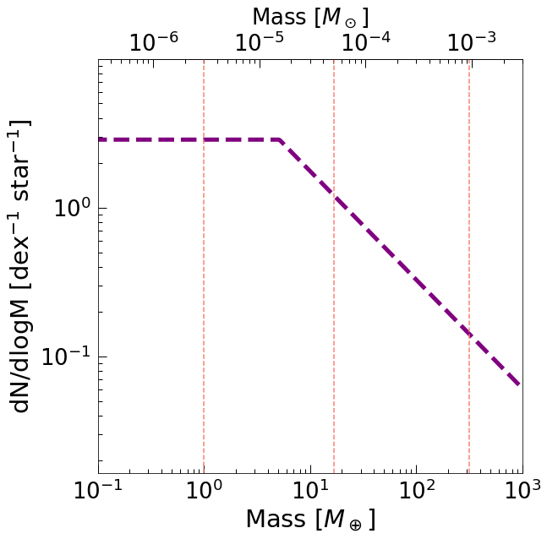
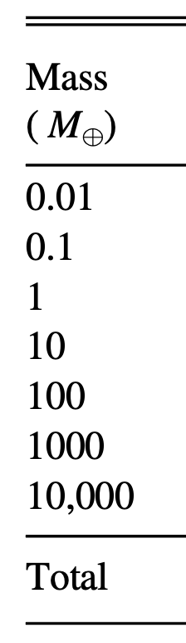
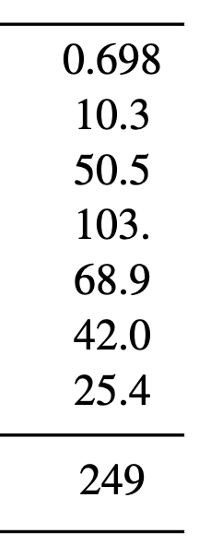
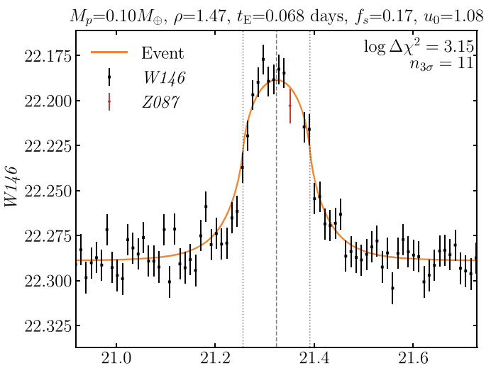


Expected yields of FFPs by Roman (Johnson et al. 2020)
Roman will discover ~250 FFPs ($>0.1 M_{⊕}$) including ~60 with $<M_{⊕}$.
MF for the bound planets was used for the FFP MF (no usable FFP MF at that time).
FFP yields
Assumed MF
FFP MF assumed in Johnson+20
$0.1 M_{⊕}$ FFP
Neptune
Jupiter
Earth
Simulated light curve
$$(0.1<M/M_{⊕}<1000)$$
Time (days)

Slide 20
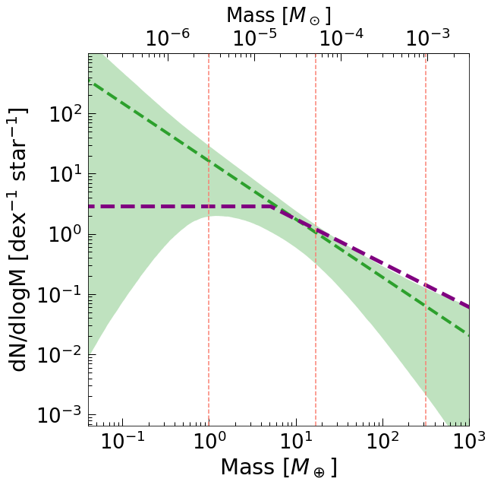

Updated expected yields of FFPs by Roman
Roman will detect ~250 280 to 2100 FFPs ($>0.1 M_{⊕}$) including ~60 30 to 1600 with $<M_{⊕}$.
Large uncertainties correspond to the room that Roman can improve the mass function, i.e., Roman will measure the FFP mass function much more precisely.
Roman’s FFP yields
MF in J20
This work
(1σ range)
MF assumed by Johnson+20
This work
0.0001 − 5546
0.4 − 2511
48 − 697
50 − 206
6 − 97
0.2 − 69
Neptune
Jupiter
0.005 − 55
Earth
281 − 2149
$$(0.1<M/M_{⊕}<1000)$$

Slide 21
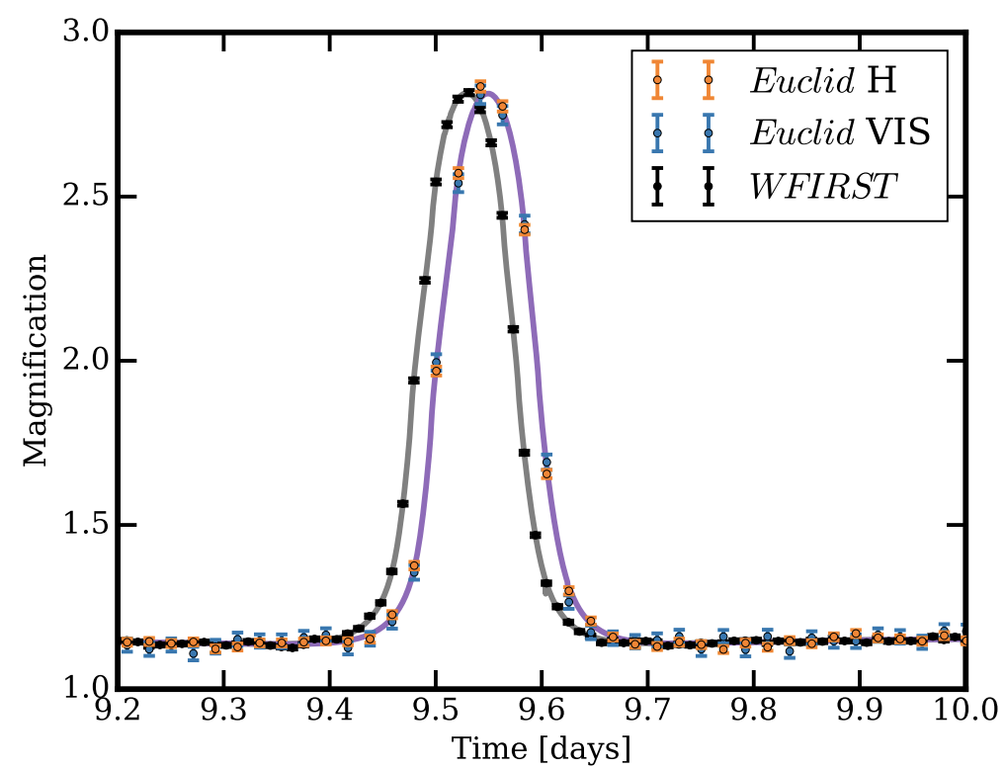
Concurrent observations help the FFP mass function measurement
Direct mass information helps constraining the MF more.
Measuring FFP mass is one of the few things that Roman cannot do alone, and requires simultaneous observations with ground-based telescopes (PRIME, Rubin, Subaru, etc.) and/or well-separated space telescopes (Euclid, ET, etc.).
Simulation
by Penny+19

Slide 22
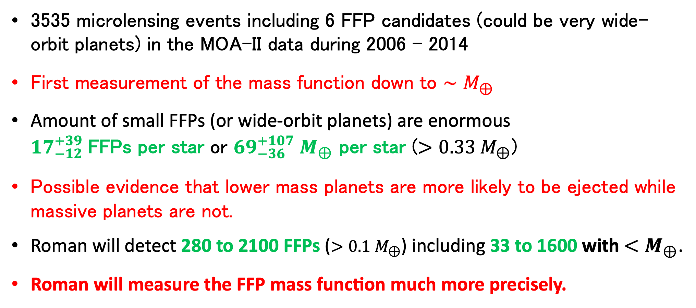
Summary
NK, Sumi et al., AJ, 166, 107
Sumi, NK et al., AJ, 166, 108
3535 microlensing events including 6 FFP candidates (could be very wide-orbit planets) in the MOA-II data during 2006 - 2014
First measurement of the mass function down to $∼M_{⊕}$
Amount of small FFPs (or wide-orbit planets) are enormous
${17}_{−12}^{+39}$FFPs per star or ${69}_{−36}^{+107} M_{⊕}$ per star ($>0.33 M_{⊕}$)
Possible evidence that lower mass planets are more likely to be ejected while massive planets are not.
Roman will detect 280 to 2100 FFPs ($>0.1 M_{⊕}$) including 33 to 1600 with $<M_{⊕}$.
Roman will measure the FFP mass function much more precisely.

Slide 23
Backup

Slide 24
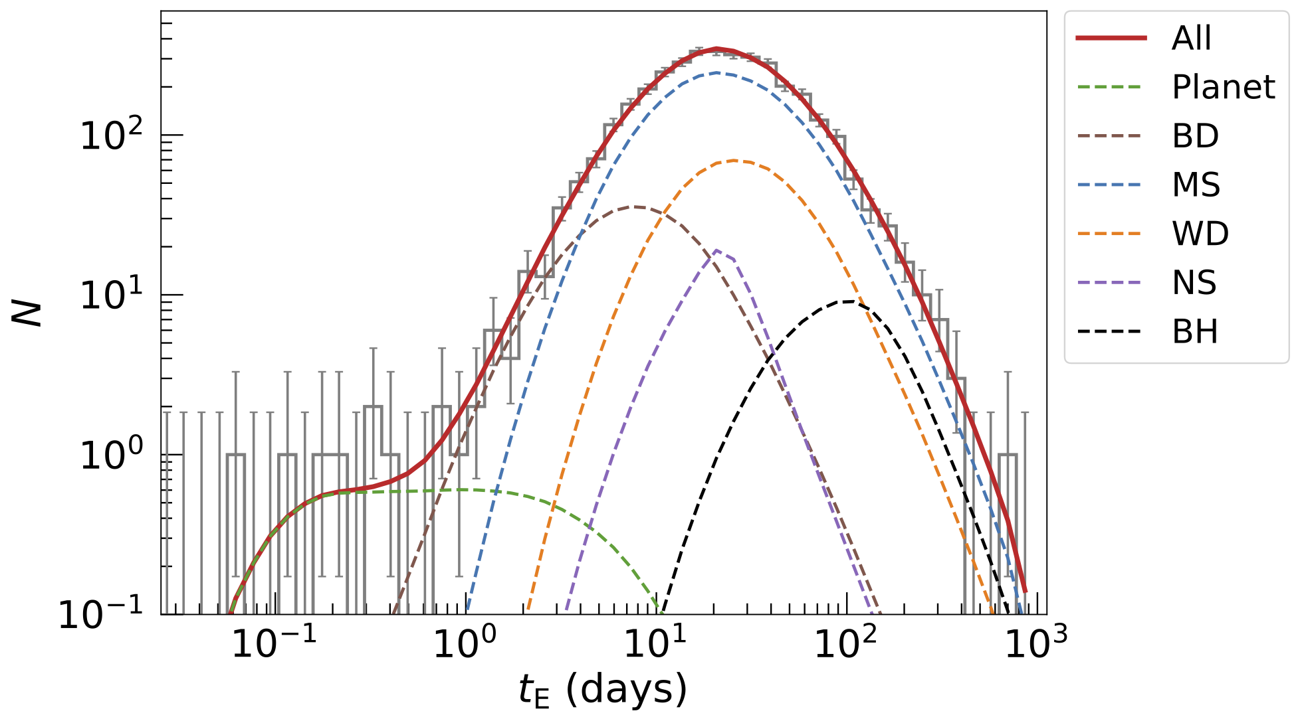
Timescale t_{E} distribution
3535events
Sumi, Koshimoto et al. 2023
Notes:
1+1/4

Slide 25
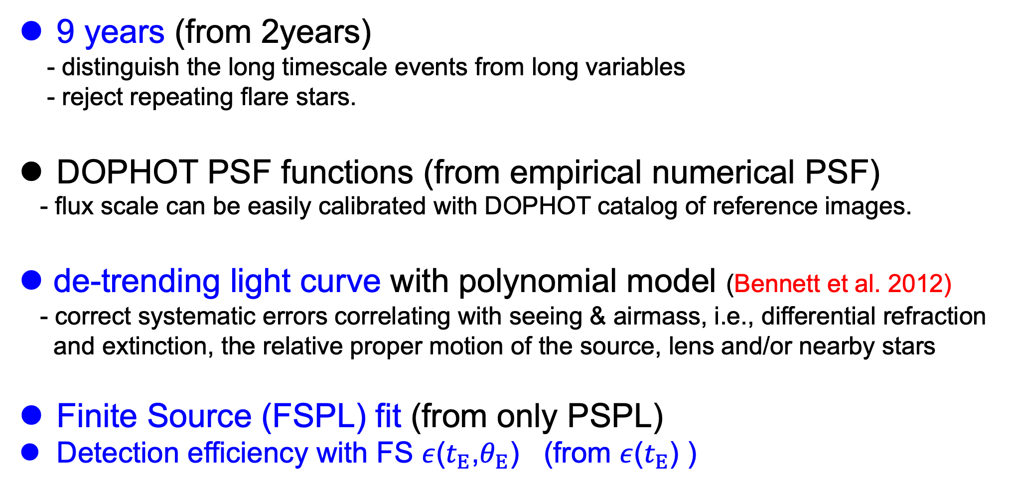
Improvements in new MOA analysis
9 years (from 2years)
- distinguish the long timescale events from long variables
- reject repeating flare stars.
DOPHOT PSF functions (from empirical numerical PSF)
- flux scale can be easily calibrated with DOPHOT catalog of reference images.
de-trending light curve with polynomial model (Bennett et al. 2012)
- correct systematic errors correlating with seeing & airmass, i.e., differential refraction
and extinction, the relative proper motion of the source, lens and/or nearby stars
Finite Source (FSPL) fit (from only PSPL)
Detection efficiency with FS $ε$($t_{E}$,$θ_{E}$) (from $ε$($t_{E}$) )
Notes:
1

Slide 26
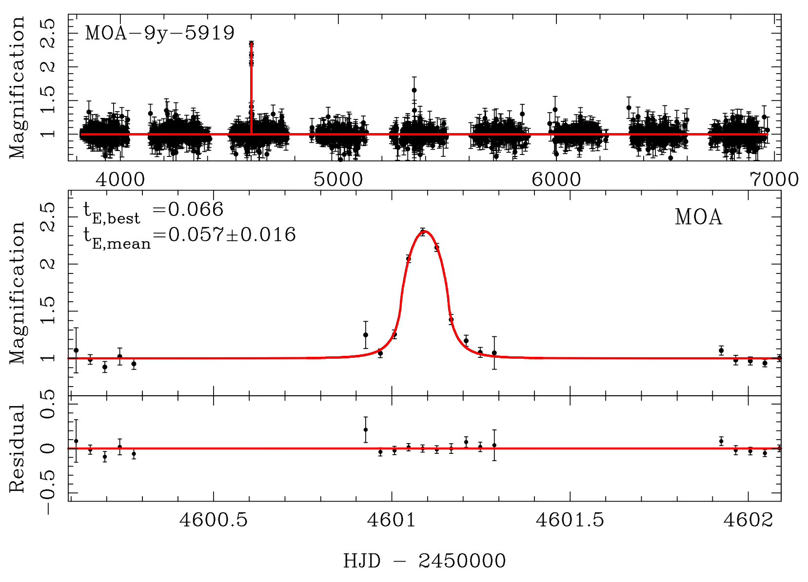
Finite source effect
3hours
Notes:
1

Slide 27
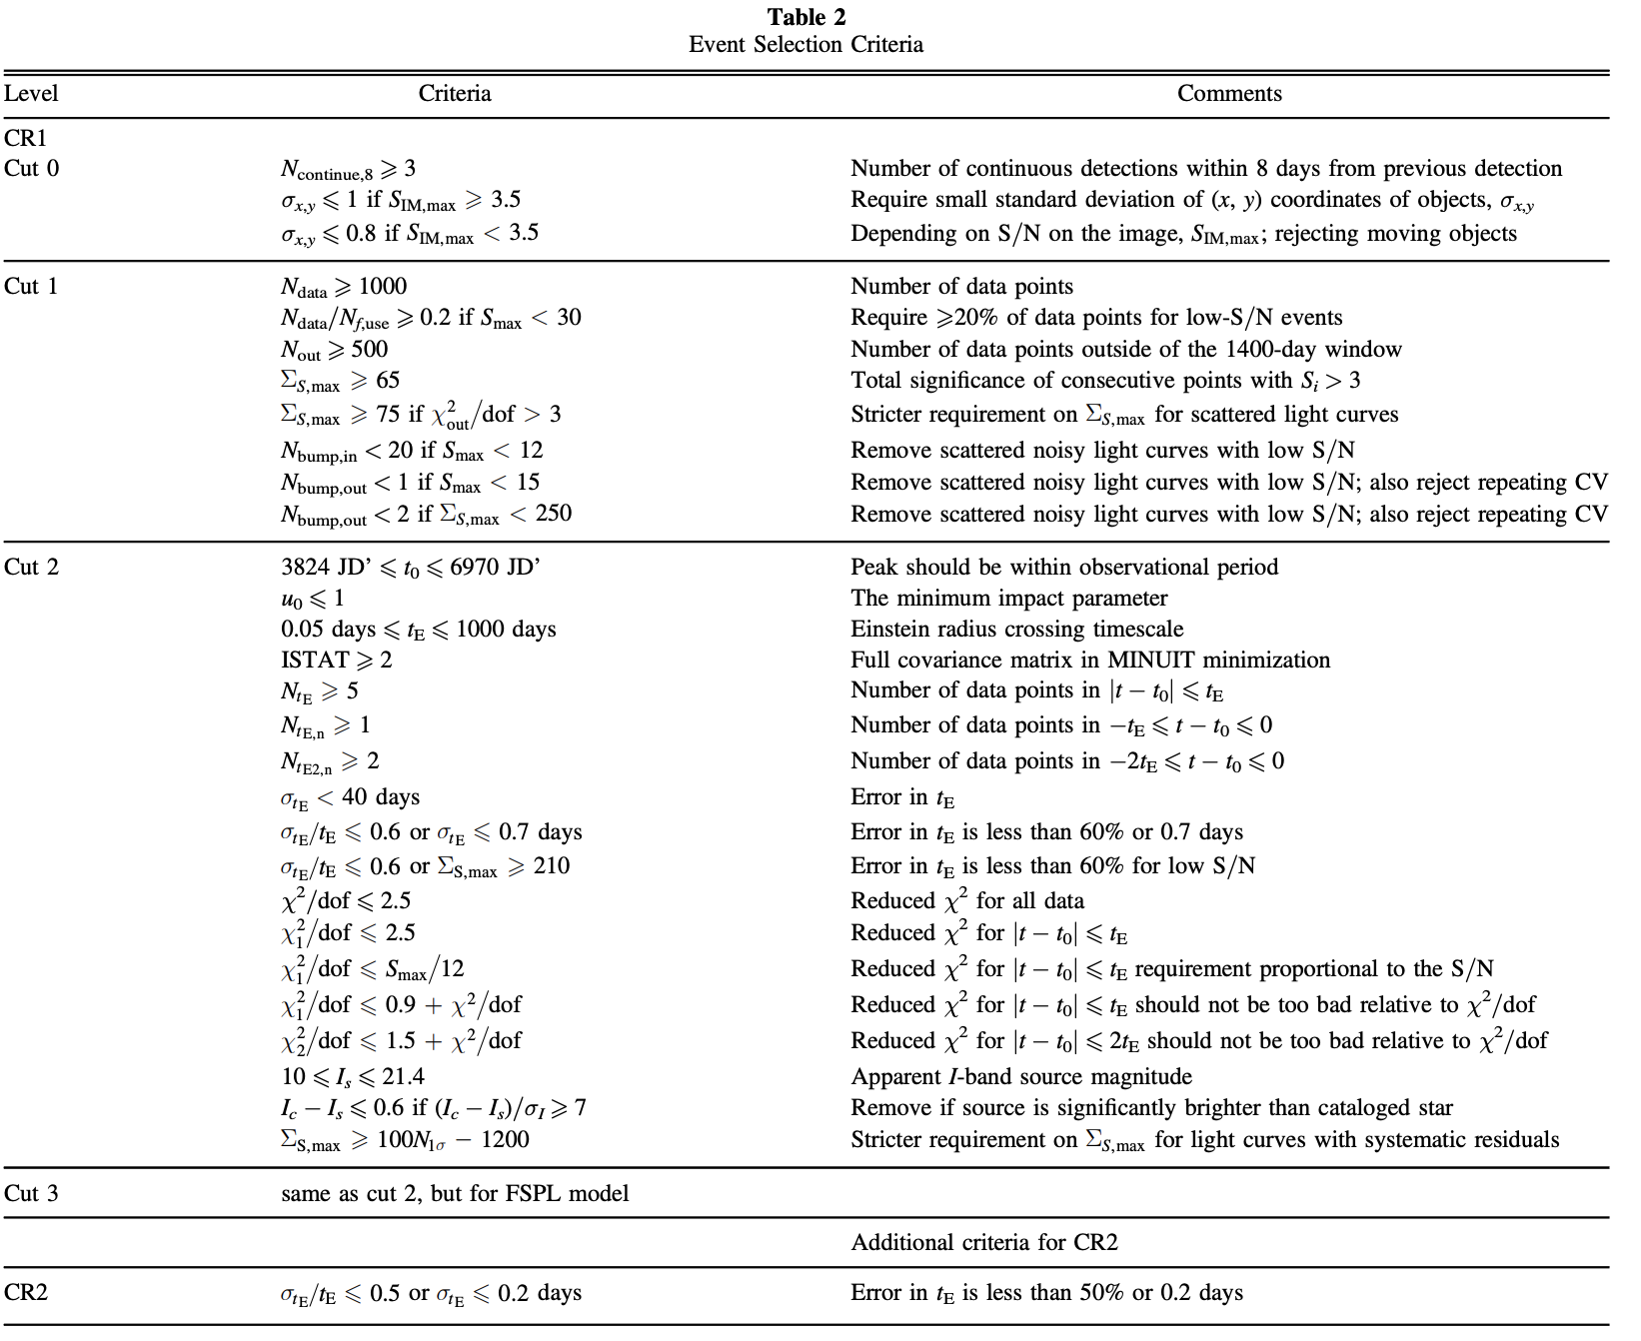

Slide 28
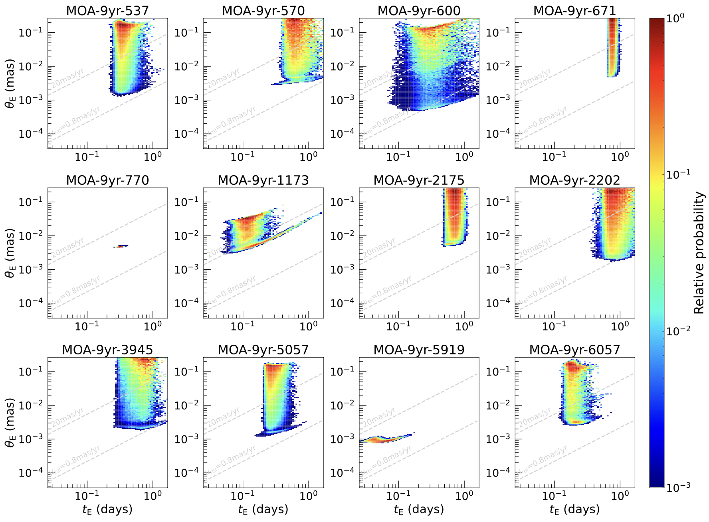

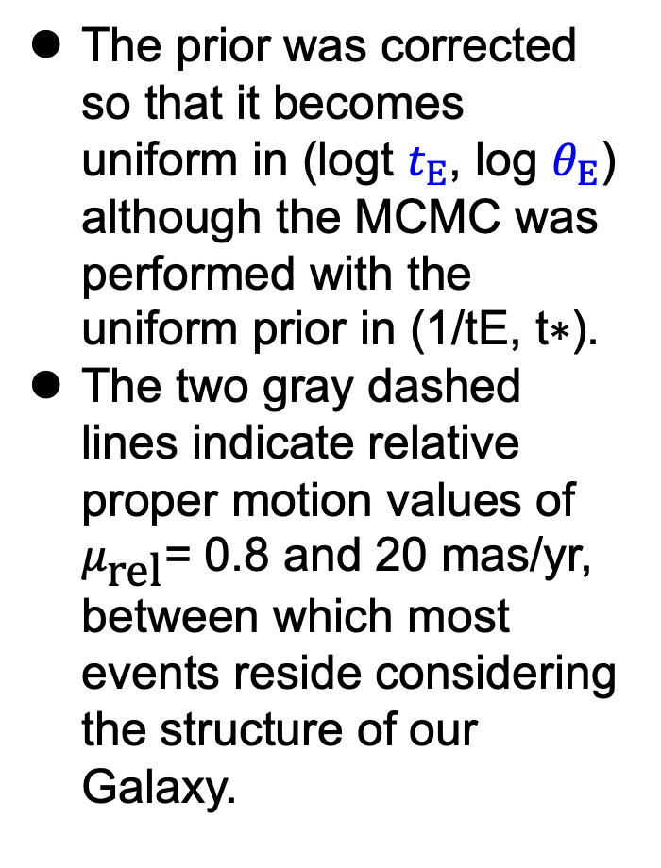
Marginalized posterior distributions of ($t_{E}$,$θ_{E}$) calculated using MCMC for 12 short timescale events with $t_{E}<$1 day
The prior was corrected so that it becomes uniform in (logt $t_{E}$, log $θ_{E}$) although the MCMC was performed with the uniform prior in (1/tE, t∗).
The two gray dashed lines indicate relative proper motion values of $μ_{\text{rel}}$= 0.8 and 20 mas/yr, between which most events reside considering the structure of our Galaxy.
Notes:
1

Slide 29
Galactic model
(Koshimoto+21, ApJ, 917, 78)
Data
Model
- Fitted to distributions of
1. Disk velocity (Gaia DR2, Katz+18)
2. Bulge RCG count (OGLE-III, Nataf+13)
3. Star & μlens count (OGLE-IV, Mróz+19)
Data
Model
4. Proper motion (VVV, Clarke+19)
4. Proper motion (VVV)
5. RV (BRAVA, Rich+07)
6. t_{E} (OGLE-IV, Mróz+17, 19)
1. Disk velocity (Gaia DR2)
2. RCG count (OGLE-III)
Data
Model
5. RV (BRAVA)
6. OGLE-IV t_{E} distribution
Mróz+17
Model
3. Star & μlens count (OGLE-IV)
N_{eve}(t_{E})
Mróz+19
Model
Notes:
So, motivated by that, we updated the Galactic model by fitting to these 6 data-sets here, including Gaia DR2 velocity data and OGLE-IV microlensing data.
I don’t explain all of them, but I believe that the Galactic model is significantly improved.
I have my code for microlensing simulation using this model public, and my poster online explains about it. So please see my poster if you are interested in.

Slide 30
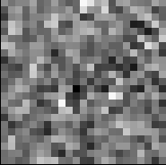
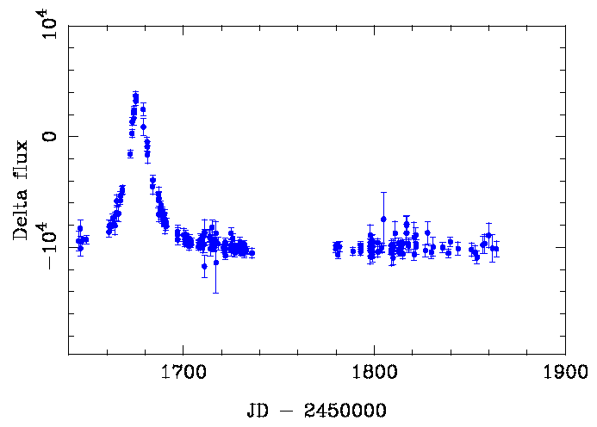
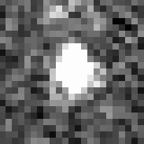
Simulation
Put artificial events on real images
Subtracted image
Sampling
noise
Artifacts
Nearby bright star,
Nearby variable star
Nearby high proper motion star
Differential refraction
Art image

Slide 31









Likelihood analysis in (t_{E},θ_{E})
likelihood:
Mass function:
Notes:
1.5

Slide 32






Likelihood analysis for FFP mass function
Model the observed distribution by
  Detection efficiency
  + Stellar density and velocity distributions in our Galaxy (NK et al. 2021)
+ Mass function
$$M^{−1.32} (0.86<M/M_{⊙}<120)$$
$$\frac{dN}{dlog M}∝$$
$$α_{PL}$$
$$M^{−0.13} (0.08<M/M_{⊙}<0.86)$$
$$M^{−α_{BD}} (3×{10}^{−4}<M/M_{⊙}<0.08)$$
$$\frac{dN_{PL}}{dlog M} = Z_{PL}{\left(\frac{M}{8 M_{⊕}}\right)}^{−α_{PL}} ({10}^{−7}<M/M_{⊙}<0.02)$$
$$\log{Z_{PL}}$$
Result from MCMC
$$α_{BD}=−{0.58}_{−0.16}^{+0.11}$$
$$α_{PL}={0.96}_{−0.27}^{+0.47}$$
$$Z_{PL}={2.18}_{−1.40}^{+0.52} dex^{−1}star^{−1}$$
$$α_{BD}$$
$$α_{PL}$$
$$\log{Z_{PL}}$$
Notes:
To derive the FFP mass function, we modeled the observed

Slide 33




Background: Short Binary Events
Wide-binaries (d = 2.2, 1.2) with planetary and brown dwarf mass ratios of q = 0.013 and 0.047
Notes:
1/8

Slide 34


Background: CV or moving objects
flares
Moving object
Moving object
a CV gives a poor microlensing fit, often with low magnification and an unphysically bright source
Moving object gives symmetric but unphysical microlensing fit, often with low magnification and an unphysically bright source
Notes:
1/8

Slide 35


Notes:
So, motivated by that, we updated the Galactic model by fitting to these 6 data-sets here, including Gaia DR2 velocity data and OGLE-IV microlensing data.
I don’t explain all of them, but I believe that the Galactic model is significantly improved.

Slide 36

Formation Scenarios
Gas cloud collapse similar to
star formation (sub brown dwarf)
  probably FFP found by NIR imaging (JWST)
2. formed around a host star and scattered out from orbit
  planet-planet gravitational scattering (e.g., Rasio & Ford 1996 )
  Hot jupiters orbiting hot stars have high obliquities （Winn et al. 2010, Triaud et al. 2010）
  Hot jupiters are alone (Latham et al. 2011)
  stellar flybys (e.g., Malmberg et al. 2011),
  binary host stars (e.g. Cheng et al. 2023),
  end stages of stellar evolution
  (e.g., Adams et al. 2013).
Notes:
1

Slide 37


Slide 38









How to derive the PDF of M_{L} & D_{L}
Microlens is reflected the galactic structure
Galactic model
(e.g., Han & Gould 1995)
Density distribution
Mass function
Velocity distribution
D (kpc)
M (M_{sun})
μ (mas/yr)
D_{L}
M_{L}
μ
(= $\frac{v_{t, L}−v_{t,⊙}}{D_{L}} −\frac{v_{t, S}−v_{t,⊙}}{D_{S}}$)
Example of PDF of M_{L} & D_{L}
If consistent with observed t_{E}
1σ: 0.12-0.51 M_{sun}
2σ: 0.06-0.90 M_{sun}
M_{L} (M_{sun})
D_{L} (pc)

Slide 39

Pascucci et al. 2018

Slide 40
OGLE-IV results
Mróz+2017
Jupiter mass lenses :
~0.05 x Main sequence
<1/4 of Main sequence
Six ultra short events
With t_{E} ~ 0.2days
Super Earth FFP?

