Slide 1
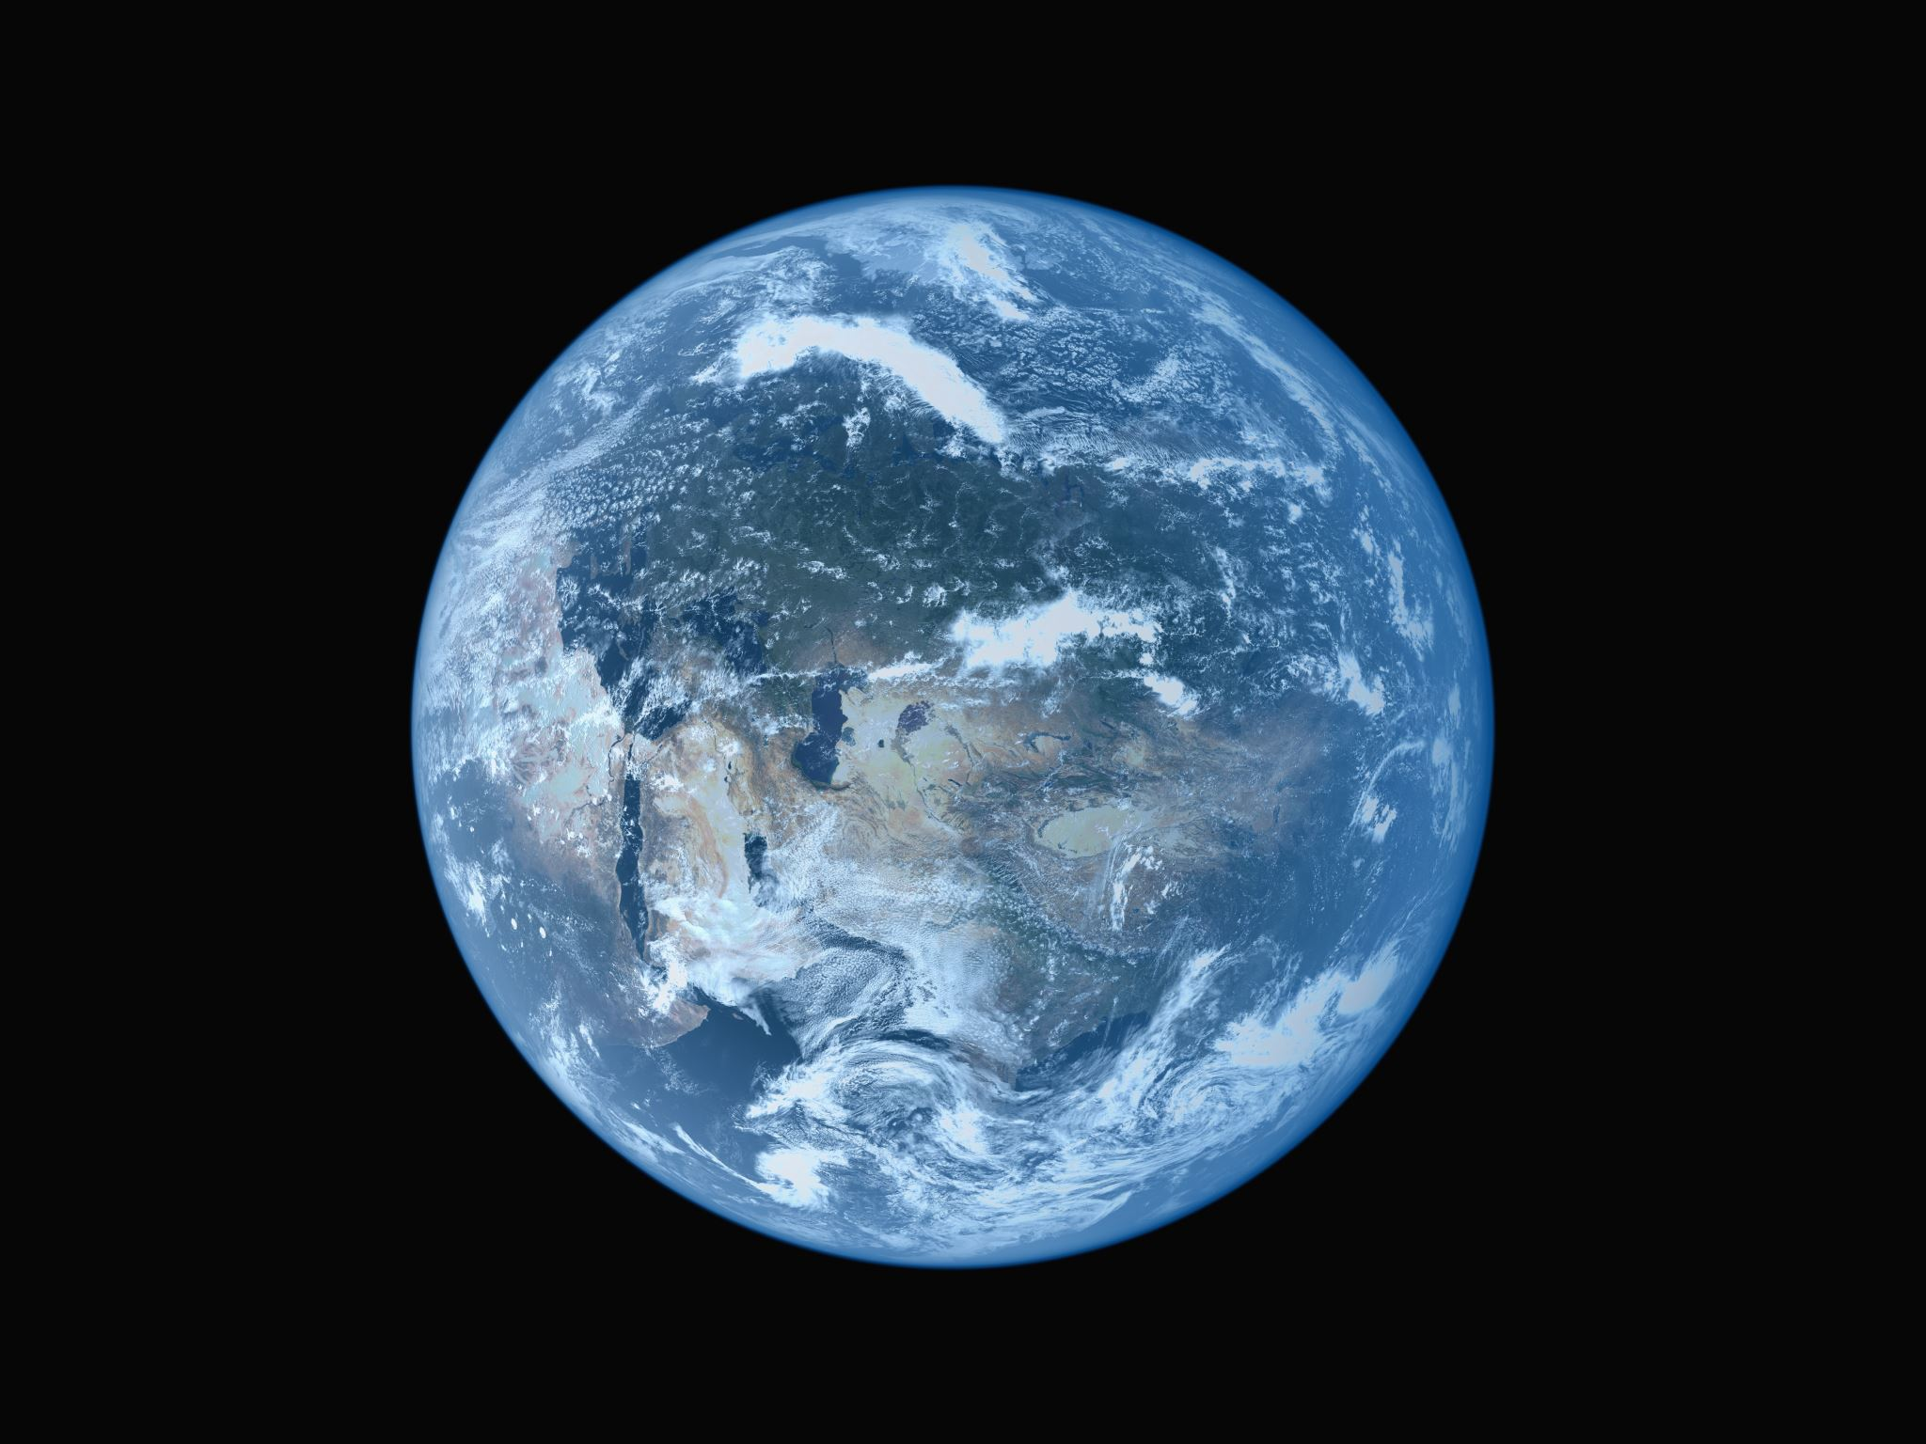
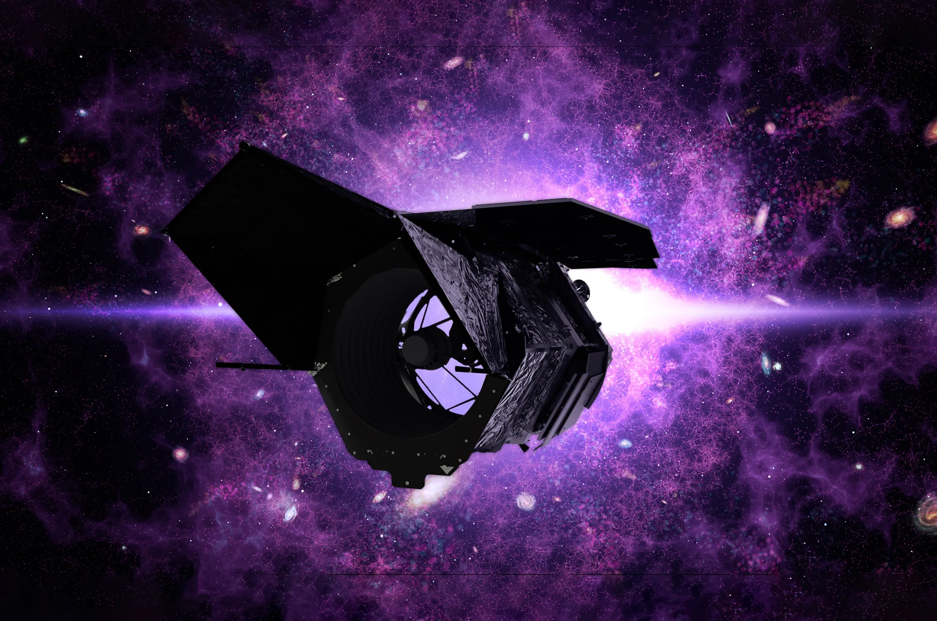
Testing Planet Formation with Roman
Eve J. Lee (McGill)

Slide 2
Unique capability of Roman
The only mission (in the foreseeable future) capable of probing rocky planets at intermediate distances
Can probe the bottom of planet mass function and mass function vs. orbital distances
Zhu & Dong ‘21

Slide 3
EJL, Karalis & Thorngren ‘22
EJL & Chiang ‘15
$$\frac{M_{gas}}{M_{core}} \sim 0.06 {\left(\frac{t}{1 Myr}\right)}^{0.4}{\left(\frac{M_{core}}{{5M}_{⨁}}\right)}^{1.7}{\left(\frac{0.02}{Z}\right)}^{0.4}$$
Core mass critically determines the initial gas content of the planet
Rogers & Owen ‘21
Driven by gas content
$$\dot{M}=−η\frac{πR_{p}^{3}F_{XUV}}{GKM_{p}}$$
Post-formation mass loss and cooling also determined by planet mass

Slide 4
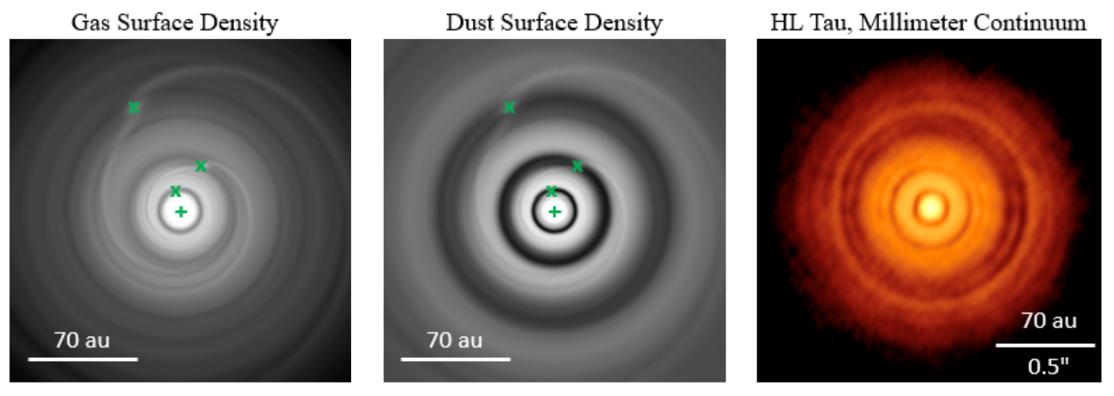
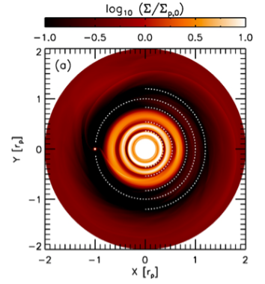
Prediction: wide-orbit planets
Depends on the level of diffusive turbulence in gas!
1 Neptune; Bae+ ‘17
3 Saturns; Dong+ ‘15
Potentially GI (A. Boss)
Bae et al. ‘23 (PPVII)
For many of the sub-structures, no conclusive & unique evidence of planet
Speedie & Dong ‘22
Disputed except for PDS 70 bc

Slide 5
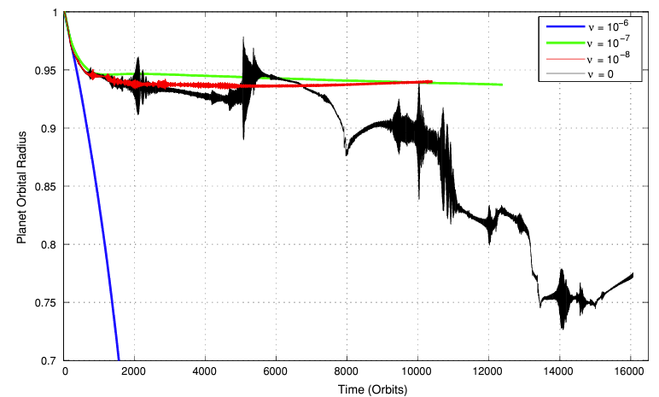
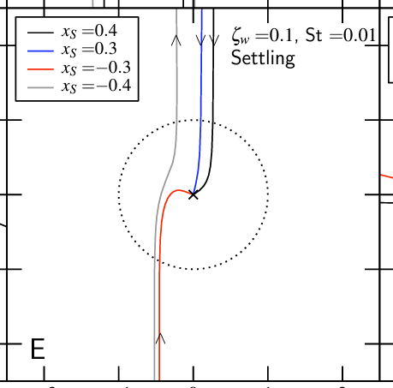
Prediction: mass function
Gas disk evolution
Unknown turbulent viscosity
Suzuki+ ’18
$$\dot{Σ}=\frac{3}{r}\frac{∂}{∂r}\left[r^{1/2}∂_{r}\left(υΣr^{1/2}\right)\right]−{\dot{Σ}}_{wind}$$
Solid disk
Radial drift depends
on unknown
Stokes number
Yu+ ‘10
Aerodynamic drag also determines initial core growth rate
Migration reduces/halts at low viscosity
Ormel & Klahr ‘10

Slide 6
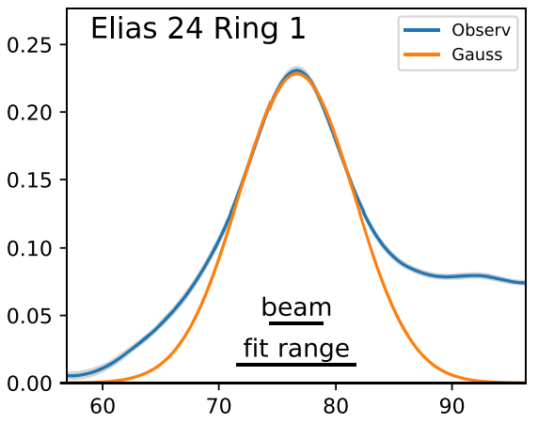
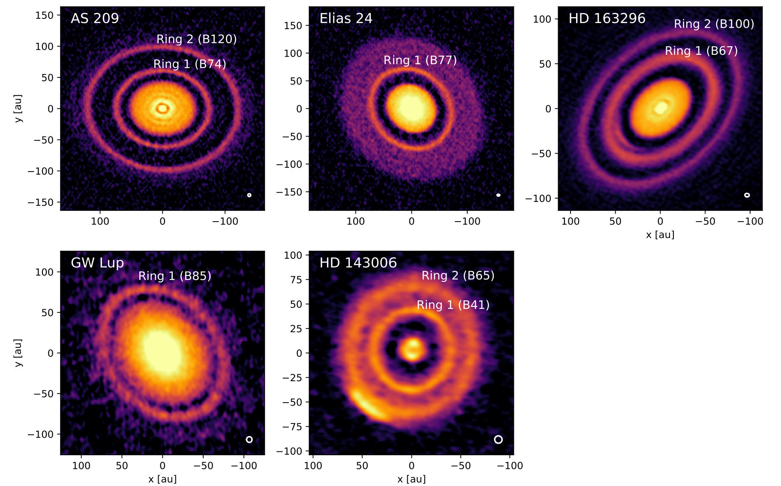
Ringed disks: St and alpha
Dullemond et al. (2018)
Diffuse by turbulence
Intensity
Collect by drag
R (au)
Relative strength between diffusion and drag
Dust ring width
$$w_{d}=w{\left(1+\frac{St}{α}\right)}^{−1/2}$$
Width of pressure bump
~ gas disk scale height

Slide 7
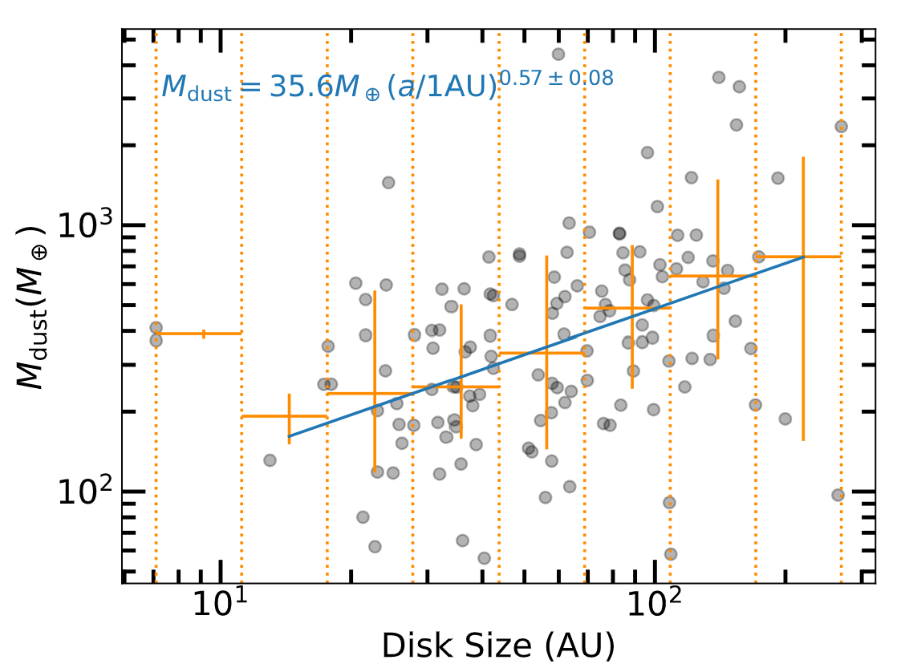
A toy model
EJL (2024)
Data from Tobin et al. (2020)
Since $\frac{St}{α}$ is measured, we can also separate the two variables!
Andrews+18, Dullemond+18
$$M_{dust}∝R^{0.57}$$
Should equate to the observed ring dust mass at a given age so we can compute $\left[α+\frac{2}{3}\left|γ\right|St\right]$
Ring dust mass from continuum flux
Aerodynamic drag
$$\dot{R }\sim −\frac{3}{2}{\left(\frac{c_{s,r}}{v_{k,r}}\right)}^{2}v_{k,r}\left[\frac{α}{1+{St}^{2}}+\frac{2}{3}\left|γ\right|St\right]$$
$M_{ring}\left(R_{0}\left(t\right)\right) \sim 35.6M_{⨁}ε_{trap}\left[{\left(\frac{R_{0}(t)}{1 AU}\right)}^{0.57}−{\left(\frac{R_{r}}{1 AU}\right)}^{0.57}\right]$
Coupled to gas accretion
~0.6-0.8 (EJL, Fuentes & Hopkins 2022)

Slide 8
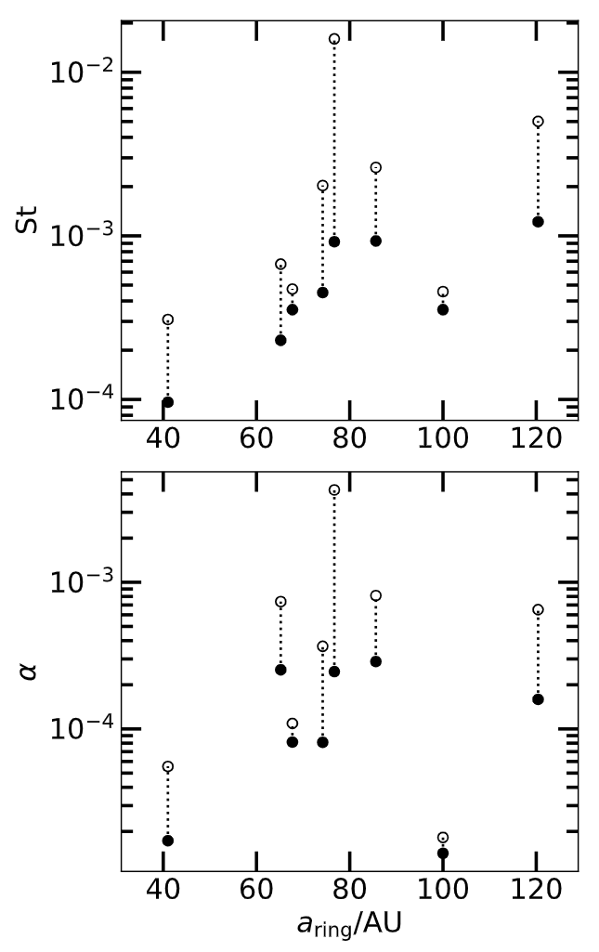
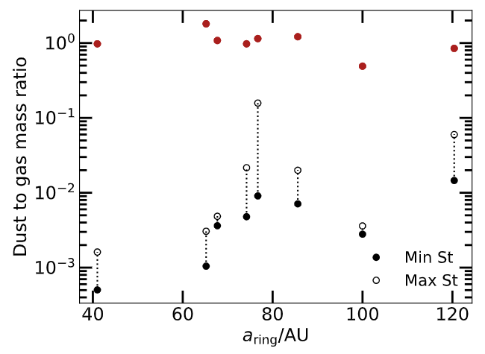
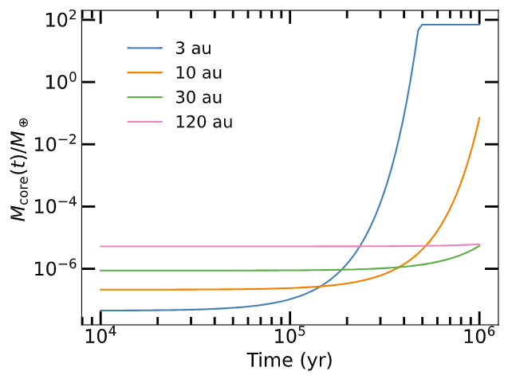
EJL (2024)
Critical value for clumping
Li & Youdin ‘21
For the level of turbulence, particles are too well-coupled to gas; hard to clump
Even if there is a chance of clumping, the clump would barely grow beyond 10 au
Minimal migration expected
Core growth accelerates inside 10 au

Slide 9
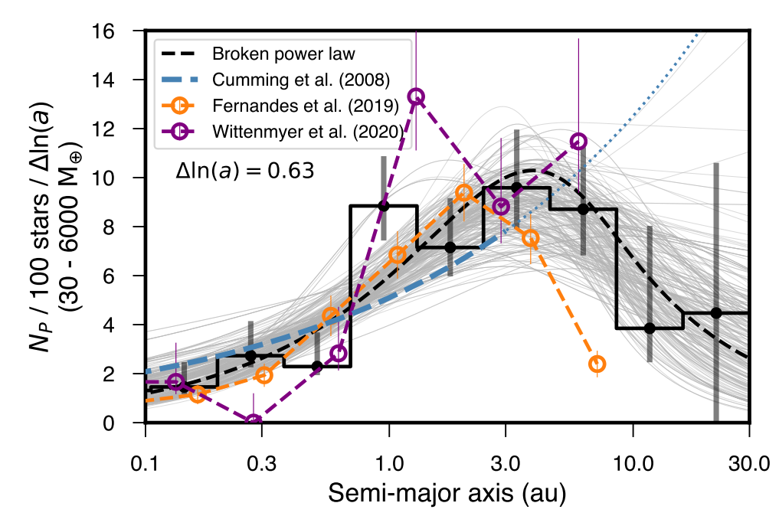
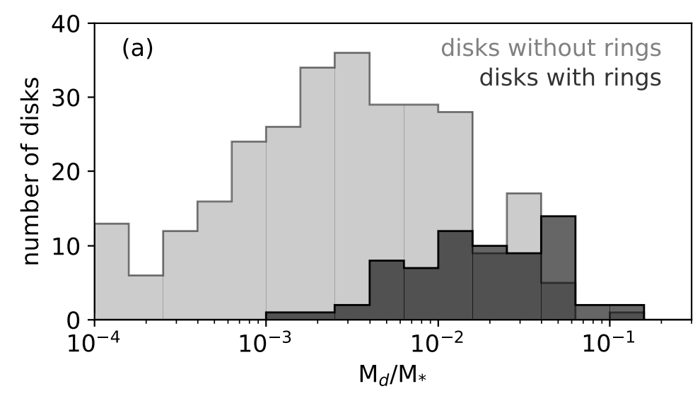
Roman-ALMA connection
Both St, and turbulent alpha tend to be low
Large-scale dusty rings either stable against clumping or very inefficient at generating planets
Consistent with the gas giant fall-off beyond ~10 AU
If there were inner substructures, they may have quickly been transformed into planets
We may see this fall-off even for smaller planets
Bae et al. PPVII
Fulton et al. (2021); see also Nielsen+19

Slide 10
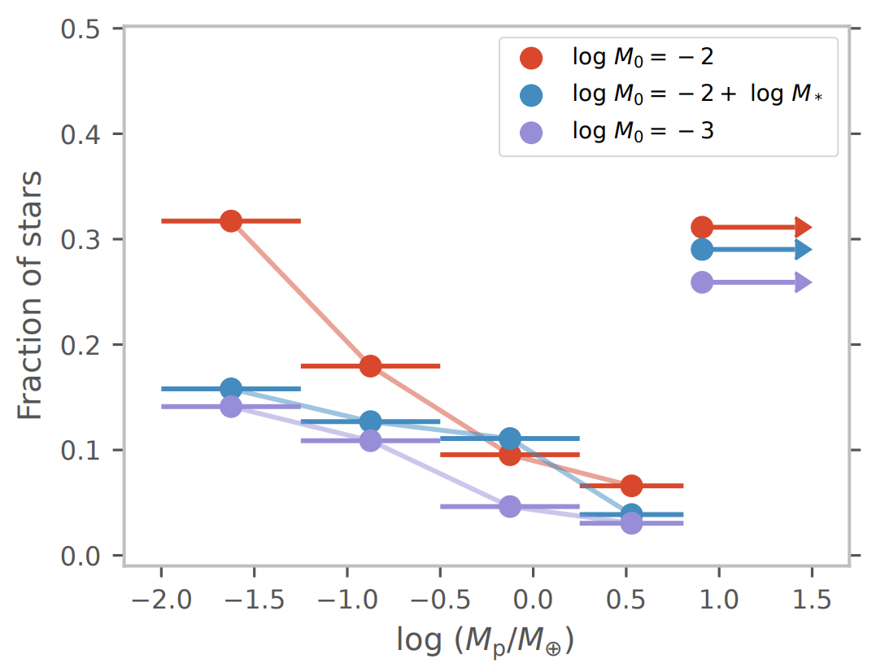
Fraction of stars with M_{p} = efficiency x disk mass function
Merger by orbital instability: gap in mass function
<10%
(Chachan & EJL ’23)
Data from Manara+ PPVII
1-10 au
Chachan & EJL (in prep)
Large initial seeds
Initial seeds tightly spaced:
unstable at lower mass
Small initial seeds
Initial seeds widely spaced:
unstable at higher mass

Slide 11
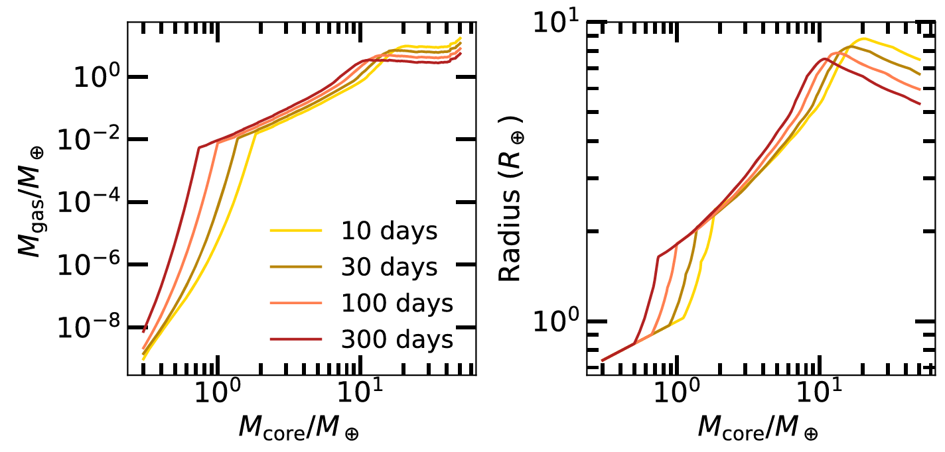
EJL, Karalis & Thorngren ‘22
Hydrodynamics
$$\frac{M_{gas}}{M_{core}} \sim 0.06 {\left(\frac{t}{1 Myr}\right)}^{0.4}{\left(\frac{M_{core}}{{5M}_{⨁}}\right)}^{1.7}{\left(\frac{0.02}{Z}\right)}^{0.4}$$
Break in mass function
Thermodynamics
More metal-rich, harder to cool, break at higher mass
Pollack et al. (1996)
RHill
Large power to keep the massive gas from collapsing
That accelerates cooling and therefore gas accretion!

Slide 12
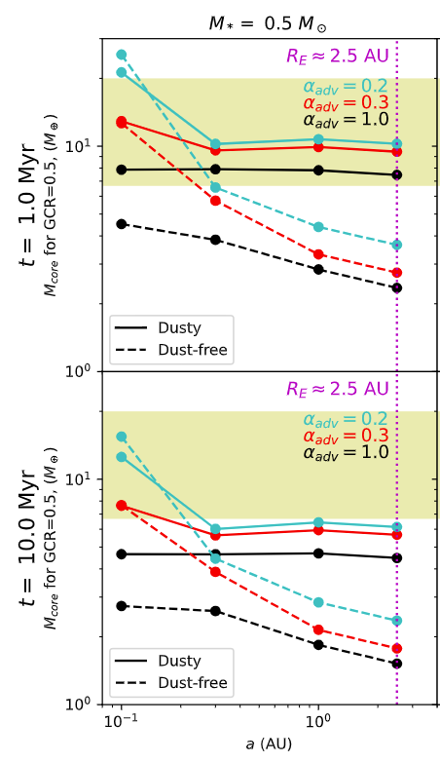
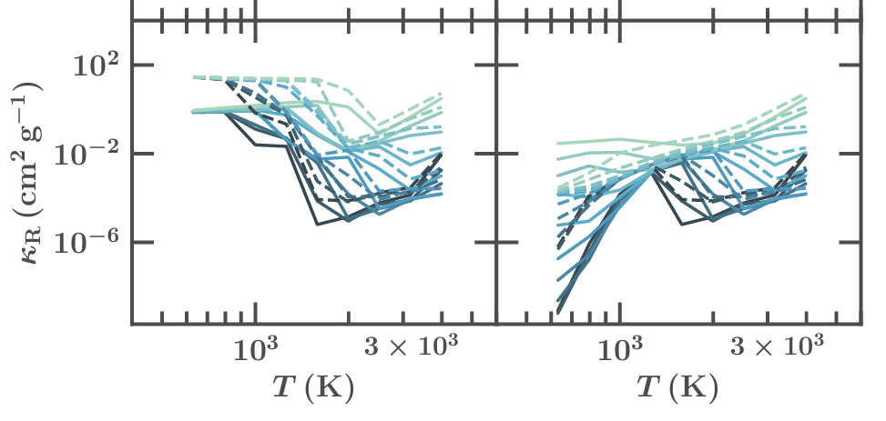
Savignac & EJL ‘23
Colder: freezing out of internal modes
EJL, Chiang & Ferguson ‘18
Colder: lower opacity
Roman-JWST connection
Best chance to distinguish different planet composition at intermediate distances
Precise measure of break in planet mass function to constrain typical composition of gas accreted onto planets

Slide 13
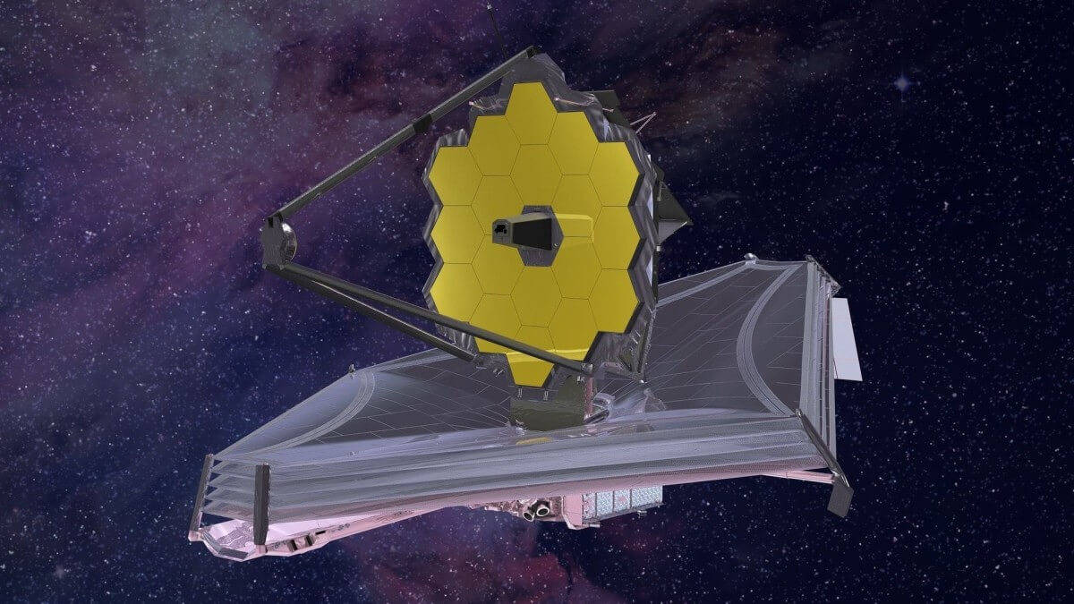
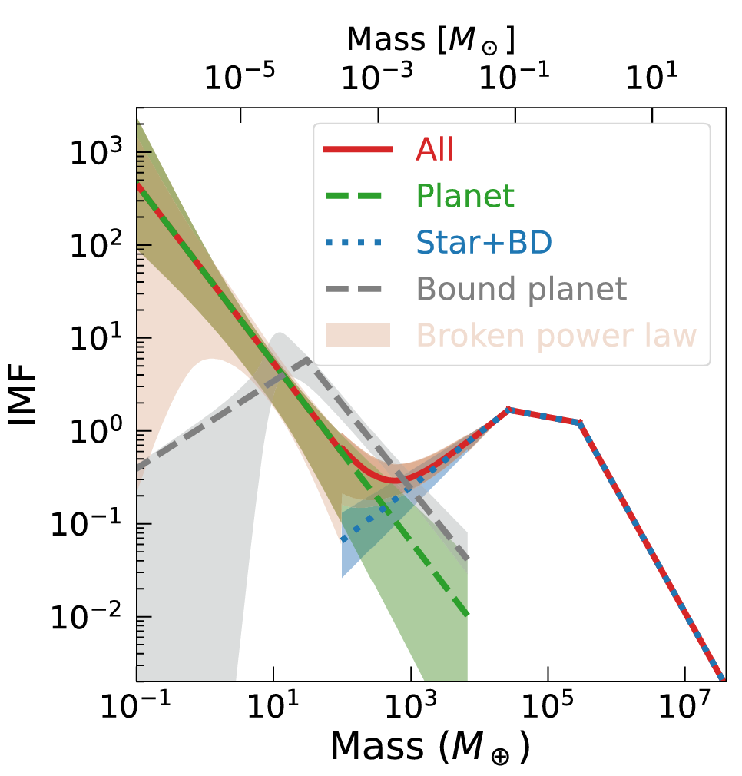
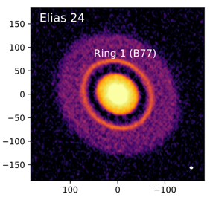
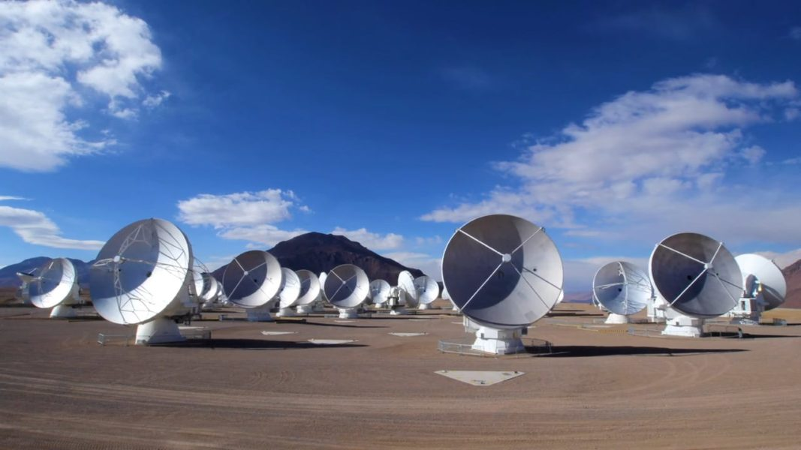
Break in mass function: composition
Constraining initial state of planetary systems
Break at higher mass: more pollution / higher metallicity
Chachan &
EJL (in prep)
Sumi+ ’23
Dullemond et al. (2018)
Mass function vs. orbital distance
Steeper: higher initial seed mass
Drop in <Neptune population expected beyond 10 au:
Ringed disks represent typical planet-forming disks
Gap in mass function expected. Higher mass: wider initial separation

