Slide 1

The Tip of Red Giant Branch-based Distance Method in the Era of Infrared Space-based Telescopes
Empirical Calibrations with:
the Hubble Space Telescope
the JWST
the Nancy Grace Roman Observatory
Max J. B. Newman
Challenging Theory with Roman:
From Planet Formation to Cosmology
7.11.24
Notes:
Hello! My goals for the next 12 minutes are as follows:
Emphasize the importance and fundamentality of measuring distances to galaxies
Introduce the Tip of the Red Giant Branch (TRGB) distance method
Present our empirical calibration methodology and results in HST and JWST photometric filters
Demonstrate the significant prospects for robust and precise TRGB calibrations in Roman data

Slide 2
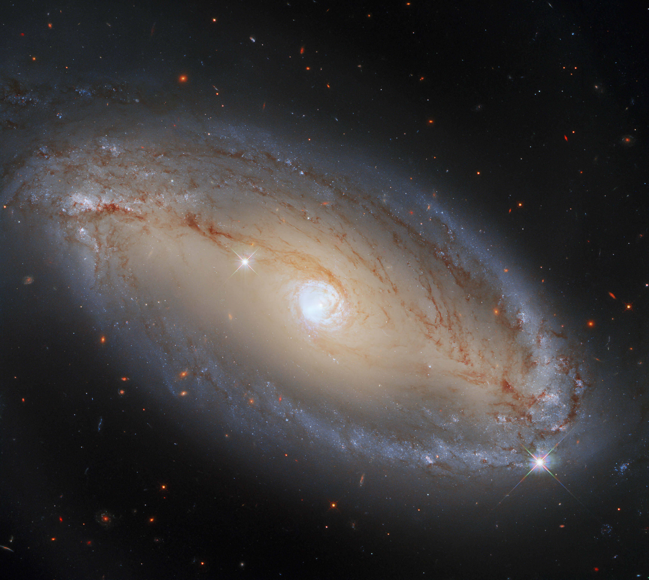
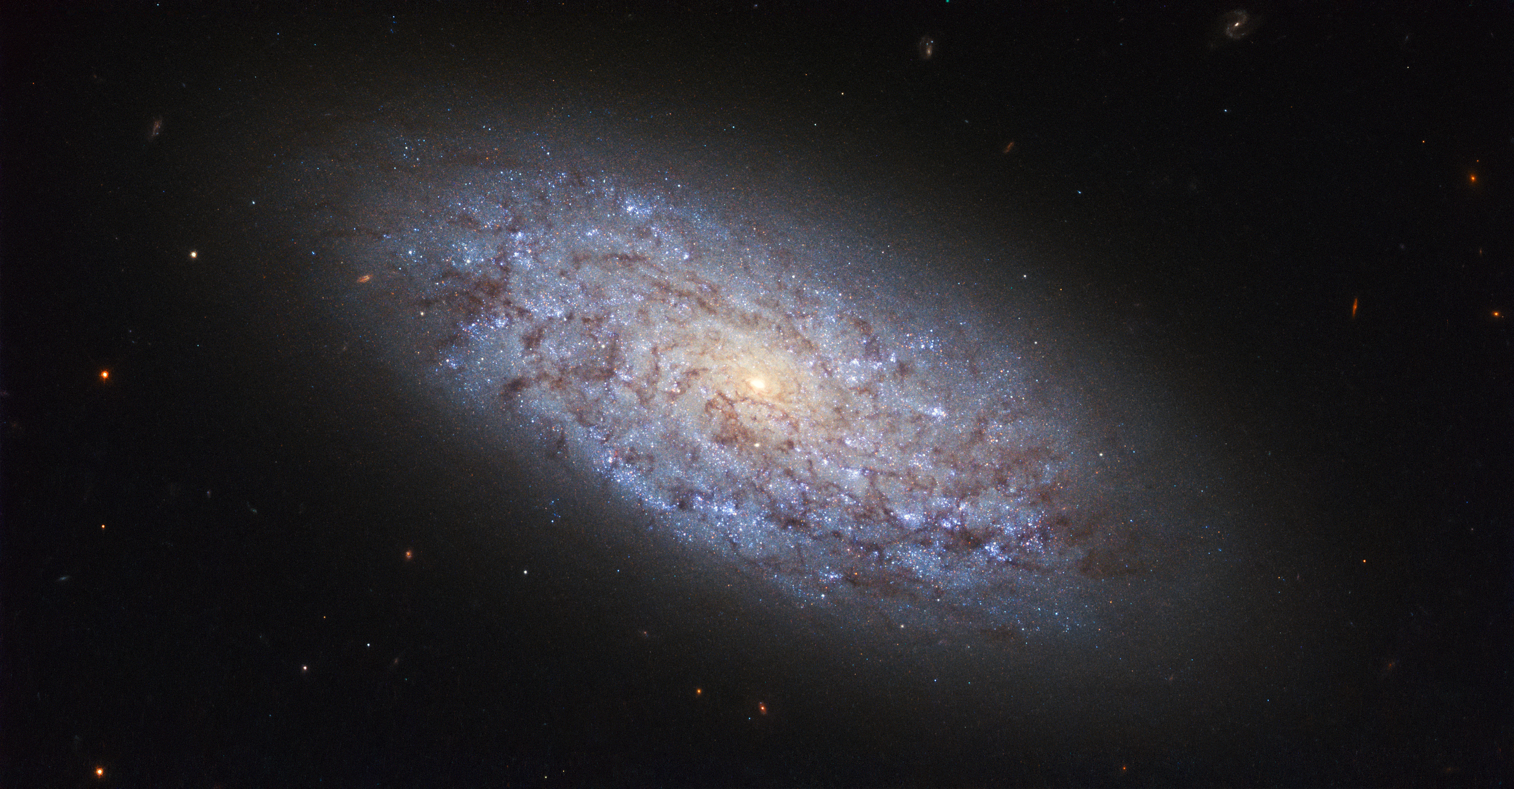
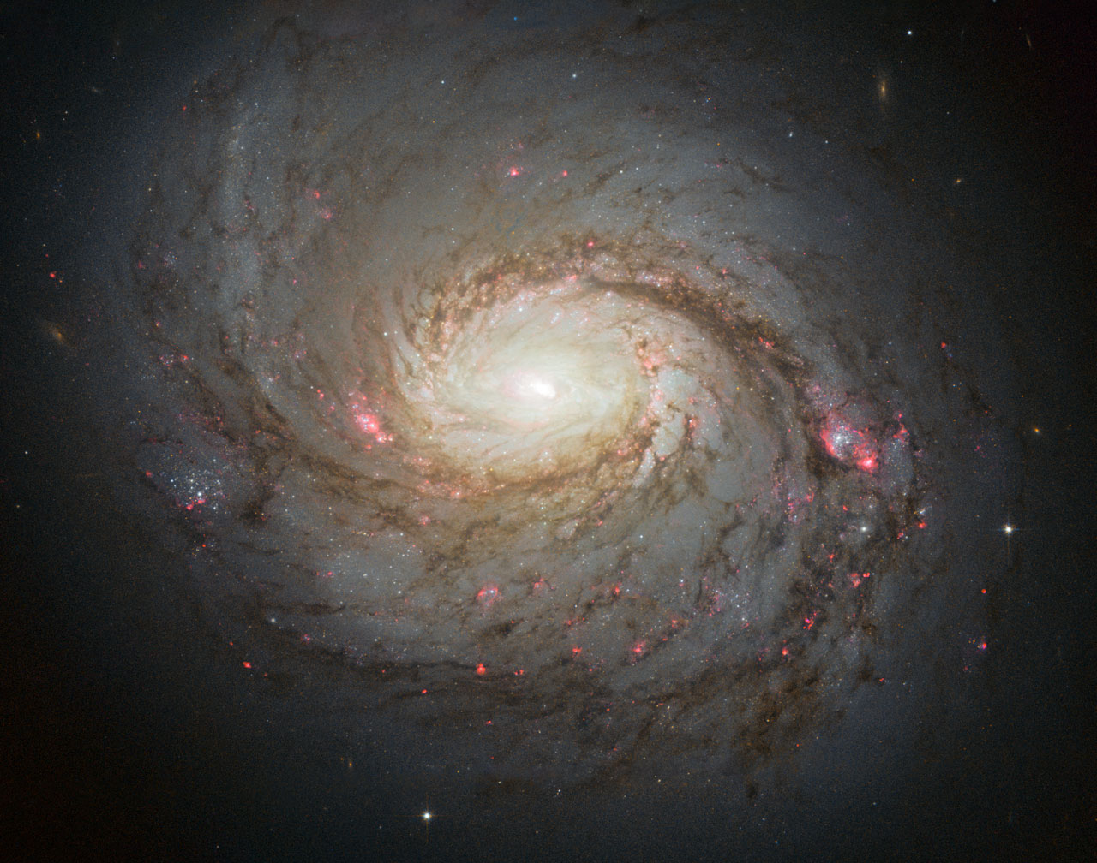
Distances to Galaxies are a Fundamental Measurement
Credit: ESA/Hubble & NASA
Image credit: ESA/Hubble, A. Riess et al., J. Greene
Credit: NASA, ESA & A. van der Hoeven
Notes:
Many if not all of us require distance measurements to objects to compare their properties on absolute scales.
As an example let’s take three different galaxies as shown here. We can say that they are spiral galaxies that appear different from each other.
However, we cannot quantitatively compare for example their masses, star formation rates, or spatial scales and myriad additional properties on absolute scales without knowing their distances.

Slide 3
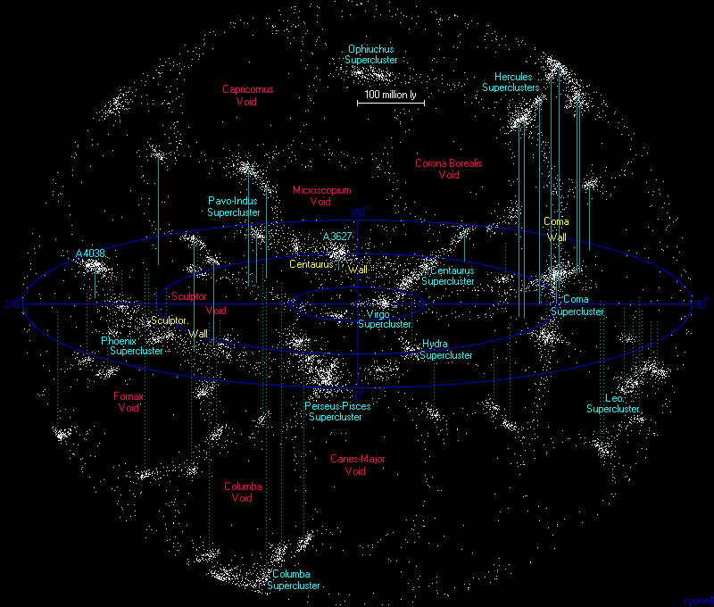
Distances to Galaxies are a Fundamental Measurement
http://www.atlasoftheuniverse.com/superc.html
Notes:
In a similar vein, this figure shows a collection of some of the nearest superclusters to Milky Way. Importantly distances to the galaxies were required to reveal meaningful structure.

Slide 4
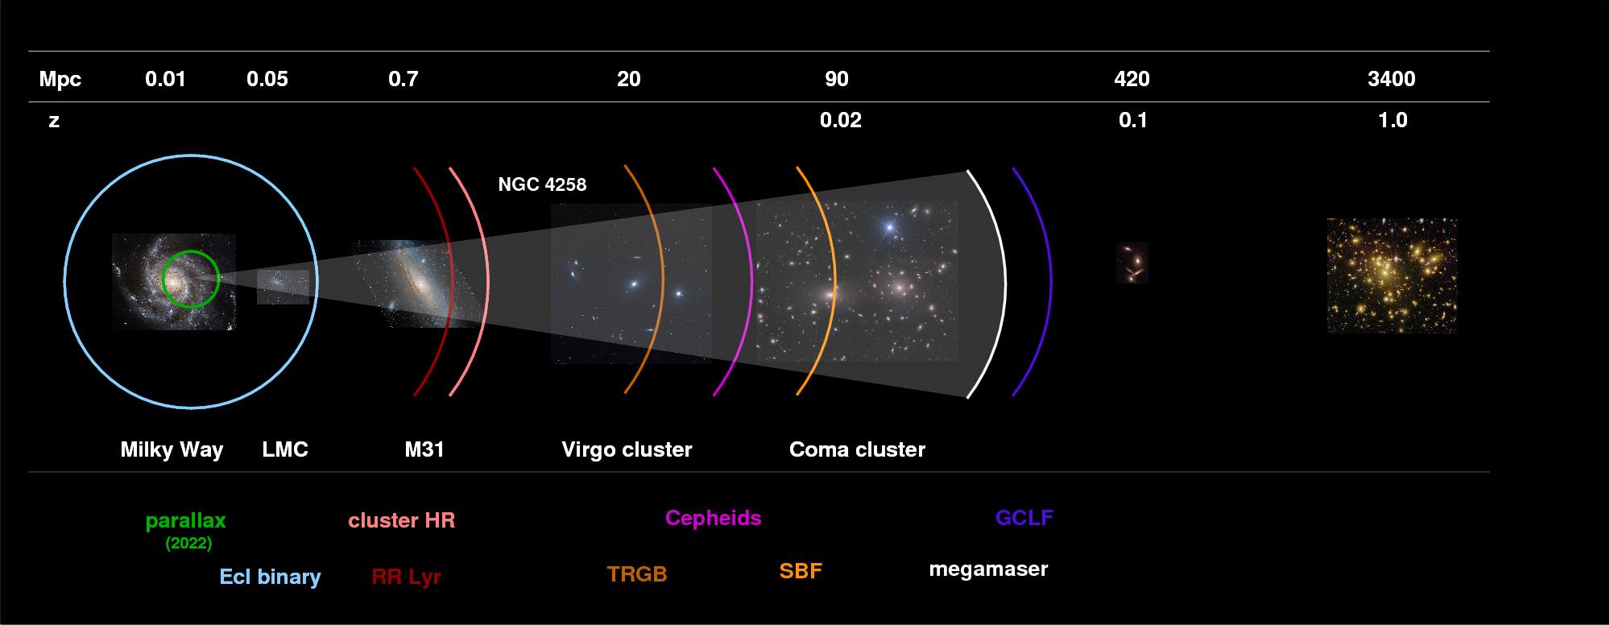
Distance Measurement Methods are Scale Dependent
Distance away from our Galaxy
http://spiff.rit.edu/classes/ladder/lectures/distant_gal/distant_gal.html
Notes:
The process of measuring distances to galaxies, however, is highly scale dependent. To clarify the different distance scales we can look at this figure.
Distances, indicated in redshift and Mpc at the top, start from the Milk Way and increase to the right.

Slide 5
Distance Measurement Methods are Scale Dependent
Distance away from our Galaxy
Redshift-based distances
peculiar velocities contribute < 1% statistical uncertainty
Peterson+2022
http://spiff.rit.edu/classes/ladder/lectures/distant_gal/distant_gal.html
Notes:
We can first focus on scales at and beyond a redshift of 0.1 or beyond 400 Mpc.
At these distances the dominant velocity is that due to the expansion of the Universe.
As such, redshift-based distances beyond a redshift of 0.1 are a reliable way to measure distances to galaxies.

Slide 6
Distance Measurement Methods are Scale Dependent
Distance away from our Galaxy
Redshift-based distances
peculiar velocities contribute 10% statistical uncertainty
Peterson+2022
http://spiff.rit.edu/classes/ladder/lectures/distant_gal/distant_gal.html
Notes:
However within a redshift of 0.1, that is, closer to our own Galaxy, redshift-based distance can be inaccurate owing to the uncertainties introduced by peculiar velocities.
For more robust and precise distance measurements we can instead use methods that are listed at the bottom of the figure. These methods leverage geometry or properties of stellar populations within extragalactic systems including but certainly not limited to RR Lyrae stars, Cepheid variable stars, and TRGB stars.

Slide 7
Distance Measurement Methods are Scale Dependent
http://spiff.rit.edu/classes/ladder/lectures/distant_gal/distant_gal.html
Notes:
For the rest of this talk I will focus exclusively on the TRGB method.

Slide 8
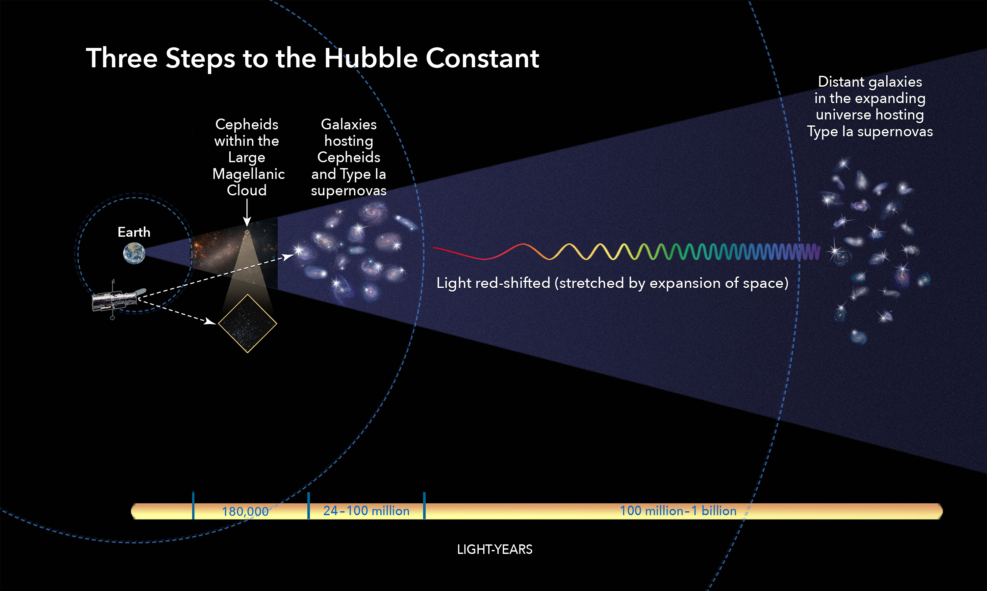
The Cosmological Distance Ladder
TRGB in the Large Magellanic Cloud
Galaxies hosting TRGB and Type Ia Supernovae
Credits: NASA, ESA, and A. Feild (STScI)
Notes:
The TRGB is one of several resolved star based methods that forms the second rung of the 3 run local distance ladder used to measure the Hubble constant.

Slide 9
The Cosmological Distance Ladder
TRGB in the Large Magellanic Cloud
Galaxies hosting TRGB and Type Ia Supernovae
Credits: NASA, ESA, and A. Feild (STScI)
Notes:
First the luminosity of the TRGB is calibrated to geometric distances in the Large Magellanic Cloud and the megamaser galaxy NGC 4258

Slide 10
The Cosmological Distance Ladder
TRGB in the Large Magellanic Cloud
Galaxies hosting TRGB and Type Ia Supernovae
Credits: NASA, ESA, and A. Feild (STScI)
Notes:
Second, TRGB-based distances are measured to nearby galaxies (presently within 20 Mpc) that host Type Ia Supernovae. This steps serves to measure the absolute brightness of Type Ia Supernovae.

Slide 11
The Cosmological Distance Ladder
TRGB in the Large Magellanic Cloud
Galaxies hosting TRGB and Type Ia Supernovae
Credits: NASA, ESA, and A. Feild (STScI)
Notes:
Third, Type Ia Supernovae are observed in the Hubble flow. While this is one major application of the TRGB distance method, it is widely applicable in numerous scenarios as I will touch on later.

Slide 12
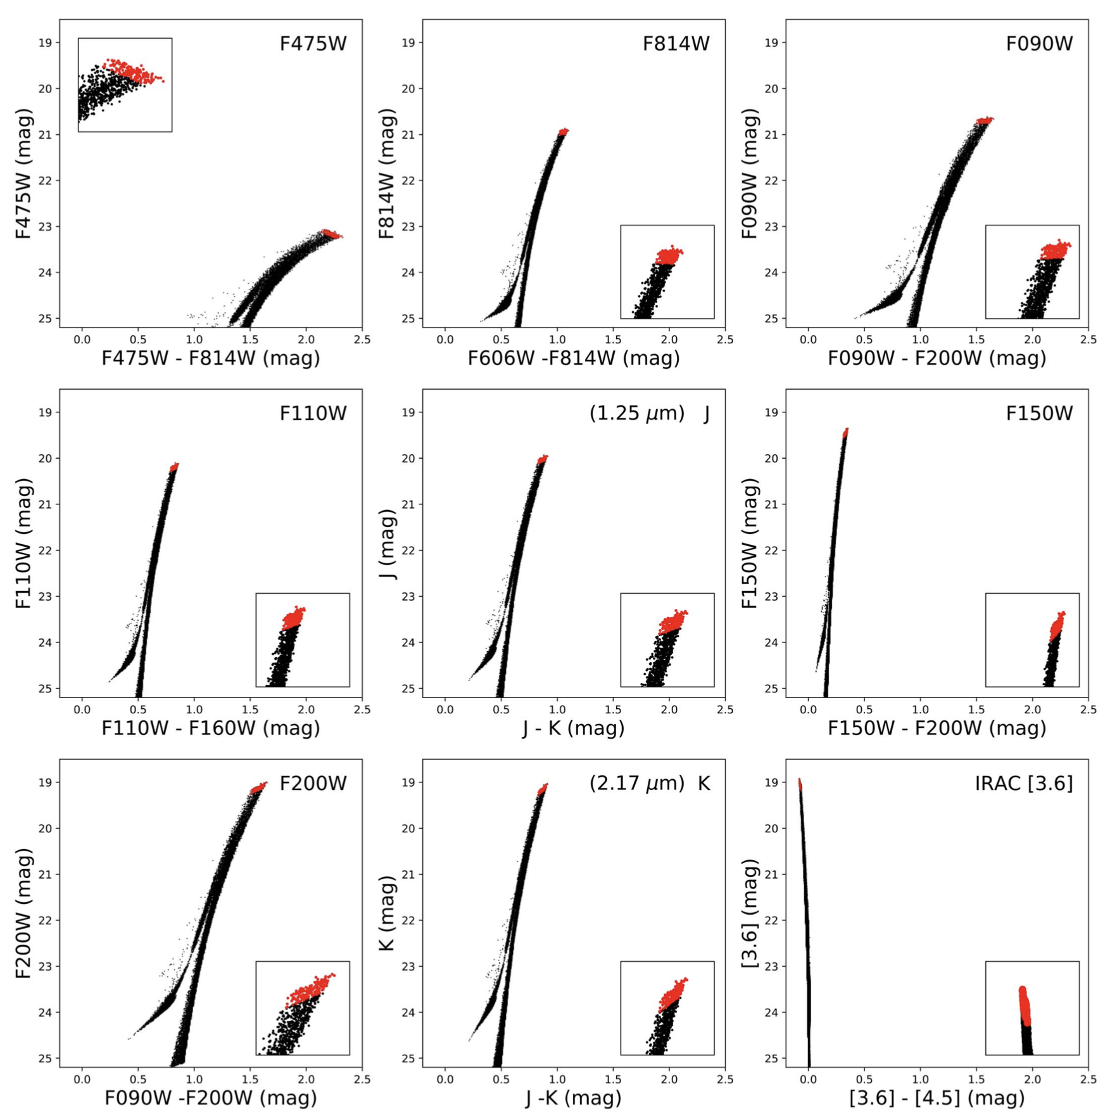
The TRGB from Optical to Near Infrared (NIR) Wavelengths
McQuinn et al. (2019)
Notes:
But what is the TRGB?
Broadly speaking it is an observed feature in a color-magnitude diagram or CMD that appears as a cutoff in the number of red giant branch stars above some brightness. In theory, the absolute magnitude of this cutoff is the same for all TRGB stars.
In practice we observe stars in specific bandpasses and the observed brightness of the stars is dependent on the bandpass.
Here I am showing a synthetic stellar population, specifically the red giant branch. On the left is a CMD with HST F814W filter on the y or magnitude axis. I’ve added a blue arrow to the inset on the bottom right of the CMD to demonstrate the location of the TRGB.
The middle panel is similar but shows the same stars now in the JWST filter F090W.

Slide 13
The TRGB from Optical to Near Infrared (NIR) Wavelengths
McQuinn et al. (2019)
Notes:
When we observe the TRGB in the near-Infrared, the stars appear much brighter.
To the right is again the same population of stars but now shown in the JWST 2micron or F200W filter.
I have added a dotted black line to highlight the changing brightness as a function of wavelength. The height of the line on the y-axis is set to indicate the brightness of the F814W TRGB.
Observationally, the increase in brightness at near-IR wavelengths means that the TRGB can be detected at larger distance than has been previously accessible with the HST F814W filter.
However, there is an important metallicity/age dependence to the brightness of the TRGB that changes as a function of wavelength.

Slide 14
The TRGB from Optical to Near Infrared (NIR) Wavelengths
McQuinn et al. (2019)
Notes:
The metallicity/age dependence is traced by the color of the stars.
In the insets of the left and middle panels that the TRGB is nearly flat as a function of the x or color-axis. The TRGB brightness in the right panel, however, increases as we move to the right on the color axis.
For the TRGB to be a robust and precise distance indicator in the near-IR JWST filters and eventually Roman filters we need a way to characterize this effect.

Slide 15
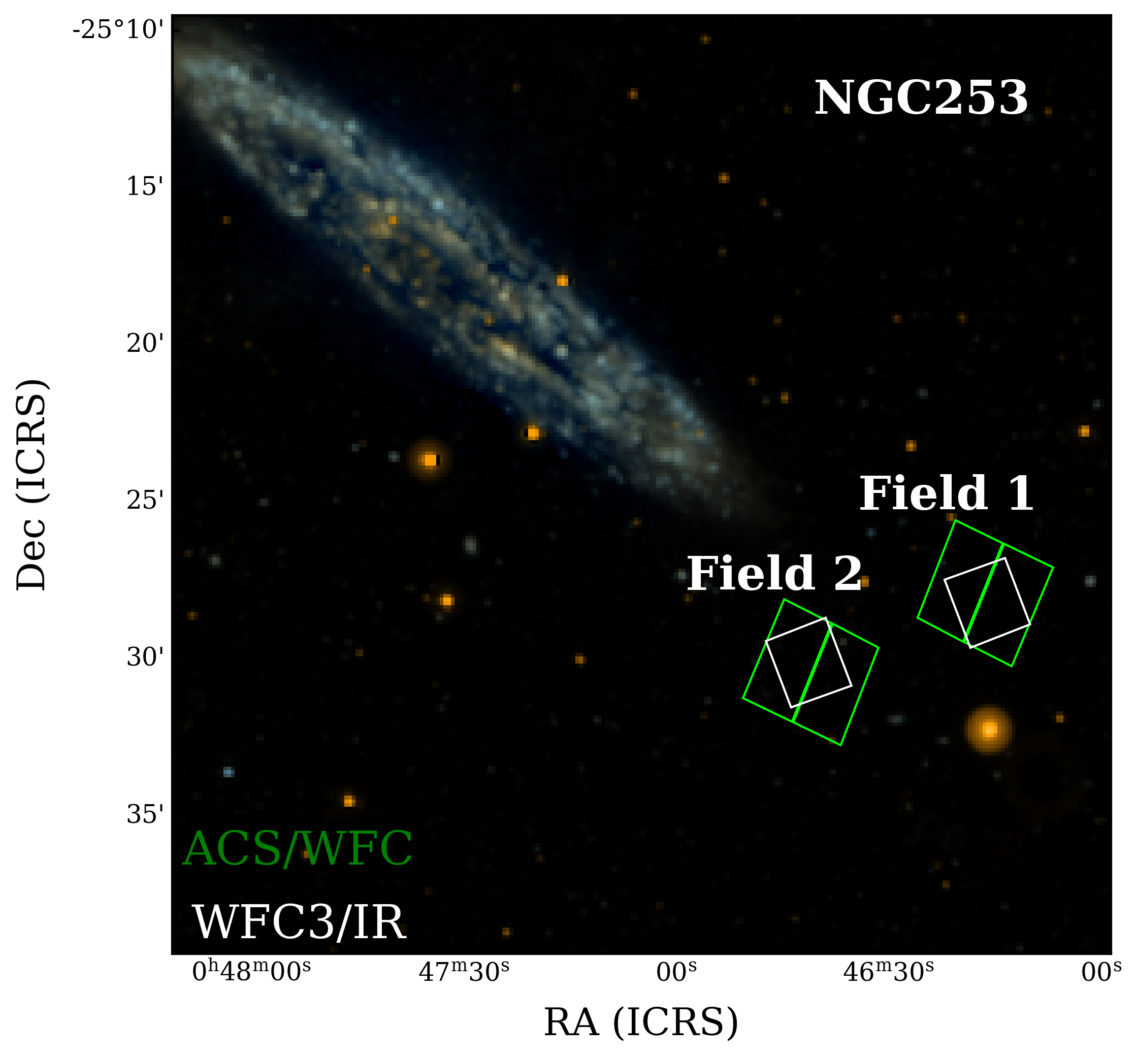
Empirical Characterization of the HST NIR TRGB color-dependence
Representative HST Observing Strategy
Newman et al. (2024a)
Notes:
We have developed a method to account for the color dependence of the TRGB.
The calibration method was first developed based on our HST program in preparation for the JWST.
Our HST program targeted 8 fields in 4 galaxies all with overlapping F814W data where the TRGB is well-calibrated, and NIR data.
Here I am showing a GALEX image of NGC253 with the location of the two fields. This is representative of our observing program.

Slide 16
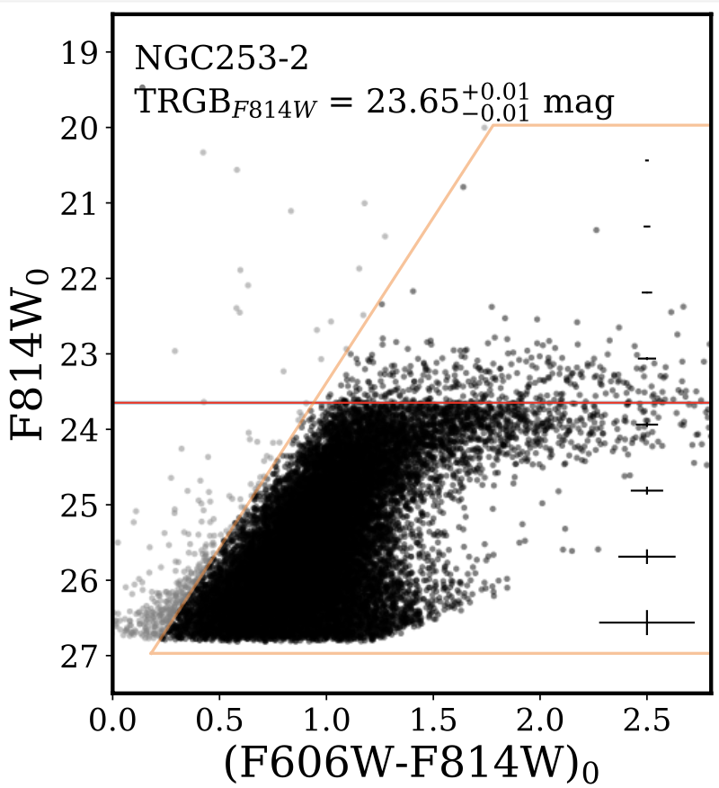
Empirical Characterization of the HST NIR TRGB color-dependence
Representative HST Observing Strategy
Representative Single Field
Measure F814W TRGB-based Distance
TRGB Magnitude
Newman et al. (2024a)
Notes:
First we anchored our distance scale by uniformly measuring the TRGB in F814W in each field in order to convert the near-IR data to absolute magnitudes. On the right is an F814W CMD that is representative of our data.

Slide 17
Empirical Characterization of the HST NIR TRGB color-dependence
All Fields NIR Combined in Absolute Magnitude
Measure NIR TRGB Slope
TRGB Slope
Newman et al. (2024a)
Notes:
Next, using NIR filters on HST, specifically F110W and F160W, we developed our empirical calibration approach as a stepping stone to JWST.
To build up number statistics and increase our color baseline we take all the NIR data, convert them to absolute magnitudes, and stack them on a single CMD.
Here on the left is the stacked CMD for F160W magnitudes. From these data we measure the slope of the TRGB magnitude as a function of color.

Slide 18
Empirical Characterization of the HST NIR TRGB color-dependence
All Fields NIR Combined in Absolute Magnitude
Remove TRGB color-dependence
and
Measure NIR TRGB Zero-point
Measure NIR TRGB Slope
TRGB Zero-point
Newman et al. (2024a)
Notes:
Finally, we remove the color dependence such that all TRGB stars are at the same absolute magnitude and measure the TRGB zero-point.

Slide 19
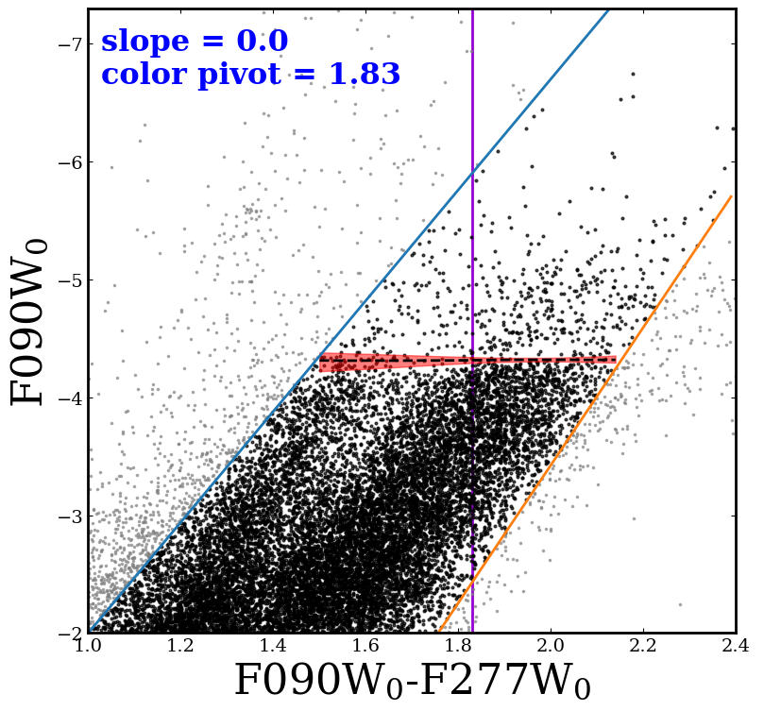
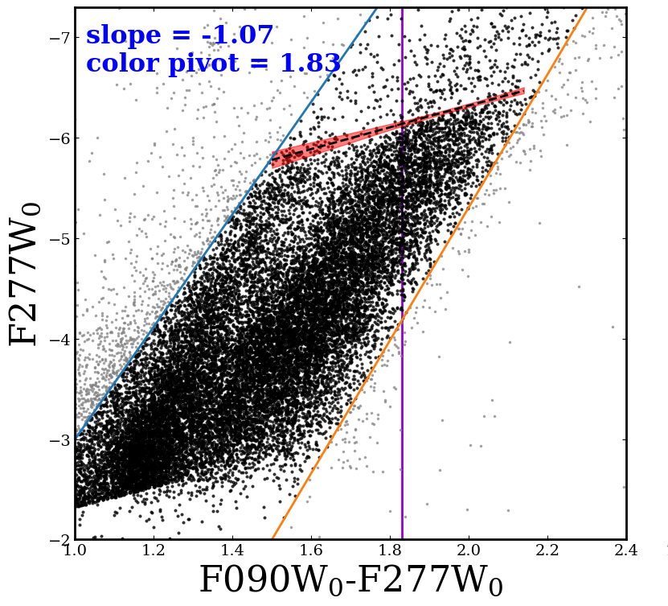
The TRGB in JWST NIRCam Wide Filters
Newman et al. (submitted)
Notes:
Using our new empirical approach we turned to JWST NIRCam data.
Our JWST program imaged one of two fields for each target from our HST program with NIRCam.
On the left is a JWST CMD with F090W on the y-axis for which we found no color dependence within our color range, similar to HST F814W. In the middle we found a significant color dependence.

Slide 20
The TRGB in JWST NIRCam Wide Filters
All NIRCam Filters:
F090W
F115W
F150W
F277W
F356W
F444W
Newman et al. (submitted)
Notes:
Our JWST TRGB calibration spans a wide wavelength range as shown to the right.

Slide 21
The TRGB in JWST NIRCam Wide Filters
All NIRCam Filters:
F090W
F115W
F150W
F277W
F356W
F444W
NIRISS F090W, F115W and F150W TRGB Calibrations (Newman et al. in prep)
Newman et al. (submitted)
Notes:
We’ll also soon be providing TRGB calibrations in three NIRISS filters.
With these calibrations the TRGB method can be applied widely to galaxies in need of precise distances.
In addition, the TRGB in several JWST NIRCam filters can now be used as a means to measure H_0.

Slide 22
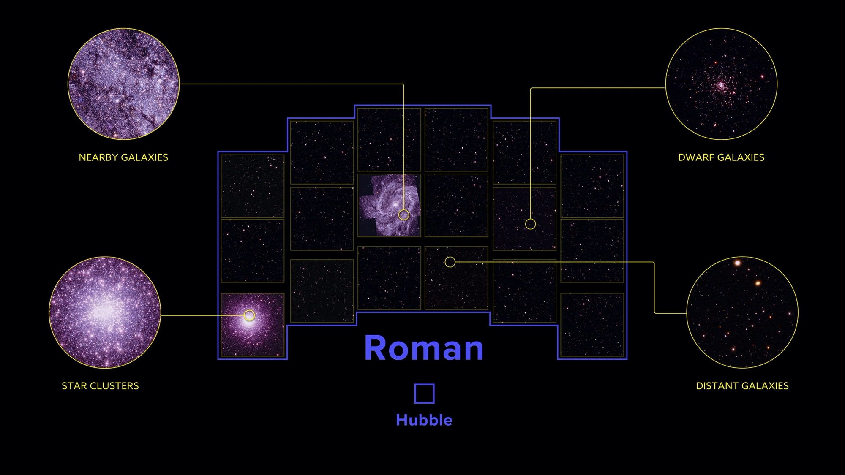
The Roman Telescope: A saving Grace
Notes:
For TRGB measurements the Nancy Grace Roman Space Telescope is all about wide field of view.
Roman has several advantages over other scopes:
Its large FoV ensures we can build up statistics of stars near TRGB
We can make sure we get highest precision phot with an emphasis on including only regions of low stellar crowding (focus on low crowding)
We can select parts of the field that are not impeded by young stars
And we can sample stellar populations that span a range of metallicities to increase our color baseline

Slide 23
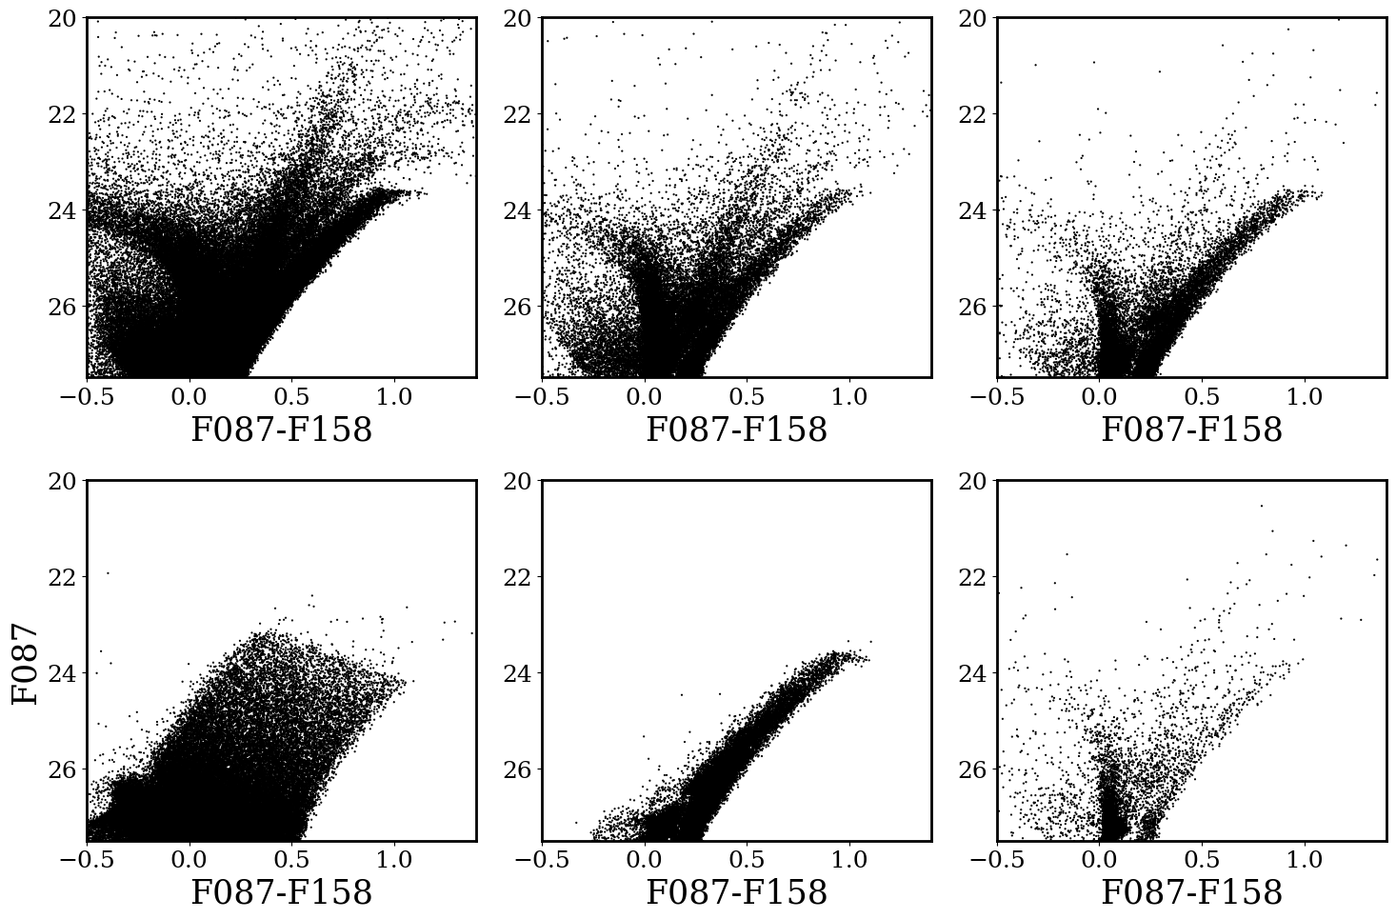
Simulated CMDs in a Single Roman WFI Observation
Significant non-RGB contamination
Notes:
To get a sense of how the structure in a CMD can vary across different regions of a galaxy I’ve simulated a handful of crude simulated observations in the Roman F087 and F158 filters
First

Slide 24
Simulated CMDs in a Single Roman WFI Observation
Significant non-RGB contamination
and
low TRGB star counts

Slide 25
Simulated CMDs in a Single Roman WFI Observation
Significant non-RGB contamination
and
low TRGB star counts
Modest contamination
and
low number statistics at the TRGB

Slide 26
Simulated CMDs in a Single Roman WFI Observation
Significant non-RGB contamination
and
low TRGB star counts
Modest contamination
and
low number statistics at the TRGB
Minimal non-RGB contamination
and
a wide metallicity range

Slide 27
Simulated CMDs in a Single Roman WFI Observation
Significant non-RGB contamination
and
low TRGB star counts
Modest contamination
and
low number statistics at the TRGB
Minimal non-RGB contamination
and
a wide metallicity range
A well-populated RGB

Slide 28
Simulated CMDs in a Single Roman WFI Observation
Significant non-RGB contamination
and
low TRGB star counts
Modest contamination
and
low number statistics at the TRGB
Minimal non-RGB contamination
and
a wide metallicity range
A well-populated RGB
Significant contamination and
no discernable TRGB

Slide 29
How does the TRGB with Roman advance science?
H0
Dwarf galaxies in the field (with sufficient star counts)
Still a plethora of spiral and early-type galaxies without secure distances

Slide 30


HST F110W and F160W TRGB Calibration
Newman et al. (2024)
JWST NIRCam Wide Filters TRGB Calibration
Newman et al. (submitted)
For additional questions please don’t hesitate to get in contact:
mjn125@physics.rutgers.edu

Slide 31
Bonus Slides

Slide 32
Theory Behind the Tip of the Red Giant Branch (TRGB)
Helium Core Ignites
Red Giant Branch
Luminosity
Main Sequence
Hydrogen Shell Burning
Hydrogen Core Burning
Temperature

Slide 33
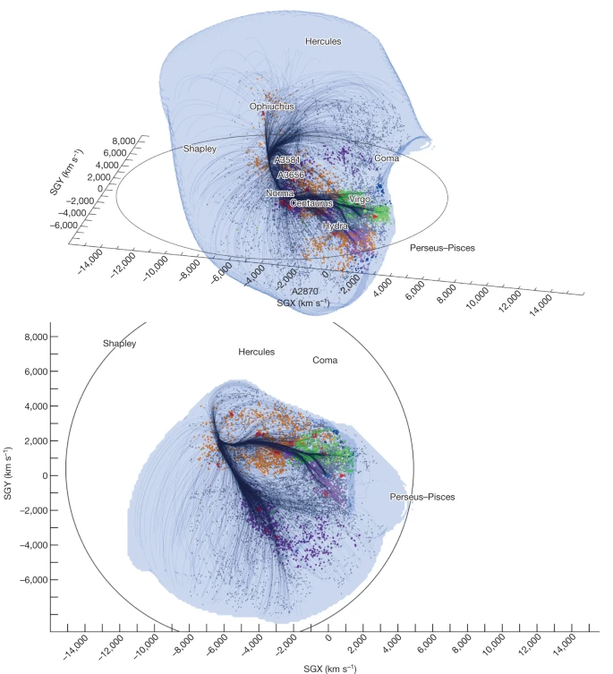
Distances to Galaxies are a Fundamental Measurement
Laniakea supercluster of galaxies
(Tully+2014)
http://www.atlasoftheuniverse.com/superc.html
Notes:
Many if not all of us require distance measurements to objects to compare their properties on absolute scales.
For example, here on the left are two projections of 3D map of the Laniakea supercluster of galaxies. These peculiar velocity maps include sky coverage out to 400 Mpc (redshift of 0.1) and entirely dependent on distance measurements to galaxies.
In a similar vein, the right-hand figure shows a collection of some of the nearest superclusters to Milky Way. Importantly distances measured in redshift or through other non-redshift-based methods reveal meaningful structure.

Slide 34
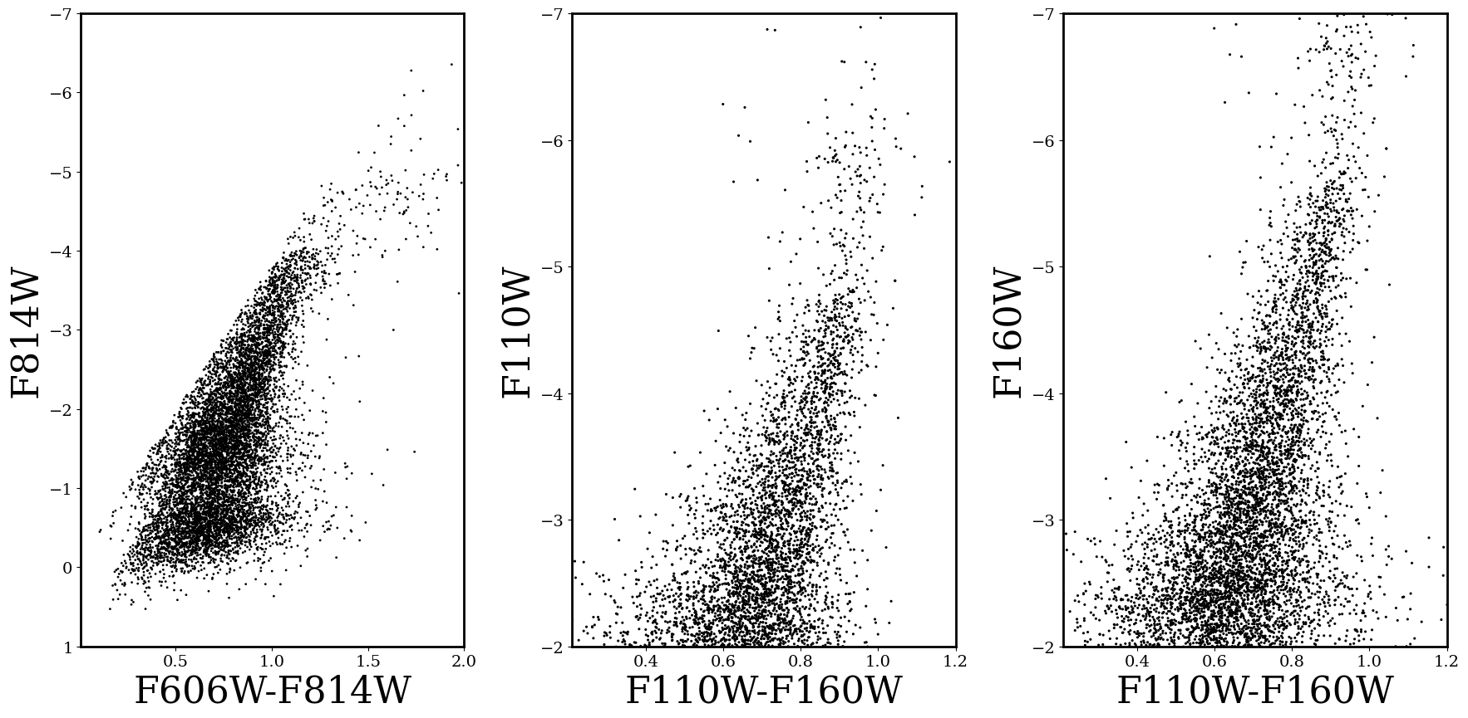


Combined Stellar Catalog:
Broadening the Color Baseline
1.6 $μ$m
1.1 $μ$m
Newman et al. (submitted)

Slide 35
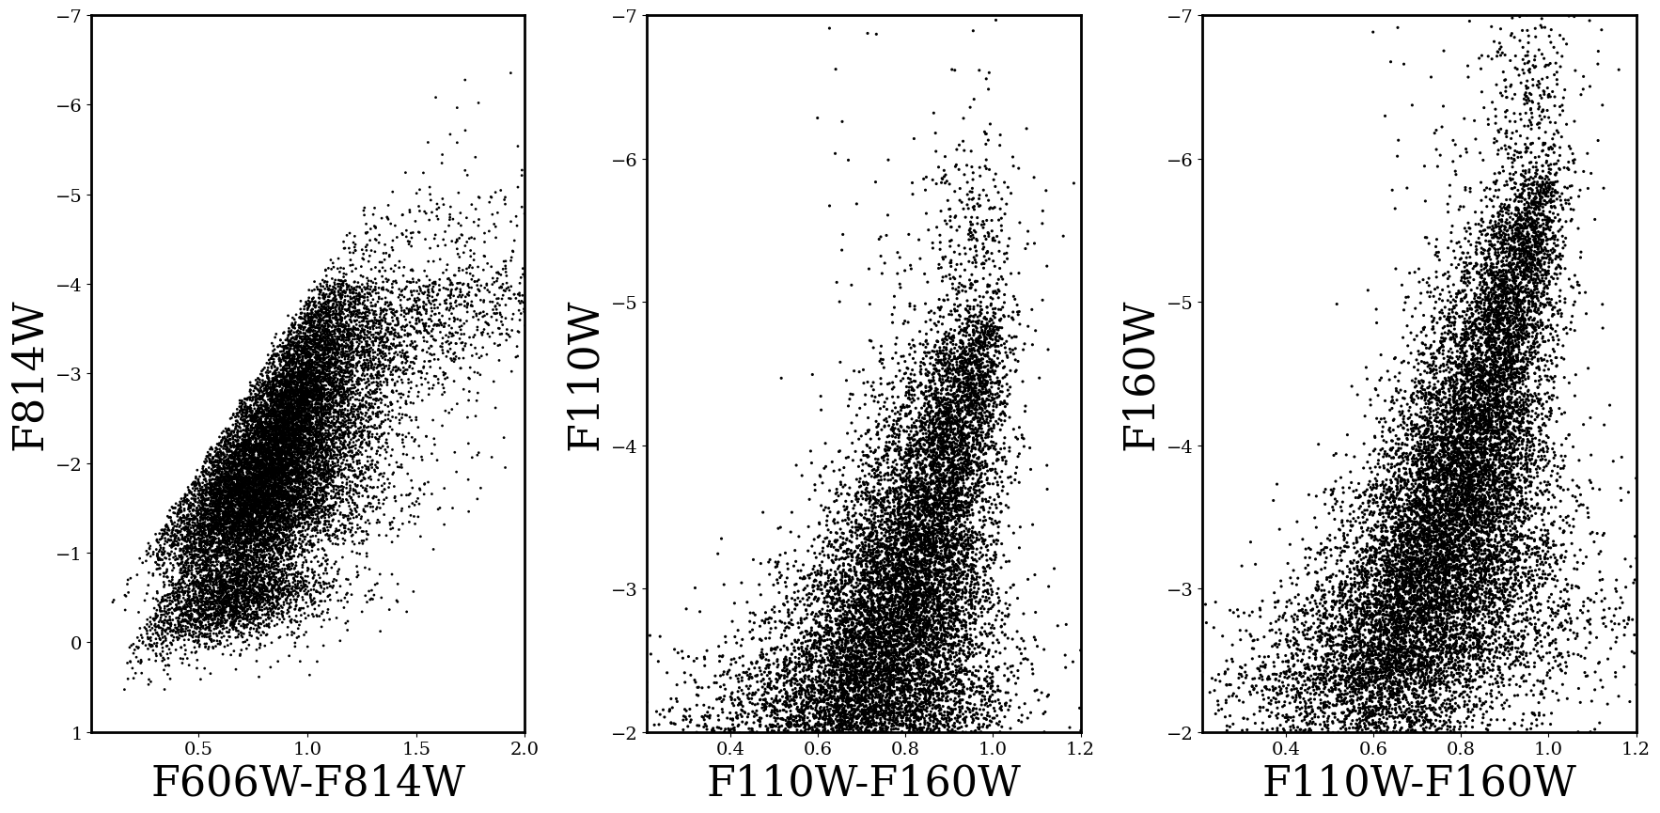
Combined Stellar Catalog:
Broadening the Color Baseline
Newman et al. (submitted)

Slide 36
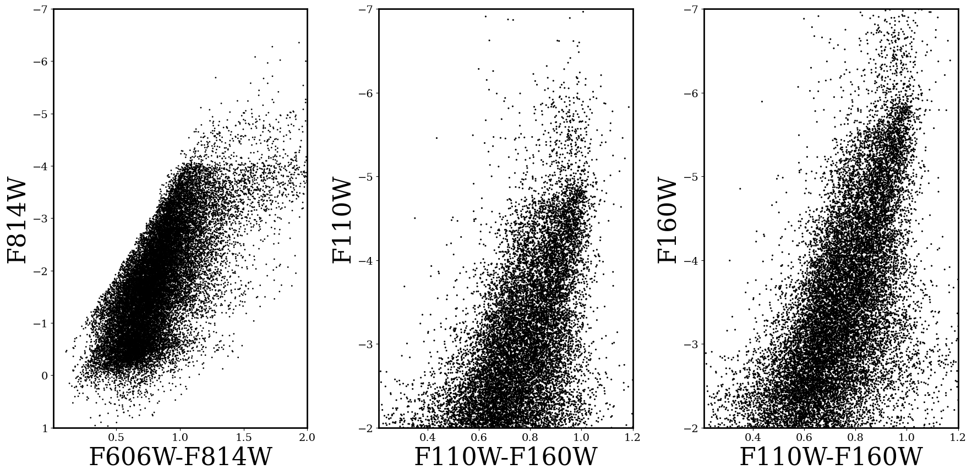
Combined Stellar Catalog:
Broadening the Color Baseline
Newman et al. (submitted)

Slide 37
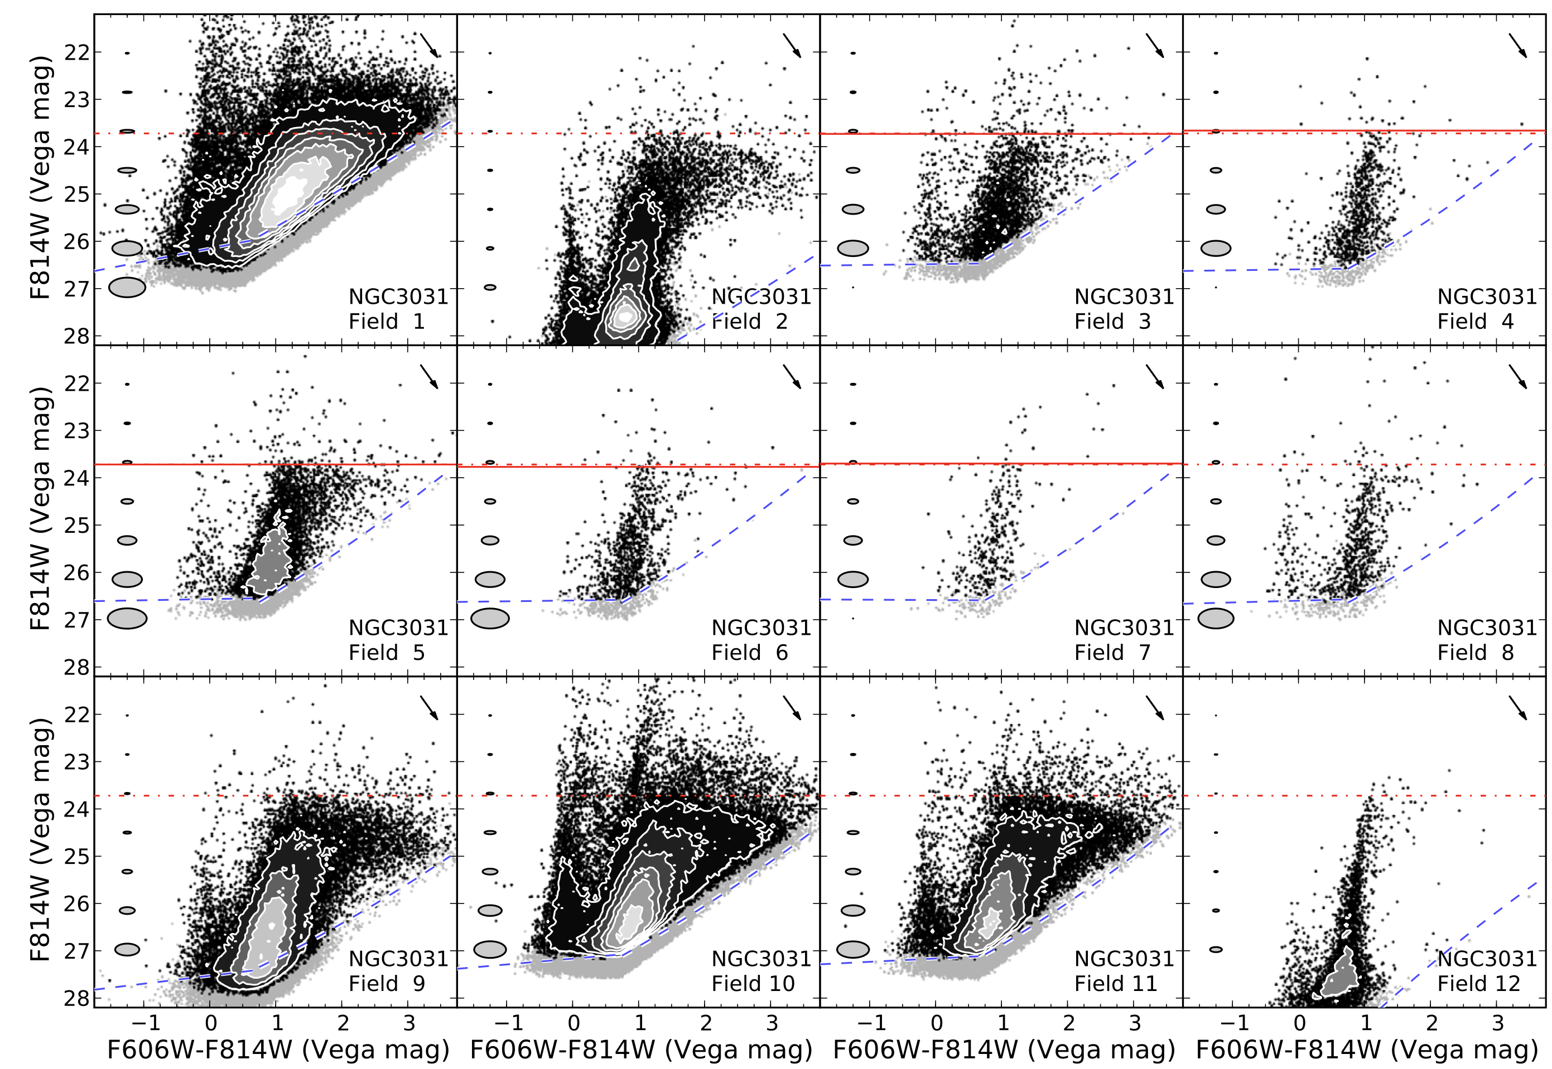
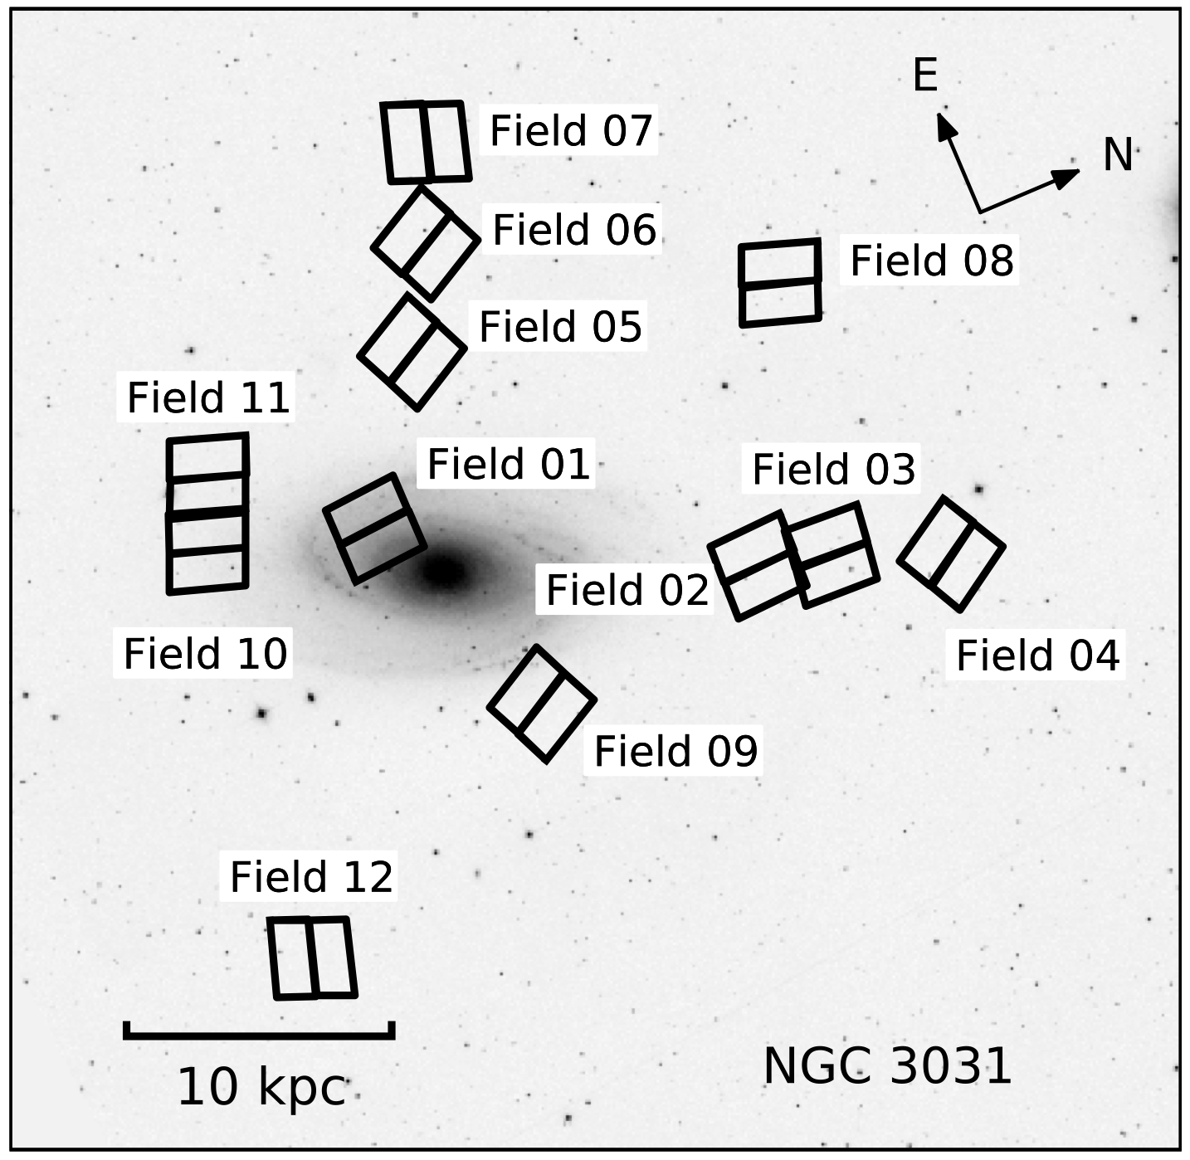
Observational Challenges of the TRGB method with HST and JWST
Radburn-Smith et al. (2011); GHOSTS

