Slide 1
The Team
Asteroseismology and Roman
Asteroseismology
Bedding, Huber, Stello, Zinn
The Marcs (Hon and Pinsonneault)
Simulations – K. Cao, Downing, Weiss
Spectroscopic Survey Liaisons
Johnson (APOGEE), Sharma (Galah)
Stellar and Population Characterization
Pinsonneault, Sharma, Zinn
μlensing and Simulation Liaisons
Gaudi and Penny
Marc Pinsonneault
OSU

Slide 2
Why Do Asteroseismology With Roman?
The Galactic Bulge is a fascinating, and poorly understood, galactic population
Cool evolved giants are potent population tracers
The GBTDS is ideally suited to measure ages of giants through the tools of asteroseismology

Slide 3
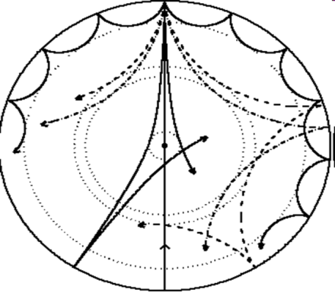
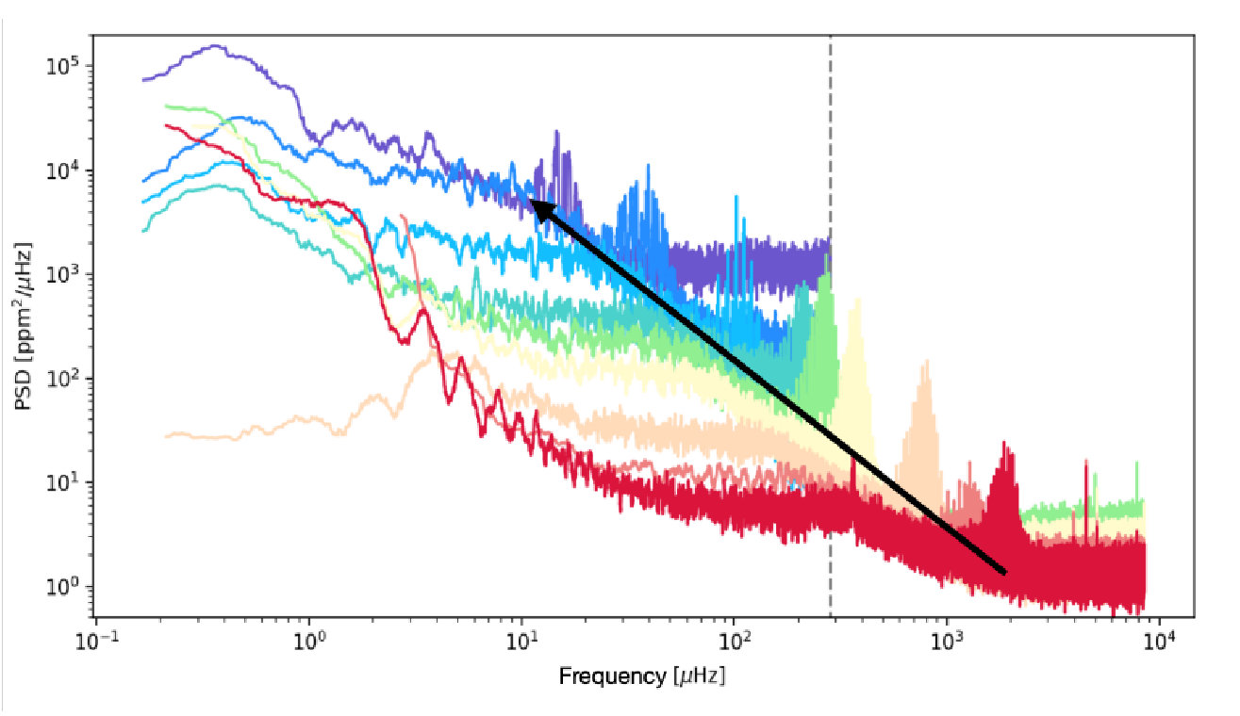
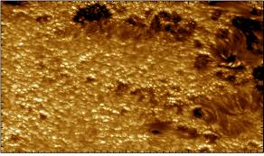
Asteroseismology Summarized
STANDING WAVES
BRIGHTNESS VARIATIONS
Oscillation Frequencies That
Depend Sensitively on Mass and Radius!
TURBULENCE

Slide 4
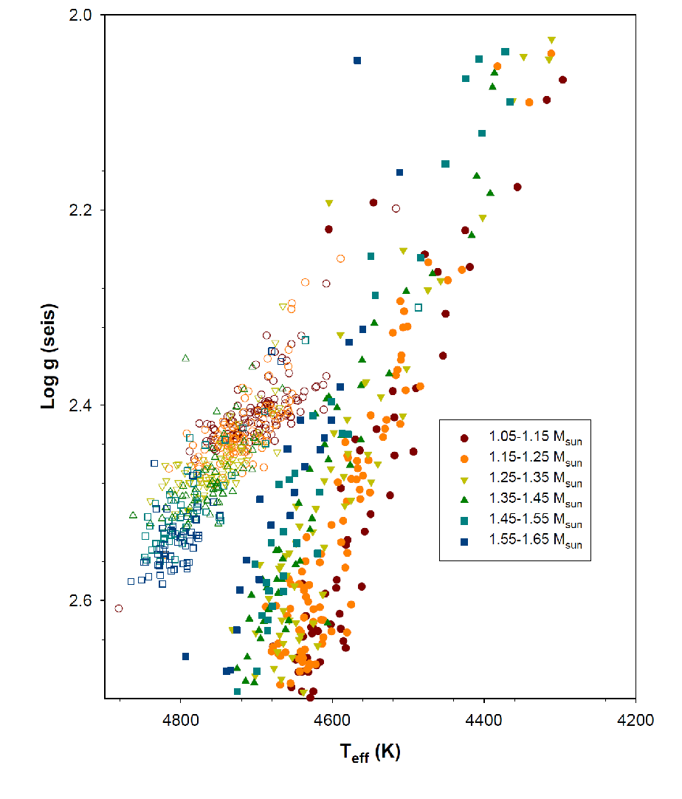
Red Clump: Powerful Population Diagnostic
Pinsonneault+2024
Samples a wide range of ages and abundances at similar magnitude, color
ν_{max} => M => age
Excellent stellar inference validation set

Slide 5
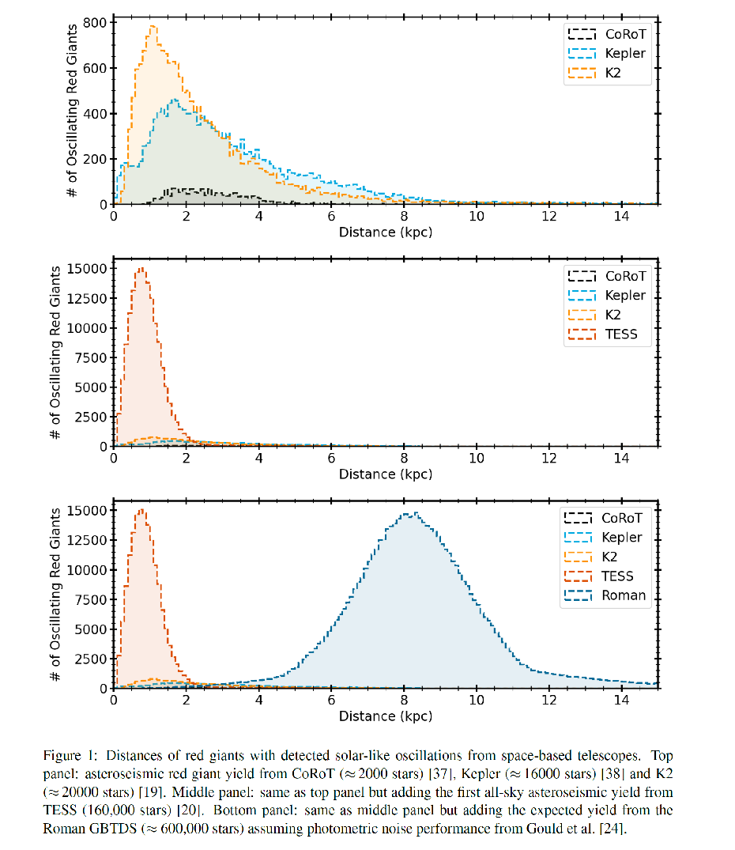
Why Do We Need Roman?
Kepler and K2 mostly sample the solar circle
TESS provides a large, but bright and local, sample

Slide 6
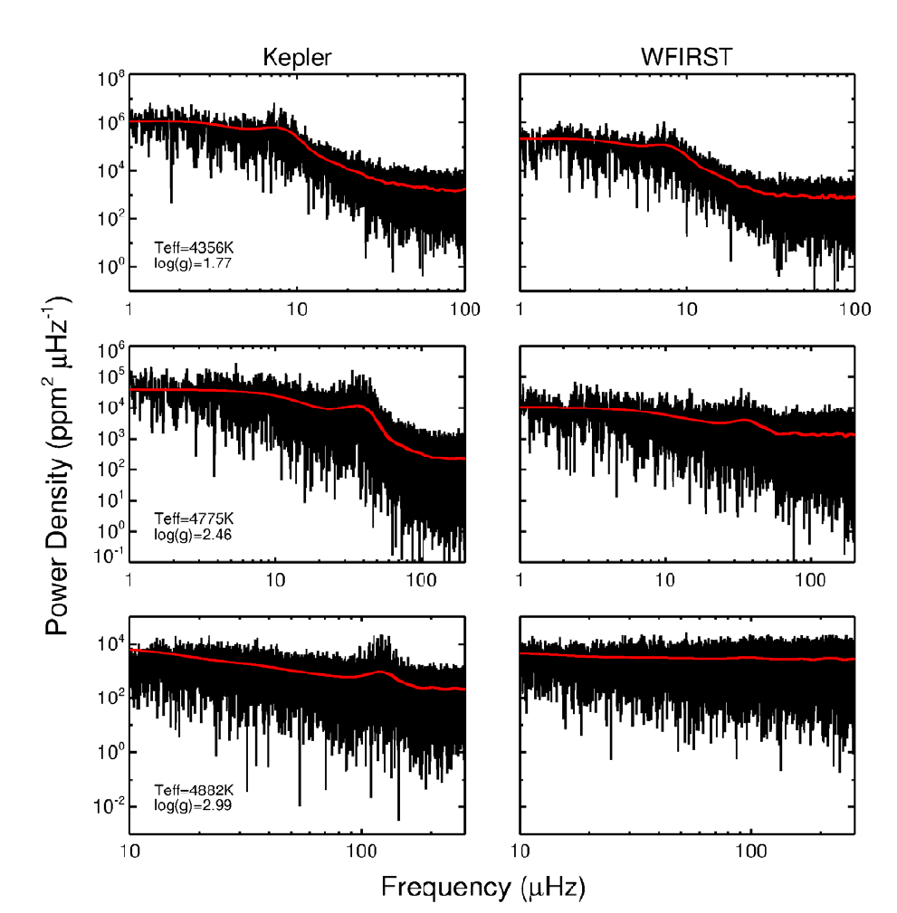
Initial Simulations: The Roman GBTDS Could Detect Oscillations
Detectable
Low L -> High L
Key Challenge 1:
Saturated Star Photometry
Detectable
Gould+2015

Slide 7
Roman: Potentially The Largest Asteroseismic Sample
Up to 600,000 detections!
Huber+2023

Slide 8
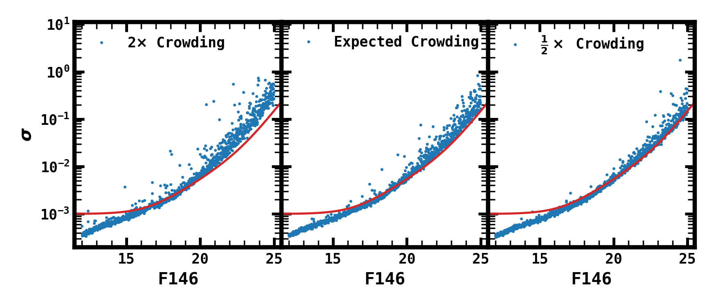
Task 1: Detection Simulations
Downing
Poster
Two Approaches: Kepler empirical and Gadfly simulations
Two Noise Models
Two Cadences
Data from R. Wilson

Slide 9
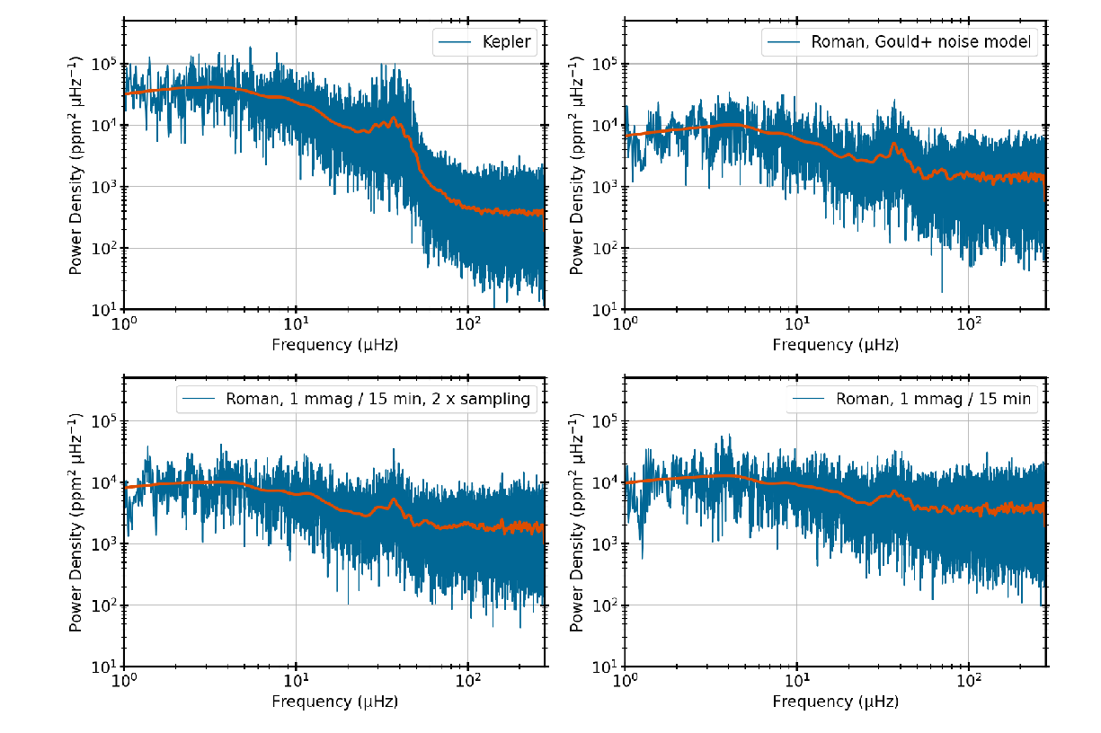
Key Challenge 2: Noise Floor
Noise Floor of 1 mmag
(Penny+2019):
Sample size reduced
by a factor of 3 vs.
Gould+2015…
A second set of
exposures per 15
minute cycle matters!
Huber+2023

Slide 10
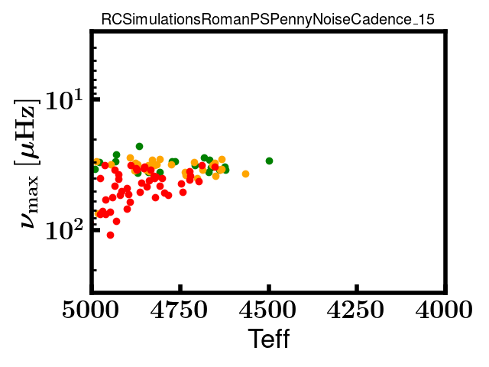
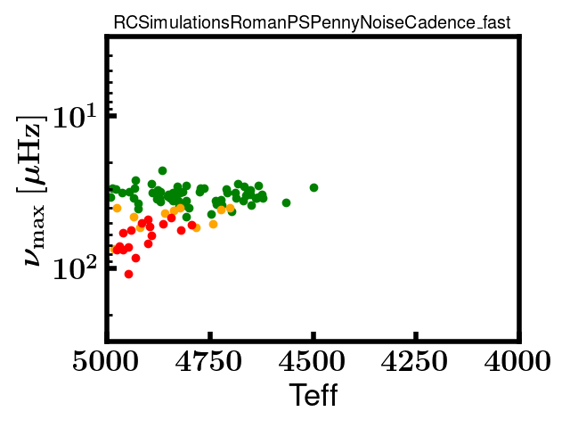
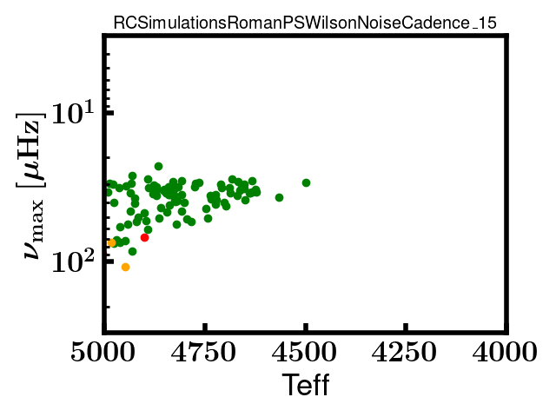
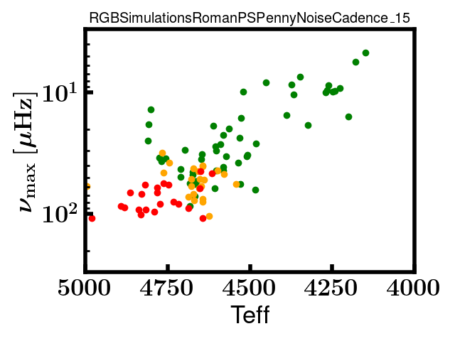
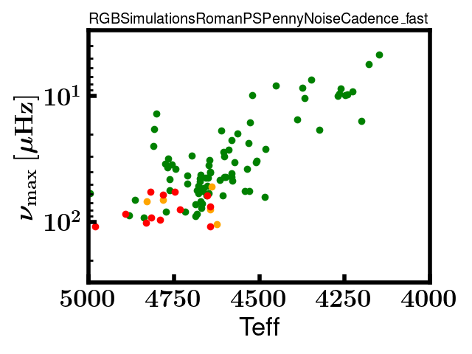
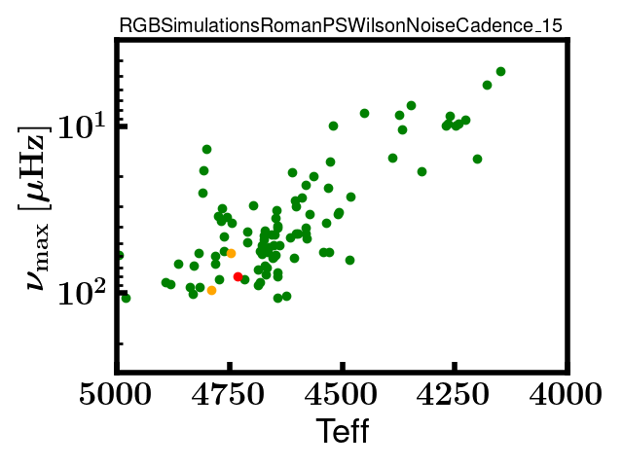
Penny 15 min
Penny 7.5 min
Wilson 15 min

Slide 11
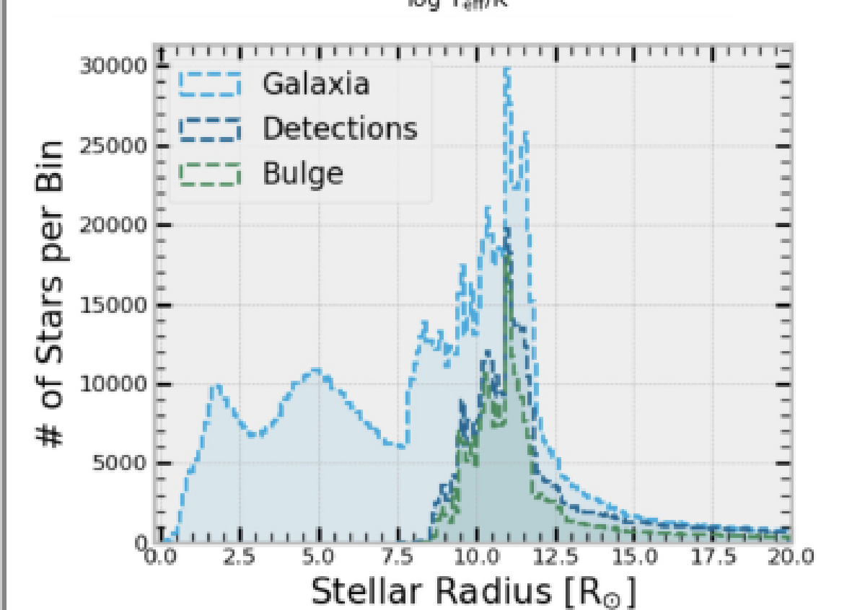
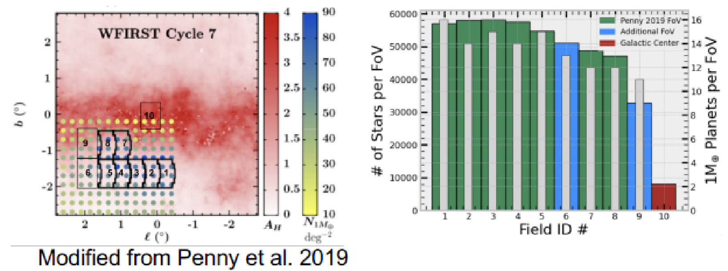
Task 2: Population Simulations
Simulate Underlying Populations with Galaxia
Use Detection Simulations to Predict Yields
Test Extinction Models
Weiss
Poster

Slide 12
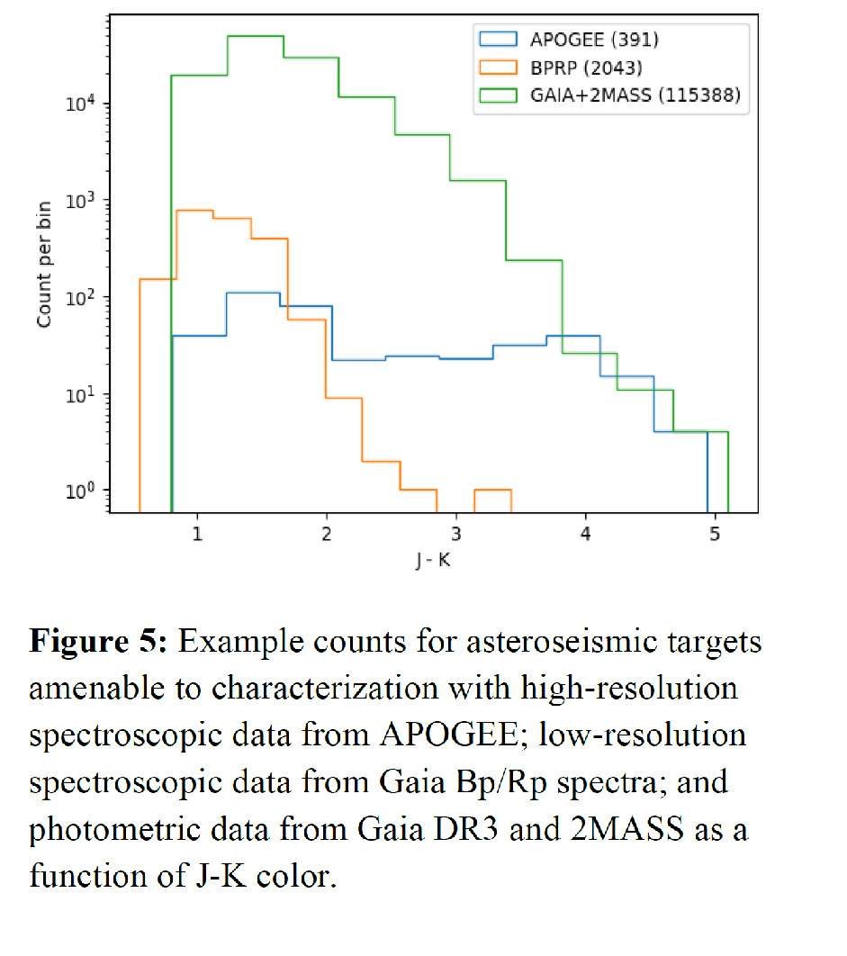
Asteroseismology: Stellar Parameter Validation
Two Steps:
Spectroscopy -> Photometry
Gives Teff and Metallicity
Differential Astrometry Gives
Radii if Tied to Gaia
Note: This is existing high-resolution spectroscopic data; much more can be obtained

Slide 13
Next Steps And Recommendations
Asteroseismology is an exciting prospect for Roman
Having a higher cadence for at least some fields will be valuable for asteroseismology
Upcoming work: using saturated star experiments; refining yields; exploring astrometry

Slide 14
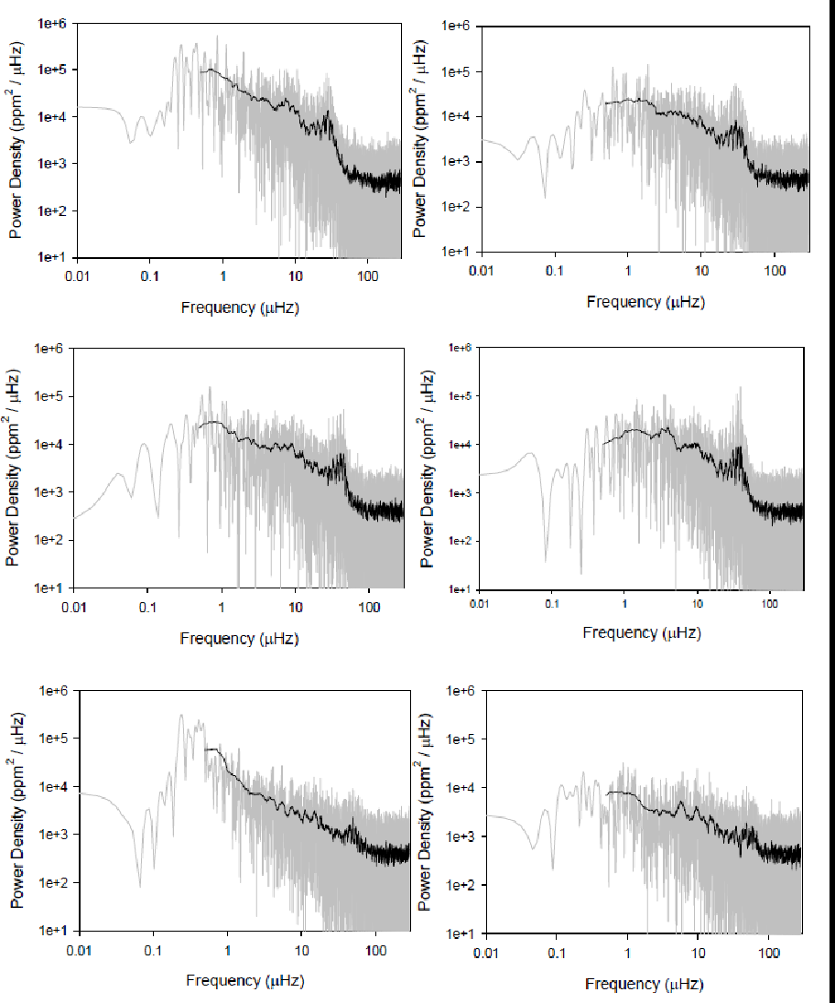
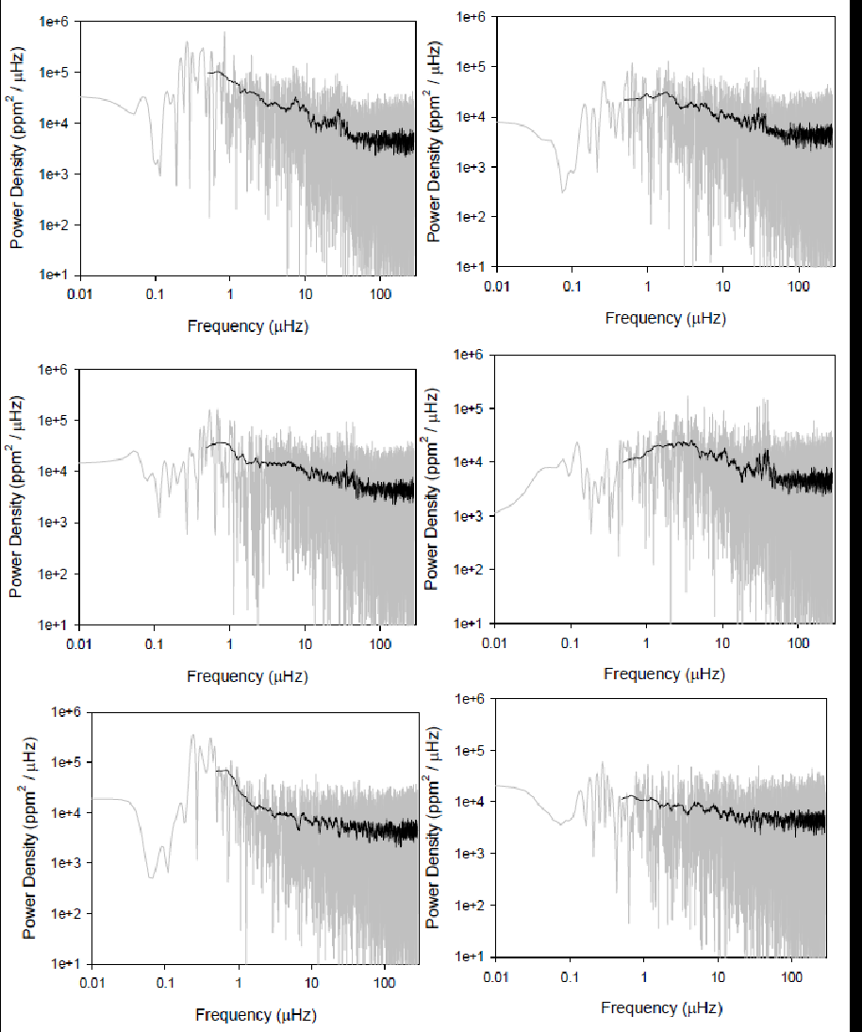
Wilson 7.5 m
Penny 15 m

Slide 15
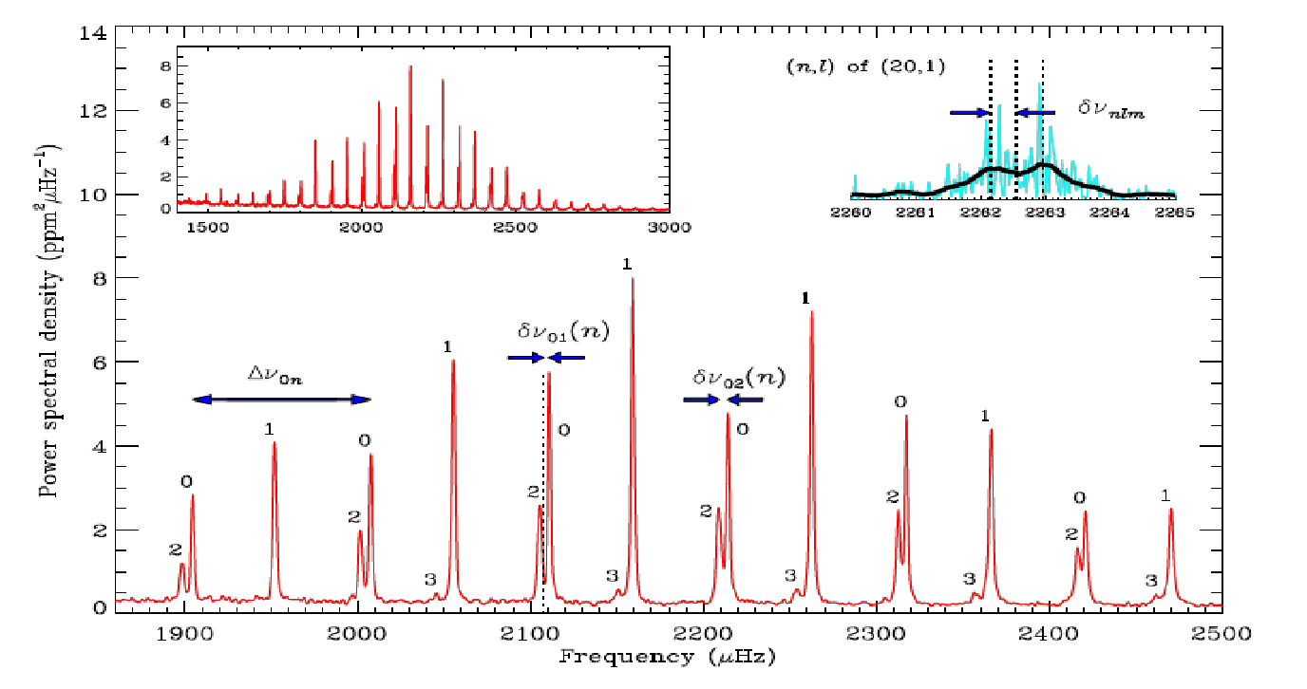
Interpreting the Frequency Spectrum:
Scaling Relations
Frequency of Maximum Power ν_{max}
16 Cyg A (Kepler Data)
Acoustic cutoff frequency that depends on log g
Metcalfe+ 2012
Frequency Spacing Δν
Stellar pulsation theory predicts that the
frequency spacing is related to the mean
density
With Abundance Information
(Spectra): Can Infer Ages

