Slide 1
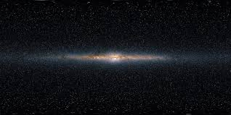
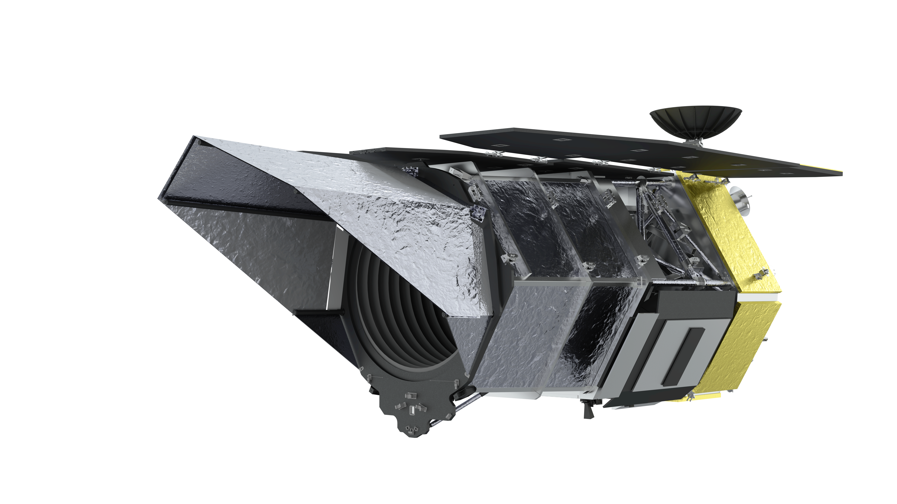
The Milky Way As The z=0 template
to Investigate Star and Planet Formation
Roberta Paladini (Caltech-IPAC)
Challenging Theory with Roman – July 9 – 12 2024, Pasadena, CA

Slide 2
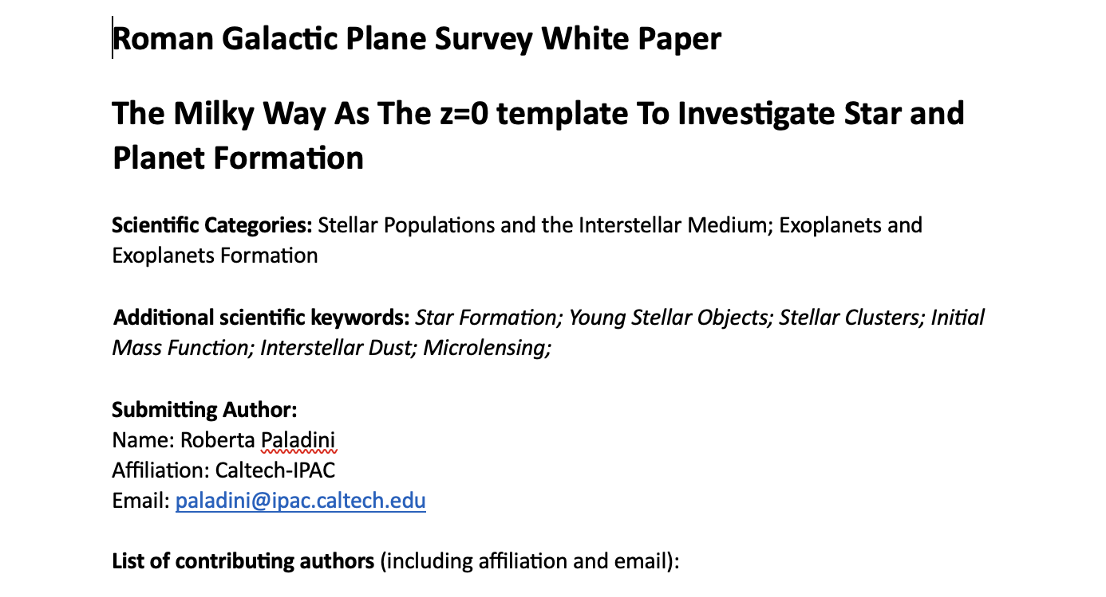
May 20th 2024
Etienne Bachelet (Caltech-IPAC), Sebastiano Calchi Novati (Caltech-IPAC), Sean Carey (Caltech-IPAC), Ranga-Ram Chary (Caltech-IPAC) James Colbert (Caltech-IPAC), Andreas Faisst (Caltech-IPAC), Sergio Fajardo-Acosta (Caltech-IPAC), Kyle Finner (Caltech-IPAC), James Ingalls (Caltech-IPAC), Wanggi Lim (Caltech-IPAC), Luisa Rebull, (Caltech-IPAC), Jennifer Sobeck (Caltech-IPAC) Sergio Molinari (INAF), Eugenio Schisano (INAF), Davide Elia (INAF), Alessio Traficante (INAF), Tom Megeath (University of Toledo), John Bally (University of Colorado – Boulder,) Adam Ginsburg, (University of Florida), Jonathan Tan (Chalmers University), Matthew Povich (Cal Poly Pomona), Jin Koda (Stony Brooke University), Gabor Marton, (Konkoly Observatory), Jorge Pineda (JPL), Alberto Noriega Crespo (STScI), Jesus Maiz Apellaniz (Centro de Astrobiologia – CAB), Frederique Motte, (IPAG/CNRS), Rob Gutermuth (Umass), Lynne Hillenbrand (Caltech), Thushara Pillai (MIT), Cara Battersby (University of Connecticut), James Urquhart (University of Kent), Mark Heyer (Umass), Massimo Marengo (Florida State University), Tracy Huard (University of Maryland), Mattia Sormani (Universita’ degli Studi dell’Insubria), Jens Kauffmann (MIT), Rachel Akeson (Caltech-IPAC), Bruce Berriman (Caltech-IPAC), David Ciardi, (Caltech-IPAC)

Slide 3
Take Home Message: Science Cases Evolve Over Time…..
(since, e.g., Green et al. 2012, Paladini et al. 2021)
December 25th 2021

Slide 4
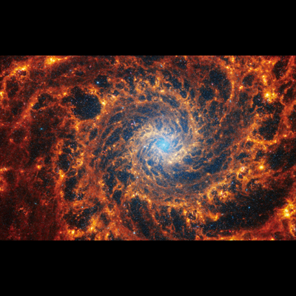
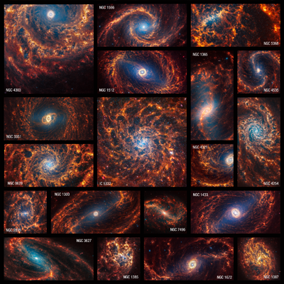
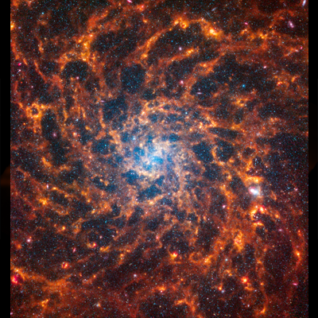
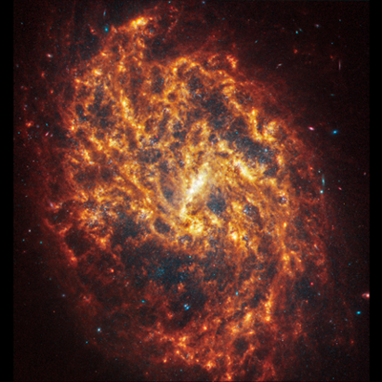
Physics at High Angular Resolution in Nearby Galaxies
(PHANGS – P.I. Eva Schinnerer, MPIA)
JWST-PHANGS – P.I. Janice Lee, STScI
19 galaxies
~5 Mpc < D < ~25 Mpc

Slide 5
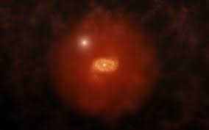
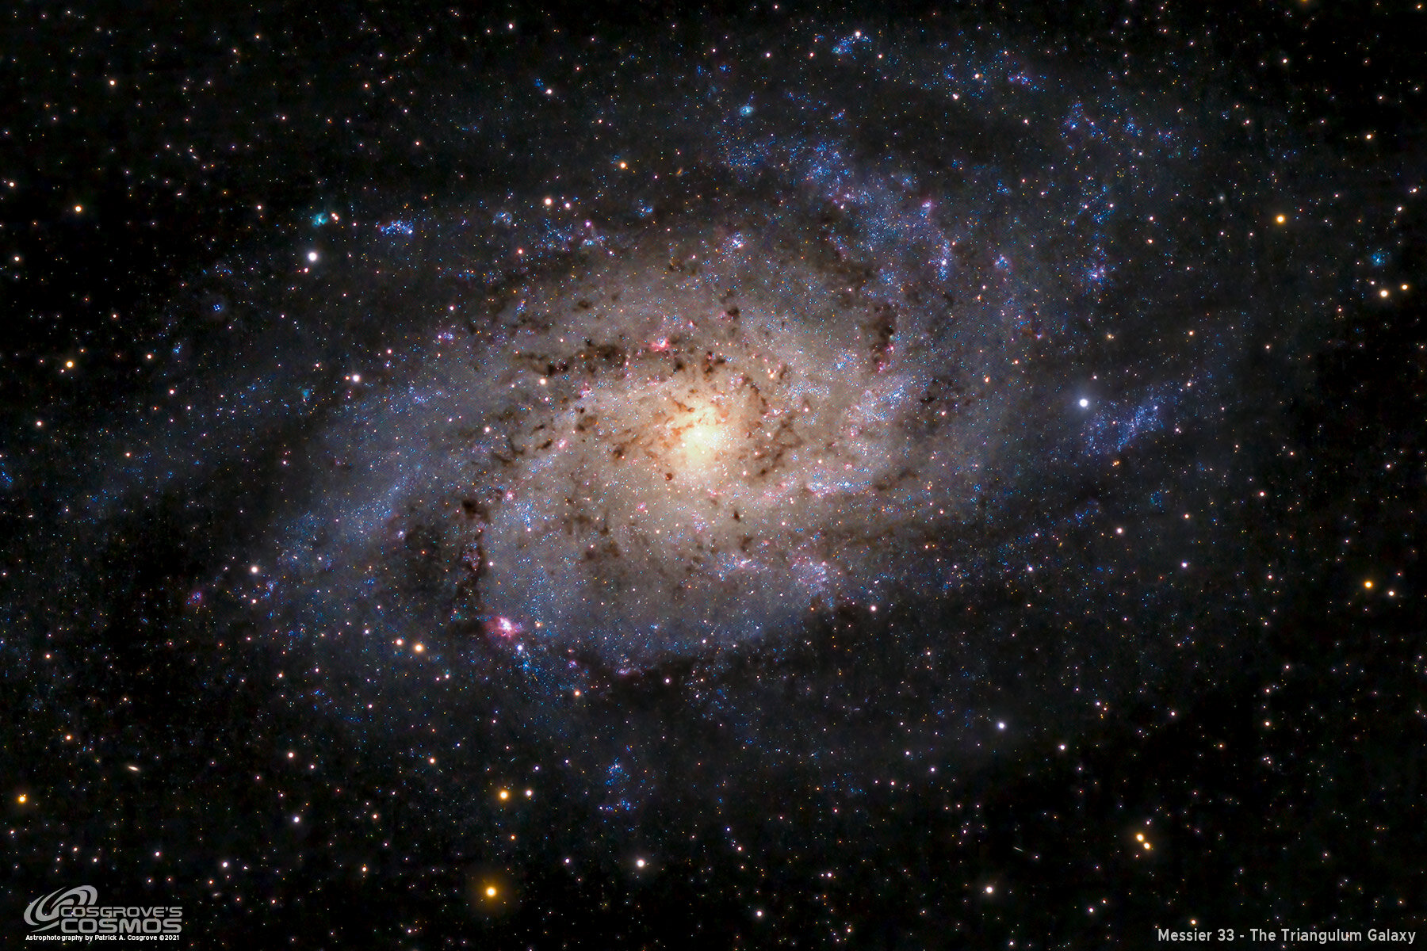
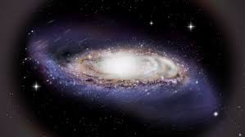
What is the new role of Galactic Astronomy in the JWST era ?
High-z galaxy
NGC 1087
D = 16 Mpc
M33
D < 1 Mpc
Milky Way
Investigating our Galaxy to build the latter from the local to the far Universe

Slide 6
What is the role of Roman for Galactic Astronomy ?
Roman will be the most efficient Galactic Star Finder ever launched
Young Stellar Objects (> ~ 0.5 Myr, Class I – II – III)
Main Sequence Stars
(evolved) Red Giant Stars (or Red Clumps)
Combined with Spitzer/Herschel ancillary data (class 0):
complete star formation history
Number of detections
Class I – II – III
Class III
Class 0 - I – II – III
Gaia
Roman/WFI
Class 0 - I – II
Glimpse/Mipsgal
HiGal
λ
Our present instrumental capabilities do not allow us to detect individual stars beyond LMC, SMC, M31 ( have to wait until launch of NASA next-generation facilities, e.g., Habitable Worlds Observatory, ~2040)

Slide 7
Roman Galactic Plane Survey: Star Formation Science Drivers
The Role of Spiral Arms and The Galactic Potential in Star Formation (science case #1)
Is there a cycle between gas inflow, star formation, and black hole feeding in galaxy centers? (science case #2)
Star and Cluster Formation Rate (science case #3)
Investigating the Initial Mass Function (science case #4)
Dust Evolution and Star/Planet Formation (science case #5)
Feedback and The Physics of Accretion (science case #6)
Dissecting Star Formation from large to small scales

Slide 8
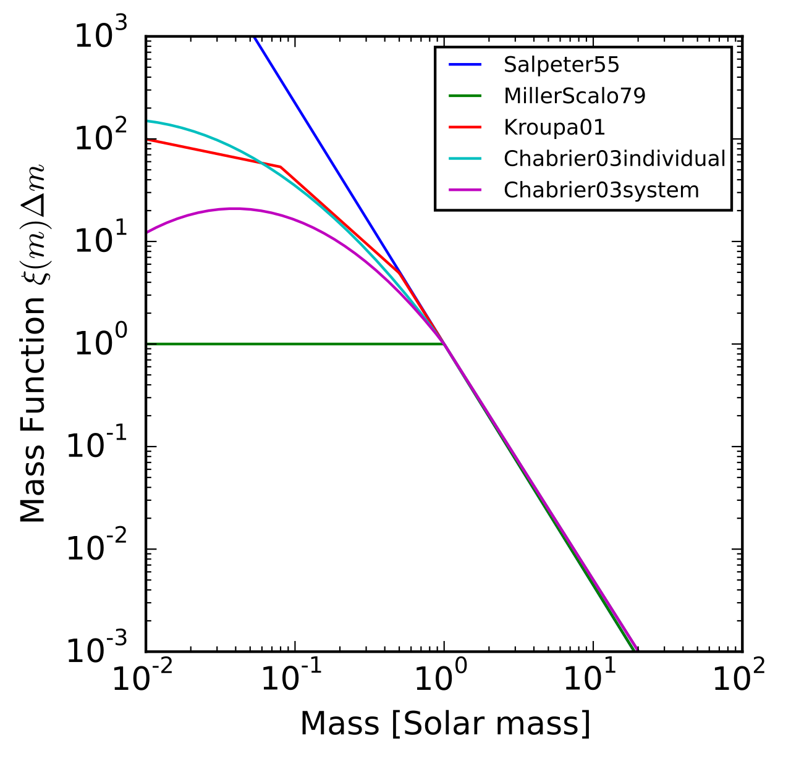
Investigating the Initial Mass Function (science case #4)
Question: Is the IMF universal ?
The stellar IMF is one of the most fundamental probes of star formation physics and the influence of both internal and environmental factors (Bastian et al. 2010)
So far the major issue has been the challenge of resolving stellar binary systems, thus preventing us from obtaining a complete stellar census to and below the hydrogen burning limit.

Slide 9
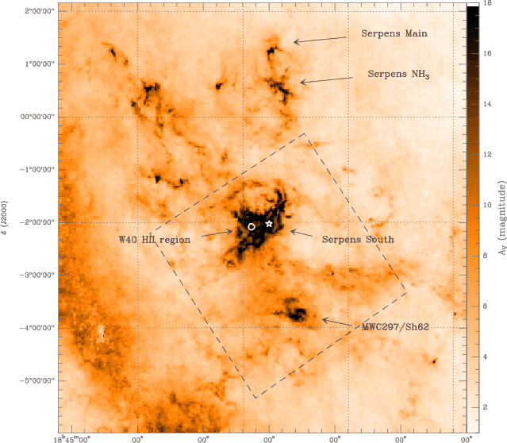
The Serpens Star Forming Region in the Aquila Rift
(436 pc)
Investigation of the ISM and more…:
Star and Cluster Formation Rate (science case #3)
Investigating the Initial Mass Function (science case #4)
Dust Evolution and Star/Planet Formation (science case #5)
Feedback and The Physics of Accretion (science case #6)
Credit: S. Bontemps

Slide 10
The Serpens Star Forming Region in the Aquila Complex
(436 pc)
Science Goals | Science Objectives | Observables | Physical Parameters | Survey Area | Location of Survey Area | Contiguous Area | Filters | Dithers | Depth | # epochs | Cadence | Grism
Is SF correlated with spiral arms Is the central BH quenching SF ? | Reconstructing spiral arms, bulge and bar exact structure and location | Red Giant Stars (Red Clumps) | 3-d geometric parameters: D (Solar distance), z (distance from Galactic Plane), for every (l,b) | 1040 deg2 (covers bulge and W40/Serpens South) | For: -30 < l < + 10, -8 < b < +8 For: -60 < l < -30 & 10 < l < 60, -2.5 < b < +2.5 | YES | F062, F087, F184 (Kokoris & Levesque 2019) or F062, F087, F213 (Alves et al. 2003) | 3 small + 1 large | 26 mag AB | 1 | N/A | NO
3. What is the Star and Cluster Formation Rate ? | Obtaining a census of low to intermediate-mass YSOs across the Galactic Plane | Young Stellar Objects (Class I- III) | YSO Masses | 1040 deg2 (covers bulge and W40/Serpens South) | For: -30 < l < + 10, -8 < b < +8 For: -60 < l < -30 & 10 < l < 60, -2.5 < b < +2.5 | YES | F129, F158, F184, F213 | 3 small + 1 large | 26 mag AB | 1 | N/A | NO
4. What is the effective mass distribution of a Young Cluster ? | Investigating IMF | Young Stellar Objects (Class I- III) in a Young Stellar Cluster | YSO Masses | ~20 deg2 | W40/ Serpens South | YES | WFI grism default | 3 small + 1 large | 21 mag AB | 1 | N/A | YES
5. What regulates dust grain growth? | Deriving NIR extinction curve towards dense lines-of-sight of the ISM | Photometry towards K, M background stars | Dust grain size | ~200 deg2 | ~10^9 independent lines-of-sight with A_v > 5 mag and spread across GP | Split into well separated areas (to study different environments) | F087, F129, F158, F184, F213 | 3 small + 1 large | 26 mag AB | 1 | N/A | N/A
6 What is the origin of short stellar feedback? | Investigating ionized gas emission and outflows / jets | Pa a, Pa b , [Fe II] lines, H2 (1-0) | Temperature of the gas, Fe abundance and ionization state | 1040 deg2 (~20 deg2: grism) | For: -30 < l < + 10, -8 < b < +8 For: -60 < l < -30 & 10 < l < 60, -2.5 < b < +2.5 (W40/ Serpens South: grism) | YES | F158, F184, F213 (WFI grism default) | 3 small + 1 large | 23 mag AB | 1 | N/A | (YES)
7. What is the physics of mass accretion onto protostars ? | Investigating Class I - III YSO Variability | Lightcurves | mass accretion rate | ~20 deg2 | W40/ Serpens South | YES | F129, F158, F184, F213 | 3 small + 1 large | 21 mag AB | ~10 | Logarithmically spaced between ~< 1 and 30 days | NO
8 . What is the exoplanet population orbiting at large diistances from the Host Star ? | Estimating the mass distribution of exoplanets | Photometry of known microlensing events | Mass and distance of the Host Star and, from these, mass of the planet | 1040deg2 | For: -30 < l < + 10, -8 < b < +8 For: -60 < l < -30 & 10 < l < 60, -2.5 < b < +2.5 | YES | F087, F158, F213 | 3 small + 1 large | 26 mag AB | 1 | N/A | N/A
Baseline Roman Galactic Plane Survey | 1. 2. 3. 4. 5. 6. 7. 8. | All the above | All the above | 1040 deg2 | For: -30 < l < + 10, -8 < b < +8 For: -60 < l < -30 & 10 < l < 60, -2.5 < b < +2.5 | YES | F087, F129, F158, F184, F213 | 3 small + 1 large | 26 mag AB | 1 | N/A | YES
Background Image: CO Dame et al. (2001)
Dashed Blue Line: Rubin Observatory overlapping sky coverage

Slide 11
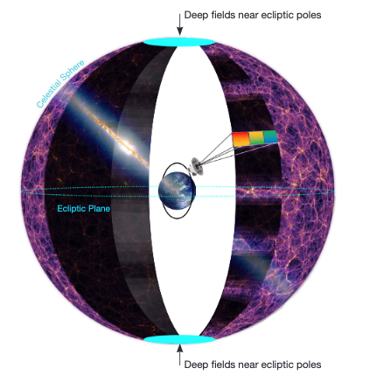
SPHEREx (https://spherex.caltech.edu)
First Near-Infrared All-Sky Spectral Survey
Science Themes:
λ = 0. 75 – 5 μm
λ/Δλ = 35 – 130
3.5⁰ X 11⁰ field of view
5-σ PS sensitivity ~ 19 AB mag per spectral channel
Launch: No later than April 2025
complete spectra every 6.2” pixel over the whole sky
~ 500 million spectra provided to the community !

