Slide 1
Variable stars in M31 stellar clusters
Dr. Richard D Smith; Avi Patel; Dr. Monika Soraisam; Prof. Puragra Guhathakurta; Pranav Tadepalli; Sally Zhu; Joseph Liu; Dr. Léo Girardi; Dr. L. Clifton Johnson; Dr. Knut A. G. Olsen; Sagnick Mukherjee; Dr. Benjamin F. Williams
Smith+ 2024, in peer review

Slide 2
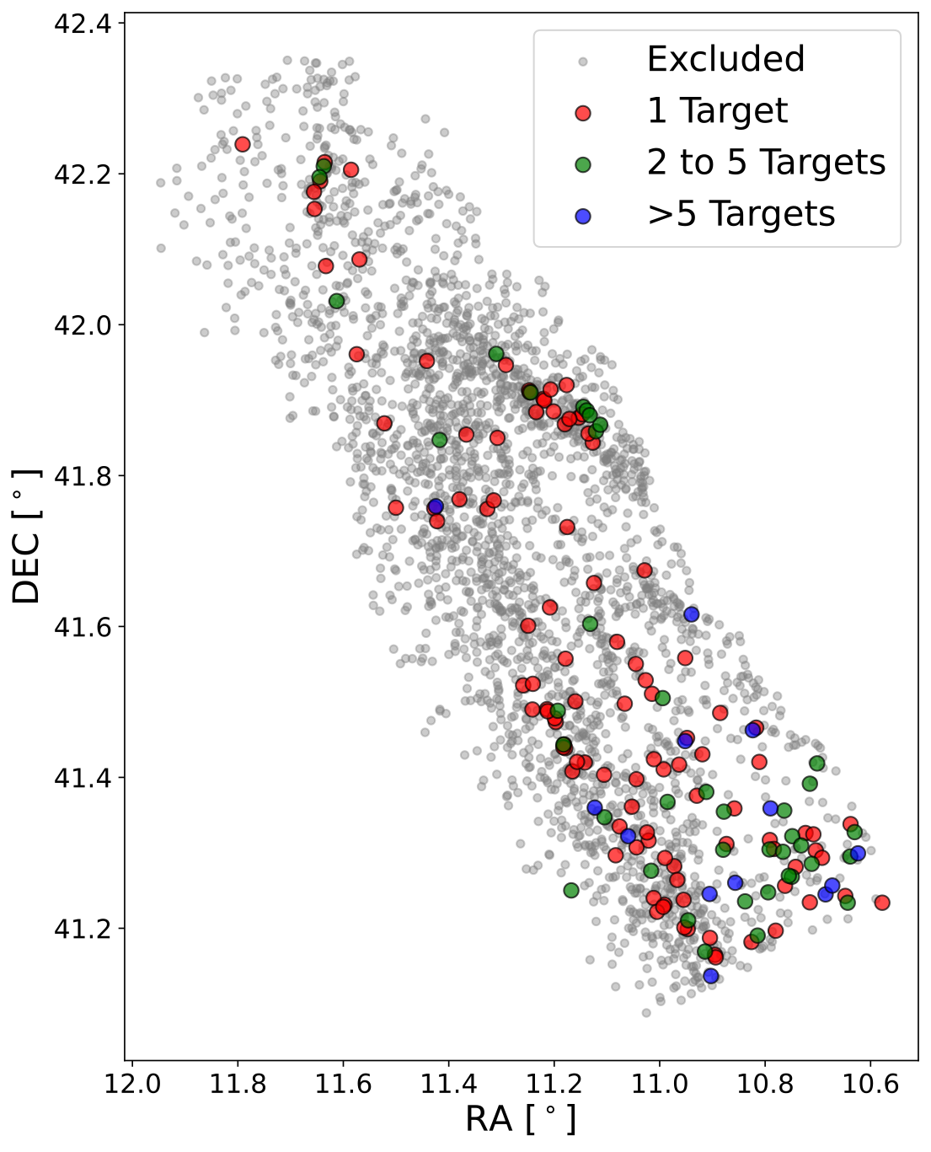
Variable stars in clusters
Stars in a stellar cluster (largely) homogeneous in age & metallicity.
Can constrain stellar physical parameters (mass, age, evolutionary phase).
Why variable stars in clusters?
Variable star physical parameters improve our understanding of pulsation, stellar evolution.
2753 stellar clusters in the PHAT survey identified by Johnson+ 2015; excluded clusters have no luminous (F814W < 19 mag) stars.
Notes:
First off - Why are we interested in variable stars (specifically) within clusters?
Stars in clusters can provide constraints on stellar properties [initial mass, age and metallicity]
This is because stars within a stellar cluster are (largely) homogeneous in age and metallicity
Understanding variable stars in particular helps improve our understanding of stellar evolution.
Not just large-amplitude variables: stars with smaller amplitude variations, e.g. caused by pulsations, give insight into stellar interiors at different evolutionary stages.
Milky Way clusters are obscured by differing interstellar dust densities and line-of-sight extinction.
The solution is extragalactic stellar clusters - e.g. in M31, shown here identified by Johnson et al 2015 using the Panchromatic Hubble Andromeda Treasury - or PHAT - survey.

Slide 3
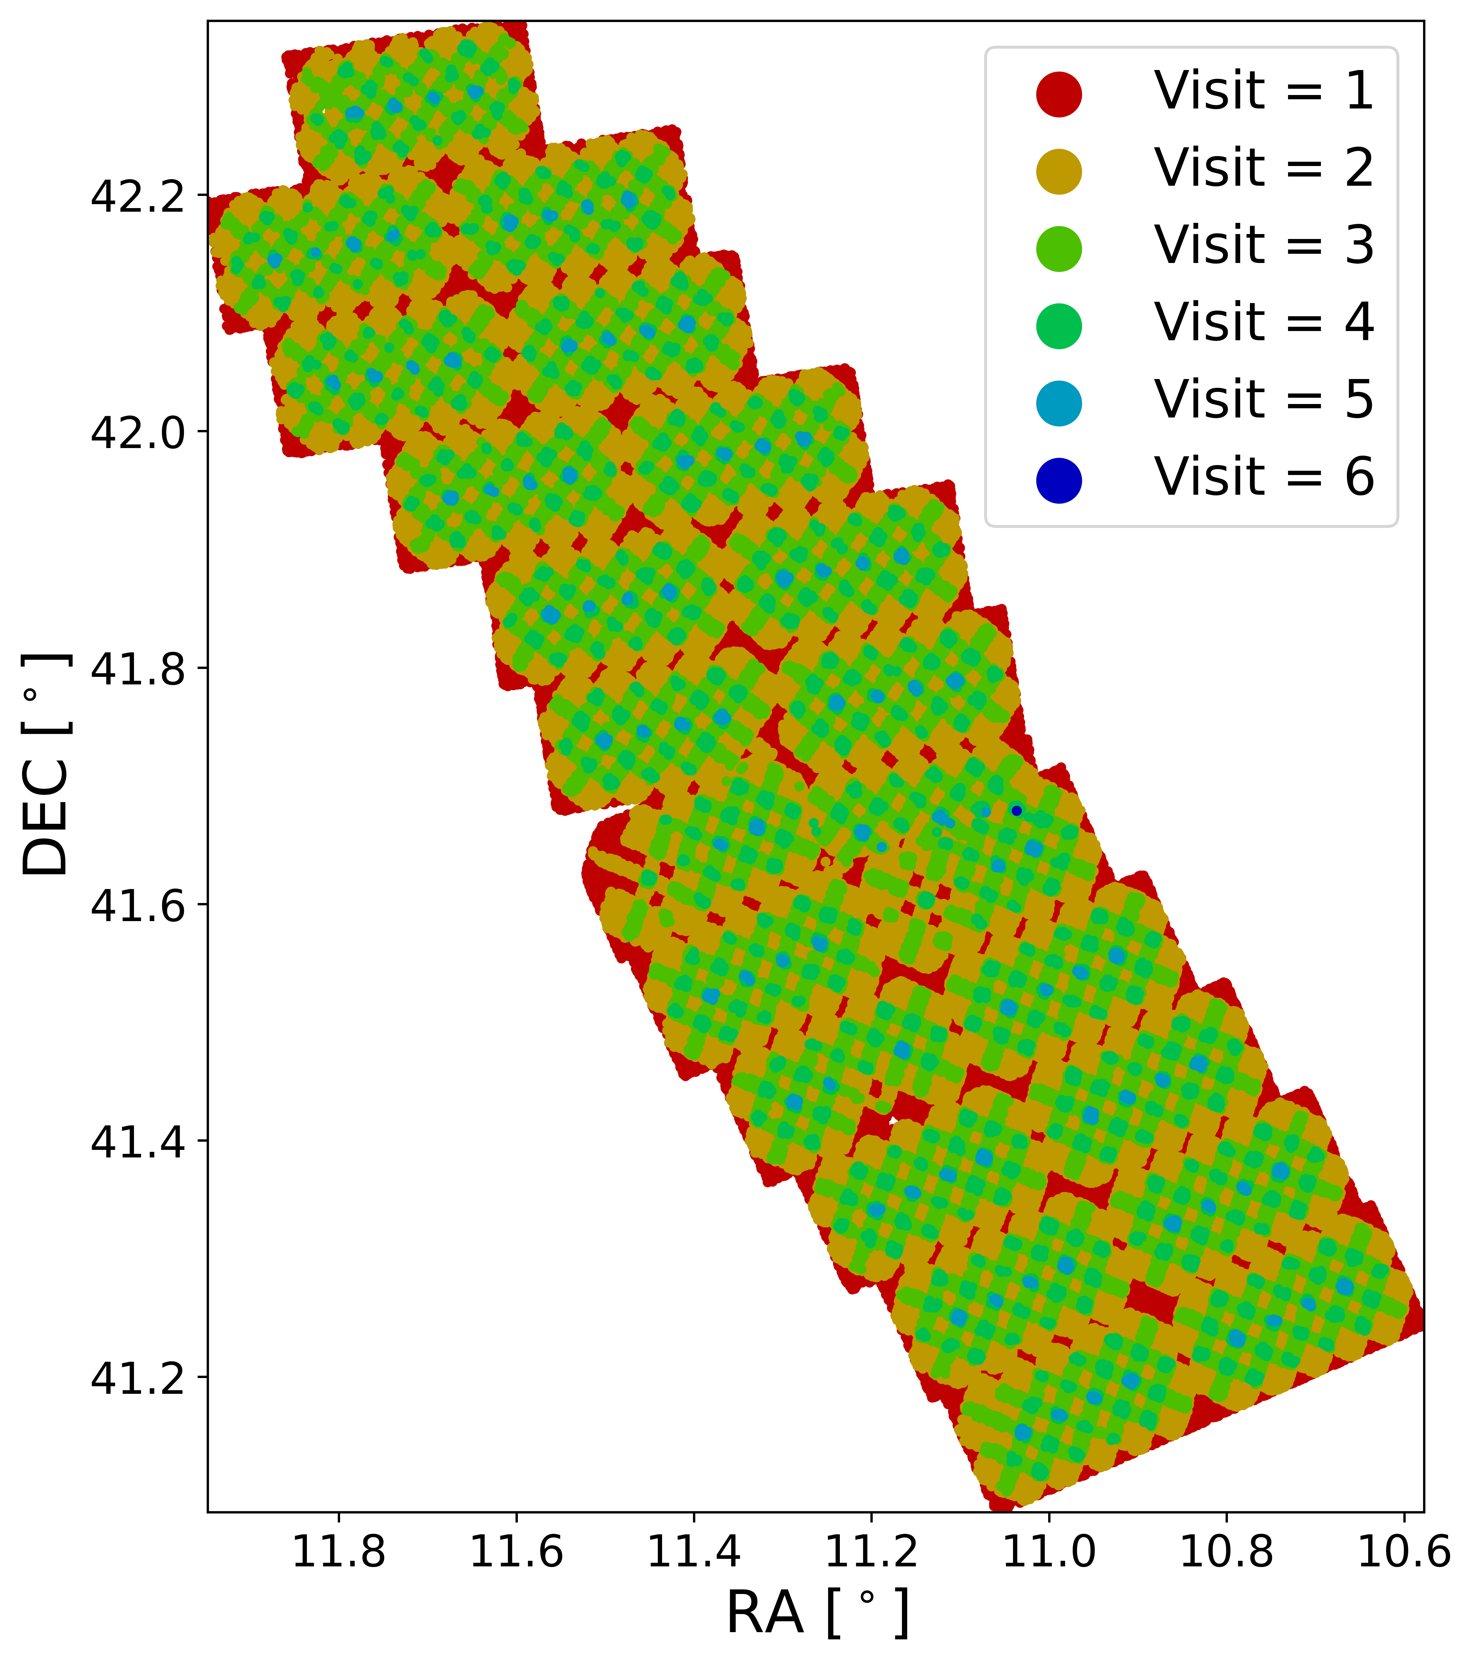
Panchromatic Hubble Andromeda Treasury (PHAT)
Mapped ~1/3 of M31’s disk (0.5 square degrees).
UV to near-IR in 6 filters; 2 instruments (ACS, WFC3).
ACS/WFC optical depths: F475W (27.9 mag) & F814W (27.1 mag).
Not designed as a time-domain study!
Divided into 23 ‘bricks’ of ~ 6’ x 12’, each containing 18 telescope pointings (‘fields’) - lots of overlapping!
Number of ACS/WFC F814W visits to representative sample of ~200,000 stars across the PHAT footprint.
Notes:
[PHAT] survey mapped roughly a third of M31’s disk, or 0.5 square degrees.
Used 6 HST filters in UV to near-IR and 2 instruments: the Advanced Camera for Surveys (ACS) and Wide Field Camera 3;
We focus on ACS and its most populous filters - F814W and F475W - [due to optical depths of 27.1 and 27.9 magnitudes, respectively.]
Notably, time-domain science was not a principle goal of the PHAT survey design!
Time-domain analysis is possible thanks to its design - dividing M31 into 23 ‘bricks’, each comprising 18 ‘fields’, with each brick observed in two halves 6 months apart by both instruments, producing overlaps as shown in the figure on the right.

Slide 4
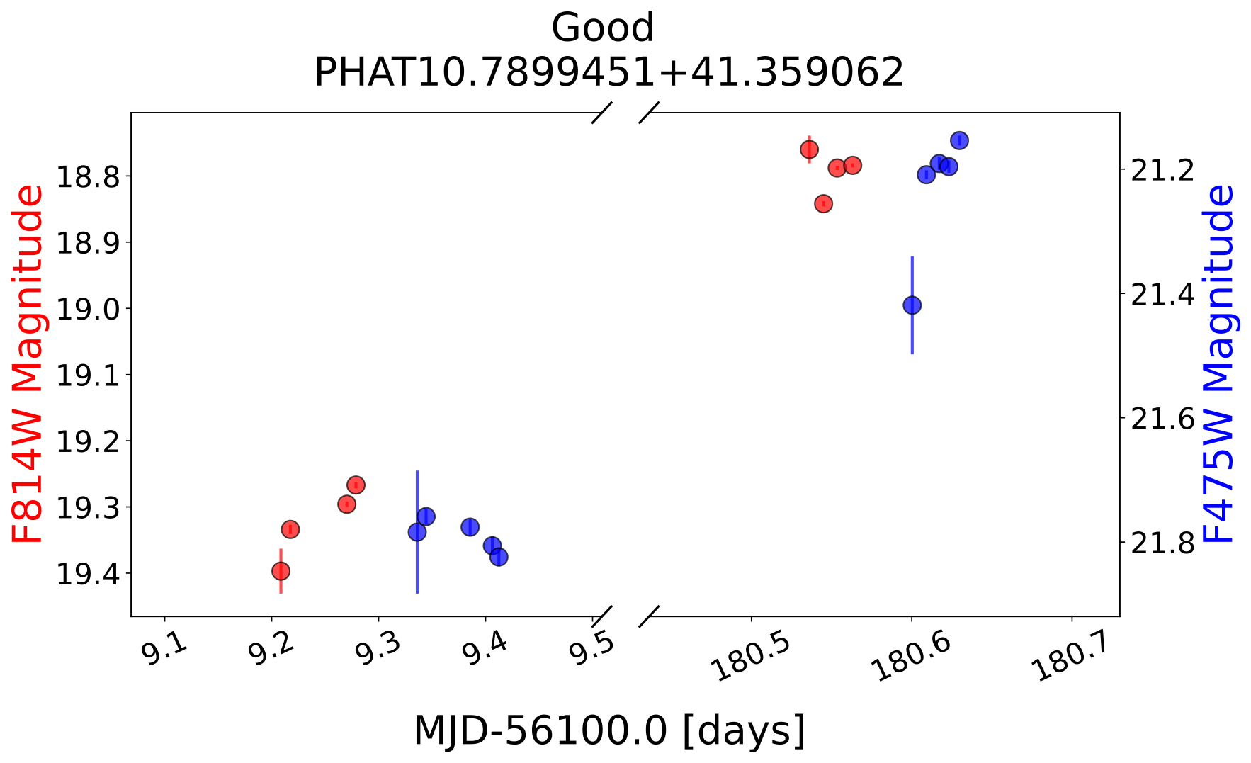
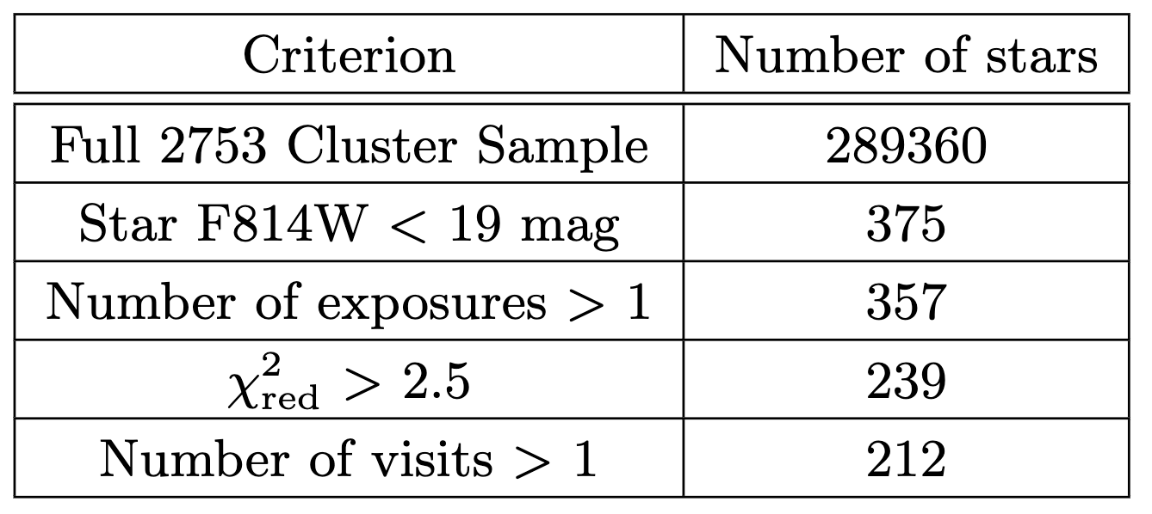
Identifying candidate variables
Step 1: Light curve analysis
Breakdown of candidate cluster variable stars identified through the various thresholding stages applied.
Example F475W (blue) & F814W (red) light curves for a cluster variable star in the PHAT survey (confirmed via difference imaging).
Notes:
How do we identify cluster variable candidates?
Over 117 million stars already identified within PHAT survey footprint by Williams et al 2014, which we use as our starting point.
We first applied a serious of thresholds and cutoffs in various parameter spaces, summarized by the table shown on the left.
Due to highly crowded cluster environment, we consider only luminous stars.
We essentially follow 3 steps to identify cluster variable stars:
Step 1 is to detect variability in their measured PHAT light curves, as shown in the figure on the left, [using reduced chi square and mean light curve magnitude to identify variability].
Clearly a sparse light curve! This is certainly one place Roman could provide some improvement thanks to larger FOV and slew times etc. [or perhaps Roman could extend/compliment observation baseline.]
This light curve analysis gives a list of candidate cluster-variable stars.
————————————————————————————————————————————————————————
We considered PHAT catalog stars within the 2x the effective radius of each M31 cluster to be within that cluster; we ensured sufficient data were available to actually produce at least an amplitude measurement for the star from available PHAT data.
We then produced light curves for each of these stars focusing on F475W and F814W as the most populous filters in the PHAT dataset,
Our reduced chi-squared 2.5 threshold is based on similar analysis performed on Cepheid variable stars which show an increase in reduced chi-squared at 2.5 concurrent with their known variation periods.

Slide 5
Identifying candidate variables
Step 2: Difference Image
Note: we only use PHAT photometry; difference images are for variability verification only.
Breakdown of candidate cluster variable stars identified through the various thresholding stages applied.
Example difference images used to verify the light curve variability of stars; crosshairs denote a detected difference image counterpart detection within 0.11” (1x ACS FWHM) of candidate variable positions.
Notes:
We then produce difference images for our candidate cluster-variable stars, identifying counterpart detections for each candidate.
Example difference images are shown on the right, with the red crosshairs denoting the measured PHAT locations of the candidate stars.
Candidates with counterpart detections within 0.11 arcsec (1x ACS FWHM) are then considered confirmed variables.
Note that we do not re-measure photometry - we only use difference imaging to verify candidate variables. [No need to re-invent the wheel when PHAT photometry is well understood and described!]

Slide 6
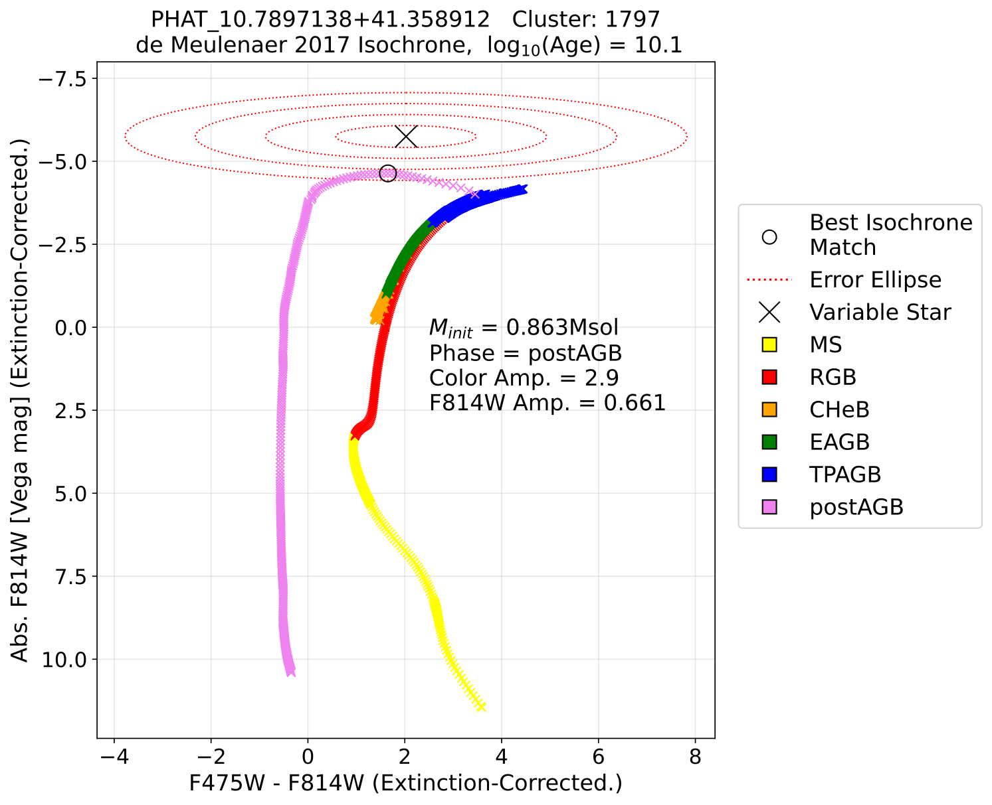
Identifying candidate variables
Step 3: Isochrone Matching
Breakdown of candidate cluster variable stars identified through the various thresholding stages applied.
Example cluster variable star CMD, including its host cluster isochrone and error ellipse scaling used to calculate the most probable isochrone datum.
Notes:
We then use the known properties of each variable star’s host cluster to obtain stellar properties, namely initial mass and evolutionary phase, via isochrone matching.
The ellipses shown here denote the measured variability in colour and magnitude of the star, which we take into account in isochrone matching.
Via this process, we identify 89 cluster-variable stars with variability confirmed via light curve and difference image analysis.

Slide 7
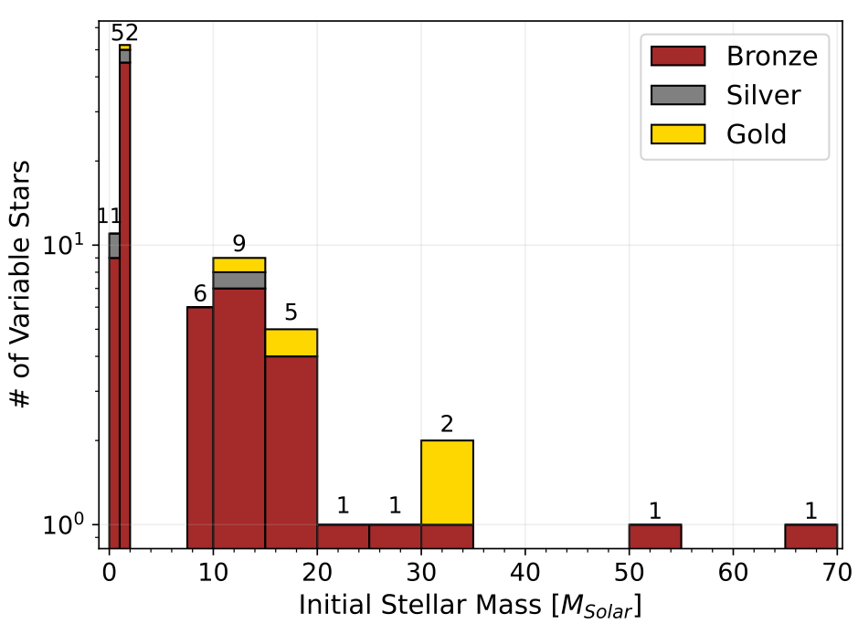
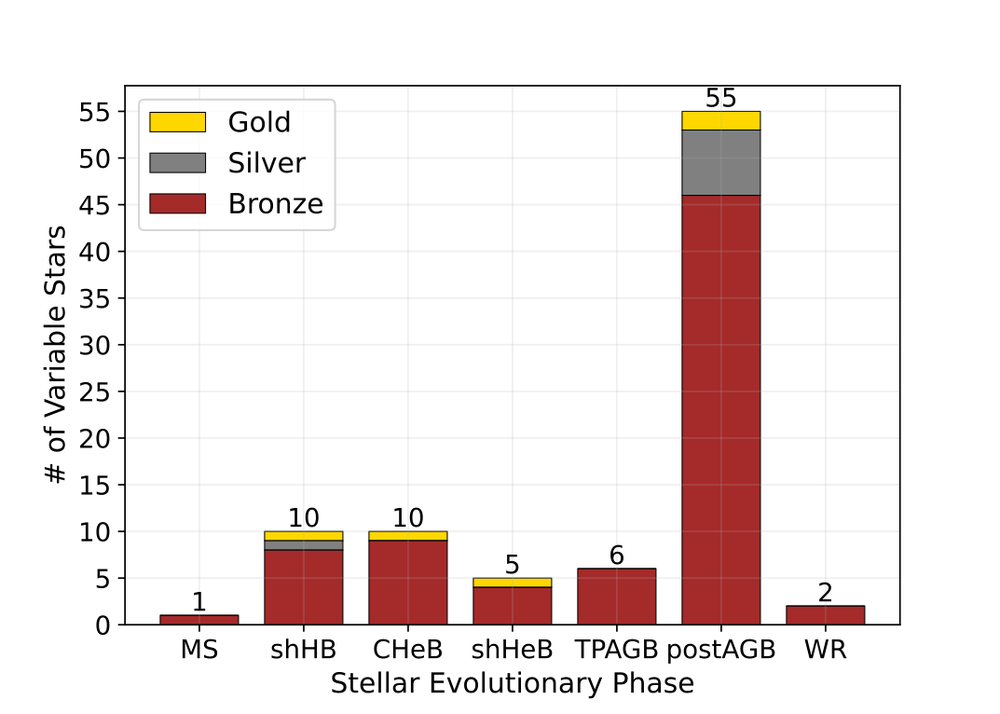
Variable physical parameters
Initial stellar mass distribution for the 89 confirmed cluster variable stars in our sample.
Stellar evolutionary phase distribution for the 89 confirmed cluster variable stars in our sample.
Notes:
These are the resulting distributions in initial stellar mass (left) and stellar evolutionary phase (right).
Clearly a large number of post-AGB stars - which is unlikely considering their age, however you will notice the Gold/Silver/Bronze bars.
These denote our level of confidence in each result, based on the quality of the counterpart difference image detection and, importantly, the likely impacts of blending on PHAT photometry caused by the highly crowded cluster environments.
So though there are a majority of post-AGBs, only 2 are of higher confidence in our sample, with the rest having photometry likely affected by blending.

Slide 8
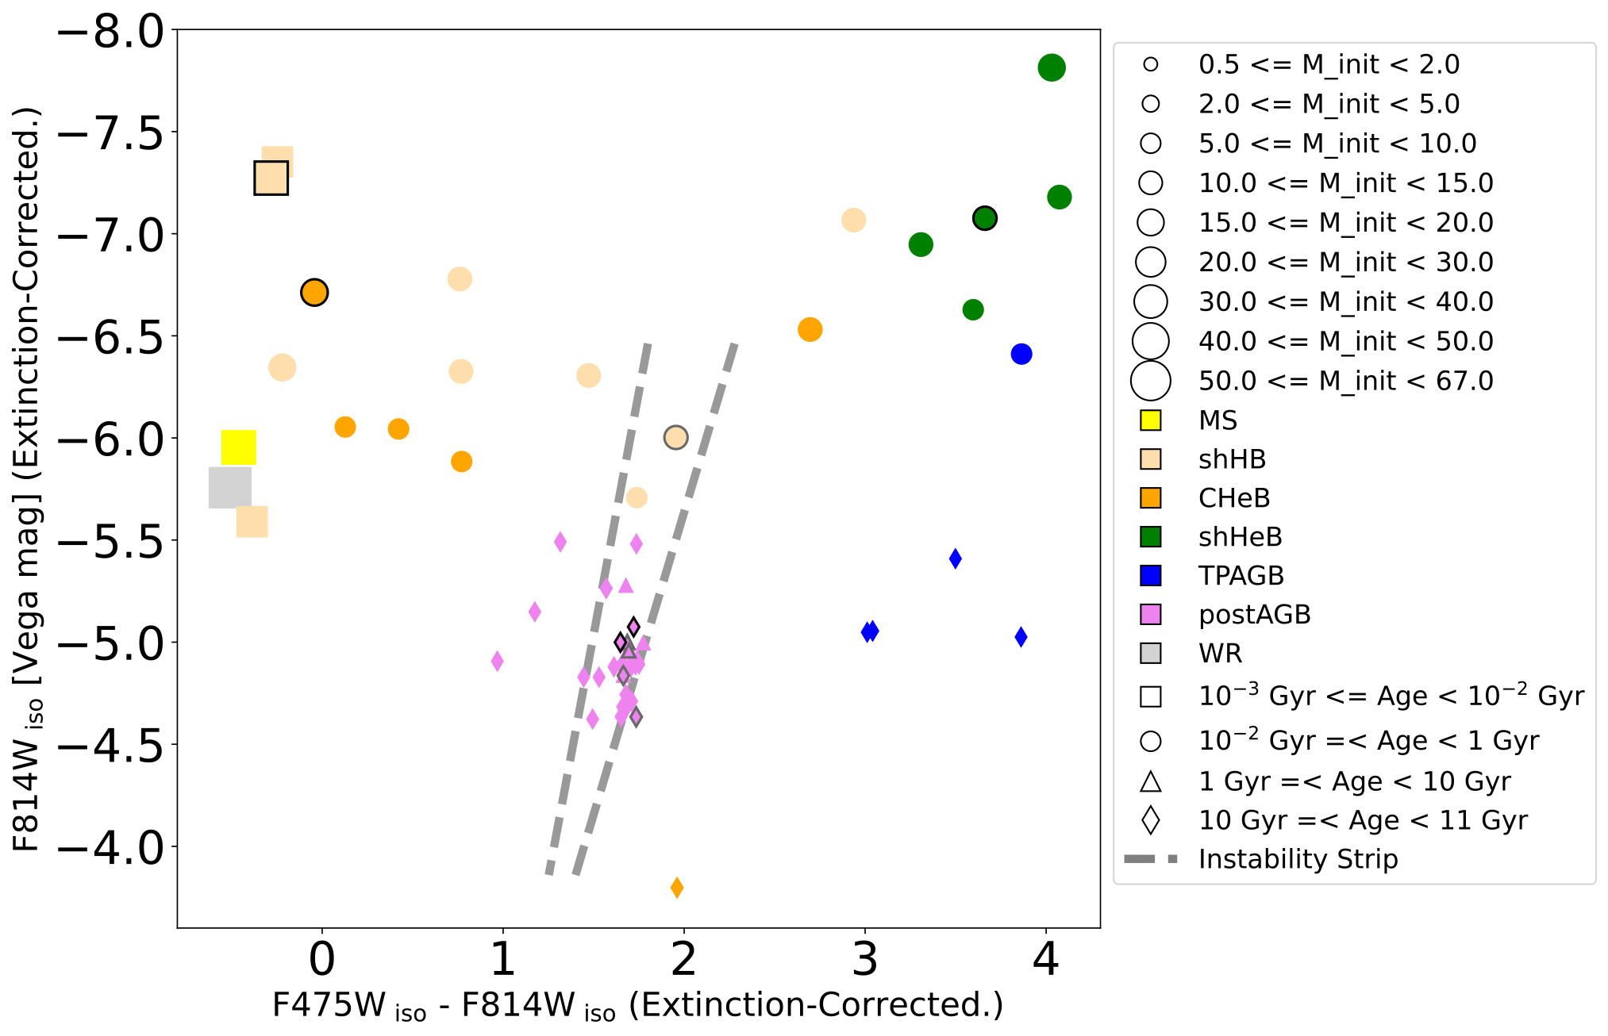
Isochrone-based variable CMD
Notes:
This is the resulting CMD for all 89 variables, using the isochrone-derived color and magnitude values (rather than observed PHAT values)
[This effectively provides their equilibrium point on the CMD based on available data and isochrone fitting].

Slide 9
Isochrone-based variable types
Red supergiants
Candidate Super-AGB
$α$ Cygni
Candidate Mira variables
RV Tauri stars
Notes:
Based on the isochrone-derived properties, we assign likely variable star classes to the 89 stars in our sample.
Highlighting just a few;
The luminous, red supergiants in upper right (initial masses greater than 8 solar masses);
Candidate Mira variables, with their red color, lower luminosity and mass;
Candidate Super-AGB star - though limited data, so follow-up would certainly be required!

Slide 10
Caveats
PHAT photometry of all cluster stars affected by blending.
Sparse PHAT light curves mean only lower limits on variability obtainable.
Results highly dependent upon accuracy of isochrone modeling and cluster properties in literature.
Lacking uncertainty estimates/constraints on cluster properties.
Assume single-star systems for isochrone generation.
Use of single cluster age & metallicity assumes all stars co-evolved.
Still, results are consistent with known variable classes.
Notes:
There are, of course, a number of caveats and assumptions we have made in this study;
Perhaps most influential is PHAT photometry of all cluster stars, which our study is based on, is affected by light blending.
Sparse light curves means we can only obtain lower limits on variability.
Results are dependent on accuracy of isochrone modeling and literature values, with the use of single cluster age & metallicity making the assumption of co-evolved stars.
All that said - the variables we identify span a range of classes, and match up remarkably well with the known properties of variables!

Slide 11
Summary
Identified & characterized 89 M31 cluster-variable stars from PHAT survey data;
Variability identified through light curve analysis, confirmed via difference imaging.
Obtained variable star initial mass and evolutionary phase from host cluster theoretical isochrones.
Attribute likely variable star types based on physical parameters and measured photometry.
Notes:
To summarize:
We have identified and characterized 89 variable stars in M31 clusters from PHAT survey data;
We obtained physical parameters for these stars through isochrone matching, allowing us to attribute likely variable star types based on physical parameters and measured photometry.

Slide 12
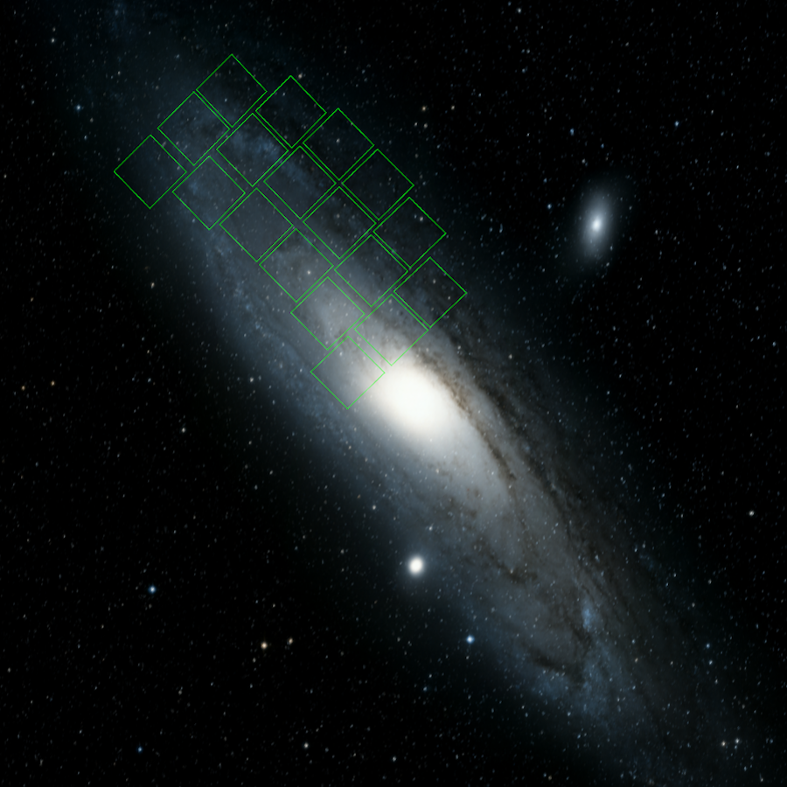
Key takeaway:
89 cluster-variable stars from a spatially limited, non-time domain HST survey;
What could Roman provide?
Roman WFI footprint on DSS image of M31; credit STSci, https://www.stsci.edu/roman/science-planning-toolbox/field-of-view-overlay
Notes:
But boiling it down, the main, key takeaway from this talk is:
We got 89 variable stars from a Hubble survey not designed for time domain study
Just imagine what’s we could we get with something similar, let alone a targeted survey, using Roman!
Thank you, and happy to take questions.

Slide 13
Left: reduced chi-squared vs. temporal baseline for 375 luminous PHAT cluster stars. Right: reduced chi-squared vs. temporal baseline for field Cepheids from Wagner-Kaiser+ 2015.

Slide 14
Difference imaging confirmation
Align science to template frame
Match template background to science
For each host cluster:
Produce 250 x 250 pixel (12”.5 x 12”.5) cutouts per brick-field ‘visit’.
Identify frame with lowest PSF resolution using non-cluster stars
Template (first) frame
Science frames
Difference image using Optimal Image Subtraction kernel, K:
Per science-template pair:

Slide 15
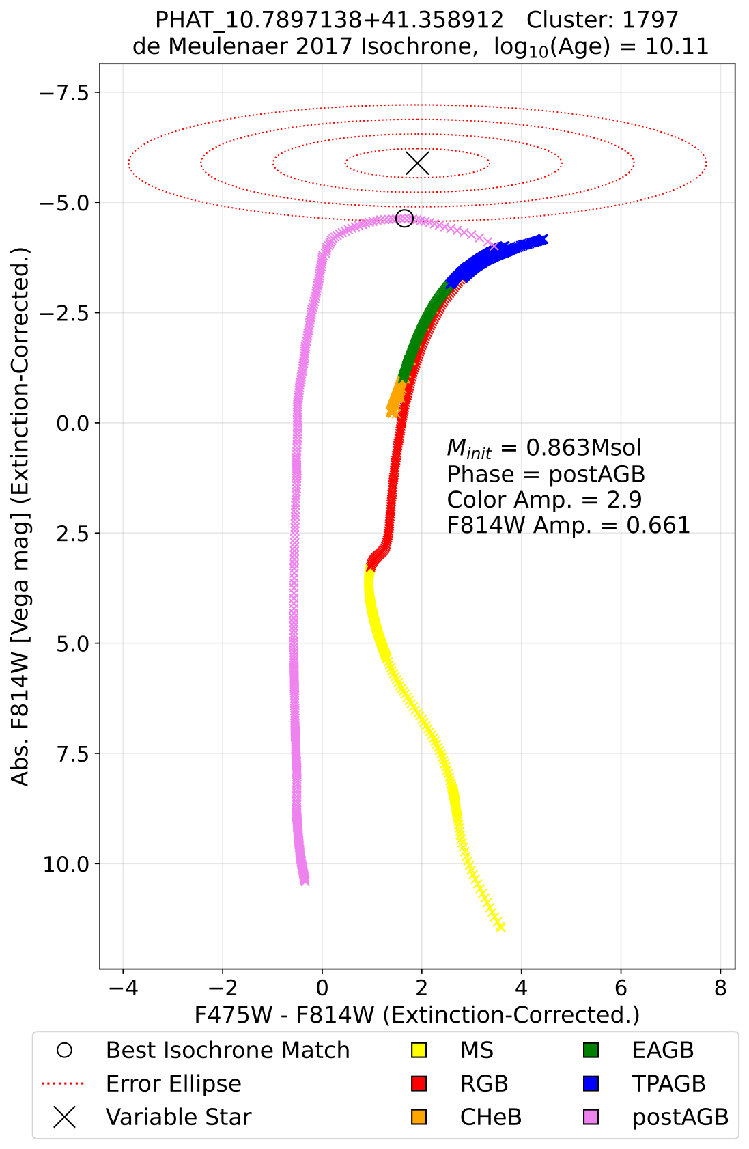
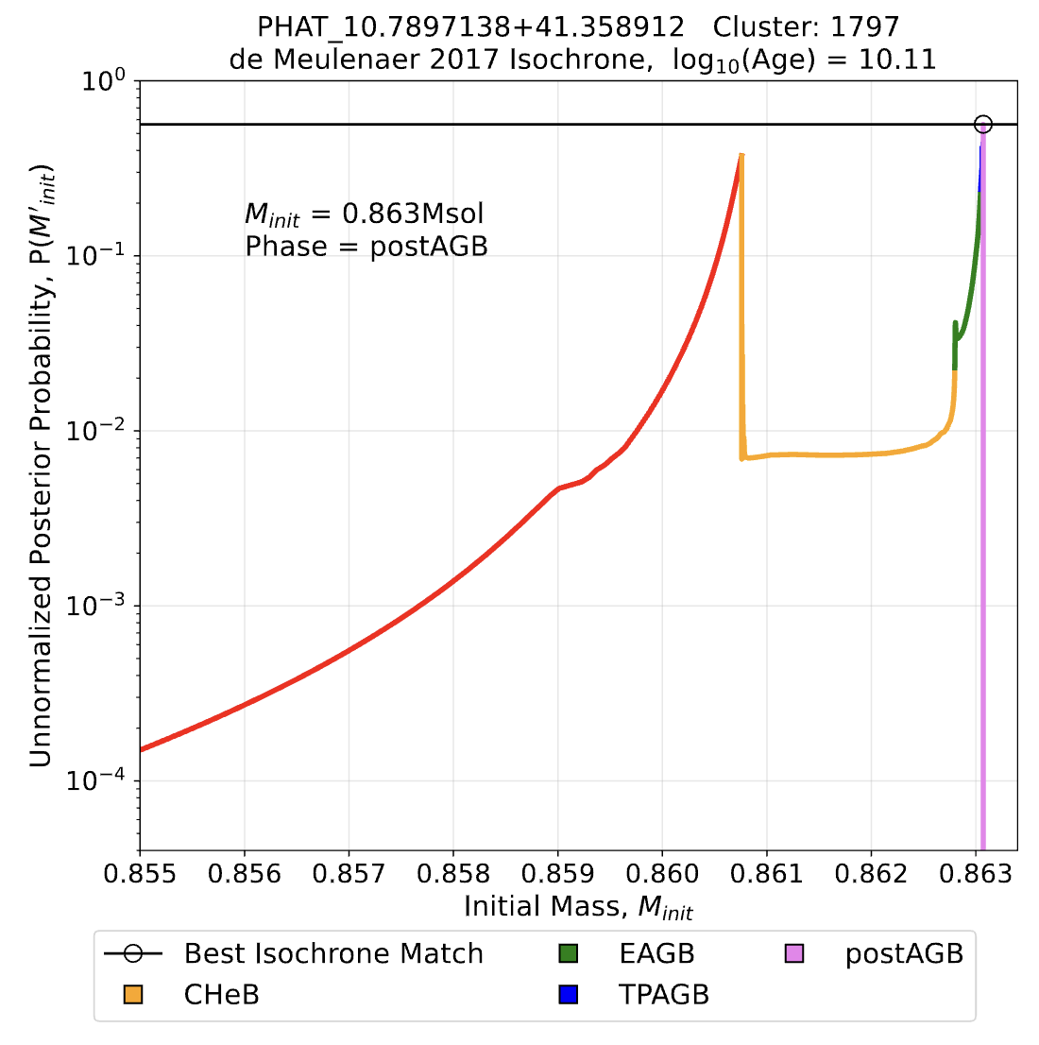
Initial stellar mass vs (unnormalised) occupation probability
CMD showing measured PHAT photometry, host cluster isochrone and light curve-based error ellipse.
Notes:
We then produce theoretical isochrones for each host cluster using the MIST web interpolator, using cluster properties from the literature [de Meulenaer et al 2017].
For each confirmed cluster variable star, we use its measured PHAT photometry and host cluster isochrone to calculate occupation probabilities along the isochrone, taking the properties of the most probable isochrone datum as those of the variable star.
But since PHAT light curves are sparse, the PHAT photometry only provides a lower limit in light curve and color amplitude
We therefore scale-up the PHAT light curve and color amplitude of the star as ellipses on its CMD until it intersects the host cluster isochrone, as shown by the ellipses on the right, using the scaled-up amplitudes as our uncertainties in calculating the occupation probability.

Slide 16
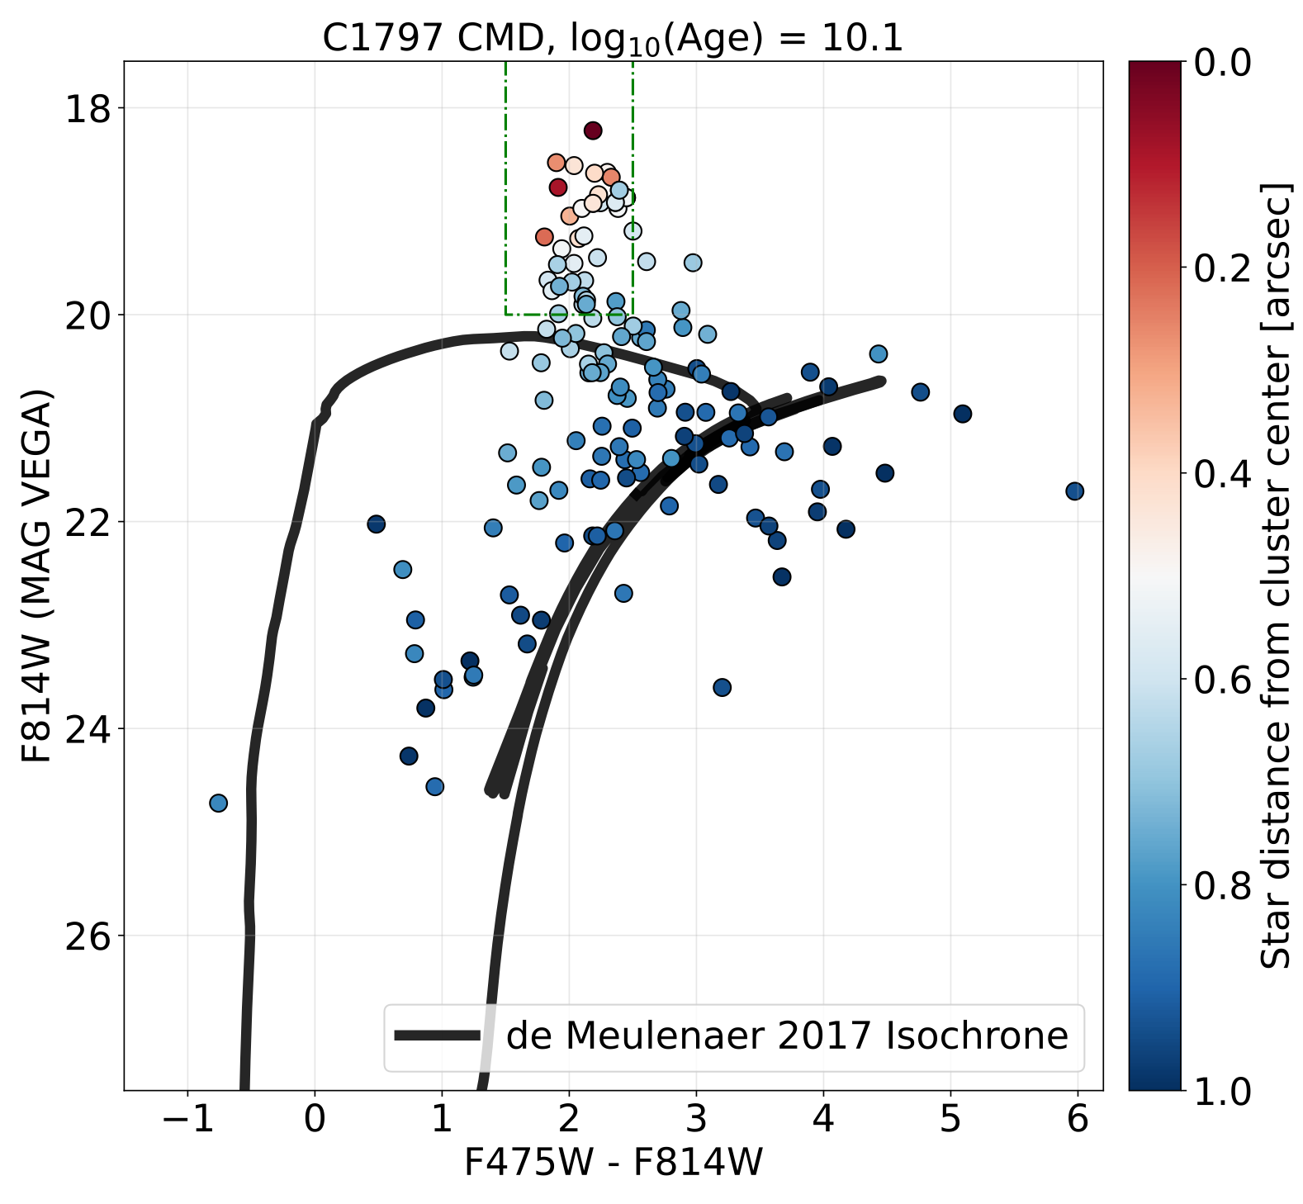
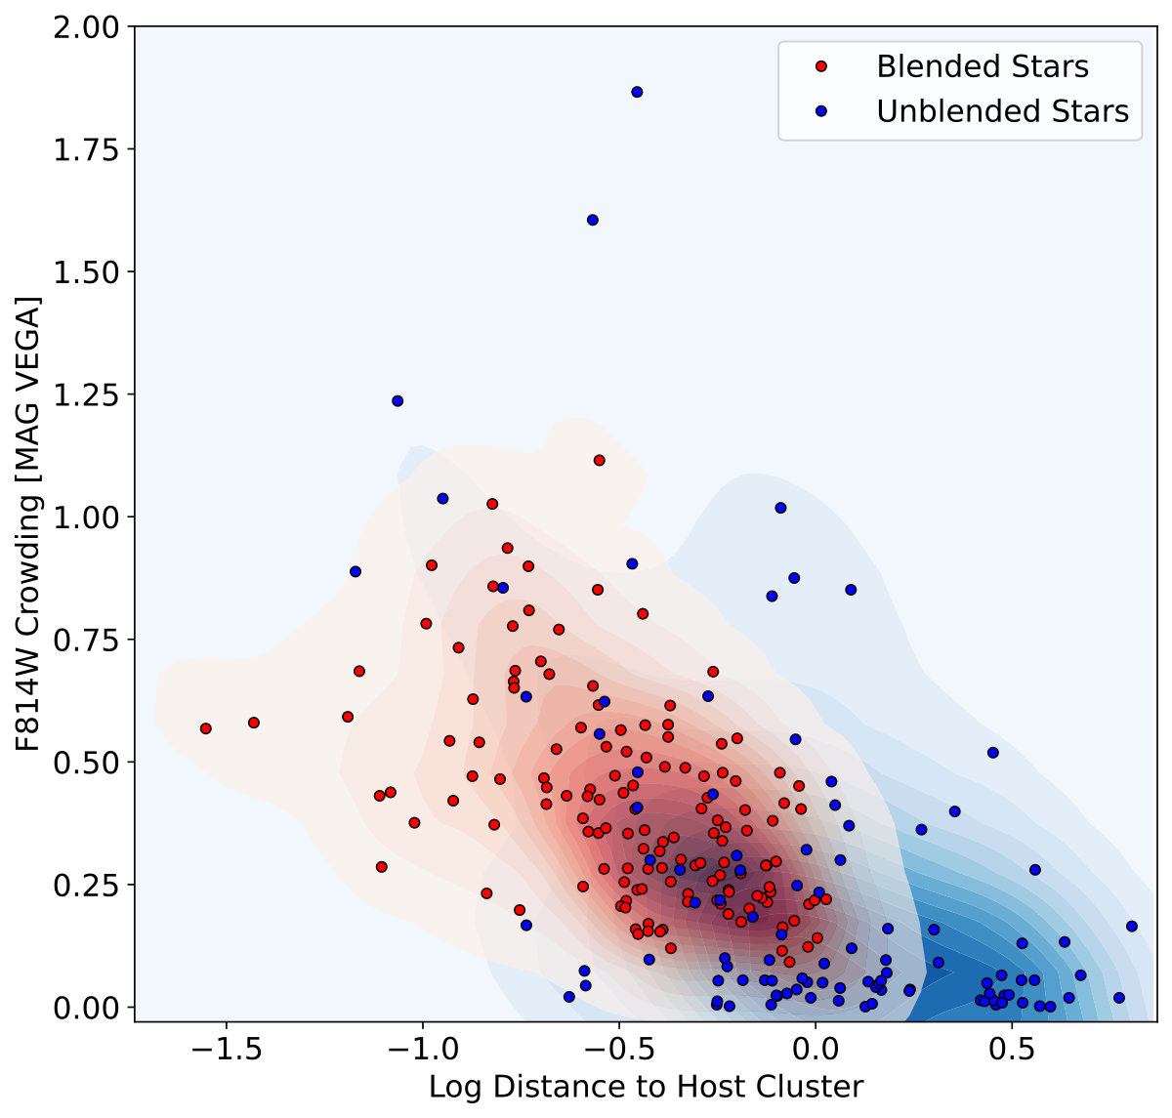
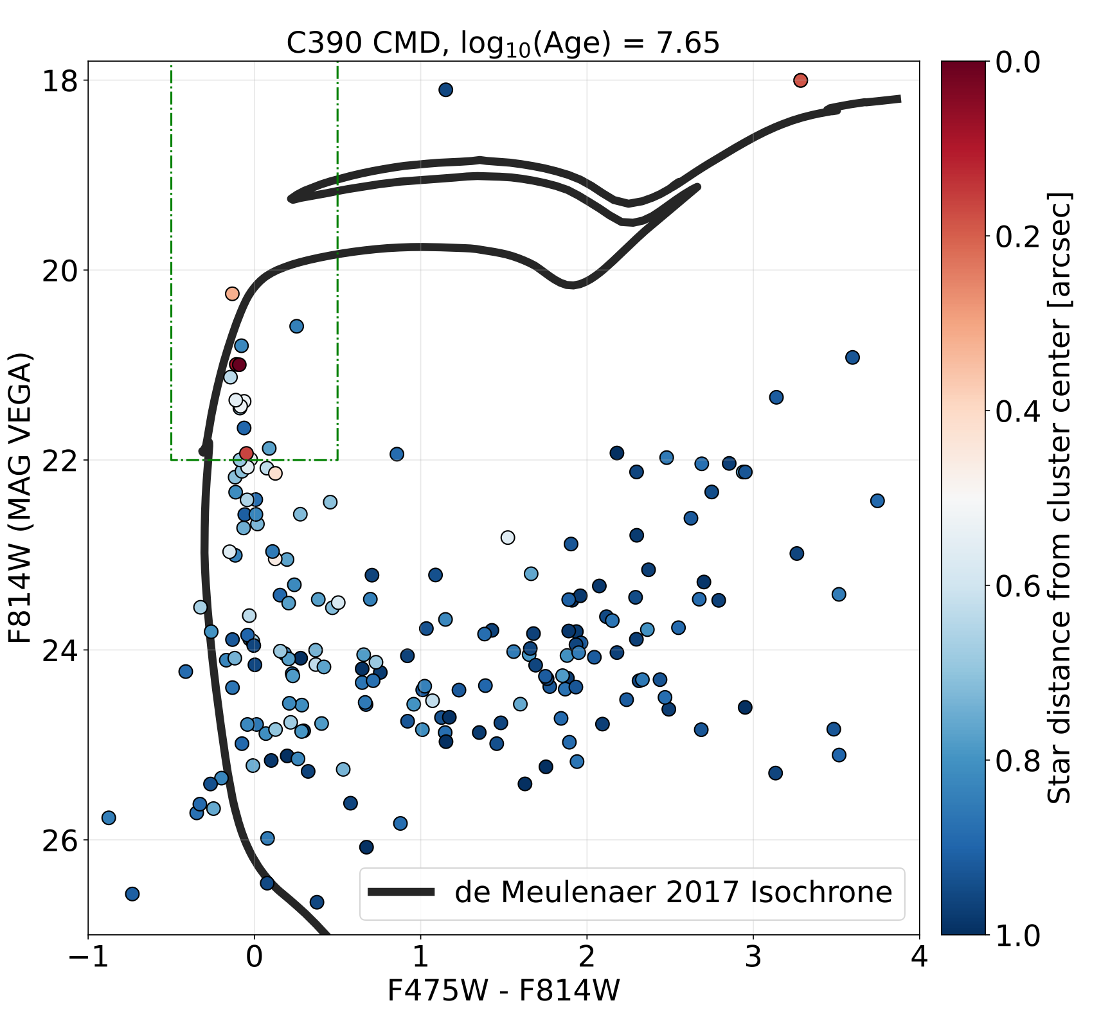
Blending probability
Blended cluster example CMD, with blending-boosted ‘plume’ stars used for KDE estimation highlighted.
Unblended cluster example CMD - stars in agreement with host cluster isochrone used for KDE estimation highlighted.

Slide 17
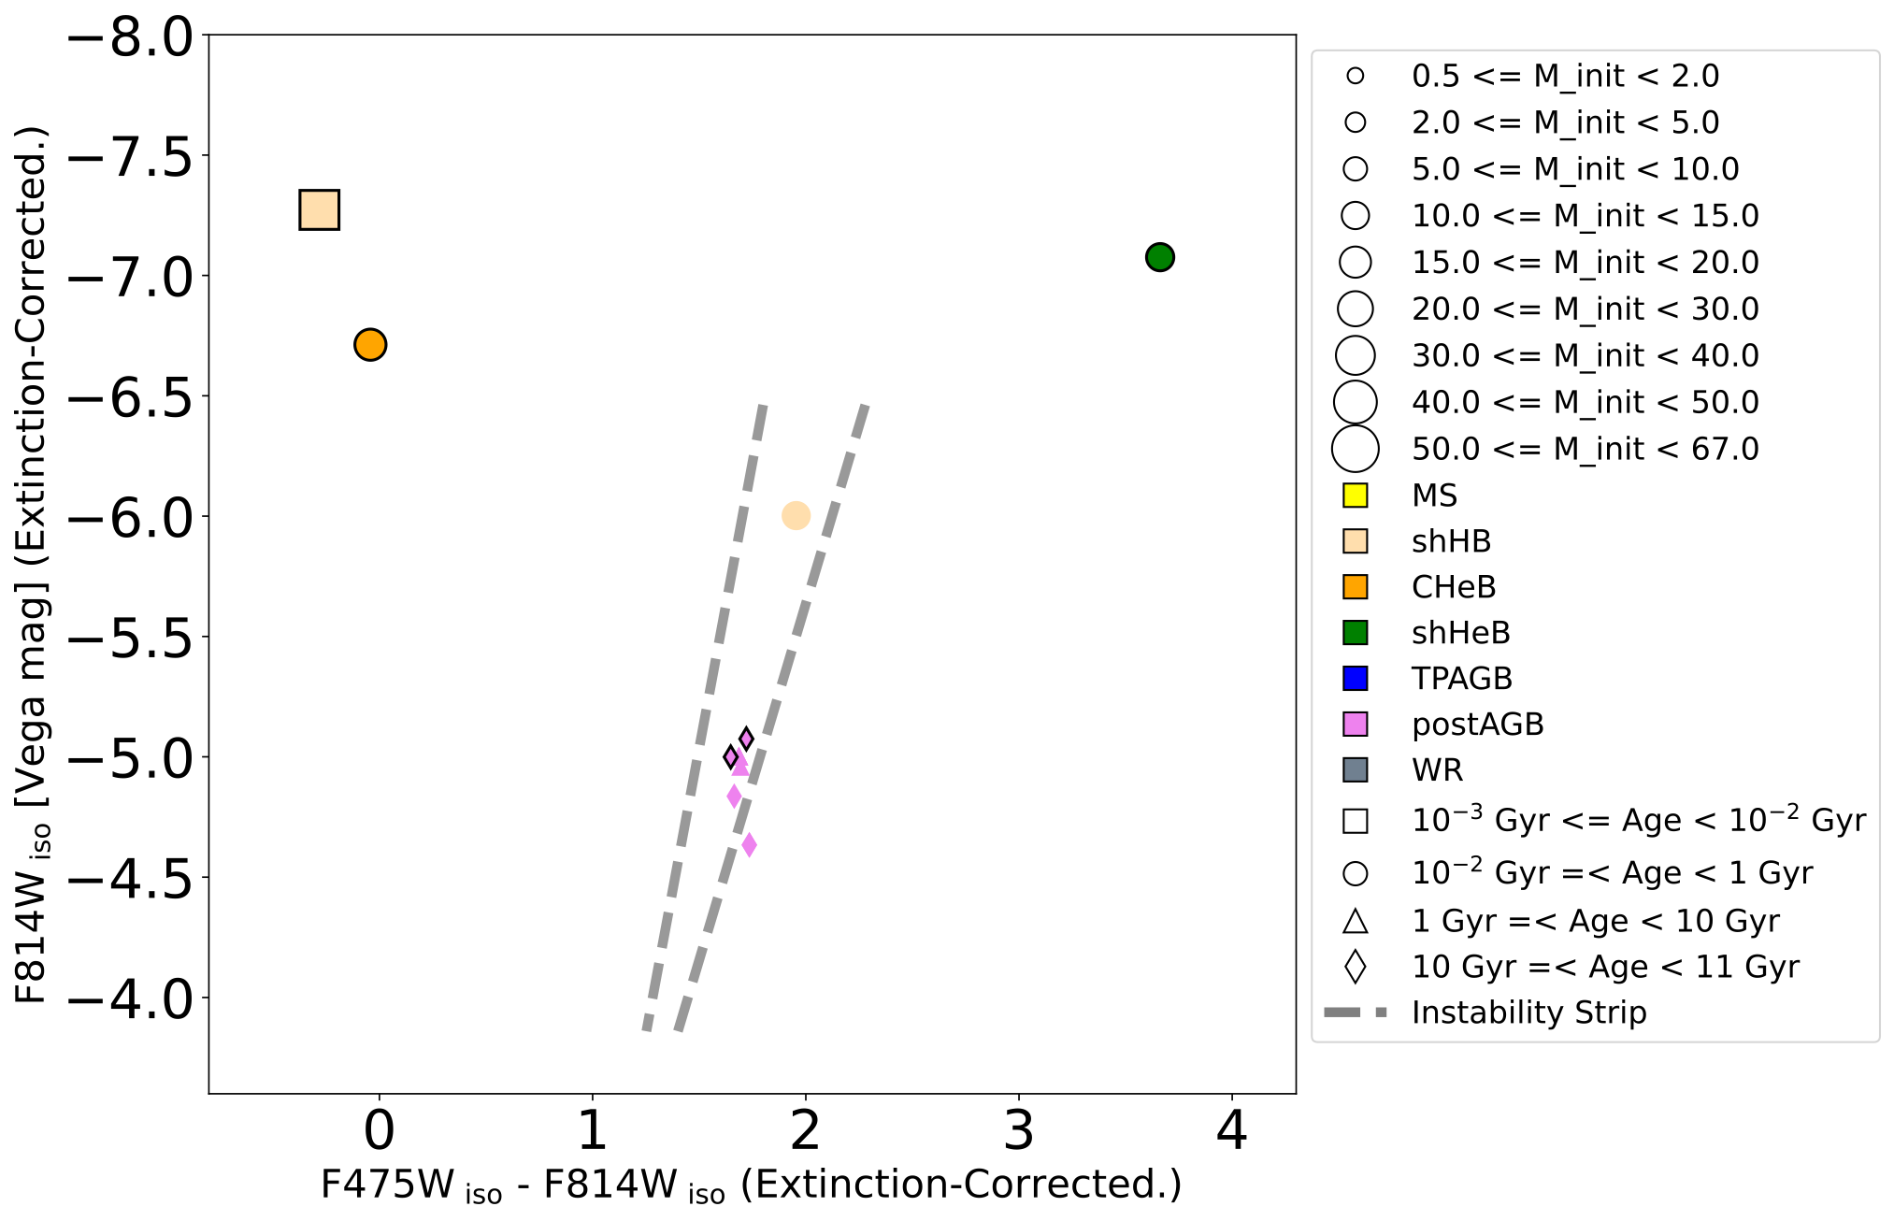

Slide 18
Roman
Compliment and extend previous studies/surveys (e.g. PHAT).
Increase sample size - improve modeling.
Specifically designed/targeted surveys;
Target specific variable star types
Target specific variable periods
Provide baseline for follow-up/future surveys

