Slide 1

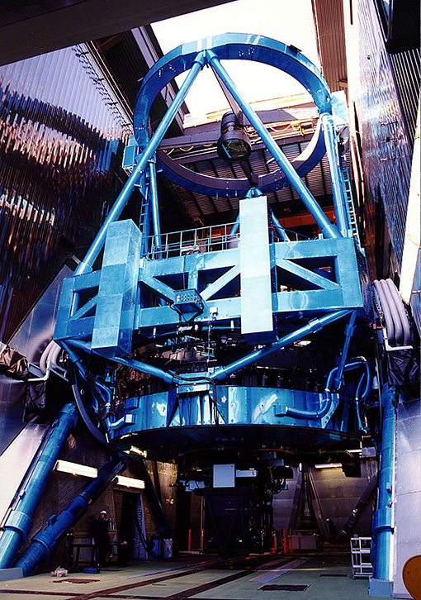
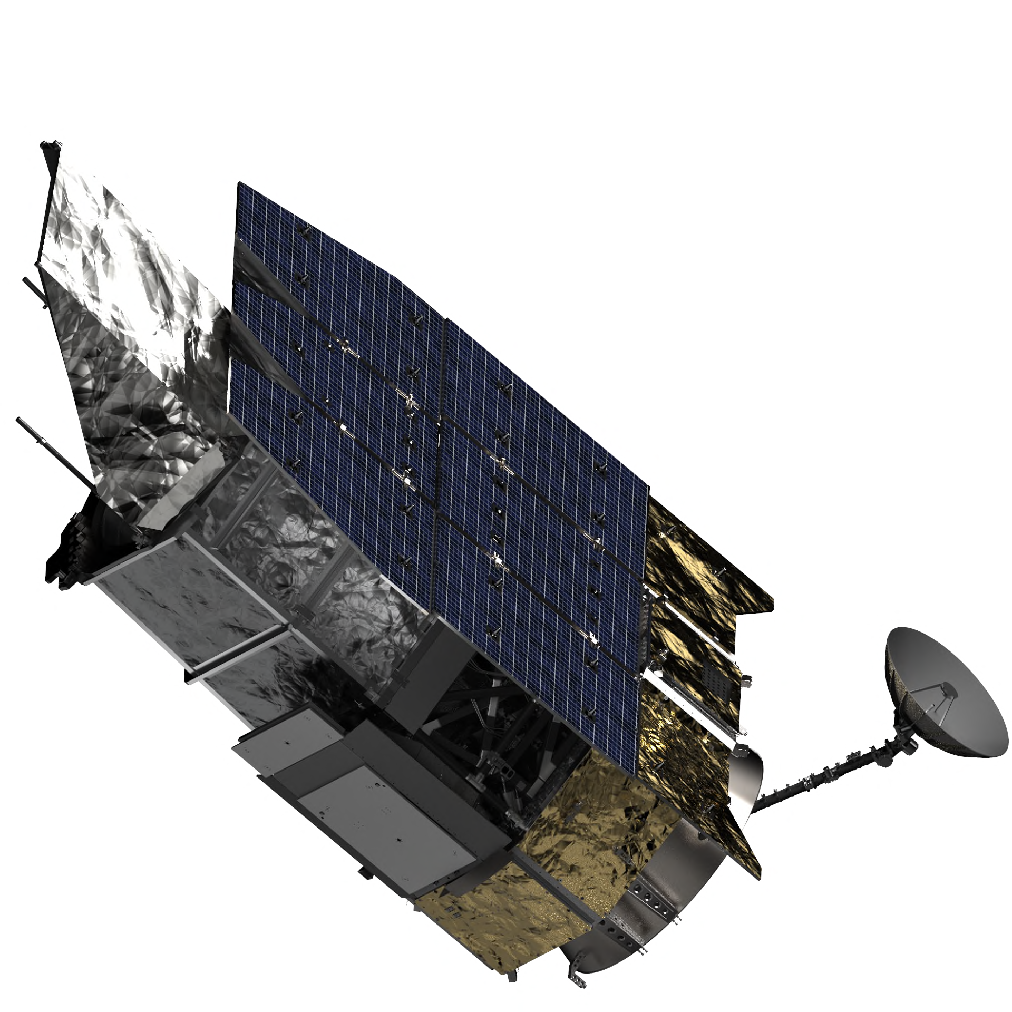
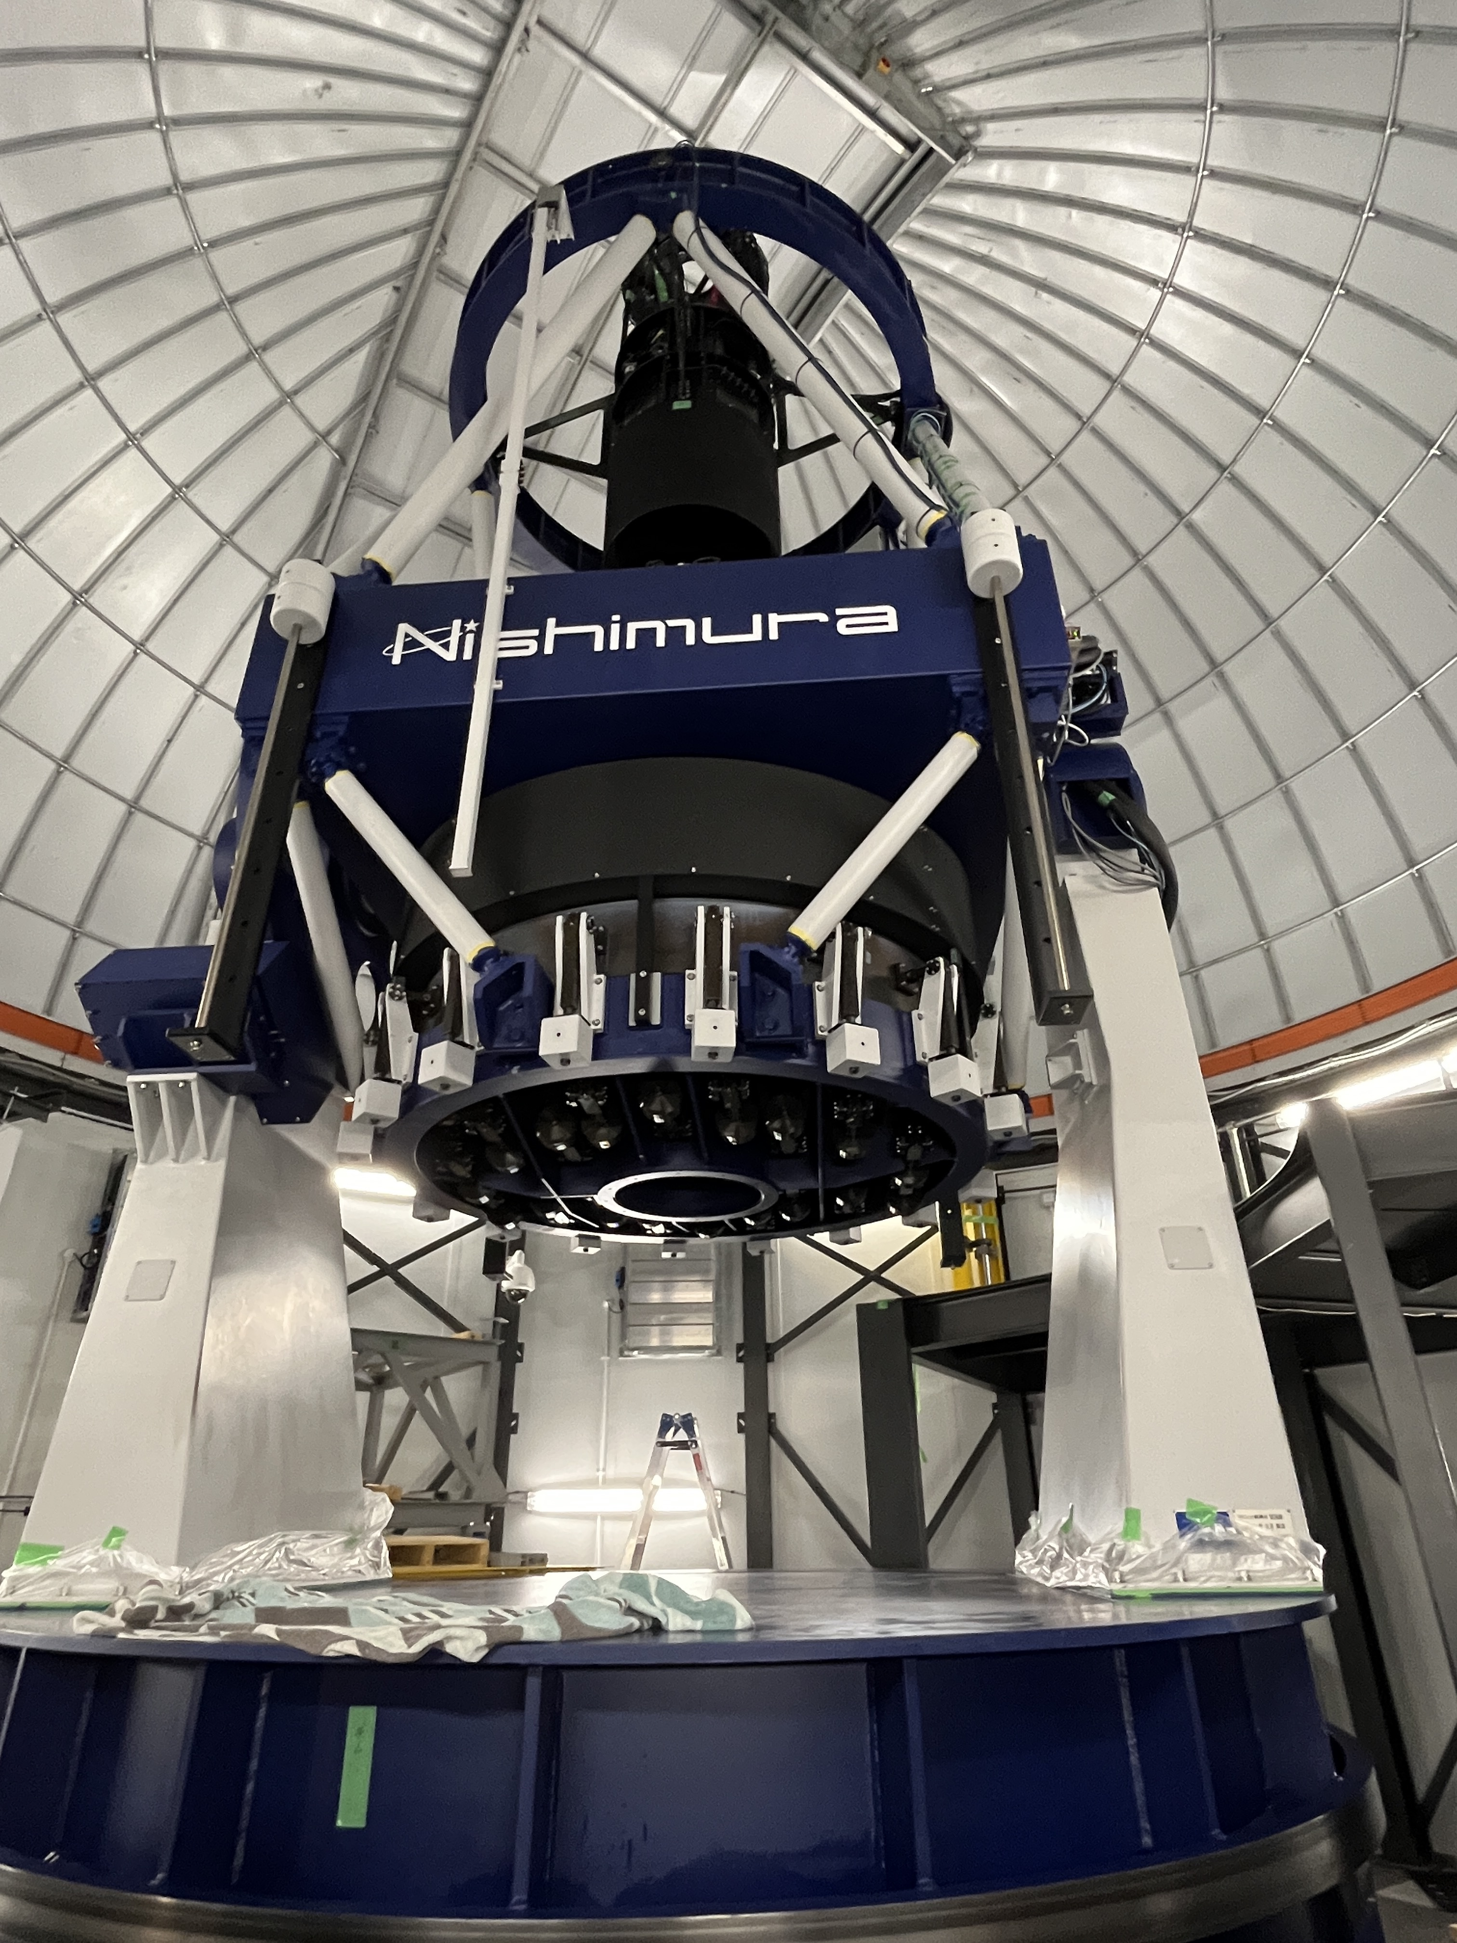
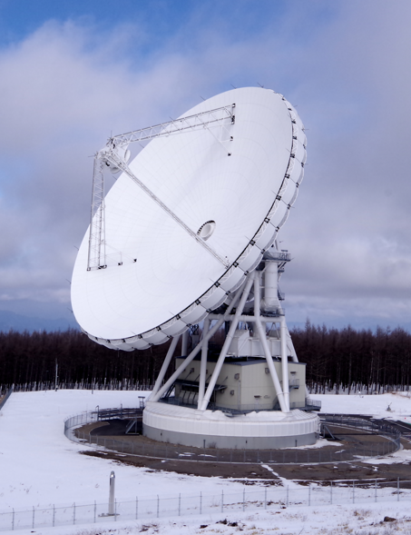
Status of JAXA contributions to
Roman Space Telescope
Sumi（Osaka U.） JAXA Roman-J Project
2024/7/9, Challenging Theory with Roman＠Caltech
Notes:
0.25

Slide 2
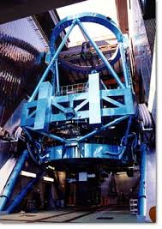
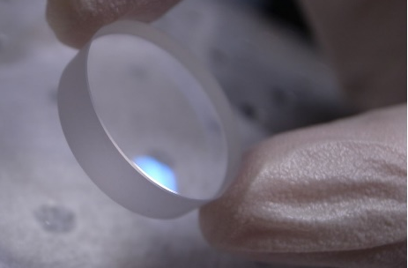
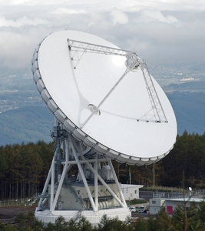
Japanese Contribution “Package” for Roman
■ JAXA Roman-J team (Team leader: T.Yamada, PI：Sumi）
1. Roman-Subaru Synergistic Observation (100nights from 2027)
    photo-z calibration (PFS etc.)
    Narrow band filters (HSC etc.)
2016/11：Director of Subaru telescope and Subaru SAC、
agreed to the Commitment
  ２．Contribution to Coronagraph Instrument
・Polarimetry unit assembled in FM CGI
・coronagraph mask substrates assembled in FM CGI
３．Ka-band Data Downlink Station in Japan
In construction
４．Ground base microlensing data sharing（MOA） done
pre/concurrent Ground microlensing obs.
with new 1.8m PRIME telescope . In operation
Subaru 8.2m
Mask substrates
GREAT:54m
PRIME1.8m
Notes:
1

Slide 3
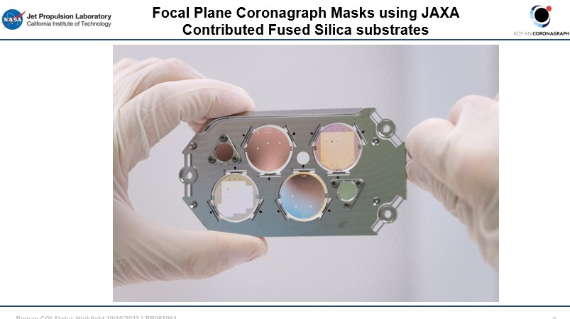
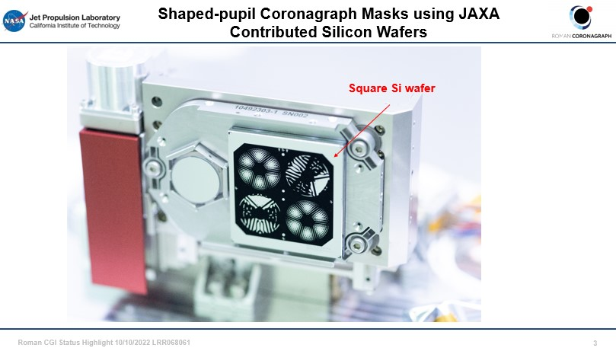
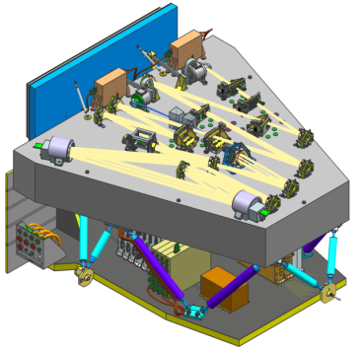
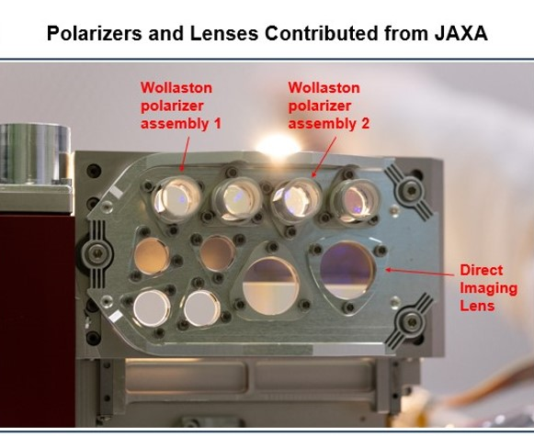
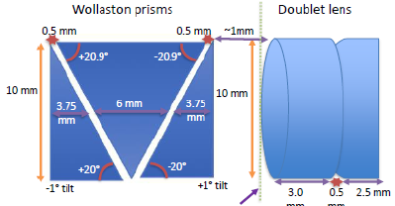
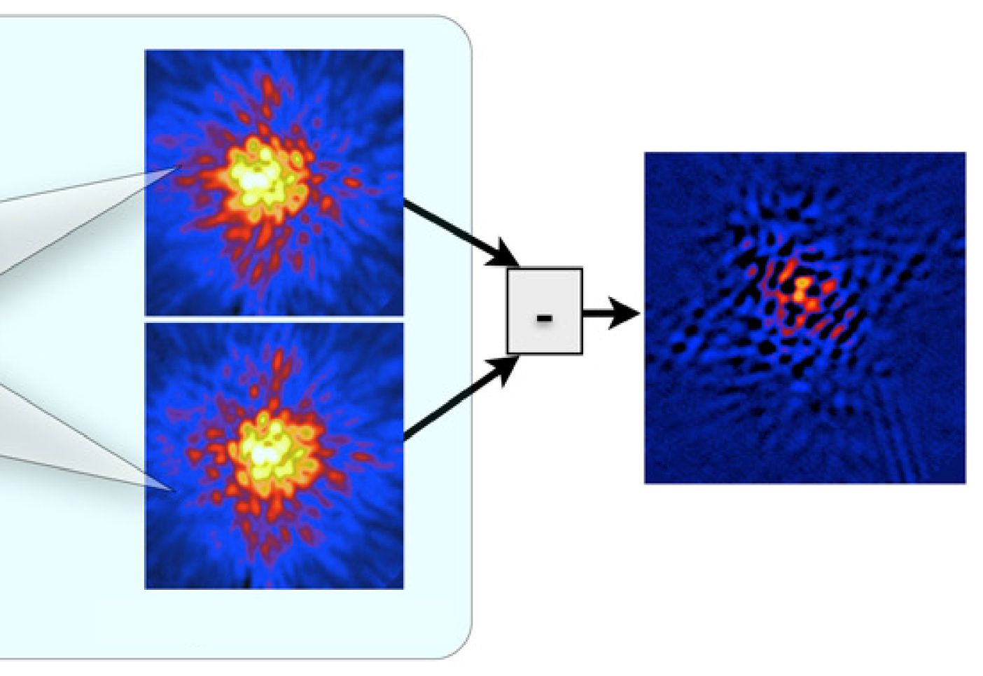
Coronagraph Instrument: JAXA contribution
Focal Plane Mask in FPAM
Provided High precision mask substrates.
(fabricated by NASA and assembled to optical interface).
Polarimetry Unit (Wollastron Prisms and camera Lenses are designed and fabricated in Japan, assembled to CGI)
  Polarimetry of planetary reflections ➡Improve effective contrast by 1-2 orders of magnitude
  Polarimetry of protoplanetary disks ➡Disks in terrestrial planet forming regions
Shaped-pupil Mask in SPAM
Polarization Unit in DPAM
Double
Difference Image
CGI
Orthogonal Polarizations (o- & e-rays)
(Perrin et al. 2015, ApJ)
Notes:
1

Slide 4
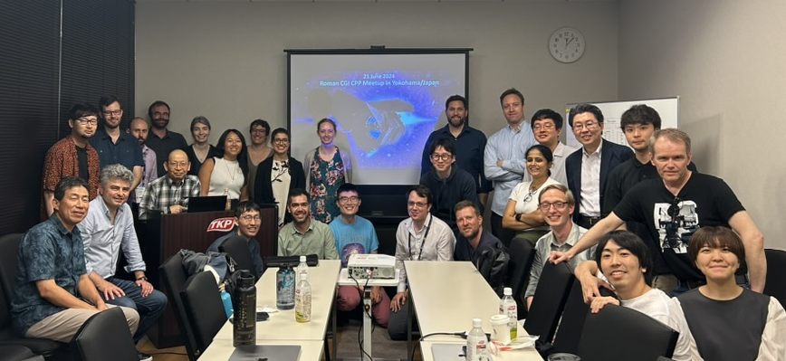
JAXA’s Participation for Roman CPP
18 Japanese scientists signed the CPP Collaboration Agreement
(about 30 people signed up for the CPP-J mailing list)
Discussions of CPP contributions from Japan
Polarimetry-related issues (technical/scientific)
Synergistic observation with Subaru telescope
New post-processing technique
Developments of atmospheric retrieval code
Polarimetry working group (Japan/US co-leads)
The fourth working group in CPP
Roman polarimetry-related issues will start soon
CPP in-person Meeting
at Yokohama/Japan June 2024
Notes:
3/4

Slide 5
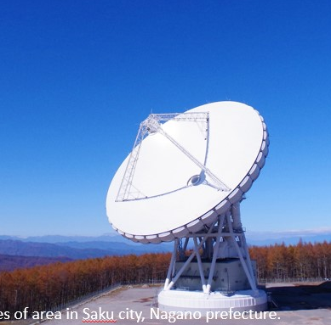
Data downlink by JAXA Misasa 54m Deep Space Station
NASA White Sands、ESA New Norcia、JAXA Misasa 54m Station
Data rate: 20,000 Tbyte/5yr (11Tbyte/day) 700xHST (172Tbyte/30yr by HST)
Ka-band 26 GHz.
250 Mbps data downlink.(Goal of 500 Mbps)
Maximum 4 hours per day
Transfer data to the NASA within 24 hours from receipt.
Required data downlink rate for
the missions with non-NEO
ミッション | 軌道 | 通信帯 | データ通信率
WMAP | L2 リサージュ | S (2GHZ) | 667kbps
Planck | L2 リサージュ | X | 1.5Mbps
Herschel | L2 リサージュ | X | 1.5Mbps
GAIA | L2 リサージュ | X | 8.7Mbps
JWST | L2 ハロー | Ka | 16Mbps-
Euclid | L2 | Ka | 74Mbps, 850Gbpd
LiteBIRD | L2 リサージュ | X | ~10Mbps TBD
SPICA | L2 ハロー | X | ~10Mbps TBD
Kepler | Earth Trailing | Ka | 4.5Mbps
TESS | Inclined Earth | Ka | 100Mbps
2024, Compatibility test of receiving data from Roman and the transformation to NASA science operation center within 24h
2025/3 Ka-band subsystem production and integration will be completed
Notes:
1

Slide 6
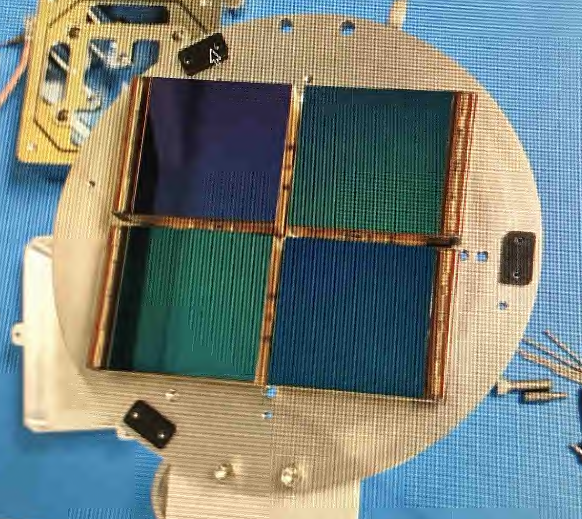
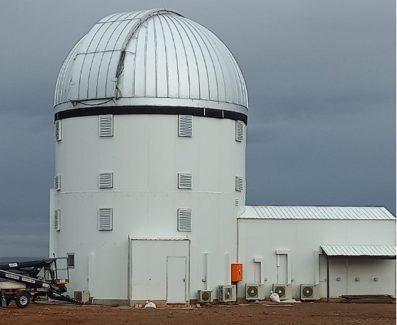

PRIME
(PRime-focus Infrared Mirolensing Experiment)
JAXA contribution
Funded by JSPS
The first dedicated NIR microlensing survey
Support Roman
  Precursor obs.
  Concurrent obs.
PRIME-cam manufactured @NASA/GSFC
Loan four H4RG-10 ACADIA electronics
from Roman
Sutherland
FOV comparisons
PRIME
満月
VISTA
Primary: 1.8m(f/2.29)
FOV:1.45deg²(0.5”/pix)
H-band @SAAO
Roman
UKIRT
Hubble
(6xfull moon).
Notes:
1

Slide 7
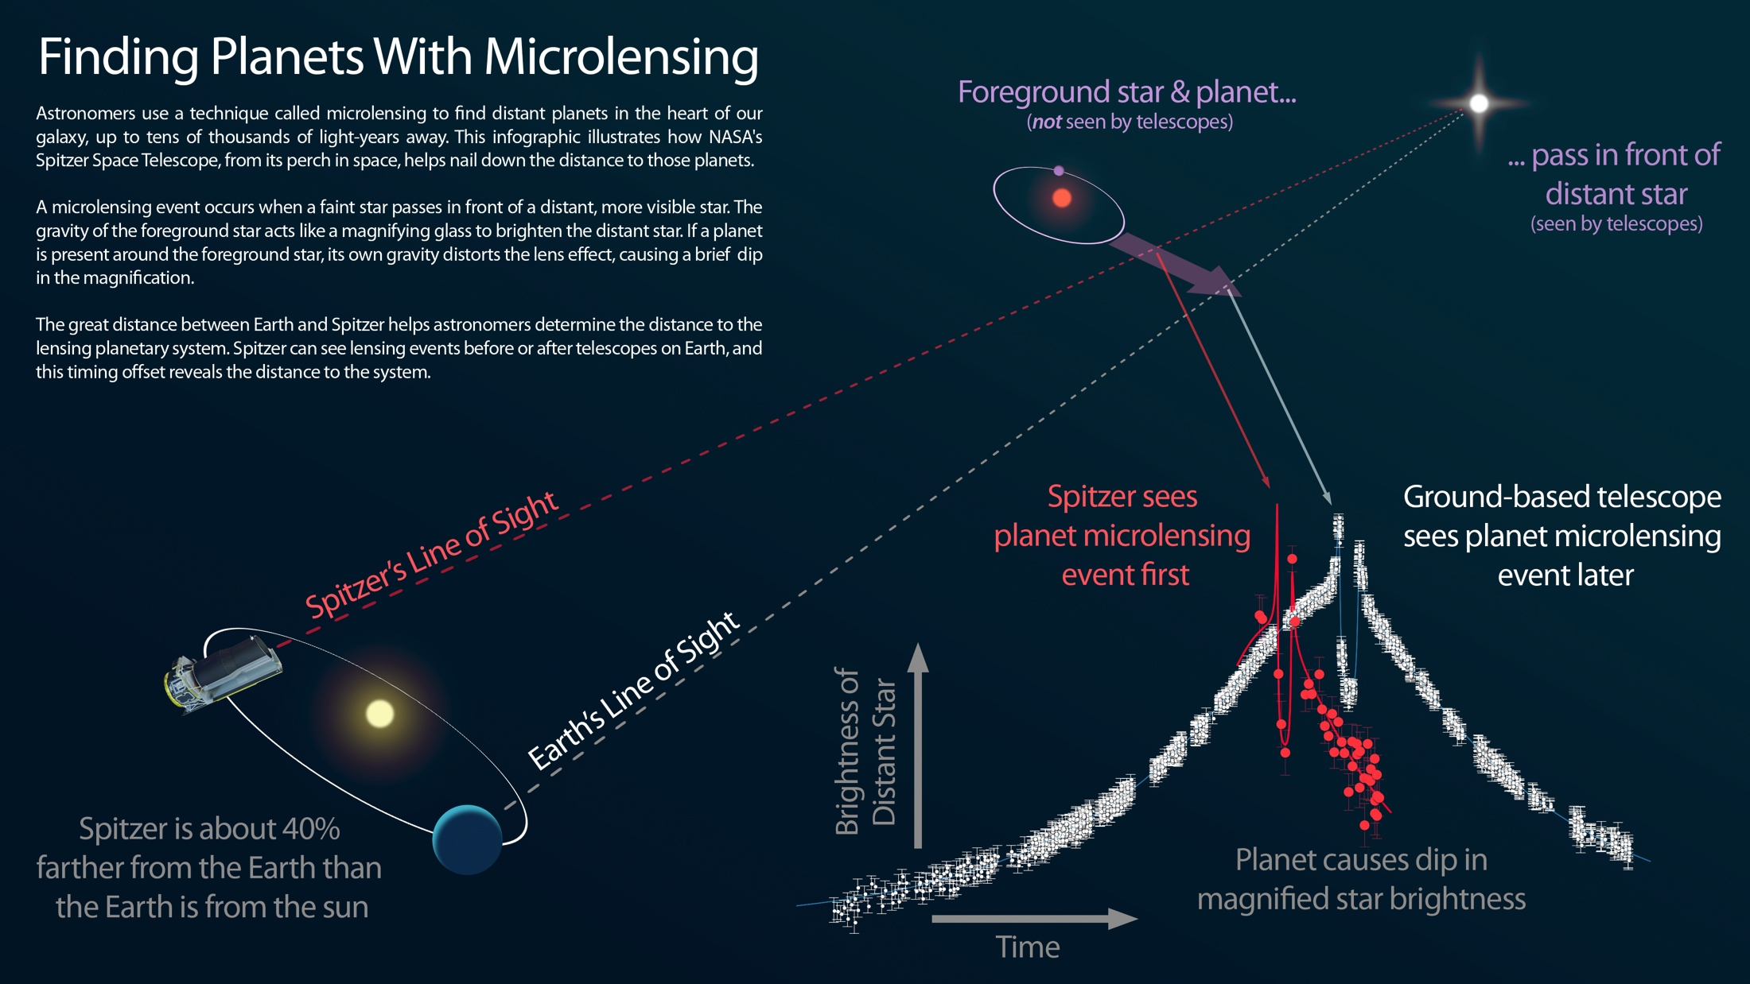
Mass Measurements via Simultaneous Roman-Ground obs.
only way to measure mass of free-floating planets
Demonstrated by Spitzer-ground tel.
Roman-PRIME can do the same
Notes:
0.5

Slide 8
Roman Science Team (9teams、 23members)
Wide Field Instrument Science (WFS) （18）
  SPQR: Spectroscopic Probes of Quantitative Reionization (WFS)
  大内正己(NAOJ), 尾上匡房(KIAA-PKU), 播金優一(ICRR)
  Roman Reference Fields and SNe Ia Calibration （WFS）
  鈴木尚孝 （LBNL）
  Roman Infrared Nearby Galaxies Survey （WFS）
  田中賢幸(NAOJ), 岡本桜子(NAOJ)
WFI Project Infrastructure Teams (PIT) (5)
  Cosmology with the Roman High Latitude Imaging Survey (PIT)
  高田昌広(Kavli IPMU), 宮武広直 (Nagoya U.), 西道啓博(Kyoto Sangyo U.), 西澤淳(Gifu Shotoku Gakuen U.)
  砂山朋美(Arizona N./Nagoya U.), Jia Liu (Kavli IPMU)
  The Roman Galactic Exoplanet Survey Project Infrastructure Team (PIT)
  住貴宏(Osaka U.), 鈴木大介 (Osaka U.), 越本直季 (Osaka U.), 宮﨑翔太(JAXA/ISAS)
  Project Infrastructure for the Roman Galaxy Redshift Survey (PIT)
  砂山朋美 (Arizona N./Nagoya U.), 斉藤俊(Missouri University of Science and Technology)
  A Roman Project Infrastructure Team to Support Cosmological Measurements with Type Ia Supernovae. (PIT)
  鈴木尚孝 （LBNL）
Coronagraph Community Participation Program (CPP)
  村上 尚史 (Naoshi Murakami) (Hokkaido U.) (Point of contact: CPP Core Team)
  （18 Japanese members participating）
Data Analysis Working Group
  小山佑世 (NAOJ), 寺居剛 (NAOJ), 古澤久徳 (NAOJ)
Notes:
1/4

Slide 9
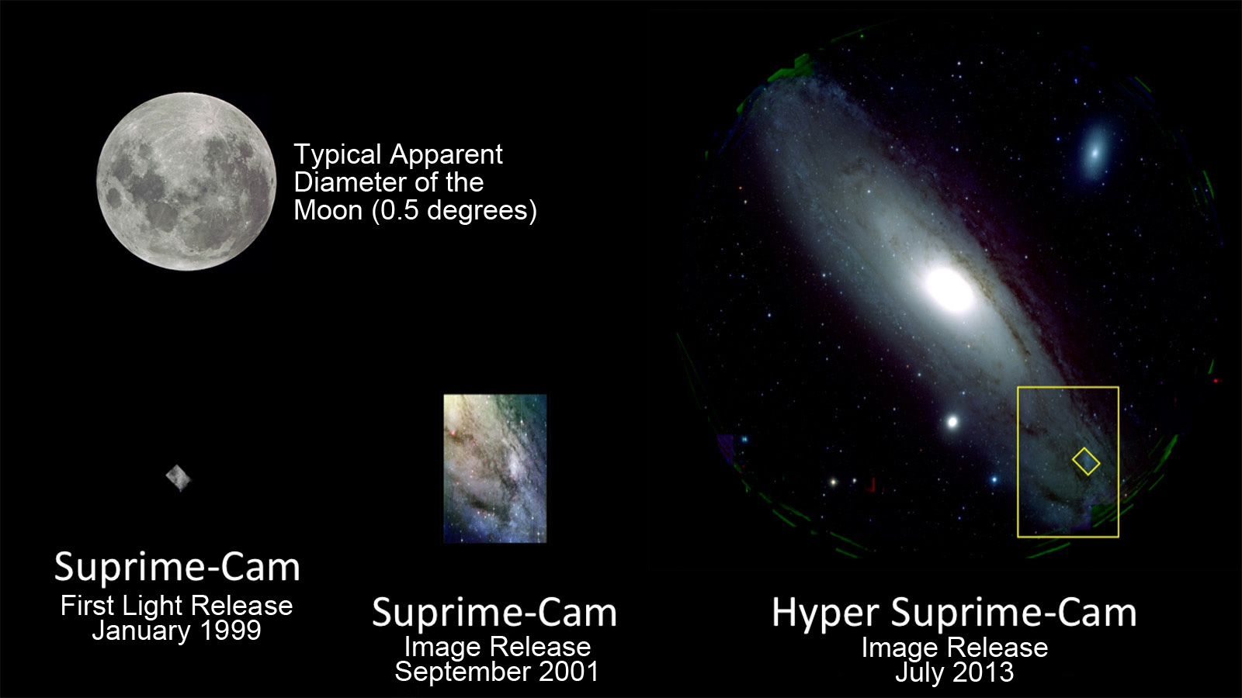
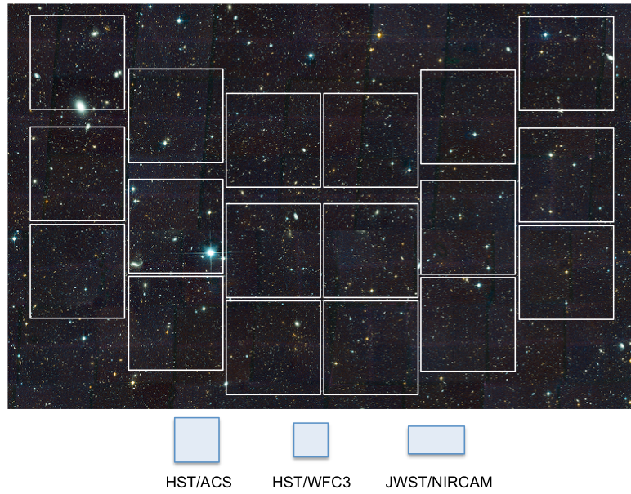
Roman-Subaru Synergistic Observations (100nights)
100 nights of Subaru reserved for synergistic Observations
Complement/enhance the Roman main survey and GO to maximize the Science
Large programs [up to 3-4?]
Decided by community
Steering Group (SG) leads discussions and decide how to solicit the programs
Roman’s wide-band imaging has good synergy
with Subaru’s multi-band capability.
Moon
0.5°
dia.
1.5°
dia.
Roman WFI
0.28deg²
(Credit: NAOJ)
Notes:
1

Slide 10
Roman-Subaru Synergistic observation Steering Group (SG)
Toru Yamada (JAXA Roman Representative) Chair
Takahiro Sumi (PI of the JAXA Roman study team)
Yusei Koyama (Subaru Telescope Representative)
Yoshiki Matsuoka (Ehime Univ)(Liaison to Subaru SAC)
Julie McEnery (Roman Project Scientist)
Jason Rhodes (Roman Deputy Project Scientist)
David Weinberg （Ohio State University)
+TBD
Lead the discussion and define the process to solicit programs for Subaru 100 nights
Liaison to the Roman Science Teams/SWGs and Japanese Subaru community & SAC
Identify and consolidate [3-4] programs to fill the 100 nights and submit to Subaru SAC
Encourage team buildings for proposal/data reduction
Notes:
1

Slide 11


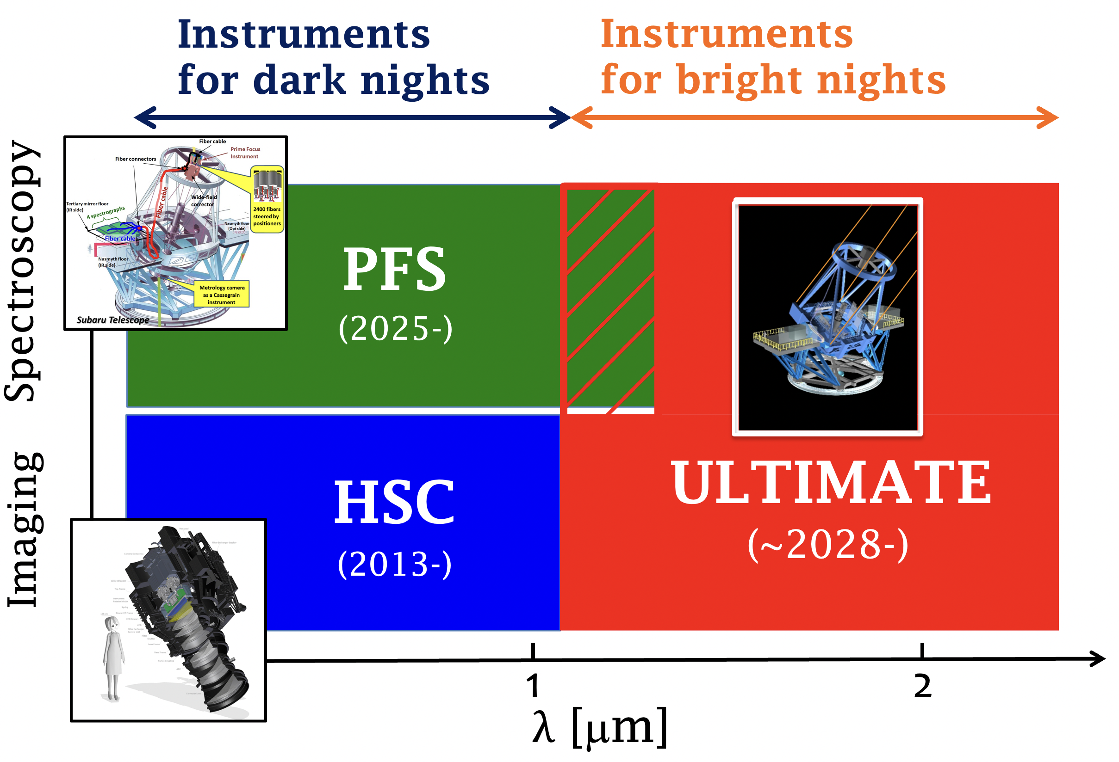
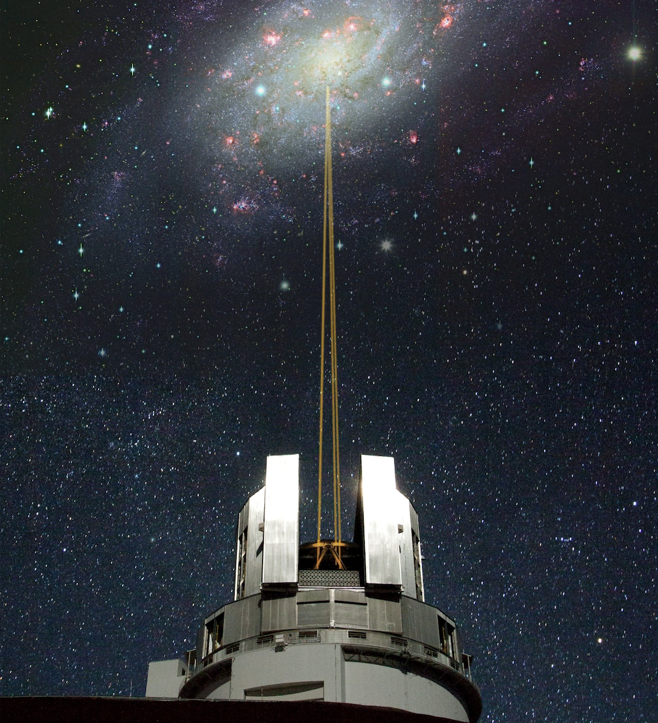

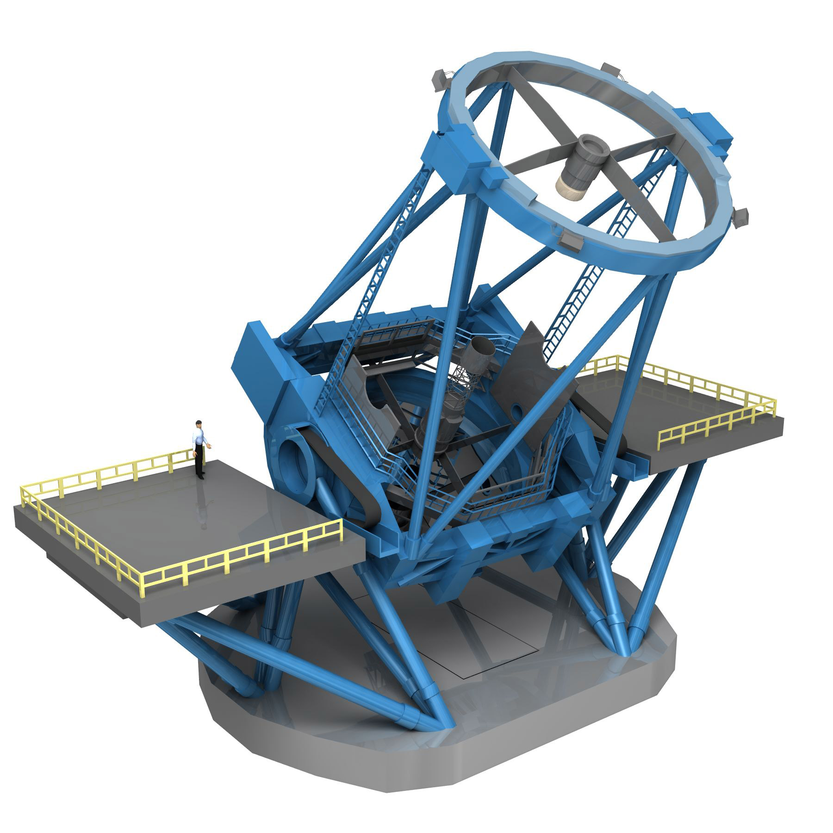
Subaru Telescope status
Wide-field AO (GLAO, D=20’) + NIR imager (WFI).
Suite of NB/MB filters, adding special value for Roman.
Subaru Telescope is now “Subaru-2.0”.
Very wide FOV (1.3deg) multi-obj spectrograph (2386 fibers) @ l=0.38-1.26um
Coming Soon !!
Very wide FOV (1.5deg) imager
ULTIMATE
Roman
Notes:
1

Slide 12
Organized by JAXA WFIRST WG, Hawaii observatory, NASA WFIRST FSWG
Participants:>90, including 16 from US, WFIRST FSWG, SIT
Scope:
Share the interests from Japan and US
Share the requirements from Subaru & WFIRST
Start considering the overall strategy
Define the rough schedule
Define the organization
Notes:
0.5

Slide 13
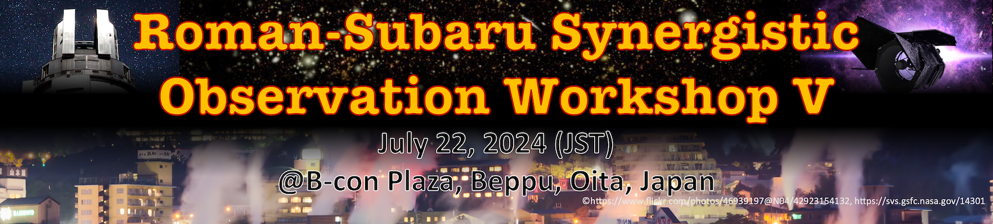

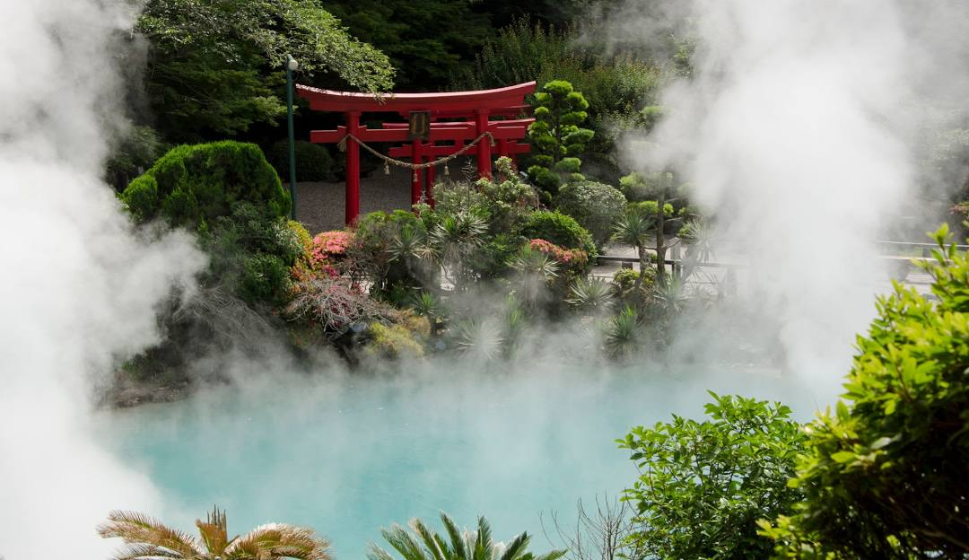

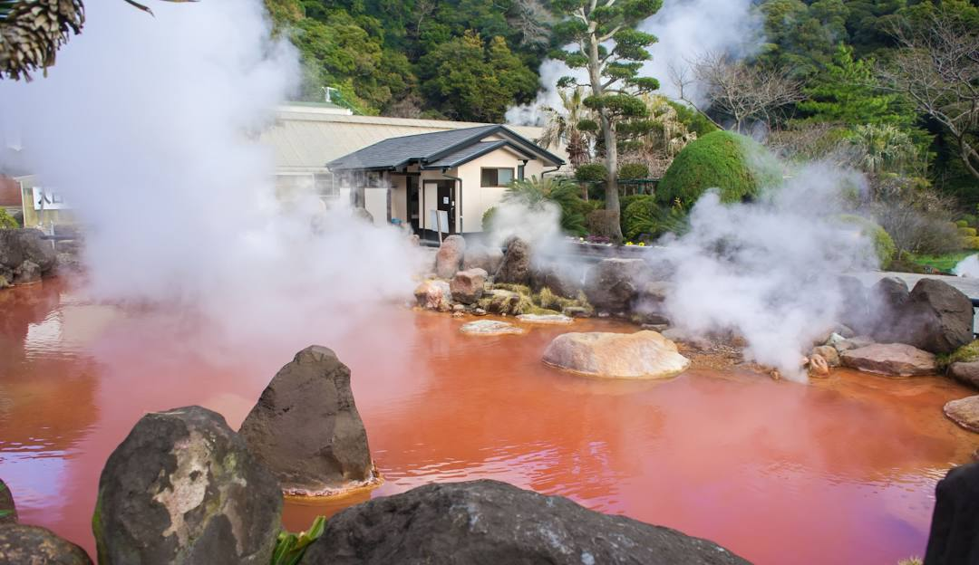
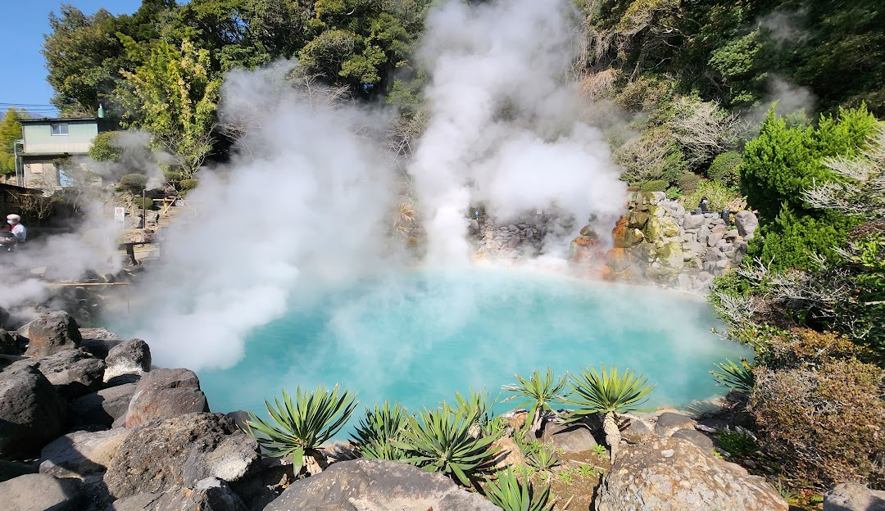
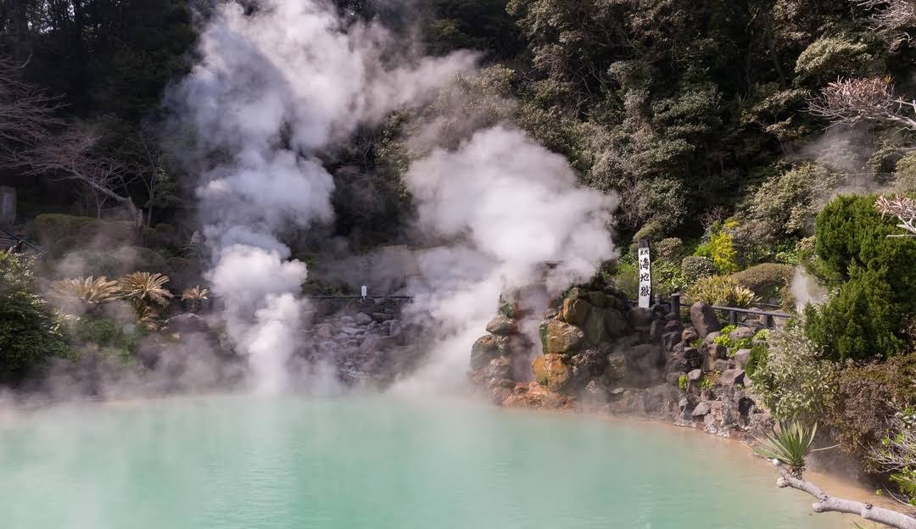
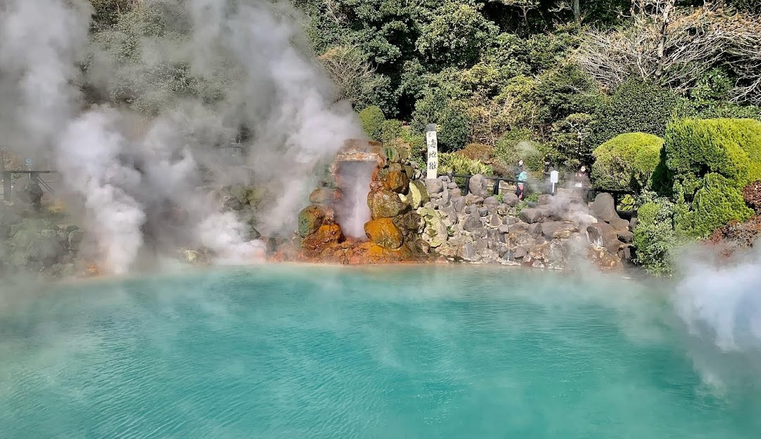
https://www.ir.isas.jaxa.jp/Roman_V/index.html
Followed by SUPER IRNET workshop
https://ultimate.naoj.org/superirnet/workshop2024_localinfo.html
AM: JST 09:00-12:30
- Framework of the Roman-Subaru Synergistic Observations [20+10min]
- Roman : Current status [20+10min] Julie
- Subaru : Current Status [20+10min]
(break)
- Summary of the Previous Discussions and Whitepapers [20+20min]
- Plan for Program Identification and Discussion [20+30min]
PM: JST 13:30-16:00
Contributed Comments from WGs +CPP/ Discussions
Notes:
0.5

Slide 14
White Paper of Synergistic observation
Enabling Breakthrough Science with the Subaru Telescope and the Wide Field Infrared Survey Telescope (WFIRST): A White paper for Subaru and WFIRST Communities
Also submitted to: US Decal survey
Principal Editors: Jason Rhodes, T.Sumi
Executive Summary: D. Spergel, T. Yamada
http://www.ir.isas.jaxa.jp/WFIRST_Subaru_II/TALKS/WFIRST_Subaru_April25.pdf
User Name: wfirst
Password: subaru
2019/4/25
Notes:
0..25
CGI is included here for some scientific precursor observations.
SIT has Milky Way, WINGS, … these are not corresponding to the WP categories.
Describing the way to the selection (Future Process section?)
100 nights around 2024, then PFS SSP? (David Spergel dream?)

Slide 15
Required nights and conditions in the Workshop IV
Topic | instruments | Nominal | Minimum | FL nom. | FL mini | Dark/Bright
microlensing | HSC | 9 | 4.5 |  |  | D
 | ULTIMATE | 16.4 | 12.4 |  |  | B
 | IRD | 11.2 | 0 |  |  | B
cosmology | PFS | 300 | 20 |  |  | D
cosmology | PFS | 40 | 20 |  |  | D
cosmology | HSC | 70 | 2.5 |  |  | D
SNIa | PFS | 20 | 8 |  |  | D
Deep Field | HSC | 16 | 12 | 10 | 6 | D
 | PFS | 15 | 10 |  |  | D
Deep Filed | HSC | 35 | 25 | 35 | 25 | D
 | PFS | 20 | 15 |  |  | D
Deep Field | HSC | 30 | 10 | 10 | 5 | D
Nearby galaxies | HSC | 10 | 5 | 10 | 5 | D
 | PFS | 15 |  |  |  | D
Reionization&Early Galaxy Growth | HSC | 30 | 5 | 2 | 1 | D
galaxy assembly | PFS | 12 | 6 |  |  | D
Obscured AGN | PFS | 20 | 1 |  |  | D
 | HSC |  |  | 20 | 1 | D
Solar System | HSC | 16 | 5 |  |  | D
 | ULTIMATE | 6 | 2 |  |  | B
Imaging planets | SCExAO/CHARIS | 5 | 2 | 5 | 2 | B
GO general | HSC, | 8 |  |  |  | D
 | PFS | 8 |  |  |  | D
 | ULTIMATE | 3 |  |  |  | B
 | IRD | 3 |  |  |  | B
 | SCExAO/CHARIS | 3 |  |  |  | B
 | Total | 721.6 | 165.4 | 92 | 45
 | Total Dark night | 674 | 149 | 87 | 43
Total requested 165〜722 nights is more than reserved 100 nights(100 nights are not enough!)
90% of required time is in Dark night with HSC/PFS.
Completion of the PFS Subaru Strategic Program (SSP: a large program up to 360 night) is delayed to start in 2025A and last until 2030. Most of Dark nights will be available after this.
Notes:
1

Slide 16
Example proposals
Lens Mass Meas. via concurrent Roman-HSC Takahiro Sumi
PFS for photo-z Training Machine leaning Jeffrey Newman
PFS for photo-z Filling Self Organizing Map (SOM) Dan Masters
Photo-z w/ 20 HSC Intermediate bands Atsushi J. Nishizawa
PFS for spec-z for Roman SN Ia cosmology sample. Steve Rodney
Roman – Subaru HSC/PFS Deep Fields Sangeeta Malhotra
HSC blue band for Roman Ultra Deep Field Anton Koekemoer
HSC for satellite galaxies and stellar substructures in nearby galaxies David Sand
Mapping Reionization with a Deep Roman+HSC/narrow-band
Ryan Endsley
ULTIMETE spec and imaging for
Solar System Sciences Tsuyoshi Terai
Talk presentations/video available@ https://www.ir.isas.jaxa.jp/Roman_IV/index.html
Notes:
1

Slide 17
Expected timeline
YEAR
2017 | 1st Workshop | Collecting ideas, broad interest
2018 | 2nd Workshop | Possible programs ➔ summarized in WP
2019 | 3rd Workshop in Subaru 20th Meeting | Possible programs in various different fields
2020 | Preliminary proposal development | developed preliminary ‘candidate programs’
2021 | 4th Workshop (online) | Summarize number of requested nights. Discuss front-loading.
2023 | New Roman Science Team(s) | (PIT, WFS)
2024.7 | 5th Workshop | Plan for Program Identification
2024 fall | 6th Workshop | presentations of ideas
2024.12TBD | Calling for Whitepapers | Review and Summary (external panel?)
2025.spring | 7th Workshop | SG shows the identified Themes
2025.fall | Call for proposal.
2026.spring | Program Identification & Consolidation. | Developing Proposals
2026.summer | SG Proposal Submission to Subaru SAC | The proposal will be reviewed by Subaru SAC
2027 TBD | Scheduling
Notes:
1

Slide 18
Summary
Japanese contributions to Roman
  Subaru-Roman Synergistic Observation agreed Commitment
    ２．Contribution to Coronagraph Instrument assembled
  ３．Ka-band Data Downlink Station in Japan in construction
  ４．Ground base microlensing data sharing（MOA） done
  pre/concurrent Ground microlensing obs. In operation
  with 1.8m PRIME telescope .
on schedule
Will develop detailed proposals for Roman-Subaru Synergistic observation （with new Roman Science teams and anyone)
Workshop on 22 July 2024.
Welcome to join to the discussion
Notes:
0.5

Slide 20
Subaru Telescope status
Currently available instruments:
AO188
HSC
Prime Focus
Wide-field imager
IRCS
AO-assisted NIR imager/spectrograph
IRD
HDS
IR high-dispersion
fiber-fed spectrometer
High-Dispersion Spectrograph
NsOpt
NsIR
SCExAO/AO188
FOCAS
CHARIS
FastPDI
MEC
REACH (IRD)
VAMPIRES
Cs
Optical Imager/MOS
IFU & Polarimetry
MOIRCS
NIR Imager/MOS
Black: Facility Instruments
Green: PI-type Instruments

Slide 21
Notes:
0..5

