Slide 1
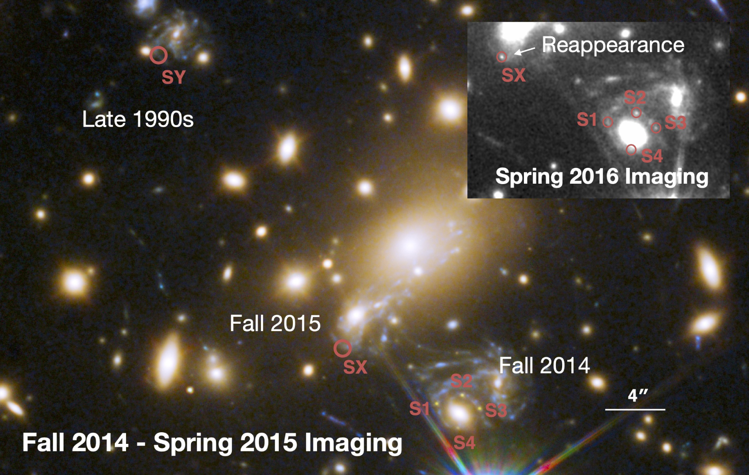
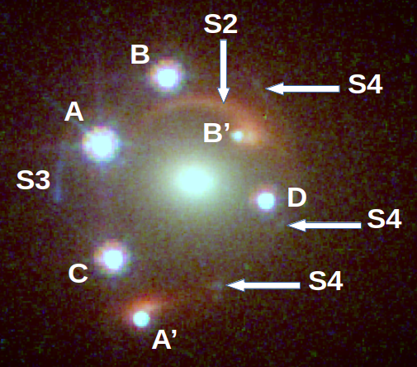
Dark Matter and Cosmology from Strong Lenses in the age of Roman
TOMMASO TREU
University of California Los Angeles

Slide 2
Outline
Introduction. The dark universe
  The expansion history of the universe and dark energy(ies)
  The nature of dark matter
A strong lensing view
  Time delays and the expansion history of the universe
  Subhalos and the nature of dark matter
The Roman revolution
  Lenses are not rare anymore!
  Discovery and follow-up in one mission!

Slide 3
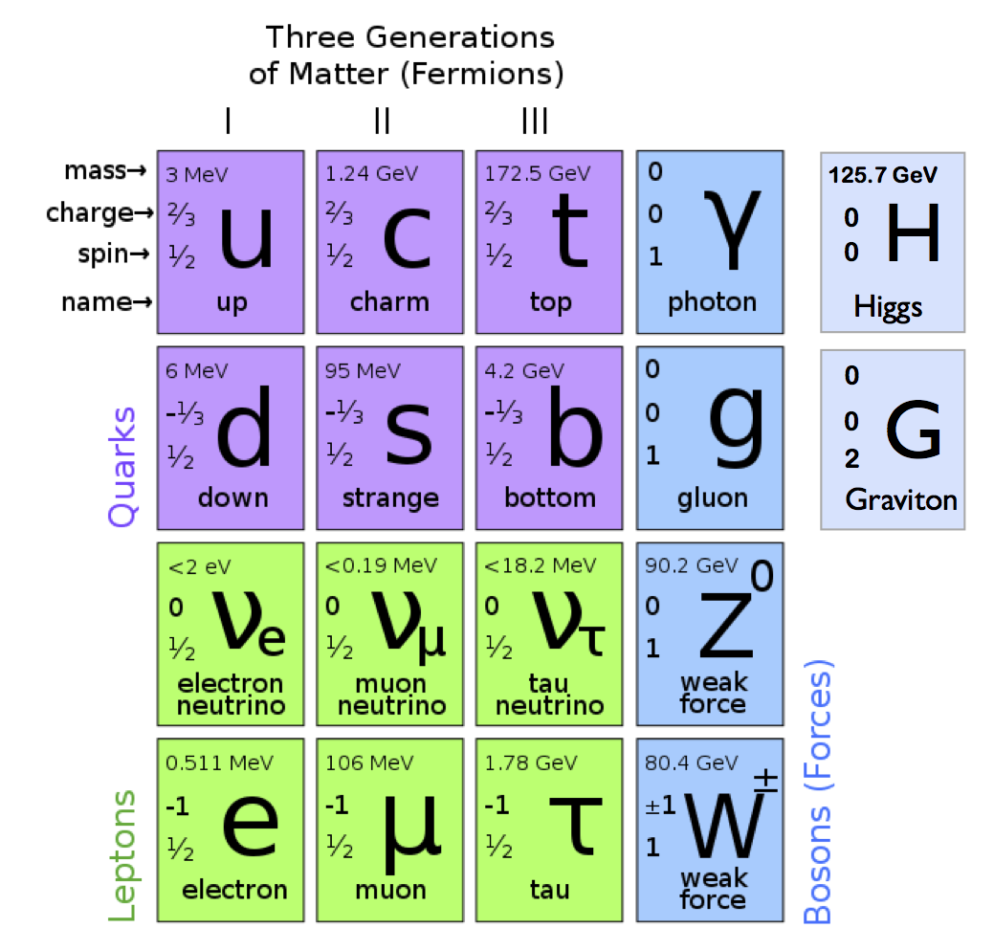
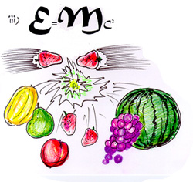
The view from Earth: standard model of particle physics

Slide 4
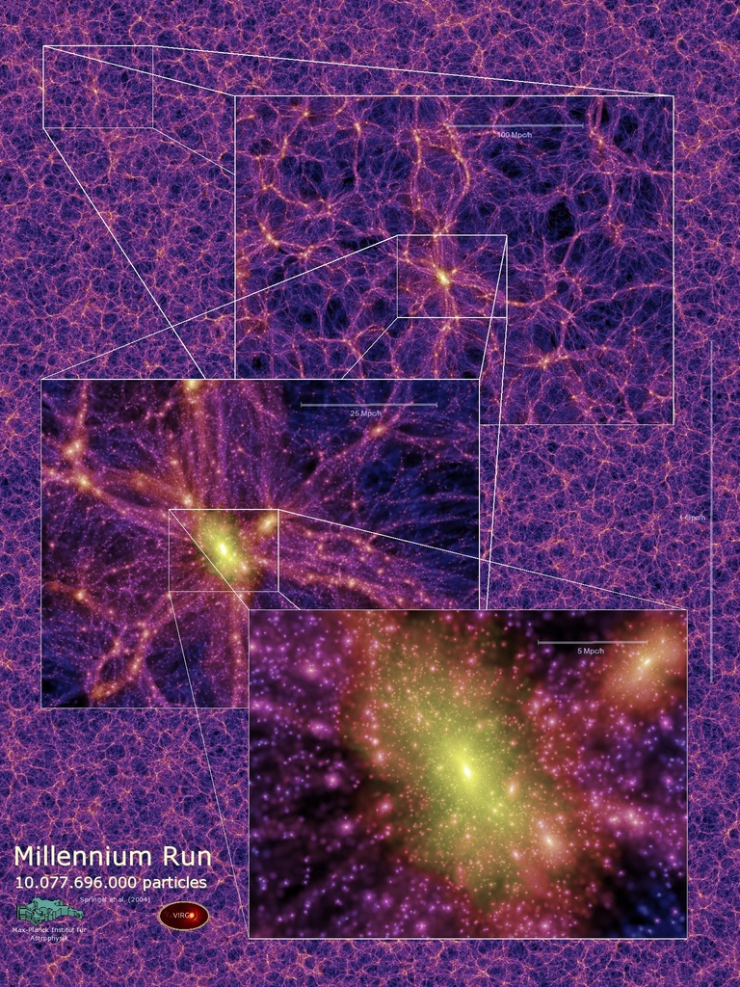
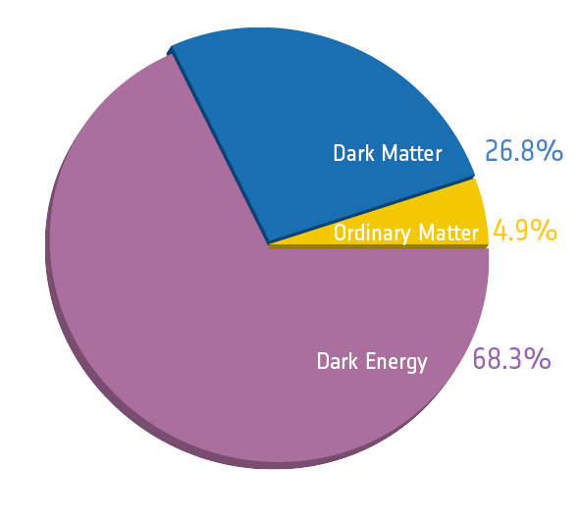
The Dark Universe

Slide 5
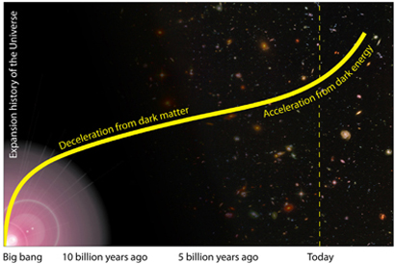
The Hubble tension and hints of new physics
Is the standard cosmological model insufficient?
Do we need early dark energy/additional particles?
“Late” z~0
“Early” (z~1000)
Notes:
A tension has recently emerged between the Hubble constant as measured in the local universe (by e.g. the local distance ladder method, megamasers, time delay lenses) and that extrapolated from early universe probes like the cosmic microwave background and primordial nucleosynthesis, assuming flat LCDM. If the tension is confirmed and not due to unknown systematic errors, it would imply that physics beyond LCDM is necessary. Leading hypothesis are “early dark energy” or a new particle that changes the sounds horizon at recombination.

Slide 6
The H₀ tension as of 2023
z~1000
z~0-1
See also Abdalla et al. 2022

Slide 7
How do we solve it?
Increase expansion rate just before recombination
  New relativistic particle?
  Early Dark Energy?
There may be already a signature of this effect in CMB data, although at low significance
Knokx & Millea 2019

Slide 8
Solutions appear non-trivial

Slide 9
The plot thickens with DESI
DESI and the Hubble tension in light of modified recombination
Gabriel P. Lynch¹,∗ Lloyd Knox¹, and Jens Chluba²
¹Department of Physics and Astronomy, University of California, Davis, CA, USA 95616 ²Jodrell Bank Centre for Astrophysics, University of Manchester, Manchester M13 9PL, UK (Dated: June 17, 2024)
Recent measurements and analyses from the Dark Energy Spectroscopic Instrument (DESI) Col- laboration and supernova surveys combined with cosmic microwave background (CMB) observations, indicate that the dark energy density changes over time. Here we explore the possibility that the dark energy density is constant, but that the cosmological recombination history differs substantially from that in ΛCDM. When we free up the ionization history, but otherwise assume the standard cosmological model, we find the combination of CMB and DESI data prefer i) early recombination qualitatively similar to models with small-scale clumping, ii) a value of H0 consistent with the es- timate from the SH0ES Collaboration at the 2σ level, and iii) a higher CMB lensing power, which takes pressure off of otherwise tight constraints on the sum of neutrino masses. Our work provides additional motivation for finding physical models that lead to the small-scale clumping that can theoretically explain the ionization history preferred by DESI and CMB data.

Slide 10
What’s dark matter?

Slide 11
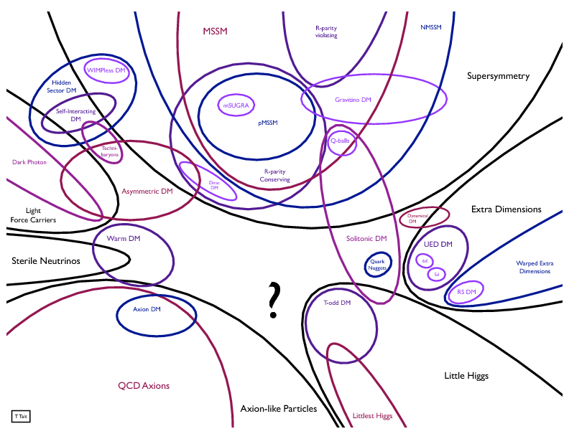
A particle theorist’s view
Tim Tait

Slide 12
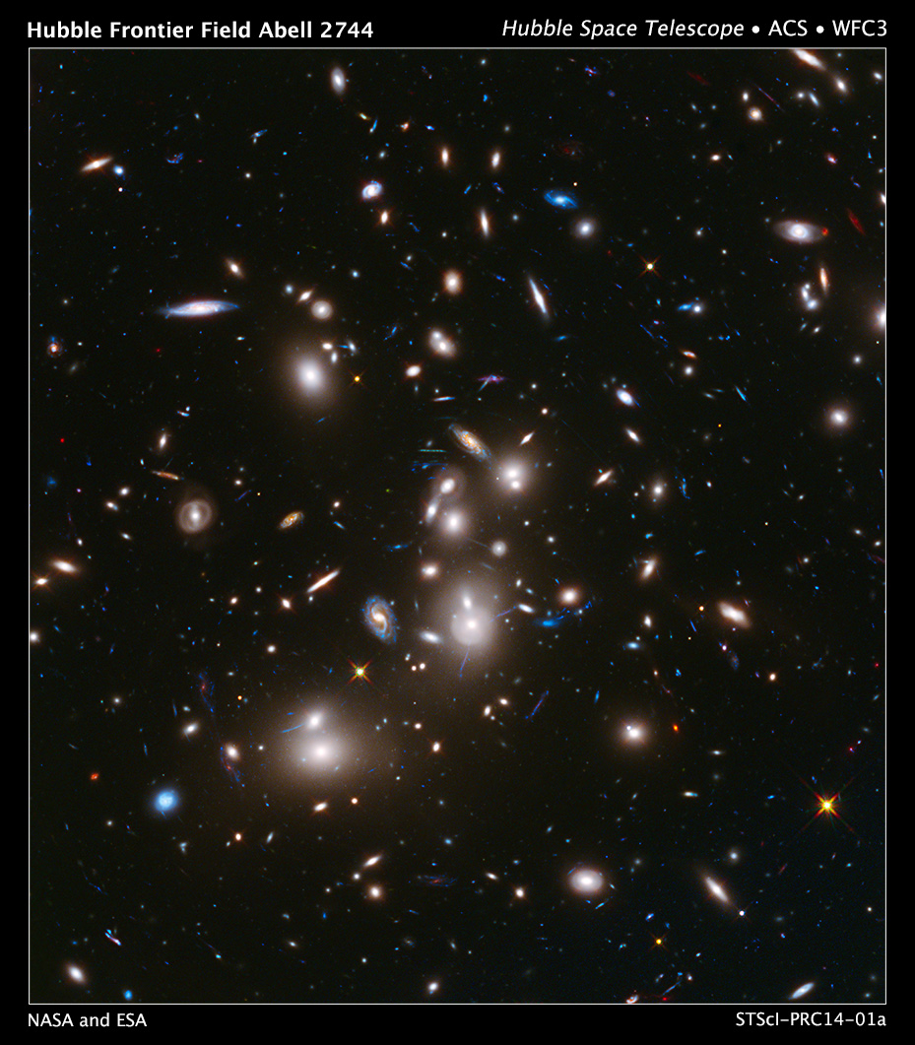
An observer’s view

Slide 13
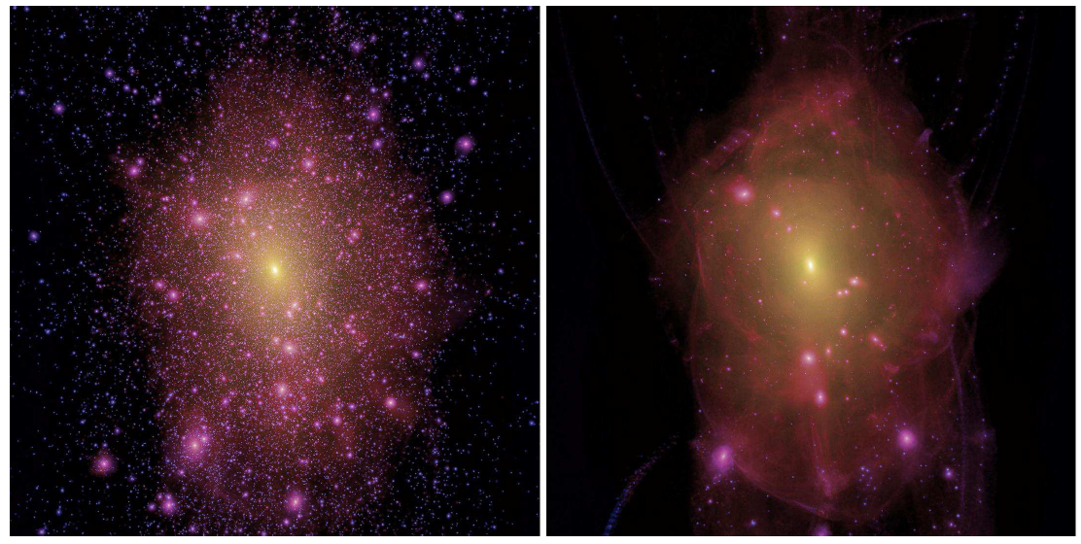
A simulator’s view
Free streaming ~kev scale thermal relic
Lovell et al. 2014

Slide 14
Time delay cosmography

Slide 15
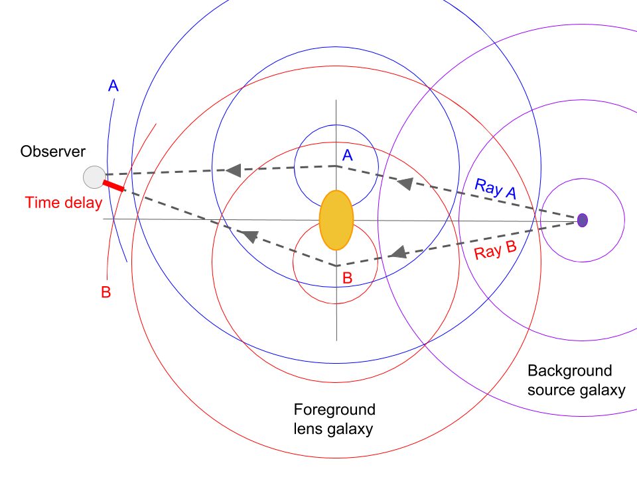
Cosmography from time delays: how does it work?
Treu & Marshall 2016

Slide 16
Time delay distance in practice
Steps:
Measure the time-delay between two images
Measure and model the potential
Infer the time-delay distance
Convert it into cosmlogical parameters

Slide 17
Modern time delay cosmography

Slide 18
Cosmography with strong lenses: the 4 problems solved
Time delay – 2-3 %
  Tenacious monitoring (e.g. Fassnacht et al. 2002); COSMOGRAIL (Meylan/Courbin)
Astrometry – 10-20 mas
  Hubble/VLA/(Adaptive Optics?)
Lens potential (2-3%)
  Stellar kinematics/Extended sources (Treu & Koopmans 2002; Suyu et al. 2009)
Structure along the line of sight (2-3%)
  Galaxy counts and numerical simulations (Suyu et al. 2010)
  Stellar kinematics (Koopmans et al. 2003)

Slide 19
Methodology - Blindness
Blinding is the most effective way to avoid experimenter bias and discover unknown unknowns
Refsdal is a rare example of a true blind test in astronomy
“Blindness” can be achieved for example via software, by removing the average of the posterior pdf during the measurement and only revealing the average/peak just prior to publication.
  Unblinded results are published without correction.

Slide 20
Results from the six-lens sample:
5.3 sigma tension
Early 2020
Wong et al. 2019

Slide 21
Extraordinary Claims Require Extraordinary Evidence

Slide 22
Successful Systematic checks
  Use different instruments: HST vs Adaptive Optics from the ground
  Data challenges: blind testing of time delays and models
  Check correlations between H0 and model parameters (none so far)
  Internal consistency between the blind measurements

Slide 23
Revisiting assumptions

Slide 24
Mass profile assumption
Power law or stars (M/L) + NFW
Assumptions consistent with observations (X-ray, dynamics, lensing, satellites) and theory (numerical simulations)
Stellar kinematics: "The resulting total density profiles were found well described by a nearly-isothermal power law ρ_{tot}(r)∝r^{−γ} from R_{e}/10 to at least 4R_{e} (Cappellari 2016)”
X-RAY: “We show that the conspiracy between the baryonic (Sersic) and dark matter (Navarro–Frenk–White/Einasto) components required to maintain a power-law total mass distribution naturally predicts an anti-correlation between α and R_{e} that is very close to what is observed.” (Humphrey & Buote 2010)

Slide 25
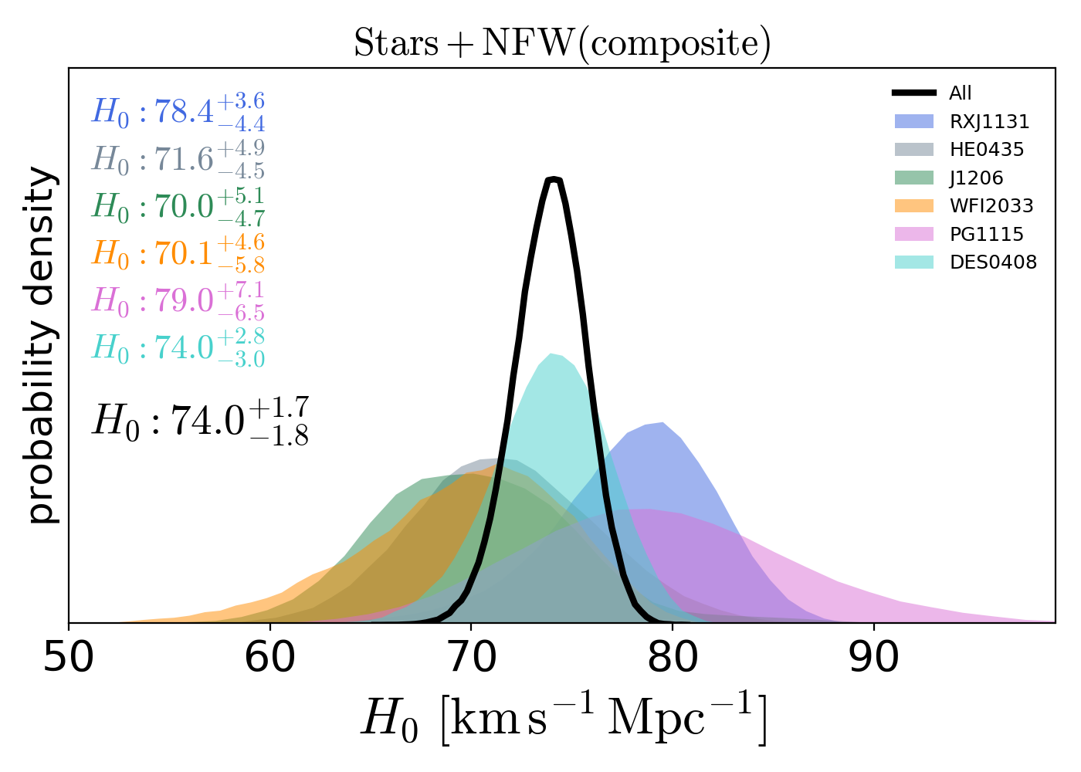
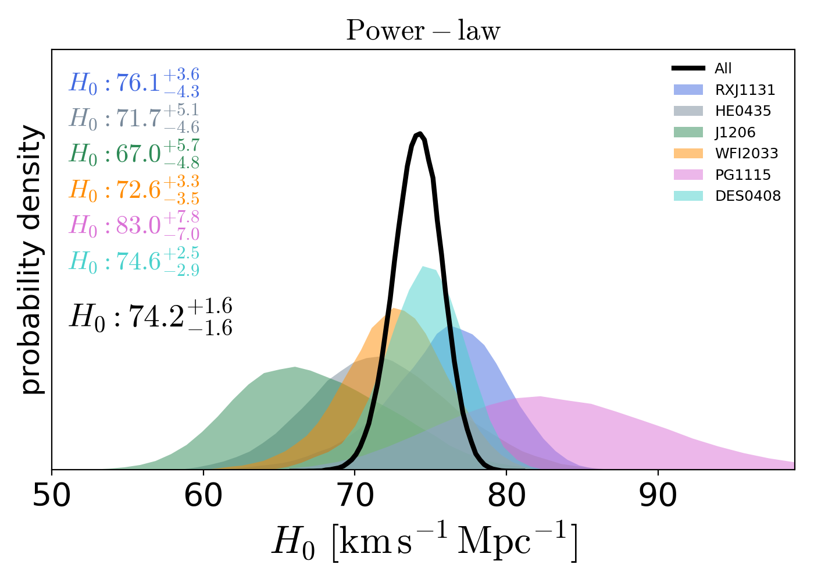
Mass profile assumption
Millon et al. 2020

Slide 26
What’s the most general mass profile?
Mass sheet transformation
If surface mass density k(x,y) is a solution of the lensing equations
Also (1- 𝞴) * k(x,y) + 𝞴 is a solution
Some of them will be unphysical
Useful to generate “maximally flexible mass profiles”, because the only constraints now come from non-lensing information
Falco et al. 1985; Schneider & Sluse 2013; Birrer et al. 2022

Slide 27
Relaxing Assumptions

Slide 28
Towards a 1% measurement with no assumptions on mass profile

Slide 29
A multi-pronged approach
Better precision per system
  Resolved stellar kinematics of time delay lenses
  External datasets
More systems (ROMAN!)
  QSO and Supernovae

Slide 30
What’s dark matter?

Slide 31
Subhalos as a probe of The NATURE OF DARK MATTER

Slide 32
Dark satellites in CDM vs WDM
Li et al. 2016; Nierenberg et al. 2013

Slide 33
“Missing satellites” and lensing
Strong lensing can detect satellites based solely on mass!
Satellites are detected as “anomalies” in the gravitational potential ψ and its derivatives
  ψ’’ = Flux anomalies
  ψ’ = Astrometric anomalies
  ψ = Time-delay anomalies
Natural scale is a few milliarcseconds. Astrometric perturbations of 10mas are expected
Notes:
TMT WIRC will go to vis, but not 1st light.
33

Slide 34
Flux Ratio Anomalies
A smooth mass distribution would predict:
This to be 100x brighter
This to be 10% brighter
These to be 2x brighter
What causes this the anomaly?
Dark satellites?
Astrophysical noise (i.e. microlensing and dust)?
Notes:
The broad line region and the continuum region are small enough that they can be affected by microlensing, i.e. perturbationgs from individual stars2
Observed H approximately equal to optical continuum for the sources
Zlens = 1.5 2.44 3.62

Slide 35
How do we make progress?
Larger samples (ROMAN!)
High precision photometry and astrometry
Avoid microlensing (narrow lines or dusty torus)
  ROMAN!
Including contribution of the line of sight

Slide 36
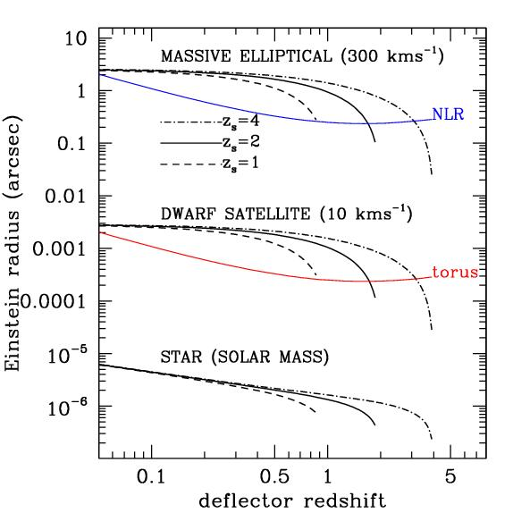
Dusty Torus and Narrow Line Region
Are not affected by microlensing
Notes:
36

Slide 37
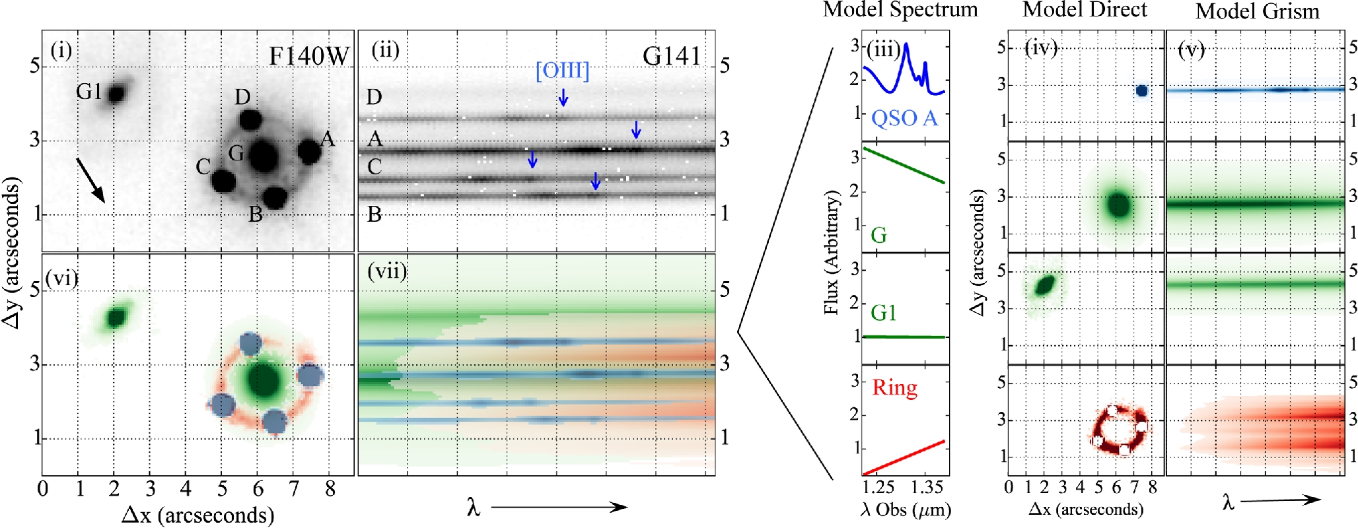
HST grism as a pathfinder for Roman
Nierenberg et al. 2017
OIII flux ratios should be easier with higer resolution of Roman
Notes:
37

Slide 38
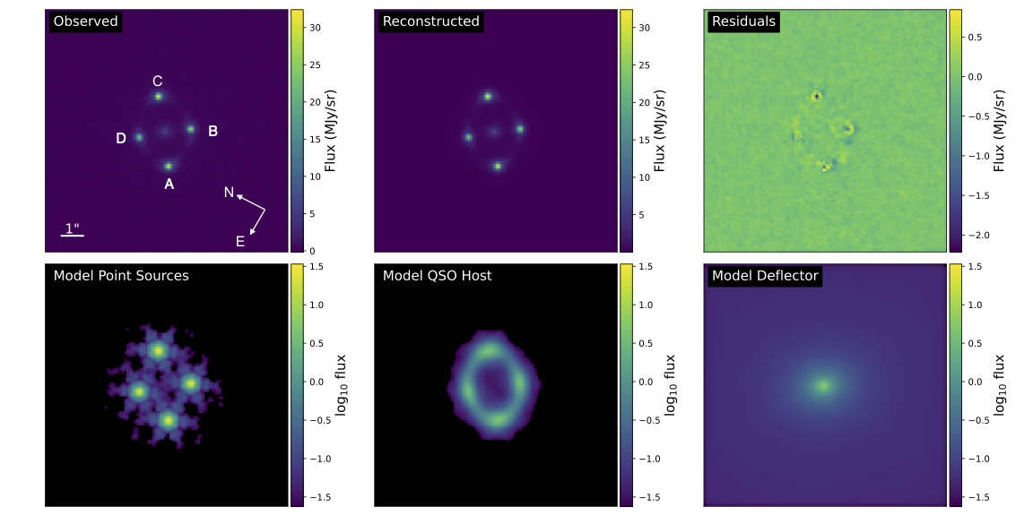
Flux ratio anomalies: RESULTS
M_{hm}<10^{7.6} M_{sun}
M_{th}>6.1 Kev
Keeley et al 2024
Nierenberg et al 2024

Slide 39
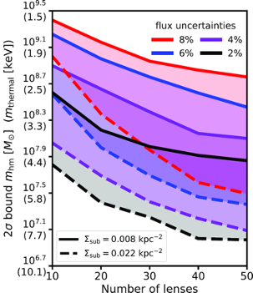
Flux ratio anomalies: Future Prospects 1
Narrow line flux ratio anomalies can currently be studied for 20 systems
Many more systems are being discovered and will be discovered
Large telescopes with AO will provide spectroscopic follow-up and emission line flux ratios
JWST got MID-IR measurements for 30 systems but more need to be discovered

Slide 40
Flux ratio anomalies: Future Prospects 2
As new systems are discovered one can explore new models, e.g. self-interacting dark matter
Gilman et al. 2021

Slide 41
The Roman Revolution

Slide 42
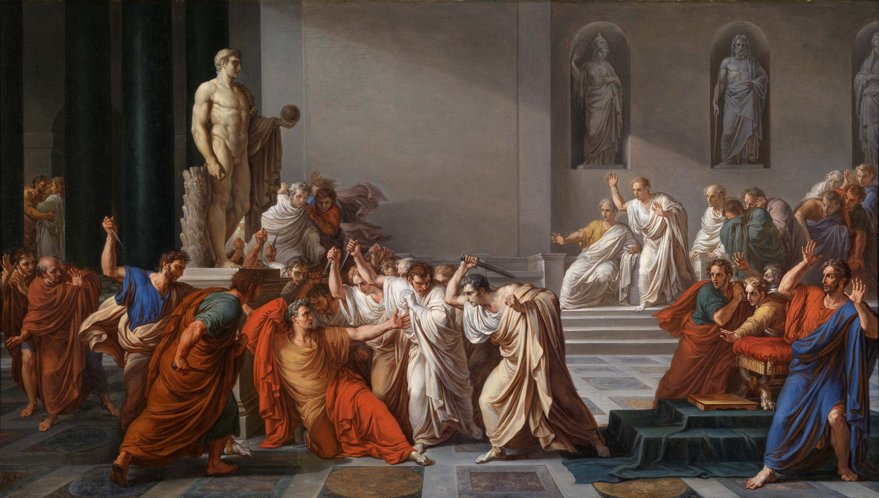
The Roman Revolution

Slide 43
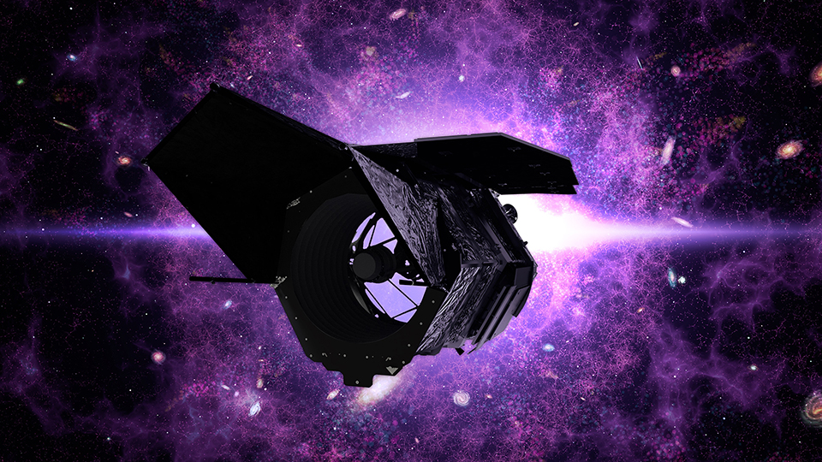
The Roman Revolution

Slide 44
Strong lenses quasars will not be rare anymore!
Lensed quasars:
  Approximately 0.1/deg² (Oguri & Marshall 2010; Oguri 2018) at HLS depth
  ~200 for 2000 square degrees

Slide 45
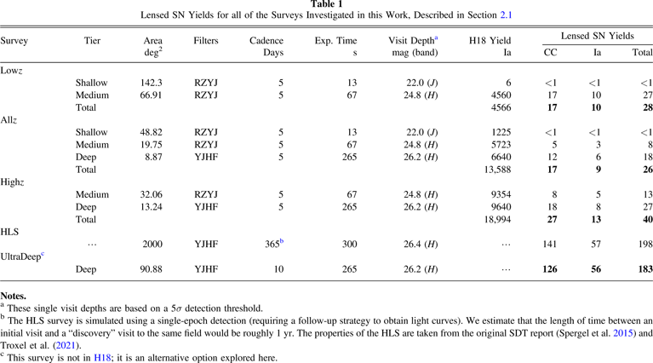
Strong lensed Sn will not be rare anymore!
Pierel et al 2021

Slide 46
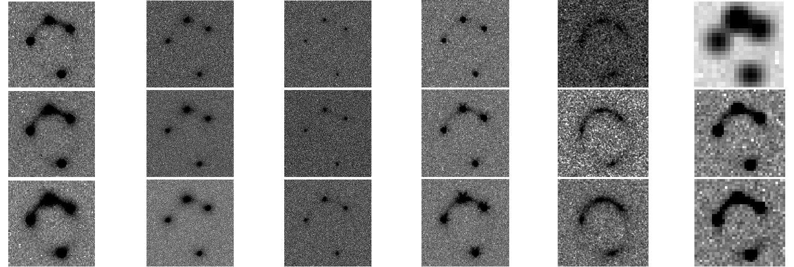
Follow-up. I: lens models
HST Keck Keck/KAPA JWST TMT/IRIS
Meng et al. 2015
Rubin/Euclid/Roman
Roman/HLS will be sufficient for lens models for most of the newly discovered systems, with no additional imaging follow-up required

Slide 47
Follow-up. II: time delays
For some survey strategies Roman will deliver time delays for 10-20 lensed supernovae (Pierel et al. 2021)
Time delays for larger numbers of lensed QSO and supernovae will require dedicated follow-up
  This can be done from the ground, 2-4m class telescopes should be sufficient, using Roman images as templates
  In overlapping areas with Rubin, for some of the systems, Rubin will provide the time delays (Liao et al. 2015)

Slide 48
Follow-up. III: redshifts and kinematics
Lens and source redshifts are needed
  Some can be obtained with the grism
  Some will require ground based spectroscopy (8-10m sufficient)
For time delay cosmography, when the source is not a Ia, stellar kinematics is required to break mass sheet degeneracy
  Spatially resolved kinematics is possible with JWST/Keck for brightest systems. Requires TMT for large samples
  Unresolved kinematics can be done with 8-10m class telescopes (but beware of mass-anisotropy degeneracy)

Slide 49
Follow-up. IV. Flux ratios
For some systems with suitable redshifts and configurations Roman will provide the line ratios (similar to HST)
For large samples of systems, follow-up with advanced AO (e.g. Keck+LIGER+KAPA or TMT+IRIS) will be necessary (Zelko Nierenberg & Treu 2024)

Slide 50
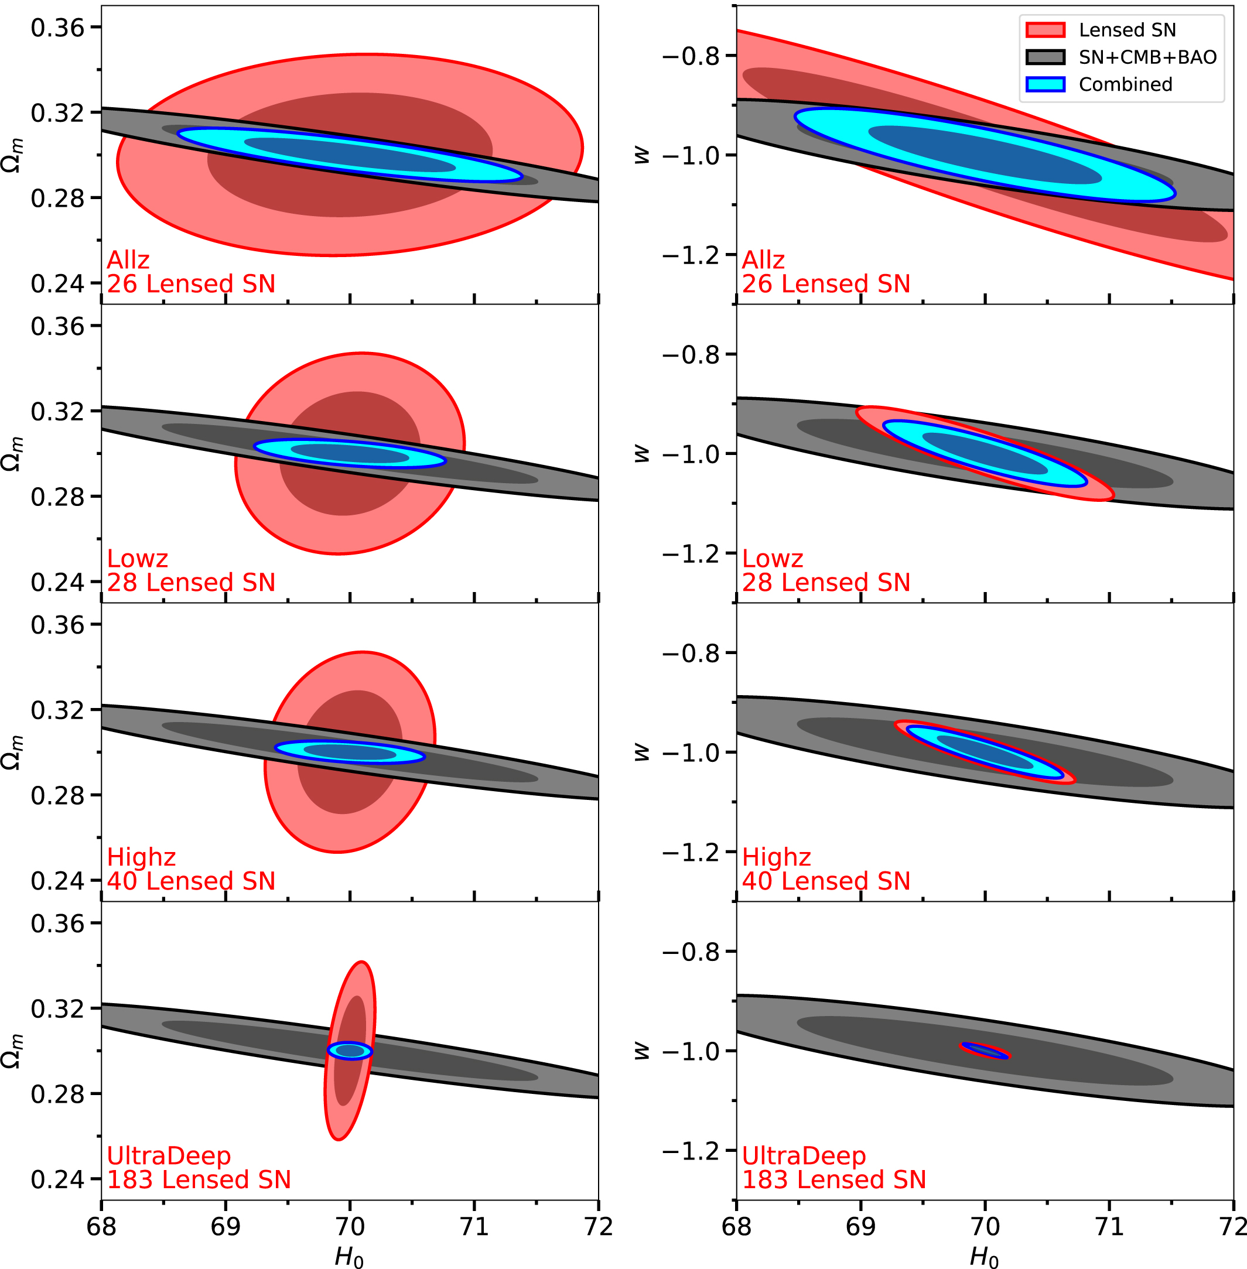
Example of time delay cosmography power in wCDM
Some will require follow-up!
Pierel et al. 2021

Slide 51
Summary
The H₀ tension and the DESI measurement may indicate a major departure from LCDM
  Given the stakes, multiple independent measurements are needed.
  Gravitational Time delays are a powerful one-step method that can reach 1% precision with resolved kinematics and large samples provided by Roman
The nature of dark matter is unknown, many alternatives to CDM are viable
  Lensing provides unique insights on the small scale structure
    CDM passed the test so far
  Many more stringent tests of broad classes of DM models are possible

Slide 52
The end

