Slide 1
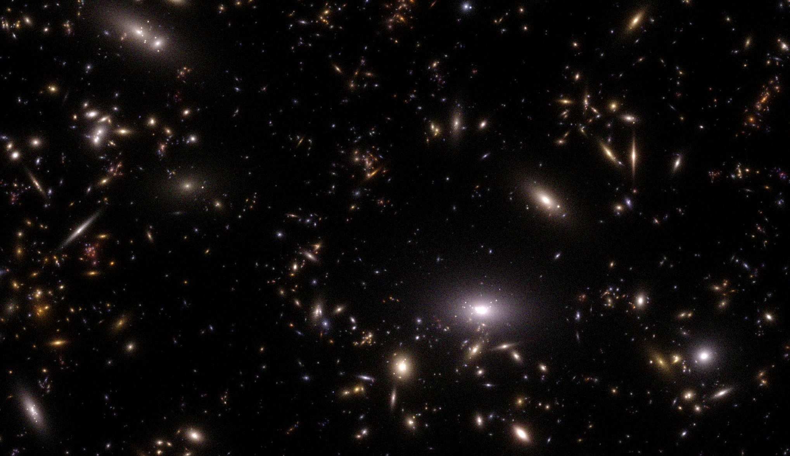
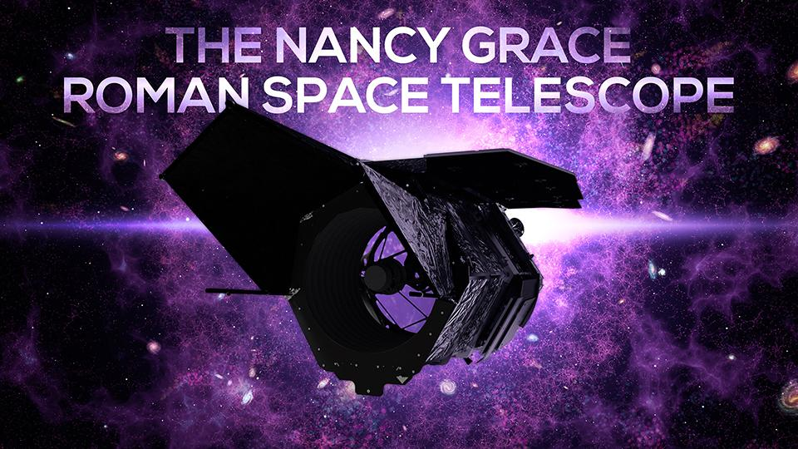
Enabling Roman science now:
New synthetic Roman+Rubin surveys
Michael Troxel
Challenging Theory with Roman
July 9, 2024

Slide 2
Roman will challenge theory, but will also challenge us…
The precision science possible with Roman, especially for weak lensing, will be truly transformative. This is even more true alongside the Rubin Observatory LSST.
To take advantage of this, we will have to reach levels of precision calibration never before achieved and face an array of new challenges.
Simulations are critical to testing and development of techniques and software before Roman launches. They are also extremely expensive and technically challenging to get right on their own…but they’ll allow us to be ready for science with Roman on Day 1.
Would you like more Roman ‘data’ than you can probably process ~now instead of waiting for Roman to launch? Then this talk is for you!

Slide 3
The OpenUniverse simulation project
In summer 2023, the OpenUniverse team was given an opportunity to partner with ALCF @ Argonne to use ~ two weeks of the entire Theta cluster before it was decommissioned.
With this opportunity, OpenUniverse, LSST DESC, and the Roman HLIS, Supernova, and RAPID Roman Project Infrastructure Teams developed an MOU and ambitious proposal during summer 2023 for how to use these resources to benefit Rubin LSST and Roman science.
OpenUniverse is a directly funded NASA effort that began in FY20
Resources to coordinate mock galaxy catalogs, image simulations, and covariance matrix generation across cosmology surveys.
All work must be relevant to two or more of the surveys.
The simulation products are made publicly available for worldwide usage.
Combines/builds on expertise from DOE and NASA communities.
Alina Kiessling (JPL, PI)
Vandana Desai (IPAC, Archives Lead)
Andrew Hearin (ANL, Mocks Lead)
Bhuv Jain (UPenn, Covariances Lead)
Michael Troxel (Duke, Images Lead)

Slide 4
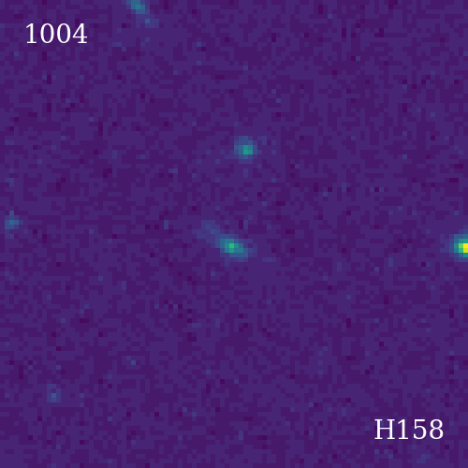
Image simulations aren’t just for weak lensing
+
Caltech-IPAC/R. Hurt
Lauren Aldoroty (Duke)

Slide 5
What we did
Main goal was to improve our previous joint LSST-Roman simulations to increase the benefit to time-domain studies. The project included 5 distinct survey goals:
The LSST ELAIS-S1 Deep Drilling Field
The full Roman Time-Domain Survey shifted to overlap the ELAIS region
Updated (from DC2) overlapping LSST Wide-Fast-Deep survey (with rolling cadence)
Updated (from DC2) overlapping Roman Wide-Area Survey in the same region
A deep-field calibration region of the Roman Wide-Area Survey in the same region
Expanded on Roman Reference survey definitions to include additional bandpasses like R062 and K213 in both wide-area and time-domain fields, enabling a larger spread of studies with potential survey modes.

Slide 6
What we did
This project was unexpected in summer 2023, but the opportunity was too great to pass up. We had a strict time-limit - Theta was going offline at the end of 2023, it had to run by then.
I want to thank everyone involved across the teams that worked for six+ months (in many cases) taking on double-duty and working overtime to make this simulation campaign a success.
To maximize impact we had to do more than just create images…we had to update many elements of the pipelines and input simulated universe to ensure we could get the maximum realism across the full optical/infrared range (~400 to 2300 nm) of LSST+Roman bandpasses.
I’ll summarize some of this effort in the next slides – a lot of this work required collaboration and coordination of pipelines across separate collaborations and teams…

Slide 7
The simulated universe
The simulated universe is based on the same underlying cosmology as the cosmoDC2 simulations. This timeline also meant some elements we would have liked to include also didn’t make it into the final simulated universe - I hope they will in the future, though!
Simulation pipeline structure: Roman imsim pipeline rewrite (https://github.com/matroxel/roman_imsim/) and significant updates to SkyCatalogs (https://github.com/LSSTDESC/skyCatalogs) framework developed in DESC to include transients and new galaxy models (thanks to Joanne Bogart, Jim Chiang, et al).
Transients: Due to the focus on transient science in the proposal, we had to ensure the transient models we used: a) had SEDs that span the needed wavelength ranges, and b) could be incorporated and accessed in the SkyCatalog framework. (Thanks to Rick Kessler, Rob Knop, Gautham Narayan, Justin Pierel, DESC/Roman transient teams, et al…)
SN Ia, SN Ibc, SN II, SNIax, SLSN-I, TDE

Slide 8
The simulated universe
Diffsky galaxy models: Work funded by OpenUniverse on a new galaxy simulation based on Last Journey paused for this effort, and the model was adapted and extended to be applied to the previous DC2 simulated universe. (Thanks to Andrew Hearin, Eve Kovacs, et al…)
Self-consistent stellar population evolution modelling separate bulge, disk, and star-forming regions in the galaxy. Represented by composite analytic profiles in the images.
Greatly improved realism in magnitudes/colors across the entire Rubin/Roman wavelength range (0.3 to 2+ microns), with associated SEDs built from the stellar populations in each galaxy component.
Leads to a highly realistic, non-empirically tuned galaxy model, which has chromatic variation across the light profile.
Stars: The same Galfast-based star simulation used in DC2 (Juric et al 2008).

Slide 9
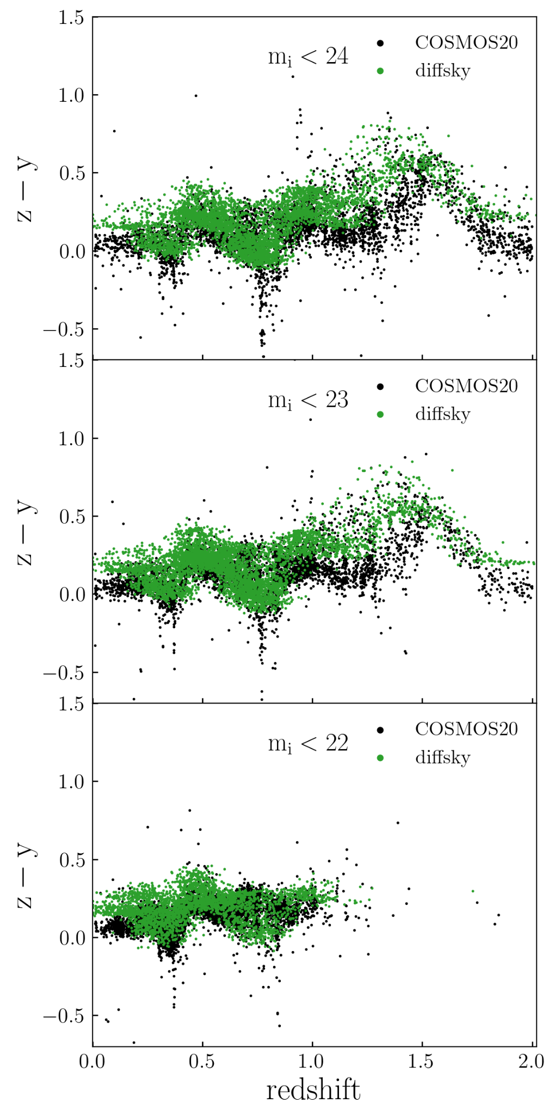
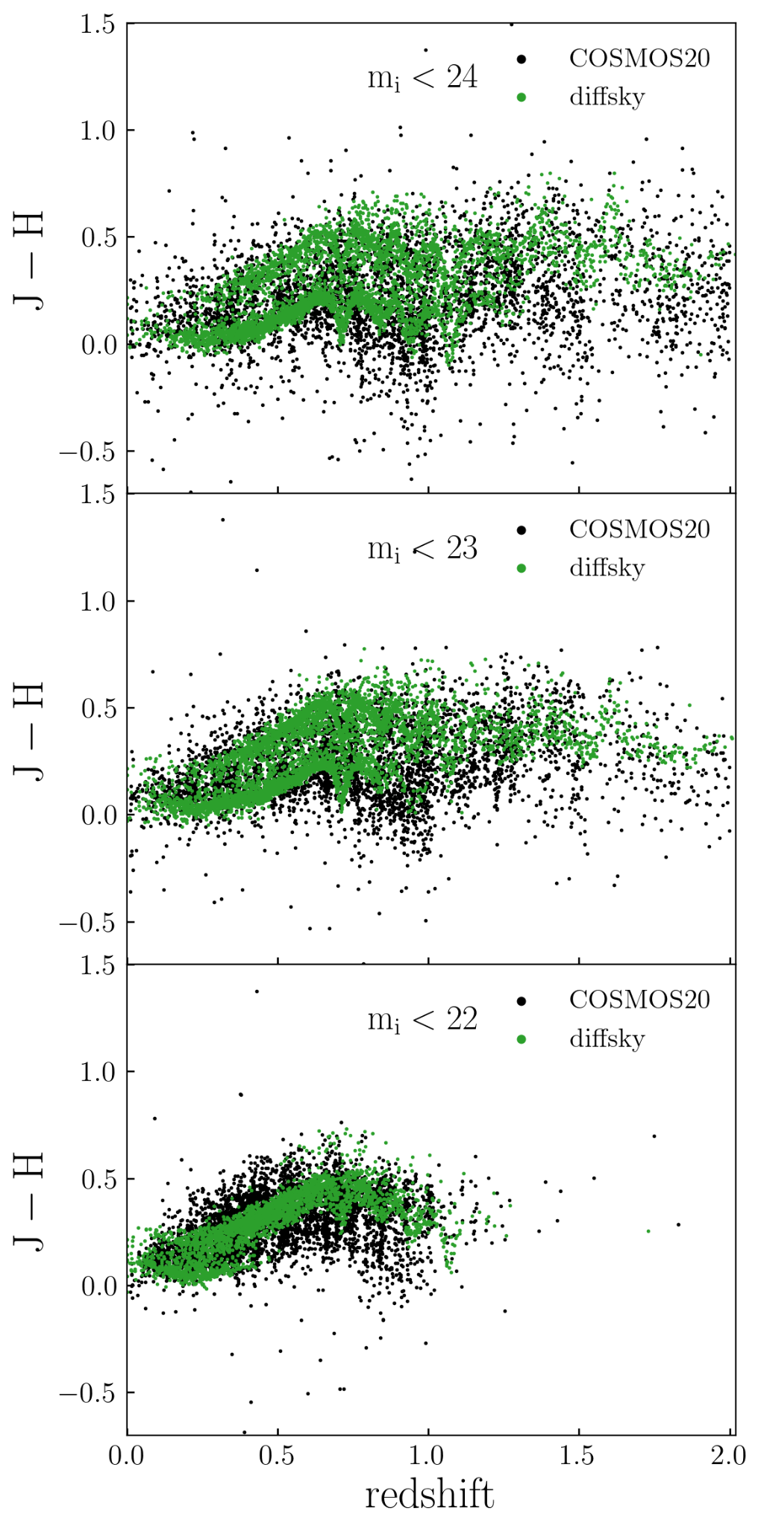
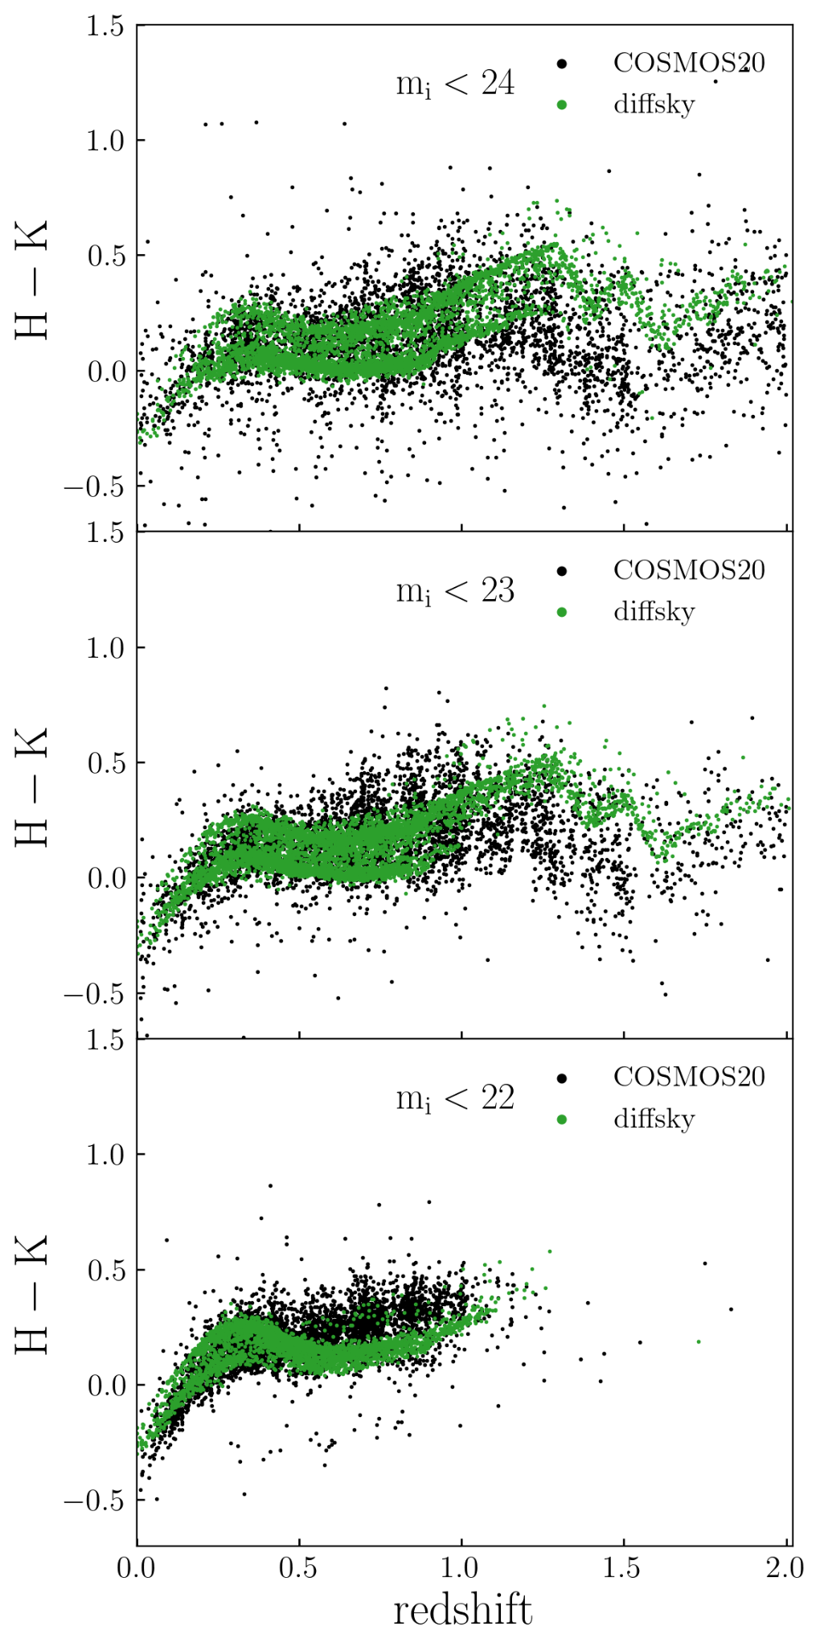
From Andrew Hearin

Slide 10
The resulting simulated data sets
In the end, we were given a two week period to use the entire Theta cluster after it ended general proposal user access.
This period started at midnight UTC December 31 (New Years eve), and Jim Chiang and I worked late into the night spinning up simulation jobs.

Slide 11
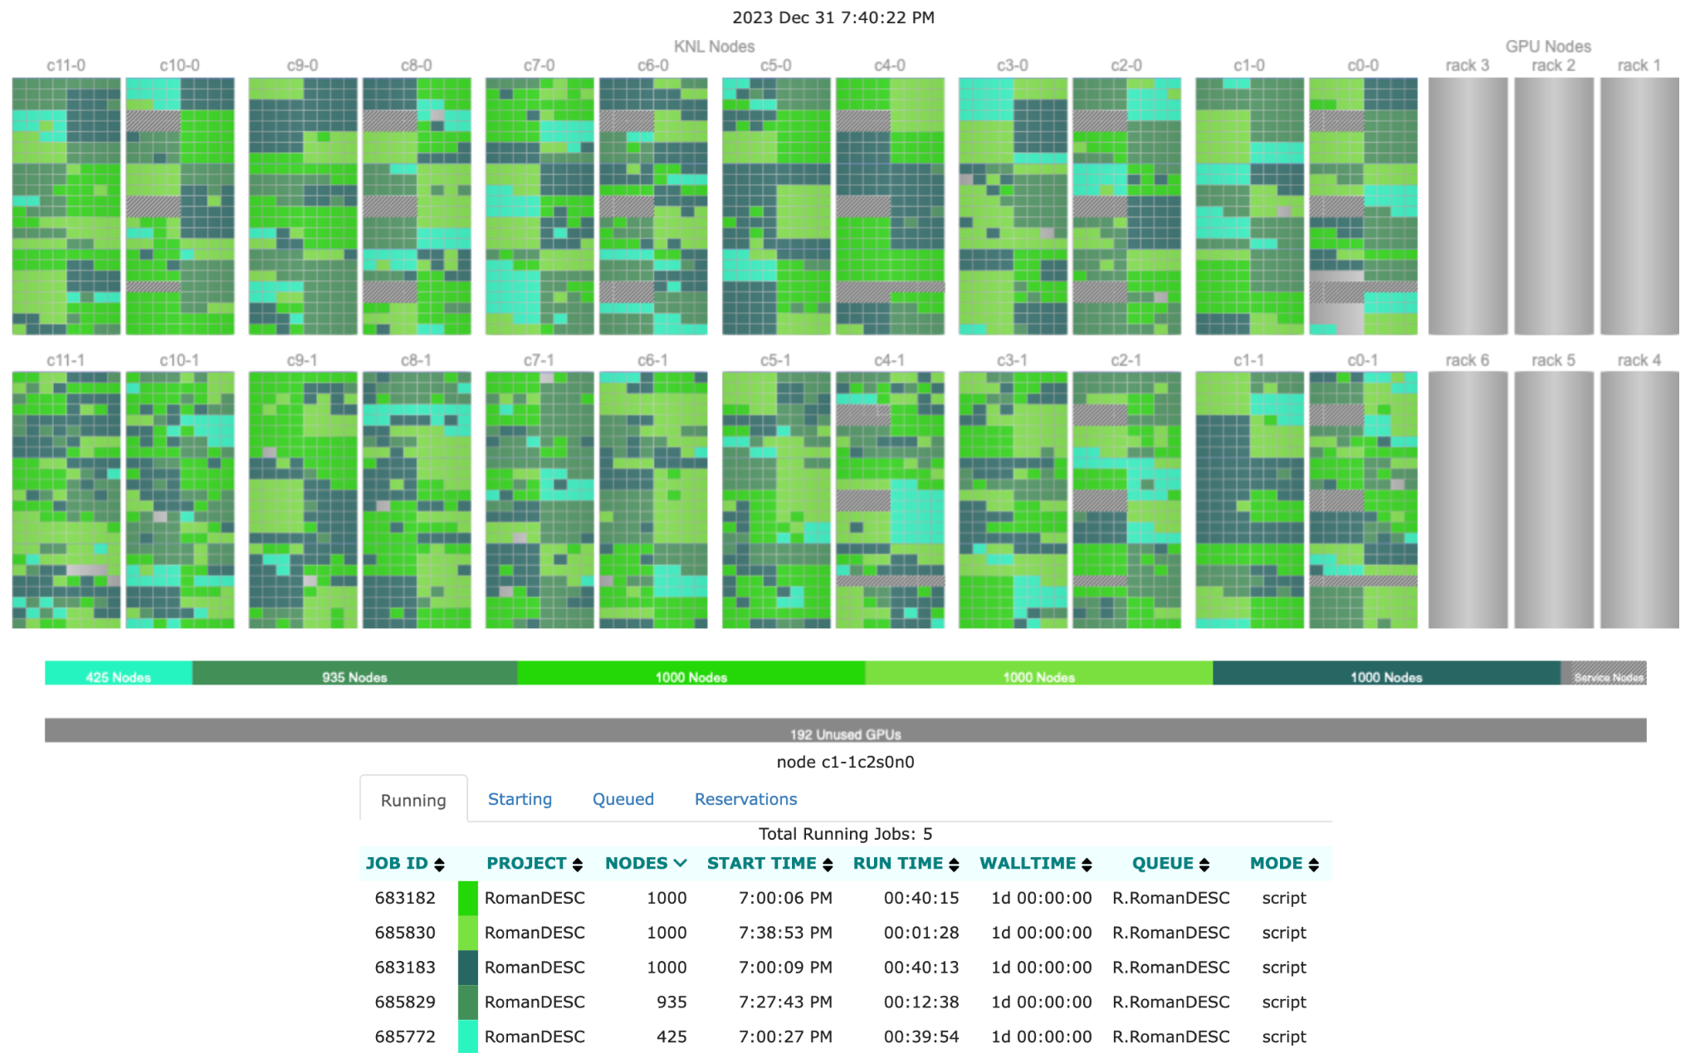
The resulting simulated data sets
In the end, we were given a two week period to use the entire Theta cluster after it ended general proposal user access.
This period started at midnight UTC December 31 (New Years eve), and Jim Chiang and I worked late into the night spinning up simulation jobs.
Nearly 250,000 images being simulated in parallel across more than 4000 nodes!

Slide 12
Full data summary - doesn’t include processed data
 | Rubin Observatory LSST |  | Roman Space Telescope
 | Wide-Fast-Deep | Deep Drilling Field | Wide-Area Survey | Time-Domain Survey
# images | 0.3 million | 2.4 million | 0.27 million | 1 million
Data size | 20 TB | 180 TB | 20 TB | 80 TB
Sky area | 70 sq deg | 9.6 sq deg | 70 sq deg | 15 sq deg
Data Preview numbers (includes processed data):
Area: 0.05 sq deg
# CCD/SCA individual images: 52k (LSST), 18k (Roman)
Data size: 6.3TB (LSST), ~1TB (Roman)

Slide 13
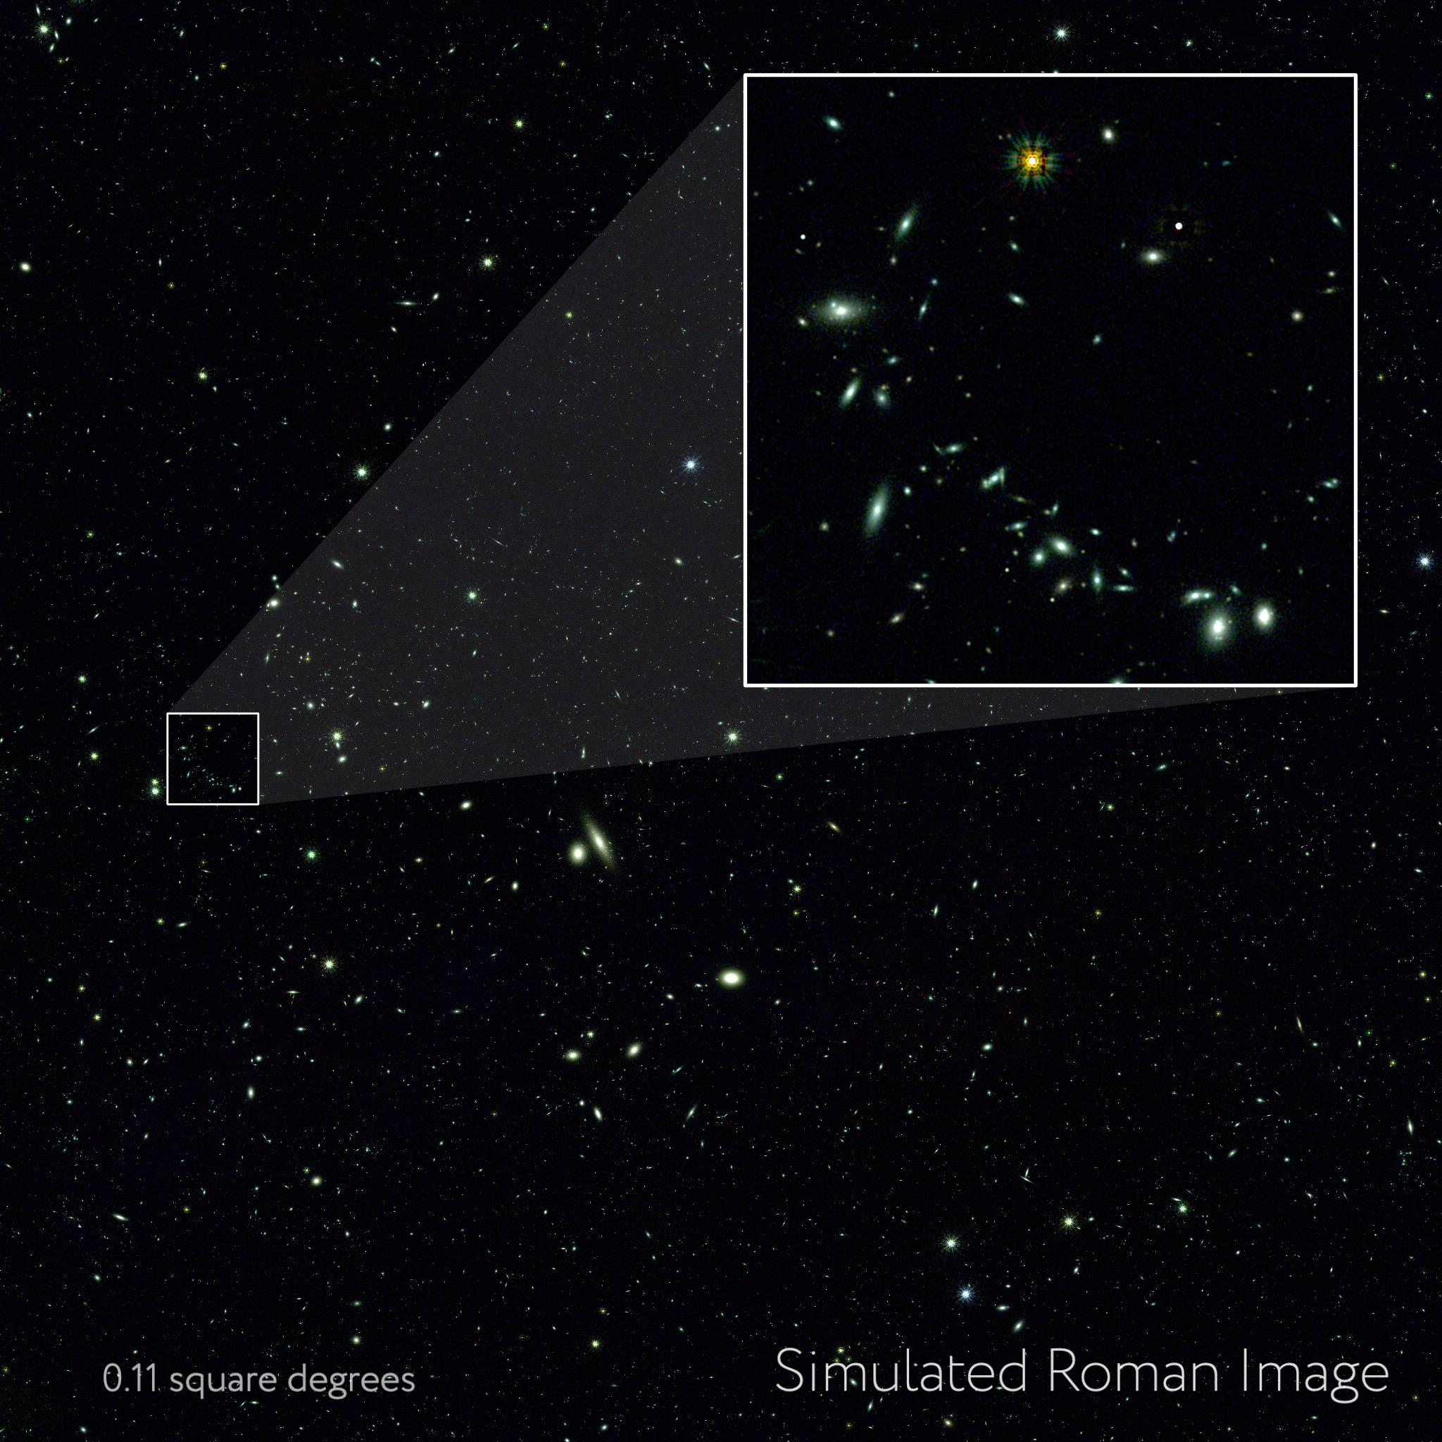
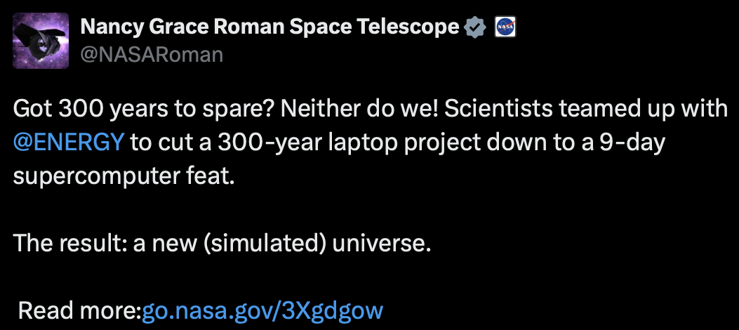
Initial data preview - June 11
https://www.nasa.gov/missions/roman-space-telescope/nasas-roman-mission-gets-cosmic-sneak-peek-from-supercomputers/
Includes full-depth processed LSST and Roman data (IMCOM coadds) overlapping 0.05 sq deg.
~10TB, hosted at IRSA (link in PR above).
Full 400TB release later this year.
C. Hirata and K. Cao (OSU) and NASA’s Goddard Space Flight Center

Slide 14
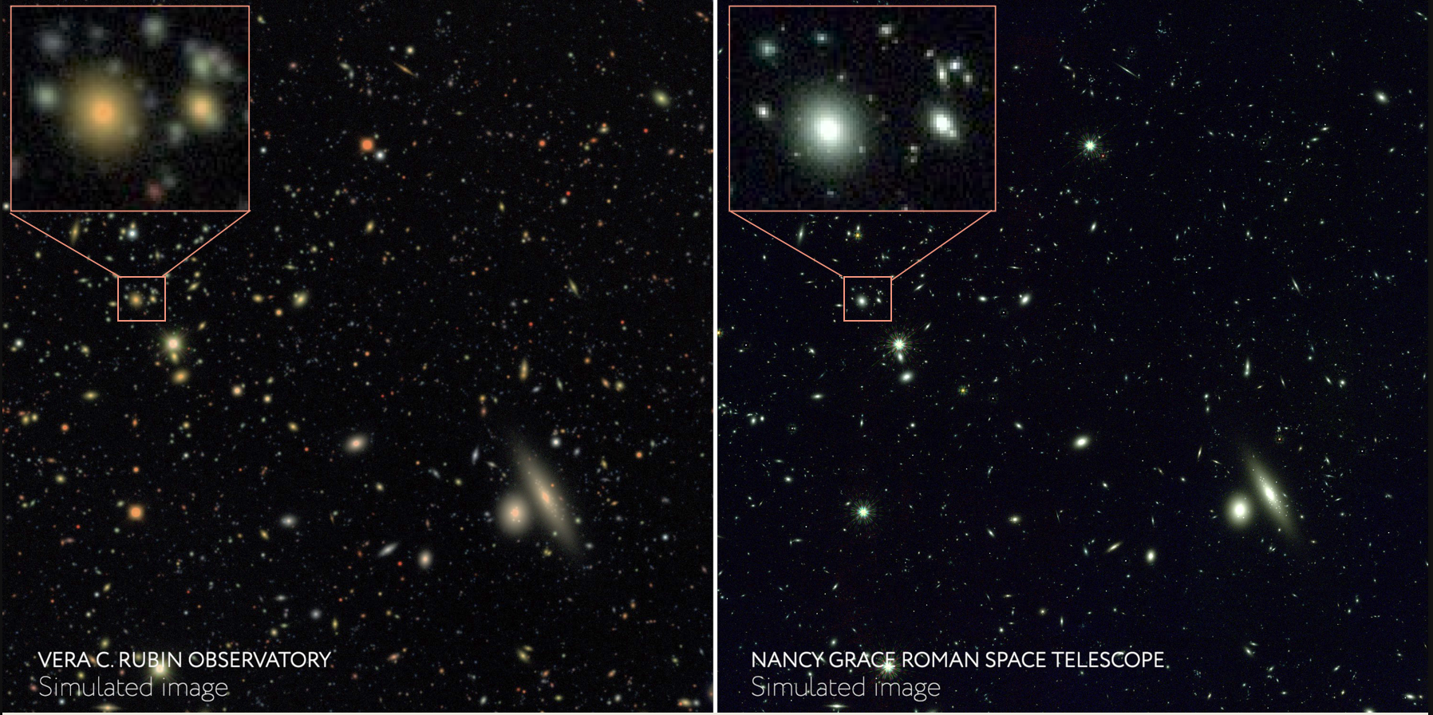
J. Chiang (SLAC), C. Hirata (OSU), M. Yamamoto (Duke), and NASA’s Goddard Space Flight Center

Slide 15
Things to look out for in the near future
Work in OpenUniverse led by Andrew Hearin (ANL) to produce even more realistic astrophysical scenes across the optical and infrared.
An overlapping Euclid-like view of the same simulated universe, led by Rachel Mandelbaum (CMU).
Work between OpenUniverse & SN PIT to include Roman prism observations in the simulation, led by Arun Kannawadi (Duke).
Validation of Roman transient recovery in simulations later this week by Lauren Aldoroty (Duke).
Updates on nyquist-sampled coaddition in the simulations later this week by Kaili Cao (OSU).
Another ~dozen ongoing projects already being enabled by these simulations this year!

Slide 16
Conclusions & Reflections
The simulation campaign was an extremely ambitious project on such a limited timescale, and I want to thank the leaders of the teams involved in the MOU for supporting it and encouraging people to work on it.
Incredible opportunity to bridge DOE and NASA teams and resources!
These kinds of simulation campaigns can drive development in teams forward, and it definitely did across the teams here.
The resulting updated Roman image simulation tools enable easy, modular reproduction via a simple yaml file structure - anyone can reproduce or modify parts of the simulation, and people in multiple PITs are already.
We aimed to support broad science goals across the team, and to support community efforts to define the final Roman Core Community Surveys in an ongoing process this year.
We look forward to seeing the science that is supported with these simulated surveys!

Slide 17
New Roman Simulations Working Group!
The first meeting of the Roman Simulations Working group will be August 2, 11am eastern.
You can sign up to the working group and get on the mailing list for announcements and more meeting info here: https://outerspace.stsci.edu/display/RSWGS/Roman+Working+Group+Sign-Up+Form

