Slide 1
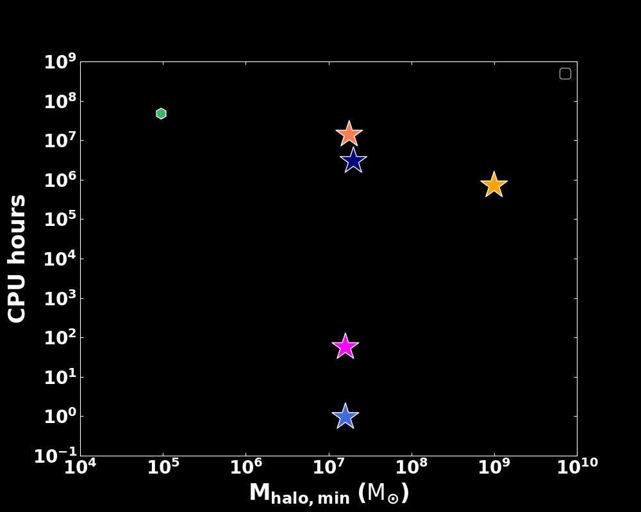
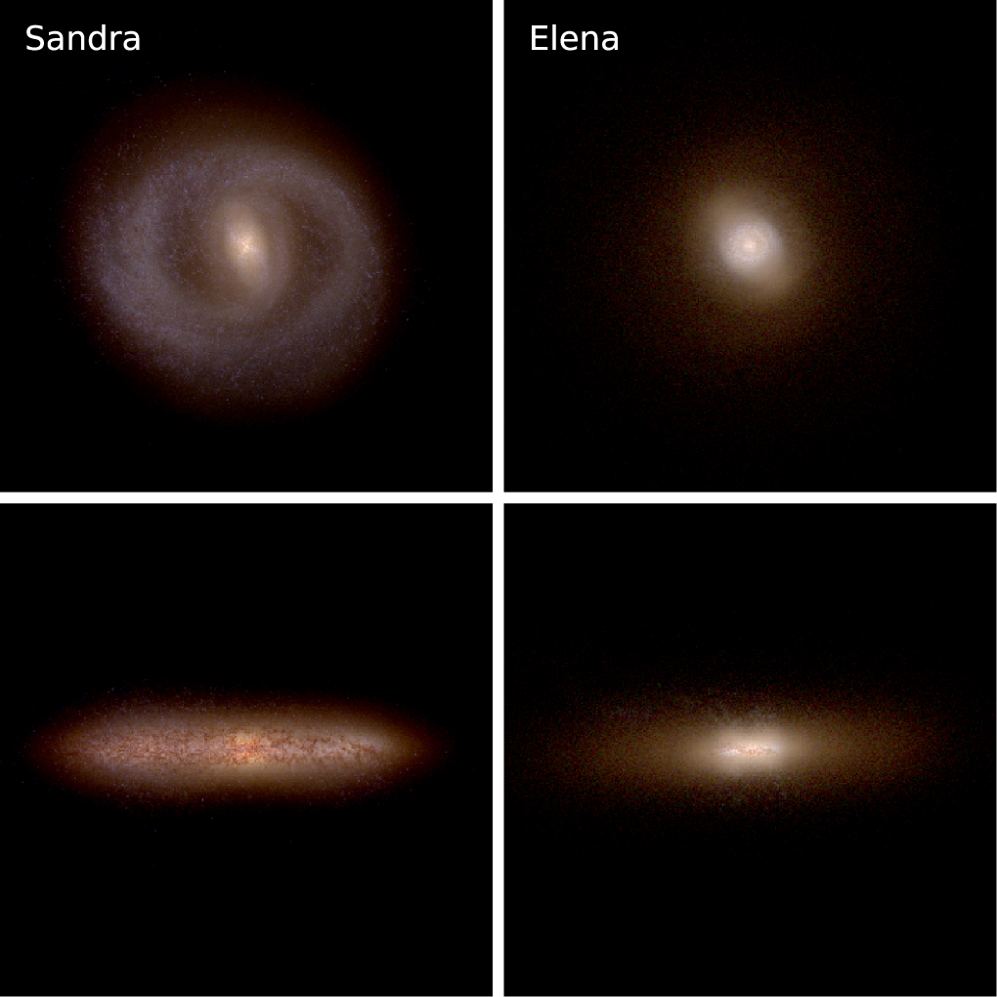
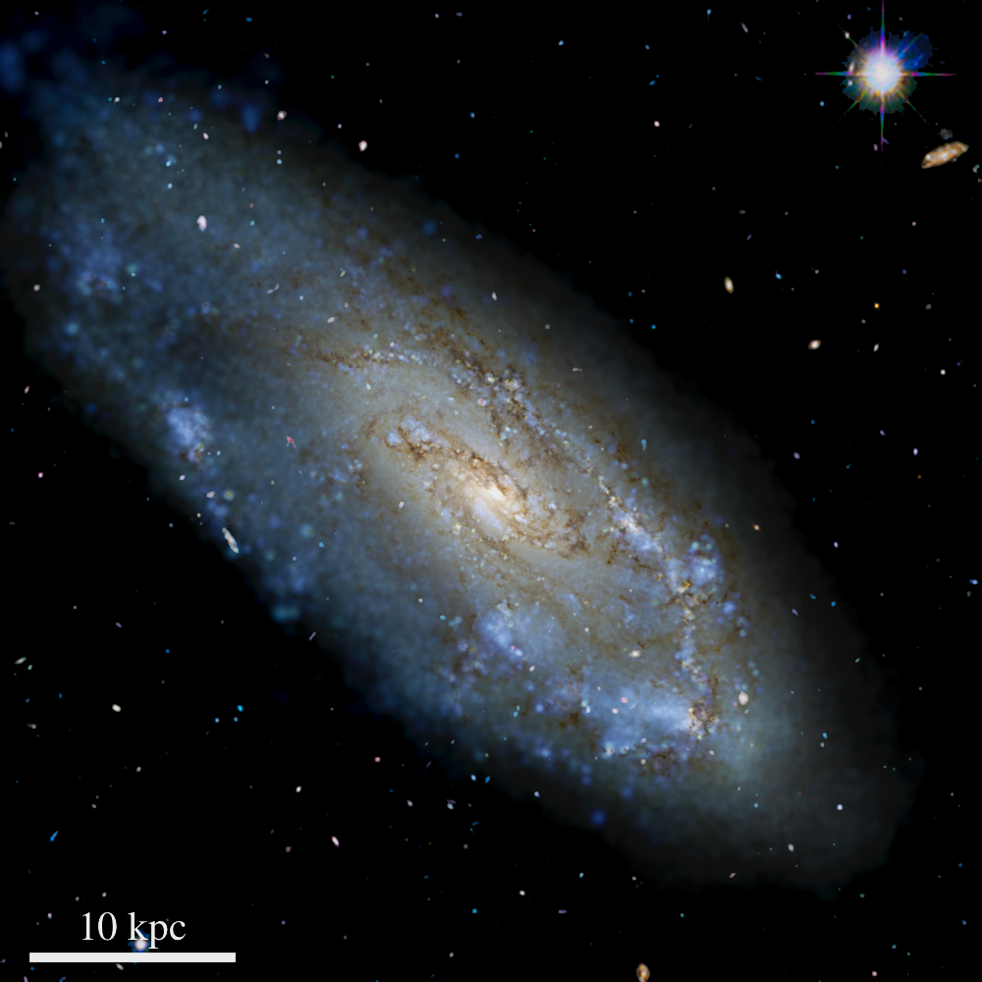
Modeling Emission Line Galaxies with Galacticus Semi-analytic Model
Sachi Weerasooriya, Andrew Benson
Carnegie Science, 813 Santa Barbara St, Pasadena CA 91101
Motivation
Why SAMs?
Galacticus (Benson 2012)
Mint Justice League
(MW, Applebaum+21)
Future surveys like Roman will provide millions of emission line redshifts and provide detailed galaxy distributions. We need models that can predict and tackle these numerous observations.
M_{res}
SAMs
VINTERGATAN
(MW, Rey+22)
Zoom in
simulations
Next generation
FIRE II
(MW,
Wetzel+16)
Large cosmological volumes: e.g.TNG 50/100
Galacticus N-body
(MW, Weerasooriya+23)
Galacticus EPS
(MW, Weerasooriya+23)
Modeling Star Forming HII Regions
Generates galaxy merger trees
Applies galaxy physics by solving ODEs
_{# Galaxies}
Our Goals
Present an improved emission line model
Constrain luminosity functions for emission line galaxies with existing observations
Future
HII regions ionized by AGN
Predictions of luminosity functions for emission line galaxies for future surveys
Acknowledgements: This work was supported by the OpenUniverse effort, which is funded by NASA under JPL Contract Task 70-711320, ’Maximizing Science Exploitation of Simulated Cosmological Survey Data Across Surveys’. We acknowledge the OBS HPC at Carnegie Science, the Resnick High Performance Computing Center, a facility supported by Resnick Sustainability Institute at the California Institute of Technology, and the MIES cluster housed at Stanford University's Forsythe Data Center at the California Institute of Technology and through the MIES cluster housed at Stanford University's Forsythe Data Center
References: Benson 2012, Ferland et al. 2013, Robotham et al. 2011, Favole et al. 2024

Slide 2
Modeling Emission Line Galaxies with Galacticus Semi-analytic Model
Sachi Weerasooriya, Andrew Benson
Carnegie Science, 813 Santa Barbara St, Pasadena CA 91101
Motivation
Why SAMs?
Mint Justice League
(MW, Applebaum+21)
Future surveys like Roman will provide millions of emission line redshifts and provide detailed galaxy distributions. We need models that can predict and tackle these numerous observations.
M_{res}
SAMs
VINTERGATAN
(MW, Rey+22)
Zoom in
simulations
Next generation
FIRE II
(MW,
Wetzel+16)
Large cosmological volumes: e.g.TNG 50/100
Galacticus N-body
(MW, Weerasooriya+23)
Galacticus EPS
(MW, Weerasooriya+23)
Modeling Star Forming HII Regions
_{# Galaxies}
Our Goals
Present an improved emission line model
Constrain luminosity functions for emission line galaxies with existing observations
Future
HII regions ionized by AGN
Predictions of luminosity functions for emission line galaxies for future surveys
Acknowledgements: This work was supported by the OpenUniverse effort, which is funded by NASA under JPL Contract Task 70-711320, ’Maximizing Science Exploitation of Simulated Cosmological Survey Data Across Surveys’. We acknowledge the OBS HPC at Carnegie Science, the Resnick High Performance Computing Center, a facility supported by Resnick Sustainability Institute at the California Institute of Technology, and the MIES cluster housed at Stanford University's Forsythe Data Center at the California Institute of Technology and through the MIES cluster housed at Stanford University's Forsythe Data Center
References: Benson 2012, Ferland et al. 2013, Robotham et al. 2011, Favole et al. 2024

Slide 3
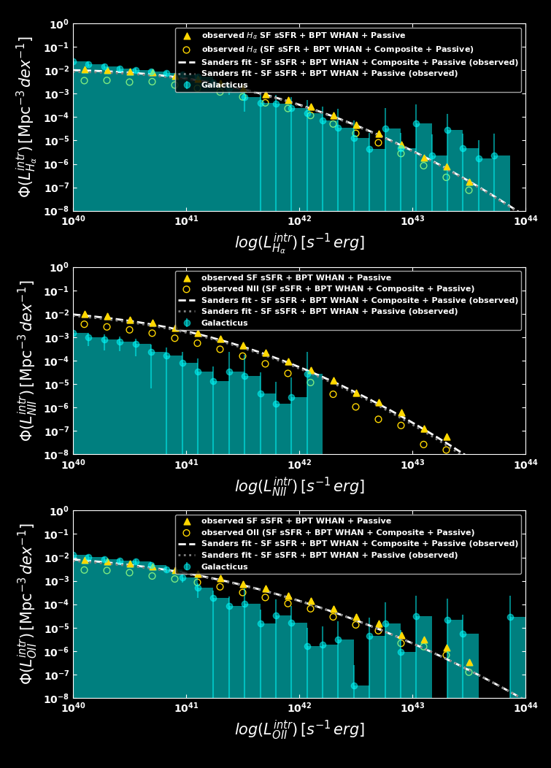
Modeling Emission Line Galaxies with Galacticus Semi-analytic Model
Sachi Weerasooriya, Andrew Benson
Carnegie Science, 813 Santa Barbara St, Pasadena CA 91101
Luminosity Functions with $n_{H}=100 cm^{−3. }$
Galaxy merger trees ${10}^{10}−{10}^{15}M_{⊙}$
Merger trees with higher masses helps to populate more luminous galaxies
Larger sample of merger trees improves the luminosity function
Observations (Favole et al. 24)
Acknowledgements: This work was supported by the OpenUniverse effort, which is funded by NASA under JPL Contract Task 70-711320, ’Maximizing Science Exploitation of Simulated Cosmological Survey Data Across Surveys’. We acknowledge the OBS HPC at Carnegie Science, the Resnick High Performance Computing Center, a facility supported by Resnick Sustainability Institute at the California Institute of Technology, and the MIES cluster housed at Stanford University's Forsythe Data Center at the California Institute of Technology and through the MIES cluster housed at Stanford University's Forsythe Data Center
References: Benson 2012, Ferland et al. 2013, Robotham et al. 2011, Favole et al. 2024

Slide 4
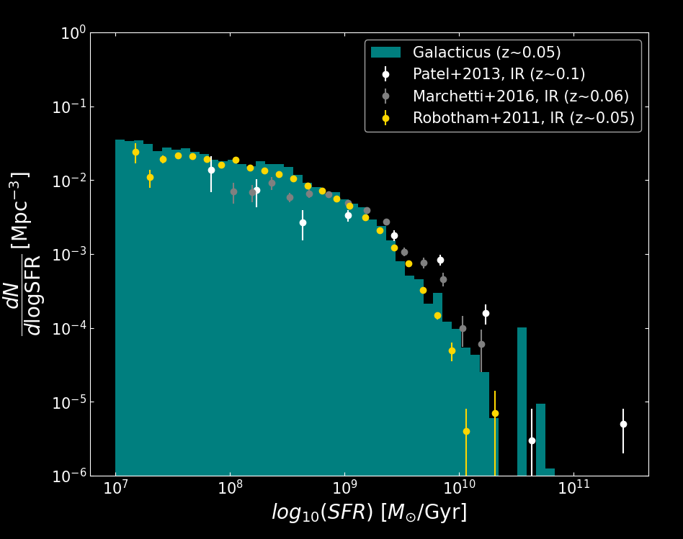
Modeling Emission Line Galaxies with Galacticus Semi-analytic Model
Sachi Weerasooriya, Andrew Benson
Carnegie Science, 813 Santa Barbara St, Pasadena CA 91101
Calibrating the models: Star formation rate distribution
We reproduce observed star formation rate distribution at z~0.05
without any recalibration
Acknowledgements: This work was supported by the OpenUniverse effort, which is funded by NASA under JPL Contract Task 70-711320, ’Maximizing Science Exploitation of Simulated Cosmological Survey Data Across Surveys’. We acknowledge the OBS HPC at Carnegie Science, the Resnick High Performance Computing Center, a facility supported by Resnick Sustainability Institute at the California Institute of Technology, and the MIES cluster housed at Stanford University's Forsythe Data Center at the California Institute of Technology and through the MIES cluster housed at Stanford University's Forsythe Data Center
References: Benson 2012, Ferland et al. 2013, Robotham et al. 2011, Favole et al. 2024

