Slide 1
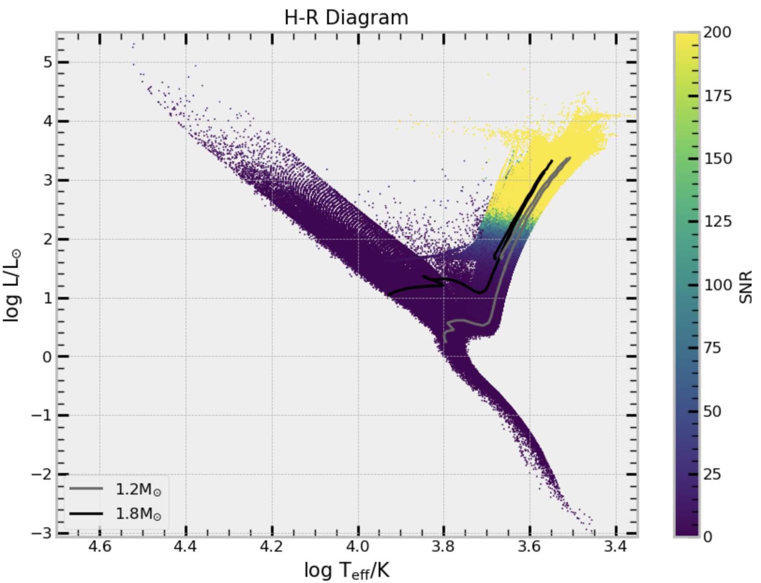
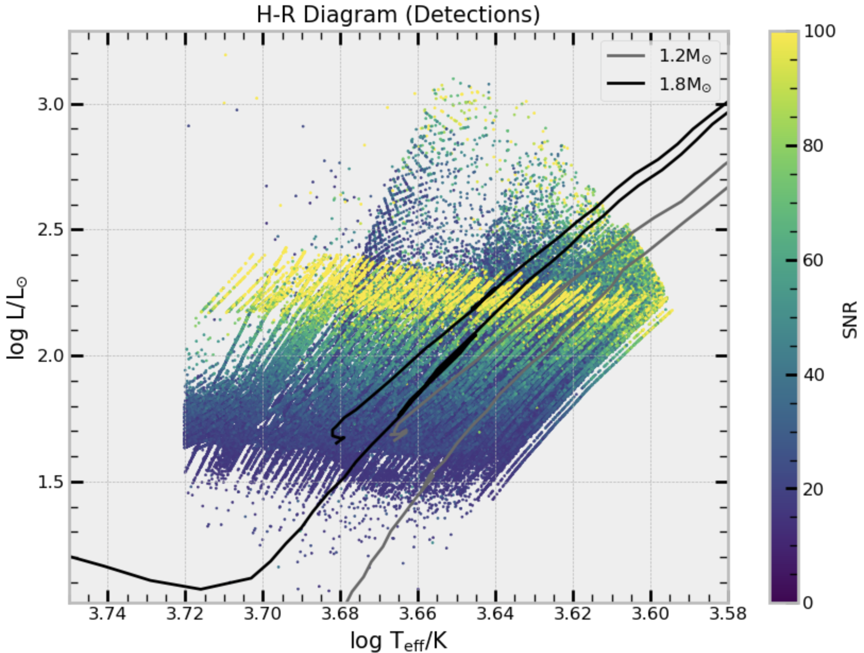
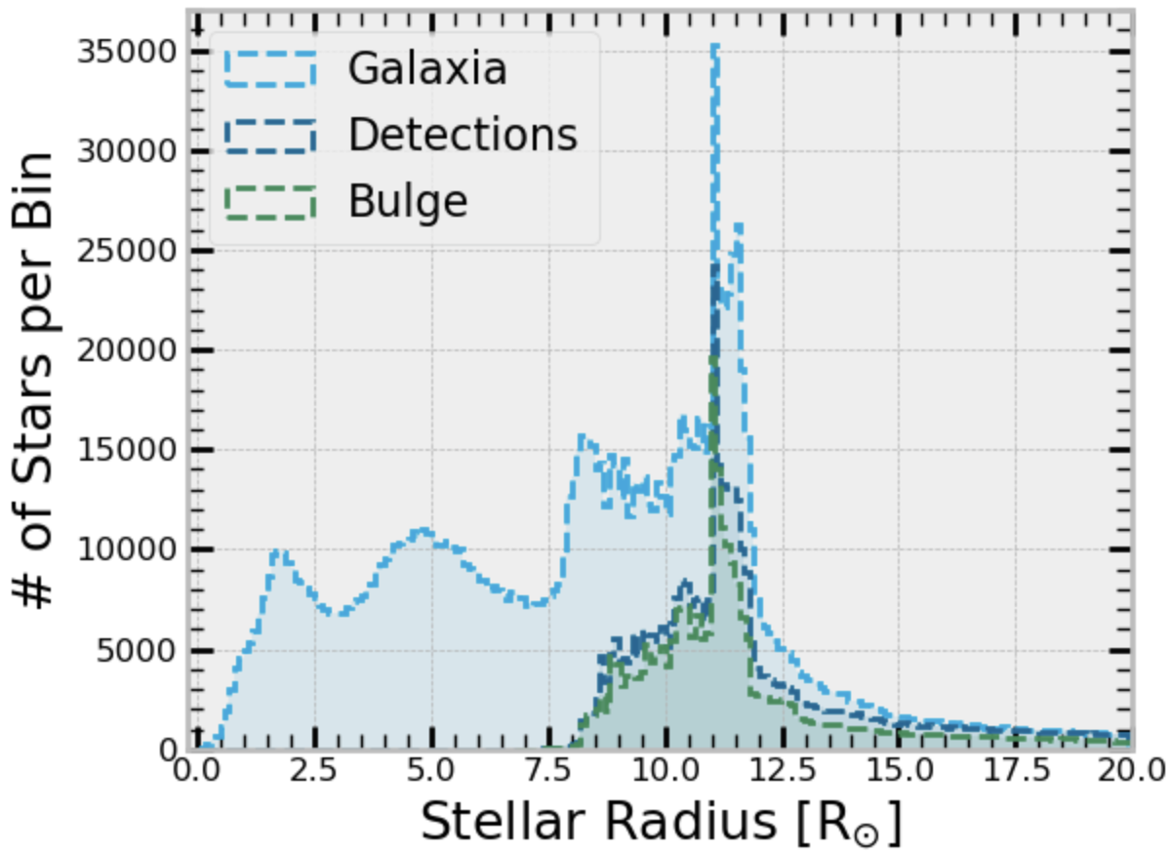
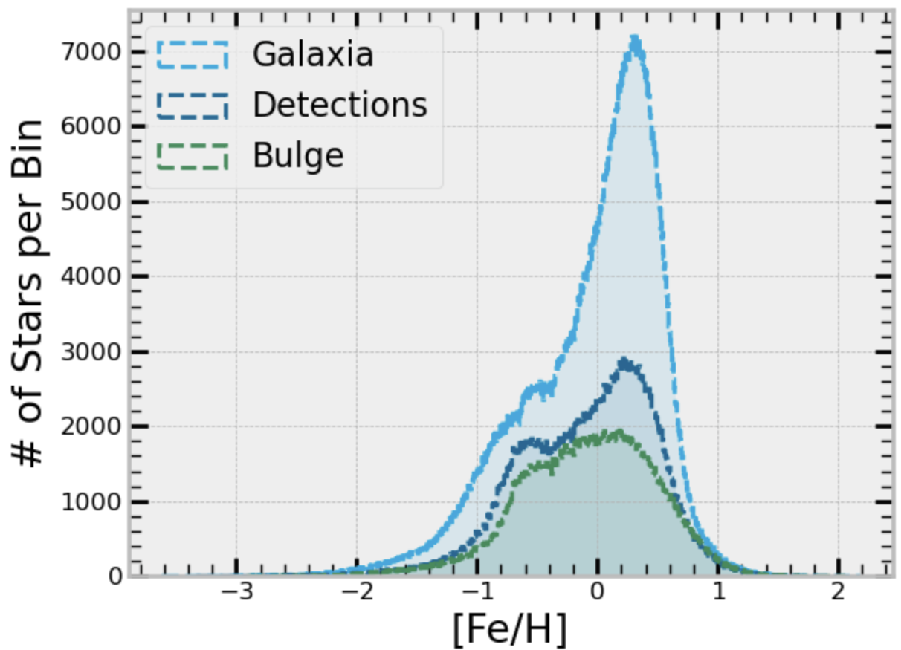
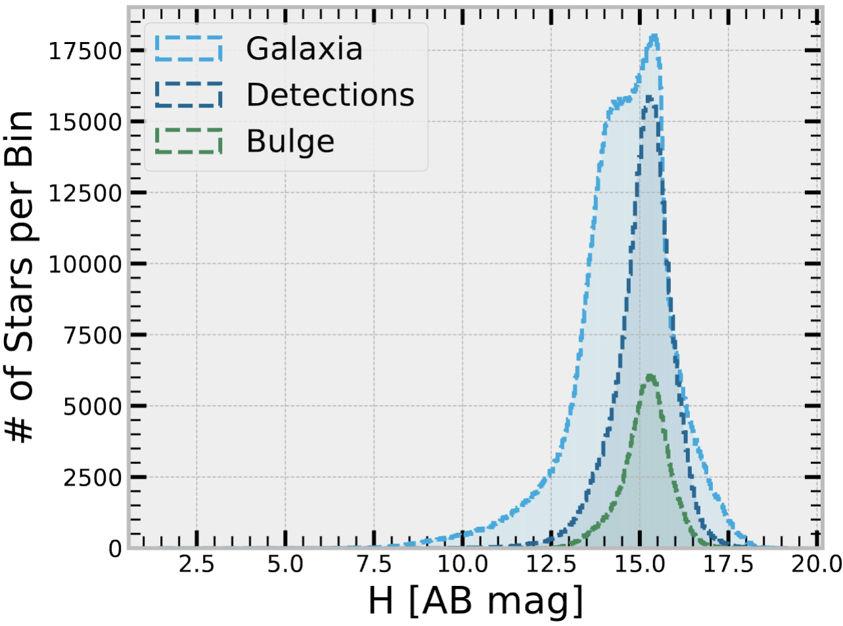
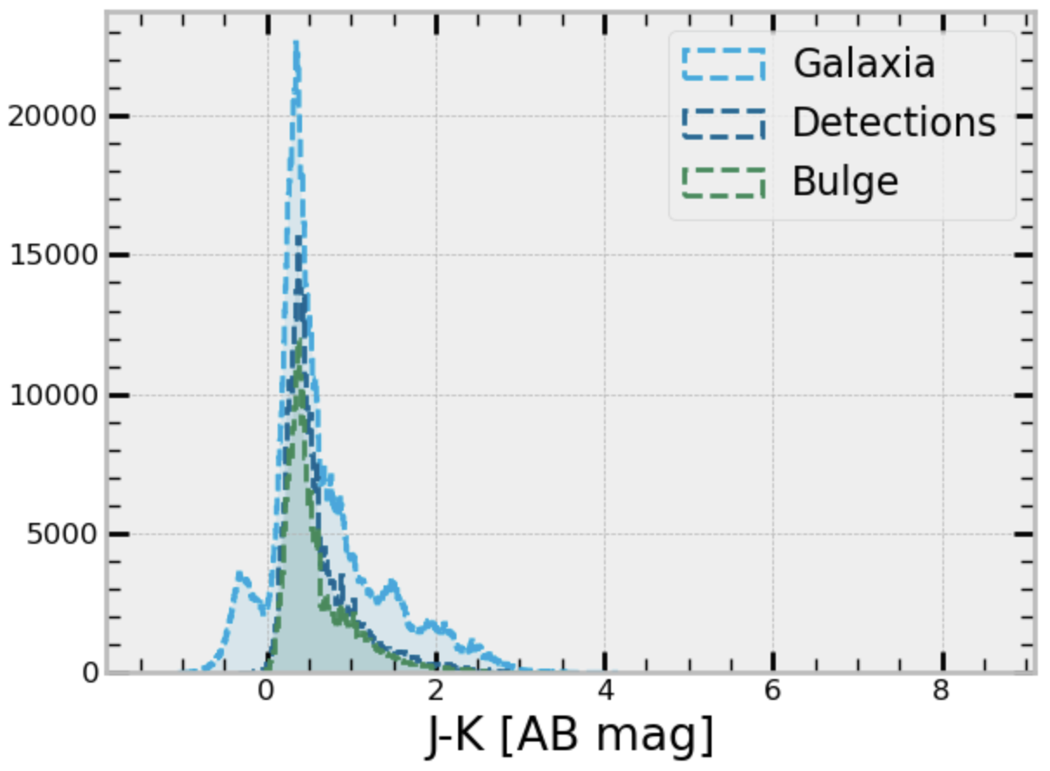
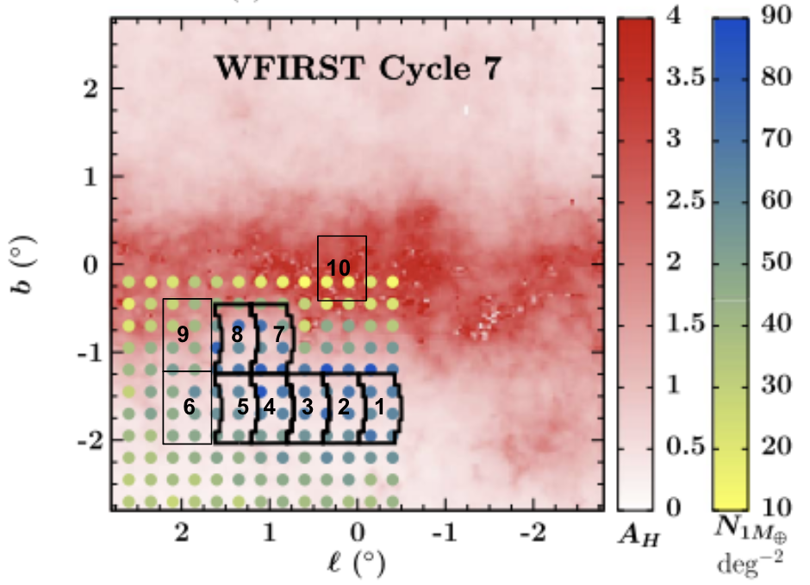
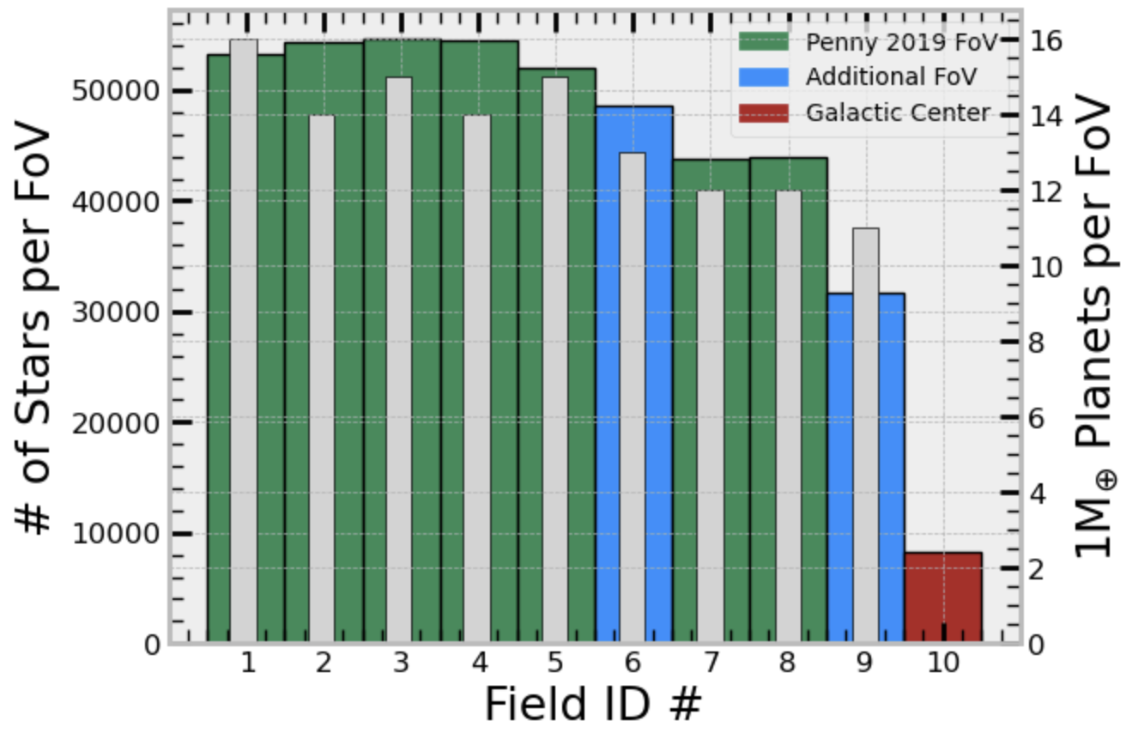
Modeling Asteroseismic Yields of the Roman Galactic Bulge Time-Domain Survey
Trevor Weiss & the Roman Asteroseismology Wide Field Science Team
Department of Physics and Astronomy, California State University, Long Beach
1
1
Introduction
Results
Conclusions and Future Work
Thanks to its nominal survey sensitivity and cadence, the Roman Galactic Bulge Time-Domain Survey should be able to detect asteroseismic signals in red giant branch bulge stars. Asteroseismology has been shown with previous NASA missions to provide precise stellar parameters, including stellar radius, mass, and age (e.g., Pinsonneault et al. 2018). Give the potential for Roman asteroseismology in the bulge (Huber et al. 2023), here we simulate asteroseismic yields for various Roman fields of view, extinction models, detection and noise models, and the age-metallicity relation of the bulge. Such asteroseismic detections promise to inform properties of microlensing stellar populations and the formation history of the bulge.
Initial models show a strong sample of asteroseismic data, with upwards of ~437,000 detections, ~294,000 of which are expected to be members of the bulge.
Including two additional fields to those of Penny to be consistent with a 15-minute cadence is shown to significantly increase the number of asteroseismic detections and the overall population of Earth-mass exoplanets.
Initial tests of increased cadence suggest the increase in SNR does not compensate for the required decrease in the number of fields of view.
Differences between Schlegel and Marshall extinction maps resulted in marginal differences to the detected populations. We will investigate a newer high-resolution extinction map of the bulge (Surot et al. 2020).
Simulated Roman light curves have been generated to produce more accurate detection probabilities (see N. Downing poster) and will be incorporated into our yields.
Roman asteroseismic yields may have a bias against old stars in the bulge due to the lack of oscillations in hot, metal-poor stars, unless selection functions are taken into accounts. This evidence encourages further work with AMR at the bulge in our simulations.
Future work will use the observed stellar properties of the modeled asteroseismic detections to construct a target list for Roman asteroseismic observations.
Asteroseismic parameters for such target lists could meaningfully inform stellar properties for exoplanet studies and can be used to make confident assertions about the age of stellar objects at the bulge.
Modeling the Sample
Our underlying stellar populations are based on models from Galaxia (Sharma et al. 2011), which uses the Besancon galaxy model (Robin et al. 2012).
We use noise models from Gould et al. 2015 combined with asteroseismic amplitude predictions from Huber et al. 2023 to predict signal-to-noise ratios. We considered a given Galaxia red giant to be detectable with Roman according to the following:
T (K) < 5250 K
Numax > 5
SNR > 15
Given parameters were chosen based on work showing that hotter stars do not exhibit solar-like oscillations (Huber et al. 2011) and that low-frequency oscillators may not be detectable by Roman.
Extinction was modelled using Marshall et al. 2006 and Schlegel et al. 1998 extinction maps.
We use Penny et al. 2019 suggested fields of view as a reference for positioning the simulated survey.
We added two additional fields to our calculations, which can be included within the 15 minute cadence and nominal slew time.
Acknowledgements
As seen in our Stellar Radius figure, our asteroseismic yields are primarily dominated by red clump stars (~10 R⊙).
We also see sensitivity of bulge yields when detailed age-metallicity relations (AMR) are implemented at the bulge, suggested by Joyce et al. 2023. Increasing stellar ages and decreasing metallicities at the bulge, we see asteroseismic detection yields shrinking to as low as ~176,000 objects.
Asteroseismic detections are predicted to be in the saturated regime (H < 16 with Roman expectations).
Differences in population yields using extinction maps between Marshall et al. 2006 or those of Schlegel et al. 1998 are marginal.
Simulations of a field of view trained on the Galactic center indicate ~800 detections within the innermost kpc of the Galaxy.
Earth-mass exoplanet yields are less sensitive to field of view placement compared to the yields of asteroseismic detections within the considered footprint, though both decrease approaching the Galactic plane.
This work was supported under NASA award 80NSSC24K0091. The Roman Asteroseismology Wide Field Science Team is composed of Tim Bedding, Kaili Cao, Noah Downing, Scott Gaudi, Marc Hon, Daniel Huber, Jennifer Johnson, Matthew Penny, Marc Pinsonneault, Sanjib Sharma, Dennis Stello, and Joel Zinn. We thank Tom Barclay, Joshua Schlieder, and the Roman Team for their insight on the project.
References
Gould, A., Huber, D., Penny, M., & Stello, D. (2015) Journal of The Korean Astronomical Society, 48(2), 93–104
Huber, D. et al. (2023). Roman Core Community Survey White Paper
Huber, D. et al. (2011). The Astrophysical Journal, 743(2), 143
Joyce, M. et al. (2023). The Astrophysical Journal, 946(1), 28
Marshall, D. J. et al. (2006) Astronomy & Astrophysics, 453(2), 635–651
Penny, M. T. et al. (2019) The Astrophysical Journal Supplement Series, 241(1), 3.
Pinsonneault, M. H. Elsworth(2018). The Astrophysical Journal Supplement Series, 239(2), 32
Robin, A. C., Reylé, C., Derrière, S., & Picaud, S. (2003) Astronomy & Astrophysics, 409(2), 523–540
Schlegel, D. J., Finkbeiner, D. P., & Davis, M. (1998) The Astrophysical Journal, 500(2), 525–553
Sharma, S., Bland-Hawthorn, J., Johnston, K. V., & Binney, J. (2011) The Astrophysical Journal, 730(1), 3
Surot, F. et al. (2020) Astronomy & Astrophysics, 644.
Modified from Penny et al. 2019

