Slide 1
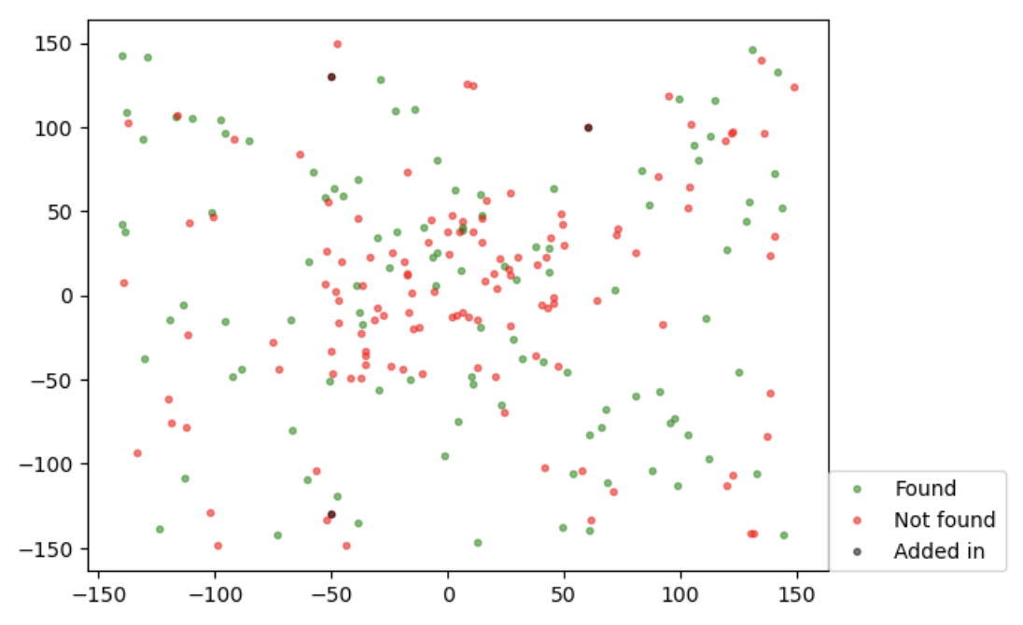
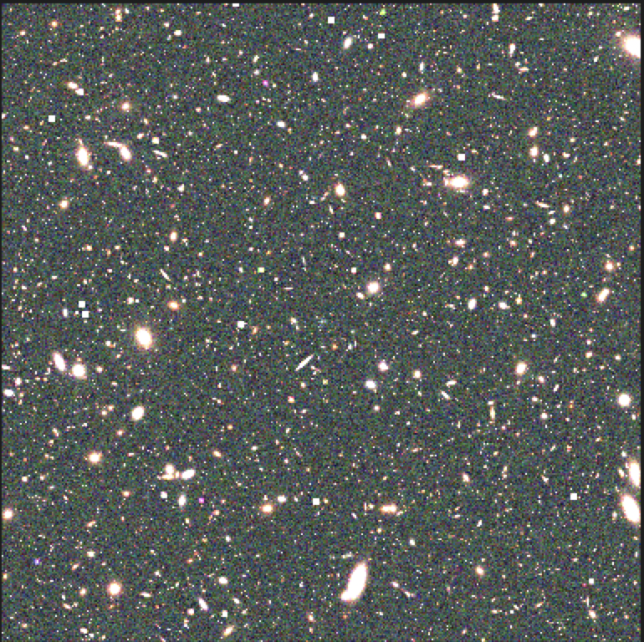
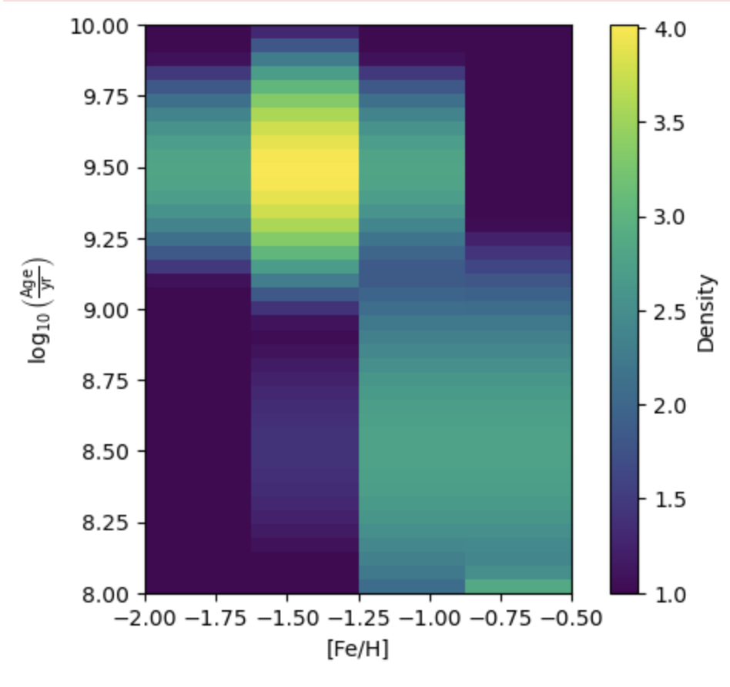
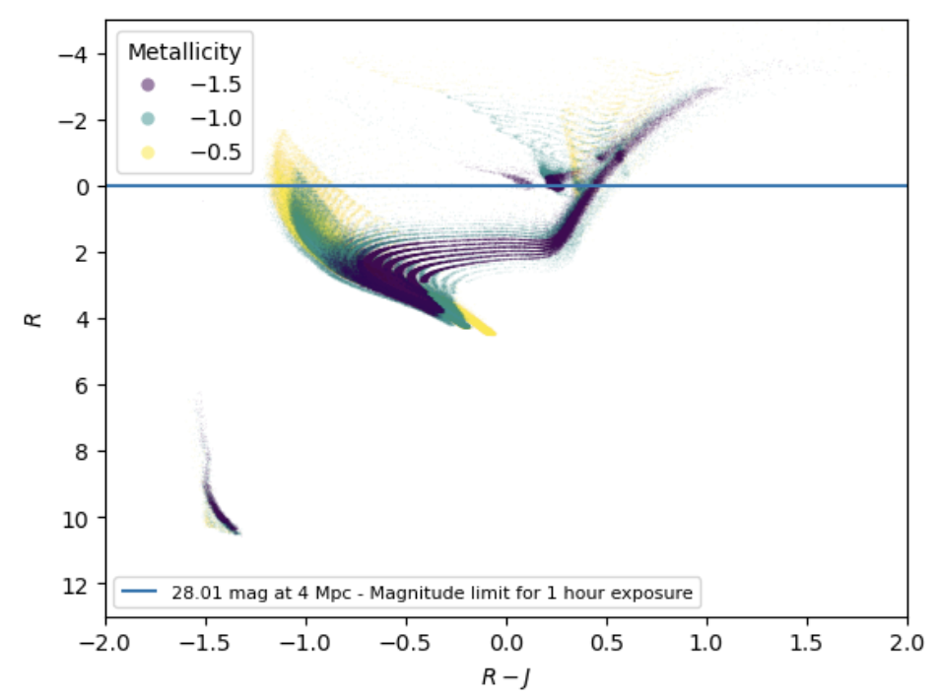
Simulating a Roman Space Telescope Survey of Nearby Dwarf Galaxies Kathryn Wynn¹, Benjamin Williams¹, Eric Bell², David Sand³, RINGS Team ¹Department of Astronomy, University of Washington; ²Department of Astronomy, University of Michigan, ³Department of Astronomy, University of Arizona
Introduction
WINGS Pipeline
This is a pipeline that we are currently developing, part of which uses STScI’s STIPS simulation software to mimic Roman observations.
The pipeline takes an input stellar catalogue, uses STIPS to ‘observe’ the catalogue using Roman detectors, and then performs photometry on the output image using DOLPHOT.
Finding Overdensities
We modified a script from Eric Bell that places a few hundred randomized dwarfs into a Bullock and Johnston halo and tests for overdensities.
This script uses simple magnitude and colour cuts to determine which dwarfs may be observable, with no added complications like there would be from a real observation.
We plan to use this output as preliminary results, prior to the photometry results from the pipeline.
We are developing a pipeline that simulates Roman observations of nearby dwarf galaxies and then measures their resolved stellar photometry.
We specifically want to probe the 1e4 to 1e6 dwarf mass range, to help constrain the dwarf galaxy mass function because of the implications for the epoch of reionization.
The goal of this pipeline is to provide tools to help determine the observational strategy required to resolve structures in extended stellar halos of nearby galaxies.
Below is an image of a part of a grid of 100 galaxies, ranging from a mass of ~1e5 at the top left, to 1e6 at the bottom right. Both images use filters F062, F106, and F158.
Methods
Making Dwarf Galaxies
We’ve developed tools for producing mock dwarf galaxies, which we have been using to produce mock Roman observations using the STScI-STIPS software tools.
We are now using a script (from WALTER¹) that uses MIST isochrones to be able to quickly make a range of dwarf galaxies with our preferred parameters.
Currently, we are making many galaxies between metallicities -0.5 and -2.0, ages of 8 Myr to 10 Myr. All dwarfs are 4 Mpc away.
We want to make a grid of about 400 dwarf galaxies with varying parameters to run through the pipeline to test Roman's ability to detect them.
The figure below shows the galaxy of about 1e5 solar masses (the middle of the mass range) from the grid above, this time with added background galaxies .
The figure above shows a few hundred randomly-added dwarfs and three manually-added dwarfs, and whether the overdensity script successfully found them.
Results
This project is still in progress and doesn't have concrete results yet, as the software is still being developed.
We aim to have preliminary results by the end of the summer.
The current version of the pipeline can be found on GitHub under benw1/WINGS.
We can now make our own dwarf galaxies and make many STIPS Roman images of them in parallel.
This Figure shows a metallicity map of one of the created galaxies (1e5 solar masses).
Acknowledgements
The figure to the left shows a colour-magnitude diagram of one of the created galaxies (1e6 solar masses) using filters F062 and F129. The blue line shows the lower observable magnitude limit for a galaxy at 4 Mpc.
This work is part of Roman Infrared Nearby Galaxies Survey (RINGS), a Wide-Field Science (WFS) program funded by NASA under grant 80NSSC24K0084. Thank you to the RINGS team and especially Prof. Ben Williams, who facilitated this project.
¹Lancaster, L., Pearson, S., Williams, B. F., et al. 2022, AJ, 164, 142, doi: 10.3847/1538-3881/ac8a95

Slide 2
Making Dwarf Galaxies Using WALTER¹
Characteristics
Ages: 8 to 10Myr
Metallicities: 0.5 to -2.0
Masses: 10⁴ to 10⁶ M⊙
Exponential profile
Randomized inclination angle
Set at 4 Mpc away
¹Lancaster, L., Pearson, S., Williams, B. F., et al. 2022, AJ, 164, 142, doi: 10.3847/1538-3881/ac8a95

Slide 3
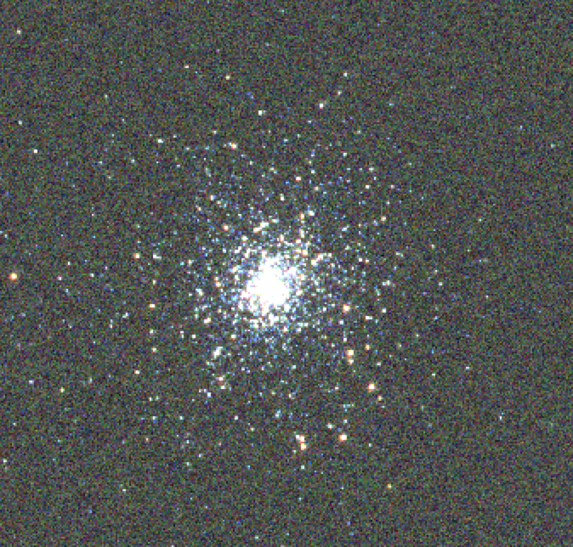
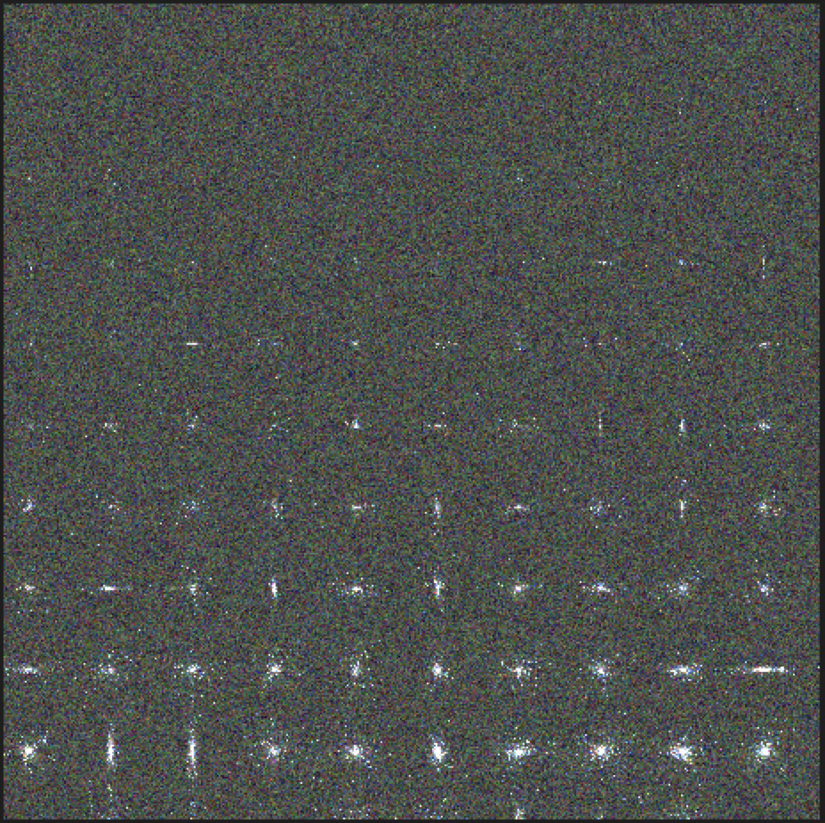
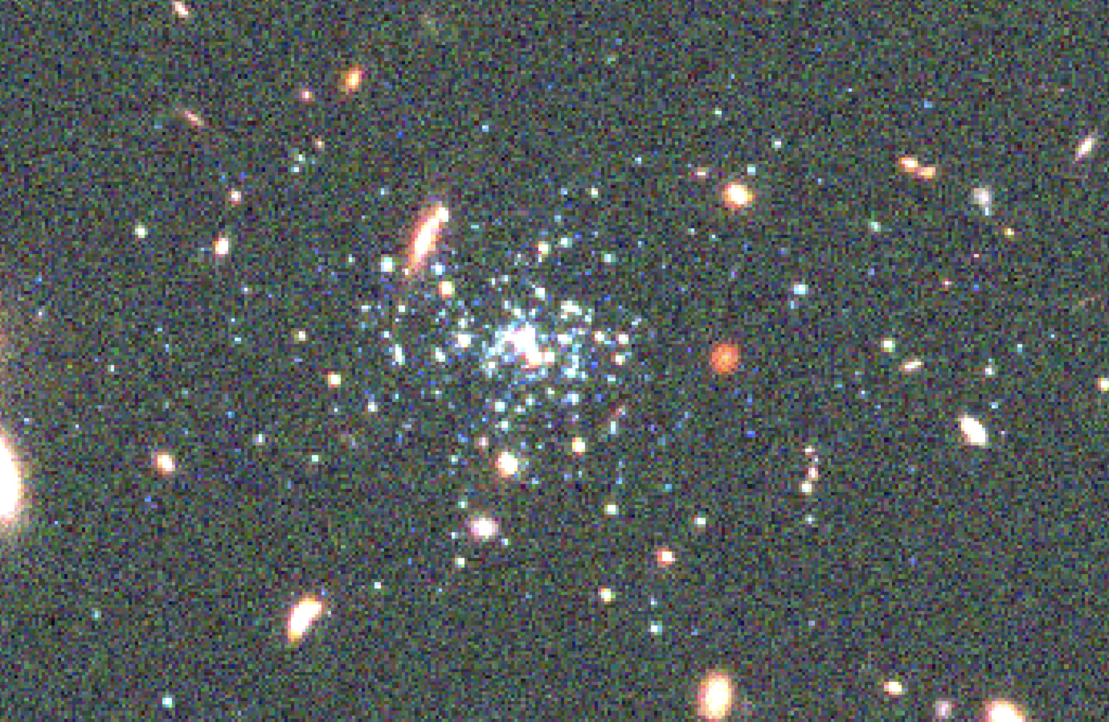
Our Pipeline Images
Probing observational capabilities for dwarf galaxies with mass ranging from 10⁴ to 10⁶ solar masses.
The pipeline is set up to use DOLPHOT¹ to perform photometry and compare to the user inputted catalogue (still in development).
~10⁴ solar masses
~10⁶ solar masses
¹Dolphin, A. 2016, DOLPHOT: Stellar photometry, Astrophysics Source Code Library, record ascl:1608.013
¹Dolphin, A. E. 2000, PASP, 112, 1383, doi: 10.1086/316630

