Slide 1
The Microlensing Planet Landscape on the Eve of Roman
Jennifer C. Yee
July 9, 2024

Slide 2
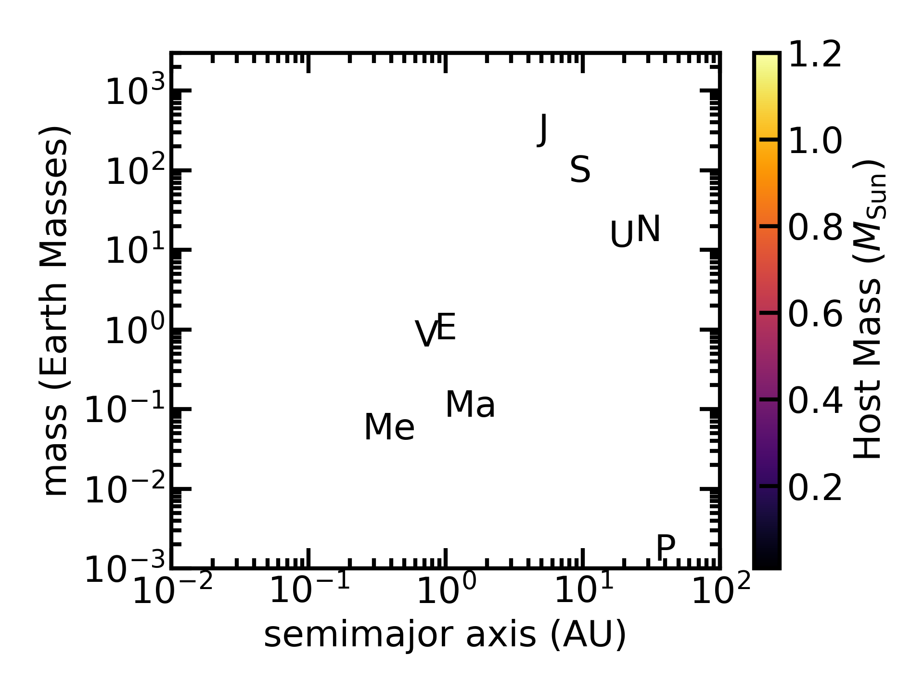
Known planets from NASA Exoplanet Archive accessed 5/20/24

Slide 3
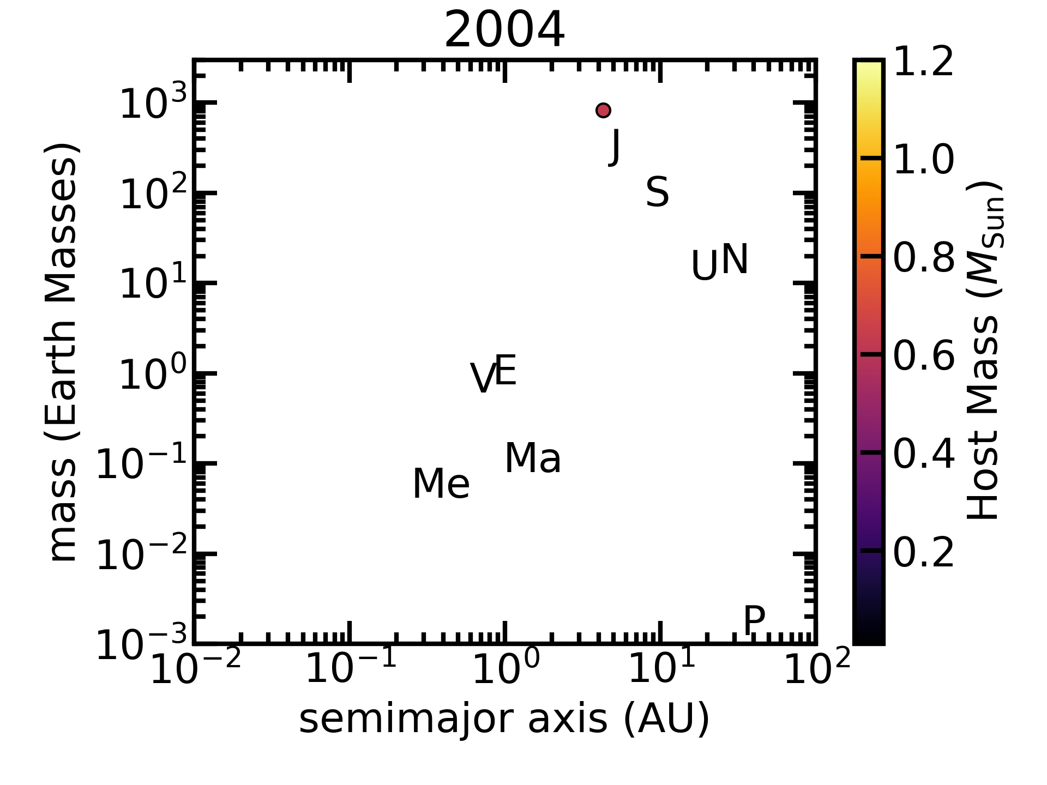
Known planets from NASA Exoplanet Archive accessed 5/20/24

Slide 4
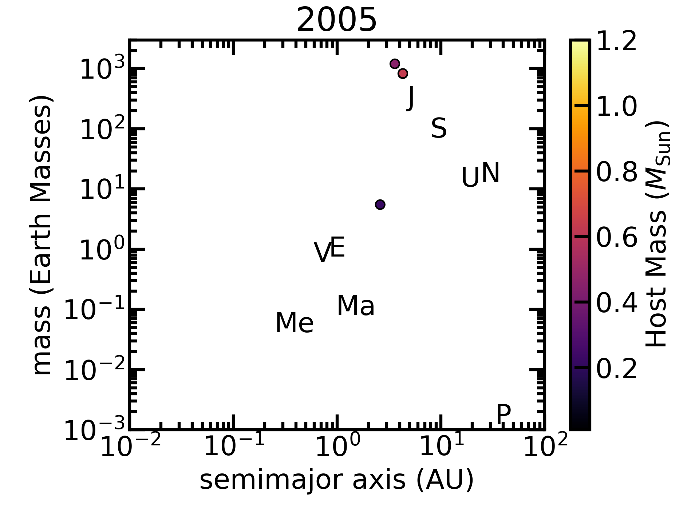
Known planets from NASA Exoplanet Archive accessed 5/20/24

Slide 5
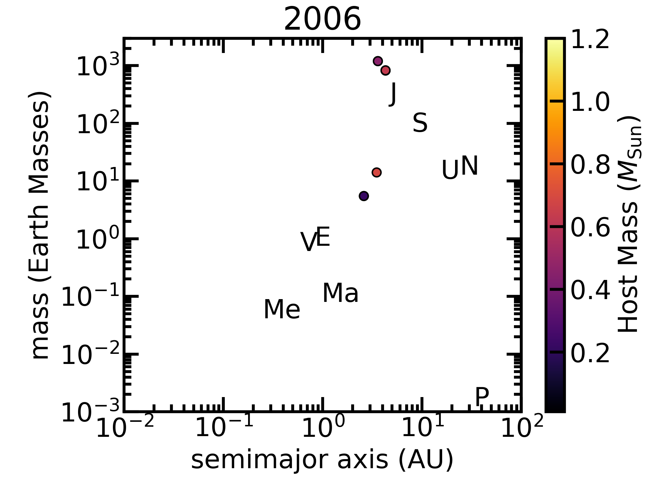
Known planets from NASA Exoplanet Archive accessed 5/20/24

Slide 6

Known planets from NASA Exoplanet Archive accessed 5/20/24

Slide 7
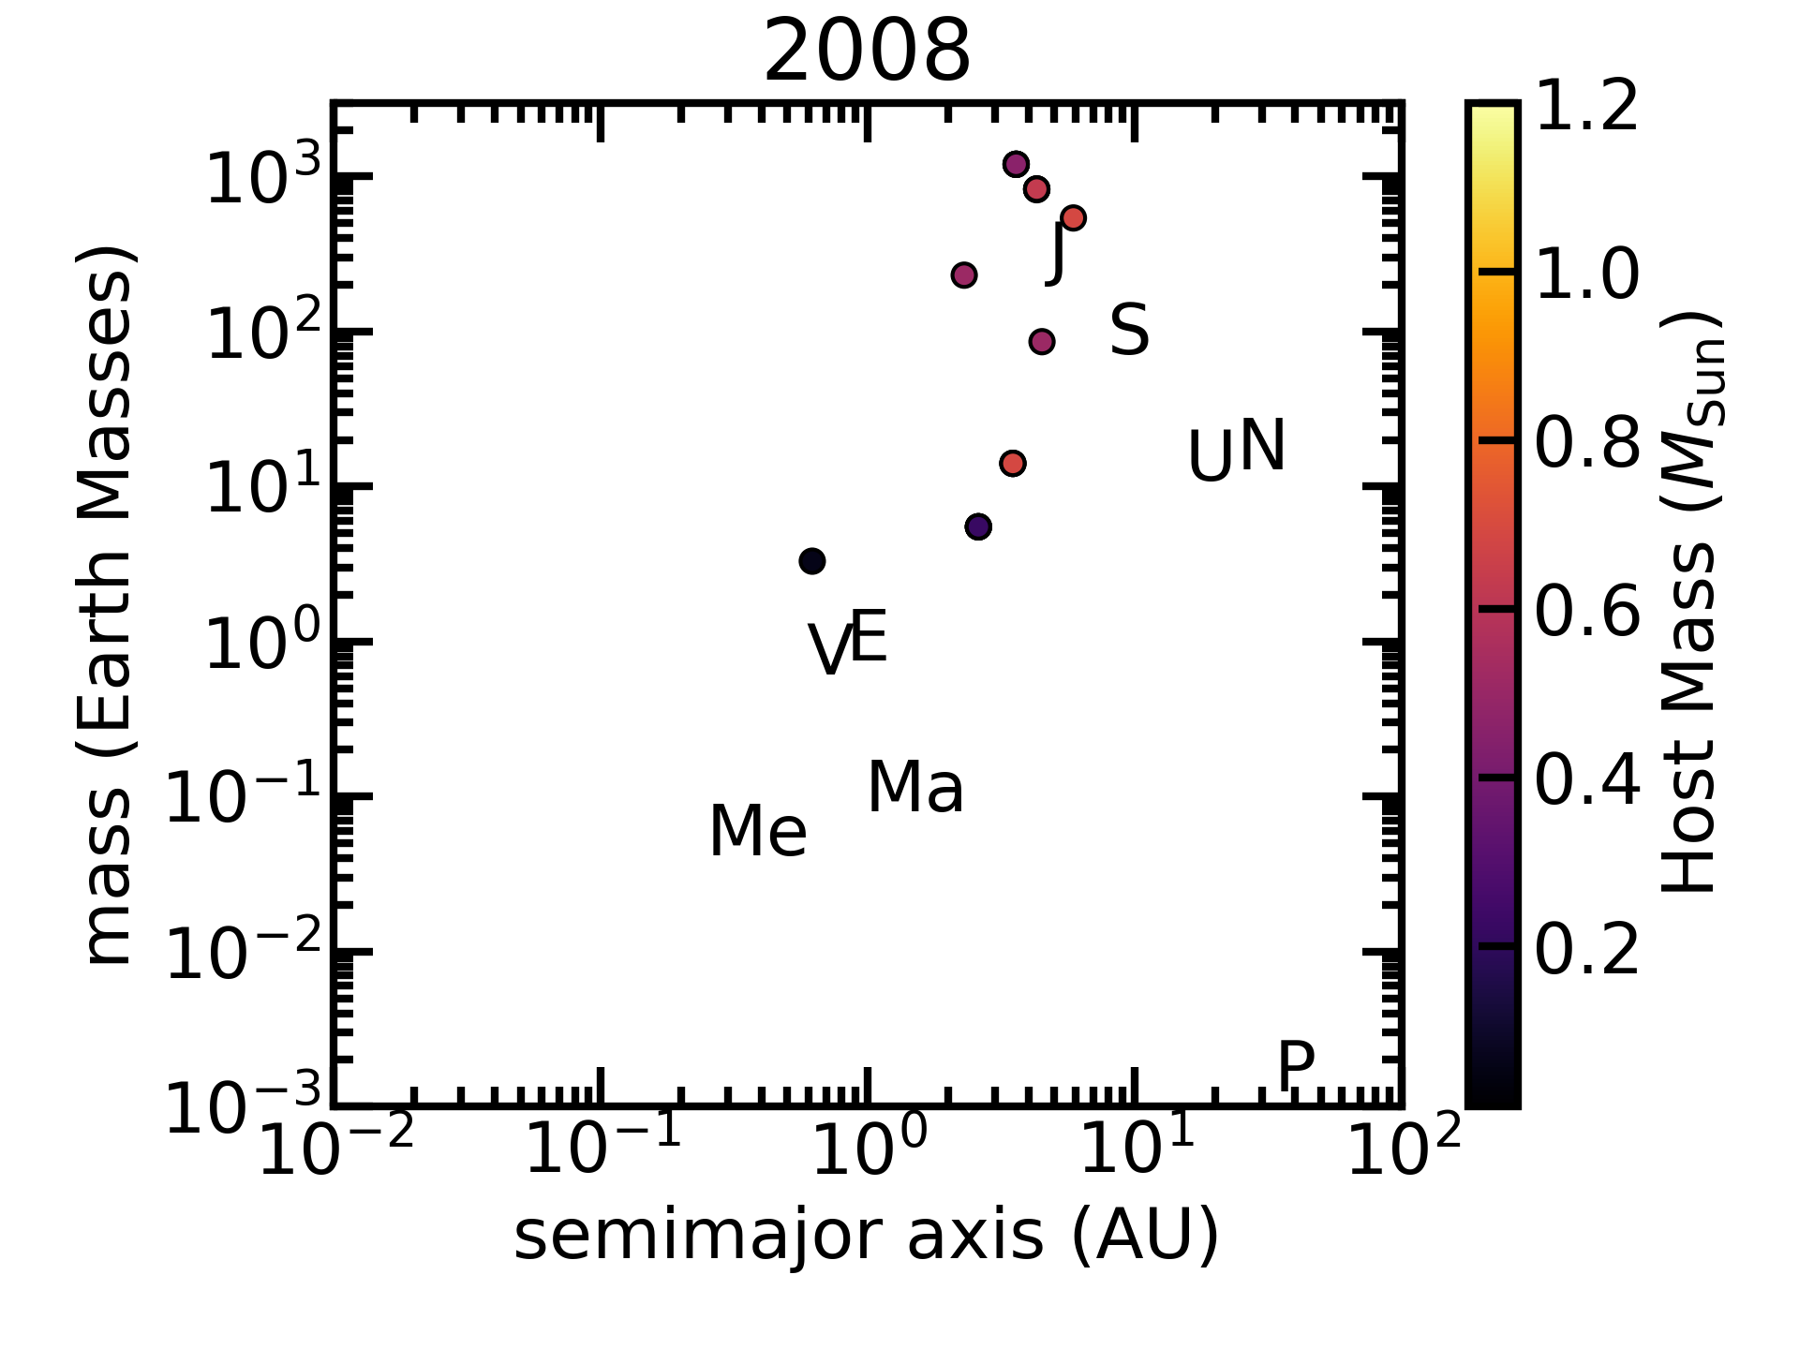
Known planets from NASA Exoplanet Archive accessed 5/20/24

Slide 8

Known planets from NASA Exoplanet Archive accessed 5/20/24

Slide 9

Known planets from NASA Exoplanet Archive accessed 5/20/24

Slide 10

Known planets from NASA Exoplanet Archive accessed 5/20/24

Slide 11
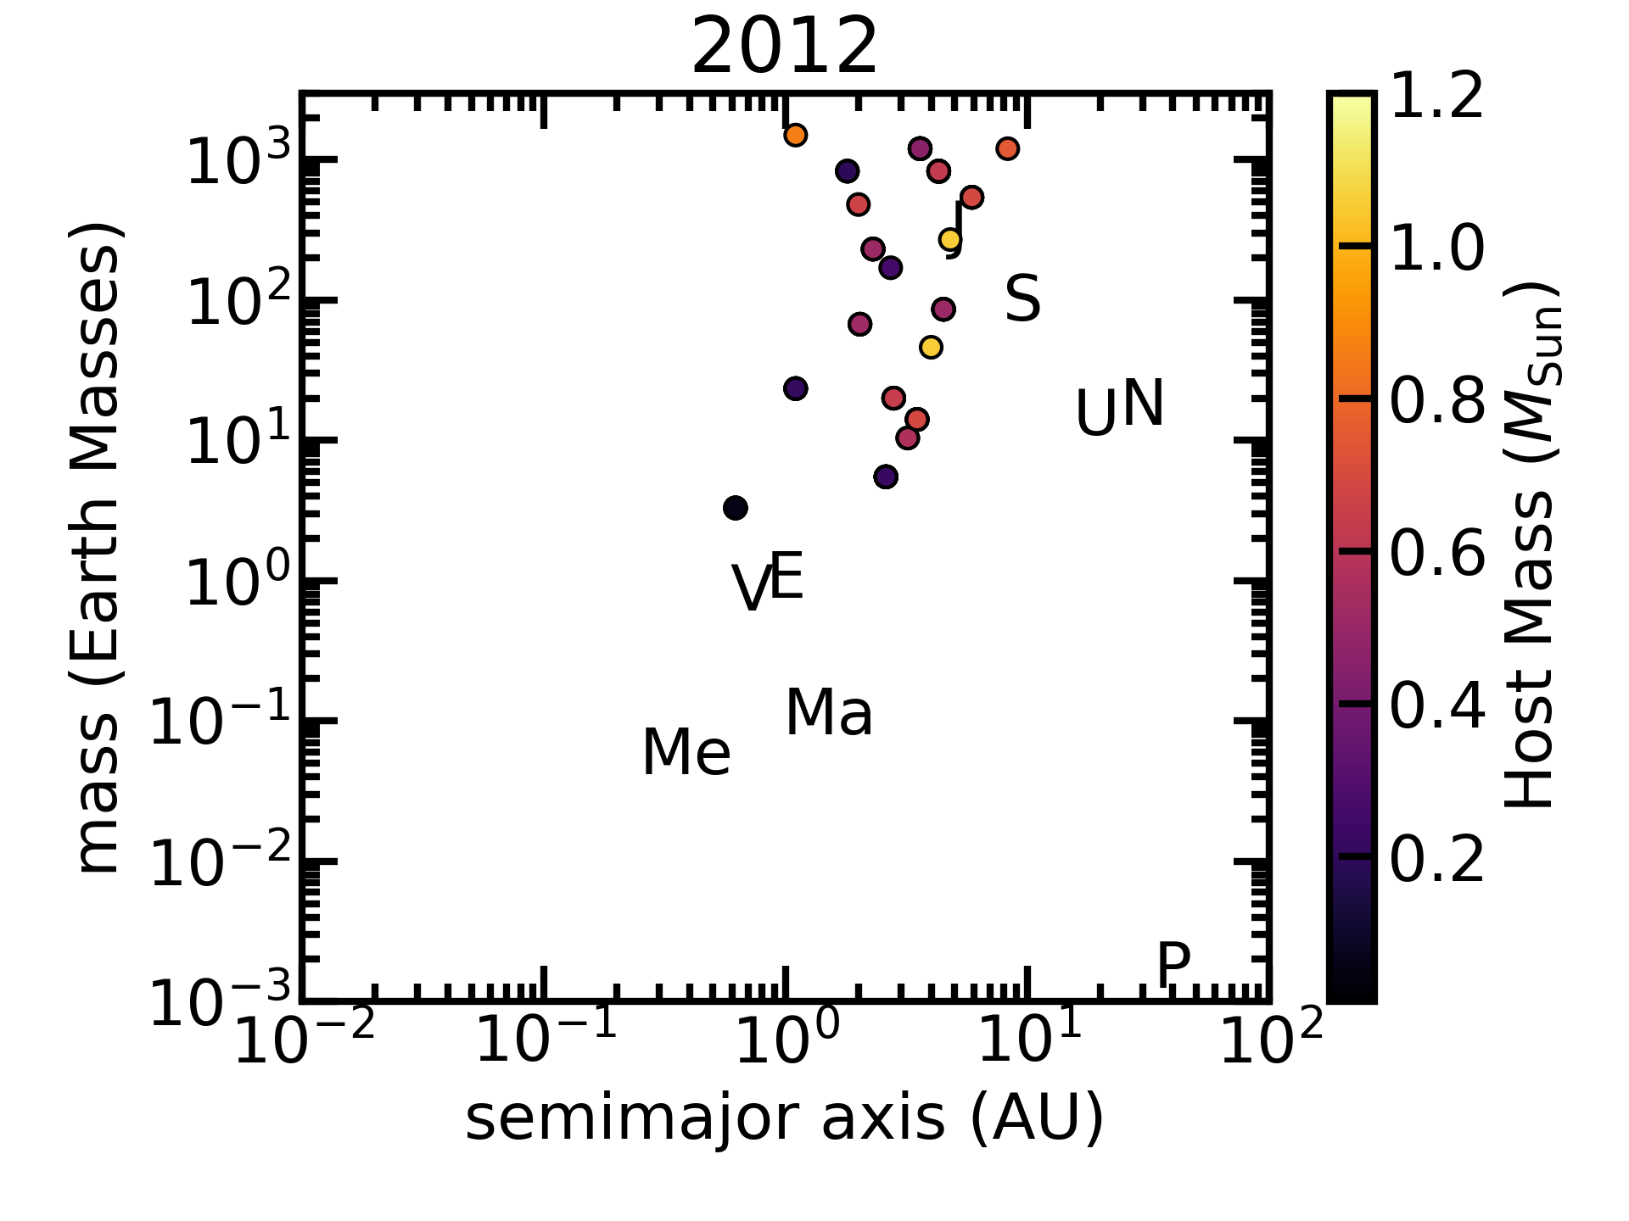
Known planets from NASA Exoplanet Archive accessed 5/20/24

Slide 12

Known planets from NASA Exoplanet Archive accessed 5/20/24

Slide 13
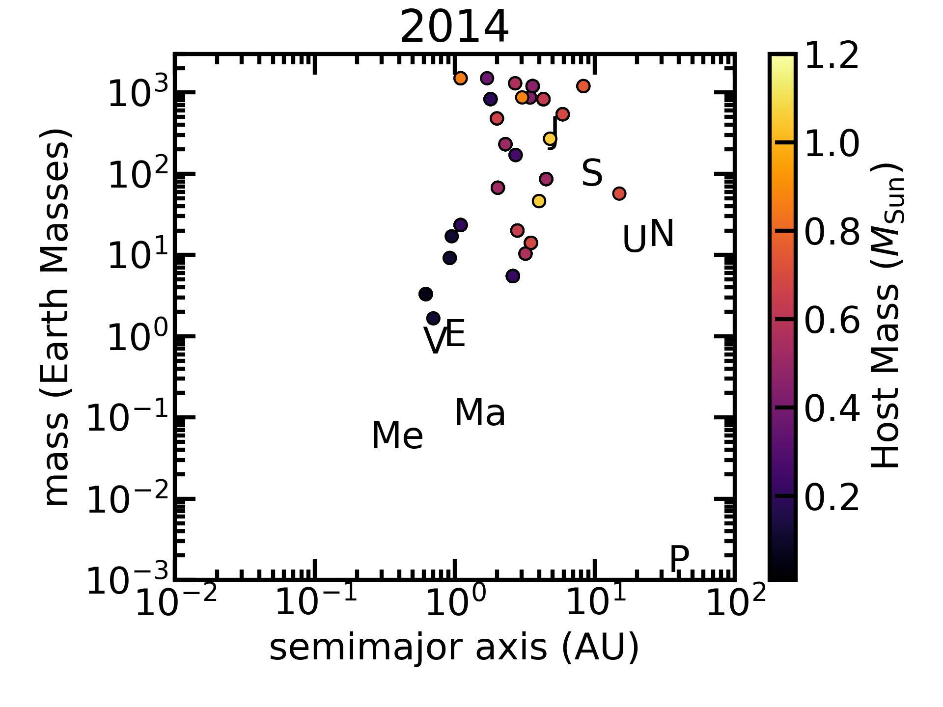
Known planets from NASA Exoplanet Archive accessed 5/20/24

Slide 14

Known planets from NASA Exoplanet Archive accessed 5/20/24

Slide 15

The Korea Microlensing Telescope NETWORK
Notes:
So, Han came up with the idea of building a telescope network with
large format cameras at three different sites in the southern
hemisphere. The goal of this network was to detect very small planets
through uniform, dense observations.

Slide 16
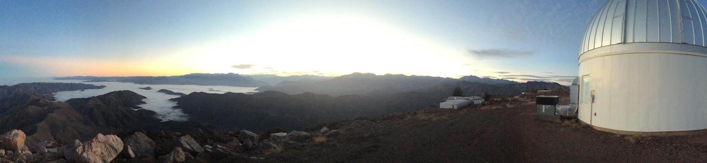
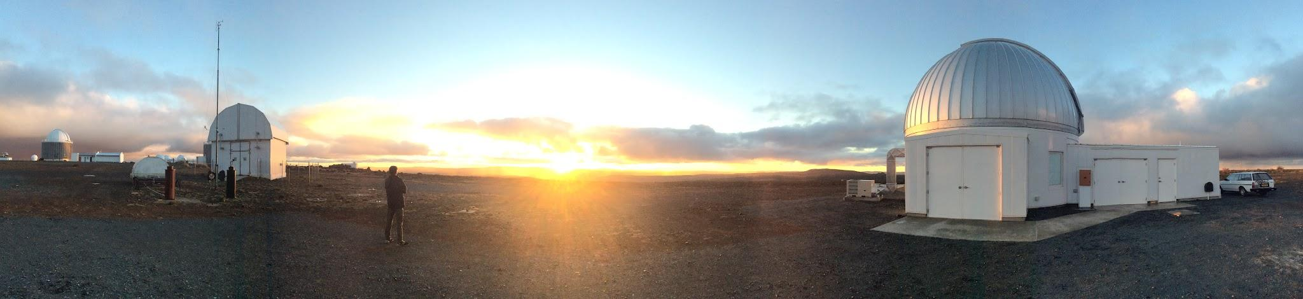
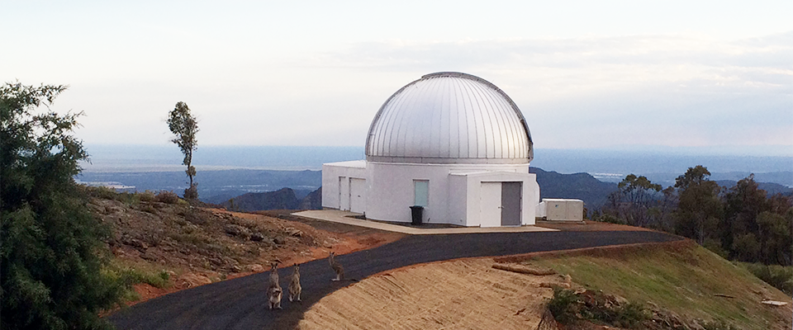

CTIO/KMTC
photo by In-Gu Shin
SAAO/KMTS
photo by In-Gu Shin
SSO/KMTA
Notes:
Three telescopes were built: one at CTIO, one at SAAO, and one at SSO.
combination near-continuous obs of bulge, single system.

Slide 17
More Stars is Better
2 degrees
Kim et al. 2016 JKAS 49, 37
Notes:
Figure 5. (Left) A sample 18k mosaic CCD image of the Galactic bulge field, taken with the KMTNet-SSO system. Exposure time was 60 seconds in I-band. The gap between mosaic CCDs was measured to be about 184 arcsec for the east-west direction and about 373 arcsec for the north-south. (Right) A zoomed image with a FOV of about 3 by 6 square arcmin. The blooming features from saturated stars are visible in this image.

Slide 18

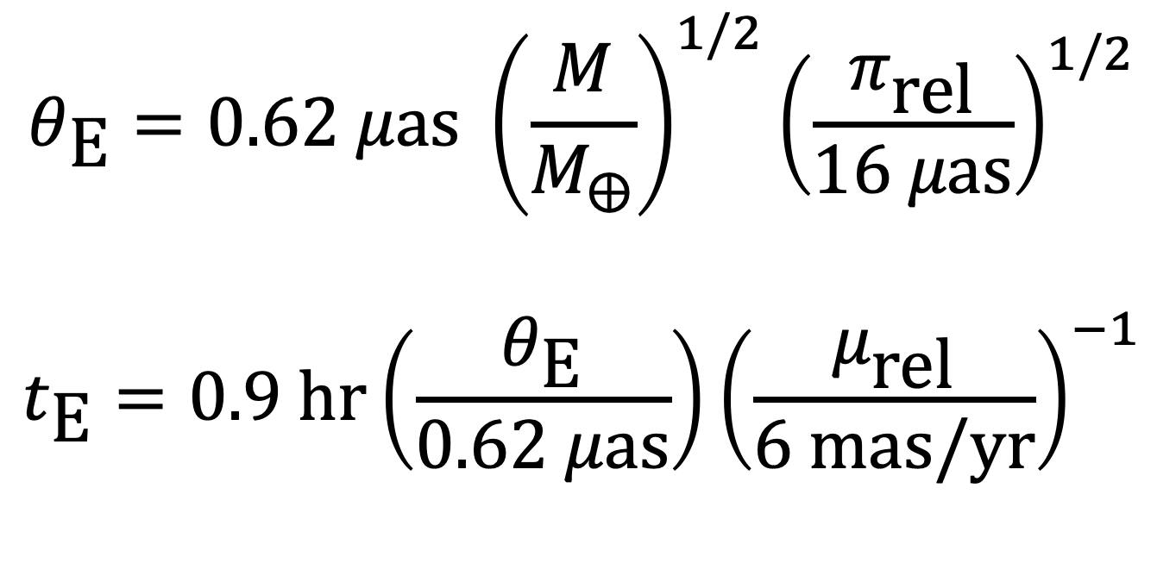
$$t_{\text{E}}∝θ_{\text{E}}∝\sqrt{M}$$
$$θ_{\text{E}}=0.62 μ\text{as} {\left(\frac{M}{M_{⨁}}\right)}^{1/2}{\left(\frac{π_{\text{rel}}}{16 μ\text{as}}\right)}^{1/2}$$
$$t_{\text{E}}=0.9 \text{hr}\left(\frac{θ_{\text{E}}}{0.62 μ\text{as}}\right){\left(\frac{μ_{\text{rel}}}{6 \text{mas}\text{/}\text{yr}}\right)}^{−1}$$

Slide 19
Higher Cadence = Smaller Planets
Super-Earths
Neptunes
Saturns
Jupiters
Figure courtesy of Matthew Penny
Notes:
So, in 2016, Andy Gould redesigned the KMTNet survey area to use a
tiered observing strategy. He kept the three best fields from 2015,
with some minor adjustments in position, including offset pointings to
fill in the gaps between detectors, and reduced their cadence to 4
observations per hour. The remaining fields were added at successively
lower cadences so that the total survey area now covers 100 square
degrees. Roughly speaking, the cadence of a field corresponds to the
typical minimum detectable mass ratio in that field. So, in the three
core fields the fifteen minute cadence is sufficient to detect planets
with super-earth mass ratios (Earth mass for 0.3 MSun) whereas Jupiters are detectable over the
full field. In practice, we've also found super earth mass ratio
planets in the lower cadence fields, because their detectability
actually depends on a variety of factors including the duration of the
event.
24*4 = 96 square degrees

Slide 20

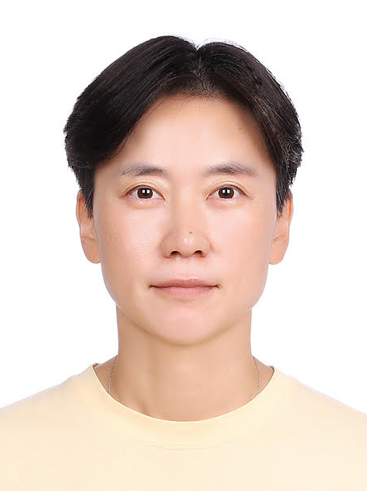
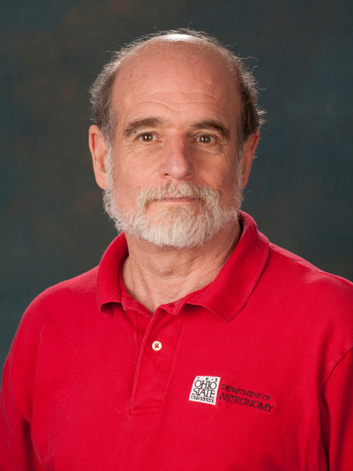
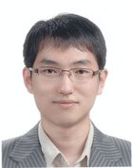
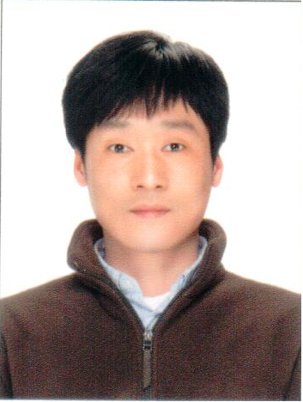
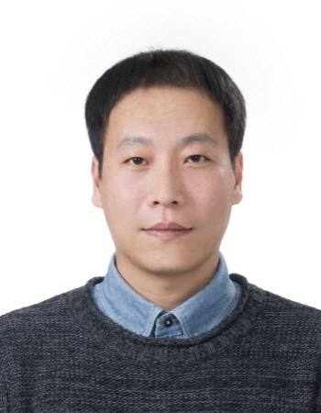
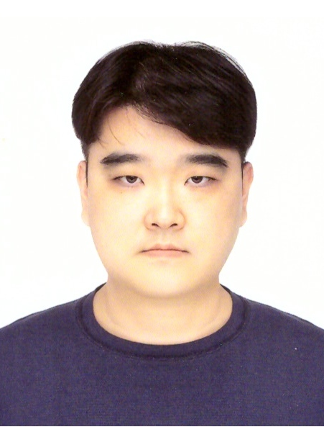
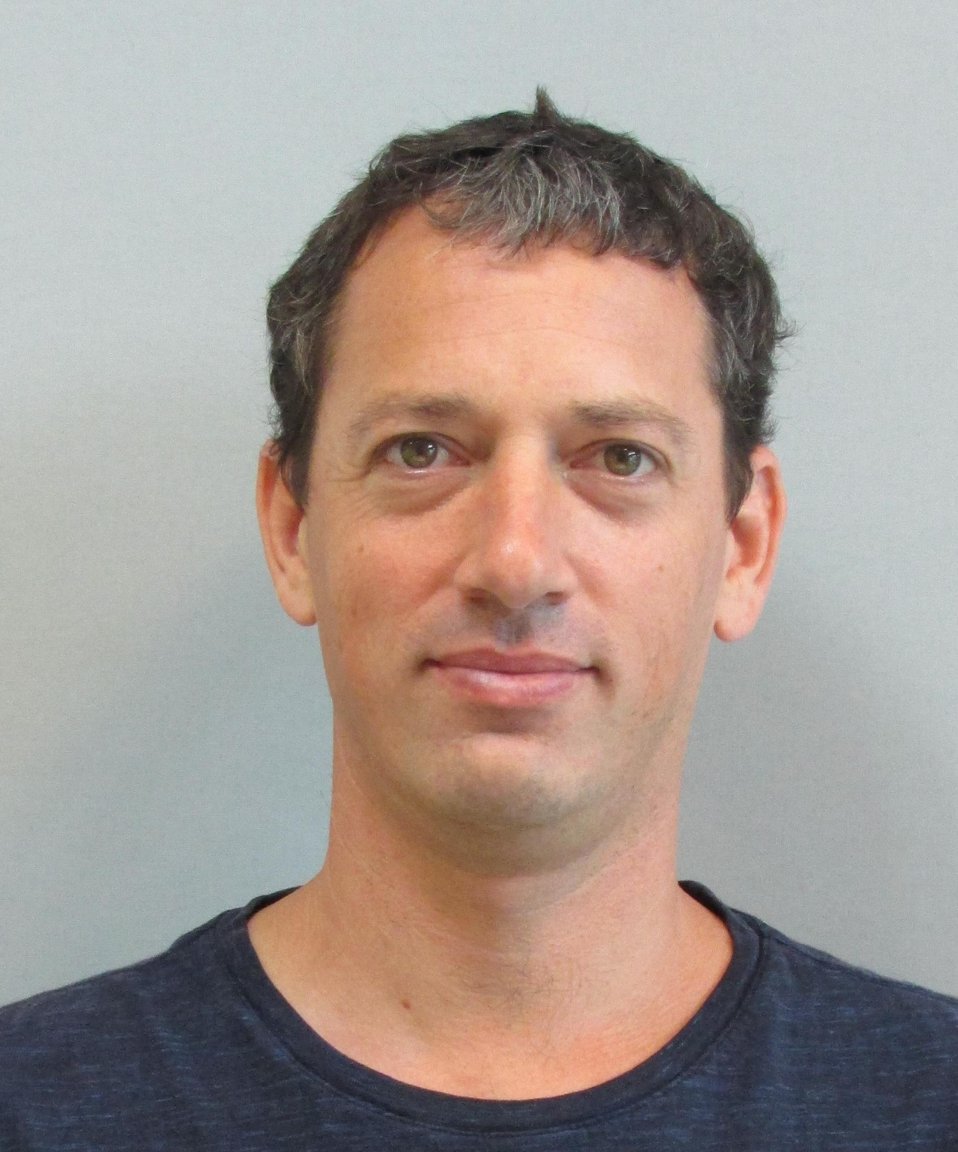

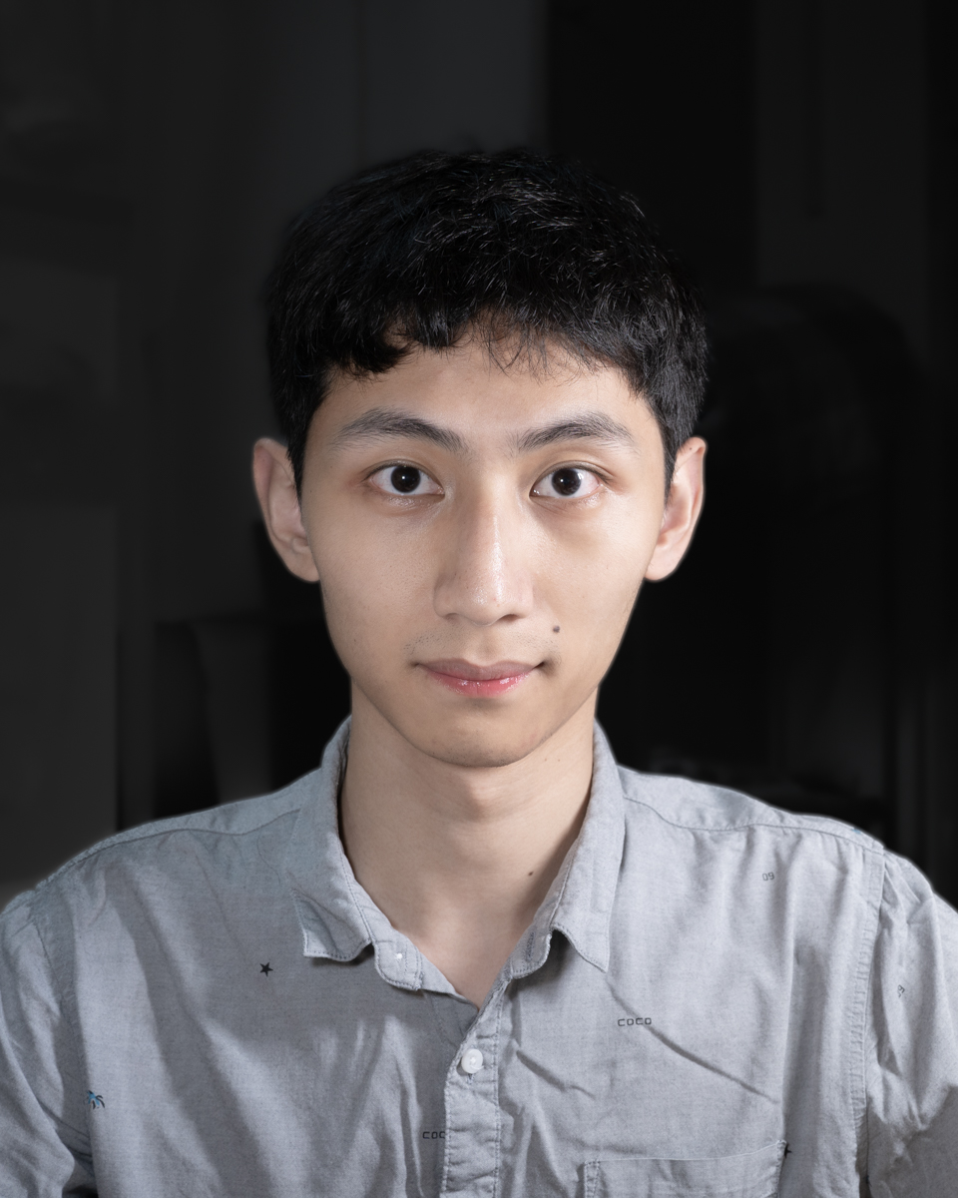
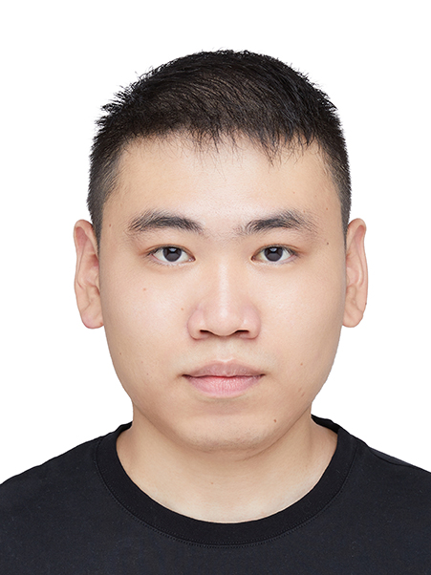
Science Team: Michael D. Albrow, Sun-Ju Chung, Andrew Gould, Cheongho Han, Kyu-Ha Hwang, Youn Kil Jung, Yoon-Hyun Ryu, In-Gu Shin, Yossi Shvartzvald, Jennifer C. Yee, Hongjing Yang, Weicheng Zang
Operations Team: Sang-Mok Cha, Dong-Jin Kim, Hyoun-Woo Kim, Seung-Lee Kim, Chung-Uk Lee, Dong-Joo Lee, Yongseok Lee, Byeong-Gon Park, Richard W. Pogge
Notes:
Finally, I would like to acknowledge that I am here representing the
KMTNet collaboration. I have included photos of the members of our
Science Team, but there is also an operations team at KASI that runs
and maintains the telescopes and network.

Slide 21
Collaboration acknowledgement:
This research has made use of the KMTNet system operated by the Korea Astronomy and Space Science Institute (KASI) at three host sites of CTIO in Chile, SAAO in South
Africa, and SSO in Australia. Data transfer from the host site to KASI was supported by the Korea Research Environment Open NETwork (KREONET). This research was supported by KASI under the R\&D program (project No. 2023-1-832-03) supervised
by the Ministry of Science and ICT.
Individual acknowledgements:
W.Zang, H.Y., S.M., R.K., J.Z., and W.Zhu acknowledge support by the National Natural Science Foundation of China (Grant No. 12133005). W.Zang acknowledges the support from the Harvard-Smithsonian Center for Astrophysics through the CfA Fellowship. J.C.Y. and I.-G.S. acknowledge support from U.S. NSF Grant No. AST-2108414. Y.S. acknowledges support from BSF Grant No. 2020740. Work by C.H. was supported by the grants of National Research Foundation of Korea (2019R1A2C2085965 and 2020R1A4A2002885).
Notes:
I would also like to briefly acknowledge our funding sources.

Slide 22
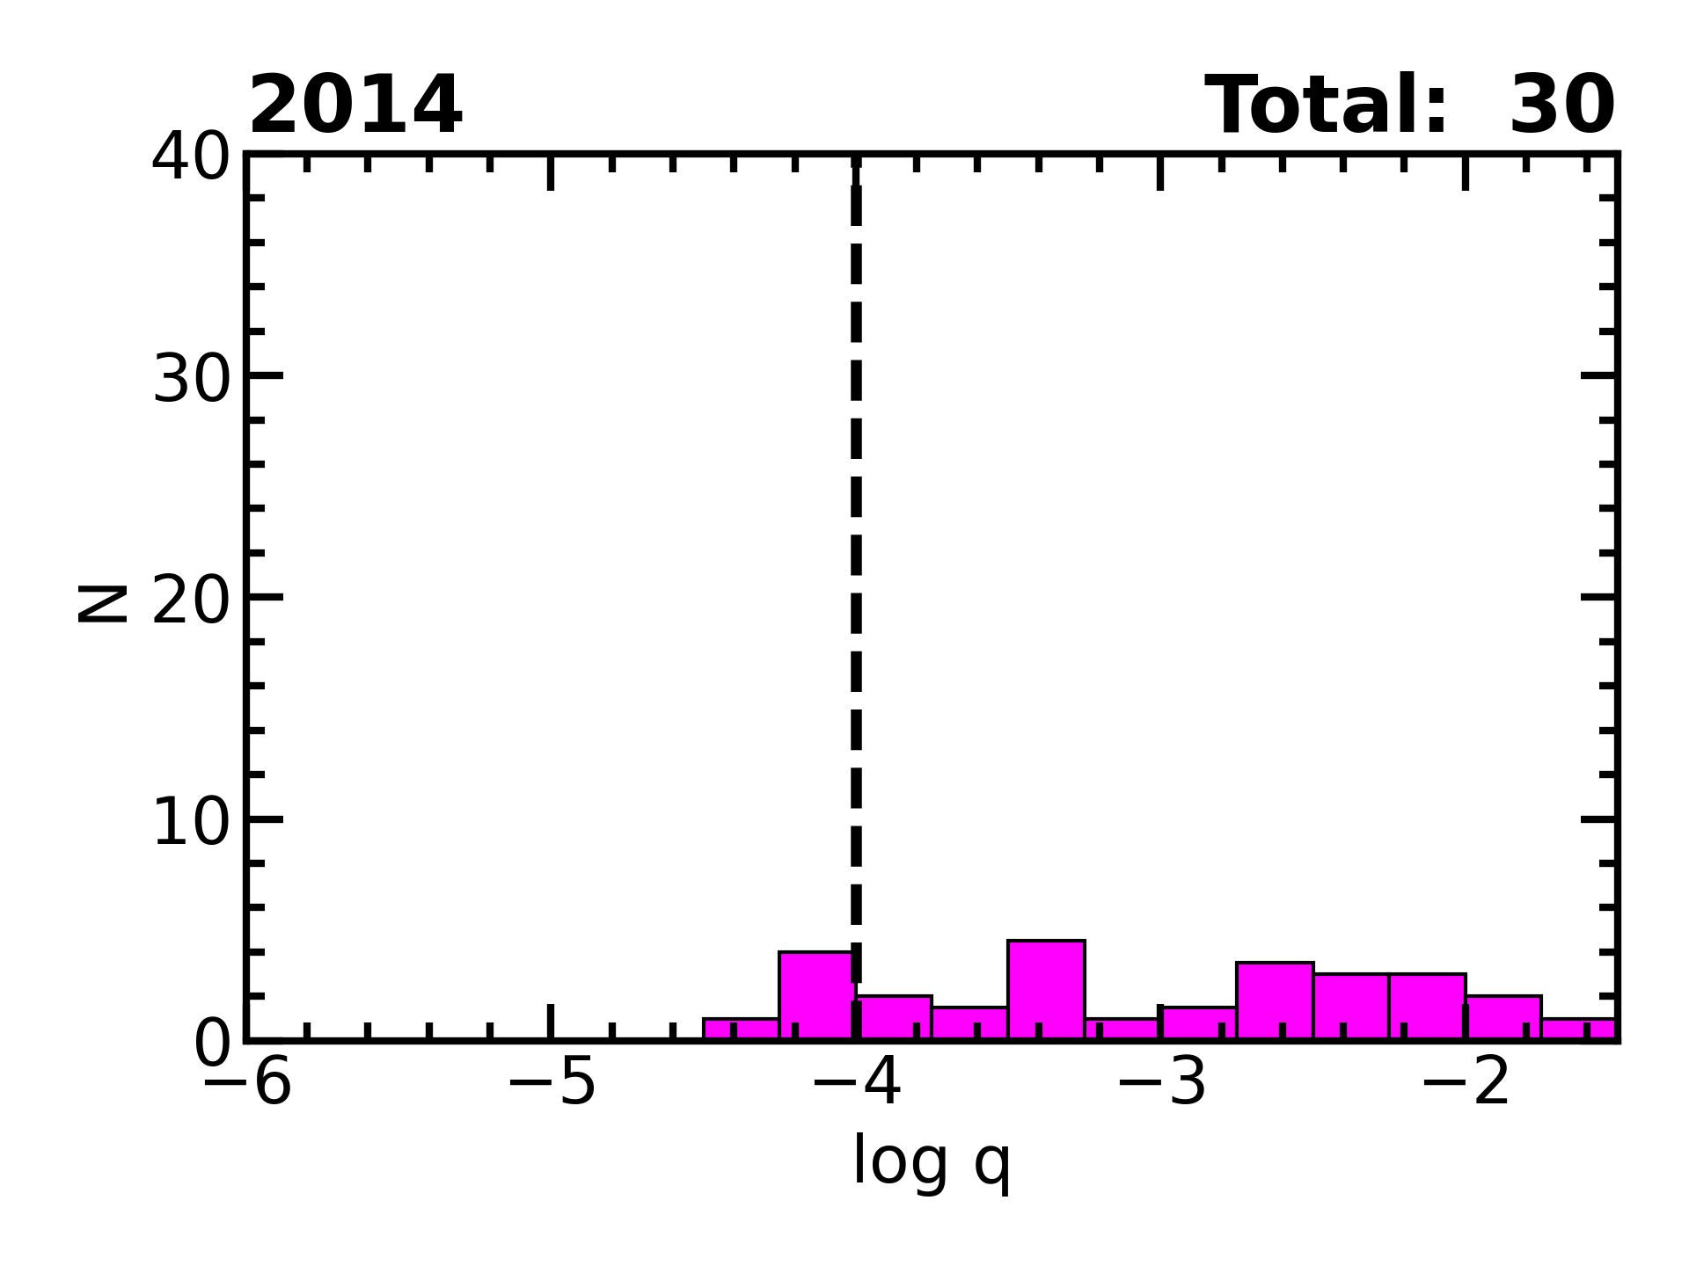
Notes:
Next, we return to the question of bound planets. Recall that there
were 30 published planets prior to the commissioning of KMTNet.

Slide 23
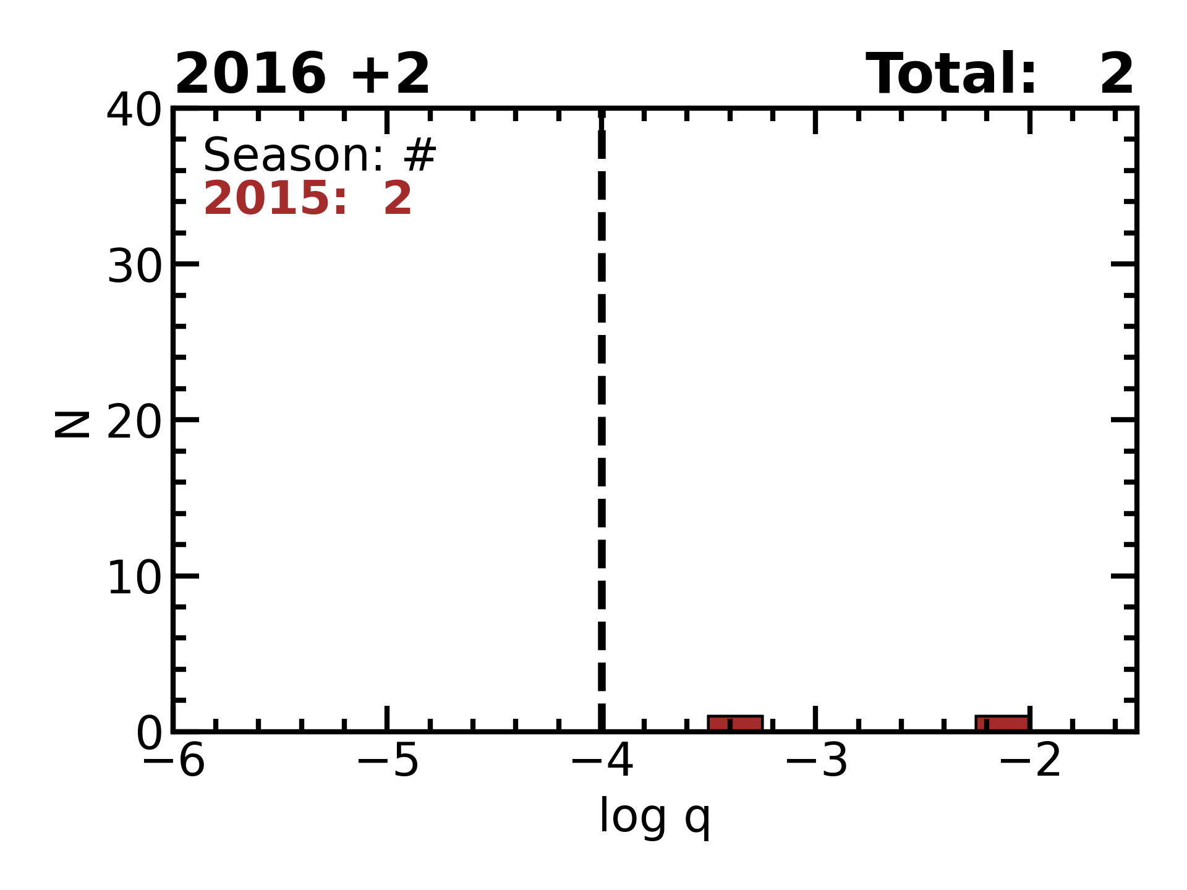
Notes:
The first two planets published from the KMTNet survey were published
in 2016. In this plot, we will have the year of publication in the
title, and the colored legend will give the season the event is from
and the total number of planets published from that season.

Slide 24
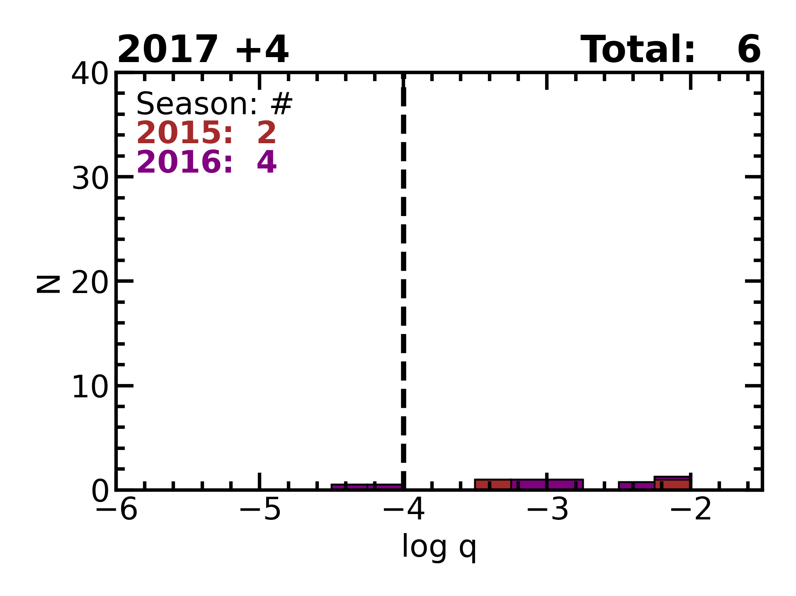
Notes:
In 2017, we add 4 planets from the 2016 season.

Slide 25
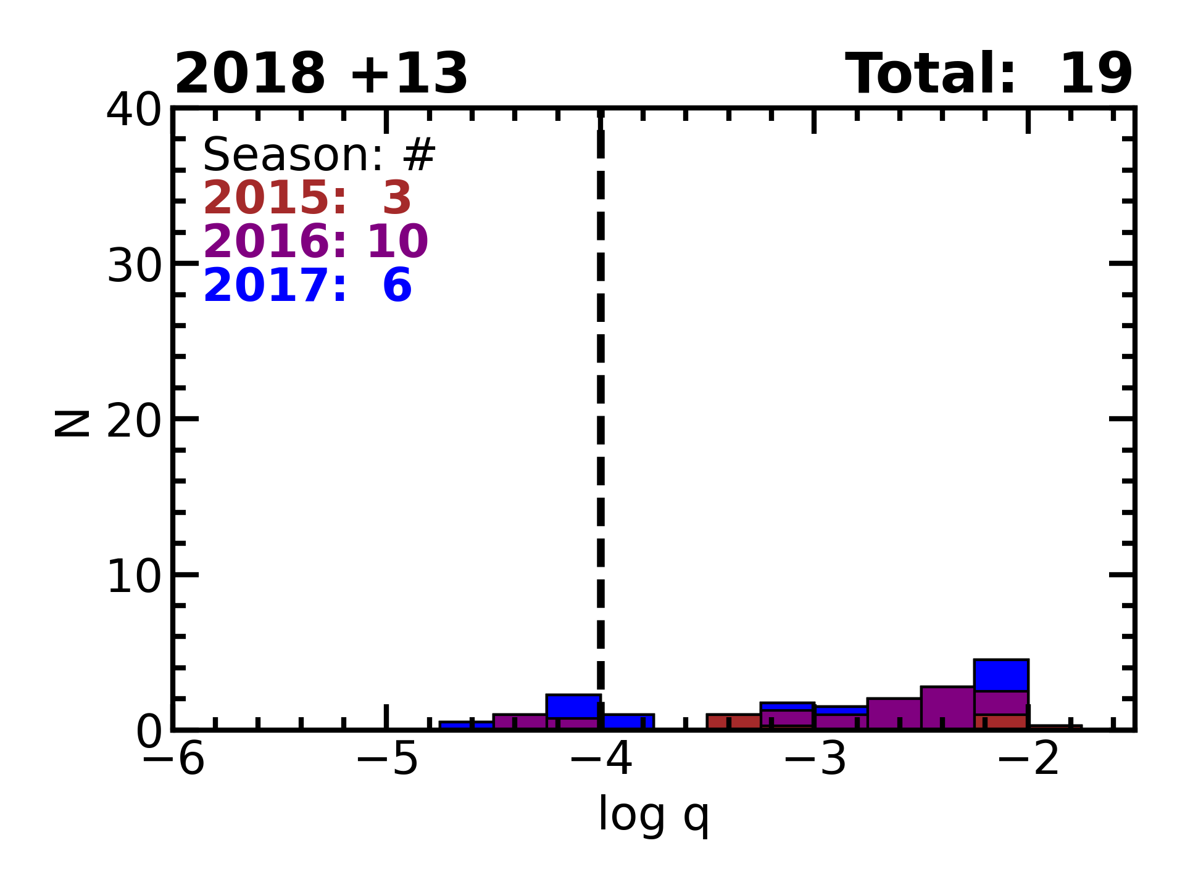
Notes:
In 2018, we add 13 planets, six from 2017 and the others from previous
seasons. Many of these planets are led by KMTNet authors, but some of
these publications were also led by other groups.

Slide 26
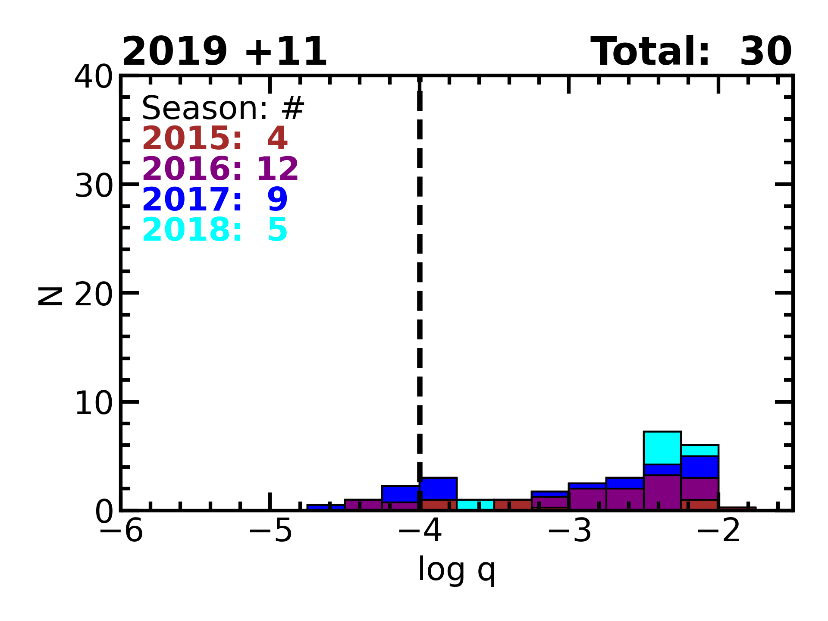
Notes:
In 2019, we add 11 planets.

Slide 27
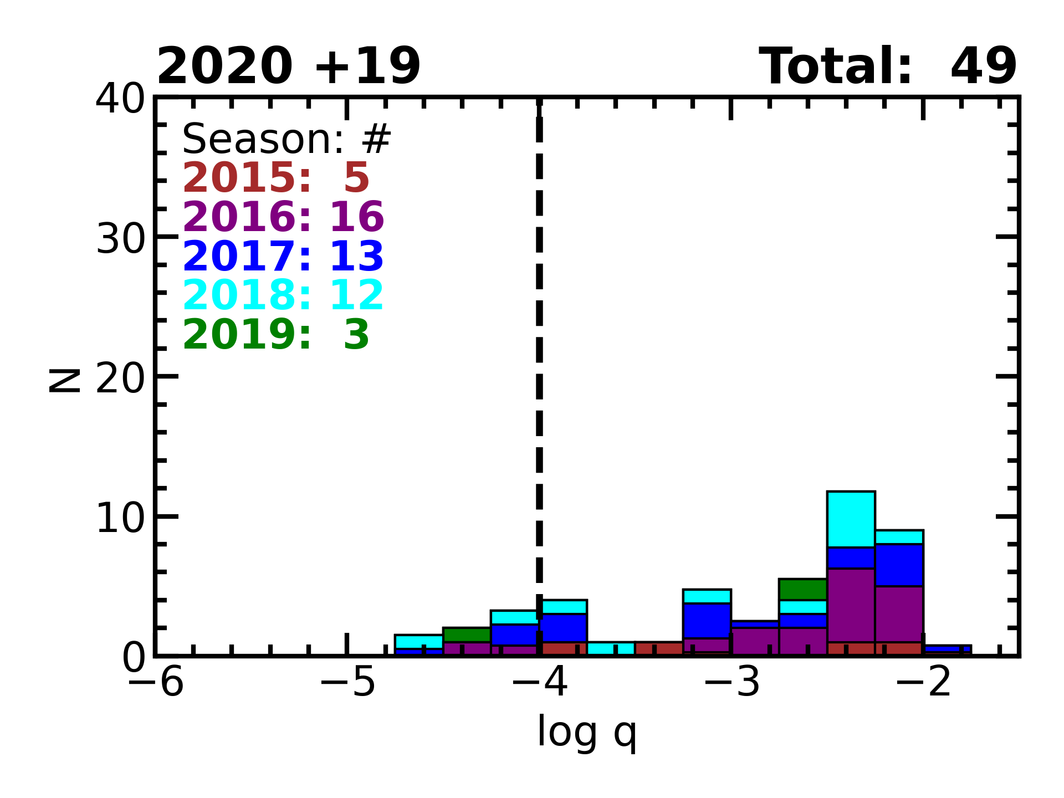
Notes:
Although 2020 was bad for observations, we were able to publish 19
planets.

Slide 28
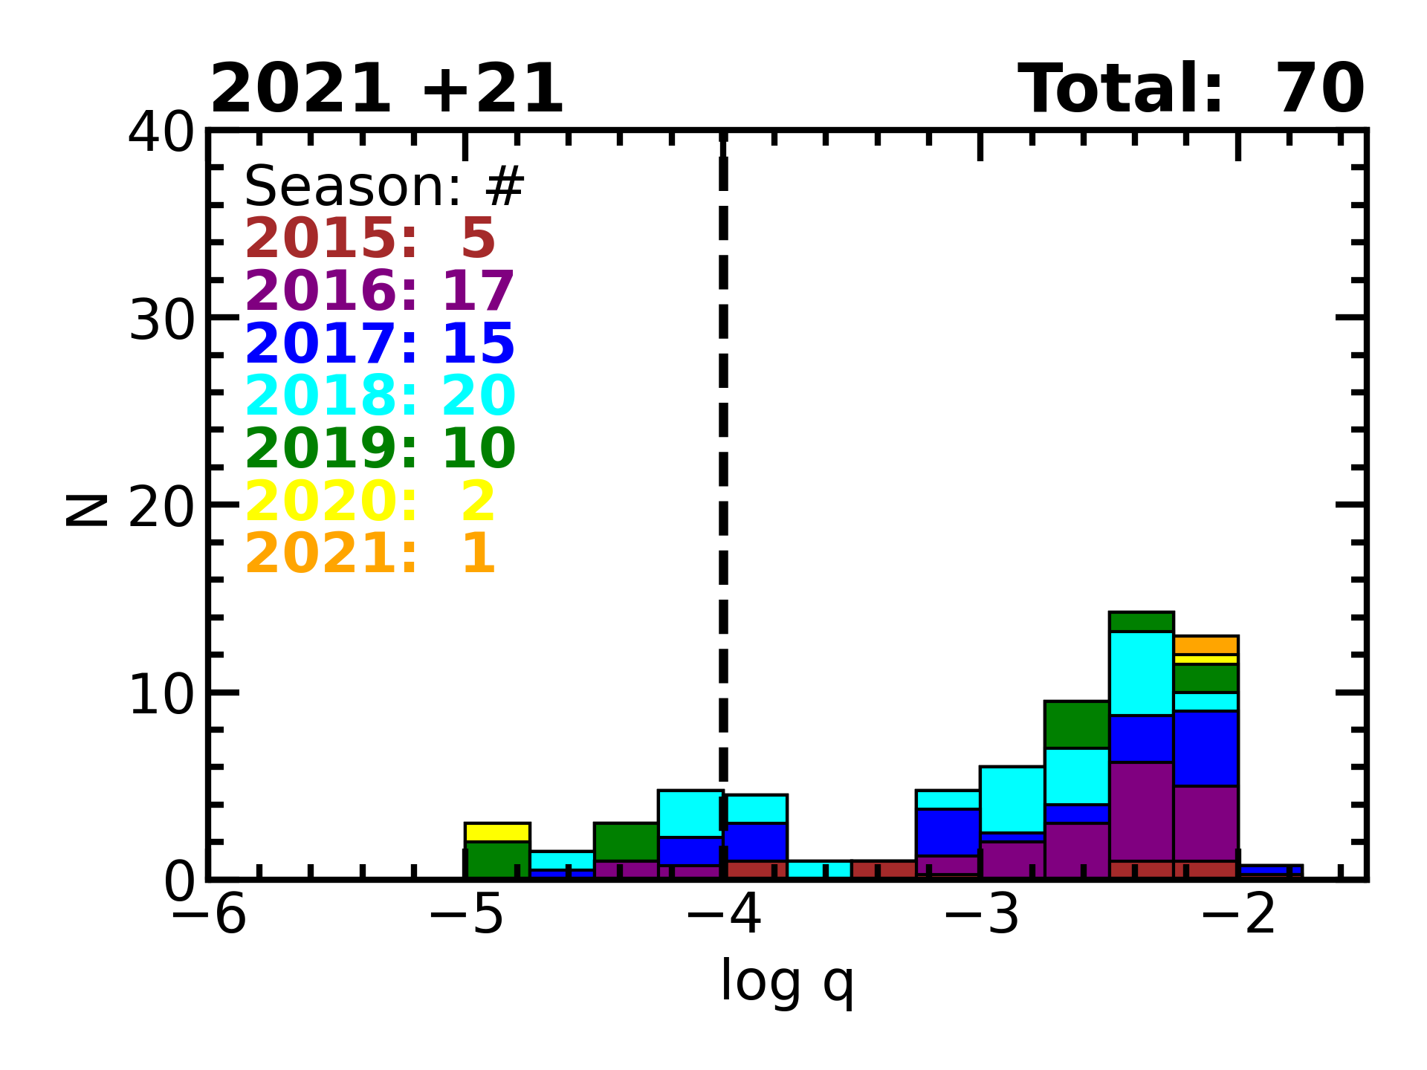
Notes:
Then, in 2021, Weicheng wrote his AnomalyFinder algorithm. So although
we don't get many new planets from 2020, we start to systematically
back-fill previous years.
First AF papers published:
AF1 & AF2 (small q from ‘18, ‘19)

Slide 29
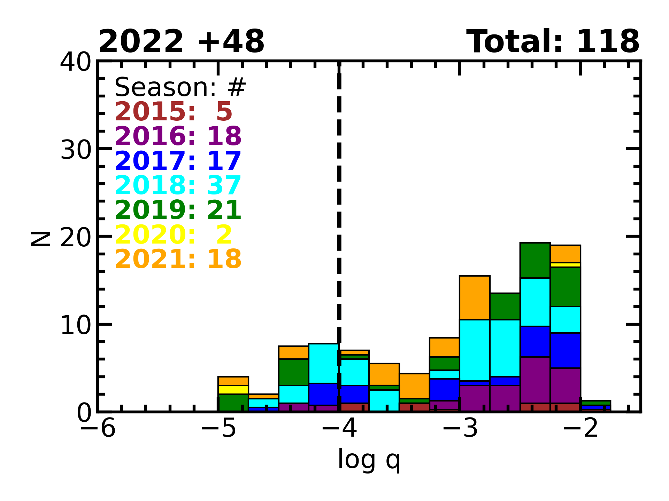
Notes:
In 2022, as systematic work continues, we publish 48 planets.

Slide 30
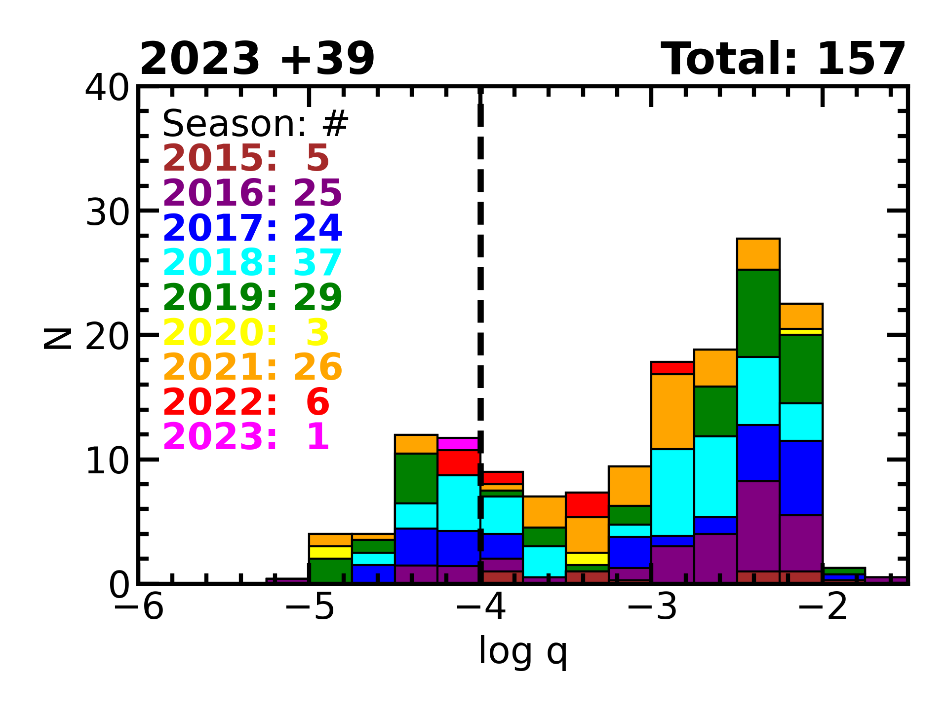
Notes:
In 2023, we publish 39 planets.

Slide 31
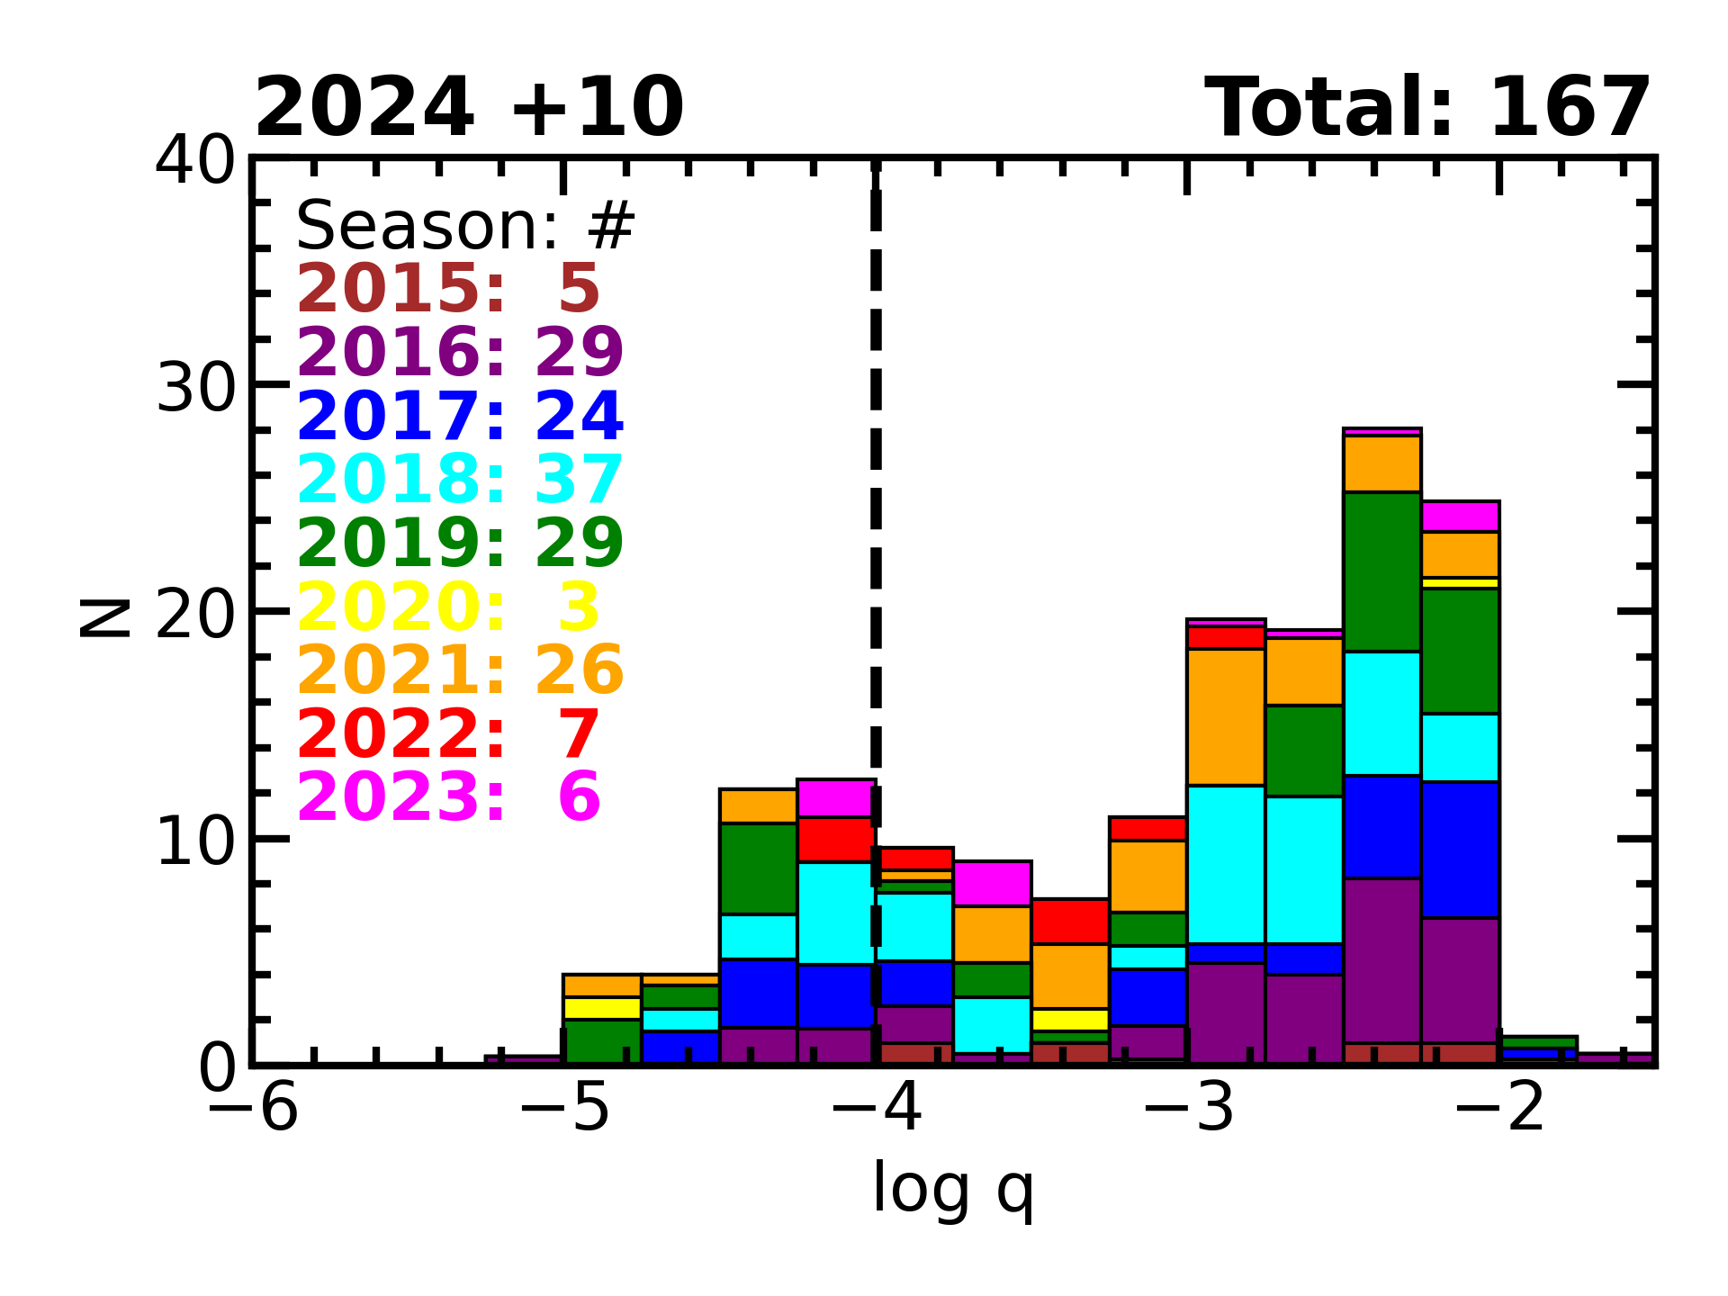
Notes:
And in 2024, we have already submitted 10 more planets for
publication. In total, KMTNet has contributed to the detection of 167
planets including a large number of small planets with mass ratios
below 10^-4. Features in the distribution: appears double-peaked
with a dip around -3.5.
But, at this point, the only criterion for inclusion in this plot is that
the events had KMTNet data. Many of these publications were led by
KMTNet members, but others were led by other groups, and I haven’t
assessed whether the planets were detectable in the KMT data alone.
So, while we see features in this distribution, we need a complete analysis
to really understand them.

Slide 32
2016-2019
2018-2019
Raw Detections
Notes:
So, we have been working on a statistical analysis of KMTNet
planets. This work is under review, so we are not ready to make
it public outside of this meeting.
First, we constructed a complete sample of planets. For
larger mass ratios, this consists of a complete sample from the 2018
and 2019 microlensing seasons. For smaller planets, we use a sample
spanning from 2016 through 2019. AF detections from KMTNet-only.

Slide 33
Corrected for Sensitivity
Raw Detections
Notes:
Then, Youn Kil Jung has been carrying out the sensitivity analysis for
this sample. And the blue line is the distribution of planets
corrected for the sensitivity.

Slide 34
Corrected for Sensitivity
Raw Detections
Notes:
This distribution is well fit by a single power law, with no
particular evidence of a single break or peak. However, the dip at log q =
-3.5 persists and there is an under-abundance of detected planets at
both the large and small mass ratio ends of this distribution.

Slide 35
Corrected for Sensitivity
Raw Detections
Notes:
Combined, these three features mean that a double-quadratic function
fits the distribution better by Delta chi2 of 22.
[OPTIONAL: This potential for a double-peaked distribution is
intriguing because it is a logical outcome of many theories of planet
formation. In core-accretion theory, cores grow rapidly to about a
Neptune mass, but then there is a long slow phase of planet growth
that is governed by hydrostatic equilibrium before runaway gas
accretion sets in. These differing timescales would naturally lead to
a pile up in planets around a Neptune mass ratio and another one are
larger, maybe Jupiter, planet mass ratios.]
As many of you know, this
paper is currently under review with Science.

Slide 36
$$t_{\text{E}}∝θ_{\text{E}}∝\sqrt{M}$$
$$θ_{\text{E}}=0.62 μ\text{as} {\left(\frac{M}{M_{⨁}}\right)}^{1/2}{\left(\frac{π_{\text{rel}}}{16 μ\text{as}}\right)}^{1/2}$$
$$t_{\text{E}}=0.9 \text{hr}\left(\frac{θ_{\text{E}}}{0.62 μ\text{as}}\right){\left(\frac{μ_{\text{rel}}}{6 \text{mas}\text{/}\text{yr}}\right)}^{−1}$$

Slide 37
t_{E} = 7.7h
𝜃_{E} = 9.2 𝜇as
Mroz et al. 2018, AJ, 155, 121

Slide 38
t_{E} = 7h
𝜃_{E} = 4.8 𝜇as
t_{E} = 41 min!
𝜃_{E} = 4.4 𝜇as
t_{E} = 6.5h
𝜃_{E} = 5.9 𝜇as
Mroz et al. 2020 AJ, 159, 282
Mroz et al. 2020, ApJL, 903, 11
Ryu et al. 2021, AJ, 161, 126
Kim et al. 2021, AJ, 162, 15
t_{E} = 9h, 𝜃_{E} = 4.4 𝜇as

Slide 39

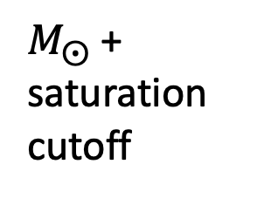
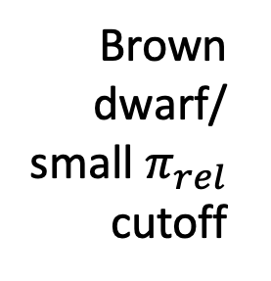
A population of planets with $θ_{E}<10 μ$as
Brown dwarf/
small $π_{rel}$ cutoff
$M_{⨀}$+ saturation cutoff
(2016 – 2019)
Gould et al. 2022, JKAS, 55, 173
Notes:
One of the first population-level results that has come out of KMTNet
was actually based on point-lens events rather than anomalous
events. From a sample of giant source events with finite source
effects, we measured the Einstein radius distribution. Shown here as cum dist. There are a number of features in this distribution. Starting at large radii,
there is a cutoff around 300 uas because there are very few stars more
massive than a solar mass. Moving toward lower radii, there is another
break just below 30 uas. This occurs because of the dropoff in the
stellar mass function at brown dwarfs and the fact that the lenses and
sources get very close together, so the lack of volume cuts the event
rate. Finally, there is a collection of four events with Einstein
radii below 10 uas. These are the free-floating planet candidates. And
the fact that there is a gap between them and the brown dwarfs, which
we call the Einstein Desert, supports the conclusion that these are a
distinct population of objects rather than being produced by the tail
of the stellar mass function.

Slide 40
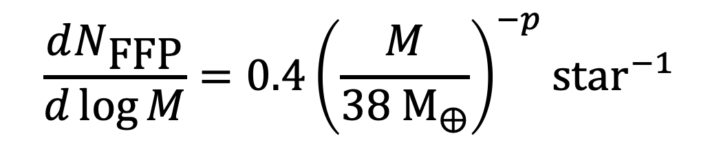
$$\frac{dN_{\text{FFP}}}{d\log{M}}=0.4{\left(\frac{M}{38 {\text{M}}_{⨁}}\right)}^{−p}{\text{star}}^{−1}$$
(bound planets)
Gould et al. 2022, JKAS, 55, 173
Notes:
This distribution may be described by a power-law, in which case, a
power-law index of 0.6, as is observed for bound planets, is ruled
out. Thus, we can conclude that the power-law index for the population
of free-floating planet candidates is steeper than for bound planets.

Slide 42
Known planets from NASA Exoplanet Archive accessed 5/20/24

Slide 43
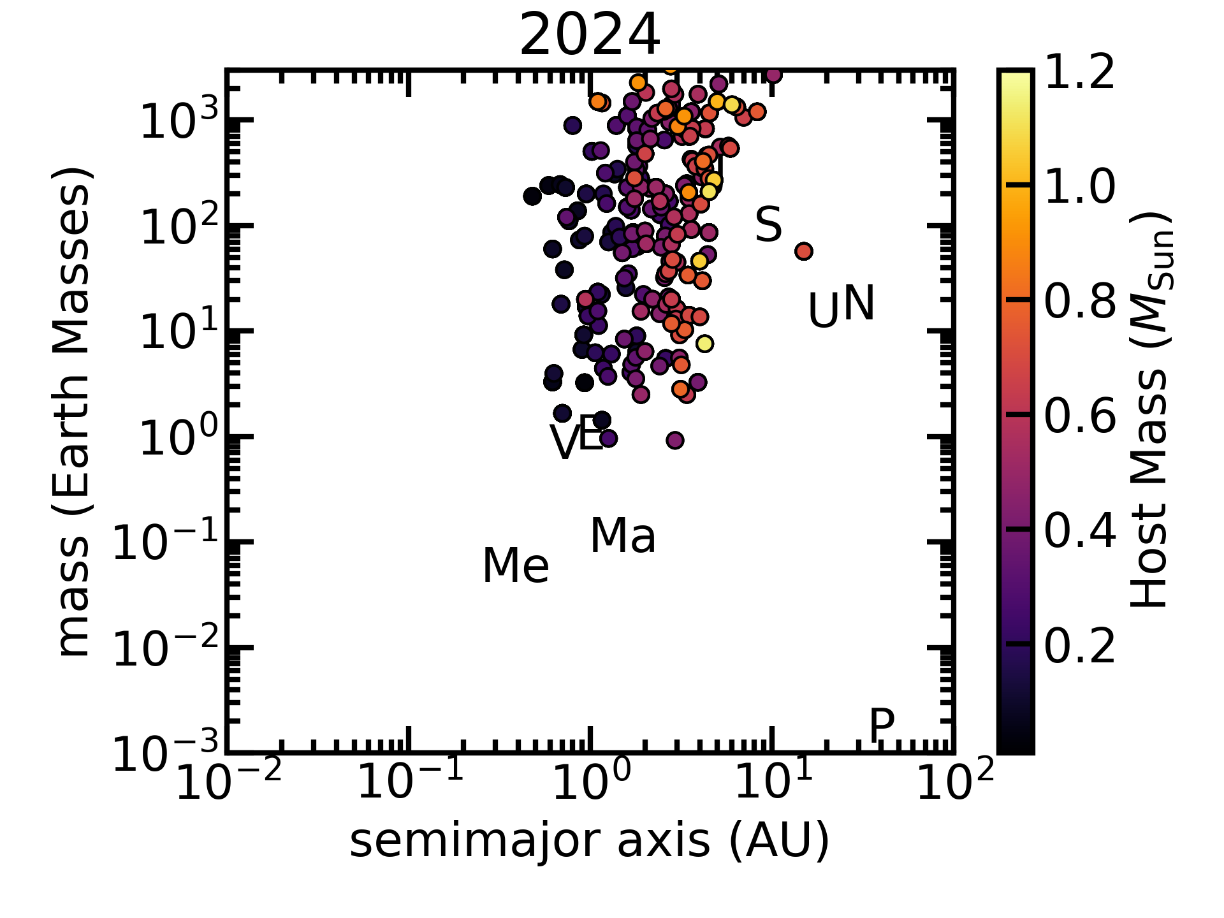
Known planets from NASA Exoplanet Archive accessed 5/20/24

Slide 44
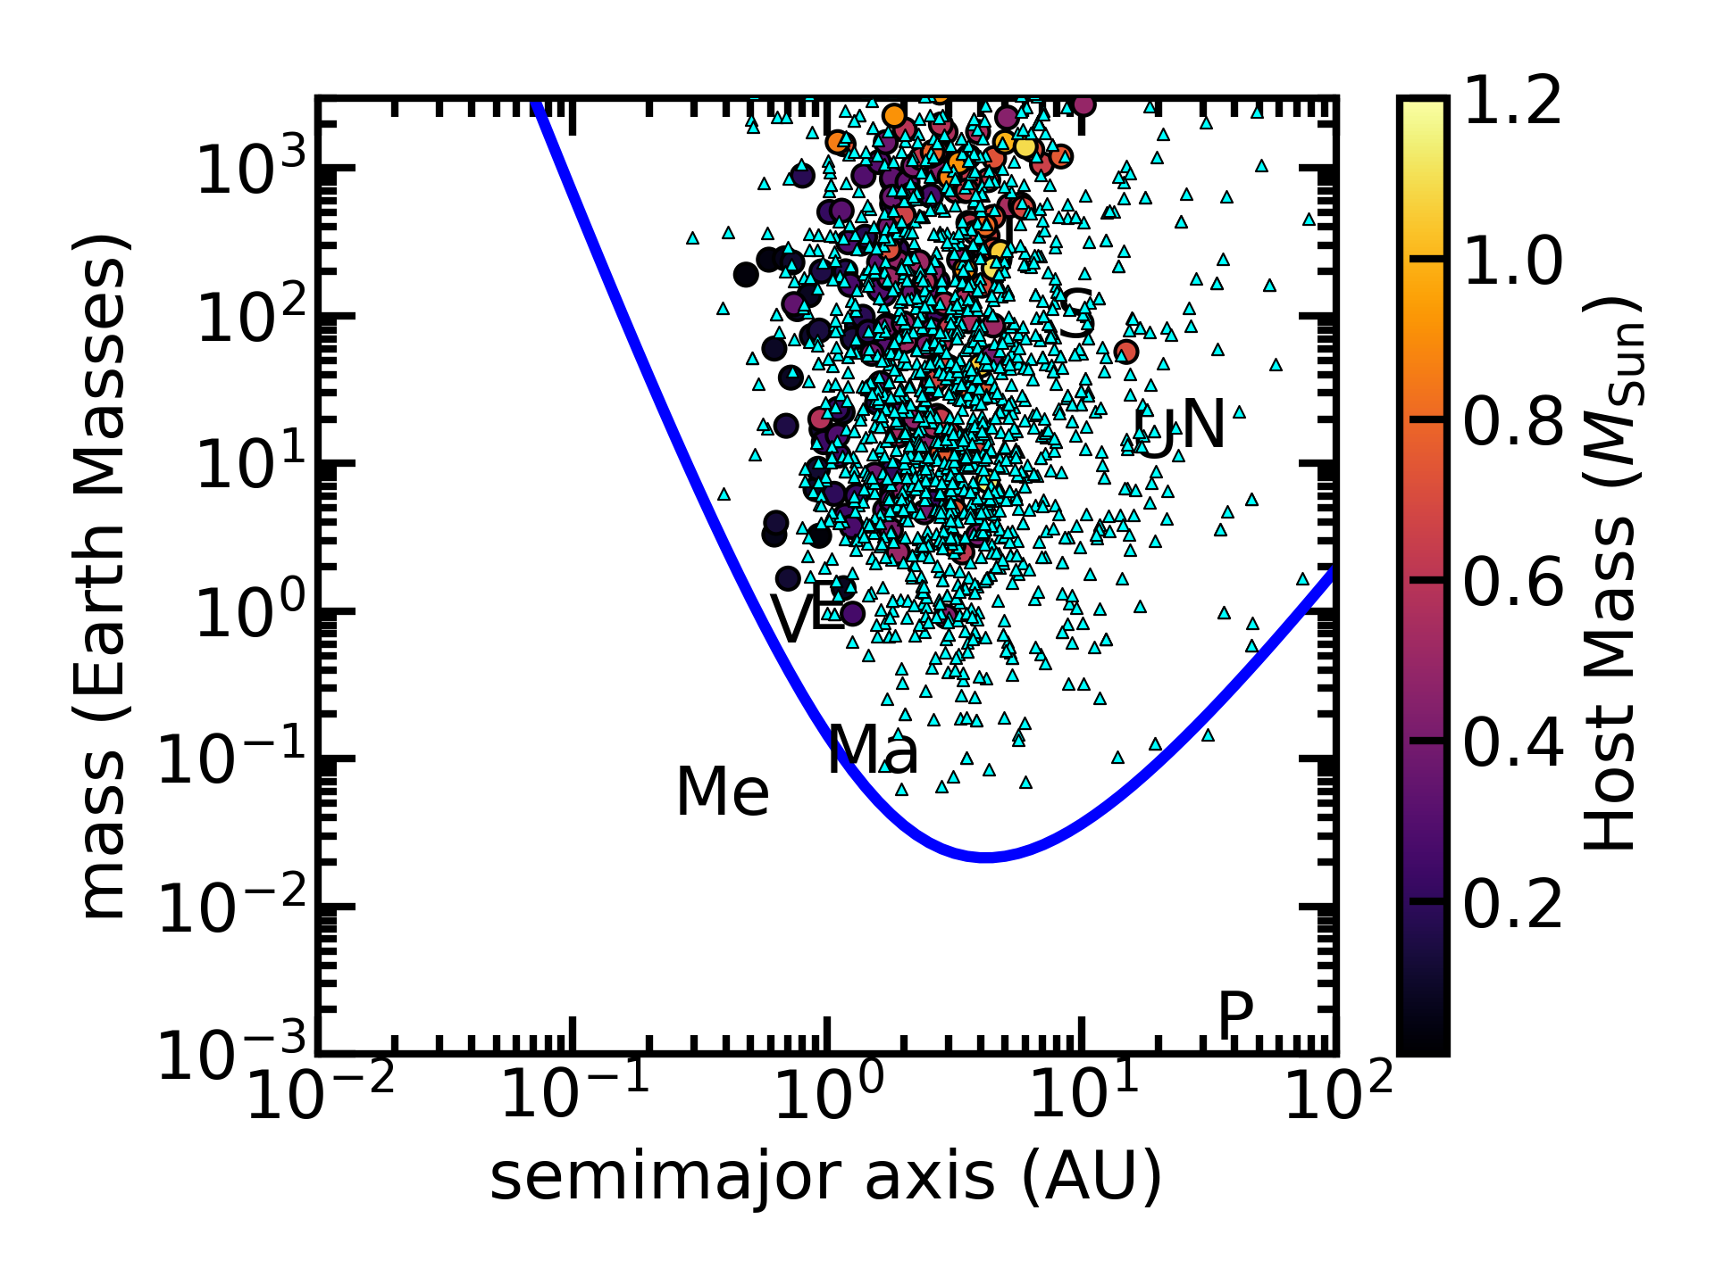
Simulated Roman planets from Penny et al. 2019
Known planets from NASA Exoplanet Archive accessed 5/20/24

Slide 45

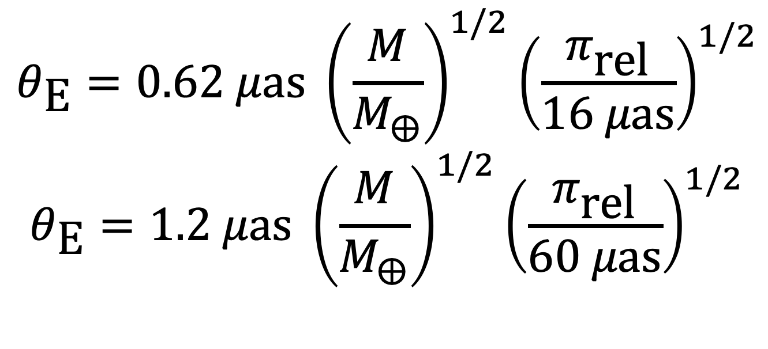
Roman: $θ_{\text{E}}≲θ_{\text{∗}} \text{for} M≲M_{⨁}$
$$θ_{\text{E}}=0.62 μ\text{as} {\left(\frac{M}{M_{⨁}}\right)}^{1/2}{\left(\frac{π_{\text{rel}}}{16 μ\text{as}}\right)}^{1/2}$$
$$θ_{\text{E}}=1.2 μ\text{as} {\left(\frac{M}{M_{⨁}}\right)}^{1/2}{\left(\frac{π_{\text{rel}}}{60 μ\text{as}}\right)}^{1/2}$$

Slide 46
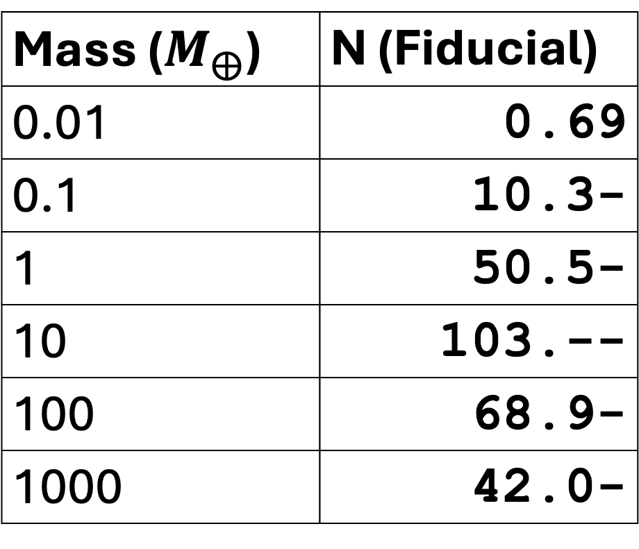

Roman FFP detections plummet below 1 $M_{⨁}$ despite flat x-section and MF.
Mass ($M_{⨁}$) | N (Fiducial)
0.01 | 0.69
0.1 | 10.3-
1 | 50.5-
10 | 103.--
100 | 68.9-
1000 | 42.0-
Johnson et al. 2020, AJ, 160, 123

Slide 47
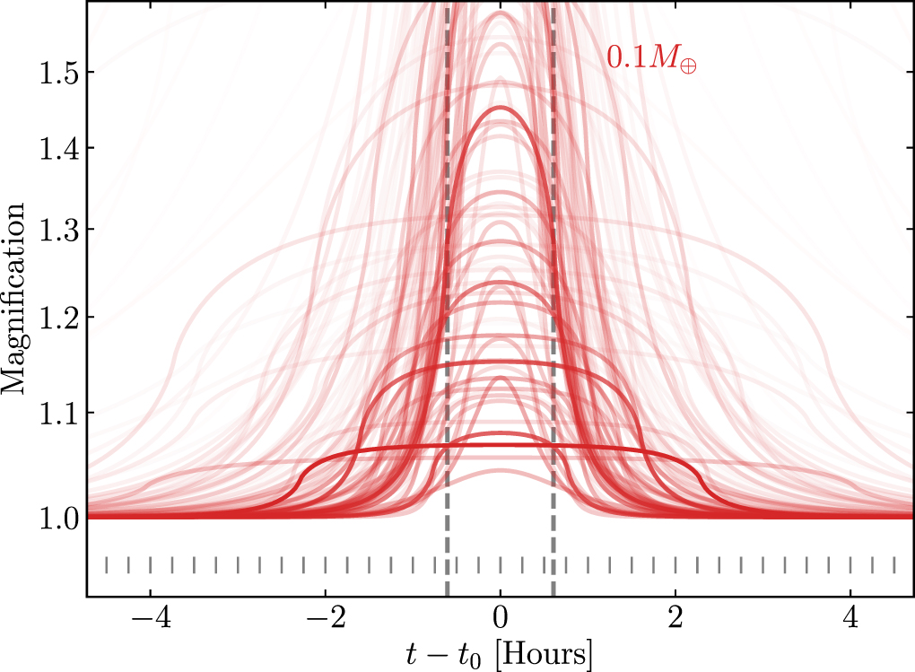
Low-Mass FFP Events are Short
S/N is NOT the problem!
Johnson et al. 2020, AJ, 160, 123

Slide 48
6 obs required but 3 are typical.
Gould, Yee & Dong 2024, arXiv:2406.14531

Slide 49
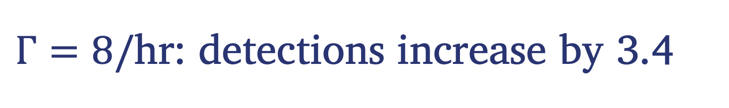
$Γ=8/\text{hr}$: detections increase by 3.4
Gould, Yee & Dong 2024, arXiv:2406.14531

Slide 50
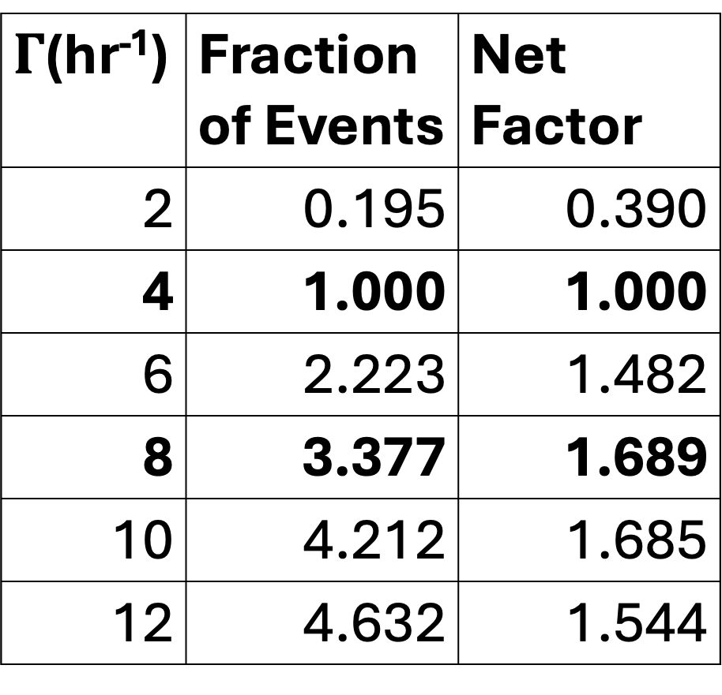
$Γ$(hr⁻¹) | Fraction of Events | Net Factor
2 | 0.195 | 0.390
4 | 1.000 | 1.000
6 | 2.223 | 1.482
8 | 3.377 | 1.689
10 | 4.212 | 1.685
12 | 4.632 | 1.544
+ more due to increased S/N
Gould, Yee & Dong 2024, arXiv:2406.14531

Slide 51
Known planets from NASA Exoplanet Archive accessed 5/20/24

