Slide 1
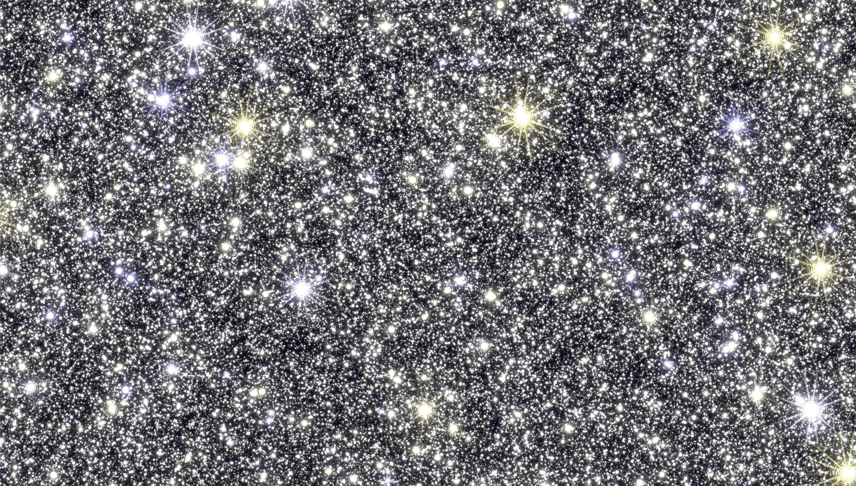
Updates on The Expected Yield Estimates of Bound Planets for Roman
Farzaneh Zohrabi
Emerson Gehr
Matthew Penny
Challenging theory with Roman
Caltech - July2024

Slide 2
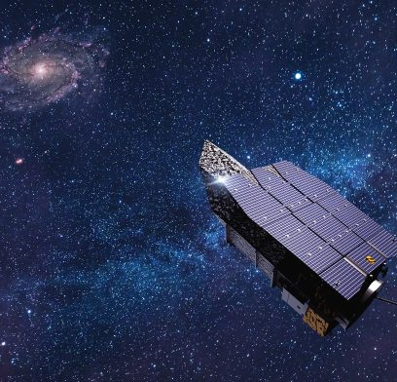
Roman Science Requirement for host stars
RST shall be capable of determining the masses of, and distances to, host stars of 40% of the detected planets with a precision of 20% or better.
40% of
$$\frac{σ_{M}}{M}<20\%$$
Source flux in two filters
ρ ≡ $θ_{∗}$/$θ_{E}$
$$M=\frac{θ_{E}}{κπ_{E}}$$
$π_{E_E}$,$π_{E_N}$
Notes:
In events with finite source effects, measurements in different filter bands can lead to $θ_{E}$ measurement, which provides a relationship between the mass and distance to the lens.
The majority of sources are located in the Bulge, making a measurement of $θ_{E}$ a valuable tool for characterizing microlensing events

Slide 3
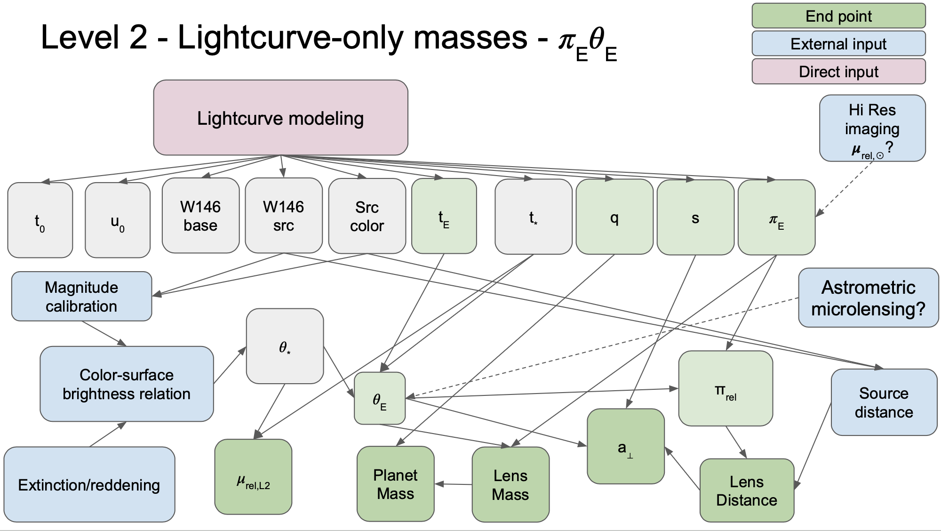
HOW TO ACHIEVE THE Roman Science Requirement for host stars ?
$$M=\frac{θ_{E}}{κπ_{E}}$$
$$ρ=\frac{θ_{∗}}{θ_{E}}$$
$$t_{E}=\frac{θ_{E}}{μ_{rel}}$$
q$=\frac{M_{planet}}{M_{host}}$
log2 $θ_{∗}$ = log $θ_{m=0}$- 0.2 m

Slide 4
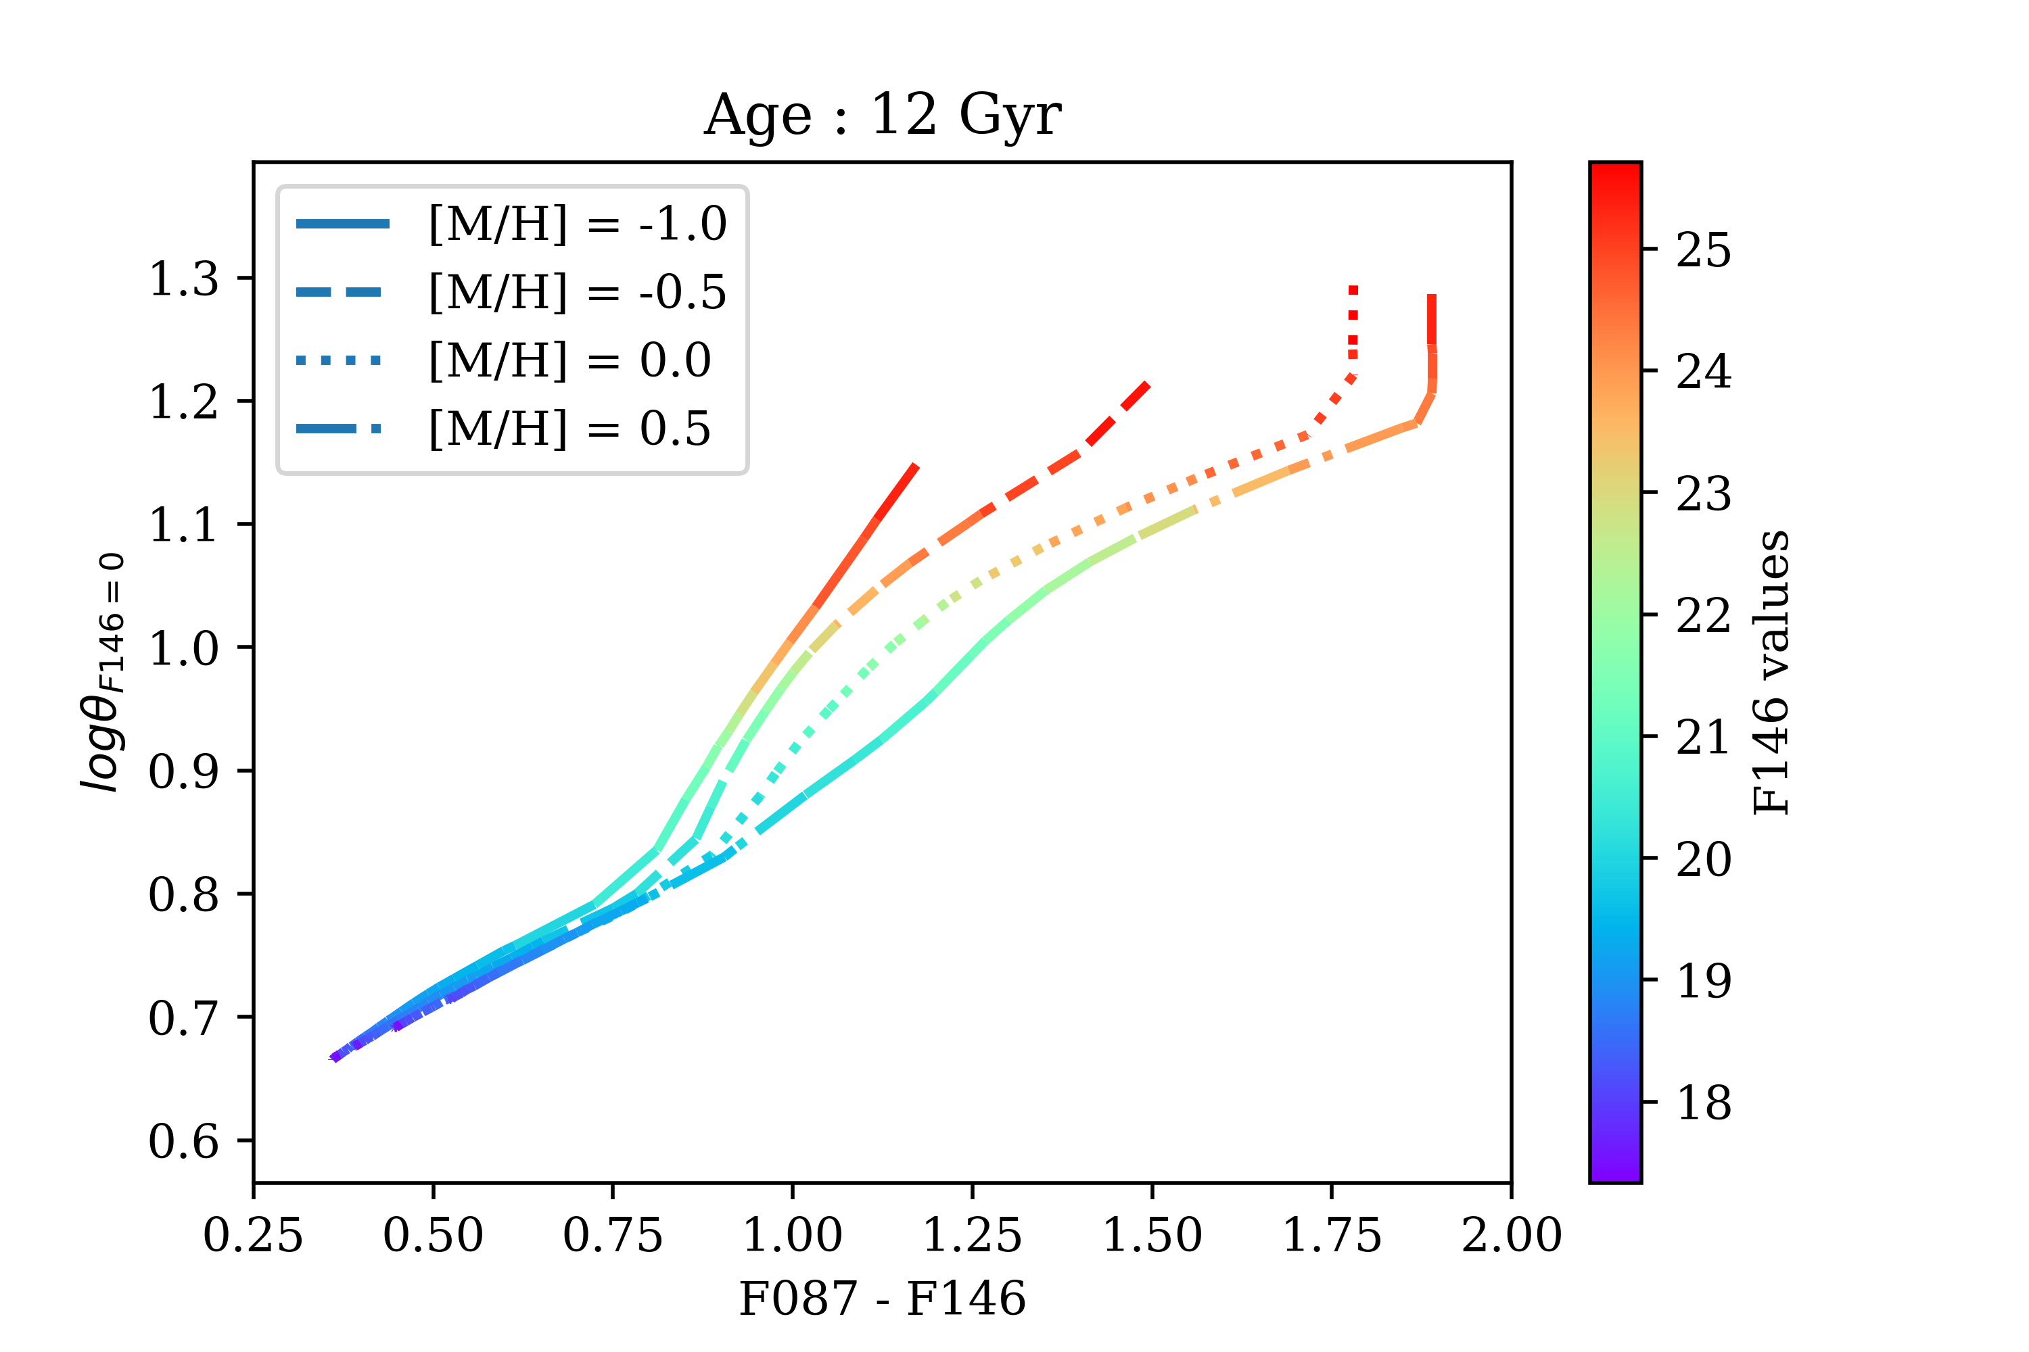
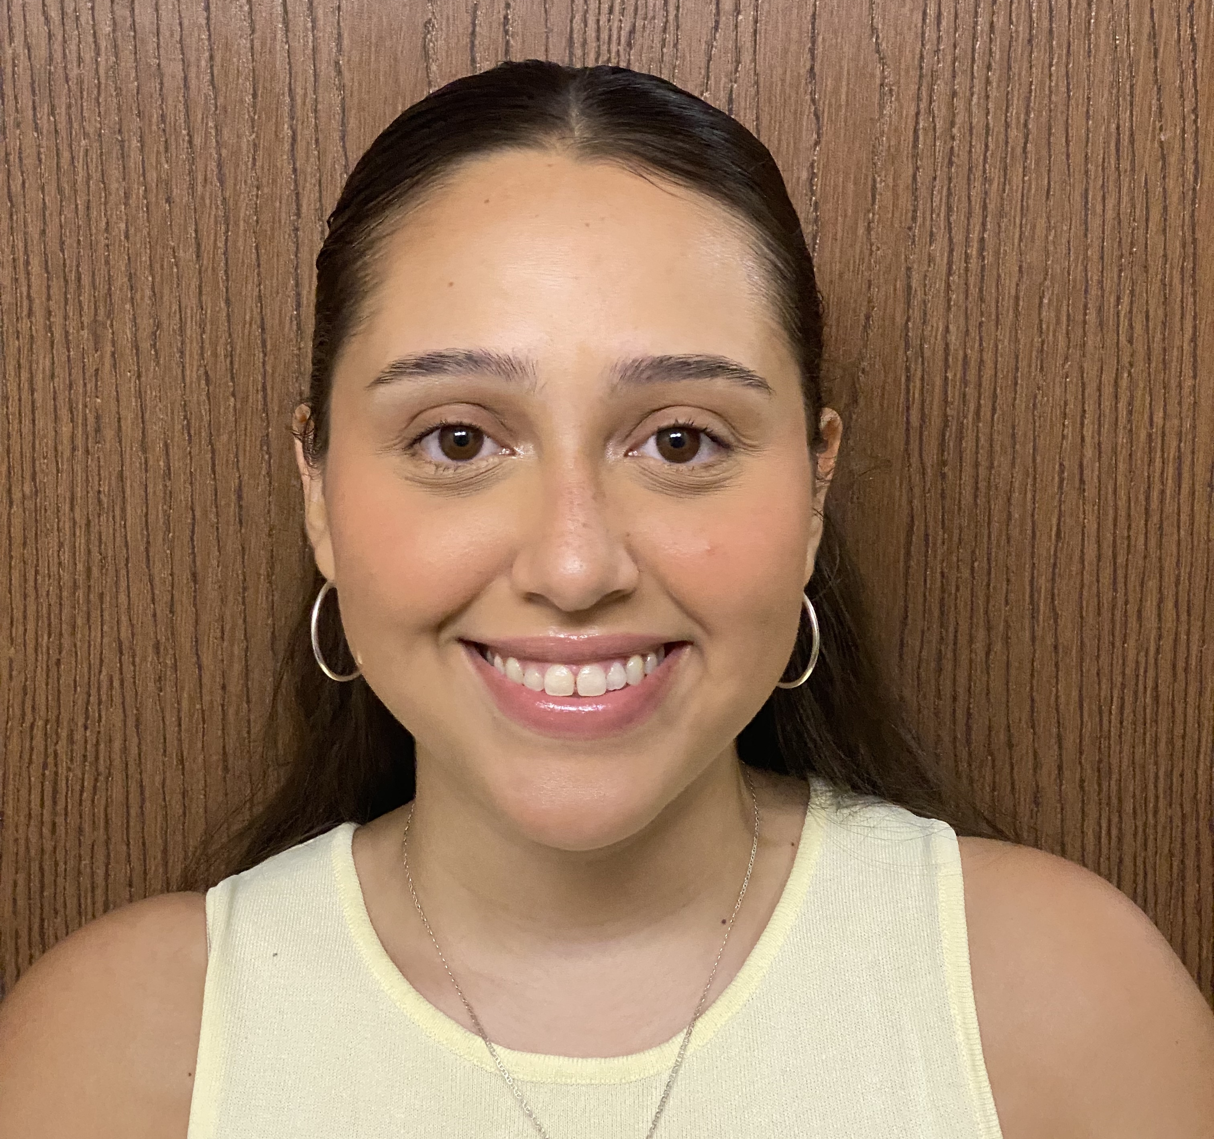
Color-Surface Brightness Relation
Credit: Emelly Tiburcio, Tabetha Boyajian, LSU.
Notes:
These plots illustrate the surface brightness relations that would be observed by the Nancy Grace Roman Space Telescope. We used the PARSEC tool to generate isochrones for stars aged between 1 Gyr and 12 Gyr, with metallicities from -1.0 to 0.5, simulating stars found in the galactic bulge. Each plot depicts different color combinations on the x-axis and the logarithm of angular diameters on the y-axis, assuming an anchor value of zero. For instance, if F146 is the anchor, the logarithm of the angular diameter is calculated by logθ_(F146=0) = logθ_obs + (0.2 × F146), where θ_obs is derived from the luminosity and temperature provided by PARSEC. The plots are color-coded by F146 magnitudes in the bulge, calculated as F146 + 5 log(8000) – 5. The majority of planet detections will occur within the F146 range of 20 to 24. To avoid overcrowding and to clearly differentiate between dashed and solid lines, only the 12 Gyr data is displayed.

Slide 5
pyLIMASS
Credit: Etienne Bachelet, Markus Hundertmark and Sebastiano Calchi Novati

Slide 6
GULLS Simulation
Galactic Model
Fisher Matrices
SynthPop
Parallax
Binary lenses
Filters
Limb Darkening
W149
Z087
Notes:
We extend the gulls simulation from Roman survey to compute Fisher matrix estimates of the planet parameter uncertainties obtainable with Roman observations of individual microlensing events.

Slide 7
Covariance matrix :
$$C_{kl} ≡cov\left(y_{k},y_{l}\right)$$
Suppose we have N data points $y_{k}$ with associated errors σk, and we have a model that makes predictions for the values of these data points $y_{k, model}$. Then $χ^{2 }$is defined to be:
$$χ^{2 }\text{≡} \sum_{k=1}^{N}{\frac{(y_{k}−y_{k, model})^{2}}{σ_{k}^{2}}}$$
Fisher matrix look for where $χ^{2 }$is minimum and then measures the second derivative of the model with respect to each parameter.

Slide 8
Fisher Uncertainties Distributions
Notes:
The Fisher information is a measure of the amount of information an observation of a random variable carries about a parameter according to a probability function that relates them.

Slide 9
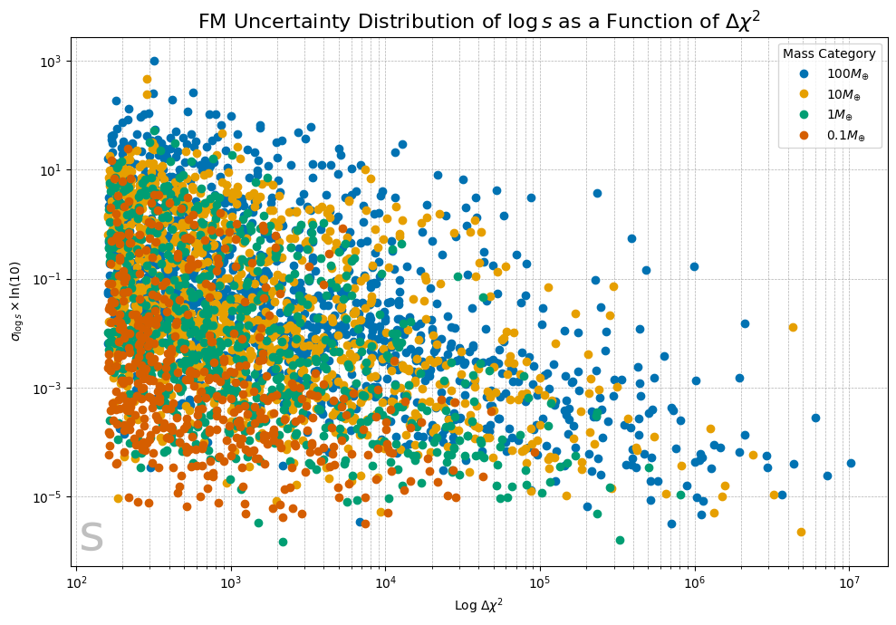
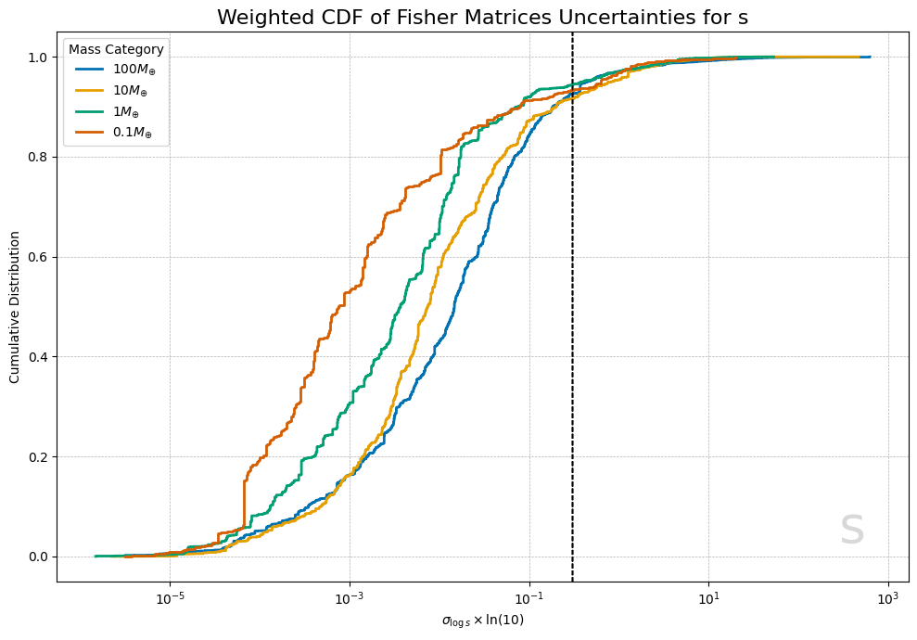
Fisher Uncertainties Distributions

Slide 10
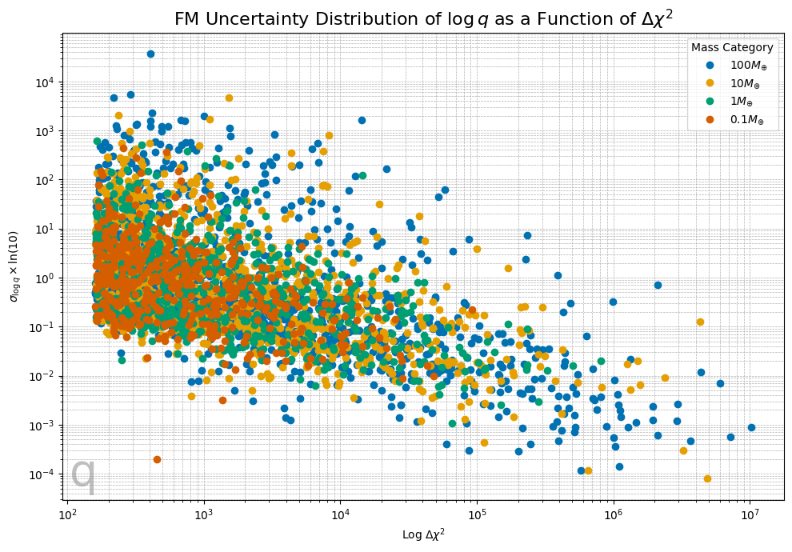
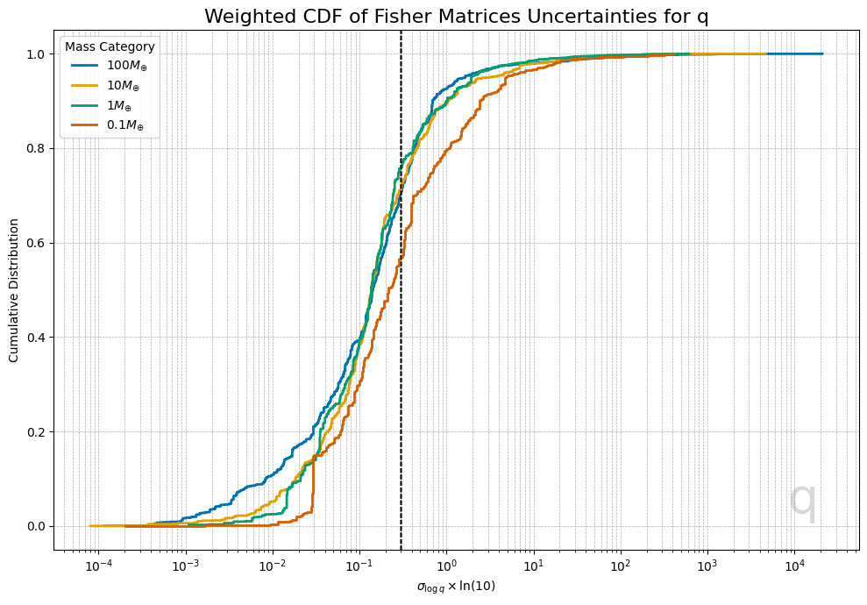
Fisher Uncertainties Distributions

Slide 11
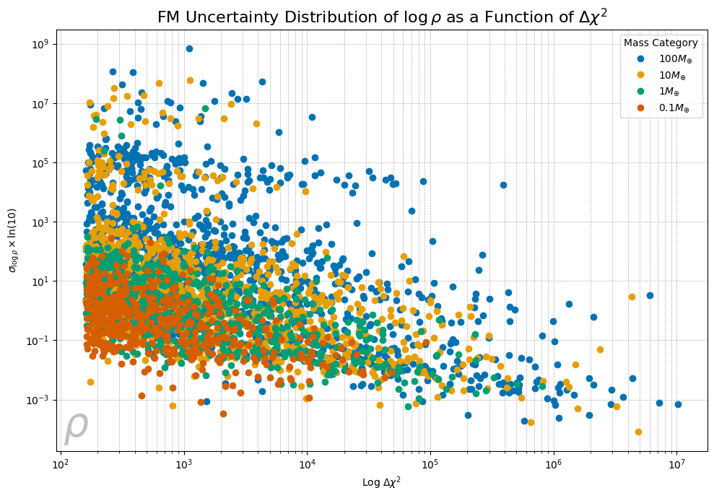
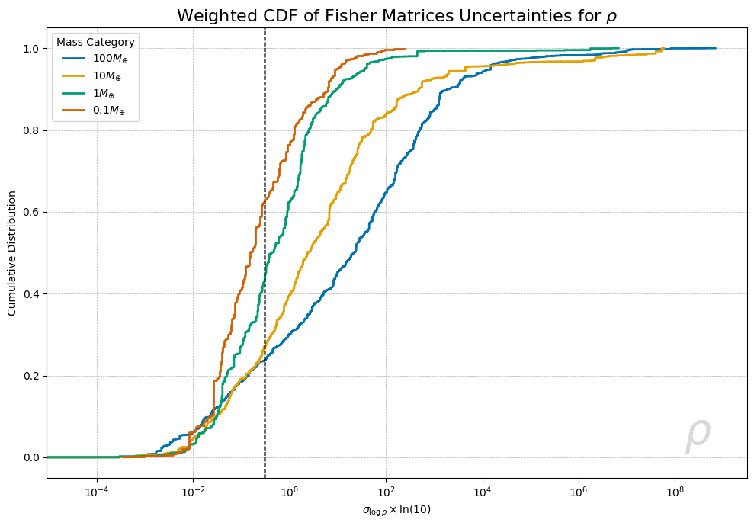
Fisher Uncertainties Distributions

Slide 12
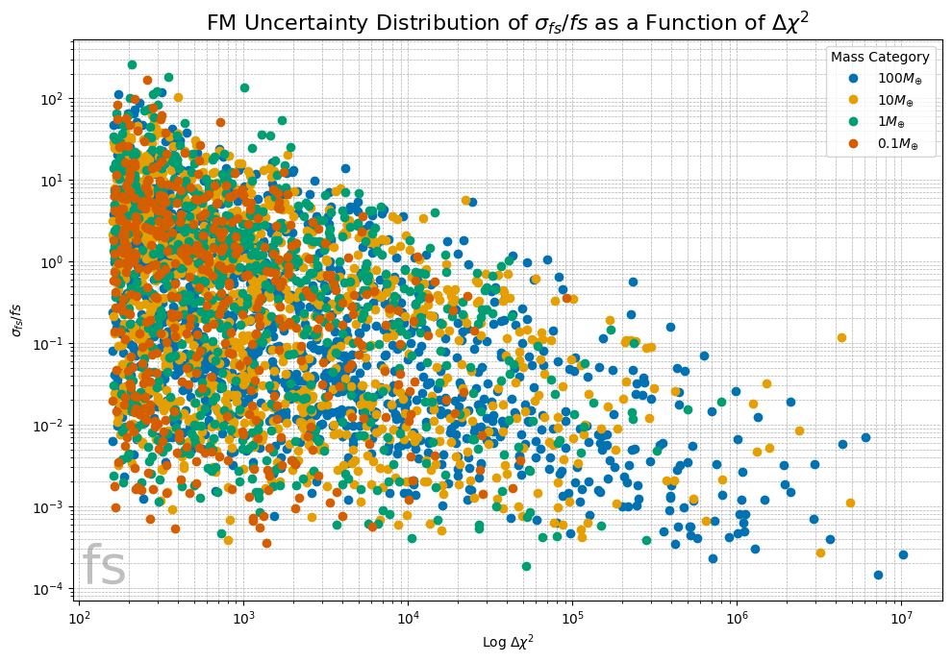
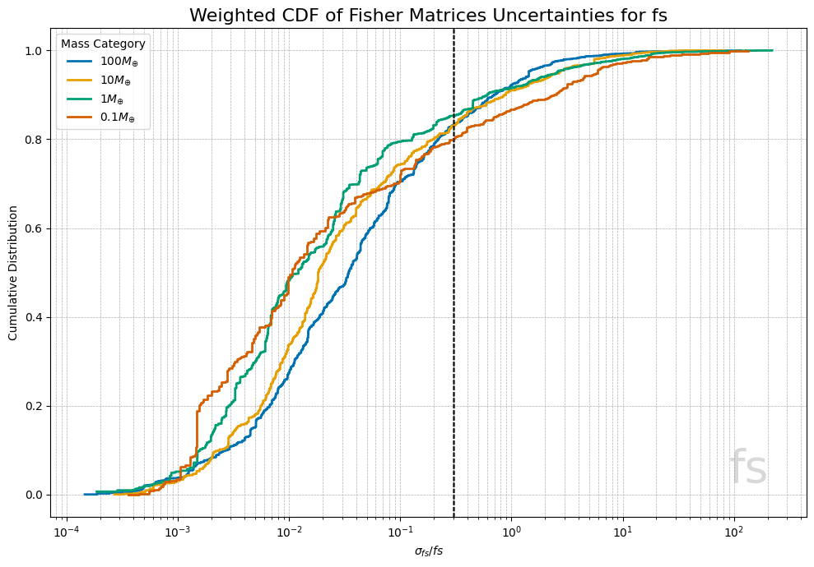
Fisher Uncertainties Distributions

Slide 13
Future work
Roman Yield Simulations Plans
New yield baseline with 8+1 fields
Explore cadences between 7.5 and 15 minutes (& different fields)
Explore color filter choice and cadence (Blue: R062 & Z087, Red: F184 & K213)
Addition of off-season low-cadence observations
New features: fisher matrix error estimates for bound planet properties, masses

Slide 14
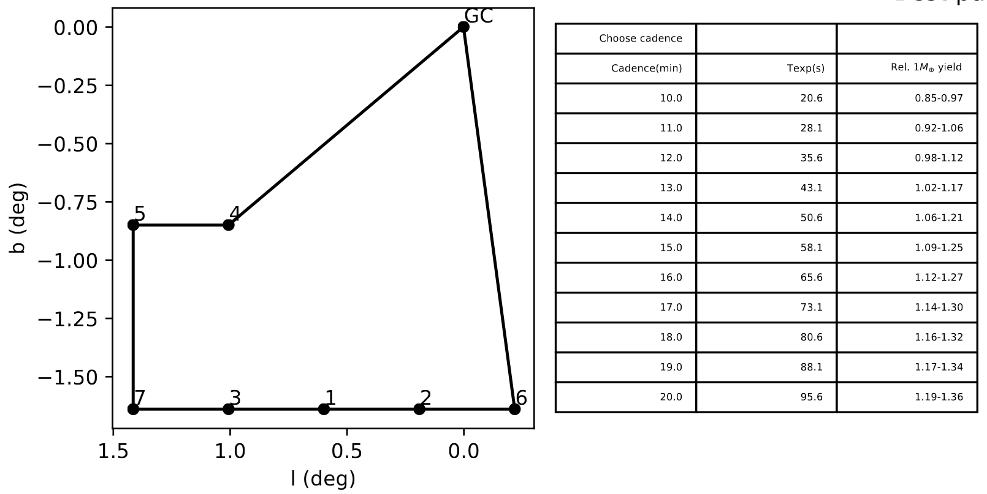
Play around with cadence and field selection at:
https://github.com/mtpenny/gbtds_optimizer

Slide 15
Thank You Contact me via fzohra2@lsu.edu

