Slide 1
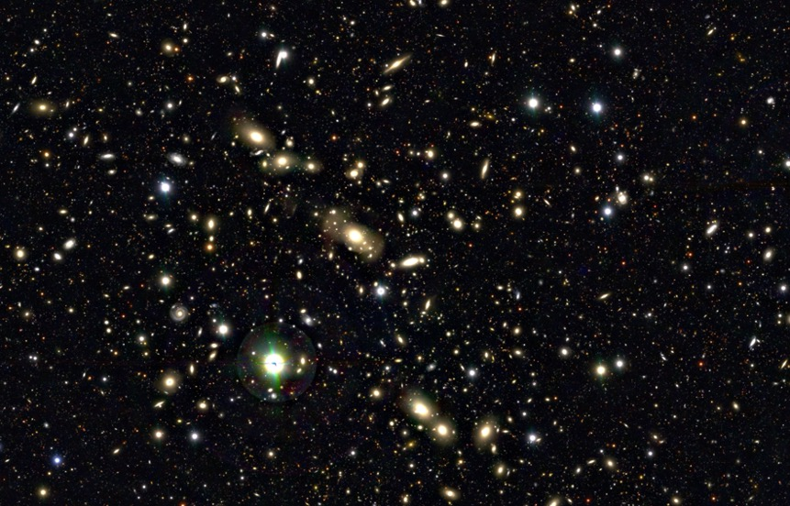
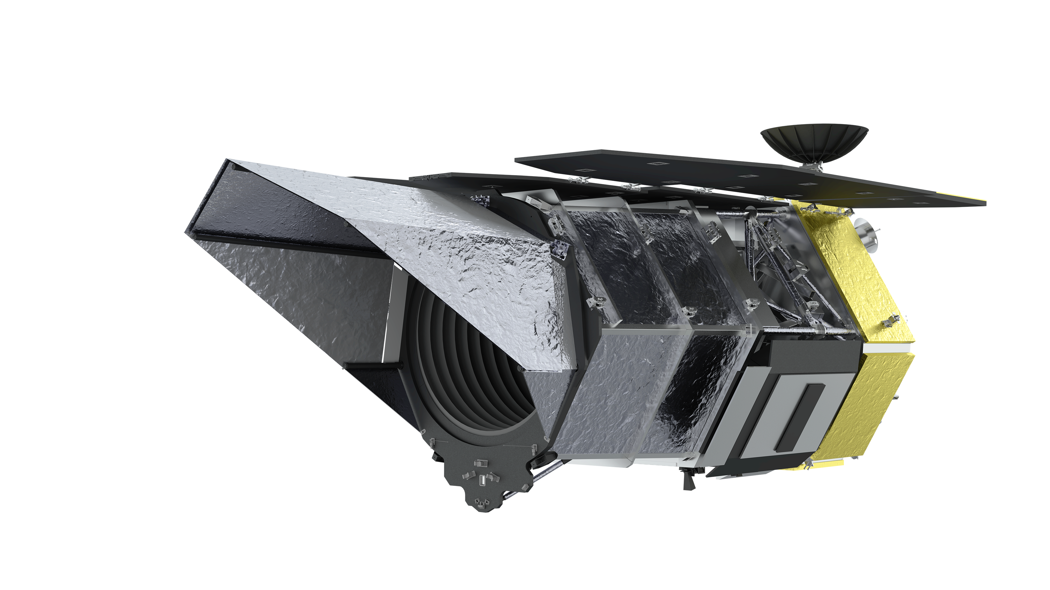

Studying the Formation and Evolution of Galaxy Clusters with Roman Weak Lensing
Kyle Finner (Caltech/IPAC)
Challenging Theory with Roman
Caltech, July 11 2024

Slide 2
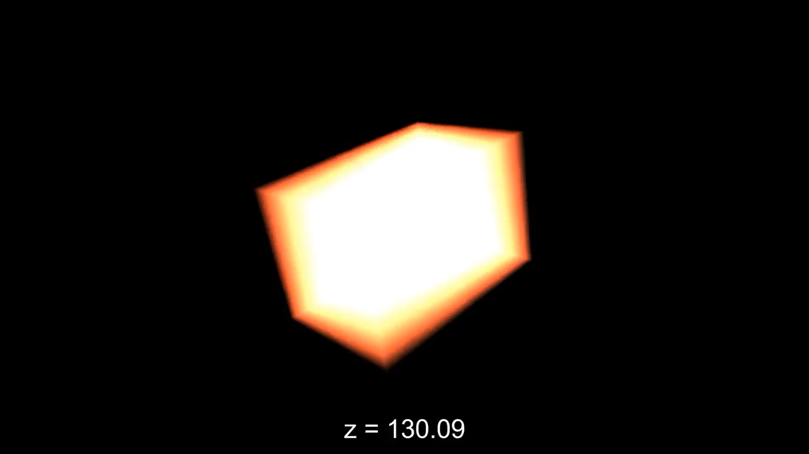

Slide 3
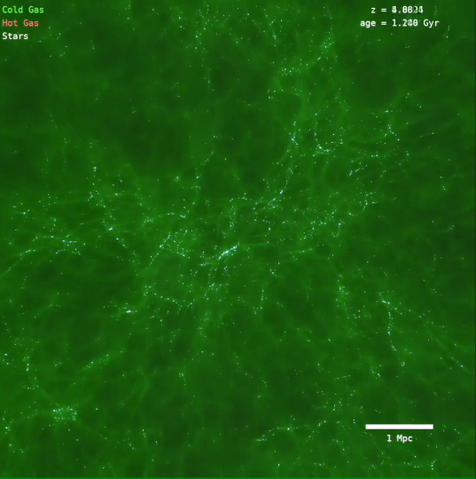
Growth of Galaxy Clusters
Yonsei Zoom-in Cluster Simulation (YZiCS)

Slide 4
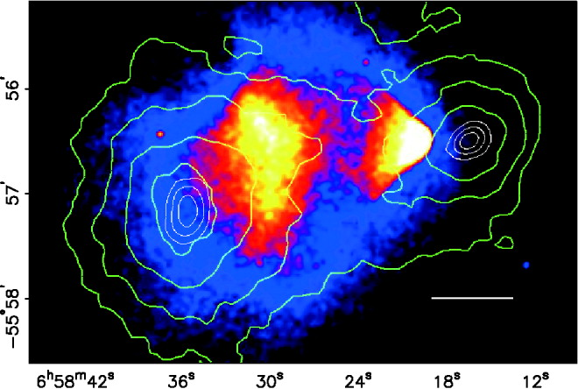
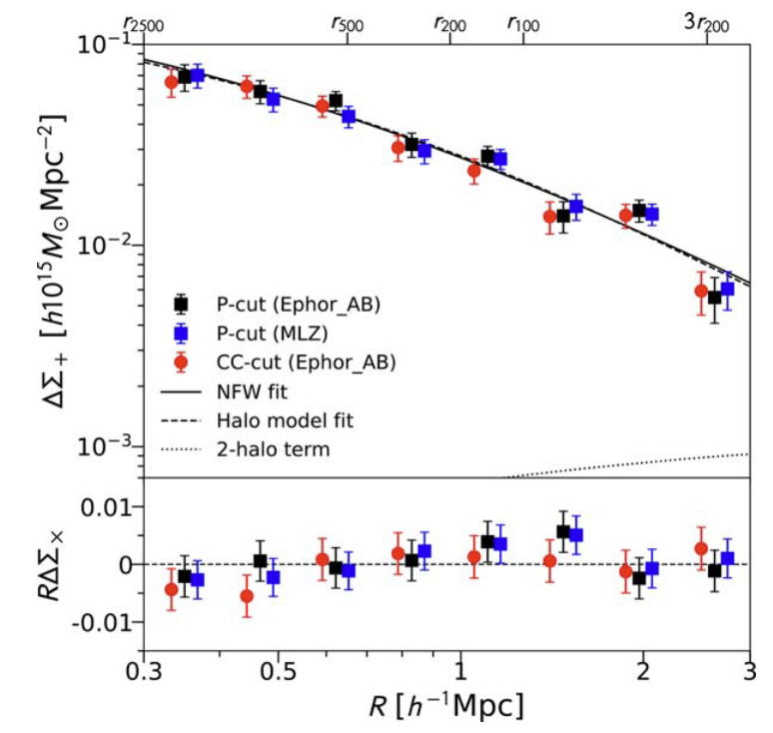
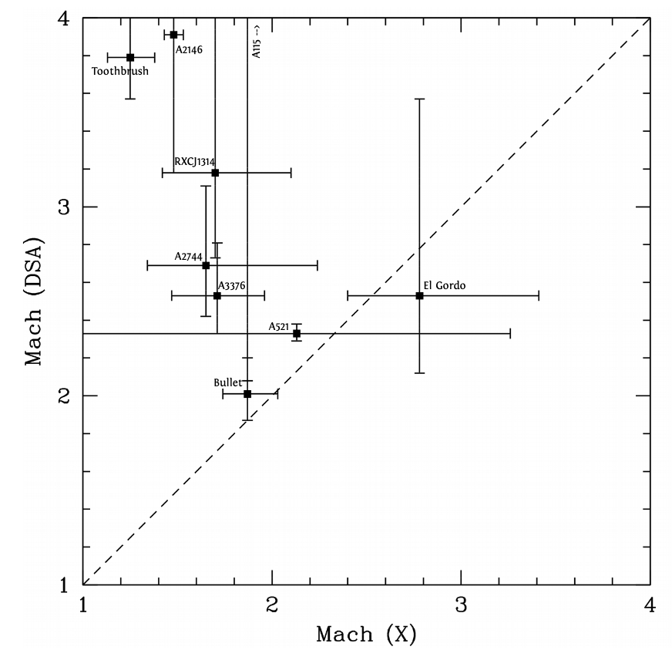
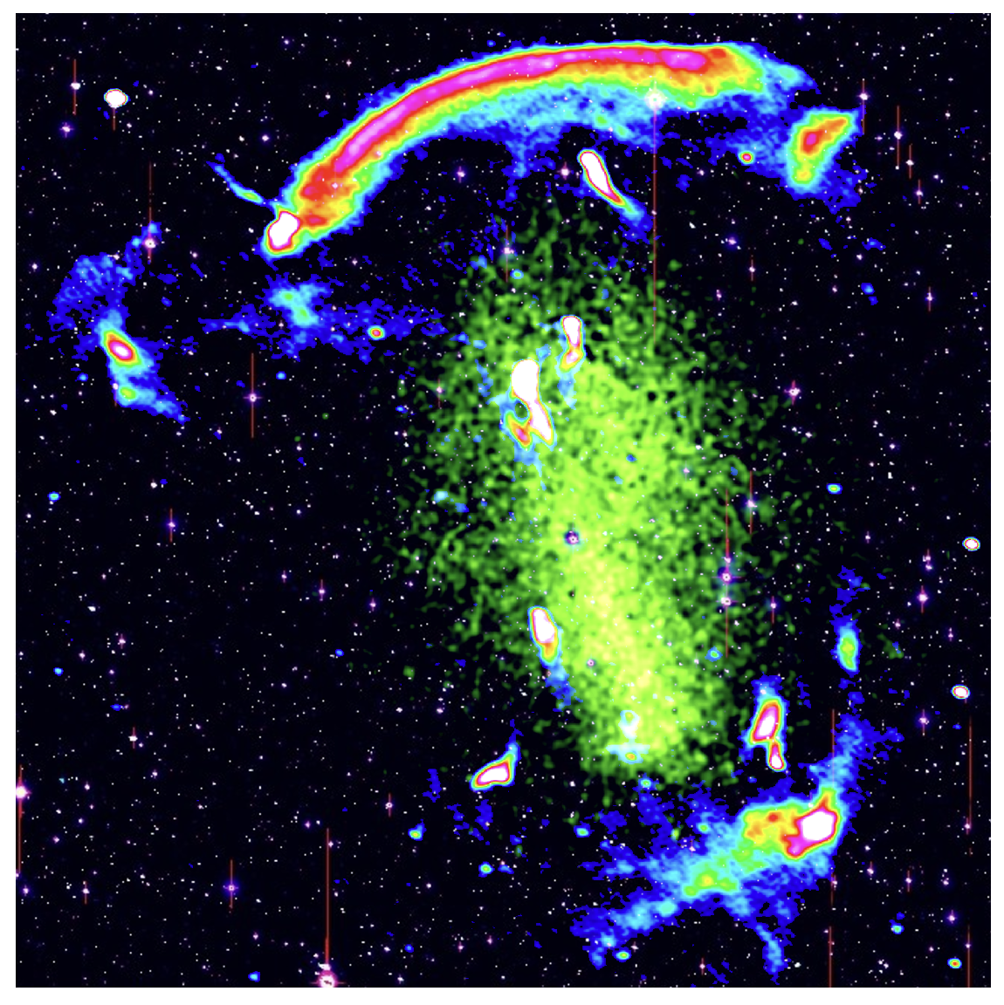
Physics of Galaxy Clusters
Dark matter distribution
Behaviour of dark matter
  Is it self interacting?
  Does it follow the NFW relation?
Evolution of the intracluster medium
  Formation of shocks
  Magnetic fields
  Rarity of radio relics – shocks are ubiquitous, but radio relics are rare
    Electron acceleration mechanism/efficiency
    Distribution of suprathermal electrons throughout the ICM
Challenging to study because
  Timescales are long (Gyrs) – each cluster provides a snapshot into the evolutionary stage
  Clusters are filled with a large variety of astrophysics
X-ray emission from ICM
Clowe+2006
Umetsu+2020
Radio relic
Hoang+2018
Botteon+2020

Slide 5
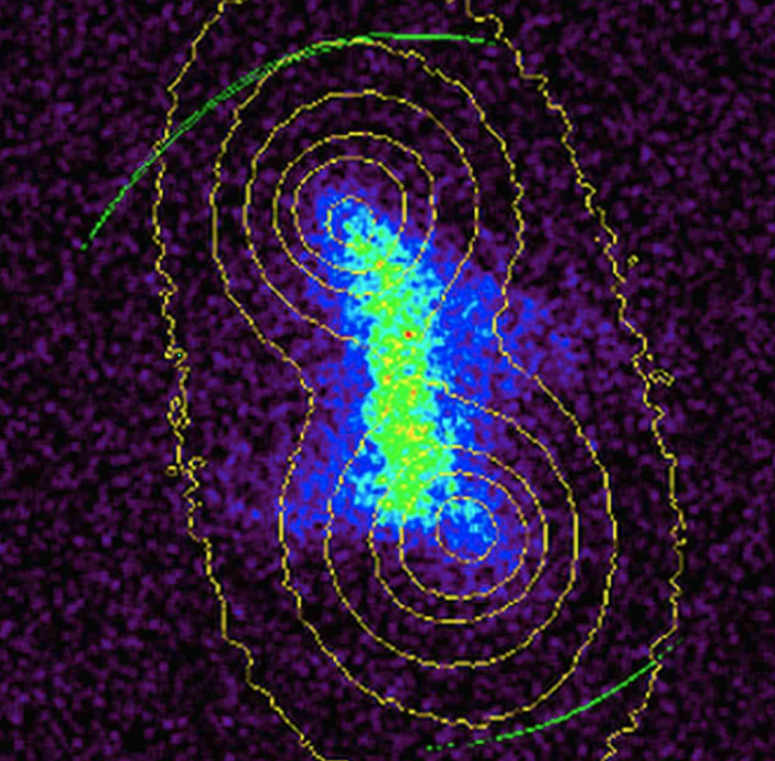
Modeling the Merger
X-ray
Radio
Shock velocity
Merger axis
Merger state
Gas properties
Biased mass estimate
Shock velocity
Shock position
Timescale of merger
Merger axis
Merger viewing angle
Weak lensing
Spectroscopy
Subclusters
Mass estimate
Subcluster positions
Viewing angle
Subcluster positions
Cluster galaxy membership
Biased mass estimate
Simulations
Learn
Mass distribution
Gas distribution
Shock positions
Nature of dark matter (SIDM?)
Shock acceleration mechanism
Magnetic field strength
Time evolution of merger features
Compare
Molnar et al. 2017
Finner et al. 2021

Slide 6
A2255 (z=0.08) – Subaru Color Image

Slide 7
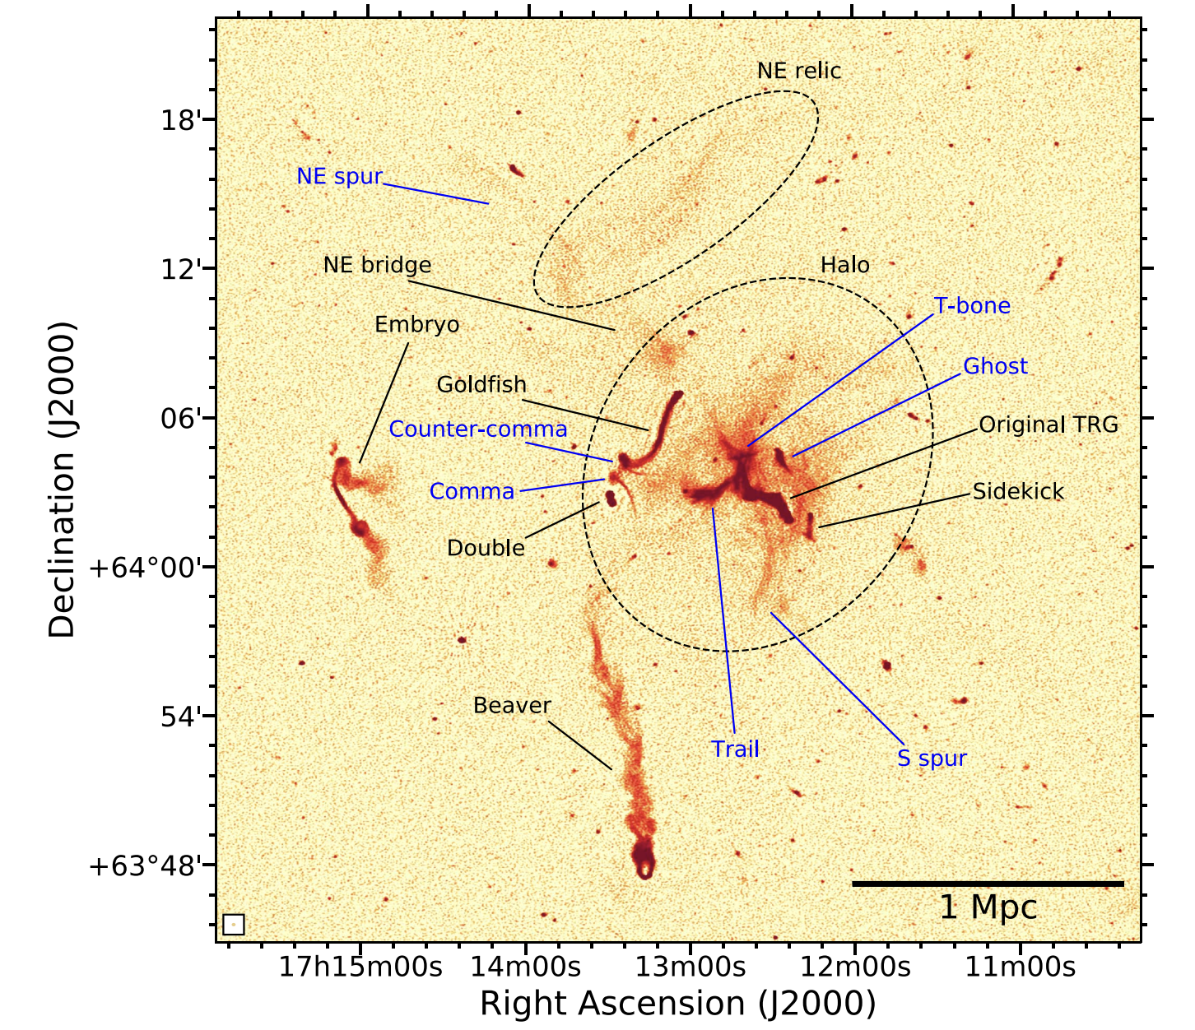
The Beautiful Mess – Abell 2255
Botteon+2020

Slide 8
A2255 – X-ray image / Radio Relic Contours

Slide 9
A2255 – Projected Mass Map
Weak lensing is our best tool for identifying substructures.

Slide 10
A2255 – Multi-wavelength picture
Past collision that formed shock

Slide 11
How can Roman help?

Slide 12
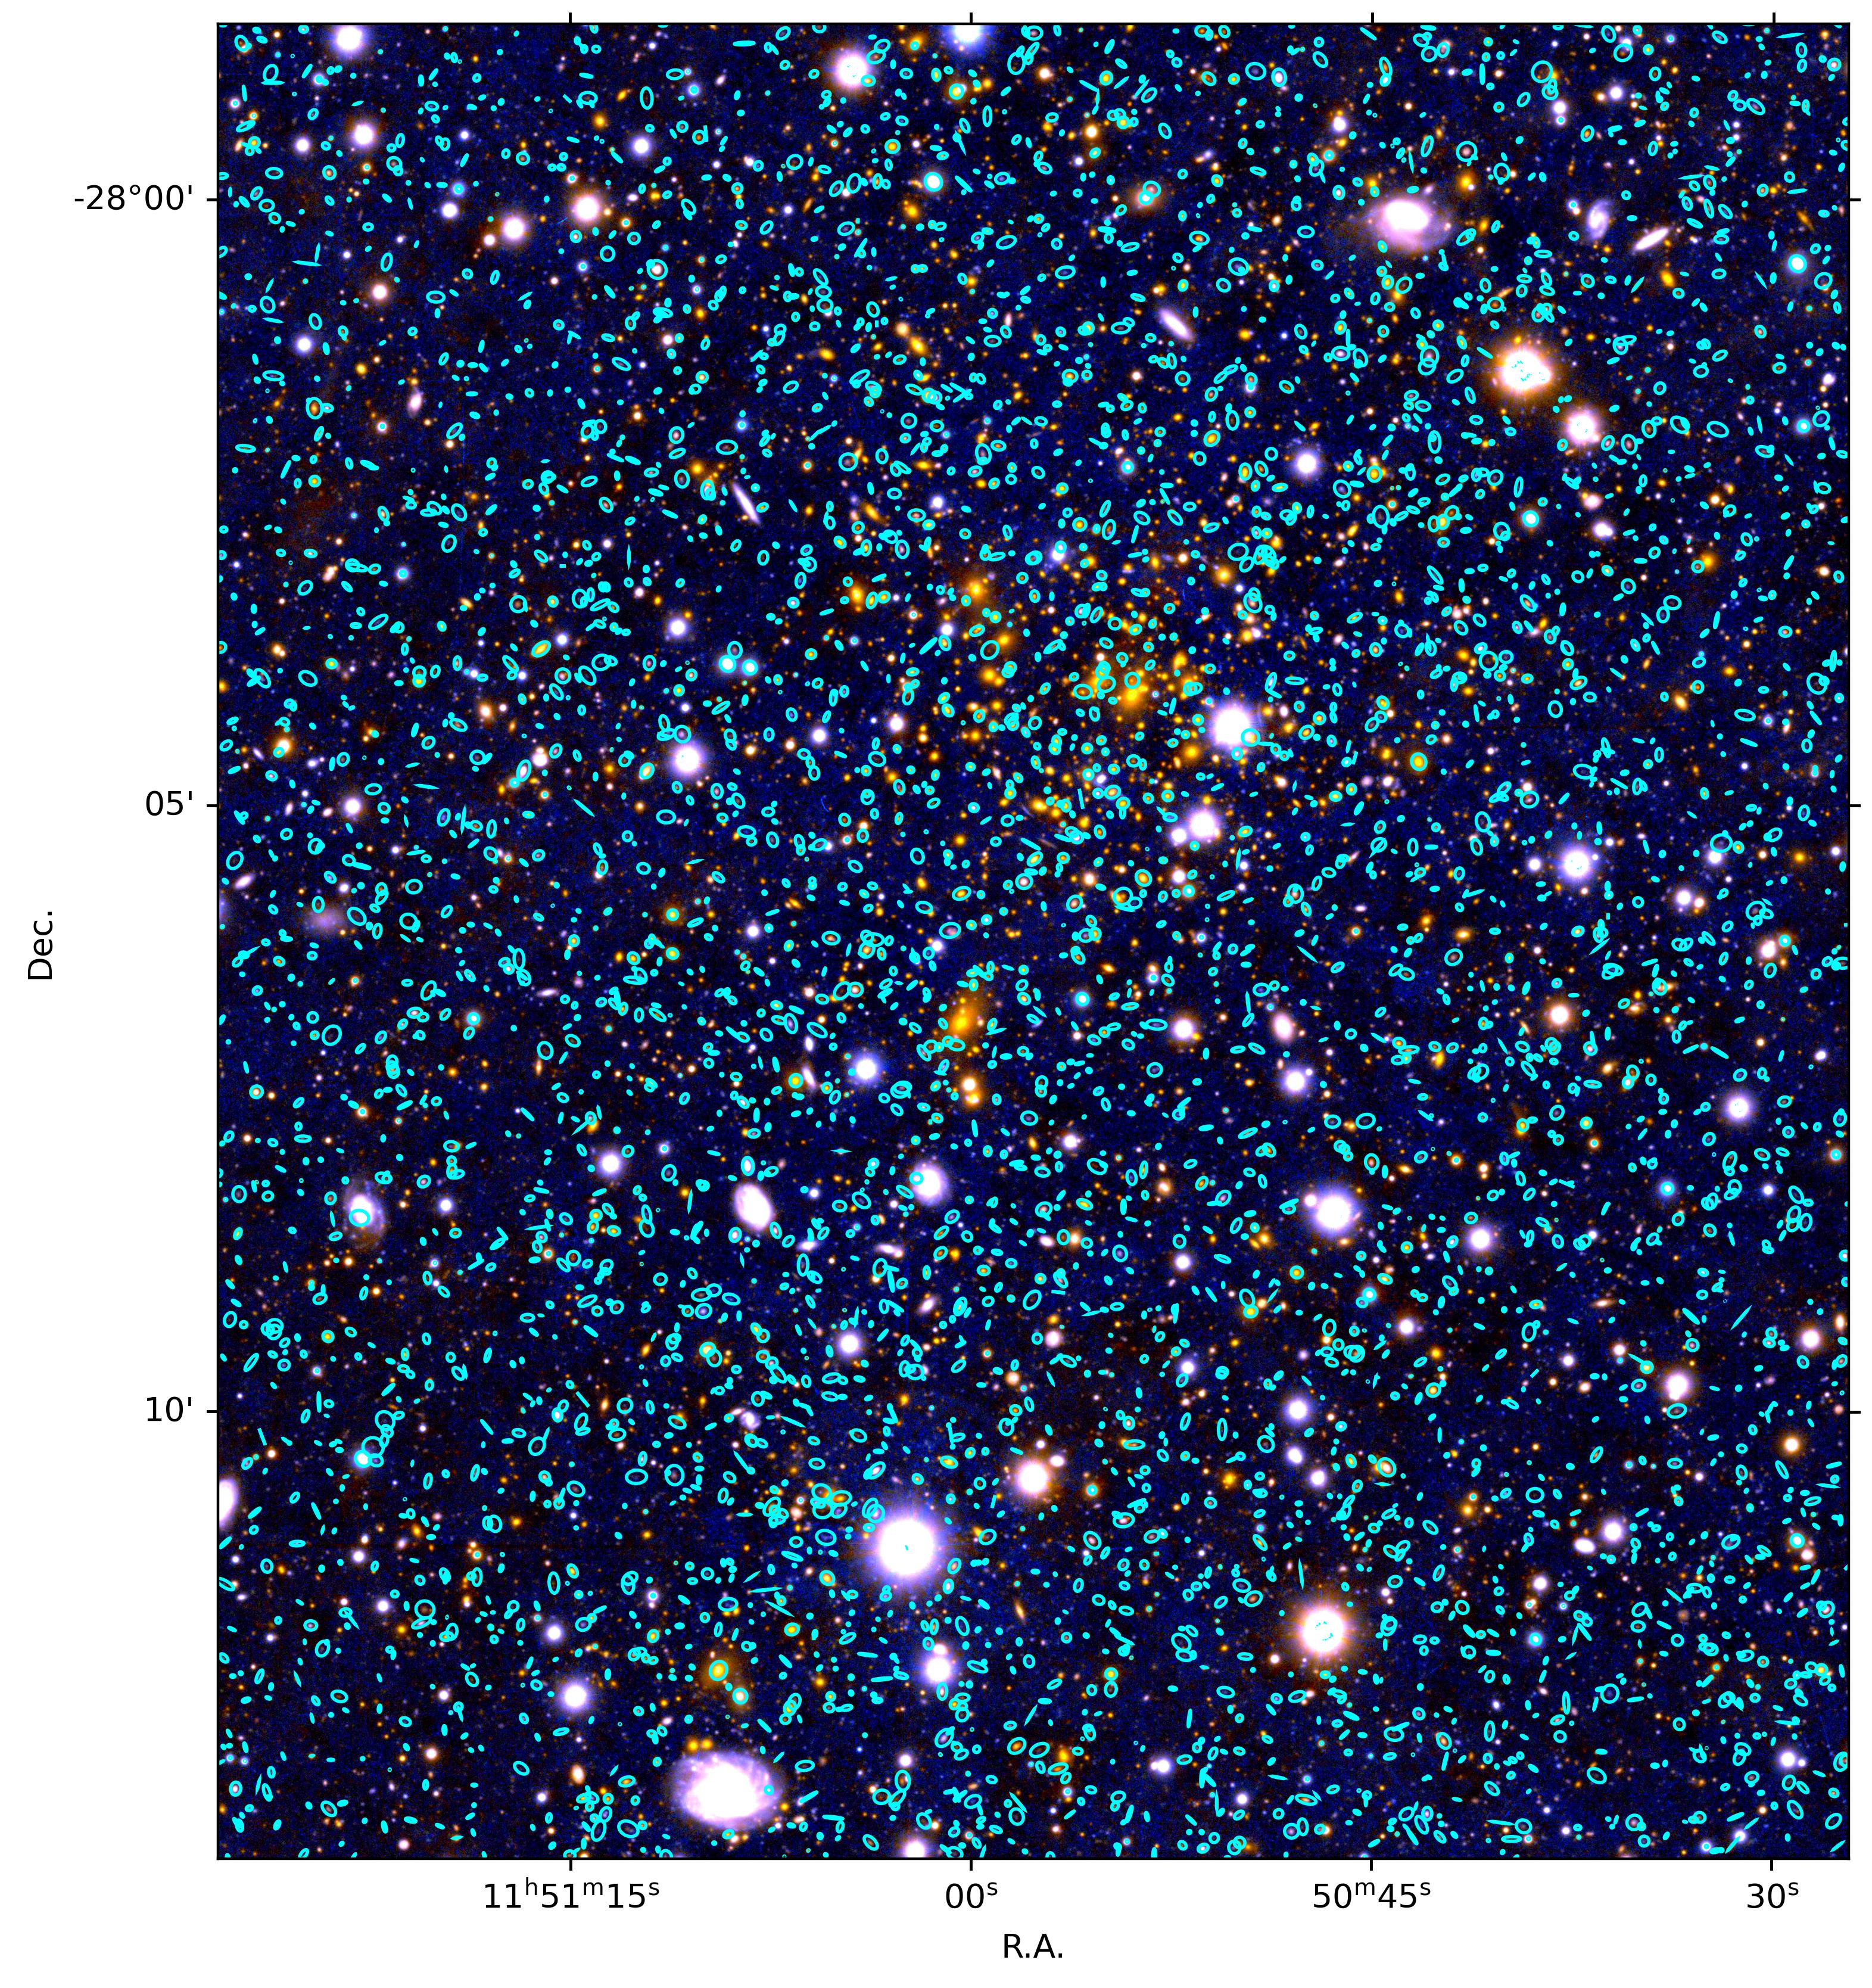
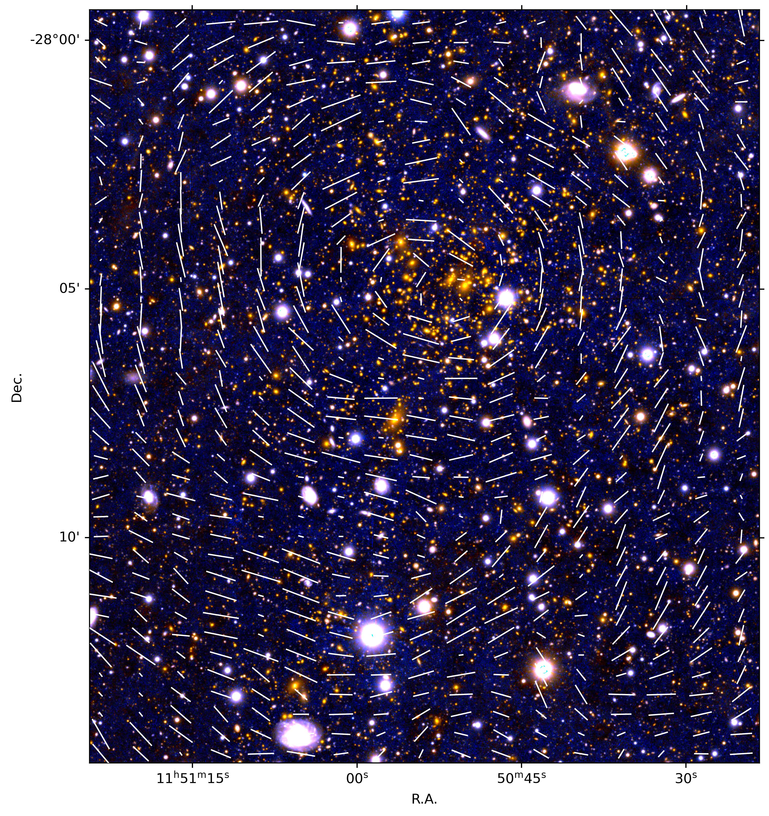
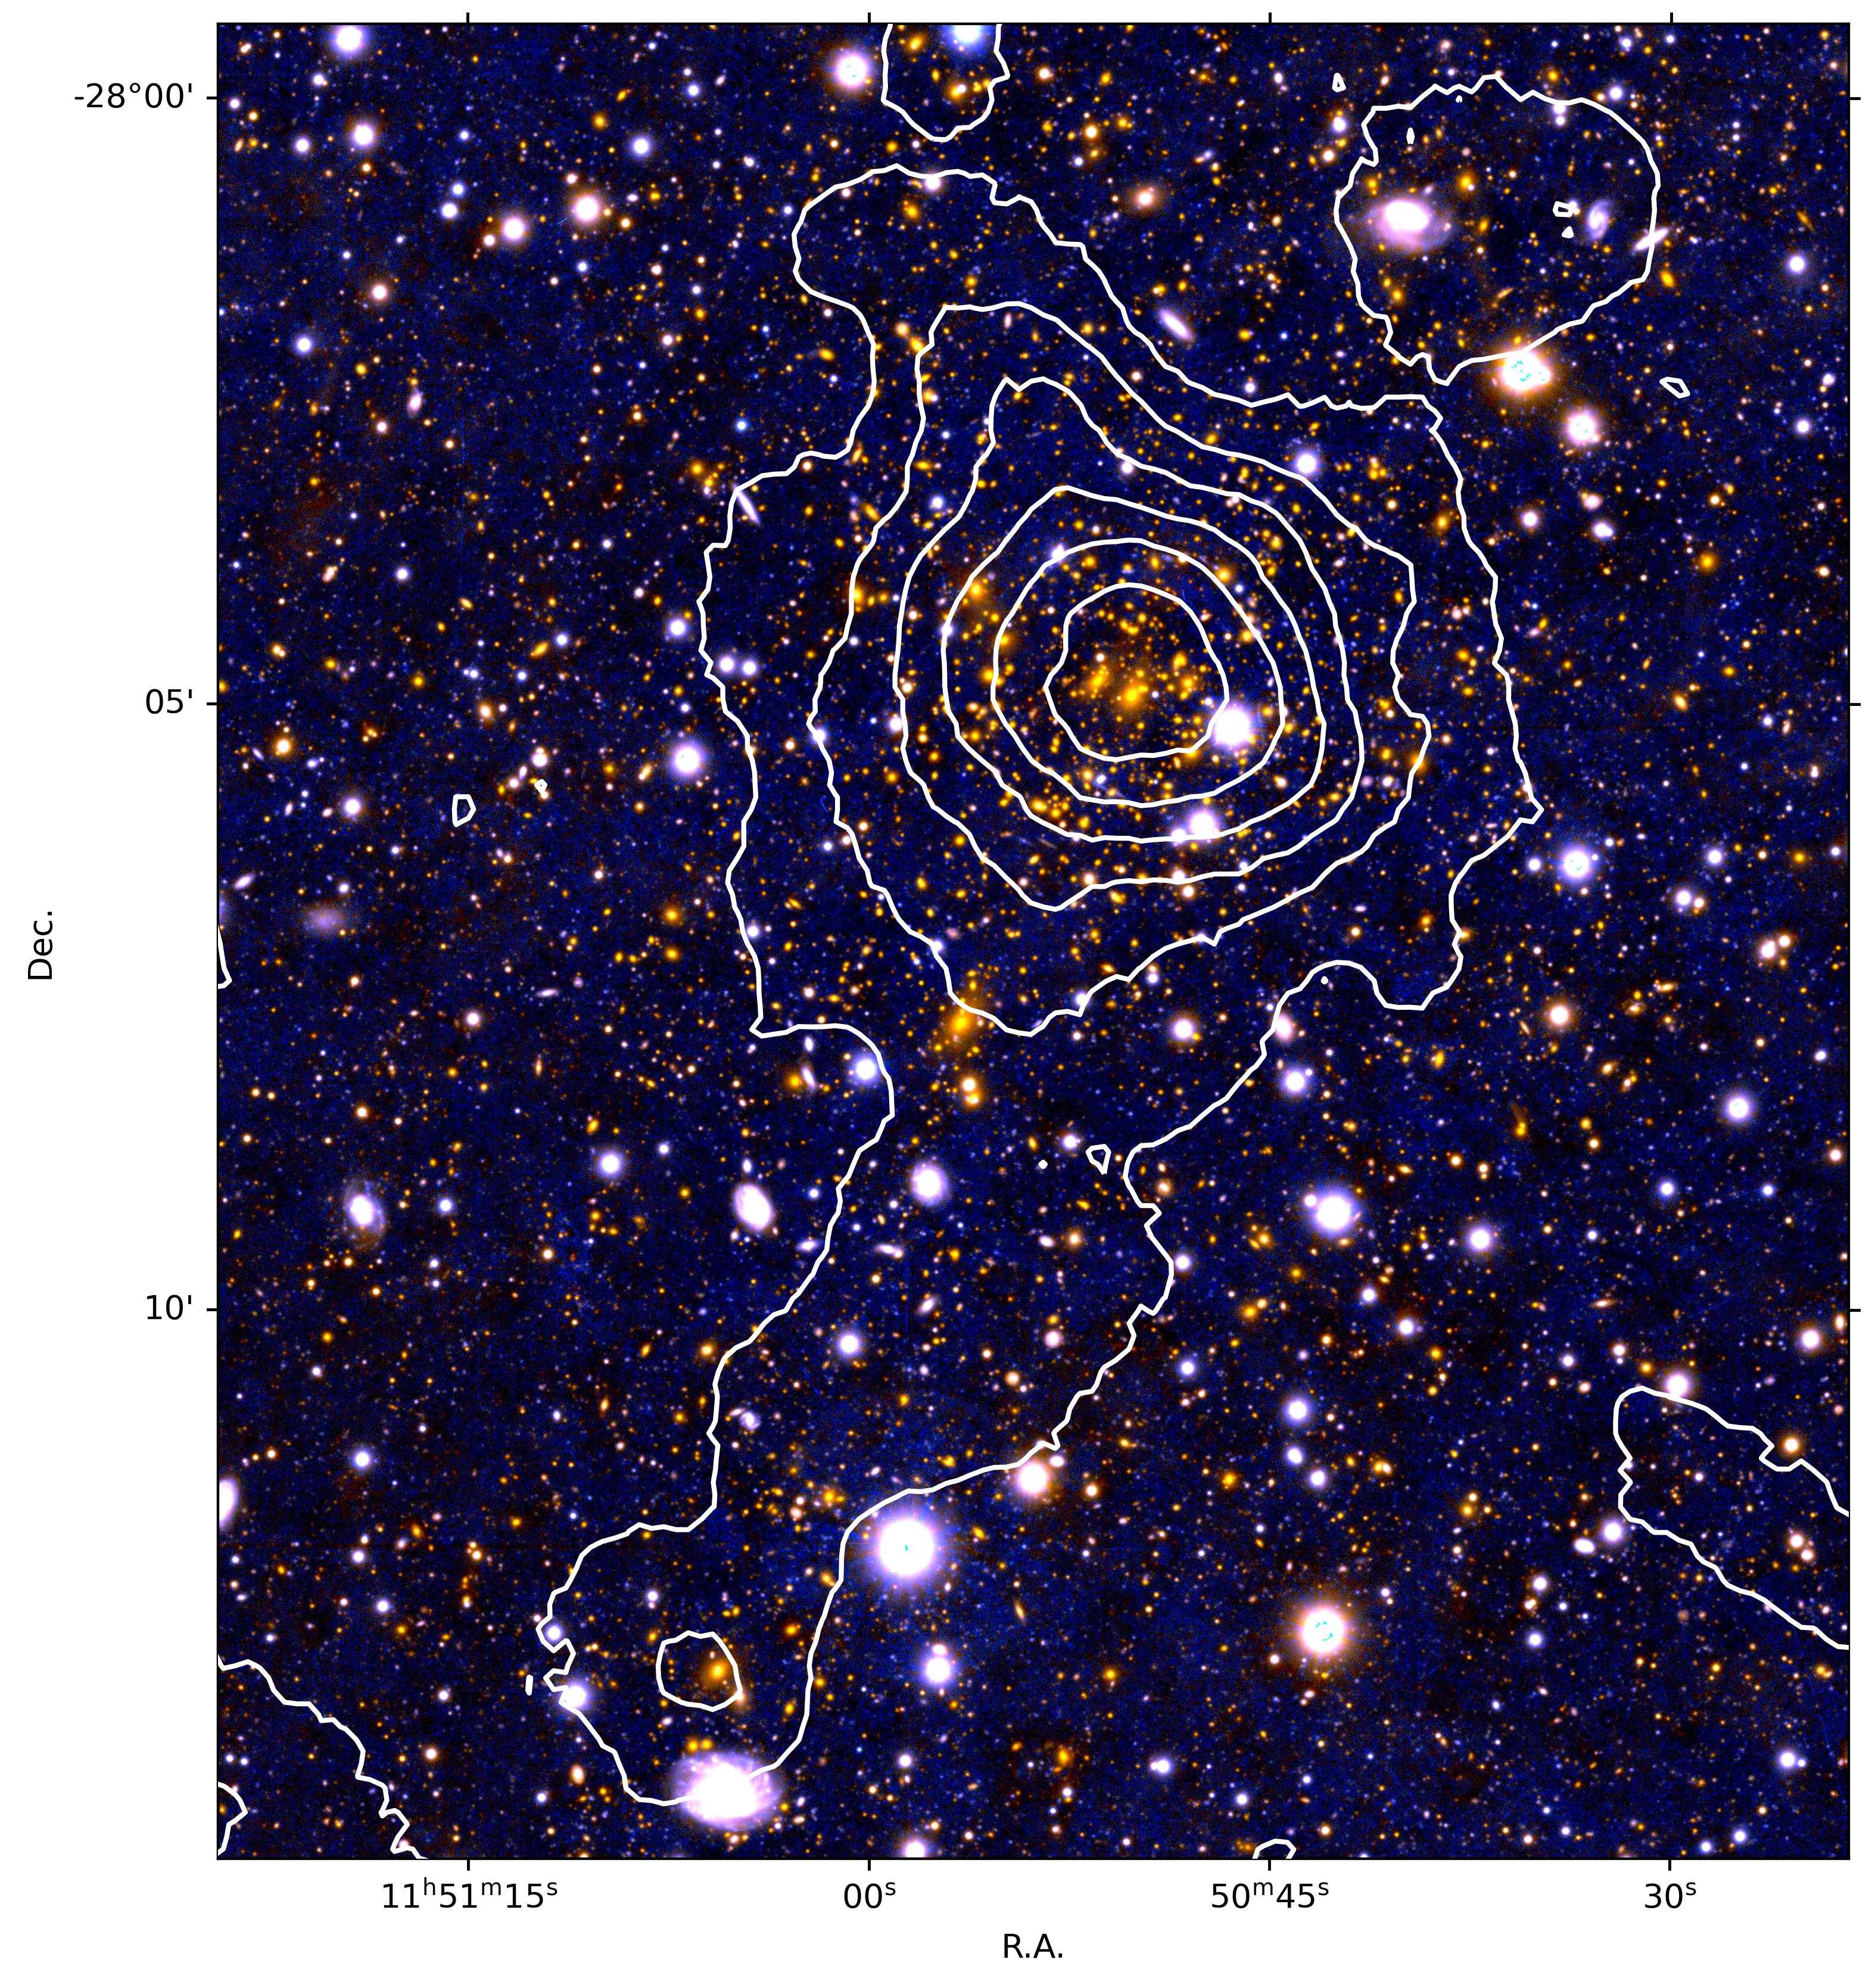
Weak Gravitational Lensing
Measure galaxies ellipticity
Reduced shear
Projected mass density
Ground-based Subaru data
30 galaxies per arcmin^2
Resolution depends on number density

Slide 13
High Resolution Advantage
Subaru
HST/ACS
30 galaxies per arcmin^2
Finner+2017
60 galaxies per arcmin^2

Slide 14
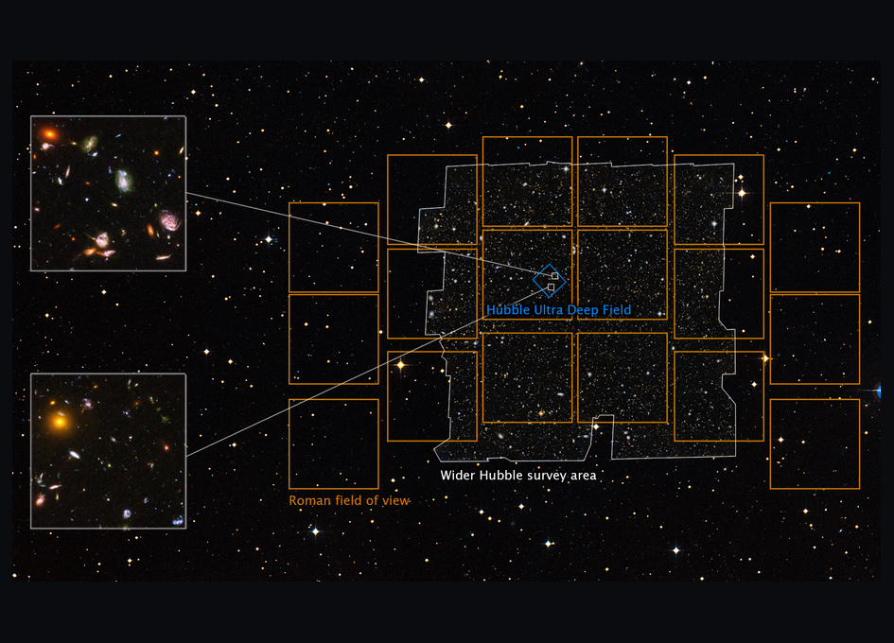
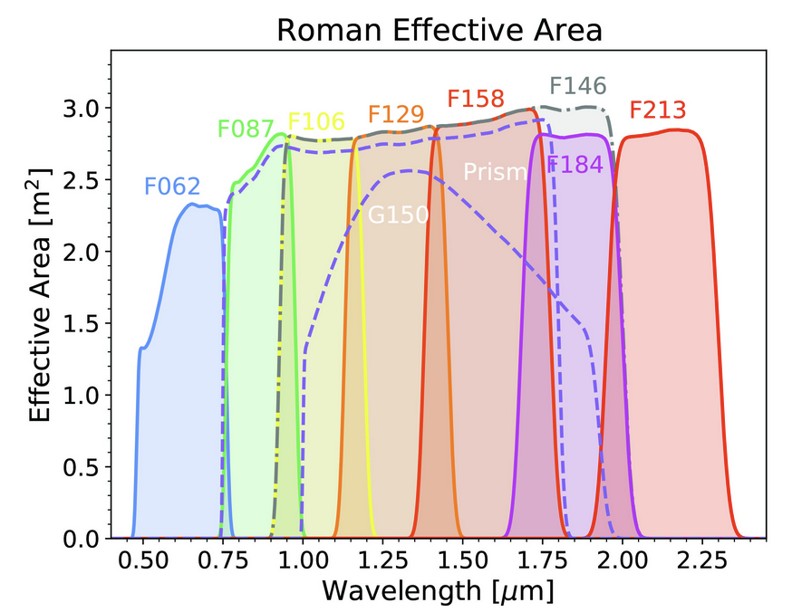
Weak Lensing With Roman
More efficient!
Wide field of view: 48 arcmin x 24 arcmin
  Full coverage of cluster at most redshifts
More effective!
High resolution: 0.11 arcsec / pix
  Valuable for separation of galaxies (more galaxies)
Red filter set
  Better for fitting a smooth model (more galaxies)
  Better detection of high-z galaxies (more galaxies)
At 27th magnitude -> 150 galaxies per arcmin^2
Credits: NASA, ESA, and A. Koekemoer (STScI)
NASA/GSFC

Slide 15
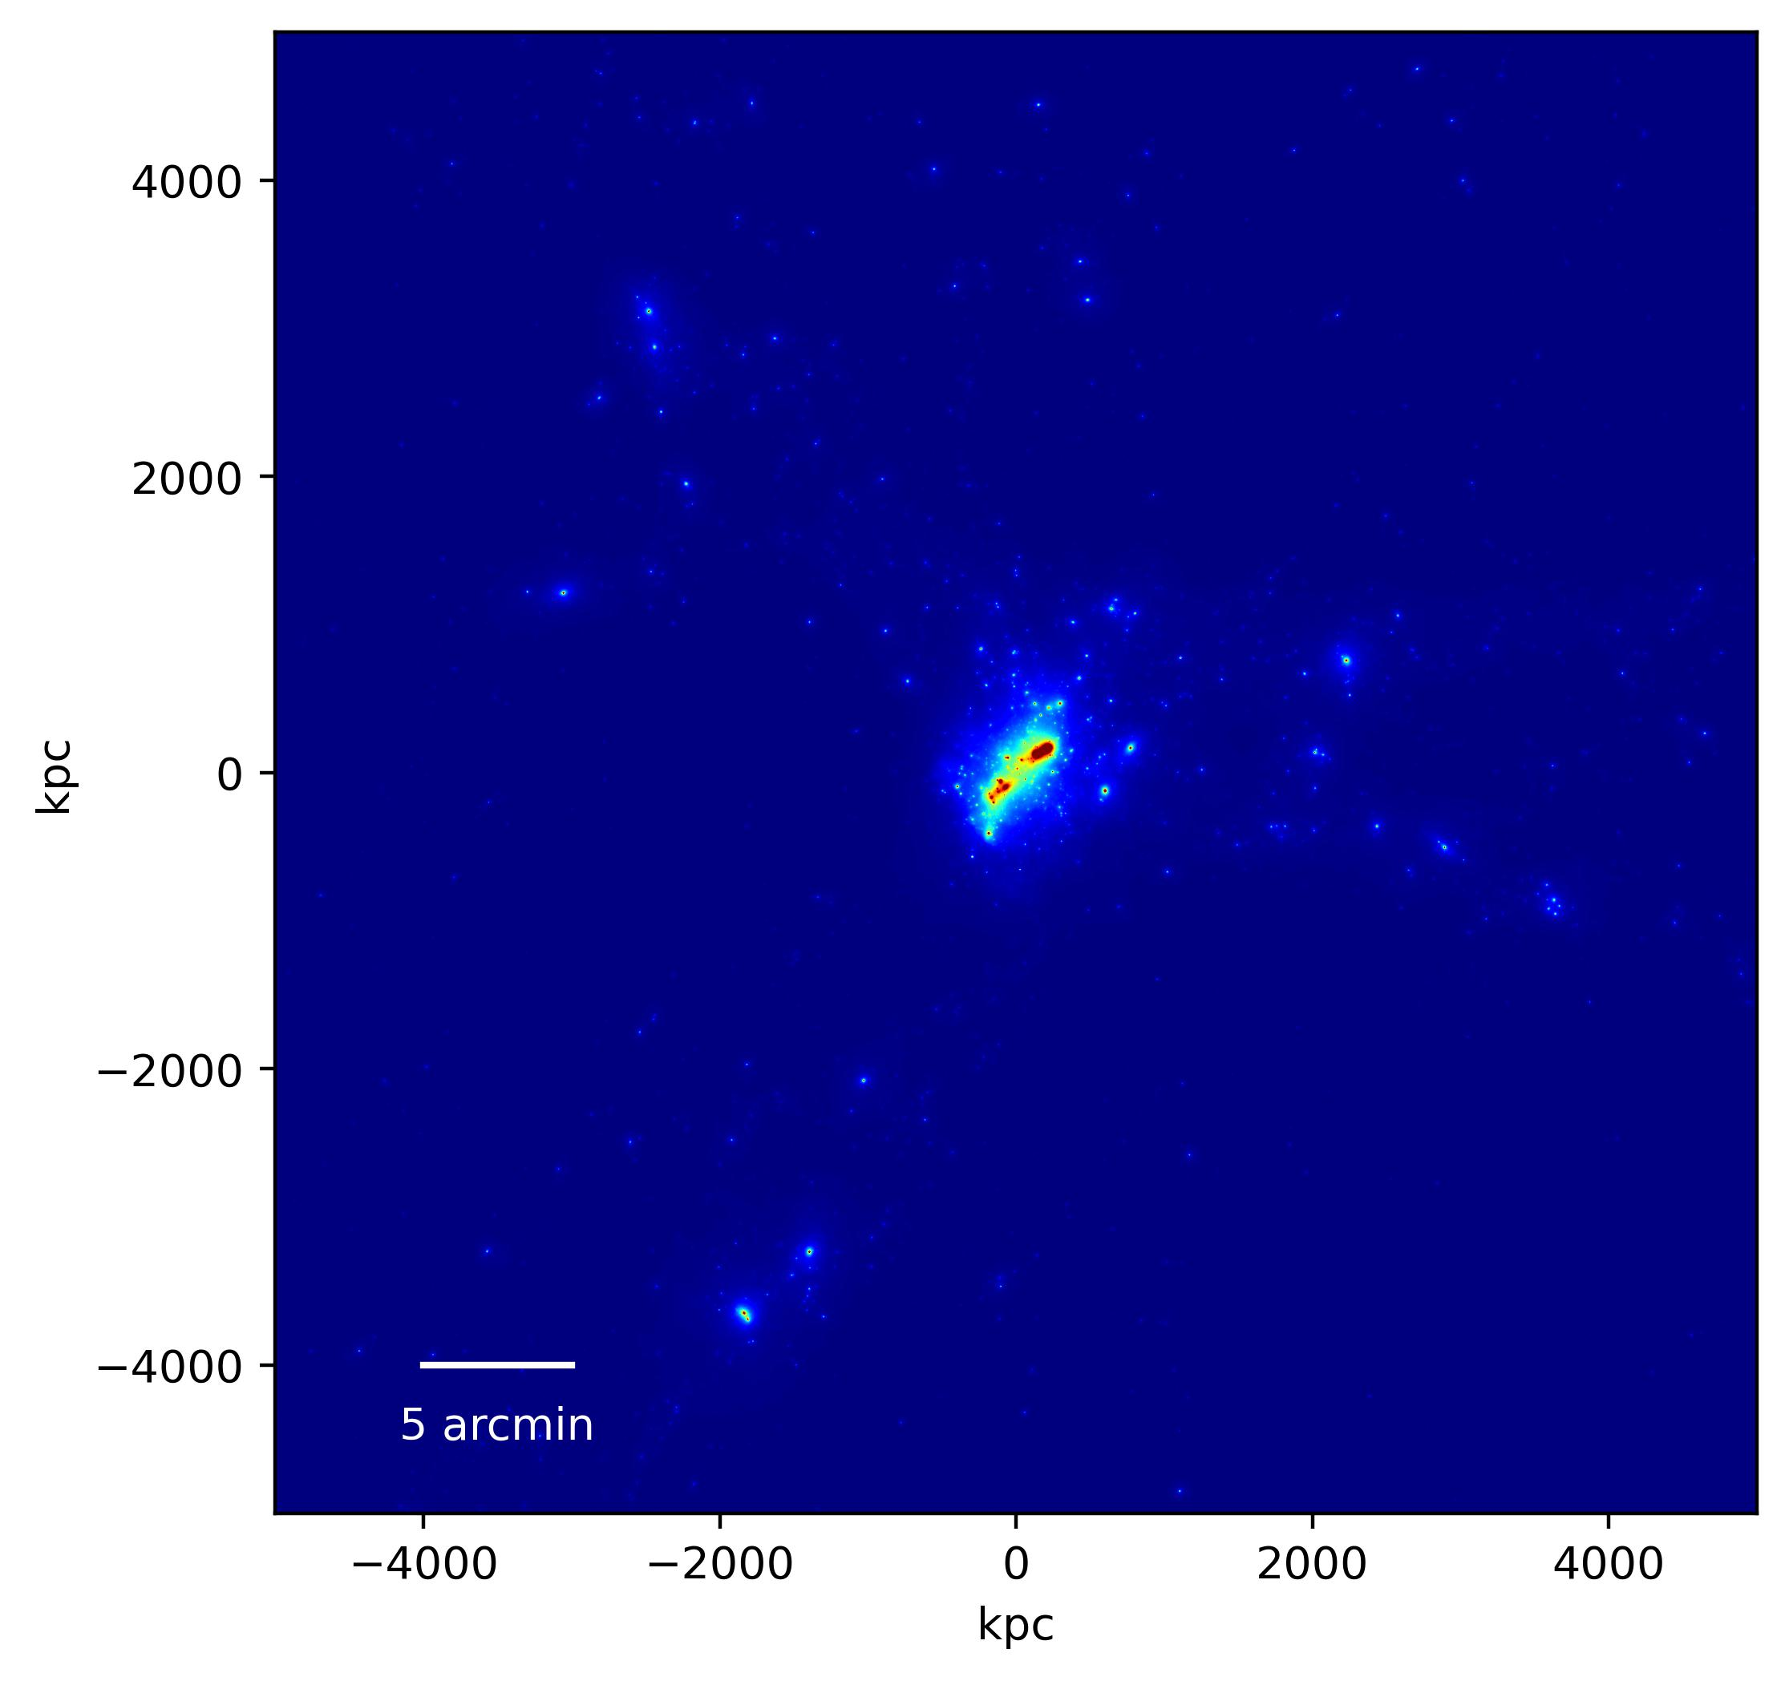




Weak Lensing Simulations
TNG-Cluster Simulation Projected Mass Density Map
10 Mpc x 10 Mpc (z = 0.2)
$${10}^{14} M_{⊙}$$
$${10}^{14} M_{⊙}$$
${10}^{15} M_{⊙}$ cluster
$${10}^{14} M_{⊙}$$

Slide 16
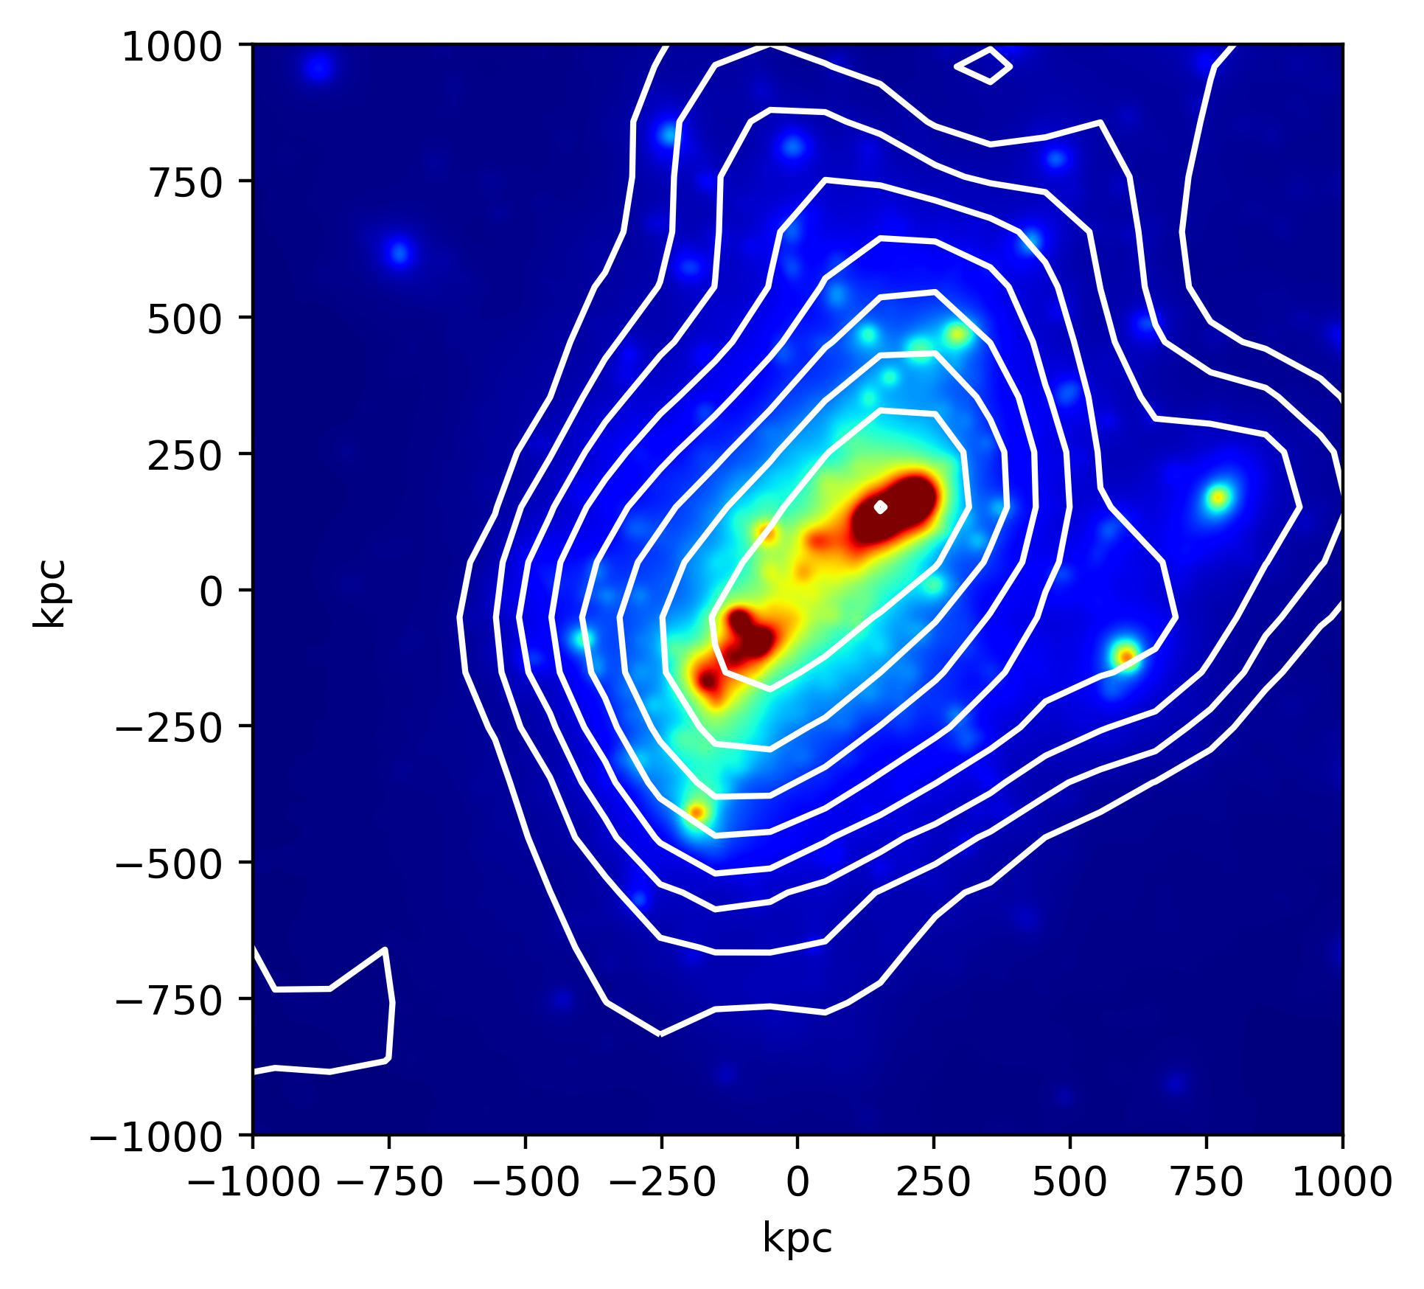
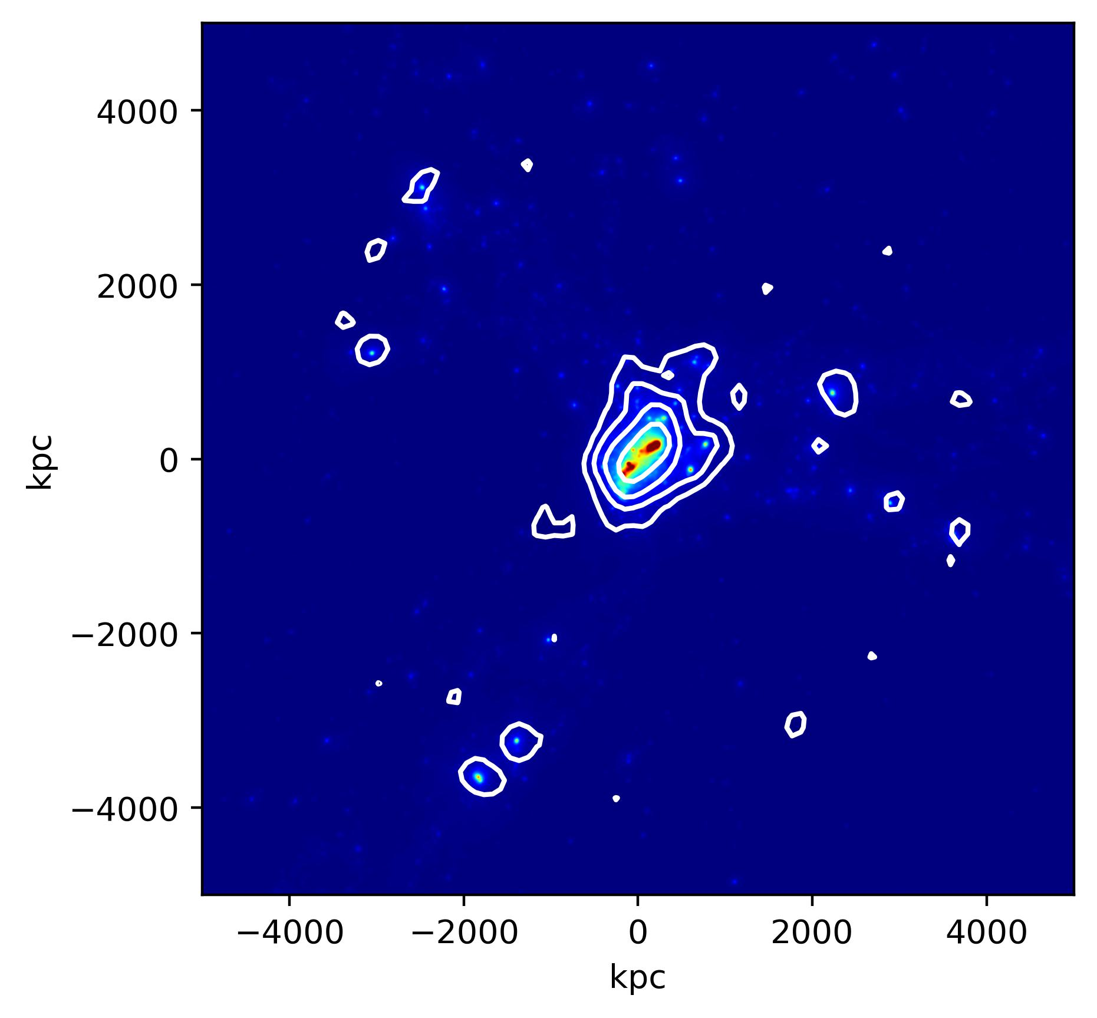
Weak Lensing Simulations
Ground-based Weak Lensing
30 galaxies per arcmin^2
40 arcmin field of view

Slide 17
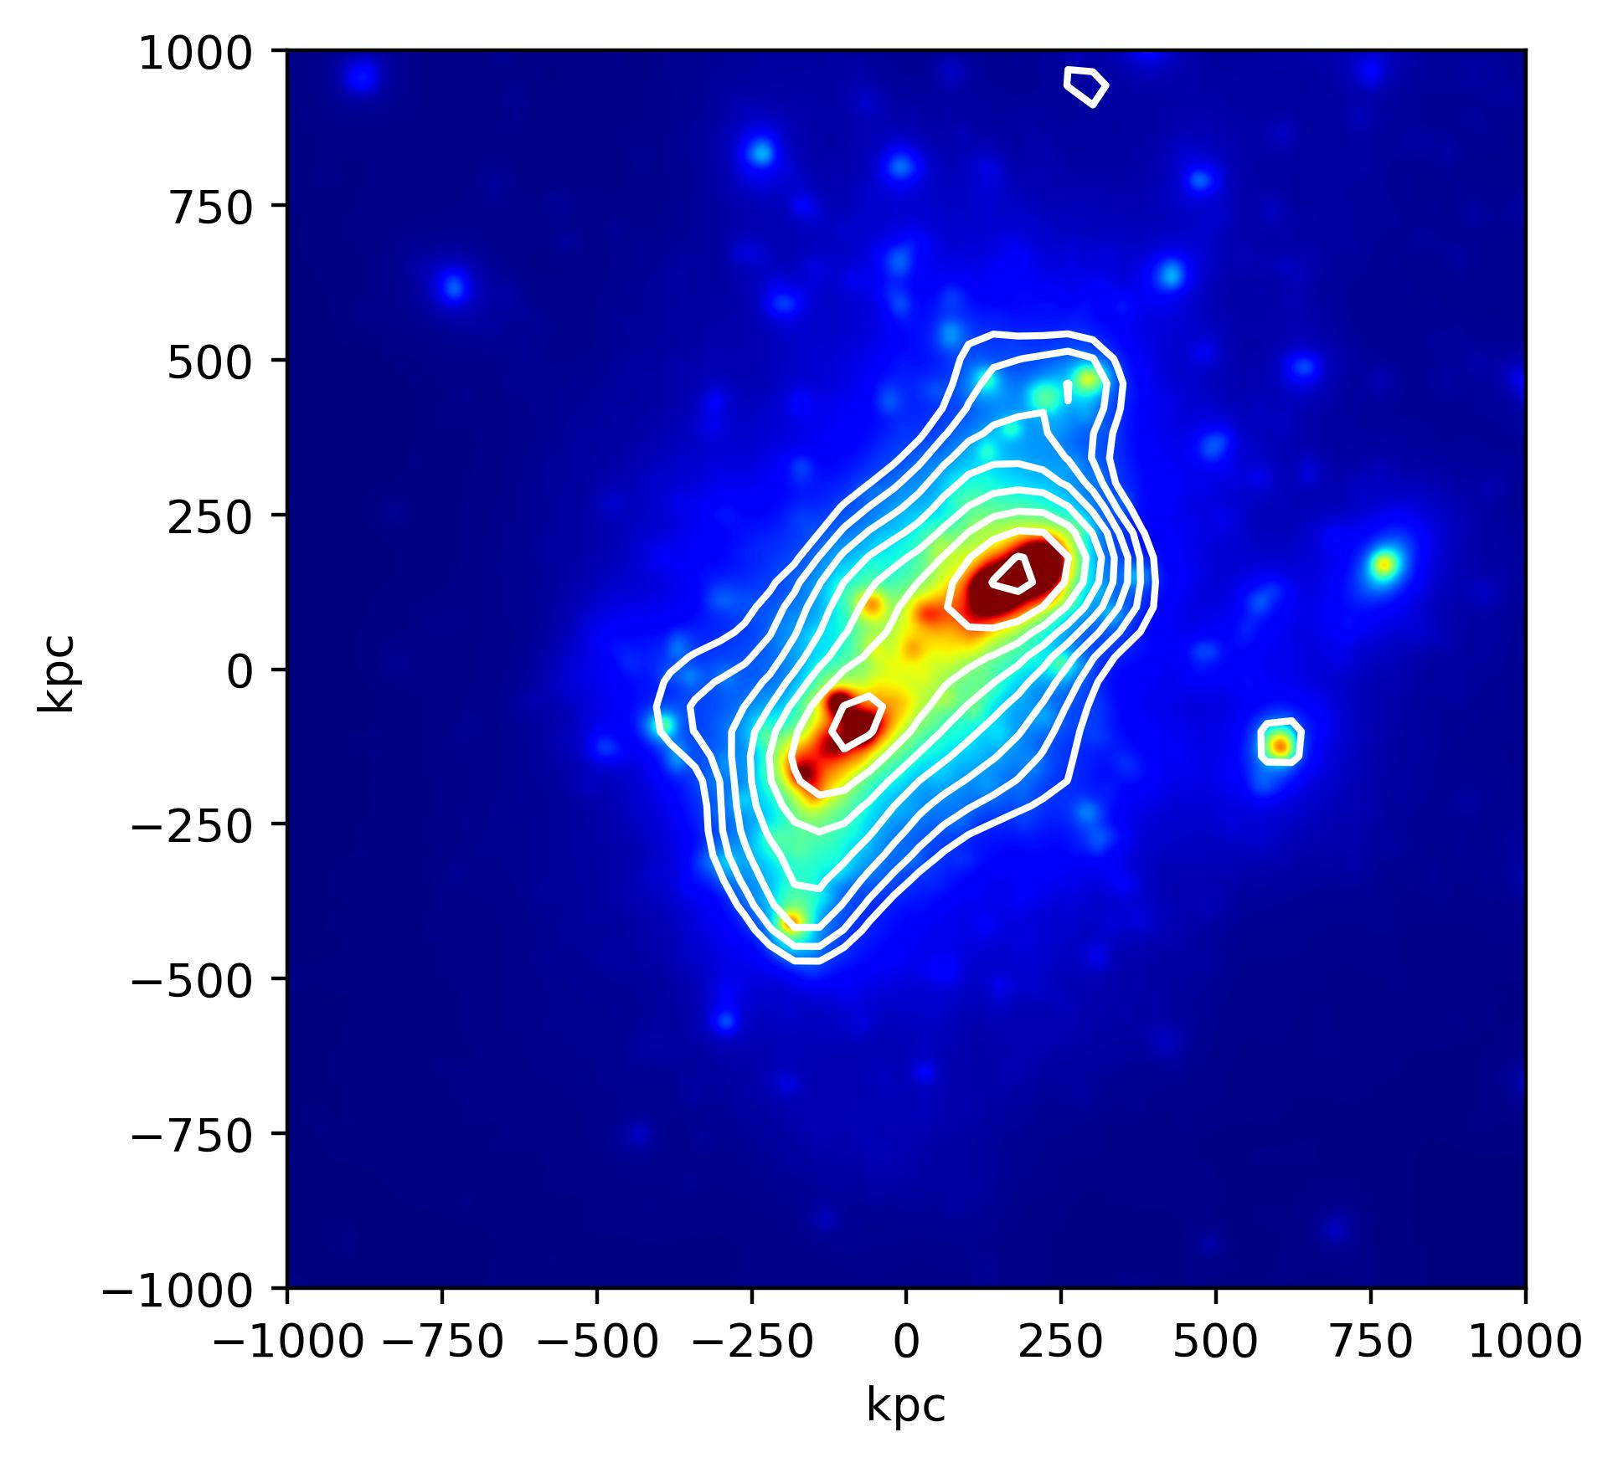
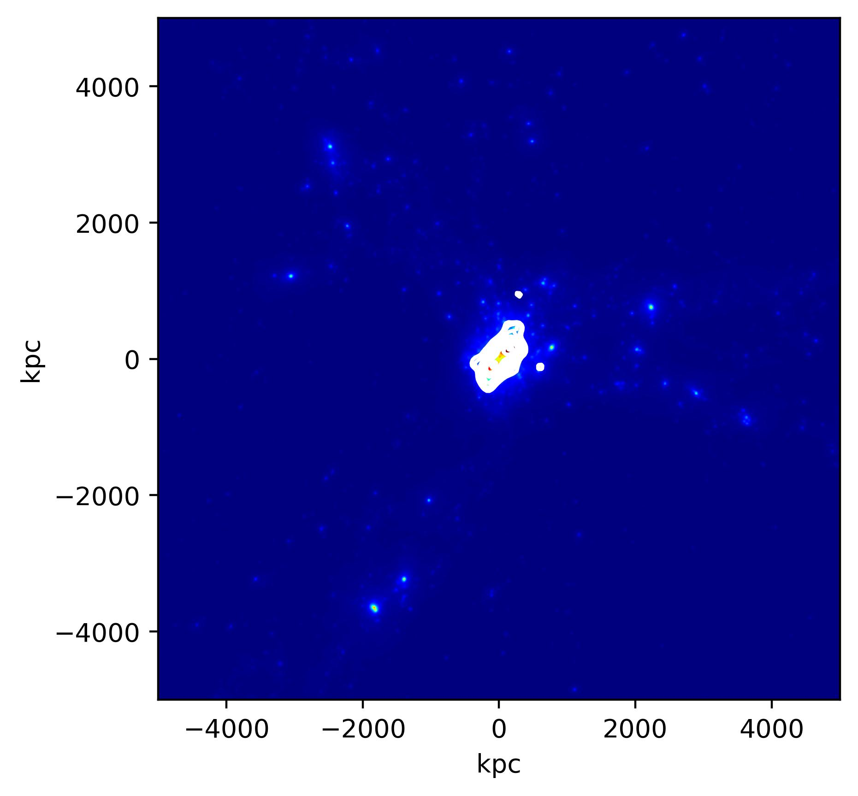
Weak Lensing Simulations
HST/ACS-like Weak Lensing
60 galaxies per arcmin^2
5 arcmin field of view

Slide 18
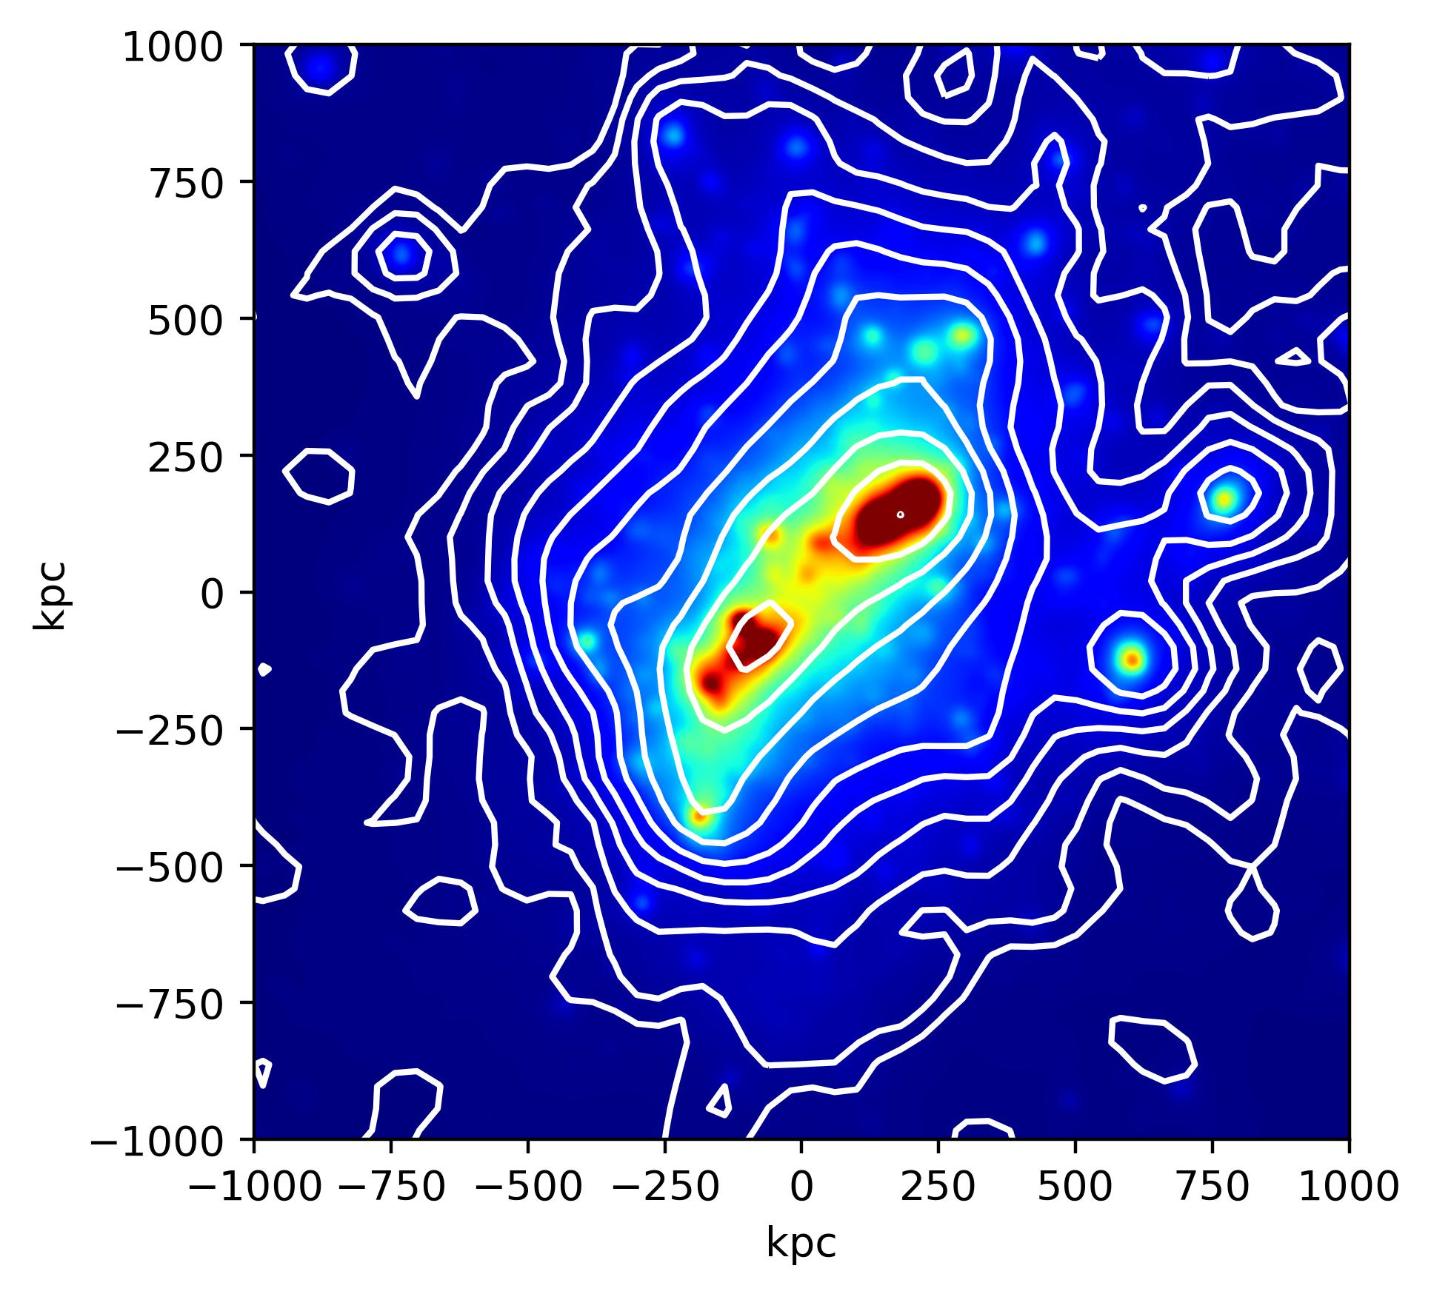
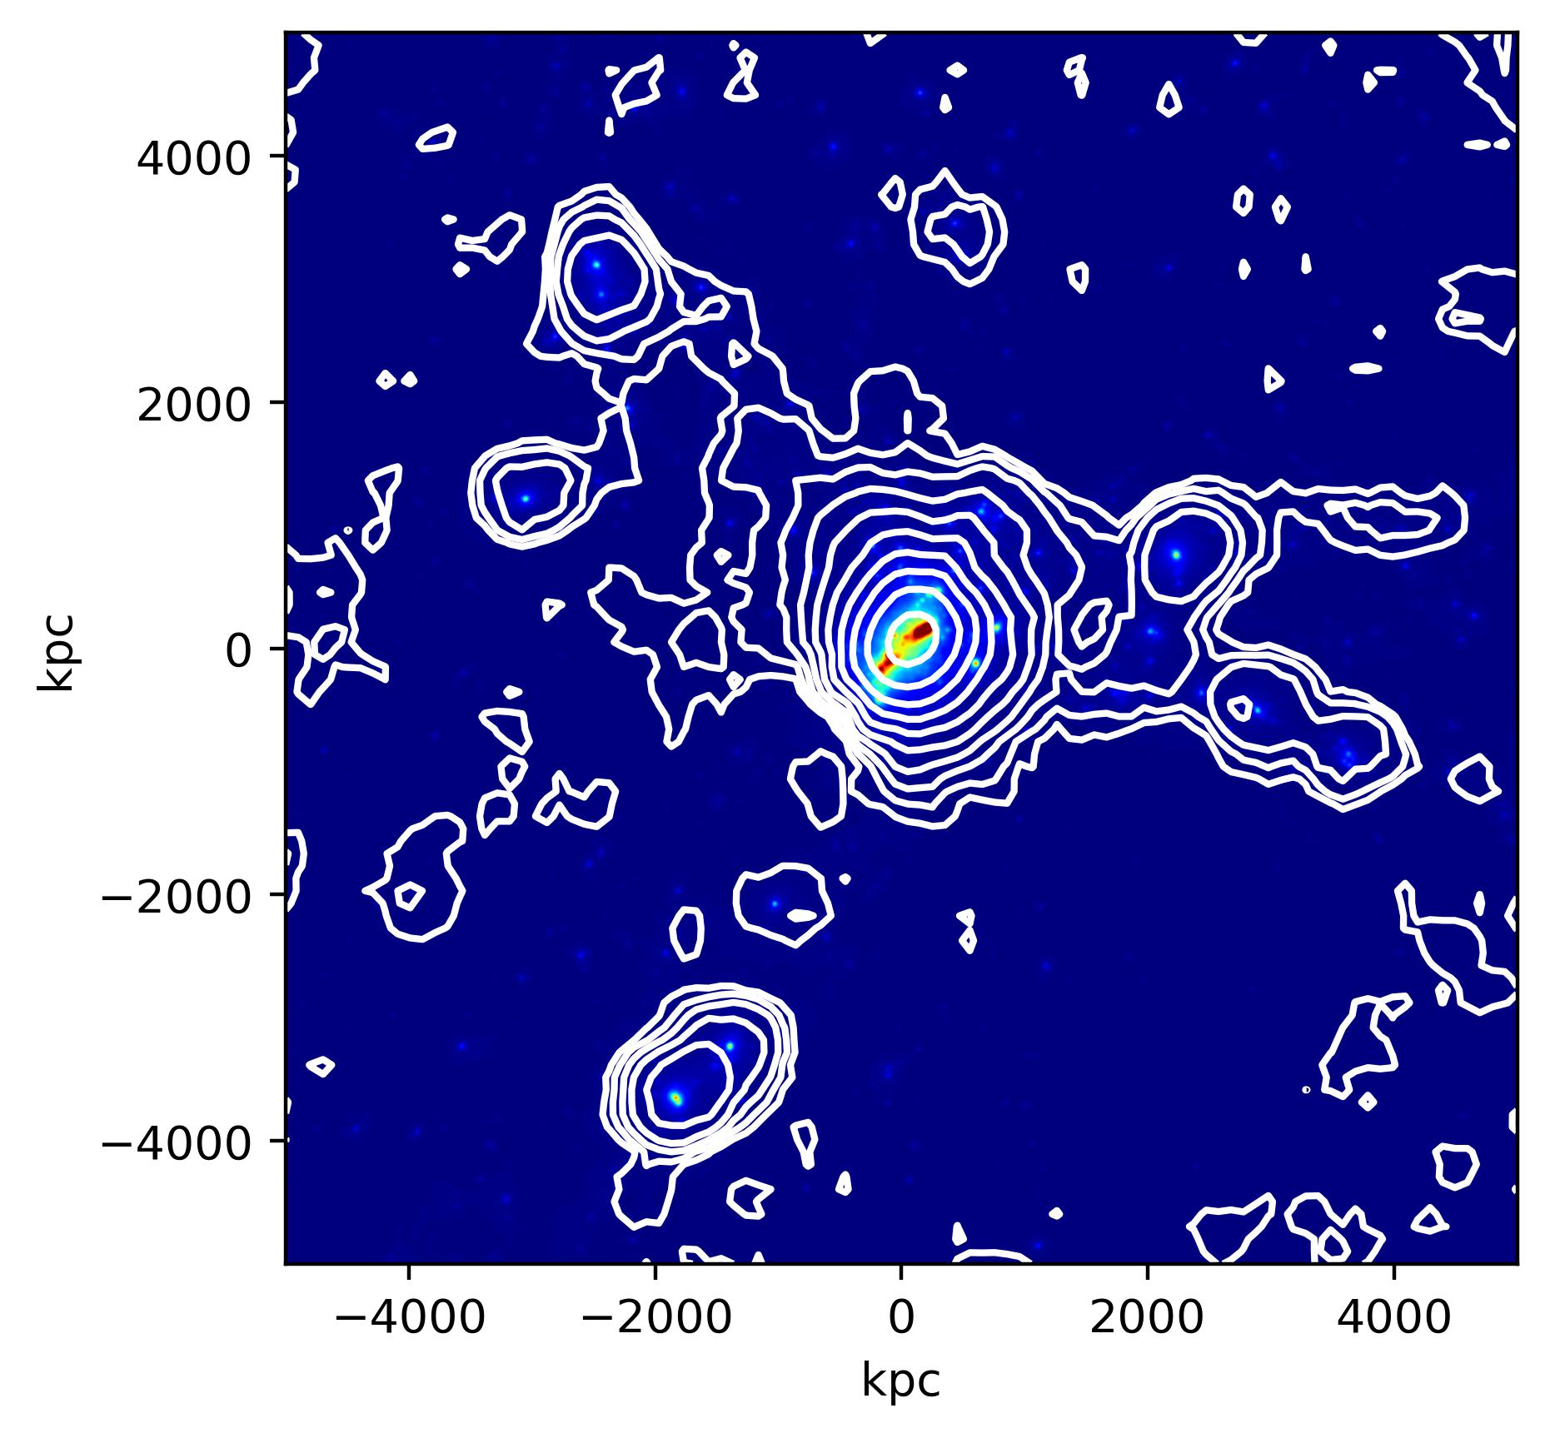
Weak Lensing Simulations
Roman-like Weak Lensing
150 galaxies per arcmin^2
40 arcmin field of view

Slide 19
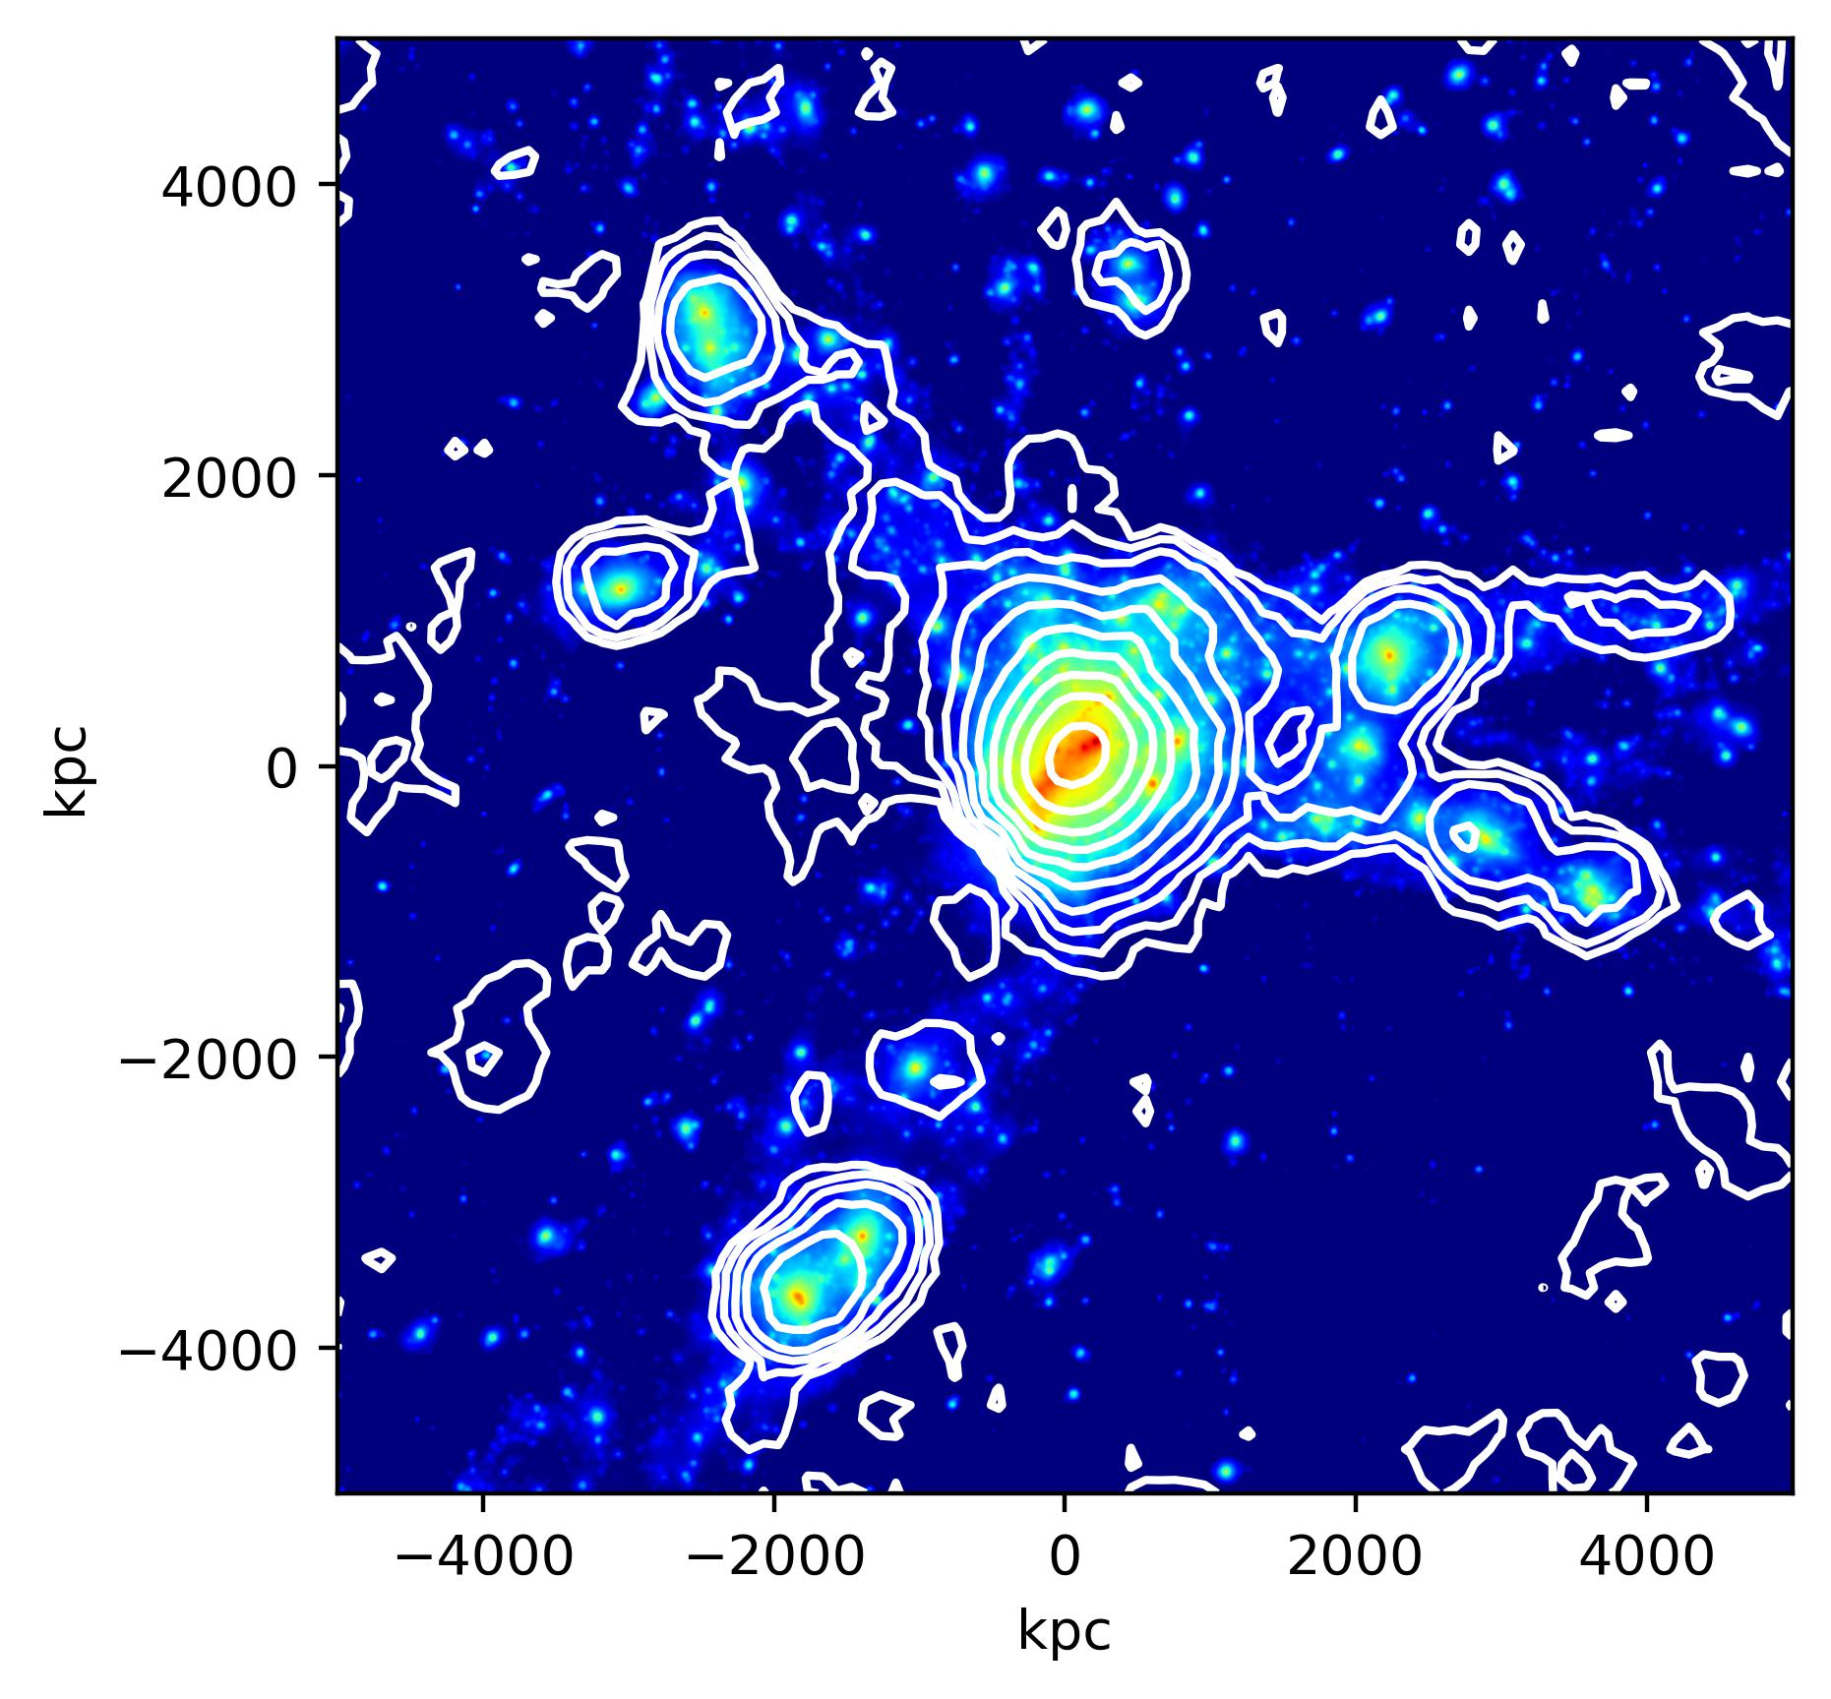
The Next Frontier for Weak Lensing: Filaments
With Roman, we will be able to detect and characterize the dark matter content of large-scale filaments.

Slide 20
Summary
The FOV, resolution, and filters of Roman are of great advantage for studying galaxy clusters and the large-scale structure with weak lensing.
Improvements:
Pin-point accuracy for the location of DM centroid – investigating DM
Detection and identification of substructures
Robustly characterize the dark matter of clusters
Begin to truly map the large-scale dark matter filaments of the universe

Slide 21
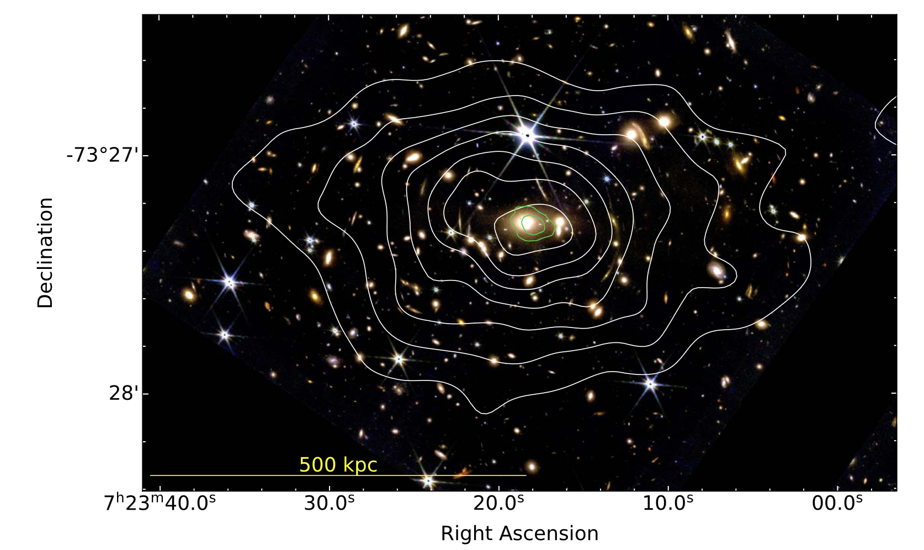
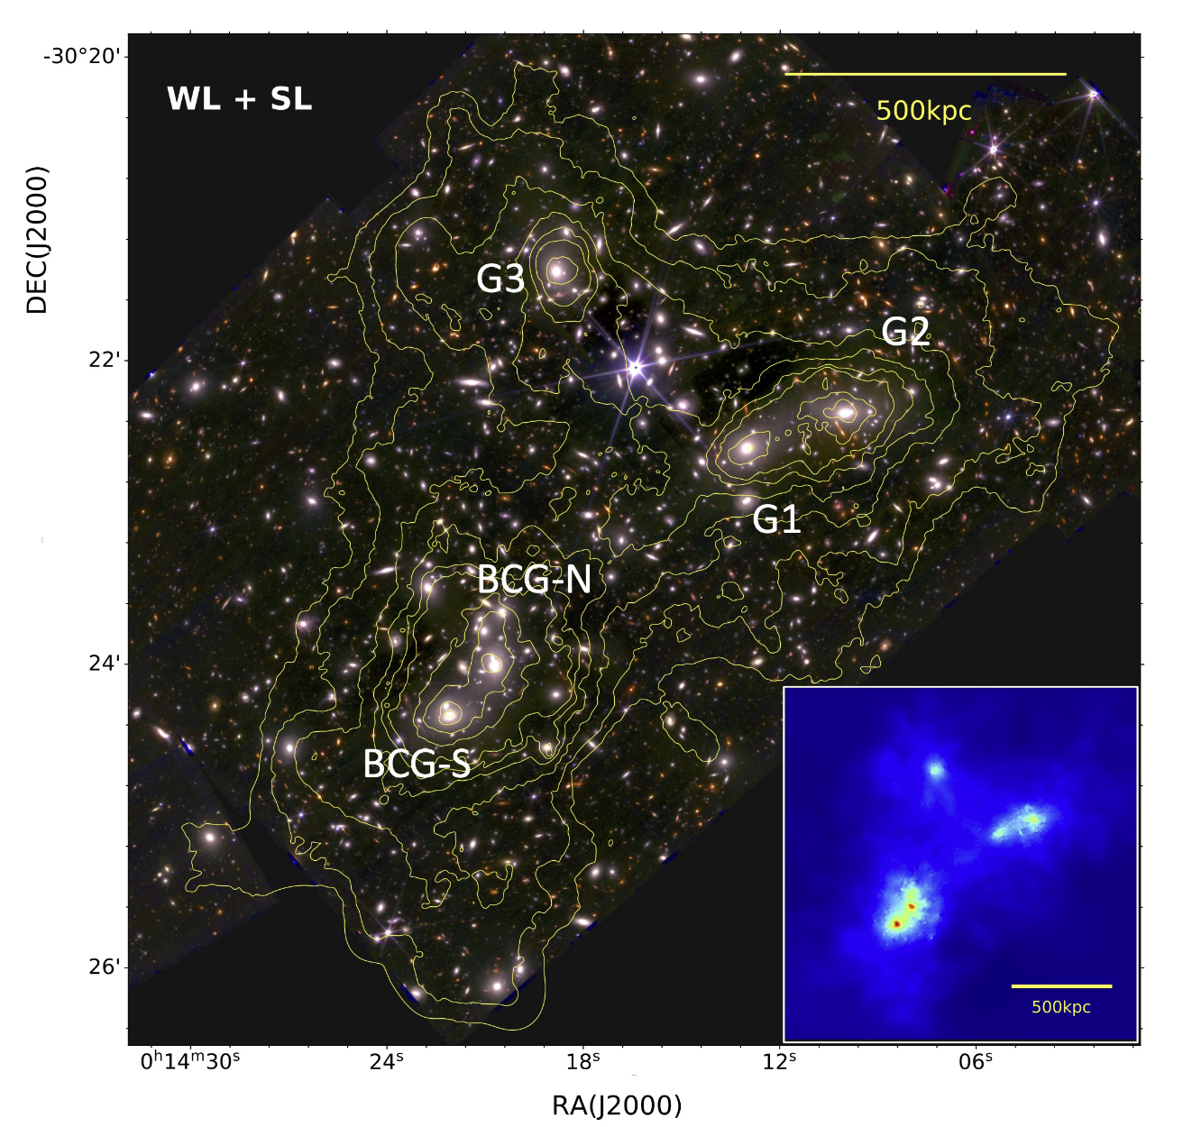
JWST
Two WL studies so far. Both show great promise.
~250 galaxies per arcmin^2
~350 galaxies per arcmin^2

