Slide 1
Toward the host star mass dependence of the planet frequency in Roman era
Kansuke Nunota (Osaka University)
Collaborators: Naoki Koshimoto, Daisuke Suzuki, Takahiro Sumi, David P. Bennett,
Aparna Bhattacharya, Yuki Hirao, Sean K. Terry, Aikaterini Vandorou

Slide 2
Introduction
- More than 5,000 planets have been discovered
Microlensing
Transit
  Kepler
Radial Velocity
Direct Imaging
- The dependence of planet frequency on the host star mass is crucial information for understanding the planet formation process

Slide 3
Introduction
- For inner planet, it has been well investigated
by RV
but
- It has not been well investigated for outer planets
because ground-based microlensing surveys cannot measure the host star mass in most cases
due to the degeneracy between mass and distance

Slide 4
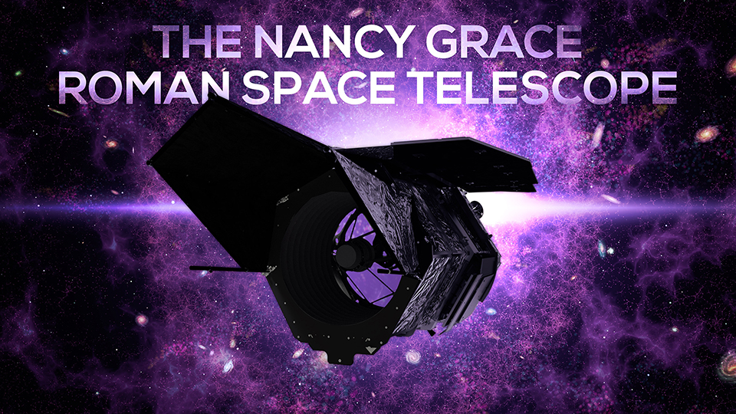
Introduction
- Roman is expected to
discover more than
1,000 planets
- degeneracy between mass and distance
can be solved by measuring
the microlensing parallax, lens flux, …
- It is difficult to avoid statistical bias when using
only samples with measurements
of mass and distance

Slide 5
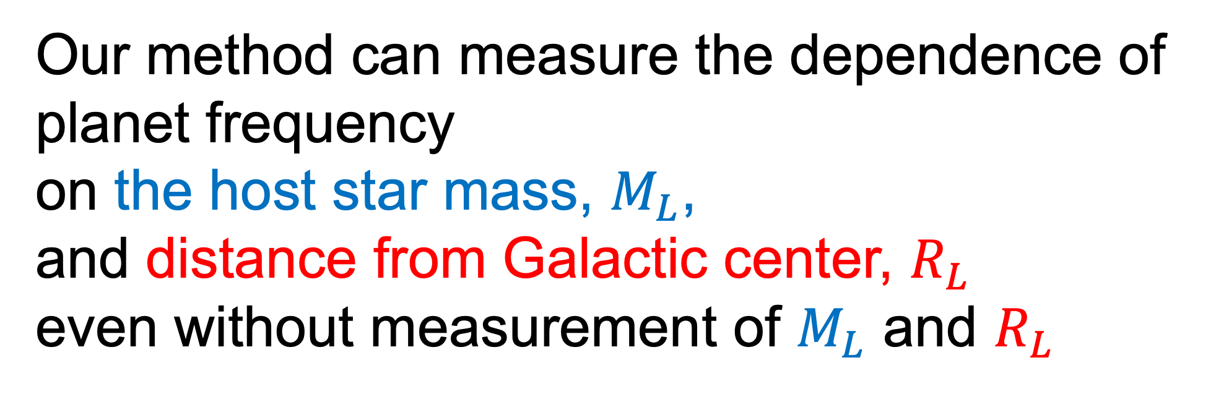

Introduction
Our method can measure the dependence of planet frequency
on the host star mass, $M_{L}$,
and distance from Galactic center, $R_{L}$
even without measurement of $M_{L}$ and $R_{L}$
$$P_{host}∝M_{L}^{m} × R_{L}^{r}$$

Slide 6
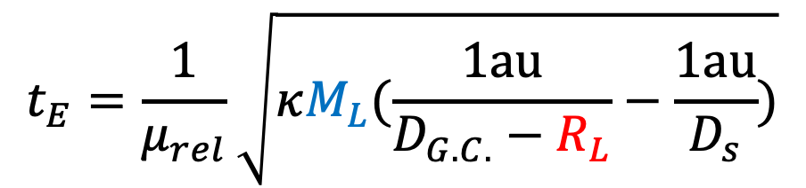


Method
Observables for planetary event (ground-based survey)
Event timescale
Lens-source relative proper motion
$$t_{E}=\frac{1}{μ_{rel}}\sqrt{κM_{L}(\frac{1au}{D_{G.C.}−R_{L}}−\frac{1au}{D_{s}})}$$
$$μ_{rel}$$
$$({D_{G.C} ,D}_{s}\sim 8kpc)$$
We focus on the $t_{E}$ and $μ_{rel}$ distribution

Slide 7
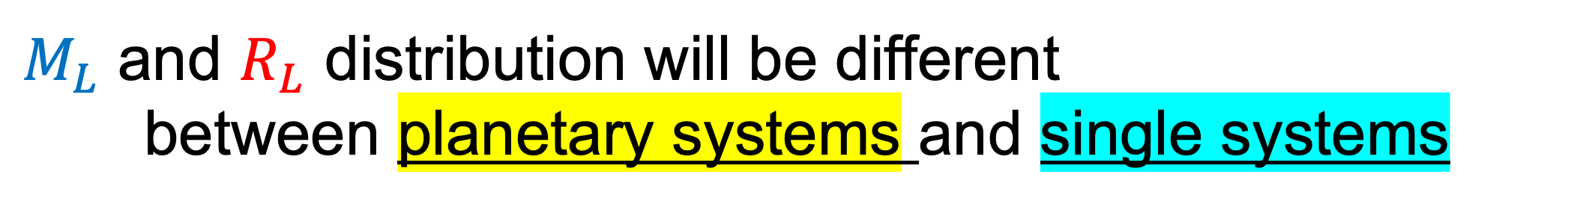
Method
If the planet frequency is dependent on $M_{L}$ and $R_{L}$
$M_{L}$ and $R_{L}$ distribution will be different
between planetary systems and single systems
$t_{E}$ and $μ_{rel}$ distribution should also be different

Slide 8
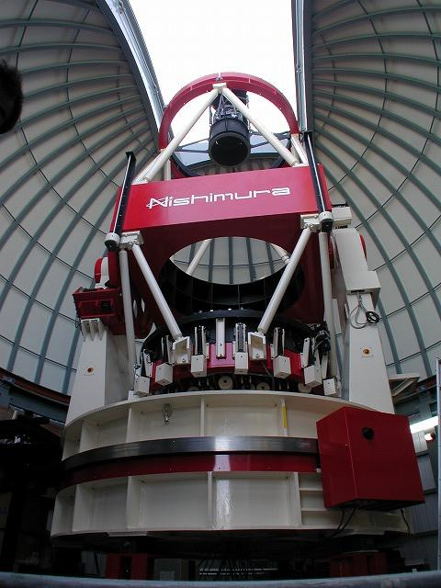
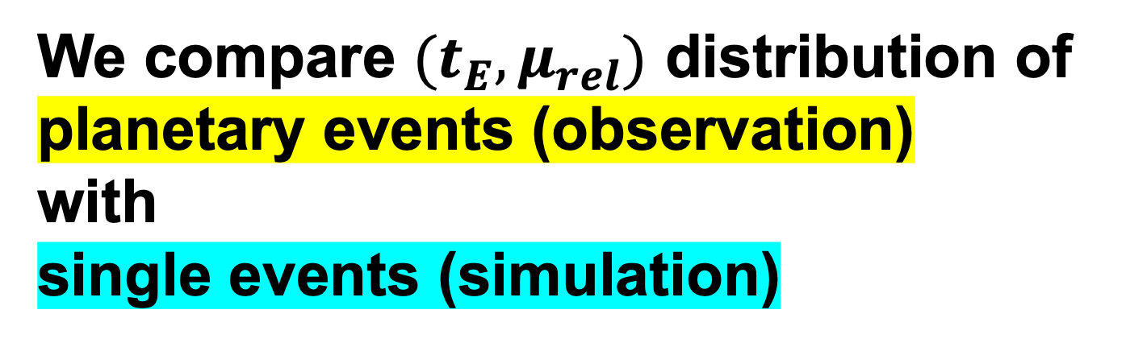
Application to samples from MOA-II
We compare ${(t}_{E},μ_{rel})$ distribution of planetary events (observation)
with
single events (simulation)
22 planets from MOA-II survey
Koshimoto Galactic model
(Koshimoto+21)

Slide 9
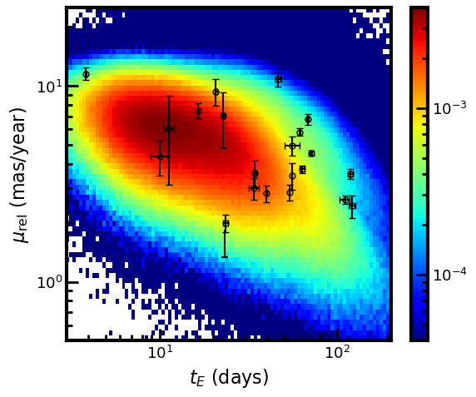
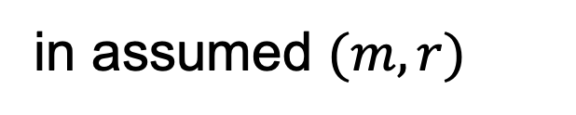

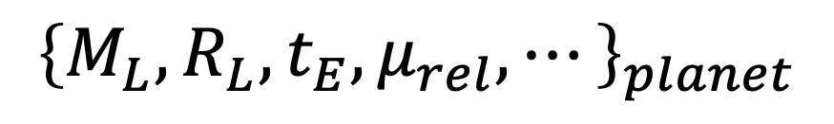

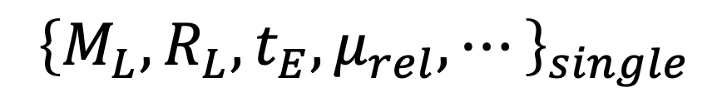
Observation vs Galactic model
$$m=0 , r=0$$
Galactic model
$${\left\{M_{L},R_{L},t_{E},μ_{rel},⋯\right\}}_{single}$$
weighted
sampling
$$P_{host}∝M_{L}^{m} × R_{L}^{r}$$
$${\left\{M_{L},R_{L},t_{E},μ_{rel},⋯\right\}}_{planet}$$
in assumed $(m,r)$

Slide 10
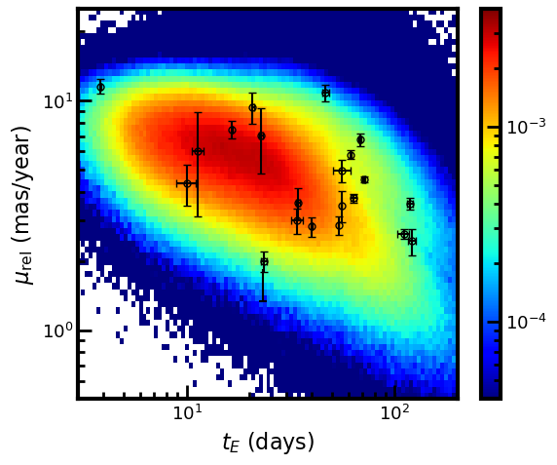

Observation vs Galactic model
$$m=0.4 , r=0.2$$
Galactic model
$${\left\{M_{L},R_{L},t_{E},μ_{rel},⋯\right\}}_{single}$$
weighted
sampling
$$P_{host}∝M_{L}^{m} × R_{L}^{r}$$
$${\left\{M_{L},R_{L},t_{E},μ_{rel},⋯\right\}}_{planet}$$
in assumed $(m,r)$

Slide 11
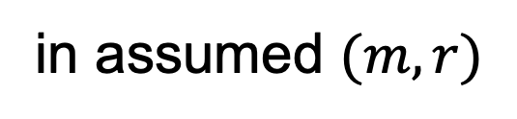
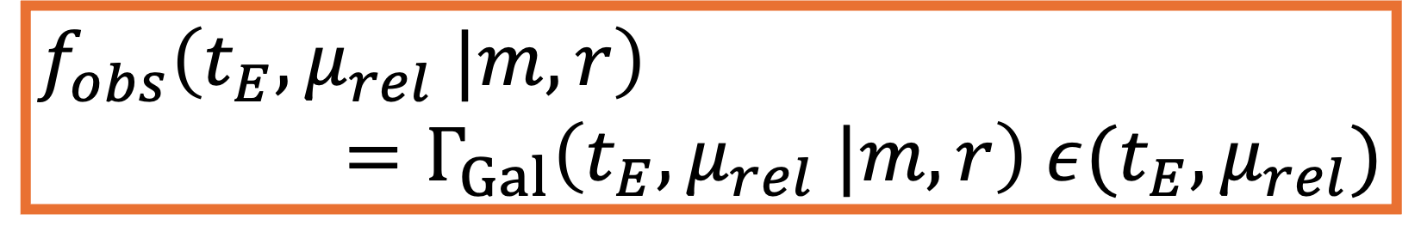
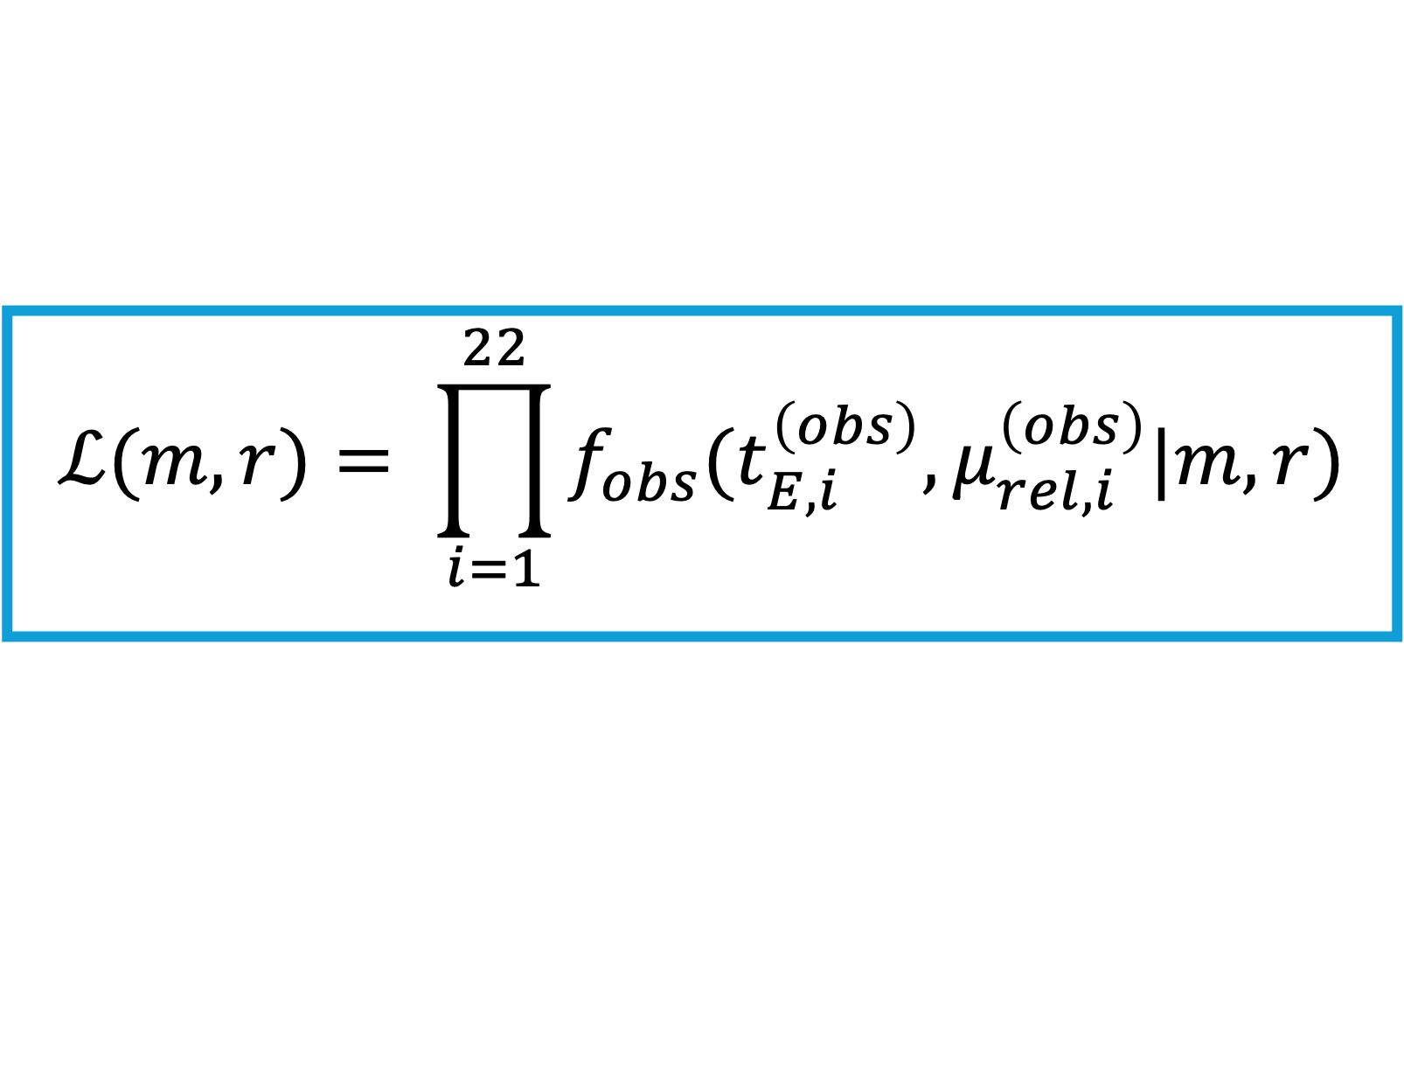
Observation vs Galactic model
$$m=0.4 , r=0.2$$
Galactic model
$$f_{obs}\left(t_{E},μ_{rel} |m,r\right)$$
$$=Γ_{Gal}\left(t_{E},μ_{rel} |m,r\right) ε(t_{E},μ_{rel})$$
$${\left\{M_{L},R_{L},t_{E},μ_{rel},⋯\right\}}_{single}$$
weighted
sampling
$$P_{host}∝M_{L}^{m} × R_{L}^{r}$$
$$ℒ(m,r)= \prod_{i=1}^{22}{f_{obs}(t_{E,i}^{\left(obs\right)},μ_{rel,i}^{\left(obs\right)}|m,r)}$$
$${\left\{M_{L},R_{L},t_{E},μ_{rel},⋯\right\}}_{planet}$$
in assumed $(m,r)$

Slide 12
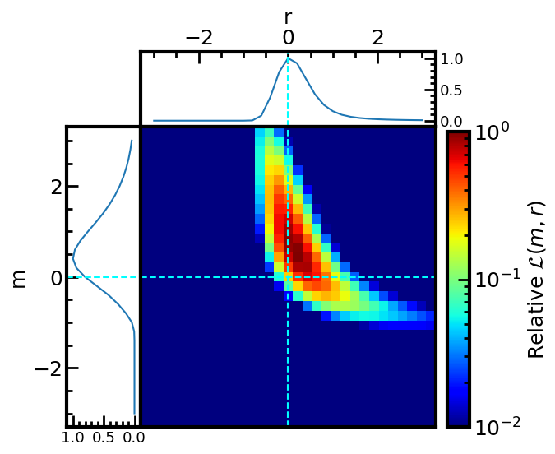
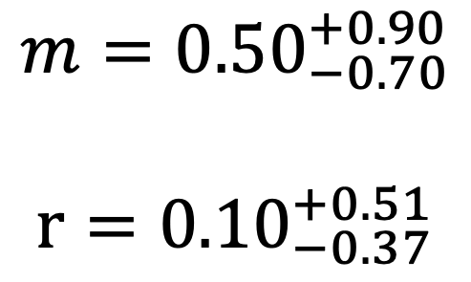
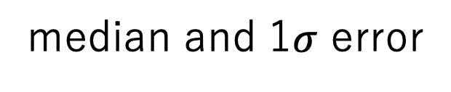
Result
median and 1$σ$ error
$$m={0.50}_{−0.70}^{+0.90}$$
$$r={0.10}_{−0.37}^{+0.51}$$

Slide 13
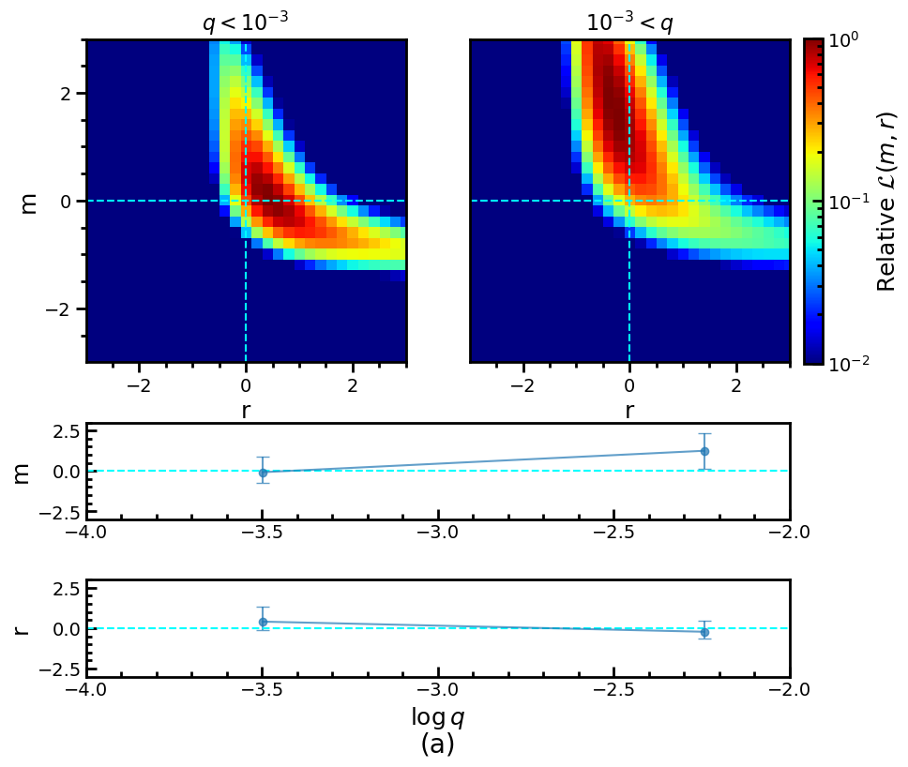
Relationship with mass ratio
Sub-samples are divided
by there mass ratio
- massive planets would be more
likely to exist around more
massive stars
- lower-mass planets
commonly would exist
regardless of the host star mass

Slide 14
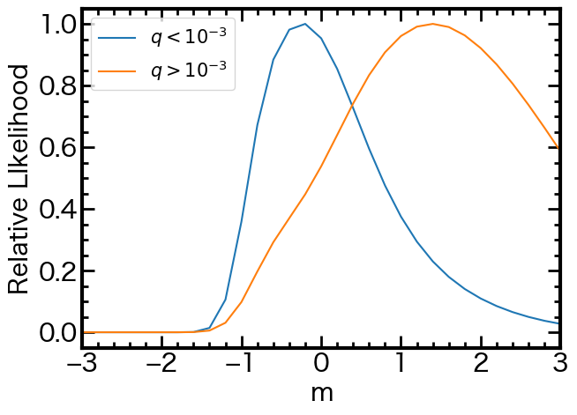
Relationship with mass ratio
Sub-samples are divided
by there mass ratio
- massive planets would be more
likely to exist around more
massive stars
- lower-mass planets
commonly would exist
regardless of the host star mass

Slide 15
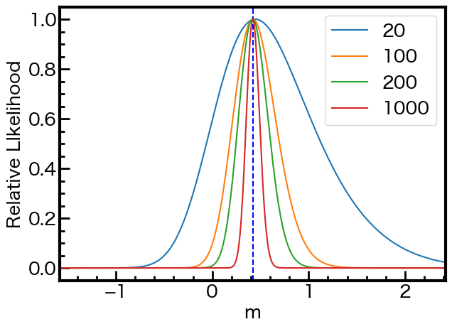
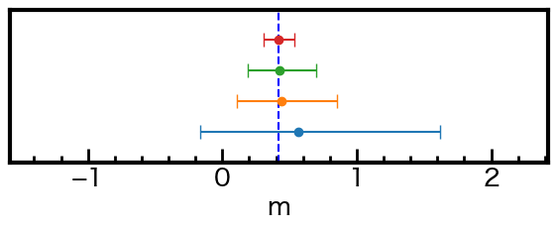
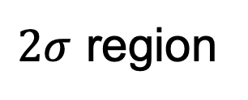

Additional constraint by Roman
$$m=0.4 r=0.2$$
- Roman is expected to
discover more than
1,000 planets
- We performed mock data analysis at various numbers of planets.
$2σ$ region

Slide 16
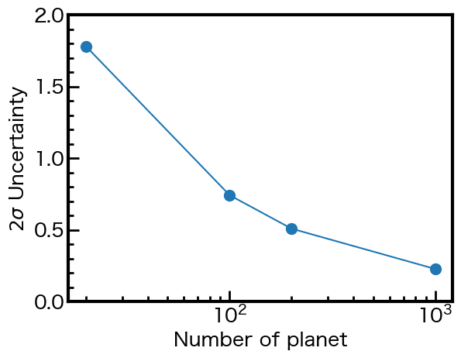
Additional constraint by Roman
- Uncertainty
will be reduced to
~30% using 200 samples
- Lens flux and parallax can make this constraint much stronger

Slide 17
Additional constraint by Roman
We can settle on whether this result is correct or not
by using samples from Roman
?

Slide 18
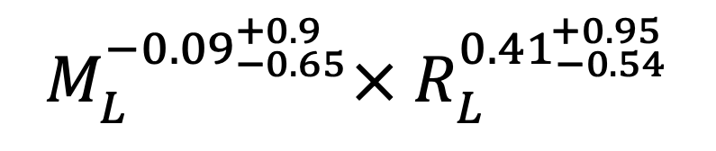
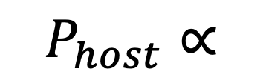
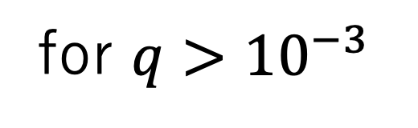
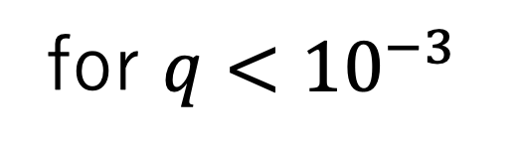
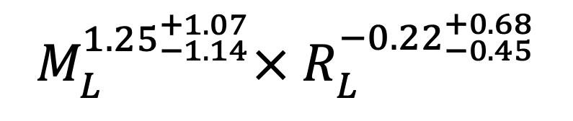
Summary
Ground-based microlensing surveys suggest that
massive planets are more likely to exist around massive stars,
lower-mass planets exist regardless of the host star mass
$$P_{host}∝$$
$$M_{L}^{{−0.09}_{−0.65}^{+0.9}}× R_{L}^{{0.41}_{−0.54}^{+0.95}}$$
for $q<{10}^{−3}$
$$M_{L}^{{1.25}_{−1.14}^{+1.07}}× R_{L}^{{−0.22}_{−0.45}^{+0.68}}$$
for $q>{10}^{−3}$
Roman can settle on whether this result is correct or not

