Slide 1
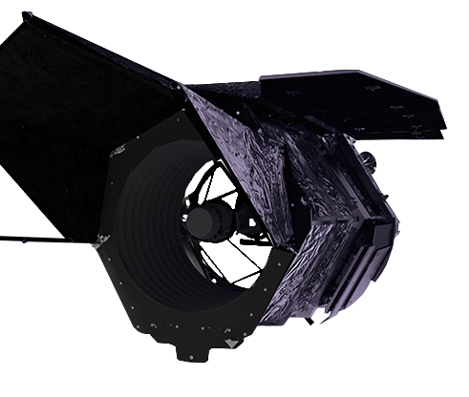
Transits in the Roman galactic EXoplanet Survey (TRExS):
Smashing Formation & Evolution Theories with the Demographics
Hammer
Robby Wilson
NASA GSFC
And the TRExS Team: N. Espinoza, K. Hoffman, E. Kerins, J. Martinez-Palomera, B. Montet, S. Mullally, M. Newman, M. Penny, E. Quintana, T. Barclay, K. Carden, Y. Chai, J. Christiansen, D. Ciardi, S. Gaudi, C. Hedges, M. Huston, V. Kostov, D. Louie, I. McDonald, B. Powell, A. Priyadarshi, J. Rowe, J. Schlieder, A. Youngblood, R. Zellem

Slide 2
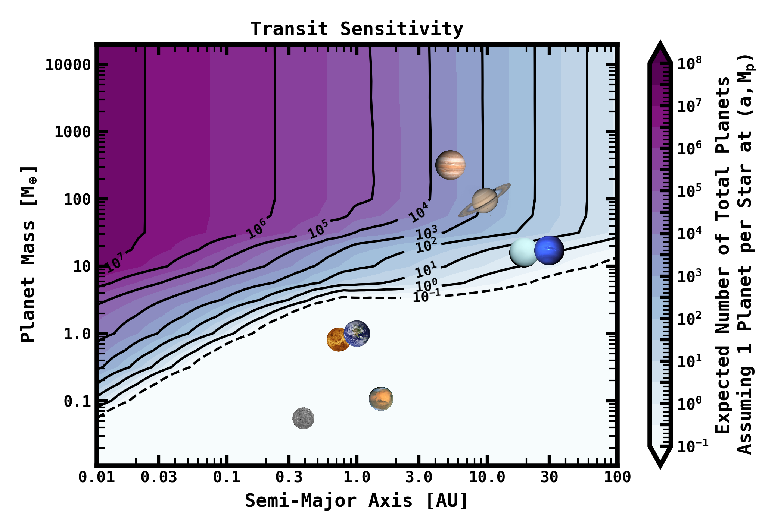
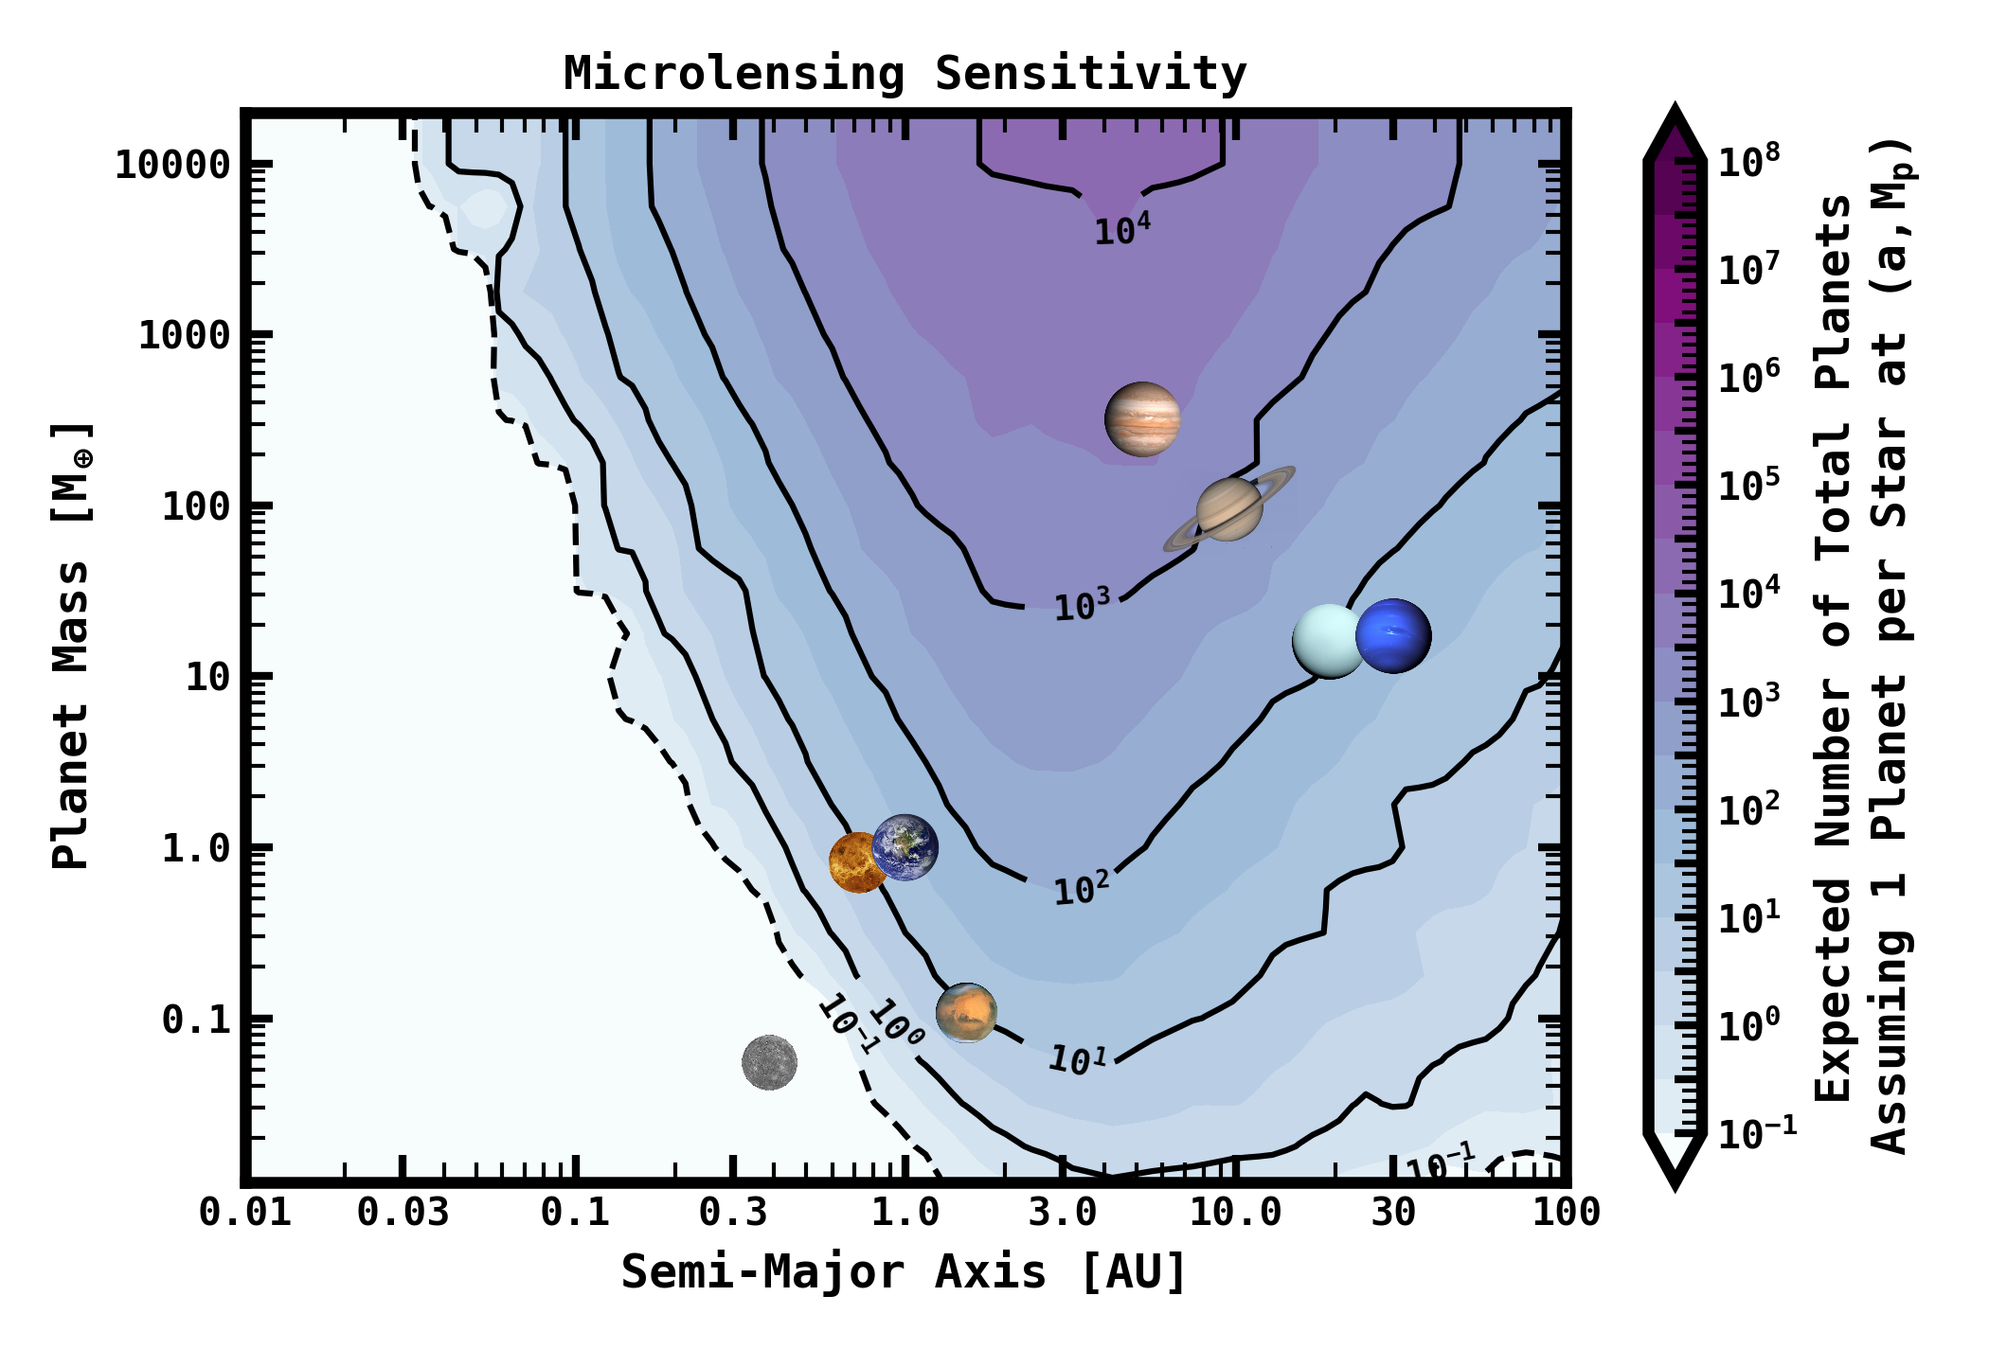
TRExS: Transits in the Roman galactic EXoplanet Survey
[INSERT MICROLENSING AND TRANSIT SENSITIVITY CURVES]
Wilson+2023
Sensitivity
Penny+2019
Sensitivity

Slide 3
TRExS: Transits in the Roman galactic EXoplanet Survey
Yield = (~1 planets/star) x (~10⁸ stars) x (~1/ 10³ detected) = ~10⁵
Yield: ~60,000 – 200,000 (F146<21 mag)
~90-95% sub-Saturns and Jupiters
  (~40-100x more than are known)
~7000-12,000 Small Planets (< Neptune)
  (~2-4x more)
~350-2600 Giants with M dwarf Hosts
  (~100x more)
~40-120 Habitable Zone Super-Earths
~2000 Exoplanets with a> 1 AU

Slide 4
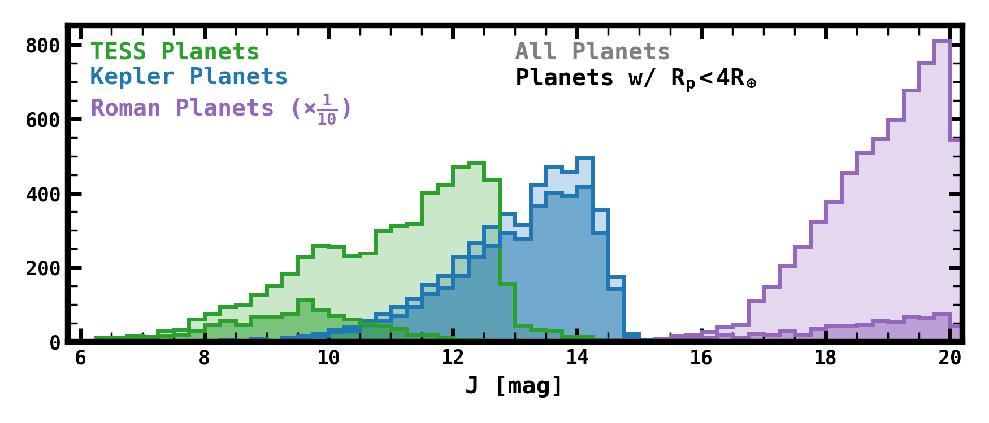
TRExS: Transits in the Roman galactic EXoplanet Survey

Slide 5
TRExS Science Drivers

Slide 6
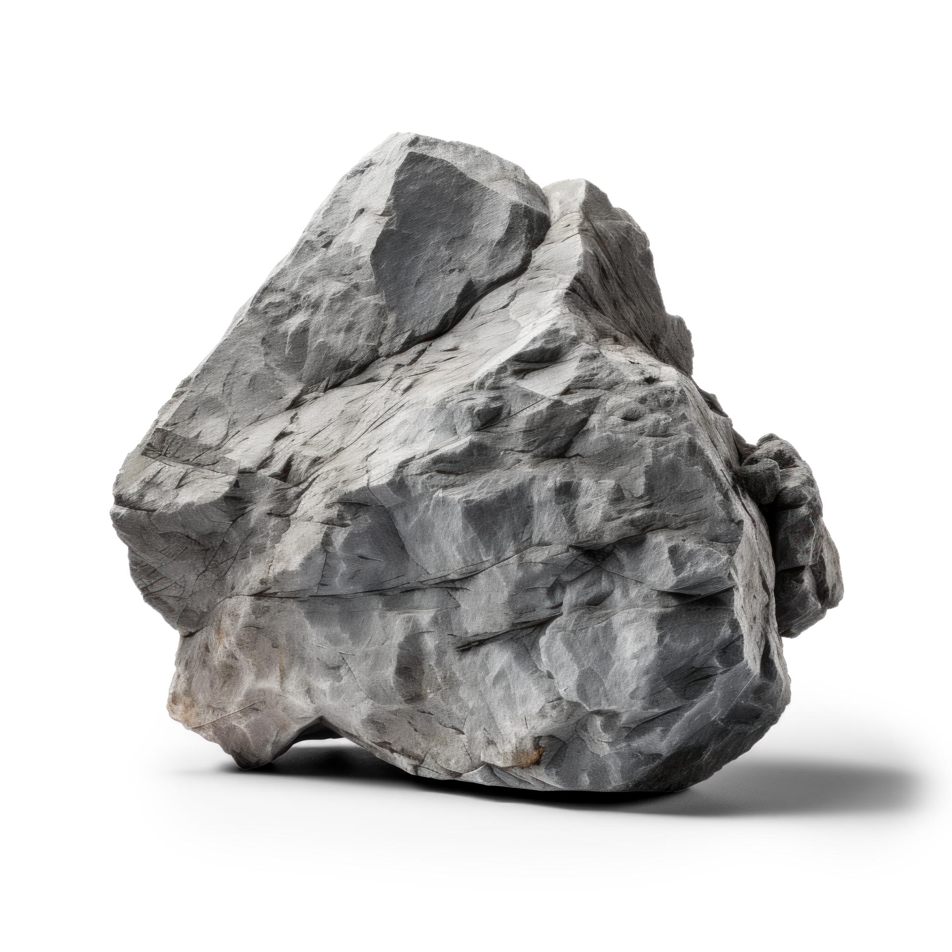

  “When nothing seems to help, I go and look at a stonecutter hammering away at his rock perhaps a hundred times without as much as a crack showing in it. Yet at the hundred and first blow it will split in two, and I know that it was not that blow that did it, but all that had gone before.”
  -Jacob Riis

Slide 7
  “When nothing seems to help, I go and look at a stonecutter hammering away at his rock perhaps a hundred times without as much as a crack showing in it. Yet at the hundred and first blow it will split in two, and I know that it was not that blow that did it, but all that had gone before.”
  -Jacob Riis
  “If you have 101 hammers, maybe you
  only need to swing once.”
  -Roman Scientists, probably

Slide 8

Giant Planets
Hosted by M dwarfs:
Core Accretion or GI?

Slide 9
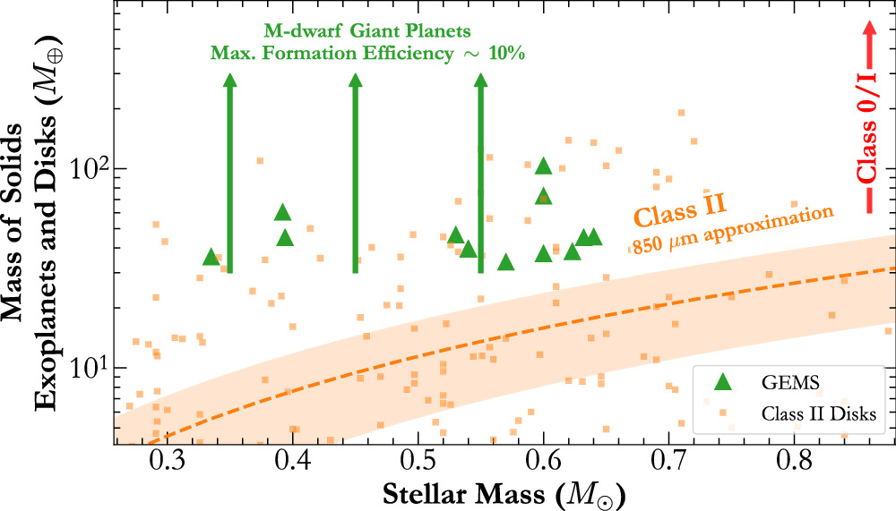
M Stars with Giant Planets: Core Accretion or Gravitational Instability?
M dwarf Disks don’t have enough dust to form giant planets
~30 M-star giant planets known
Roman Yield: ~300-2600
From Kanodia+2024
Estimated Heavy-
Element Mass in
Giant Planets

Slide 10
M Stars with Giant Planets: Core Accretion or Gravitational Instability?

Slide 11
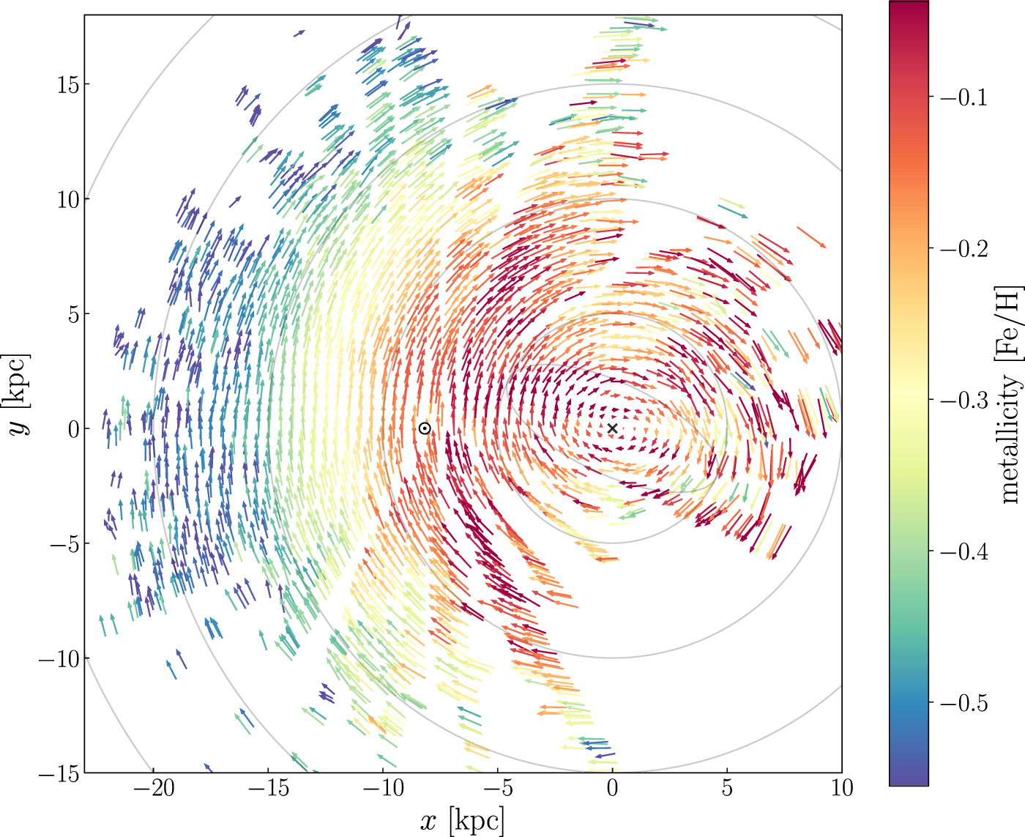
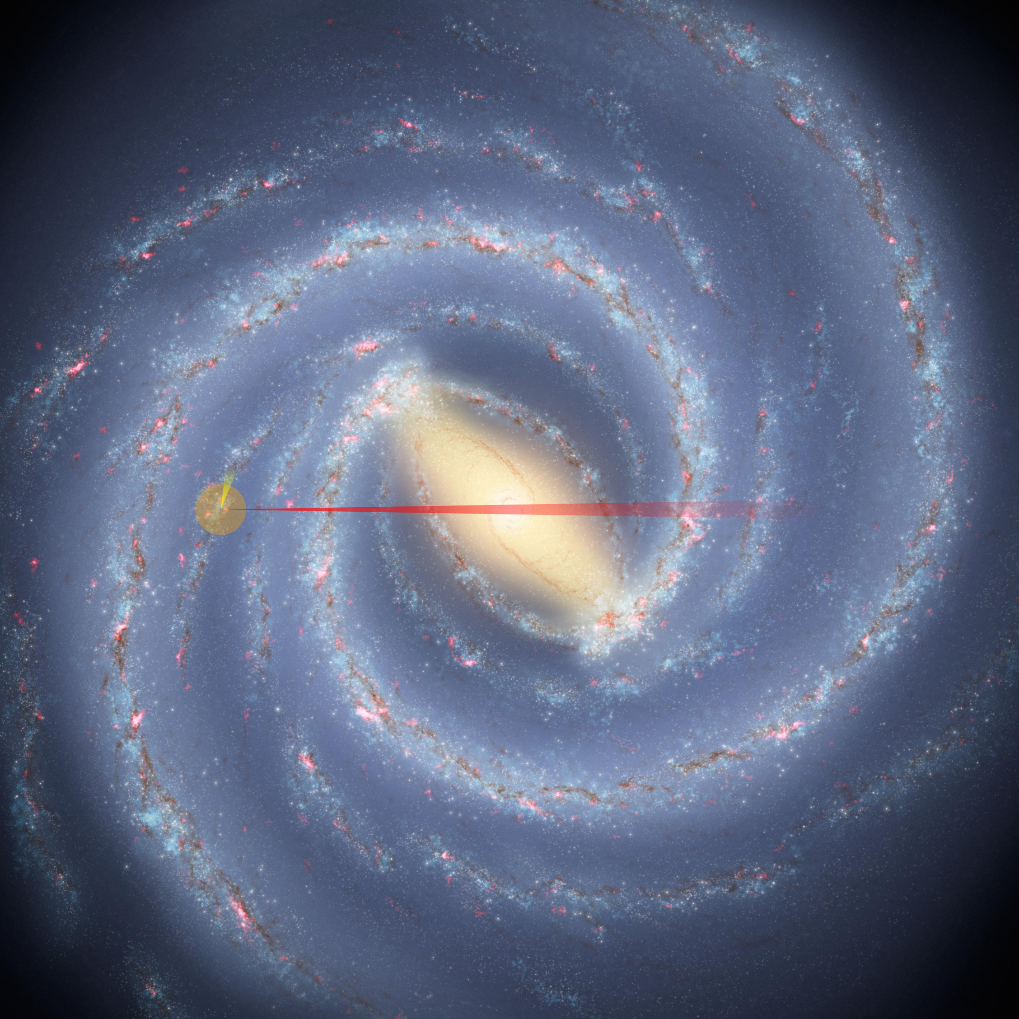
M Stars with Giant Planets: Core Accretion or Gravitational Instability?
Kepler
TESS
Roman
Eilers+2022

Slide 14
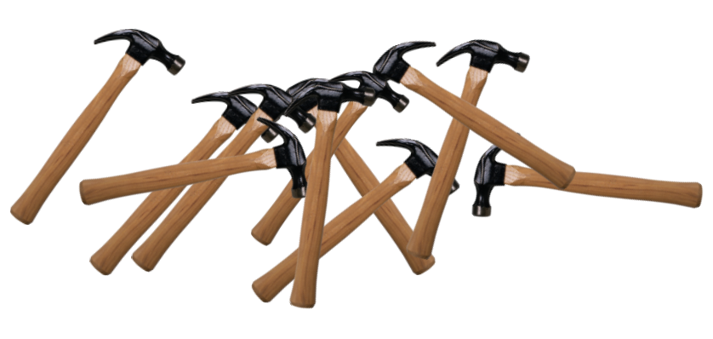
Giant Planets
Hosted by M dwarfs:
Core Accretion or GI?

Slide 15
Giant Planets
Hosted by M dwarfs:
Core Accretion or GI?
Tidal Migration and
Stellar Evolution-
Driven Engulfment

Slide 16
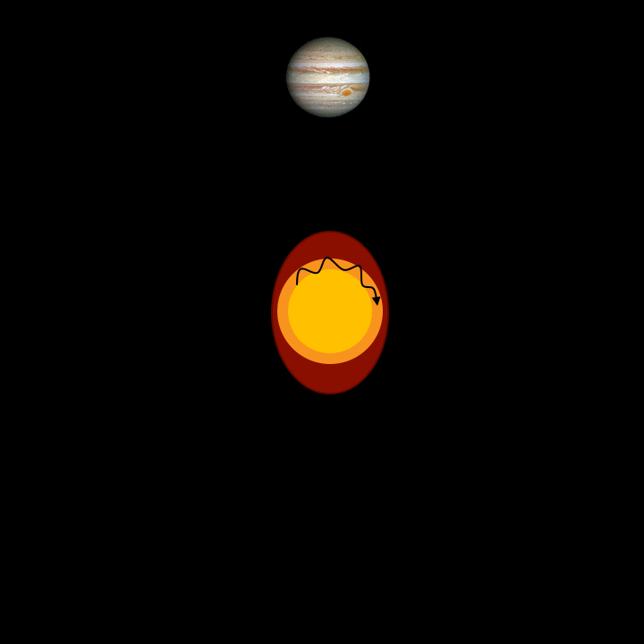
Tidal Migration and Stellar Evolution-Driven Engulfment
Orbiting planets generate seismic waves in the star via tidal forces
As the host star evolves, these waves are no longer able to propagate freely and crash into the star’s core
Weinberg+2017, Sun+2019

Slide 17
Tidal Migration and Stellar Evolution-Driven Engulfment
Orbiting planets generate seismic waves in the star via tidal forces
As the host star evolves, these waves are no longer able to propagate freely and crash into the star’s core
Crashed wave is converted to heat, and new waves are continuously generated, robbing the planet of its orbital energy
Weinberg+2017, Sun+2019

Slide 18
Tidal Migration and Stellar Evolution-Driven Engulfment
Simulated red giant oscillations
Estimated Yield of 2100 +/- 300 giant planets with giant hosts
  Strong function of minimum orbital distance, yield can be as high as ~3500 +/- 500
Comparing to the ~40k-80k giant planets with main sequence host stars should constrain when planet engulfment occurs

Slide 19
Tidal Migration and Stellar Evolution-Driven Engulfment
Simulated red giant oscillations
Estimated Yield of 2100 +/- 300 giant planets with giant hosts
  Strong function of minimum orbital distance, yield can be as high as ~3500 +/- 500
Comparing to the ~40k-80k giant planets with main sequence host stars should constrain when planet engulfment occurs
RGB Planet host Properties

Slide 20
Giant Planets
Hosted by M dwarfs:
Core Accretion or GI?
Tidal Migration and
Stellar Evolution-
Driven Engulfment

Slide 21
Hot Jupiter Global Climate Models
Giant Planets
Hosted by M dwarfs:
Core Accretion or GI?
Tidal Migration and
Stellar Evolution-
Driven Engulfment

Slide 22
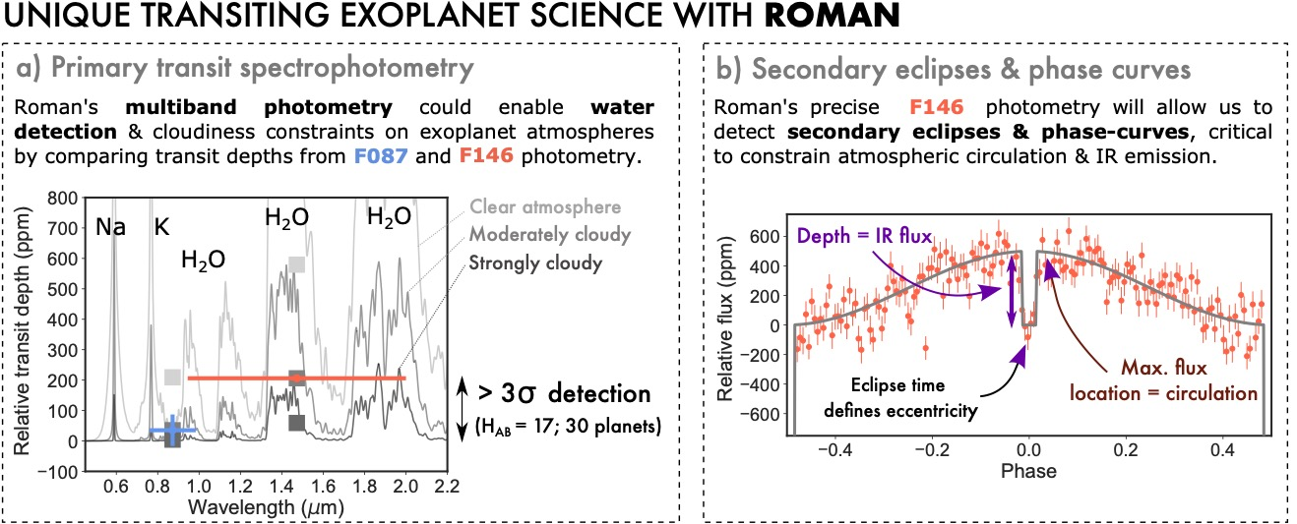
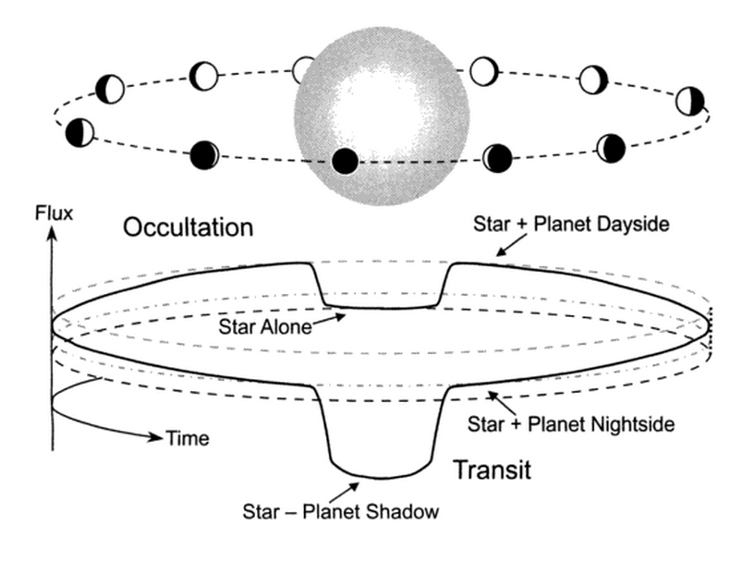
Testing Heat Circulation Models via Emission Spectrophotometry
Secondary Eclipses give Brightness Temperature of Planet
Trends w/ Equilibrium Temp reveal more detailed physics

Slide 23
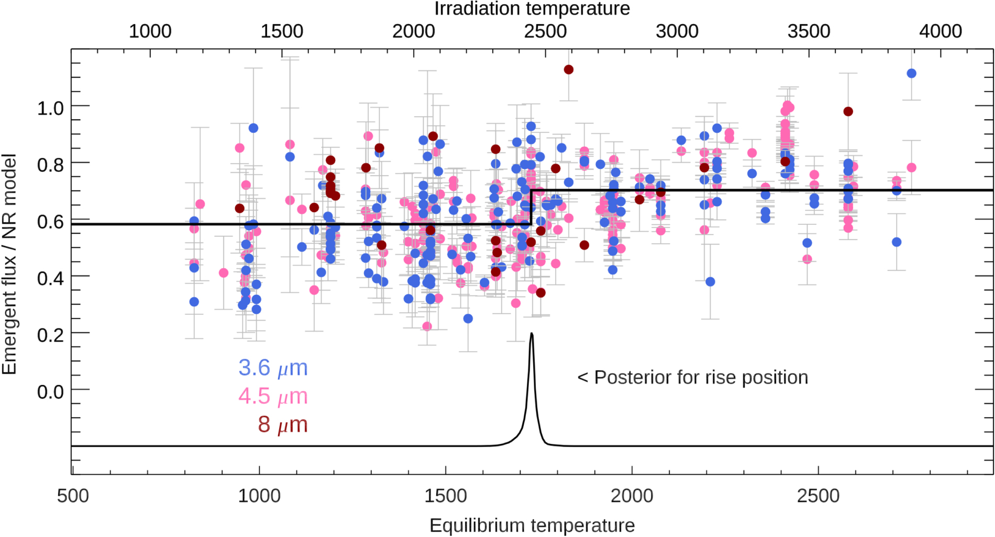
Testing Heat Circulation Models via Emission Spectrophotometry
Trends w/ Equilibrium Temp reveal more detailed physics
Abrupt change at Teq~1750 K: caused by
  Onset Magnetic Drag
  Cloud dissipation
Nspitzer ~ 120
Deming+2023

Slide 24
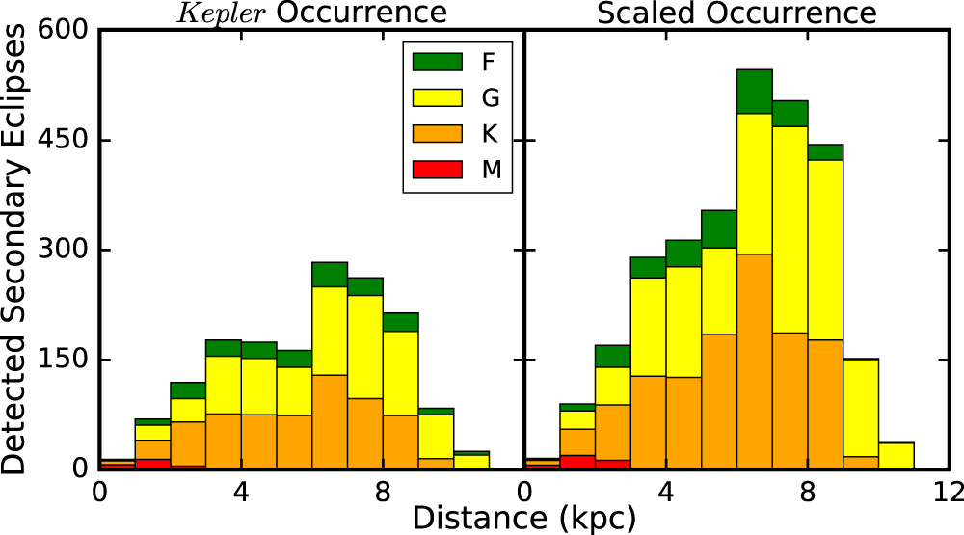
Testing Heat Circulation Models via Emission Spectrophotometry
Trends w/ Equilibrium Temp reveal more detailed physics
Abrupt change at Teq~1750 K: caused by
  Onset Magnetic Drag
  Cloud dissipation
Nspitzer ~ 120
Nroman ~ 3,000
Montet+2017

Slide 25
Testing Heat Circulation Models via Transmission Spectrophotometry
Multi-color observations in blue filter at a 6-12 hours cadence (still TBD)

Slide 26
Testing Heat Circulation Models via Transmission Spectrophotometry
Multi-color observations in blue filter at a 6-12 hours cadence (still TBD)
Averaging transit light curves of ~10s – 100s of systems should show atmospheric trends in the planet population

Slide 27
Hot Jupiter Global Climate Models
Giant Planets
Hosted by M dwarfs:
Core Accretion or GI?
Tidal Migration and
Stellar Evolution-
Driven Engulfment

Slide 28
TRExS Activities and Infrastructure Development

Slide 29
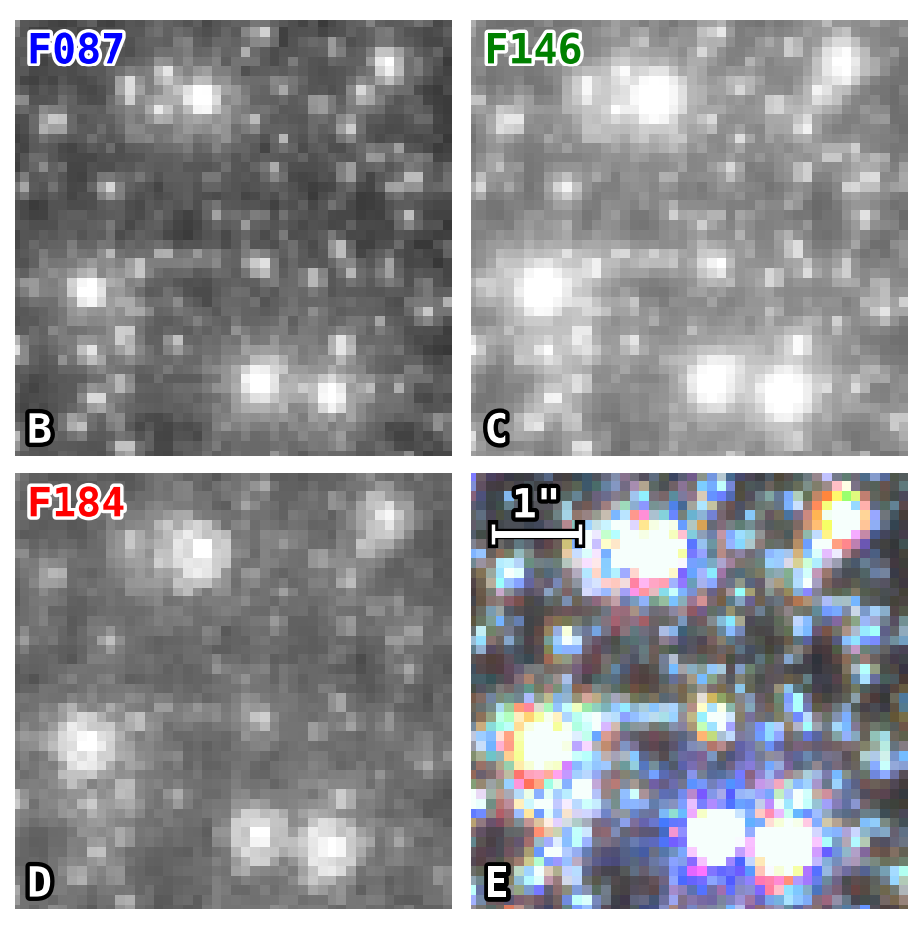
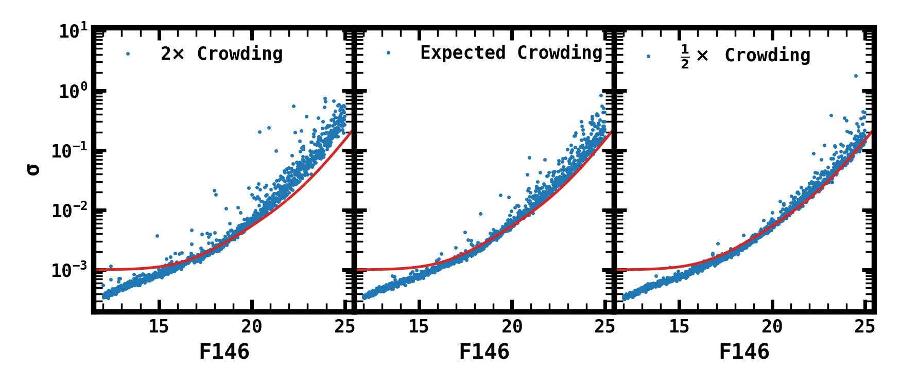
Pixel- & Light Curve-Level Simulations
Use of RImTimSim for Prototyping & Estimating Photometric Performance
Performance dominated by Extinction/Crowding
Future simulations will incorporate TVAC data

Slide 30
Pixel- & Light Curve-Level Simulations
Use of RImTimSim for Prototyping & Estimating Photometric Performance
Performance dominated by Extinction/Crowding
Future simulations will incorporate TVAC data
Discrepancy dependent on detector effects for saturated stars (e.g., persistence, CRNLs, BFE)
Assumes we can reach photon limit for semi-saturated pixels in wings of PSF
Assumes a single-exposure noise floor of 0.1%

Slide 31

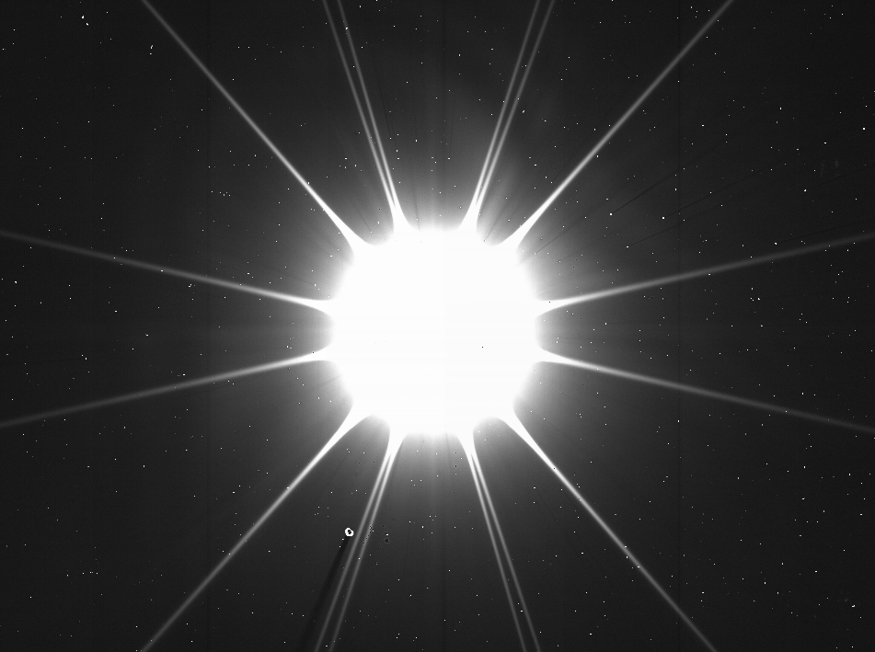


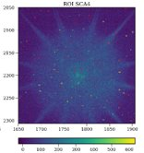
Pixel- & Light Curve-Level Simulations
Use of RImTimSim for Prototyping & Estimating Photometric Performance
Performance dominated by Extinction/Crowding
Future simulations will incorporate TVAC data
Discrepancy dependent on detector effects for saturated stars (e.g., persistence, CRNLs, BFE)
Assumes we can reach photon limit for semi-saturated pixels in wings of PSF
Assumes a single-exposure noise floor of 0.1%
Analysis under way to incorporate saturated star data into simulations!

Slide 32
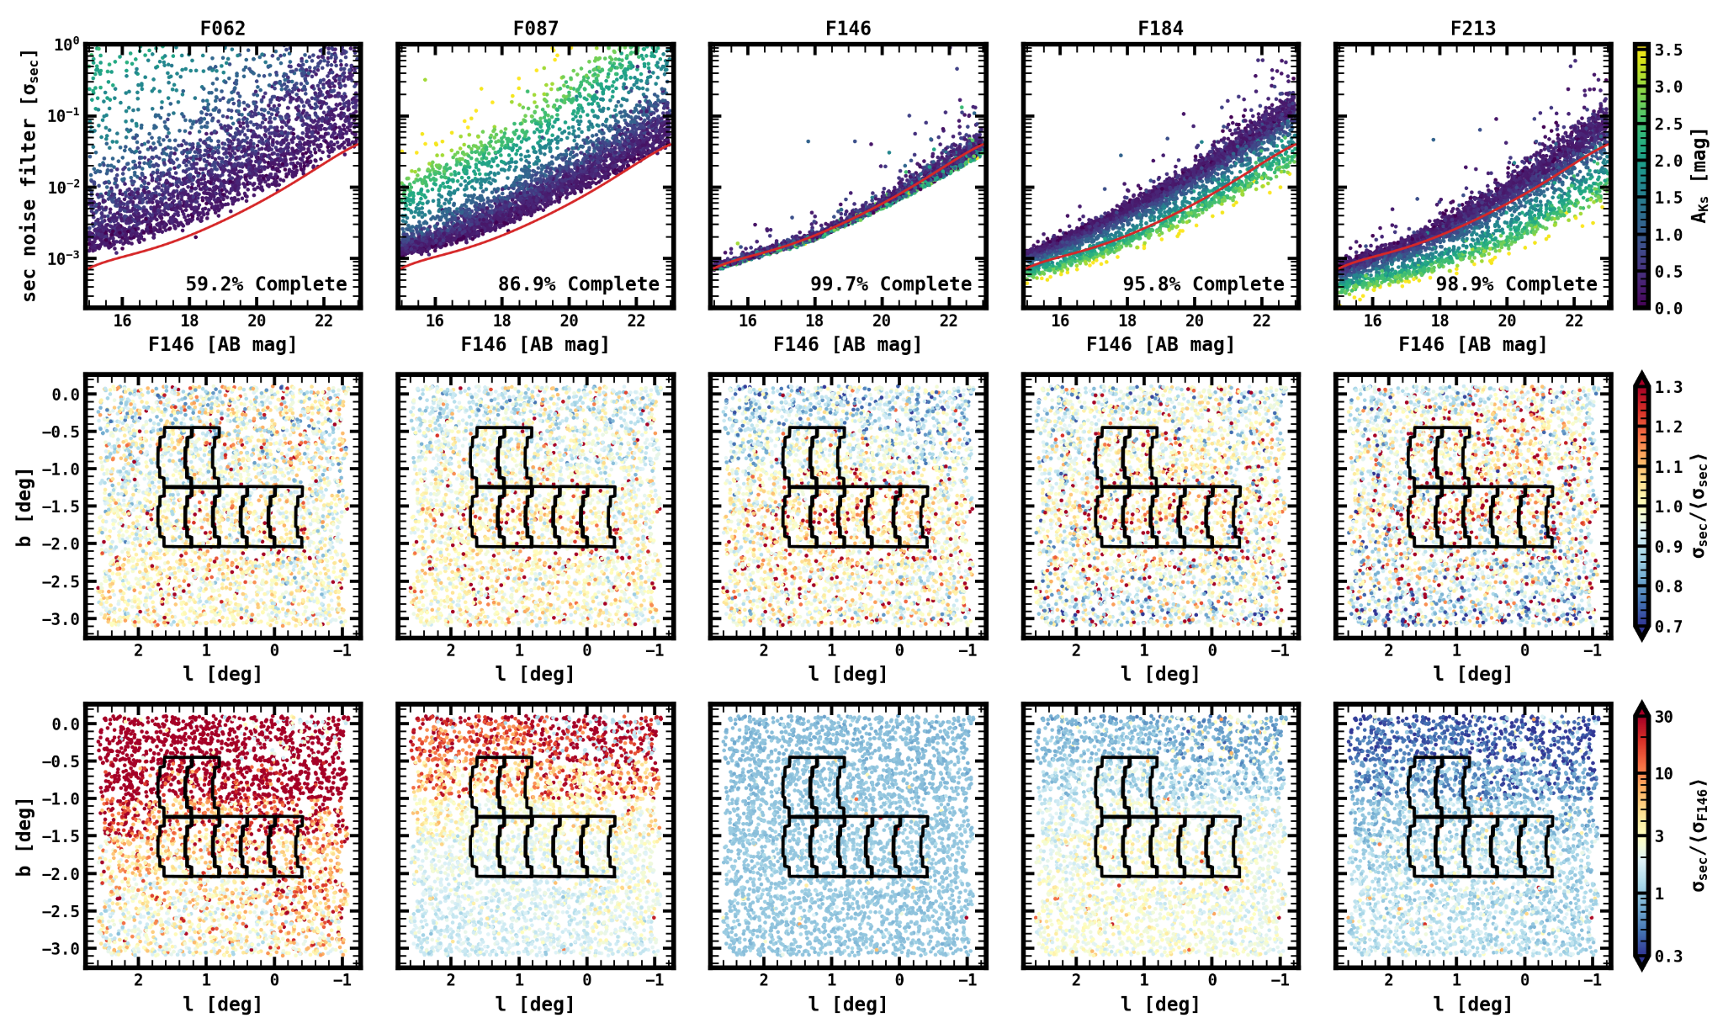
Performance
Compared to F146
Variations
From Crowding
Variations
From Extinction

Slide 33

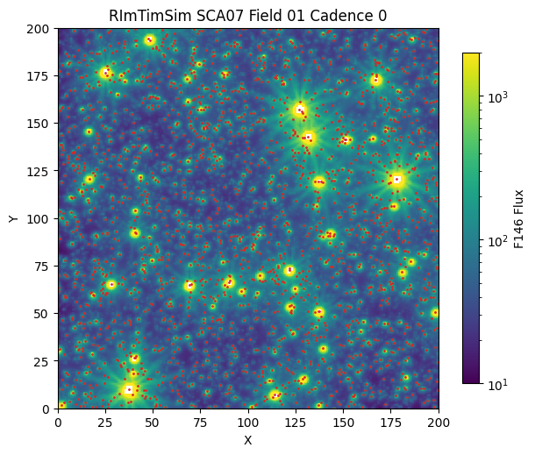
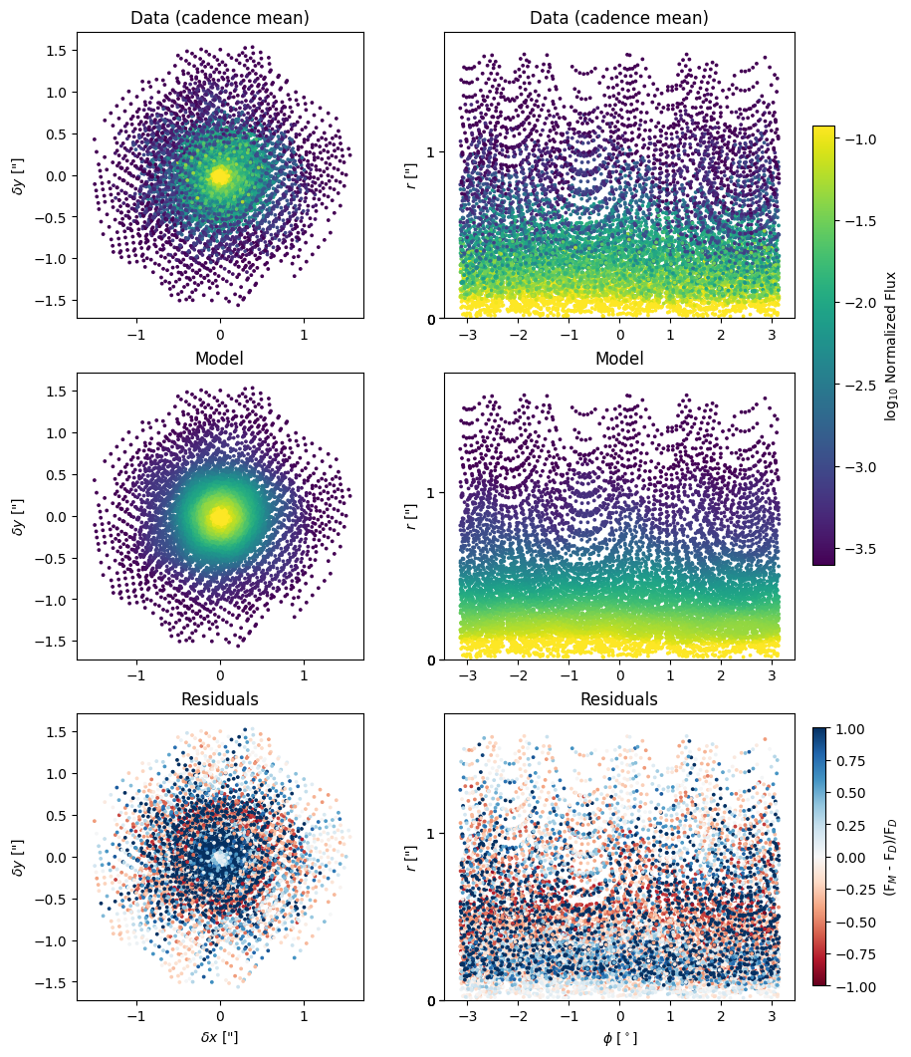
Data-Driven PRF Light Curves
Flexible & Analytical PRF model (PSFMachine)
  Mean PRF + Single-Cadence Perturbations
Fully Linear Model -> Computational Efficiency
Optimized for photometric precision

Slide 34
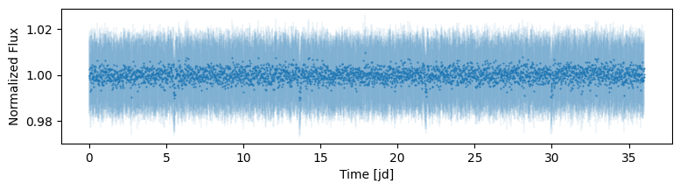
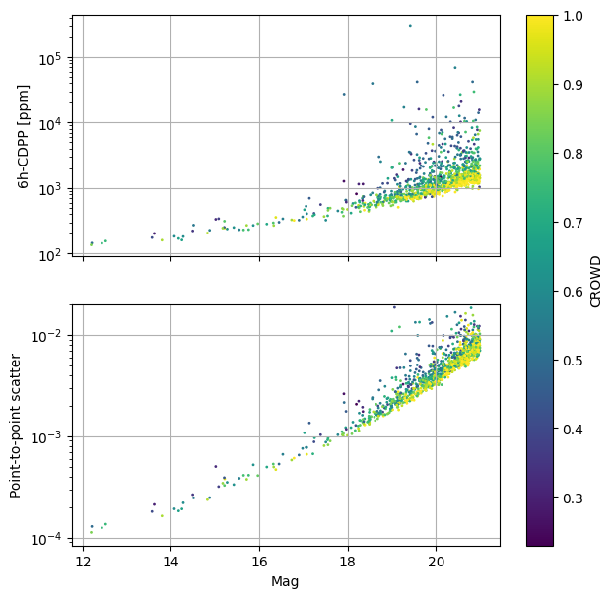
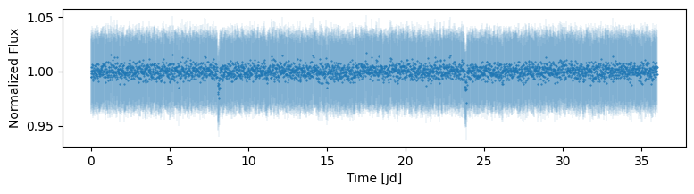
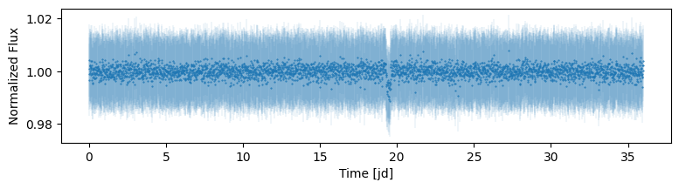
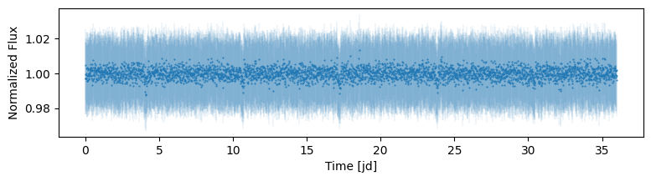
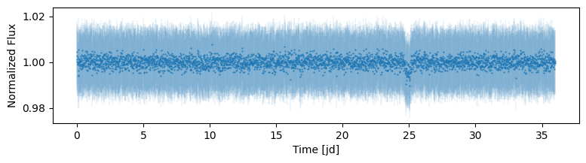
Data-Driven PRF Light Curves
Flexible & Analytical PRF model (PSFMachine)
  Mean PRF + Single-Cadence Perturbations
Fully Linear Model -> Computational Efficiency
Optimized for photometric precision

Slide 35
Transit Detection & Vetting Pipeline

Slide 36

Transit Detection & Vetting Pipeline
Developing a Transit-Search Infrastructure based on Box-Least-Squares
  Most algorithms are already well-tested on TESS/Kepler Data
Transiting Planet Candidate Extraction Validated on Simulated Roman Light Curves
More work needed to Predict/Understand Distribution of Eclipsing Binaries for Statistical Validation

Slide 37
Transit Detection & Vetting Pipeline
Developing a Transit-Search Infrastructure based on Box-Least-Squares
  Most algorithms are already well-tested on TESS/Kepler Data
Transiting Planet Candidate Extraction Validated on Simulated Roman Light Curves
More work needed to Predict/Understand Distribution of Eclipsing Binaries for Statistical Validation

Slide 38
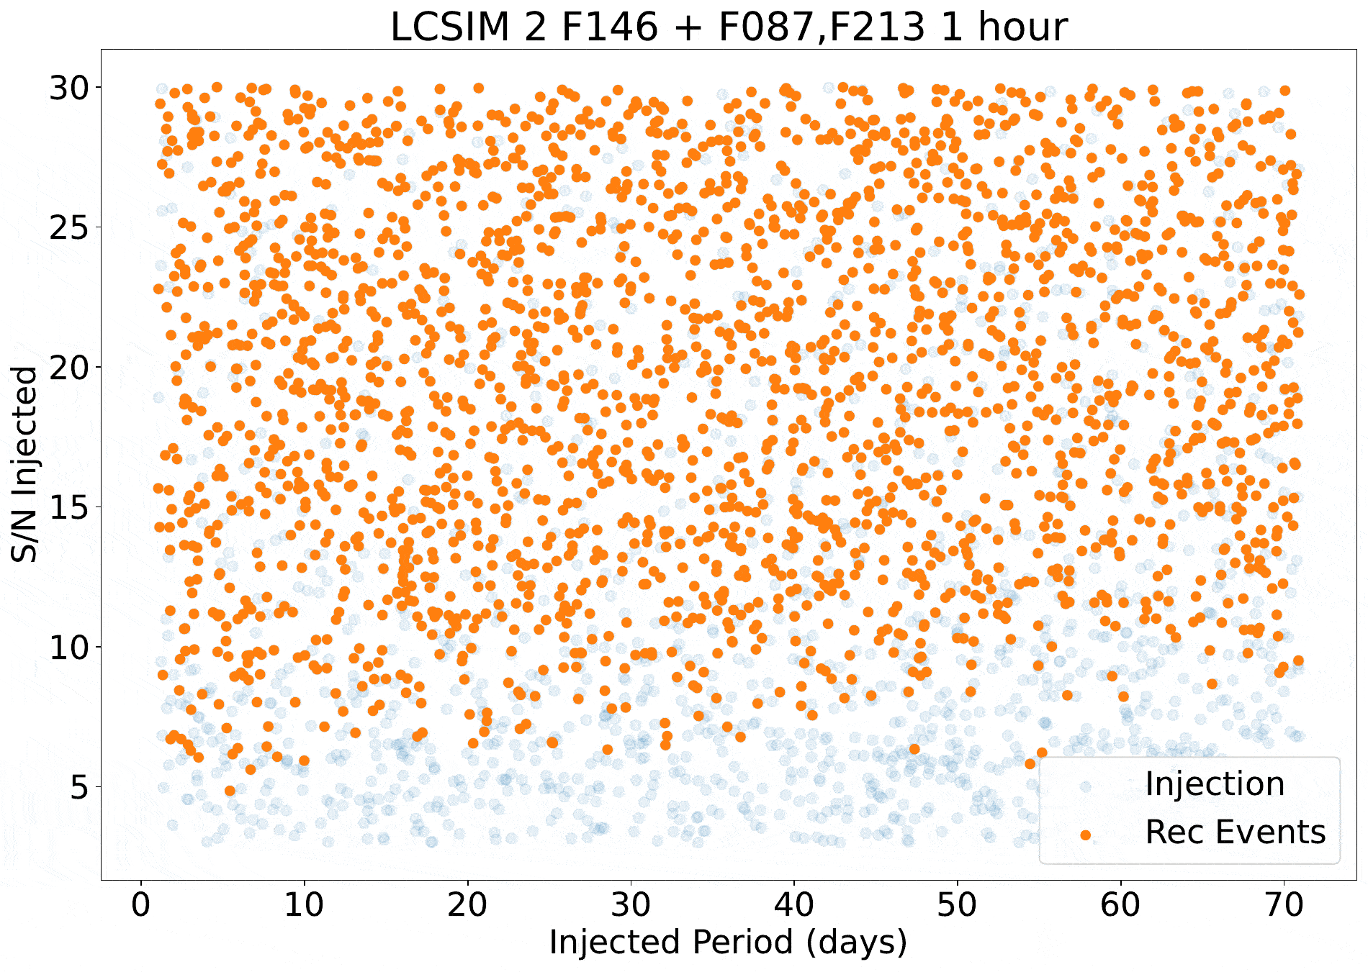
Transit Detection & Vetting Pipeline
Developing a Transit-Search Infrastructure based on Box-Least-Squares
  Most algorithms are already well-tested on TESS/Kepler Data
Transiting Planet Candidate Extraction Validated on Simulated Roman Light Curves
More work needed to Predict/Understand Distribution of Eclipsing Binaries for Statistical Validation

Slide 39


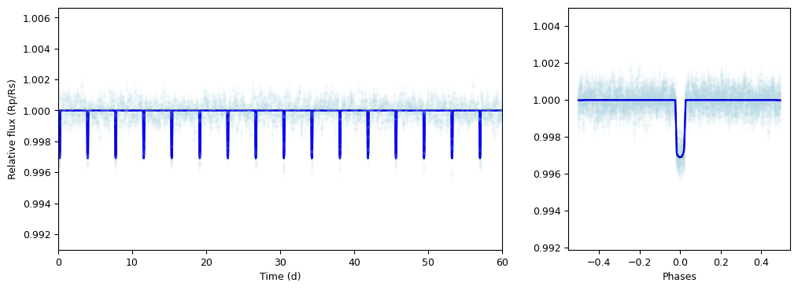
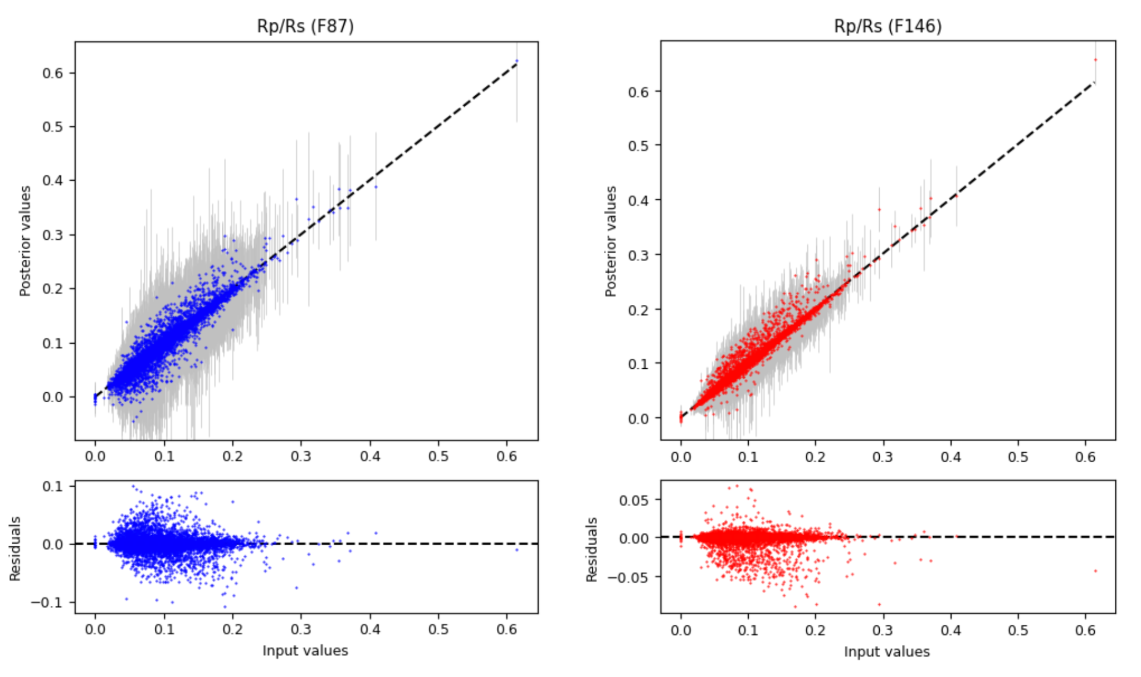
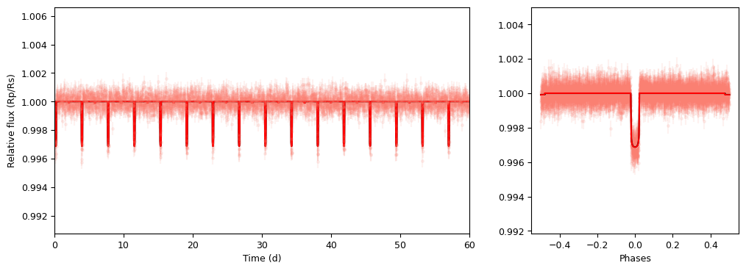
Simulated Emission and Transmission
Ensemble Spectrophotometry
Transiting Exoplanet injections, with Rp/Rs determined from Atmospheric models
Verifying framework with basic injection/ recovery tests

Slide 40
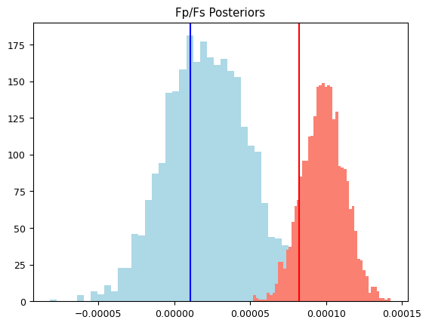
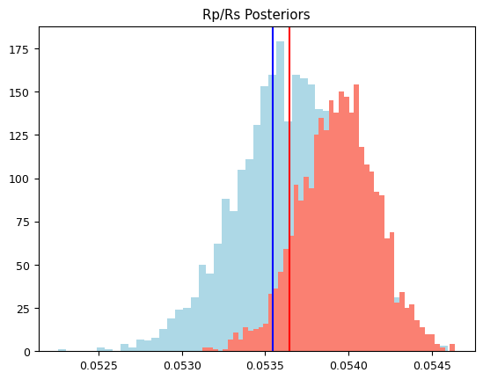
Simulated Emission and Transmission
Ensemble Spectrophotometry

Slide 41
Summary and Conclusions
Roman will find a lot of Hammers. It’s up to us to wield them.
Infrastructure Development:
  Data-driven PRF light curve pipeline-- promising photometric precision
  Search/Vetting Pipeline -> ~1/3 now verified on simulated Roman light curves
Preliminary Lessons from Simulations:
  Preference of F087/F213 Filters driven by crowding/extinction
  Filter change at Higher Cadence leads to Lower Completeness. Sweet spot at ~3-6 hr

Slide 42
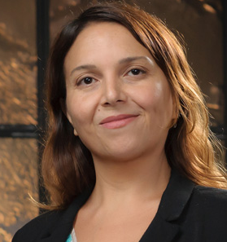


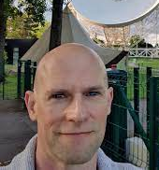


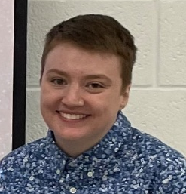









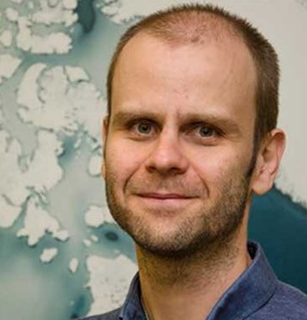



The TRExS Team
Working Group Leads
Early Career

